Slide 1
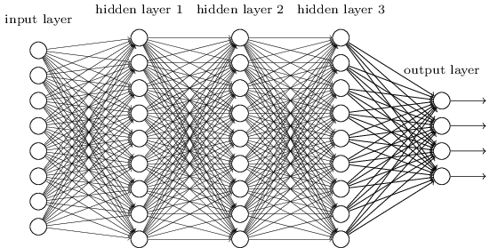
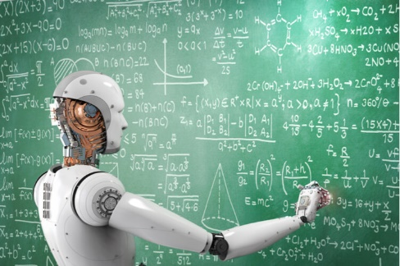
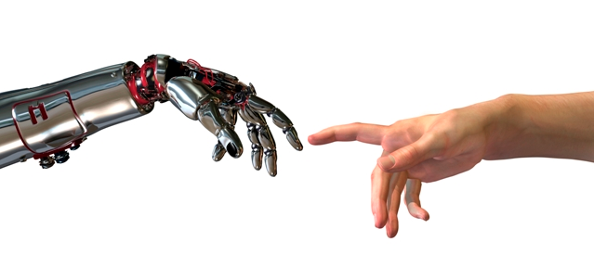


Machine
Learning
Recognize Digits
in Python
(Google)
Colaboratory
Python
Machine Learning: Overview
Recognizing Digits I/O
Neural Networks
Learning
"Probability" and Error
Test/Homework
Jeff Edmonds
www.eecs.yorku.ca/~jeff/courses
Notes:
4*1.5hrs - not Example …, not unsupervised.

Slide 2

Test/Homework
Aaaaah: I don’t know Python!
or machine learning!!!
Don’t panic. It is not hard and you don’t need to know much.

Slide 3

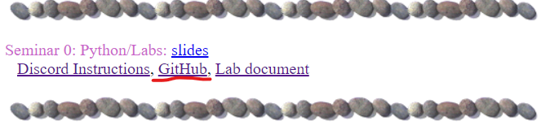
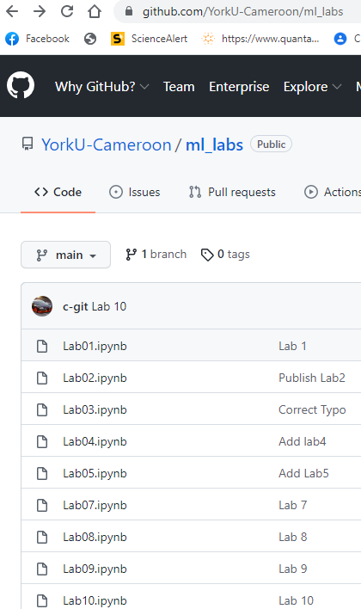
Colaboratory

Slide 4

Colaboratory
Google has a nice platform for playing around.
Tutorial Instructors in Cameroon (2022)
Berthine Nyunga Mpinda
Yolande Ngueabou
Sarah Vollmer
Tyler Thomson
Ariel Freeman-Fawcett
Chester Wyke

Slide 5
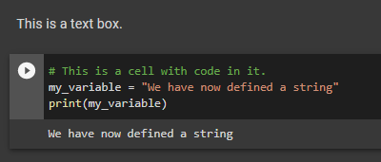
Colaboratory
Lots of little “cells”.
Text box
Comment in code box
Code
Output
You can
Modify what is on your screen.
Run the code on your screen.
Save a copy to your own google drive.
Code & outputs saved. Not execution.

Slide 6


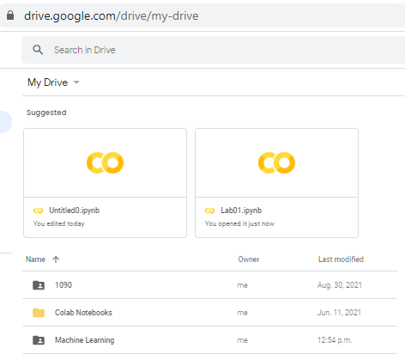

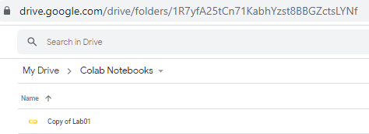
Colaboratory
Save copy in drive
Save a copy to your own google drive.
Code & outputs saved. Not execution.

Slide 7
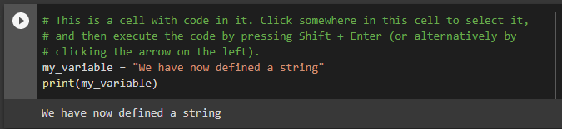

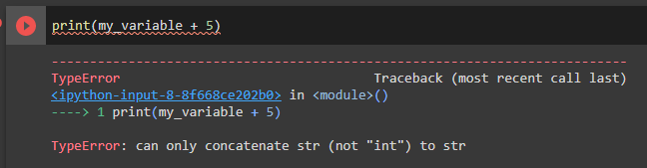
Colaboratory
Interpreted:
Try typing code.
Hit the arrow or shift+enter and it runs.
Variables remember their value for later boxes.

Slide 8
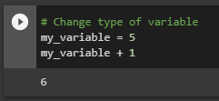
Colaboratory
Interpreted:
Try typing code.
Hit the arrow or shift+enter and it runs.
Variables remember their value for later boxes.
Prints last “uncaptured” values

Slide 9
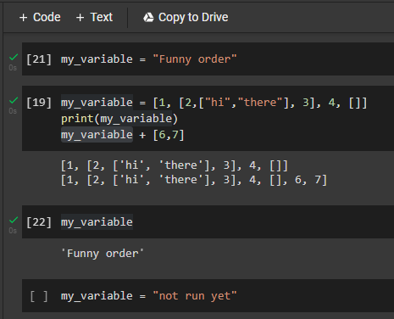
Colaboratory
Add new cells
Executed
Execution order
Execution order,
not cell order,
matters.

Slide 10
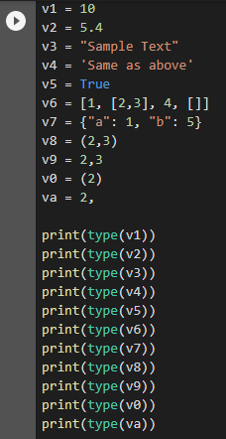
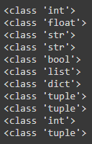
Python

Slide 11
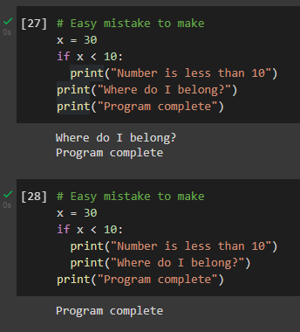
Python
Indentation
maters

Slide 12
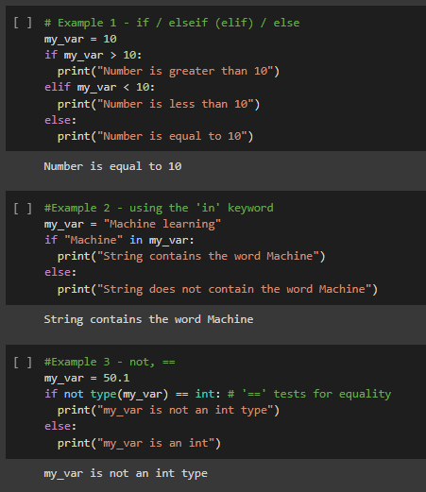
Python

Slide 13
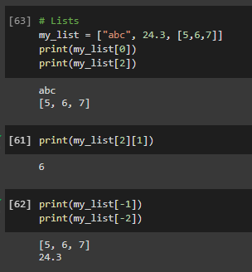
Python
-3 -2 -1
0 1 2
Define a List
Index 0 .. n-1
List of List
Index from end
0 1 2

Slide 14
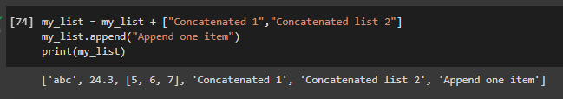
Python
Object Oriented Programing
Object
Data in object
Method/Procedure in object

Slide 15
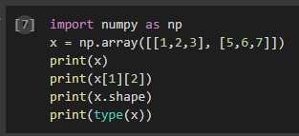
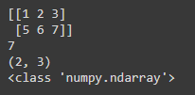
Python
This is the same as a list of lists, except
Each row and column of the matrix need to be the same size
When you first define one, its dimensions need to be fixed. The function zero is useful for doing this.
X = np.zeros((nItems,nDimensions))
The ones I have seen are all real number
The computation time on this is better.

Slide 16
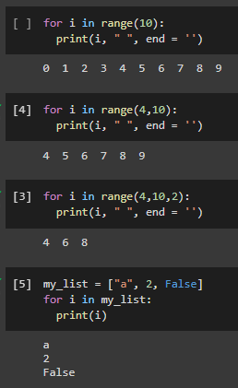
Python
Loop for values in some list
range = 0..n-1
= i..j-1
in steps of 2
strange list
Print
i
space
no return line

Slide 17
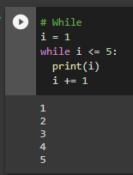
Python

Slide 18
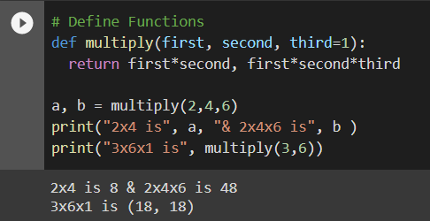
Python
Functions:
  Define
  Function name
  Input
  Returns two values
  Optional input
  with default value

Slide 19
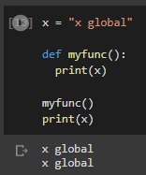
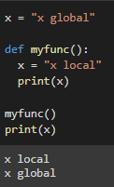
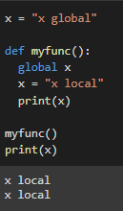
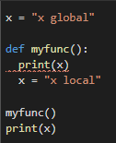
Python
Global variable
used locally
Global variable
& locally variable
Global variable
changed locally
Flagged as local
Can’t use global value.

Slide 20
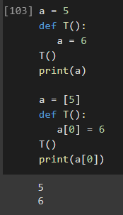
Python
Call by value
Function changes a primitive value
It only changes locally
Call by reference
Function changes value in object
Change is permanent

Slide 21
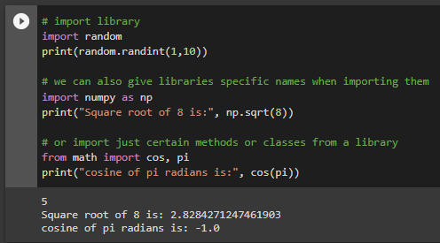
Python
Library
Method (procedure)
Renamed library
Method
math.cos

Slide 22
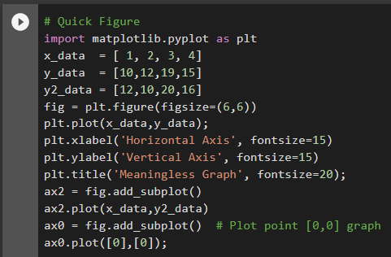

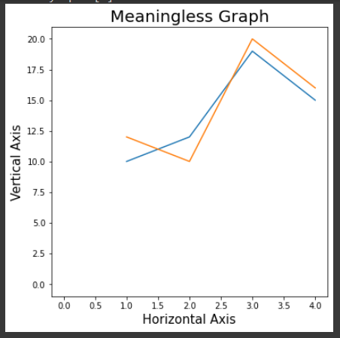
Python
Figures
Make plt our plotting object
Data
Optional
  Set size of figure
  Add labels
  Add a second plot
  Name of fig
  These could be fig too
  Add point [0,0]
  Suppresses output of
  last “uncaptured” code
  But I still get text
  I don’t like

Slide 23
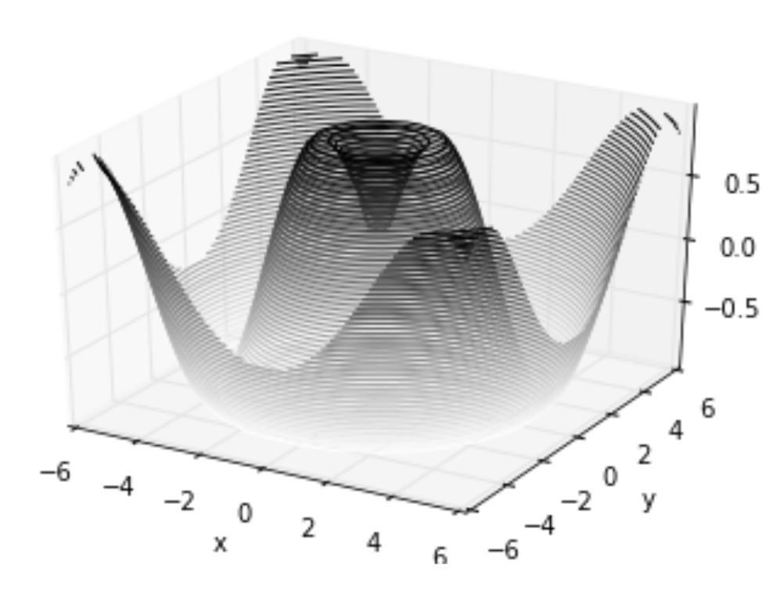
Python
https://jakevdp.github.io/PythonDataScienceHandbook/04.12-three-dimensional-plotting.html

Slide 24
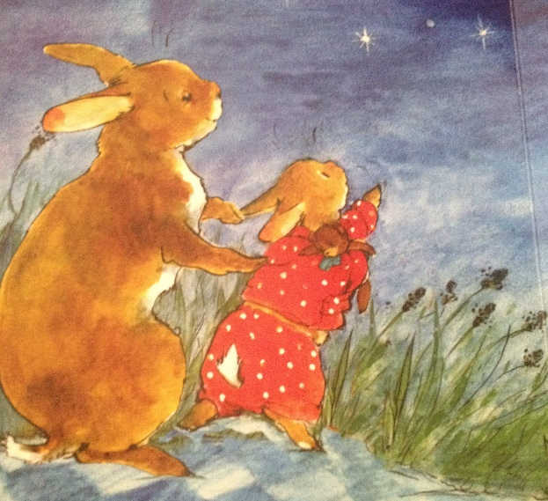
Machine Learning: Overview
I find it oddly spiritual.
Emergent Complexity
And what arises
is awe inspiring

Slide 25
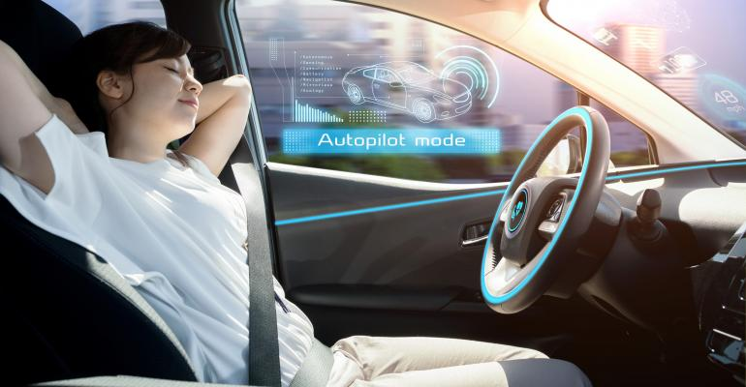
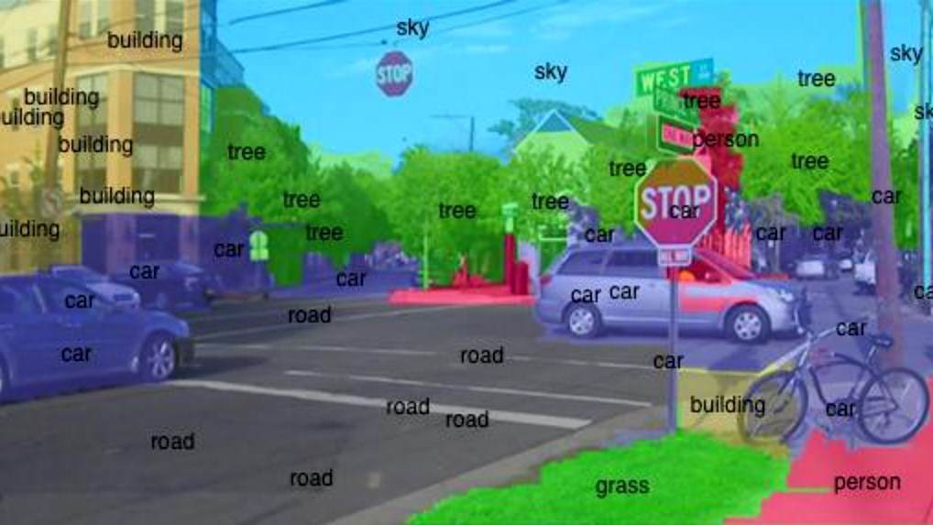
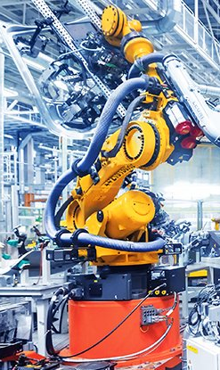
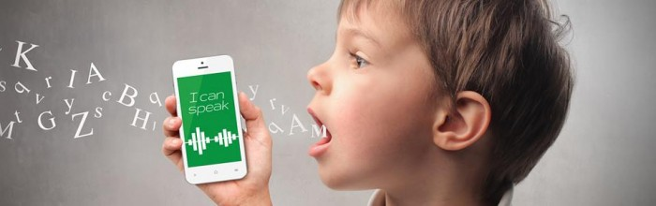
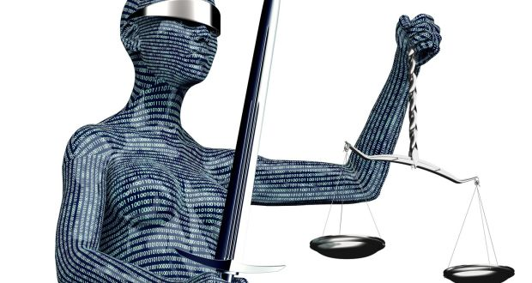

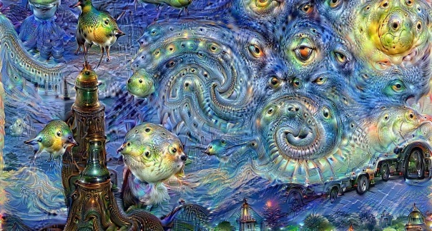

Machine Learning: Overview
Image processing
Self diving cars
Speech processing
  May make the world much
  better.
Art
Robots
Financial,
Medical Experts
Legal and

Slide 26
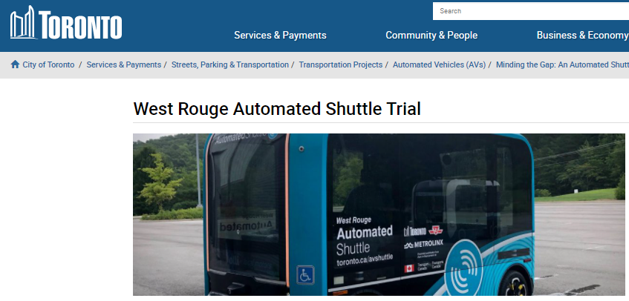
Machine Learning: Overview

Slide 27



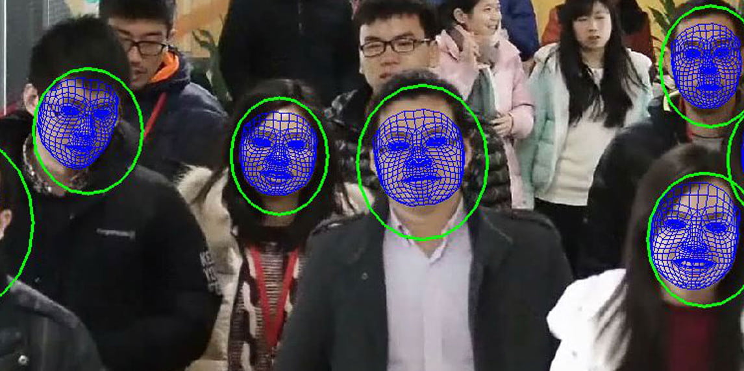

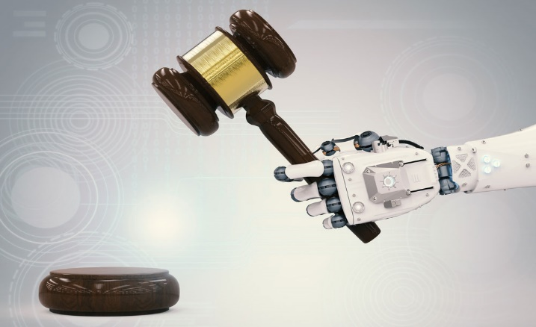
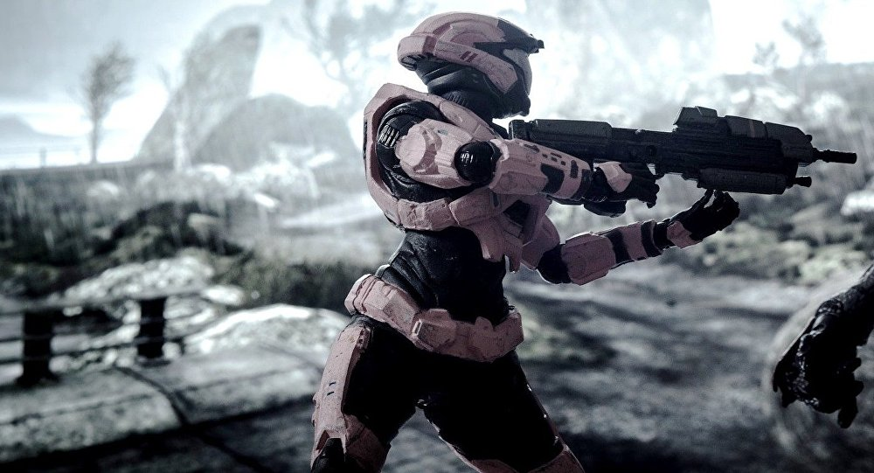
Machine Learning: Overview
By Watching You
  Customizing your world
  Pick out “criminals”
  in a crowd
Cyber Security
  Killing machines
  Judges

Slide 28
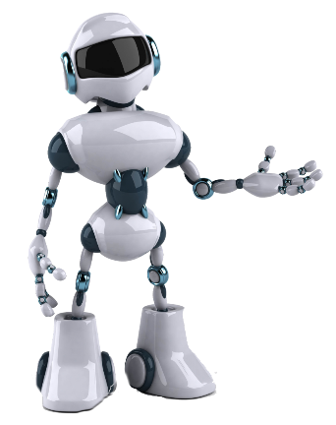

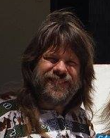
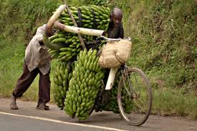
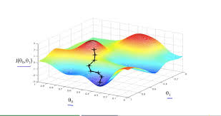


Machine Learning: Overview
Good first try!
I am a machine
and I want to learn
to identify
faces and bicycles.
As your supervisor,
I give you
labeled training data
Goal
Here is a
measure of
your error.
face
bicycle
w_{k}
bicycle
face
bicycle
face
My current
weights ⟨w₁,…,w_{m}⟩.
⟨w₁,…,w_{m}⟩ visualized here
by my location.
How I answer questions
is 100% dictated by these.
w₁
w₂

Slide 29
Machine Learning: Overview
Much better!
I am a machine
and I want to learn
to identify
faces and bicycles.
As your supervisor,
I give you
labeled training data
Here is a
measure of
your error.
face
bicycle
w_{k}
face
face
face
I learn by changing
my weights ⟨w₁,…,w_{m}⟩.
⟨w₁,…,w_{m}⟩ visualized here
by my location.
I increase weights w_{k} influencing
correct answers
and decrease those influencing
incorrect answers.
w₁
w₂

Slide 30
Machine Learning: Overview
Much better!
I am a machine
and I want to learn
to identify
faces and bicycles.
As your supervisor,
I give you
labeled training data
Here is a
measure of
your error.
face
bicycle
w_{k}
face
face
face
This defines
the error surface.
⟨w₁,…,w_{m}⟩ visualized here
by my location.
I move in the direction and speed of steepest decent.
I hope to find
a deep valley
where the error is small.

Slide 31
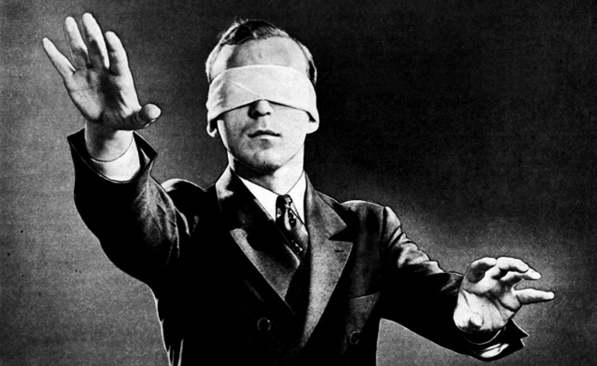
Machine Learning: Overview
Much better!
I am a machine
and I want to learn
to identify
faces and bicycles.
As your supervisor,
I give you
labeled training data
Here is a
measure of
your error.
face
bicycle
w_{k}
face
face
face
⟨w₁,…,w_{m}⟩ visualized here
by my location.
We can’t really see
the whole
10000 dimensional
error functions.
w₁
w₂

Slide 32
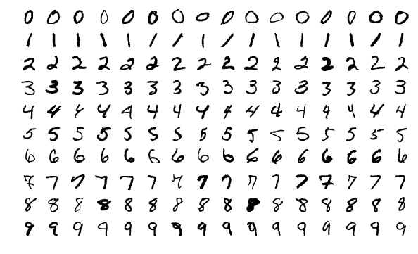
Recognize Digits I/O

Slide 33

Recognize Digits I/O
Aaaaah: Later things won’t work,
if you don’t execute the earlier boxes.

Slide 34

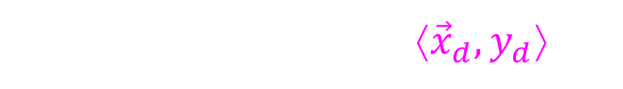




Recognize Digits I/O
Training data is a set of input/output pairs
{ ⟨${\vec{x}}_{1},y_{1}$⟩, ⟨${\vec{x}}_{2},y_{2}$⟩, …, ⟨${\vec{x}}_{D},y_{D}$⟩ }
For the graph we pretend ${\vec{x}}_{d} \text{and} y_{d}$ real numbers.
Each dot is a data item ⟨${\vec{x}}_{d},y_{d}$⟩.
Goal is to learn this function.
Output y
$$\text{y}\text{d}$$
Supervisor's answer for ${\vec{x}}_{d}$.
Input
$$\vec{x}$$
$${\vec{x}}_{d}$$
The d^{th} training input.

Slide 35




Recognize Digits I/O
Training data is a set of input/output pairs
Each input ${\vec{x}}_{d}$ is an image
{ ⟨${\vec{x}}_{1},y_{1}$⟩, ⟨${\vec{x}}_{2},y_{2}$⟩, …, ⟨${\vec{x}}_{D},y_{D}$⟩ }
Each output y_{d} (provided by the supervisor)
Categorizing: y_{d} labels it as a 0, 1, … 9.
Data base of digits
Training Data: With which we will learn a neural network
Test Data: With which we will test
how good our neural network performs
Do NOT touch this when learning.

Slide 36



Recognize Digits I/O
Training data is a set of input/output pairs
Each input ${\vec{x}}_{d}$ is an image
{ ⟨${\vec{x}}_{1},y_{1}$⟩, ⟨${\vec{x}}_{2},y_{2}$⟩, …, ⟨${\vec{x}}_{D},y_{D}$⟩ }
Each output y_{d} (provided by the supervisor)
Categorizing: y_{d} labels it as a 0, 1, … 9.
Data base of digits
${\vec{x}}_{d}$ is an image
y_{d} labels it as a 0, 1, … 9.

Slide 37

Recognize Digits I/O
Training data is a set of input/output pairs
Each input ${\vec{x}}_{d}$ is an image
{ ⟨${\vec{x}}_{1},y_{1}$⟩, ⟨${\vec{x}}_{2},y_{2}$⟩, …, ⟨${\vec{x}}_{D},y_{D}$⟩ }
The machine takes an tuple of values in as input.
i
x_{i}

Slide 38


Recognize Digits I/O
Square matrix of pixels
Same number of number in an array
The neural network loses which pixels are neighbors.
Each pixel ∈{0,…,255}
Each pixel ∈{0,…,1}

Slide 39

Recognize Digits I/O
Normalizing Data
  Preprocess your data to have mean zero, variance one
  by subtracting the mean and dividing by the standard deviation.
Gradient Decent: It is hard not to overstep narrow river valleys.
Regularization: Avoids over fitting by trading off between
  Error of the machine and Complexity of the machine.
Scaling up the y values, scales up the error
  This would not matter,
  except it throws off the regularization balance.

Slide 40

Recognize Digits I/O
Normalizing Data
  Preprocess your data to have mean zero, variance one
  by subtracting the mean and
  dividing by the standard deviation.

Slide 41
Recognize Digits I/O
data = np.asarray( [ [ 6.0, 9.0, 1.0, 6.0],
[ 4.0, 7.0, 2.0, 0.0],
[ 3.0, 8.0, 5.0, 4.0] ] )
mean = data.mean(axis=0)
[ 4.3, 8.0, 2.7, 3.3]
data -= mean
[ [ 1.7, 1.0,-1.7, 2.7],
[-0.3,-1.0,-0.7,-3.3],
[-1.3, 0.0, 2.3, 0.7] ]
mean = data.mean(axis=0)
[ 0.0, 0.0, 0.0, 0.0]
std = data.std(axis=0)
data /= std
std = data.std(axis=0)
[ 1.0, 1.0, 1.0, 1.0]
ie data = data - mean
test_data -= mean
test_data /= std

Slide 42

Recognize Digits I/O
Training data is a set of input/output pairs
{ ⟨${\vec{x}}_{1},y_{1}$⟩, ⟨${\vec{x}}_{2},y_{2}$⟩, …, ⟨${\vec{x}}_{D},y_{D}$⟩ }
If the answer $y_{d}$was a cost, then 7,8,9 is about the same.
But when it labels the image as a 0, 1, … 9,
these are very different.
Is 0
= 0.02
0
Is 1
= 0.01
0
Is 2
= 0.92
1
…
0
The machine says that the “probability”
that the input is a 2 is 0.92
Hoped for probabilities

Slide 43

Recognize Digits I/O
0 1 2 3 4 5 6 7 8 9
The supervisor labels the image with a 2.
The required output

Slide 44


Neural Networks
A neuron:
When a neuron fires, it sends a signal to its neighbors across its synapses.
These synapses have different weights in their influence.
When a neuron’s incoming signal
reaches a threshold
it fires.

Slide 45








Neural Networks
An artificial neuron:
Input: $\vec{x}$= = ⟨x₁,…, x_{n}⟩.
x_{i} = = brightness of i^{th} pixel.
Eg: x₁=0.5, x₂=0.3, …, x_{n}=0.4.
Edge Weights $\vec{w}$ = ⟨w₀,w₁,…,w_{n}⟩.
w_{i} = influence of i^{th} pixel on neuron.
Eg: w₀=8, w₁=4, w₂=-2, …, w_{n}=9.
Total incoming signal: z = x₁×w₁ + x₂×w₂ +…+ x_{n}×w_{n}
= 0.5×4 + 0.3×(-2) +…+ 0.4×9
i
Don’t worry about colour
0.0=dark … 1.0=bright
×
+
w₀ +
8 +
i
= 18.2
0.5=
=4
0.3=
=-2
=8
$$z$$
= 18.2
$$y$$
=9
$$z= \sum_{i=0..n}{w_{i}}x_{i}$$
0.4=
y $=φ\left(z\right)= \frac{1}{1+e^{−z}}$

Slide 46

Neural Networks
An artificial neuron:
Total incoming signal: z = 18.2
y is the activation of the right unit.
In a brain, a neuron either fires or it doesn’t.
The picture is either a cat or not.
One might model this by
1 if z ≥ 0
0 else
y =
= 18.2
$$z$$
= -18.2
= 0
$$y$$
= 1
$$z= \sum_{i=0..n}{w_{i}}x_{i}$$
Linear Separator
y $=φ\left(z\right)= \frac{1}{1+e^{−z}}$

Slide 47





Neural Networks
An artificial neuron:
Total incoming signal: z = 18.2
y is the activation of the right unit.
In a brain, a neuron either fires or it doesn’t.
The picture is either a cat or not.
One might model this by
1 if z ≥ 0
0 else
y =
$$z$$
= 0
$$y$$
= 1
$$z= \sum_{i=0..n}{w_{i}}x_{i}$$
Linear Separator
These neurons can compute
AND
y $=φ\left(z\right)= \frac{1}{1+e^{−z}}$
OR
NOT
NOT

Slide 48
Neural Networks
So we can later hill climb,
we want change
to happen gracefully.
An artificial neuron:
Total incoming signal: z = 18.2
y is the activation of the right unit.
In a brain, a neuron either fires or it doesn’t.
The picture is either a cat or not.
One might model this by
Instead of YES/NO
allow maybe so.
1 if z ≥ 0
0 else
0.98
y =
0.02
$$z$$
= 0
$$y$$
= 1
$$z= \sum_{i=0..n}{w_{i}}x_{i}$$
y $=φ\left(z\right)= \frac{1}{1+e^{−z}}$

Slide 49
Neural Networks
So we can later hill climb,
we want change
to happen gracefully.
An artificial neuron:
Total incoming signal: z = 18.2
y is the activation of the right unit.
In a brain, a neuron either fires or it doesn’t.
The picture is either a cat or not.
One might model this by
Instead of YES/NO
allow maybe so.
y = Sigmoid(z)
= 0
= 18.2
$$z$$
= -18.2
= 0.5
= 0.02
$$y$$
= 0.98
$$z= \sum_{i=0..n}{w_{i}}x_{i}$$
y $=φ\left(z\right)= \frac{1}{1+e^{−z}}$

Slide 50

Neural Networks
So we can later hill climb,
we want change
to happen gracefully.
An artificial neuron:
Total incoming signal: z = 18.2
y is the activation of the right unit.
In a brain, a neuron either fires or it doesn’t.
The picture is either a cat or not.
One might model this by
Instead of YES/NO
allow maybe so.
y = Rectilinear(z)
(ReLU)
= -18.2
= 18.2
$$z$$
= -18.2
= -1.82
= 18.2
$$y$$
= 0
$$z= \sum_{i=0..n}{w_{i}}x_{i}$$
y $=φ\left(z\right)= \frac{1}{1+e^{−z}}$

Slide 51

Neural Networks
So we can later hill climb,
we want change
to happen gracefully.
An artificial neuron:
Total incoming signal: z = 18.2
y is the activation of the right unit.
In a brain, a neuron either fires or it doesn’t.
The picture is either a cat or not.
One might model this by
Instead of YES/NO
allow maybe so.
y = G??linear(z)
(GeLU)
$$z$$
$$y$$
$$z= \sum_{i=0..n}{w_{i}}x_{i}$$
y $=φ\left(z\right)= \frac{1}{1+e^{−z}}$

Slide 52




Neural Networks
1
2
3 ‧ ‧ ‧
4 ‧ ‧ ‧
1
2
3
4
$$y$$
$$z= \sum_{i=0..n}{w_{i}}x_{i}$$

Slide 53
Neural Networks
1
2
1
2
$$y$$
$$z= \sum_{i=0..n}{w_{i}}x_{i}$$

Slide 54

Neural Networks
1
512
layer
dense
with
edges
(28*28)
pixel
image
1
$$y$$
$$z= \sum_{i=0..n}{w_{i}}x_{i}$$
Rectilinear (ReLU)
keeps positive
and zeros negative values.

Slide 55

Neural Networks
2
10 for
0,…,9
512
layer
dense
with
edges
layer
dense
with
edges
(28*28)
pixel
image
2
$$y$$
$$z= \sum_{i=0..n}{w_{i}}x_{i}$$
z₁
M₁
Is 0
= 0.02
z₂
M₂
Is 1
= 0.01
Act like probabilities
z₃
$M_{j}= \frac{e^{zj}}{\sum_{k=1..c}{e^{z_{k}}}}$
M₃
Is 2
= 0.92
z₄
M₄
Is ‧ ‧ ‧

Slide 56

Learning
optimizer = a version of gradient decent.
error function = –log(prob correct answer)
standard when outputs are “probabilities”.
% correct

Slide 57

Learning
Learn Neural Net
Training Images
Training Labels
Epochs = 5 = # of times through data
Batch size = 128
= # data items per gradient decent step
Running Time
Error function = –log(prob correct answer)
standard when outputs are “probabilities”
% correct

Slide 58

Learning
Try it on Test data
Test Images
Test Labels
Running Time
Error function = –log(prob correct answer)
standard when outputs are “probabilities”
% correct

Slide 59


Machine Learning Regression
y
x
How can we approximate this function
with a neural network?
₁
₁
₁
x
y
₁
₁
What does this 2-level neural network compute?

Slide 60
Machine Learning Regression
y
Neuron Fires
x
w₁
d×
-w₁
d×
₁
x≥w₁
z₁ = x×1 + 1×(-w₁)
= x-w₁
y₁ = 1 if z₁ ≥0
ie if x≥w₁
d×
×d
x
₁
changes nothing

Slide 61
Machine Learning Regression
c₁= c₀+w
w = c₁- c₀
y
c₀
c₁
c₀+w
Neuron Fires
x
w₁
-w₁
₁
₁
c₀
₁
x≥w₁
w
c₁-c₀
if x<w₁
y = 1×c₀ + 0×w
= c₀
if x≥w₁
y = 1×c₀ + 1×w
= c₀+w
x
₁
y
c₁- c₀
c₁

Slide 62
Machine Learning Regression
y
c₃
c₀
c₁
c₄
c₂
x
if w₃≤x<w₄
node 1,2,3 fire
and 4 does not.
y = 1×c₀
+ 1×(c₁-c₀)
+ 1×(c₂-c₁)
+ 1×(c₃-c₂)
+ 0×(c₄-c₃)
= c₃
-∞
w₁
w₂
w₃
w₄
∞
-w₁
₁
₁
x≥w₁
c₀
-w₂
c₁-c₀
₁
₁
x≥w₂
c₂-c₁
x
₁
y
₁
-w₃
c₃-c₂
₁
₁
x≥w₃
c₄-c₃
-w₄
₁
x≥w₄

Slide 63
Machine Learning Regression
y
c₃
c₀
c₁
c₄
c₂
I claim that for any neural net with thresholds,
if you fix all variables but one
and graph the result wrt the remaining variable,
then the graph will have
d flat pieces,
where d is the number of nodes this variable goes into
in the first level.
x
-∞
w₁
w₂
w₃
w₄
∞
-w₁
₁
₁
x≥w₁
c₀
-w₂
c₁-c₀
₁
₁
x≥w₂
c₂-c₁
x
₁
y
₁
-w₃
c₃-c₂
₁
₁
x≥w₃
c₄-c₃
-w₄
₁
x≥w₄

Slide 64


Machine Learning Regression
y
c₃
c₀
c₁
c₄
c₂
Having a sigmoid activation
will round these corners.
I don’t know about this one.
x
-∞
w₁
w₂
w₃
w₄
∞
-w₁
₁
₁
x≥w₁
c₀
-w₂
c₁-c₀
₁
₁
x≥w₂
c₂-c₁
x
₁
y
₁
-w₃
c₃-c₂
₁
₁
x≥w₃
c₄-c₃
-w₄
₁
x≥w₄

Slide 65

“Probability” of Category and Error
Soft Max
z₁
M₁
Is 0
z₂
$M_{j}= \frac{e^{z_{j}^{}}}{\sum_{k=1..c}{e^{z_{k}}}}$
M₂
Is 1
z₃
M₃
Is 3
z₄
M₄
Is ‧ ‧ ‧
Probabilities require 0 ≤ M_{j} ≤1 and ∑_{j=1..c} M_{j} = 1
This layer coverts the values z_{j} to these.
  Turns z= 10 into e¹⁰ = 2,206
  z=-10 into e⁻¹⁰ = 0.00004
  Divides by the total so that the total becomes one.

Slide 66


“Probability” of Category and Error
Jeff’s Soft Max
z
M₁
$M_{}=log⁡(\sum_{k=1..c}{e^{z_{k}})}$
0
M
${}_{}=log⁡(e^{z}+1+1+1$)
≈ z
0
M₃
0
M
Personally, I think a “Max” should return
one number close to the maximum.
Not a 1 indicating which is the maximum.

Slide 67

“Probability” of Category and Error
Jeff’s Soft Max
z
M₁
$M_{}=log⁡(\sum_{k=1..c}{e^{z_{k}})}$
z
M
${}_{}=log⁡(e^{z}+e^{z}+e^{z}+e^{z}$)
≈ z + log(4)
z
M₃
z
M
Personally, I think a “Max” should return
one number close to the maximum.
Not a 1 indicating which is the maximum.

Slide 68

“Probability” of Category and Error
Categorical Cross Entropy
Machine’s
answer
Supervisor's
answer
M_{d,1} = 0.01
y_{d,1} = 0
Is 0
M_{d,2} = 0.02
y_{d,2} = 0
Is 1
E(w₁,…,w_{m})
M_{d,3} = 0.95
y_{d,3} = 1
Is 3
M_{d,4} = 0.02
y_{d,4} = 0
Is ‧ ‧ ‧
Error:
M_{d,j} = Machine’s estimated “probability”
that input d is of category j: cat, dog, …
y_{d,j} = Supervisor’s 0-1 answer.
Error:
E($\vec{w}$) = $\sum_{d=1..D}{{ ( y_{d} − M_{\vec{w}}\left({\vec{x}}_{d}\right) )}^{2}}$

Slide 69

“Probability” of Category and Error
Categorical Cross Entropy
Machine’s
answer
Supervisor's
answer
M_{d,1} = 0.01
Is 0
M_{d,2} = 0.02
Is 1
E(w₁,…,w_{m})
M_{d,3} = 0.95
y_{d} = 3
Is 3
M_{d,4} = 0.02
Is ‧ ‧ ‧
Error:
M_{d,j} = Machine’s estimated probability
that input d is of category j: cat, dog, …
y_{d} = Supervisor’s index answer.
$M_{d,y_{d}}$is “prob" M gives to the correct ans for d^{th} data item

Slide 70




“Probability” of Category and Error
Categorical Cross Entropy
Error:
$M_{d,y_{d}}$is “prob" M gives to the correct ans for d^{th} data item
${\text{p}\text{M}=M}_{1,y_{1}}{× M}_{2,y_{2}}$ ${ …  M}_{D,y_{D}}$
is “prob" M gives that all data items are correct.
(Assuming we had a distribution, and it was independent.)
We want to choose $M$ to maximize this measure.
Maximizing p_{M} is the same as minimizing
E($\vec{w}$) = -log(p_{M})
$${\text{=}−log(M}_{1,y_{1}}{)−log⁡(M}_{2,y_{2}}{)−…−log⁡(M}_{D,y_{D}})$$
= $\sum_{d=1..D}{{−log{M_{d,y_{d}}} }_{}}$
= $\sum_{d=1..D}{{\sum_{i=1..\#outputs}{{−y_{d,i} log{M_{d,i}} }_{}}}_{}}$

Slide 71



“Probability” of Category and Error
Categorical Cross Entropy
Error:
E($\vec{w}$) = $\sum_{d=1..D}{{−log{M_{d,y_{d}}} }_{}}$
Advantages:
It is a sum over the data items
The log might counter
$M_{j}= \frac{e^{z_{j}^{}}}{\sum_{k=1..c}{e^{z_{k}}}}$
$$M_{d,y_{d}}$$
$$−log10{M_{d,y_{d}}}$$
1
0.1
0.01
0.001
0.0000001
0
1
2
3
7
Perfect Ans ➔ No Error
Wrong Ans ➔ Error
“Close”
real numbers
Different
Error Measure

Slide 72



“Probability” of Category and Error
Categorical Cross Entropy
Error:
E($\vec{w}$) = $\sum_{d=1..D}{{−log{M_{d,y_{d}}} }_{}}$
Funny! This measure error
is oddly similar to mean square error.
2
E($\vec{w}$) =
$\sum_{d=1..D}{}$
$${\left(\text{y}\text{d}\text{−}M_{\vec{w}}\left(\vec{x}\right) \right)}^{}$$
See Conditional Log-Likelihood
and Mean Squared Error

Slide 73
Test/Homework
Trying to Understand Machine Learning for Regression
Your task will be to make lots of graphs.
Learned Function:
Regression learns a function y=f(x₁,...,x_{n}) from reals to reals.
We will graph the function f_{Learned} computed
by the learned neural network.
All the x_{j} variables except say x_{i} will be fixed to constants.
Then we plot x_{i} vs f_{Learned}(0,…,x_{i},...,0).

Slide 74
Test/Homework
Trying to Understand Machine Learning for Regression
Your task will be to make lots of graphs.
Many Attempts:
Here we will repeat what we did above many times.
Each attempt will be modified some how by
the value attemptParameter.
Here are some ideas that you might want to try.
The y=f(x) function to learn
The amount of error we introduce to our data
Anything about the neural network
Anything in the learning process
Then we will graph the result.
The horizonal axis will be attemptParameter.
The vertical axis will quantify how well it learned.

Slide 75
Test/Homework
Trying to Understand Machine Learning for Regression
Your task will be to make lots of graphs.
Jeff's Attempt:
Quite curious himself, Jeff will have his own go at doing this.
He will give you everything he comes up with.
To Do:
Your task it to modify what Jeff has done in your own creative ways.
You will hand in a report of what you learned.
In the appendix, put your code (but not Jeff’s).
What you hand in will be ranked compared to what others hand it.

Slide 76

End
Thanks
for coming
Do you have any questions?
Please give me feedback
so that I can better serve you.
Notes:
76

Slide 77
import numpy as np
data = np.asarray( [[6.,9.,1.,6.],[4.,7.,2.,0.],[3.,8.,5.,4.]] )
routine
input to routine is data
np is an object.
In object oriented programming, these contain
data and routines/actions

Slide 78
import numpy as np
data = np.asarray( [[6.,9.,1.,6.],[4.,7.,2.,0.],[3.,8.,5.,4.]] )
print(data.shape)
tensor
d-dimensional array
faster
list of list
ie (3,3)
3-items, each with 3 items
two-dimensional array
which have sizes 3 and 3

Slide 79
data = np.asarray( [[6.,9.,1.,6.],[4.,7.,2.,0.],[3.,8.,5.,4.]] )
Vectorize/Categorize
Need: results = [ [0,1,0,0,0,0,1,0,0,1],
[0,0,1,0,1,0,0,1,0,0],
[0,0,0,1,0,1,0,0,1,0] ]
print(results[0][3])
print(train_data[0][1])
print(x_train[0][train_data[0][5]])
from keras.utils import to_categorical
train_labels = to_categorical(train_labels)
test_labels = to_categorical(test_labels)
ie categories: 0 1 2 3 4 5 6 7 8 9
ie 0.0 means word 3 does not appear
in 0th review.
ie 9 means 1th word in 0th review is word 9
ie should be 1.1
9
prewritten routine

Slide 80
data = np.asarray( [[6.,9.,1.,6.],[4.,7.,2.,0.],[3.,8.,5.,4.]] )
def vectorize_data(data, dimension=10,y=8):
x_train = vectorize_data( data,y=5)
x_test = vectorize_data(test_data,5)
We are defining a function
With name ‘vectorize_data’
It has one required input/parameter data
And two optional inputs.
If you dont include them
then the default values are 10000 and 8
If you include one extra value, it is given to dimmension.
If you want to give y a value, then you need to say y=5.

Slide 81
data = np.asarray( [[6.,9.,1.,6.],[4.,7.,2.,0.],[3.,8.,5.,4.]] )
def vectorize_data(data, dimension=10,y=8):
results = []
for item in data: ie item = [6,9,1] …
row = np.zeros(dimension) ie row = [0,0,0,0,0,0,0,0,0,0]
for word in item: ie word = 6 …
row[word] = 1.0 ie row[6] = 1.0
results.append(row) ie add [0,1,0,0,0,0,1,0,0,1]
return results
x_train = vectorize_data( data,y=5)
x_test = vectorize_data(test_data)

Slide 82
data = np.asarray( [[6.,9.,1.,6.],[4.,7.,2.,0.],[3.,8.,5.,4.]] )
results = np.zeros((len(data),dimension))
for i in range(0,len(data)): ie data[i] = [6,9,1] …
for word in data: ie word = 6 …
results[i][word] = 1.0 ie results[0][6] = 1.0
results[0][6] = 1.0 (lists and np arrays)
results[0,6] = 1.0 (np arrays)
results[0,[6,9,1]] = 1.0
Crazy: changes results[0,6], results[0,9] and results[0,1]
for i in range(0,len(data)):
results[i,data[i]] = 1.0

Slide 83
grocery = ['bread', 'milk', 'butter’]
for item in grocery: ie item = bread …
enumerate(grocery) ie [(0, 'bread'), (1, 'milk'), (2, 'butter’)
for item in enumerate(grocery): ie item = (0, 'bread’) …
for index, item in enumerate(grocery):
ie index = 0, … & item = bread, …

Slide 84
data = np.asarray( [[6.,9.,1.,6.],[4.,7.,2.,0.],[3.,8.,5.,4.]] )
for index, sequence in enumerate(data): ie index = 0 … seq =[6,9,1]
results[index, sequence] = 1. ie results[0,[6,9,1]] = 1.
ie results[0,6] = 1 …

Slide 85
I struggled with this.
astype('float32’)
astype(np.float32)
y_train = np.asarray(train_labels).astype(np.float32)
import numpy as np
list of list
tensor = d-dimensional array
faster

Slide 86
To Update

Slide 87
For better or worse, I coded it as follows.
Bad Form: setAP("graph_x", [8,8,8,8])
Note this has two inputs: a parameter to change and what to change it to.
Good Form: setAP(["graph_x", [8,8,8,8]])
Good Form: setAP(["graph_x", [8,8,8,8]],['nHidden', 10])
This routine can take any number in inputs.
Each input is a list ['nHidden', 10] of two things. A parameter to change and what to change it to.
Any AP parameter not mentioned IS CHANGED to the default.
Sorry, I am inconsistent with this last routine.
Good Form: plotAP(True,"activation",["relu","sigmoid"], [['nHidden', 10], ])
This one has four inputs.
The second and third give the parameter to change and a list of things to change it to.
The forth gives a list of more things to change.

Slide 88
Chester. For next term, maybe we should change this so this routine takes any number of inputs.
New Form 1: plotAP(True,"activation",["relu","sigmoid"], ["graph_x", [8,8,8,8]], ['nHidden', 10] )
The second and third give the parameter to change and a list of things to change it to.
New Form 2: plotAP(True,["activation",["relu","sigmoid"]], ["graph_x", [8,8,8,8]], ['nHidden', 10] )
The second is also a list of two things: the parameter to change and a list of things to change it to.
Thought?

Slide 89
Chester. For next term, maybe we should change
Learn to return
- error on training data, on test data, and running time.
Plot all of these in plotAP
Remove running time from examples.
Give graph the input [3,3,3,3]
Sort and give heading to parameters

