Slide 1
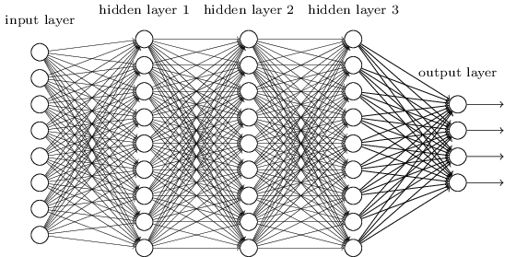
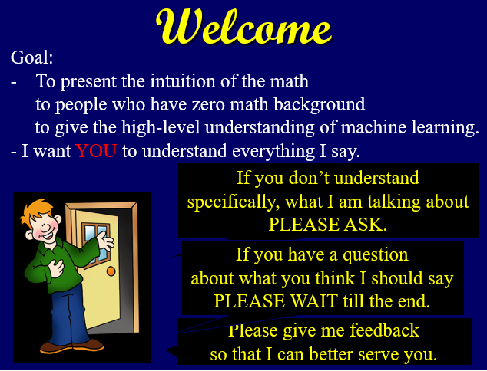
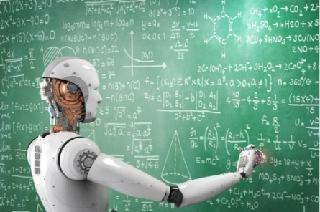
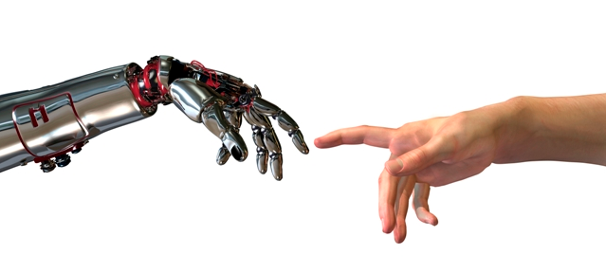
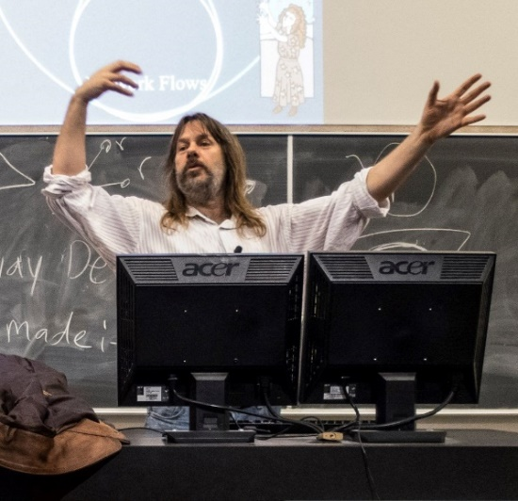



Machine Learning
Ethics
Jeff Edmonds, Comp. Sci.
www.eecs.yorku.ca/~jeff/courses/machine-learning
Notes:
4*1.5hrs - not Example …, not unsupervised.

Slide 2
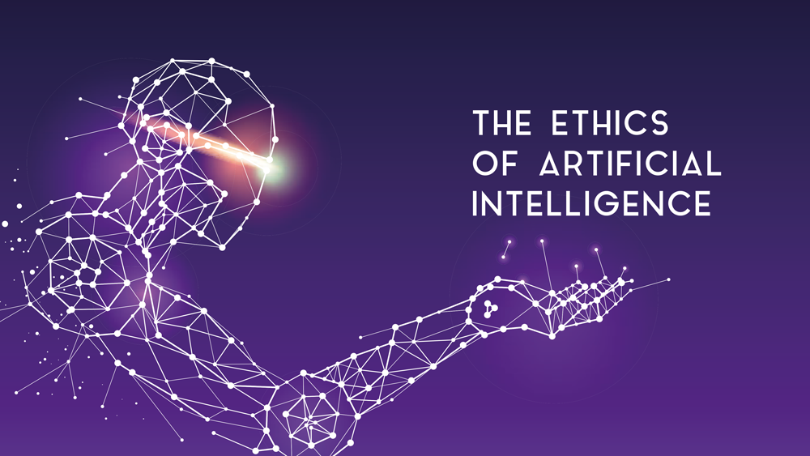
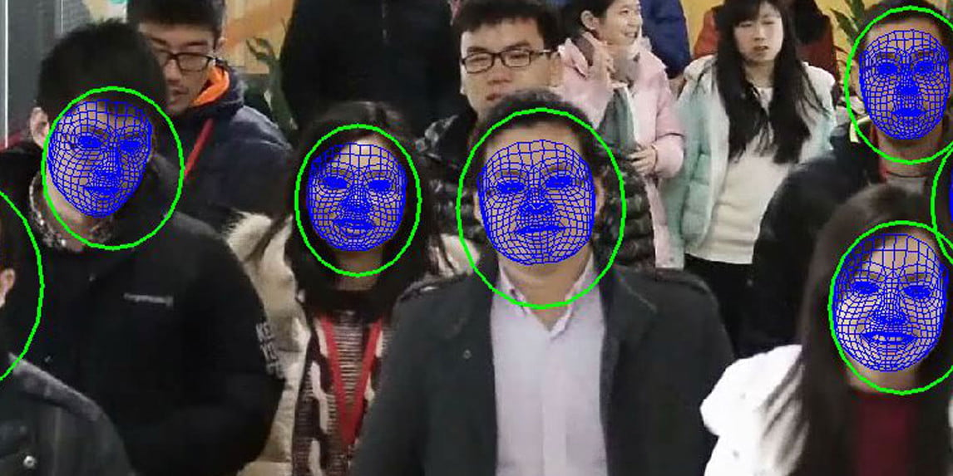
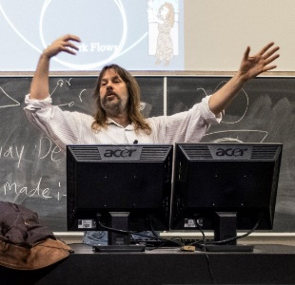

Jeff Edmonds
www.eecs.yorku.ca/~jeff/courses
Notes:
4*1.5hrs - not Example …, not unsupervised.

Slide 3
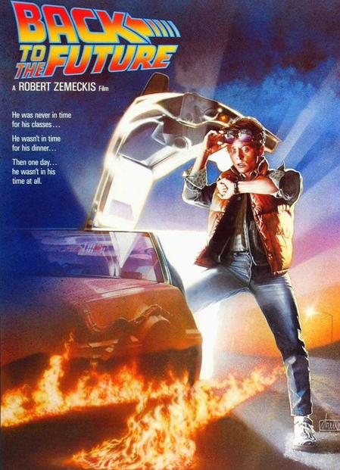
The Future is unknown
but is nigh!
For better or worse, this will change the world.
My first reaction is dominated by “Cool”
But what are the long term implications?

Slide 4
What are the positive things that machine learning is bringing the average person either now or soon?

Slide 5
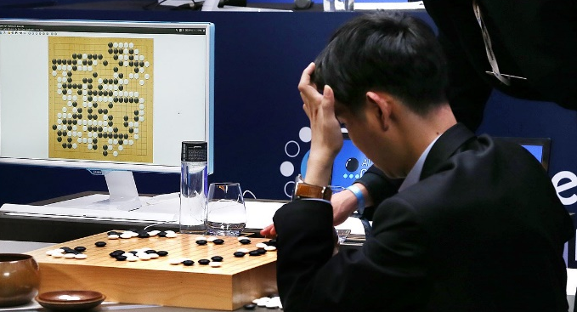
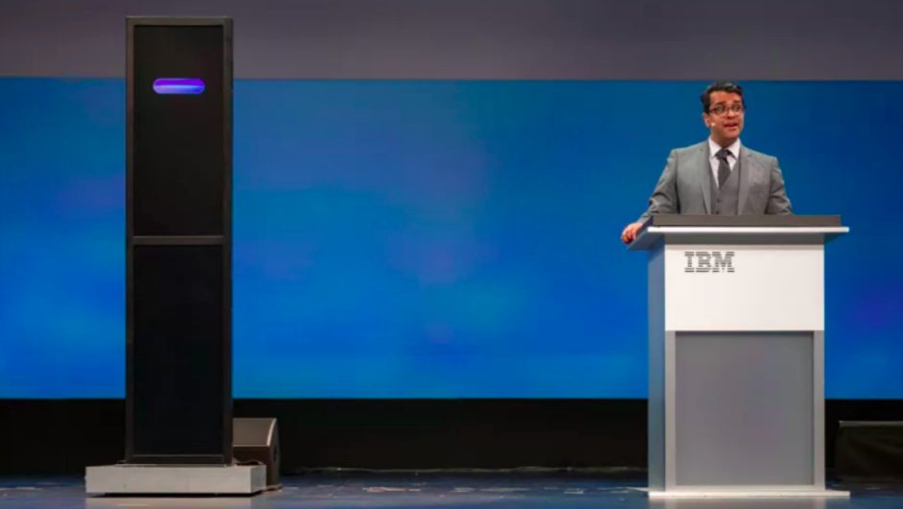
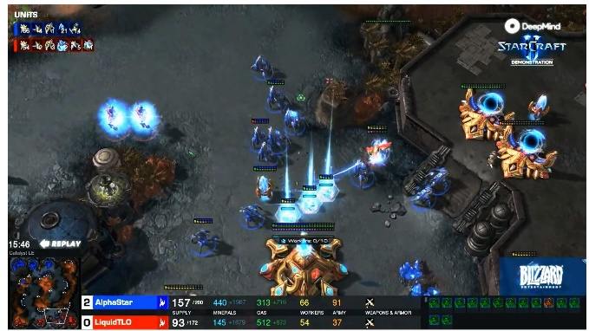
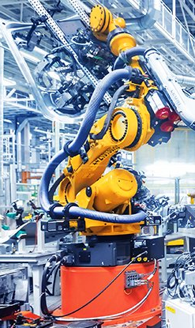
Hopeful Applications
  2015/17 Learn to play
  any game with no human skill given.
2018 IBM Debater
  May make the world much
  better.
2018 win at Starcraft2
Real time decision making.
Robots

Slide 6
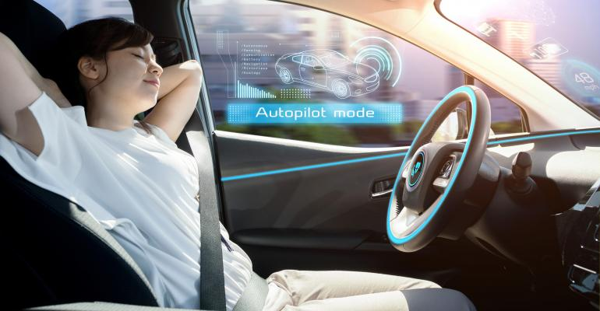
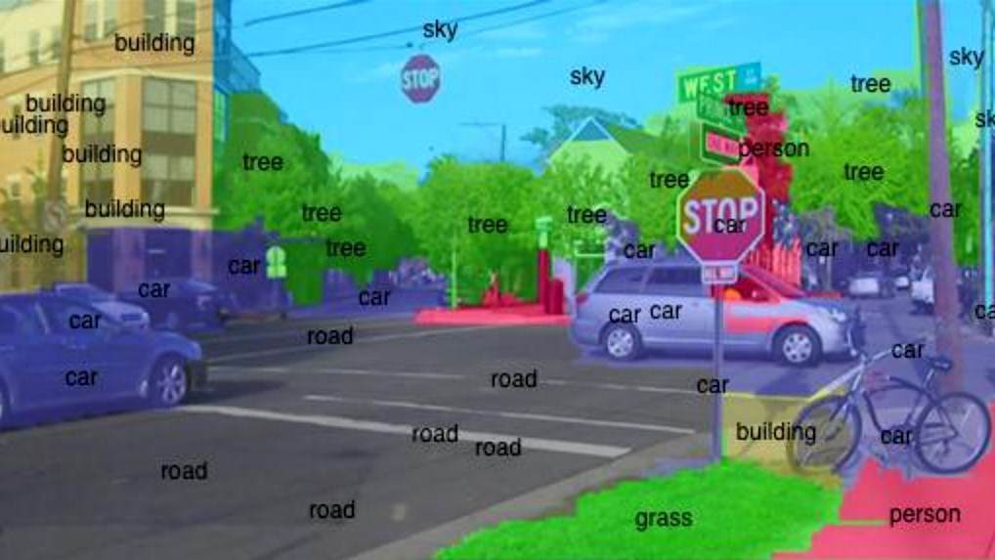
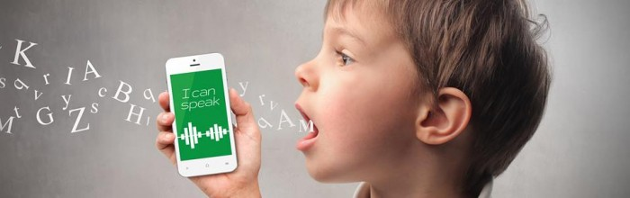
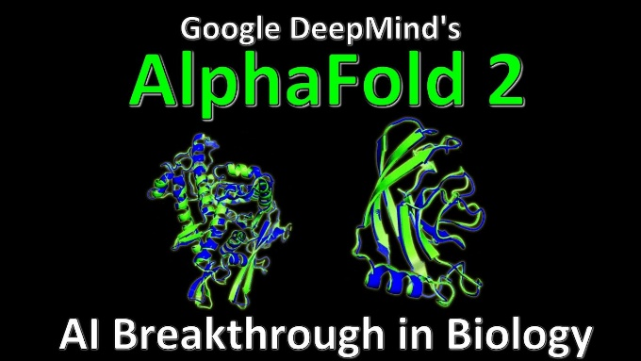
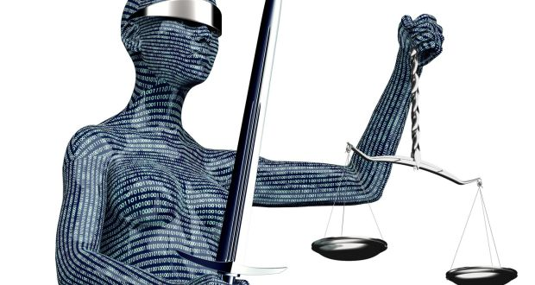
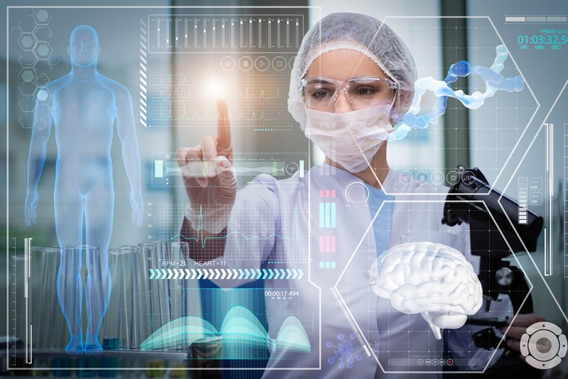
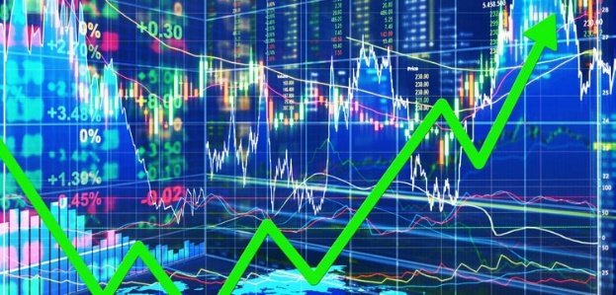
Hopeful Applications
Image processing
Self diving cars
Speech processing
  May make the world much
  better.
2020 protein
folding
Financial,
Medical Experts
Legal and

Slide 7
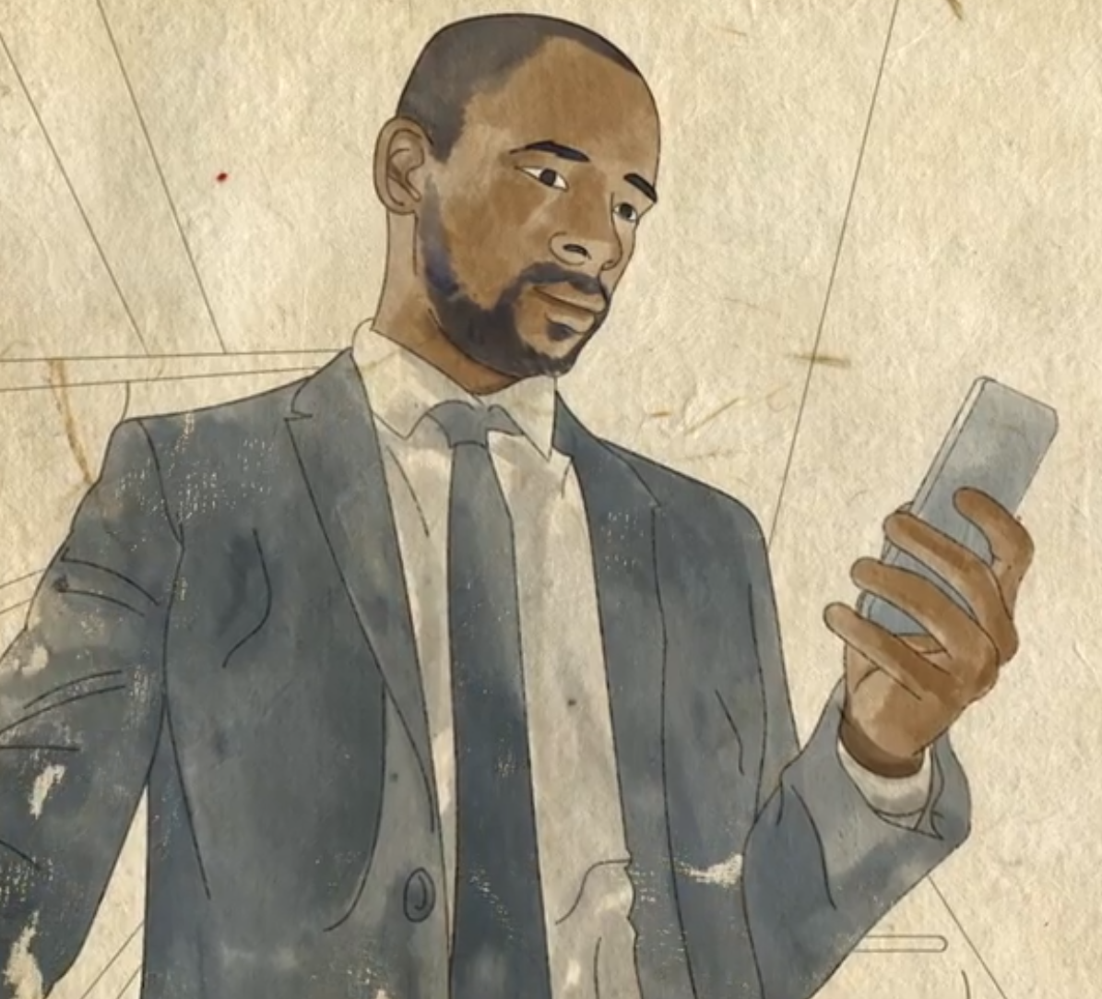
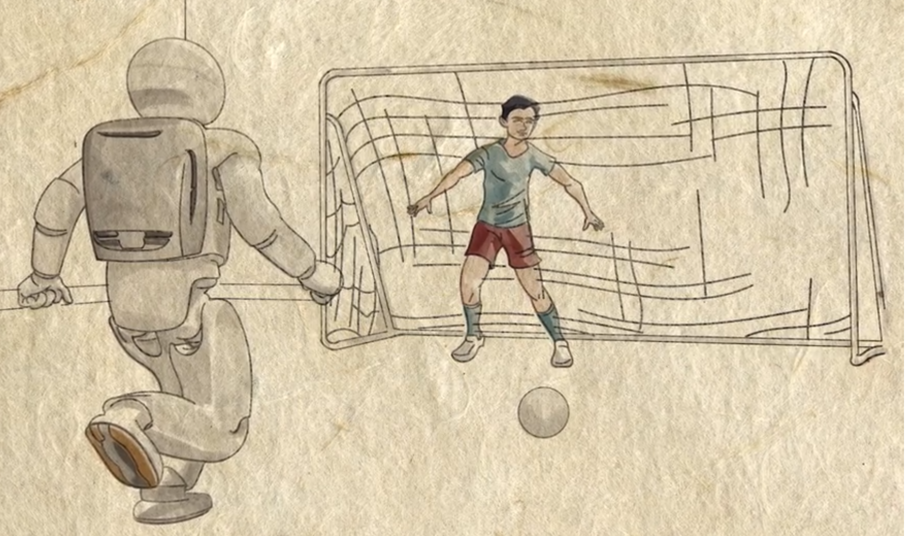
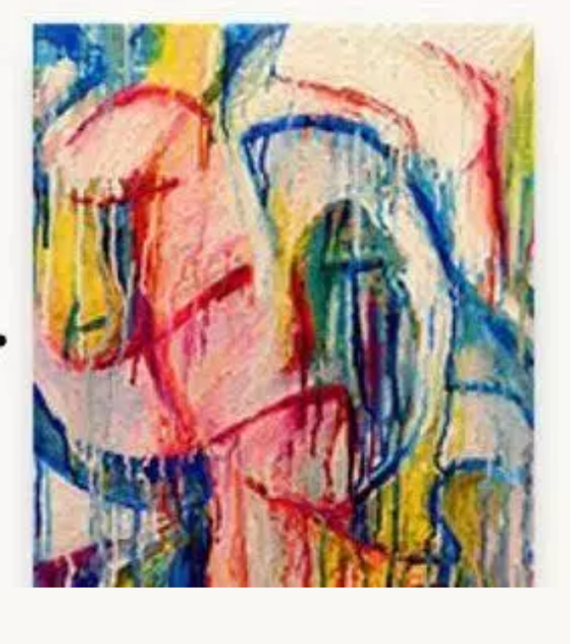
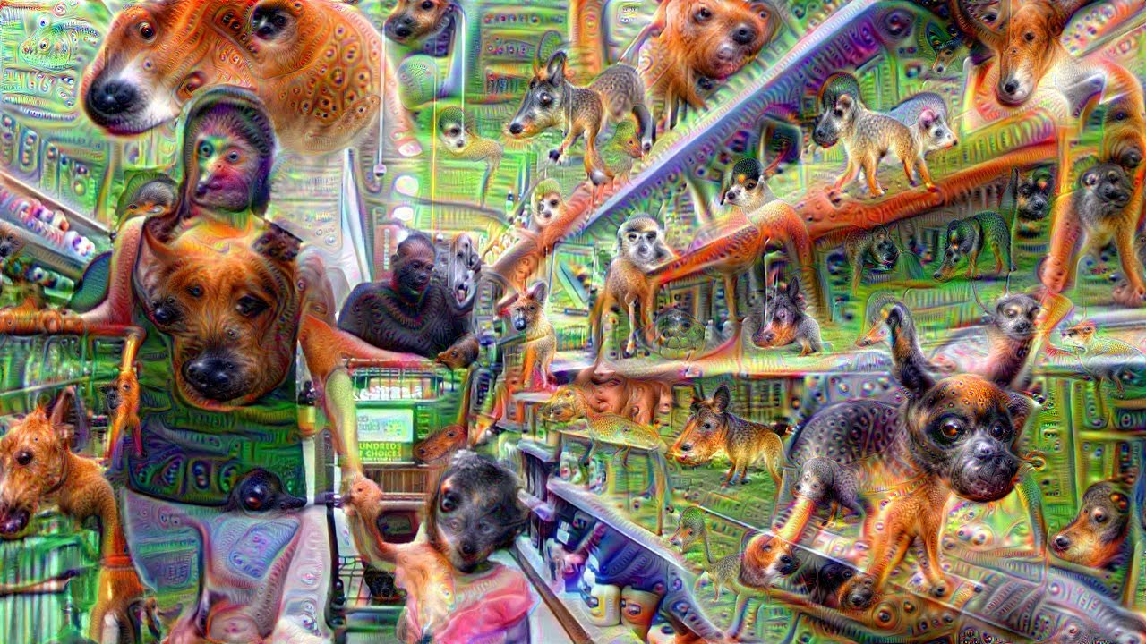
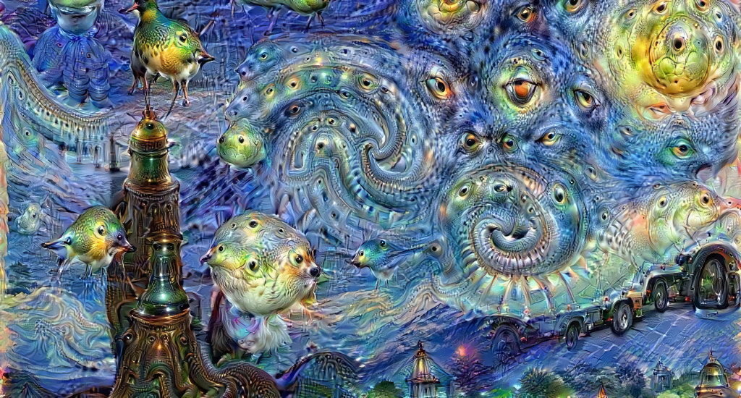
Hopeful Applications
Managing our lives
Entertainment
  May make the world much
  better.
  Generate new art
    Machine’s having nightmares

Slide 8
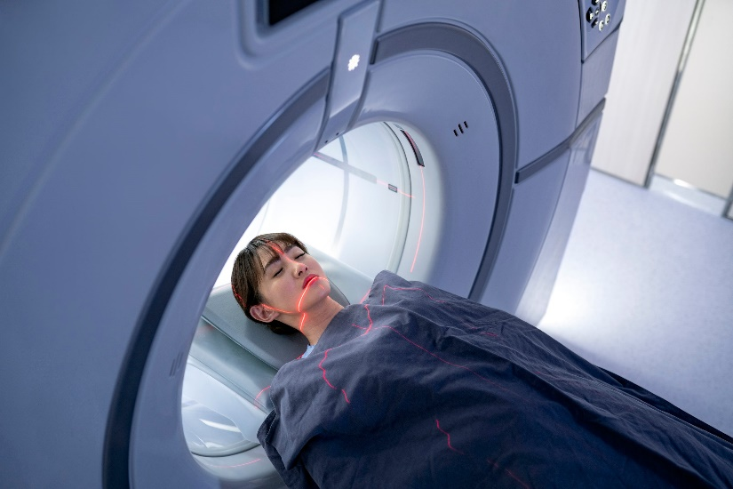
Hopeful Applications
Thoughts in a Coma
Is the person in a coma thinking?
Can we communicate with them?
y_{d} = “Think about playing tennis”
or “Think about your mom”
x_{d} = MRI scans of their brain
Machine learning can learn
to know y_{d} from x_{d}.
Does it know what the person
in a coma is thinking?
  May make the world much
  better.

Slide 9
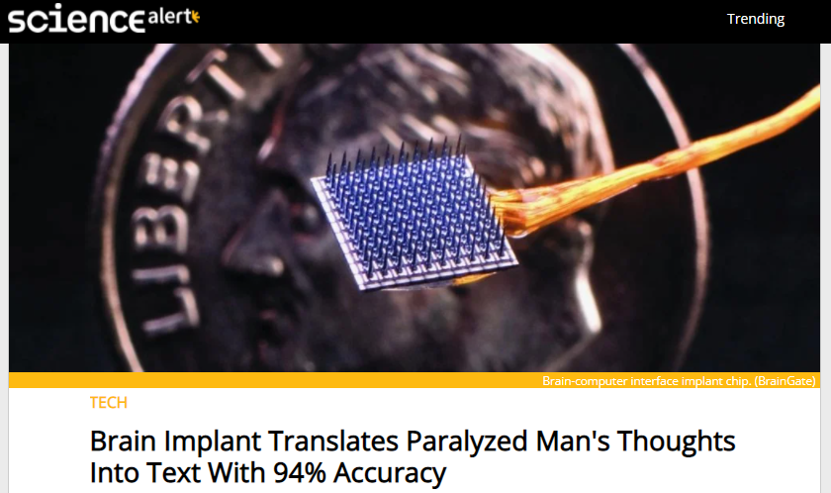
Hopeful Applications
  May make the world much
  better.

Slide 10
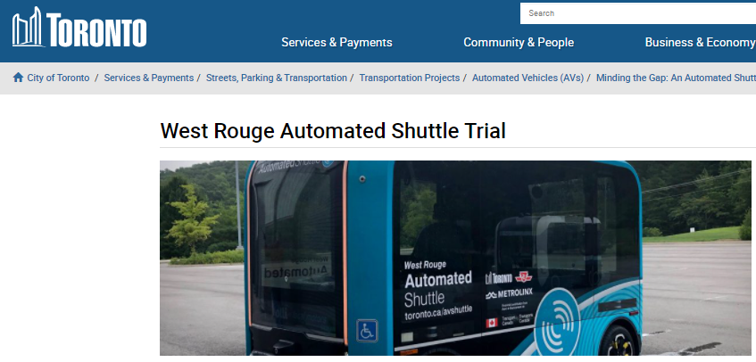
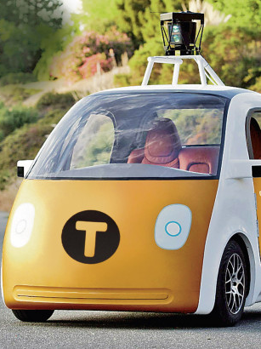
Hopeful Applications
    In 2018, Google/Uber had driverless taxis pick up people.
Stopped:
Snow
Morals
Consumer confidence

Slide 11
What are the negative effects that machine learning may have on the average person either now or soon?

Slide 12
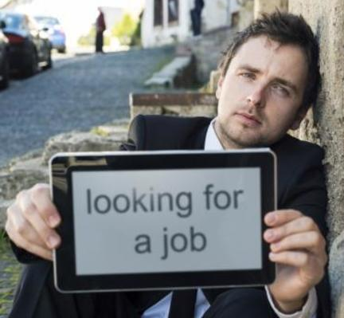
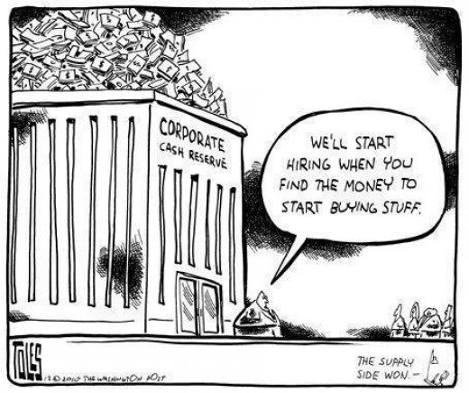
Scary Applications
  In 10-15 years,
  half current jobs
  will be obsolete.
  When lawyers
  lose their jobs,
  what will they do?
  I am hoping for basic income

Slide 13
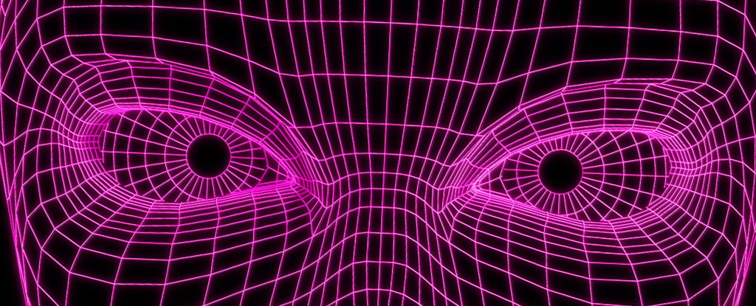
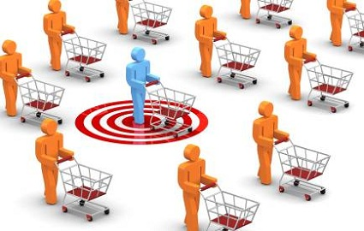
Scary Applications
By Watching You
  The world may be a scarier place
  Customizing your world

Slide 14
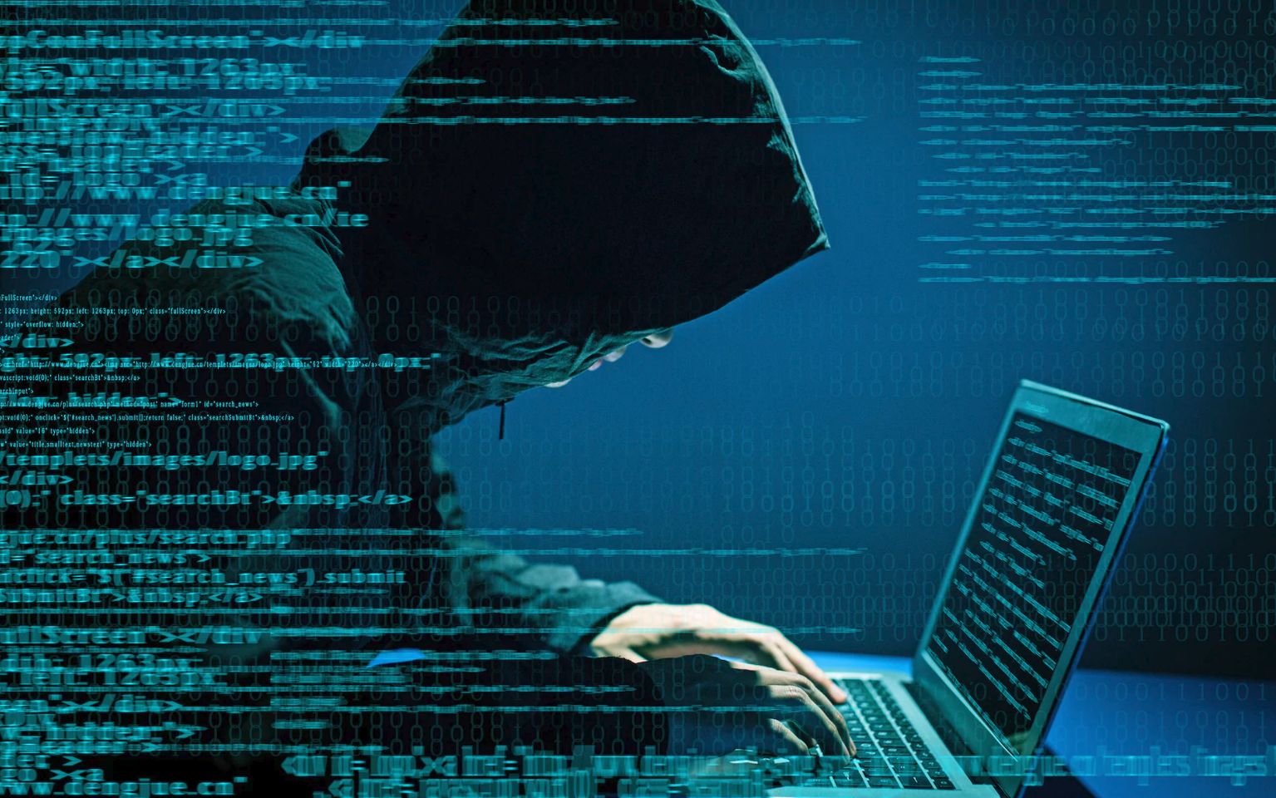
Scary Applications
By Watching You
Cyber Security
Hacking a million
self driving cars?
  The world may be a scarier place

Slide 15
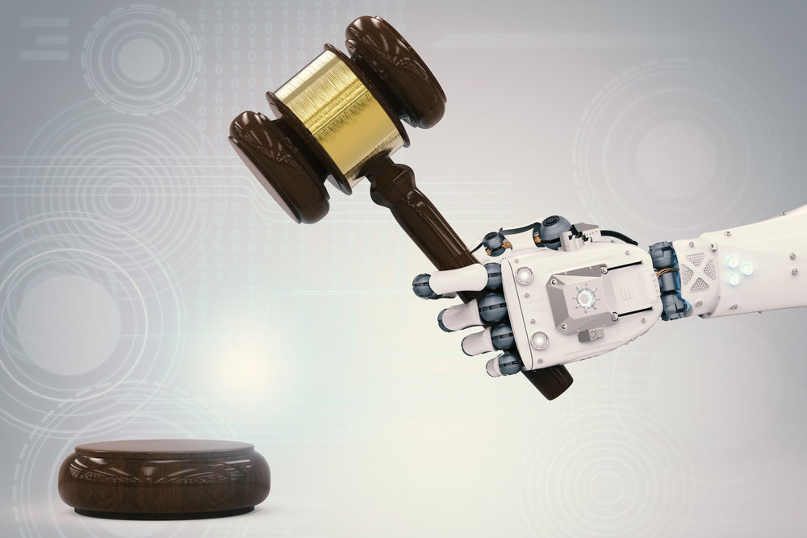
Scary Applications
By Watching You
Cyber Security
  Decide who to get a mortgage or get out of jail
  Is it fair?
  Do we understand how it makes its decisions?
  Judges

Slide 16
Scary Applications
  Your criminal may be
  my activist
Cyber Security
  Pick out “criminals”
  in a crowd
  Judges

Slide 17
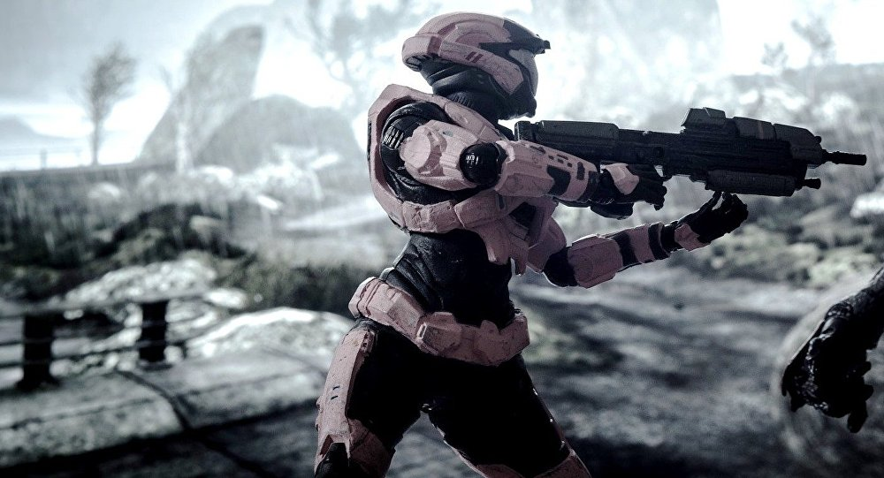
Scary Applications
  The problem with them is ???
  Everyone will want one!
  Killing machines
  Pick out “criminals”
  in a crowd
  Judges

Slide 18
Will AI machines be replacing humans any time soon?

Slide 19
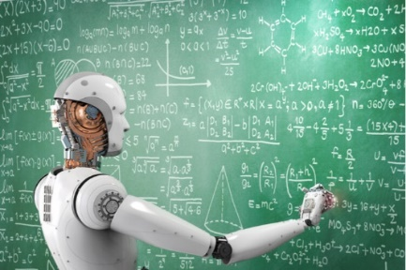
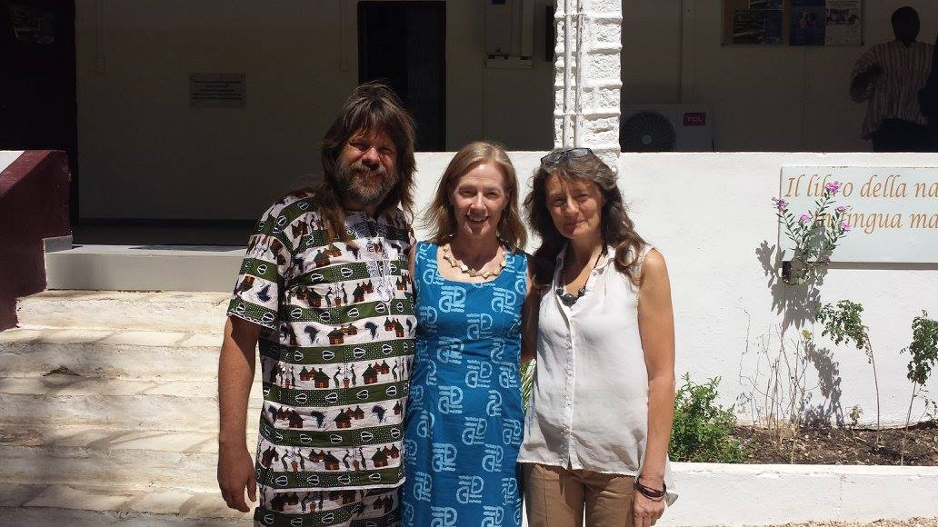
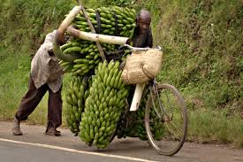
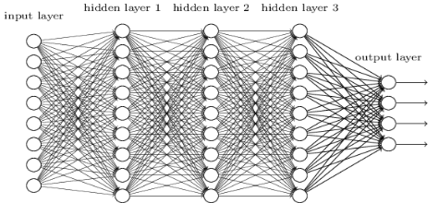
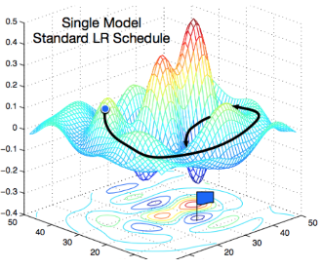
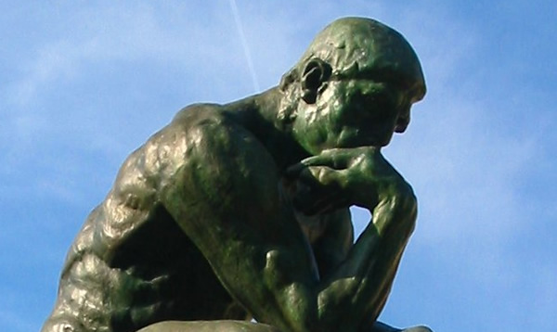
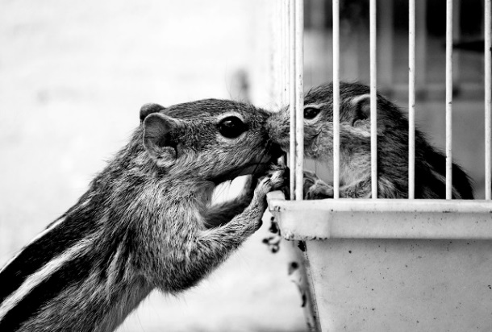
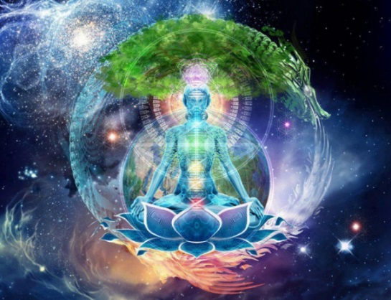
Limitations
Machine Learning
Training Data
Areas in which
machine learning
is not likely to find
the pattern soon.
face
bicycle
Complex
Understanding
Emotions
& Empathy
Consciousness

Slide 20
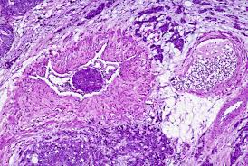
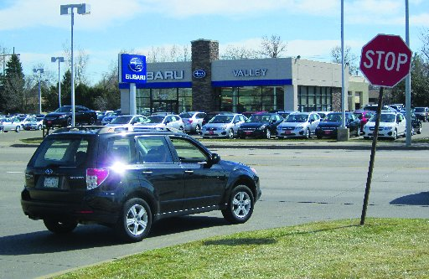
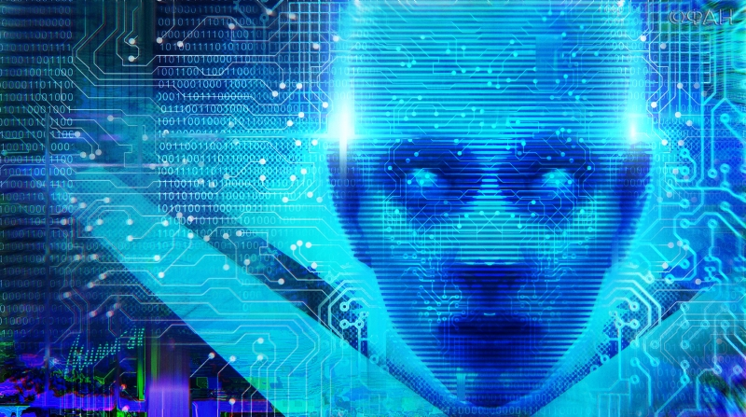
Limitations
  Computer vision can now label a picture better than humans.
Unsupervised Learning: Finding pattern in data still too hard
    Eg. An alien walks the world and discovers the concept of cars and stop signs even though she doesn’t know what they are.

Slide 21

Limitations
2018 IBM Debater
Great at finding arguments in data base
Poor at responding to complex argument
Hanabi
Card game requiring cooperative and subtle commination between players that don't know each other.

Slide 22
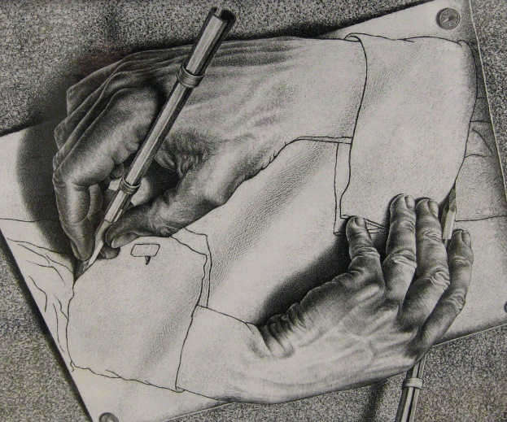

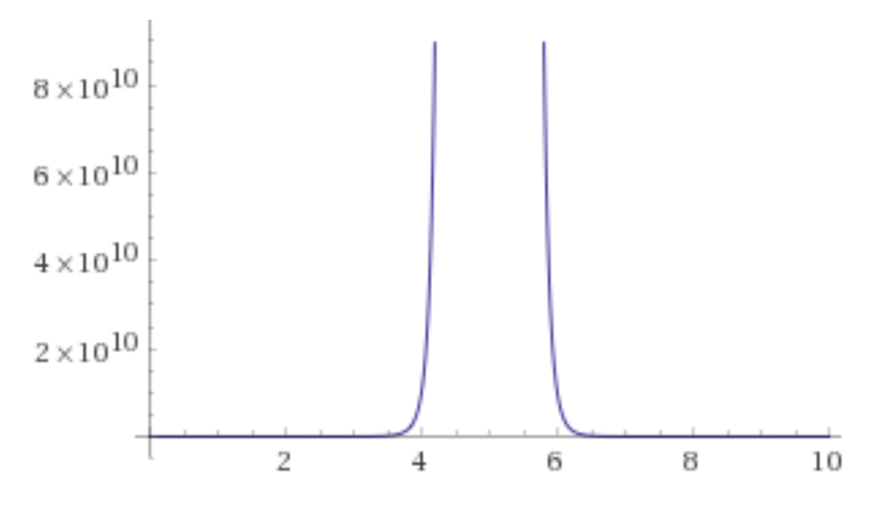
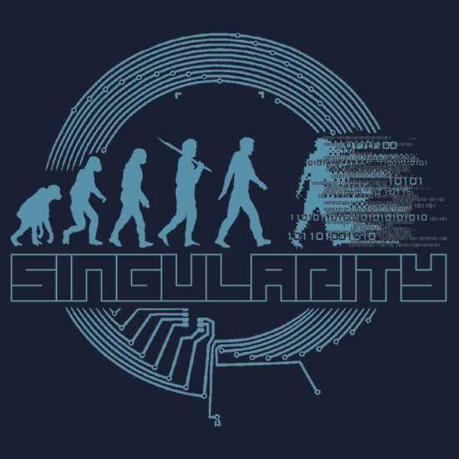

Limitations
On the other hand?
  As machines get better at building new machines,
  things will go fast!
Technology
What does life
look like here?
12:00pm

Slide 23
How capable is AI as a judge?

Slide 24




AI As A Judge
  The AI is only as good as the data that it learns from.
  Our data is biased.
  And not understood.
  We don’t understand the resulting neural net
  any better than we understand our own brains.
  We don’t understand how the human judge makes its decision either.

Slide 25


AI As A Judge
  We have heard that the new AI does not recognize poor black faces.
  But that is because society
  (and hence the data)
  does not recognize them.
  What does it even mean not to discriminate when choosing who to give a mortgage to or let out of jail?
  Don’t consider their race!
  Do you consider
    their neighborhood?
    their job/income?
    Do you focus on police and children’s aid data?
    Each systematically targets poor blacks.
  Built into
  our data

Slide 26



AI As A Judge
  How does one decide
  who to kill?
  Certainly we want to minimize the number of
  US soldiers killed.
  Half truth ☺
  Half sarcasm ☹
  Who is the enemy?
  Do we want China selling its technology to dictators?
  Do we trust the US government any better?
  Who do you trust?

Slide 27

AI As A Judge
  We hear of concern
  with AI and ethics.
  It will force a public decision on such issues.
  A woman jumped in front of a self-driving car and died.
  The car could not have stopped in time.
  But the AI “saw” her and
  “chose” not to try to stop.
  Google temporarily stopped the program

Slide 28
What are your thoughts on social media?

Slide 29





Social Media
  Positive:
  Great for empowering people within their community
  And bringing them access to knowledge.
  Negative:
  Great for pushing everyone to some extreme.
  Great for propaganda
  and fake news.
  This will only get more extreme.

Slide 30
What will happen when we all loose our jobs to machines?

Slide 31

Jobs

Slide 32


Jobs
  In the past, people retrained
  and found a new job.
  I don’t think we will be so lucky this time.

Slide 33



Jobs

Slide 34



Jobs
25% to 33% of a CEO’s job can now be automated.
She says
“I would really like that time back to do more high value things.”
Human Empathy
Creativity

Slide 35




Jobs
30% of the work done by a CEO.
70% of the work done by a financial trader
30% of the work done by a legal person
22% of the work done by a medical person
27% of the work done by an educators!!!!

Slide 36


Jobs
  Certainly, the first step is a minimum guaranteed income for everyone.
  Even if people hate their job,
  they also find
  life meaning from it.
  We will have to find other ways to find meaning.
  Maybe hire half the people
  to entertain the other half.

Slide 37
How is the “software” of a neural net produced.

Slide 38

Magic

Slide 39




Magic
Do you know the basics
of how the things in your world work?

Slide 40








Magic
Building a Computer
From Sand
GCD(a,b) = GCD(x,y)
<x,y>
⇒ <y,x mod y>
https://www.eecs.yorku.ca/~jeff/courses/fun/Building_Computer.pptx

Slide 41


Magic
Training Data
  Neural Networks
  Deep Learning
  Gradient decent.
face
bicycle
  Not coded by a human
  Learns from LOTS of data.

Slide 42






Magic
Training Data
Machine Learning
is similar to evolution
face
bicycle
Both are simple systems
making small
changes based on positive feedback.
We don’t understand
the resulting brain
or neural network.
I find it oddly
spiritual.
Emergent Complexity:
And what arises
is awe inspiring

Slide 43


Magic
Training Data
face
bicycle
    Useful when humans are unable to explain their expertise (walking)
    Useful when a pattern
    can be found in
    lots of data.

Slide 44
But how can the machine know the answers outside the training data?

Slide 45



Generalizing from Training Data
Math Theorem:
If on the randomly chosen training data,
a machine is found that gives good answers
without simply memorizing,
then we can prove that with high probability
this same machine will also work well
on never seen before instances.

Slide 46
Ethics??
Leadership??

Slide 47
The Future is unknown
but is nigh!
For better or worse, this will change the world.

Slide 48


The Future is unknown
but is nigh!
  We hear of concern
  with AI and ethics.
  I don’t believe these questions are new.
For better or worse, this will change the world.
  But the technology
  makes them more stark.
  Hopefully, it will force
  a fruitful public discourse.

Slide 49

The Future is unknown
  No doubt the people controlling the AI will be very rich and very powerful.

Slide 50






The Future is unknown
  No doubt the people controlling the AI will be very rich and very powerful.
  The questions are:
  Will our (human) overlords
  be benevolent or evil.
  How poor and powerless
  will the masses be?
  Who will define,
  influence,
  and enforce
  morality?

Slide 51






Benevolent or Evil?
  This is much more
  important than the
  race to the moon was.
  Who do you
  want to lead in AI?

Slide 52


Slide 53


















My Hope is with the Hippy Coders

Slide 54

End
Thanks
for coming
Do you have any questions?
Please give me feedback
so that I can better serve you.
Notes:
54

Slide 55
Ethics
9. Imagine you have designed a machine learning system for a bank. The system uses an artificial neural network to decide whether to approve mortgages based on client income, banking and credit history, and some demographic data such as gender, ethnic background and age. The network has many layers and over 2 million parameters (weights). A client is asking you why their desired mortgage was not approved by the system and they are accusing you of discrimination based on gender. What level of detail are you able to provide them in your response by simply looking at the values of your weights? Can you easily check whether your model is making decisions based on their gender? Why or why not? (3 marks)

Slide 56
Ethics
This is a scary topic.
You put in sensitive information which is against the law.
We do not understand the weights at all so we don't know how it uses this sensitive information.
We can guess that if the labels (give mortgage) in the training data are correlated with this sensitive information then the machine will naturally learn to reflect this correlation.
I suppose you could test it by flipping the client's sensitive data and seeing if the result changes.
Even if you just ask for the client's address then
this may correlate with their race
which then in turn may correlate with whether or not
they pay back their mortgage.
It is all very hard <3

Slide 57
Questions
Q: What is machine learning and why care?
Q: Positive effects on the average person?
Q: Negative effects on the average person?
Q: Will AI machines be replacing humans any time soon?
Q: How capable is AI as a judge?
Q: What are your thoughts on social media?
Q: Loosing our jobs to machines?
Q: How is the “software” of a neural net produced.

Slide 58





The Singularity
$$There is exponential growth in$$
Technology
Human population
Wealth of the rich
But what is the singularity?
$y=Y\left(t\right)$
Consider these as a
function of time.

Slide 59

The Singularity
$$\frac{\text{δ}\text{y}}{\text{δ}\text{t}}=rate of change$$
# of inventions this year
human births - deaths
income – money spent
$y=Y\left(t\right)$
Consider these as a
function of time.

Slide 60




The Singularity
$$\frac{\text{δ}\text{y}}{\text{δ}\text{t}}=0$$
We were too busy
to invent anything.
$y=1$
So what we know
stays constant.

Slide 61



The Singularity
$$\frac{\text{δ}\text{y}}{\text{δ}\text{t}}=1$$
We invent one new thing per year.
$y=t$
So what we know
grows linearly

Slide 62




The Singularity
$$\frac{\text{δ}\text{y}}{\text{δ}\text{t}}=t$$
Our salary increases
by one each year.
$y=½ t^{2}$
So our money grows quadratically.

Slide 63



The Singularity
$$\frac{\text{δ}\text{y}}{\text{δ}\text{t}}=y$$
The growth rate
≈ current value
$y=e^{t}$
Value grows exponentially.

Slide 64


The Singularity
$$\frac{\text{δ}\text{y}}{\text{δ}\text{t}}=y$$
# of inventions this year
≈ what we already know
$y=e^{t}$
Technology grows exponentially.

Slide 65


The Singularity
$$\frac{\text{δ}\text{y}}{\text{δ}\text{t}}=y$$
# births
≈ # of people having babies
$y=e^{t}$
Population grows exponentially.

Slide 66


The Singularity
$$\frac{\text{δ}\text{y}}{\text{δ}\text{t}}=y$$
# interest income
≈ amount in account.
$y=e^{t}$
Wealth grows exponentially.

Slide 67




The Singularity
$$\frac{\text{δ}\text{y}}{\text{δ}\text{t}}=y \ln^{2}(y)$$
# of inventions this year
≈ slightly super linearly
in what we already know
Having AI really does change
things fast.
$y=e^{t}$
Technology grows
FASTER than
exponentially.
$y=e^{e^{t}}$
FASTER
$y=e^{e^{e^{t}}}$
FASTER
All of these in finite time
stay finite!
FASTER

Slide 68
The Singularity
$$\frac{\text{δ}\text{y}}{\text{δ}\text{t}}=y \ln^{2}(y)$$
# of inventions this year
≈ slightly super linearly
in what we already know
Having AI really does change
things fast.
Y = ¹/_{(12-t)}
This does not look so bad.
When time = 12:00pm,
technology = ∞.
What does life
look like here?
12:00pm

