Slide 1
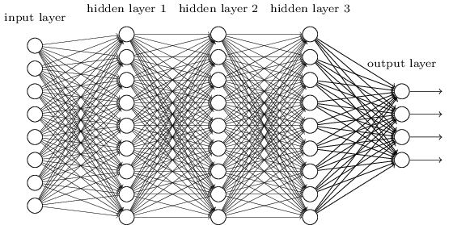
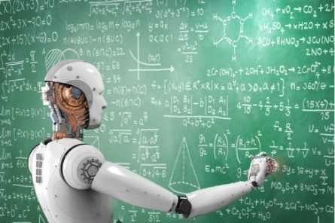
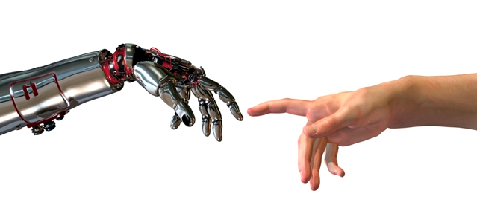
Machine Learning
Dimension Reduction & Maximum Likelihood
Compression
Dimension Reduction
Probabilities
Max Likelihood = ML
Max Likelihood Normal
Statistics
Bayesian & ML
Extras
Chernoff
More Max Likelihood
Bias
More Baysian
Bias
Bias
Jeff Edmonds, Comp. Sci.
www.eecs.yorku.ca/~jeff/courses/machine-learning
Notes:
4*1.5hrs - not Example …, not unsupervised.

Slide 2
Dimension Reduction & Maximum Likelihood:
How to compress your data while retaining the key features.
A randomly chosen bit string cannot be compressed at all. But if there
is a pattern to it, eg it represents an image, then maybe it can be
compressed.
Each pixel of an image is specified by one (or three) real numbers.
If an image has thousands/millions of pixels, then each of these acts
as a coordinate of the point where the image sits in a very high
dimensional space. A set of such images then corresponds to a set of
these points.

Slide 3
We can understand the pattern of points/images as follows. Maximum
Likelihood assumes that the given set of points/images were randomly
chosen according a multi-dimensional normal distribution and then
adjusts the parameters of this normal distribution in the way that
maximizes the probability of getting the images that we have. The
obtained parameters effectively fits an ellipse around the
points/images in this high dimensional space.
We then reduce the number of dimensions in our space by collapsing
this ellipse along its least significant axises. Projecting each
point/image to this lower dimensional space compresses the amount of
information needed to represent each image.

Slide 4
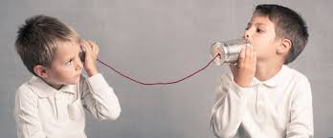
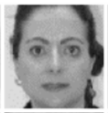
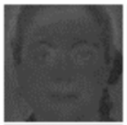
Compression
I want to send you a message.
I want to receive it.
I want to send as few bits as possible.
I want to send only 100 numbers.
Decode
Encode
Suppose this is an image of a face
with 100×100=10,000 pixels.
Each pixel, being black&white, is described by one number.
But each pixel was not chosen randomly.
There is structure to the image.
Eyes and noses in a fixed place.
Hence, something like JPEG can compress it into a file with far fewer bits.

Slide 5
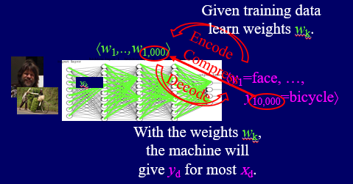
Compression
I want to send you a message.
I want to receive it.
I want to send as few bits as possible.
I want to send only 100 numbers.
Decode
Encode
We do this with machine learning.
By compressing our data, we hope to understand its underlying pattern better.

Slide 6
Compression
I want to send you a message.
I want to receive it.
I want to send as few bits as possible.
I want to send only 100 numbers.
Decode
Encode
In the 80s, they used a different method.
By compressing our data, we hope to understand its underlying pattern better.

Slide 7
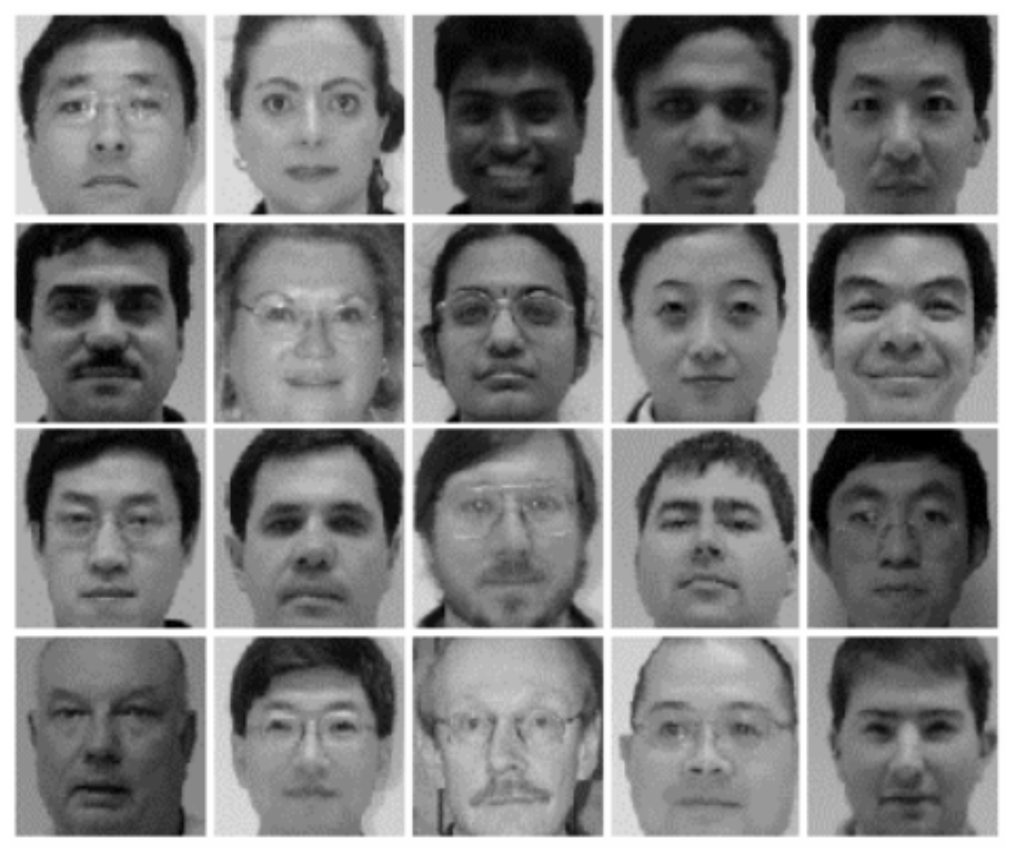
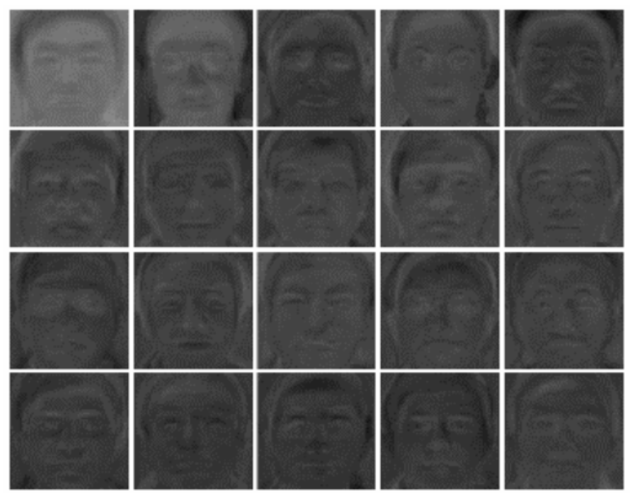
Dimension Reduction
Described by 10,000 numbers
Described by 100 numbers
Then recognize the face using these 100 numbers

Slide 8
Dimension Reduction
Each 10,000-pixel face is represented by a single point in 10,000-dimensional space.
pixel x₂
pixel x₁

Slide 9
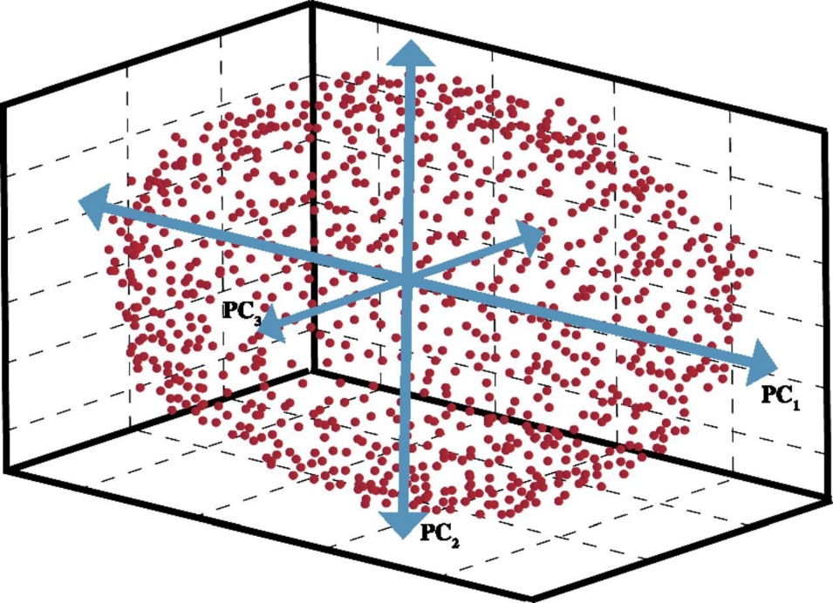
Dimension Reduction
Locate lot of faces.
“Fit” the data with a multi-dimensional ellipse.
pixel x₂
pixel x₁

Slide 10
Dimension Reduction
Delete the information in the direction of the smaller axis by projecting against the remaining plane.
pixel x₂
pixel x₁

Slide 11
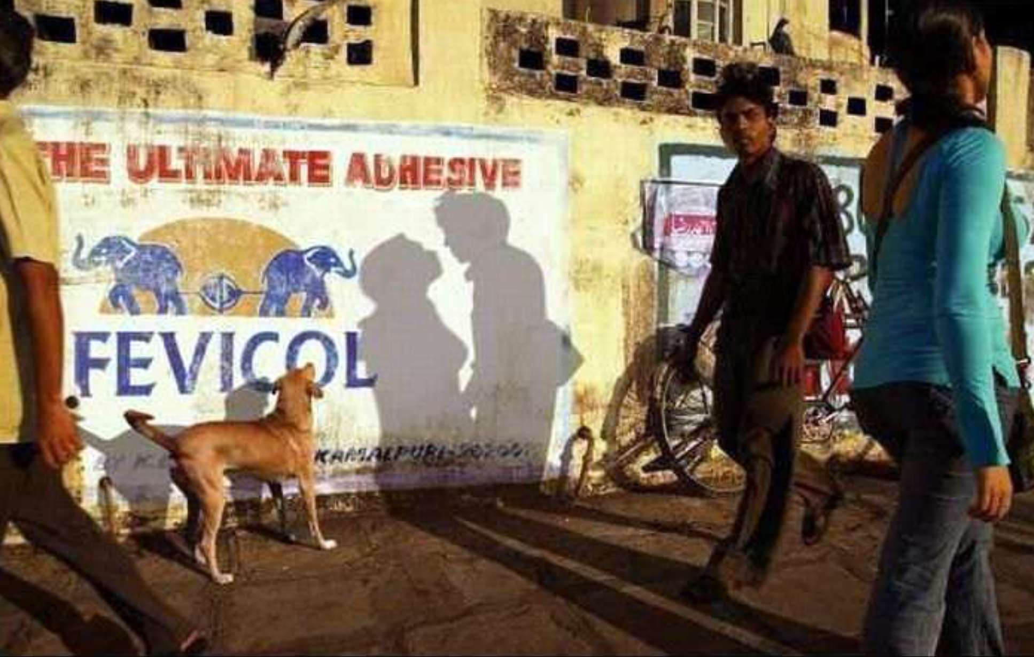
Dimension Reduction
Delete the information in the direction of the smaller axis by projecting against the remaining plane.
pixel x₂
pixel x₁

Slide 12
Dimension Reduction
Delete the information in the direction of the smaller axis by projecting against the remaining plane.
Instead of a face being defined by ⟨x₁,…,x_{10,000}⟩. it is defined by ⟨z₁,…,z₁₀₀⟩.
i.e. We project from the 10,000 dimensional space to a 100 dimensional subspace.
pixel x₂
z₁
pixel x₁

Slide 13
Dimension Reduction
Delete the information in the direction of the smaller axis by projecting against the remaining plane.
Instead of a face being defined by ⟨x₁,…,x_{10,000}⟩. it is defined by ⟨z₁,…,z₁₀₀⟩.
i.e. We project from the 10,000 dimensional space to a 100 dimensional subspace.
This point in
10,000 dim-space
represents this image.
pixel x₂
z₁
This point is in a
100 dim-sub-space.
It is also still in
10,000 dim-space
and as such can be
displayed as an image.
pixel x₁

Slide 14
Dimension Reduction
Locate lot of faces.
“Fit” the data with a multi-dimensional ellipse.
How do you do this?
pixel x₂
pixel x₁

Slide 15
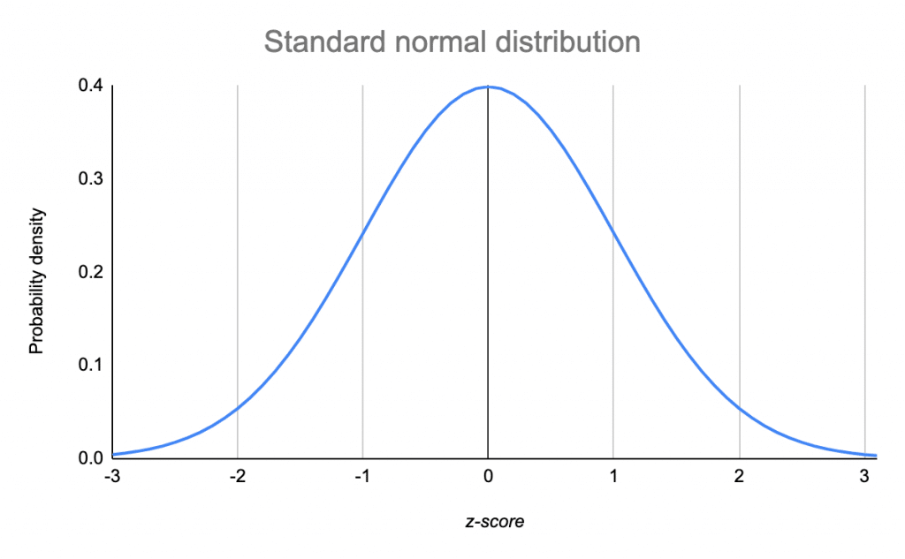
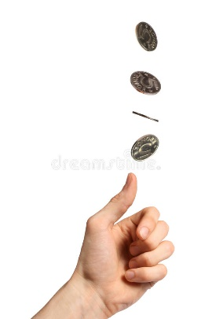
Probabilities
Experiment:
Flip a coin n=100 times
Let x denote # of head
Put a box at x.
Repeat this many times.
Scale down so area = 1
Normal/Gaussian Distribution
20
30
40
50
60
70
80
x = # coin heads

Slide 16
Probabilities
Experiment:
Flip a coin n=100 times
Let x denote # of head
Put a box at x.
Repeat this many times.
Normal/Gaussian Distribution
Experiment:
Throw a dart promised to be under the curve.
Let x denote where it lands horizontally.
Put a box at x.
Repeat this many times.
20
30
40
50
60
70
80
x = # coin heads

Slide 17
Probabilities
Experiment:
Flip a coin n=100 times
Let x denote # of head
Put a box at x.
Repeat this many times.
Normal/Gaussian Distribution
Average(# heads) = Exp(# heads)
= ½n = 50 = µ
StandDev(# heads)
= $\sqrt{Exp(\left(x\text{−}\text{µ}\right)2)}$
= $\sqrt{n}$ = 10 = σ
# of standard deviations from the mean
= ^{(x-µ)}/_{σ} = ^{(x-50)}/₁₀ = c
Eg for x=70, c=2.
20
30
40
50
60
70
80
x = # coin heads
µ =½n
σ = $\sqrt{n}$
Probability(#heads=x)
= fraction of times this happens
= height of curve
= $e^{−\text{½}c2}$ = $e^{−\text{½} {\left(x\text{−}μ\right)2}/{σ2}}$
Prob(c=6) = ${ e}^{−\text{½} 62}$ = ¹/_{65,659,969}
Standard experiment = p = ¹/₂₀

Slide 18
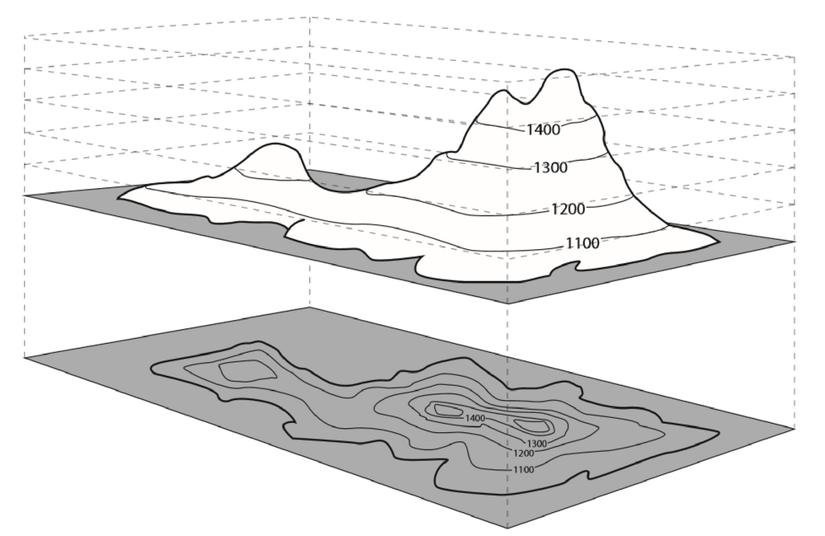
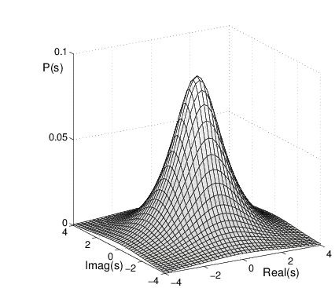
Probabilities
Experiment:
Flip a coin n=100 times
Let x denote # of head
Put a box at x.
x₂
100
Contour lines form events of the same probability.
Repeat this twice
Let x₁ denote # of head first time and x₂ the second.
Repeat this many times.
Stack up the giving a height.
Less likely to be extreme in both.
50
${\left(x1\text{−}μ\right)2+\left(x2\text{−}μ\right)2}/{σ2}$ = c
50
100
x₁
Probability(x₁ & x₂)
= the height of stack as fraction
= Prob(x₁) × Prob(x₂)
= $e^{−\text{½} {\left(x1\text{−}μ\right)2}/{σ2}}$ × $e^{−\text{½} {\left(x2\text{−}μ\right)2}/{σ2}}$
= $e^{−\text{½} {\left(x1\text{−}μ\right)2+\left(x2\text{−}μ\right)2}/{σ2}}$
= $e^{−\text{½}c2}$
µ =½n

Slide 19
Probabilities
Experiment:
Flip a coin n=100 times
Let x denote # of head
Put a box at x.
x₂
100
Contour lines form events of the same probability.
Repeat this twice
Let x₁ denote # of head first time and x₂ the second
Less likely to be extreme in both.
50
${\left(x1\text{−}μ\right)2+\left(x2\text{−}μ\right)2}/{σ2}$ = c
50
100
x₁
Distribution Density Curve:
The probability that data item falls in the red square is
the height of the curve
× the area of the square.
µ =½n

Slide 20
Probabilities
Randomly choose prob of heads to be p∈[0,…,1]
Experiment:
Flip a coin n=100 times
Let x denote # of head
Put a box at x.
x₂
100
same coin
Repeat this twice
Let x₁ denote # of head first time and x₂ the second.
If x₁ is small
→ then p is more likely small
→ x₂ is more likely small.
If x₁ is big
→ then p is more likely big
→ x₂ is more likely big.
x₁ & x₂ are positively correlated.
50
50
100
x₁

Slide 21
Maximum Likelihood = Machine Learning
Collect D objects with values x₁, x₂, x₃, …, x_{D}.
We don’t know how these numbers are created.
Let’s pretend they were created as follows:
Flip a coin n=100 times
Let x denote # of head
This is machine learning!
We used training data to learn the pattern of the universe.
We can now use this knowledge to make predictions about the future.
When I first took Statistics, I hated it because it seemed so arbitrary.
Now I see it can all be formally defined using this one simple concept.
20
30
40
50
60
70
80
If so, the coin used was not fair!
Prob of heads p was most likely 0.6.
Because this is the setting of the parameter p, that maximizes the probability of us getting our data.
0.6 = ArgMax_{p} Pr_{p}[our data]
Maximum Likelihood Model

Slide 22
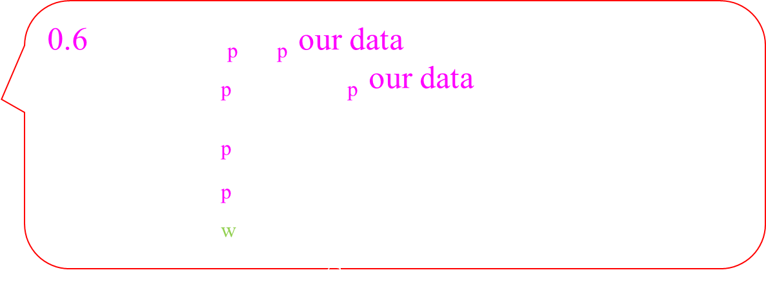
Maximum Likelihood = Machine Learning
Collect D objects with values x₁, x₂, x₃, …, x_{D}.
We don’t know how these numbers are created.
Let’s pretend they were created as follows:
Flip a coin n=100 times
Let x denote # of head
This is machine learning!
We used training data to learn the pattern of the universe.
We can now use this knowledge to make predictions about the future.
When I first took Statistics, I hated it because it seemed so arbitrary.
Now I see it can all be formally defined using this one simple concept.
20
30
40
50
60
70
80
0.6 = ArgMax_{p} Pr_{p}[our data]
= ArgMin_{p} –log( Pr_{p}[our data] )
= ArgMin_{p} –log( $e^{−\text{½} {\left(x1\text{−}μ\right)2+…+\left(xD\text{−}μ\right)2}/{σ2}}$ )
= ArgMin_{p} $\left(x1\text{−}μ\right)2+…+\left(xD\text{−}μ\right)2$
= ArgMin_{w} sum of squares error
= machine learning

Slide 23
Maximum Likelihood Normal
Our goal is to learn about the world.
We have some training data {${\vec{x}}_{1},{\vec{x}}_{2}$, …$,{\vec{x}}_{D}$}.
Let’s model the world
by finding a simple distribution
that has highest probability of producing this data.
simple
That would be the distribution that produces this data with probability 1.

Slide 24
Maximum Likelihood Normal
Our goal is to learn about the world.
We have some training data {${\vec{x}}_{1},{\vec{x}}_{2}$, …$,{\vec{x}}_{D}$}.
Let’s model the world
by finding a simple distribution
that has highest probability of producing this data.
Define a family of “simple” distributions D .
These are parameterized by $\vec{w}$.
Eg: Normal/Gaussian Distribution
Find the parameters $\vec{w}$that maximizes the probability that the data we have is obtained.
simple
$$\vec{w}$$
$\vec{w}$= ArgMax Pr[our data | $\vec{w}$ ]
$$\vec{w}$$

Slide 25
Maximum Likelihood Normal
Each 10,000-pixel face is represented by a single point in 10,000-dimensional space.
pixel x₂
pixel x₁

Slide 26
Maximum Likelihood Normal
Locate lot of faces.
“Fit” the data with a multi-dimensional ellipse.
How do you do this?
pixel x₂
pixel x₁

Slide 27
Maximum Likelihood Normal
We know that our face data came from our observations of the world.
But let’s pretend that it was randomly generated from a multi-dimensional normal distribution.
pixel x₂
pixel x₁

Slide 28
Maximum Likelihood Normal
Normal Probability Distribution:
The parameters specifying a normal distributional are given by the size and orientation of a multi-dimensional ellipse.
The ellipse gives the contour line of points that are equally likely under this normal distribution.
pixel x₂
3
2
1
pixel x₁

Slide 29
Maximum Likelihood Normal
Normal Probability Distribution:
When choosing a random data point,
Points near the middle of the ellipse are most likely.
Points further out are much less likely.
Pr [ ₁] = high
₂
₂
Pr [ ₂] = low
≈ e ^{–½ distance}
≈ e ^{–½ #standard deviations}
pixel x₂
3
2
1
₂
₁
pixel x₁

Slide 30
Maximum Likelihood Normal
Normal Probability Distribution:
When independently choosing a D random data points,
Pr [this data] =
Pr [ ₁] × … ×
Pr [ _{D}]
pixel x₂
pixel x₁

Slide 31
Maximum Likelihood Normal
Normal Probability Distribution:
If the probability distribution was defined by this ellipse
then our data might get chosen randomly,
but the probability would be low.
Pr [our data] = low
Pr [our data] = higher
pixel x₂
Pr [our data] = maximized
pixel x₁

Slide 32
Maximum Likelihood Normal
Maximum Likelihood:
Given our data,
Find the ellipse (i.e. the parameters of the distribution),
that maximizes the probability that the data we have is obtained.
Pr [our data]
= ArgMax
pixel x₂
pixel x₁

Slide 33
Statistics
Collect Statistics:
Given our data,
$Exp\left(x_{i}\right)= \overline{x_{i}}= \frac{1}{D}\sum_{d}{x_{i,d}}$
Var$\left(x_{i}\right)= Exp\left({\left(x_{i}−\overline{x_{i}}\right)}^{2}\right)$
$\text{Cov}\text{ar}\left(x_{i},x_{j}\right)= Exp\left(\left(x_{i}−\overline{x_{i}}\right)×\left(x_{j}−\overline{x_{j}}\right)\right)$
We will explain this more.
pixel x₂
pixel x₁

Slide 34
Statistics
x_{i}
Locate lot of faces.
pixel₁
pixel_{i}
pixel_{10,000}
face₁ = ⟨x_{⟨1,1⟩},…, x_{⟨1,i⟩},…, x_{⟨1,10,000⟩}⟩
face₂ = ⟨x_{⟨2,1⟩},…, x_{⟨2,i⟩},…, x_{⟨2,10,000⟩}⟩
…
face_{D} = ⟨x_{⟨D,1⟩},…, x_{⟨D,i⟩},…, x_{⟨D,10,000⟩}⟩
Find the average brightness of the i^{th} pixel.
$Avg\left(x_{i}\right)= \overline{x_{i}}= \frac{1}{D}\sum_{d}{x_{\text{⟨}\text{d}\text{,}\text{i}\text{⟩}}}$
pixel x₂
$$Exp\left(x_{i}\right)=$$
$$The expected value$$
$$if you were to randomly choose a face.$$
This gives the center of the ellipse.
pixel x₁

Slide 35
Statistics
Let's look at two faces and two pixels.
pixel₂
pixel₁
x₂
x₁
face₁ = ⟨a - u, b - v⟩
face₂ = ⟨a+u, b+v⟩
Statistics on data:
$Exp\left(x_{i}\right)= \overline{x_{i}}= \frac{1}{D}\sum_{d}{x_{\text{⟨}\text{d}\text{,}\text{i}\text{⟩}}}$
pixel x₂
face₂
face₁
pixel x₁

Slide 36
Statistics
Let's look at two faces and two pixels.
x₁
x₂
face₁ = ⟨a - u, b - v⟩
face₂ = ⟨a+u, b+v⟩
Statistics on data:
$Exp\left(x_{i}\right)= \overline{x_{i}}= \frac{1}{D}\sum_{d}{x_{\text{⟨}\text{d}\text{,}\text{i}\text{⟩}}}$
$$Exp\left(x_{1}\right)=a$$
pixel x₂
u
v
b
a
$$Exp\left(x_{2}\right)=b$$
v
u
pixel x₁

Slide 37
Statistics
Let's look at two faces and two pixels.
x₁
x₂
face₁ = ⟨a - u, b - v⟩
face₂ = ⟨a+u, b+v⟩
Statistics on data:
$Exp\left(x_{i}\right)= \overline{x_{i}}= \frac{1}{D}\sum_{d}{x_{\text{⟨}\text{d}\text{,}\text{i}\text{⟩}}}$
Var$\left(x_{i}\right)=Exp\left({\left(x_{i}−\overline{x_{i}}\right)}^{2}\right)$
Deviation from mean
$${\left(x_{1}−\overline{x_{1}}\right)}^{ }=$$
pixel x₂
$$u$$
u
u
$${\left(x_{1}−\overline{x_{1}}\right)}^{ }=−u$$
pixel x₁

Slide 38
Statistics
Let's look at two faces and two pixels.
x₁
x₂
face₁ = ⟨a - u, b - v⟩
face₂ = ⟨a+u, b+v⟩
Statistics on data:
$Exp\left(x_{i}\right)= \overline{x_{i}}= \frac{1}{D}\sum_{d}{x_{\text{⟨}\text{d}\text{,}\text{i}\text{⟩}}}$
Var$\left(x_{i}\right)=Exp\left({\left(x_{i}−\overline{x_{i}}\right)}^{2}\right)$
Squared
deviation from mean
pixel x₂
$${\left(x_{1}−\overline{x_{1}}\right)}^{2}=u2$$
u
u
$${\left(x_{1}−\overline{x_{1}}\right)}^{2}=u2$$
pixel x₁

Slide 39
Statistics
Let's look at two faces and two pixels.
x₁
x₂
face₁ = ⟨a - u, b - v⟩
face₂ = ⟨a+u, b+v⟩
Statistics on data:
$Exp\left(x_{i}\right)= \overline{x_{i}}= \frac{1}{D}\sum_{d}{x_{\text{⟨}\text{d}\text{,}\text{i}\text{⟩}}}$
Var$\left(x_{i}\right)=Exp\left({\left(x_{i}−\overline{x_{i}}\right)}^{2}\right)$
Expected squared
deviation from mean
pixel x₂
$${\left(x_{1}−\overline{x_{1}}\right)}^{2}=u2$$
u
Var$\left(x_{1}\right)= Exp\left({\left(x_{1}−\overline{x_{1}}\right)}^{2}\right) =u2$
u
$${\left(x_{1}−\overline{x_{1}}\right)}^{2}=u2$$
pixel x₁

Slide 40
Statistics
Let's look at two faces and two pixels.
x₁
x₂
face₁ = ⟨a - u, b - v⟩
face₂ = ⟨a+u, b+v⟩
Statistics on data:
$Exp\left(x_{i}\right)= \overline{x_{i}}= \frac{1}{D}\sum_{d}{x_{\text{⟨}\text{d}\text{,}\text{i}\text{⟩}}}$
Var$\left(x_{i}\right)=Exp\left({\left(x_{i}−\overline{x_{i}}\right)}^{2}\right)$
StandardDeviation$\left(x_{i}\right)=$ $\sqrt{\text{Var}\left(x_{i}\right)}$
pixel x₂
u
Var$\left(x_{1}\right)= Exp\left({\left(x_{1}−\overline{x_{1}}\right)}^{2}\right) =u2$
StandardDeviation$\left(x_{1}\right)=$ u
The units are right
u
The value of $x_{i}$
≈ its mean ± its standard deviation
pixel x₁

Slide 41
Statistics
Let's look at two faces and two pixels.
x₁
x₂
face₁ = ⟨a - u, b - v⟩
face₂ = ⟨a+u, b+v⟩
Statistics on data:
$Exp\left(x_{i}\right)= \overline{x_{i}}= \frac{1}{D}\sum_{d}{x_{\text{⟨}\text{d}\text{,}\text{i}\text{⟩}}}$
Var$\left(x_{i}\right)=Exp\left({\left(x_{i}−\overline{x_{i}}\right)}^{2}\right)$
StandardDeviation$\left(x_{i}\right)=$ $\sqrt{\text{V}\text{ar}\left(x_{i}\right)}$
pixel x₂
v
Var$\left(x_{2}\right)= Exp\left({\left(x_{2}−\overline{x_{2}}\right)}^{2}\right) =v2$
StandardDeviation$\left(x_{2}\right)=$ v
v
The units are right
The value of $x_{i}$
≈ its mean ± its standard deviation
pixel x₁

Slide 42
Statistics
Let's look at two faces and two pixels.
x₁
x₂
face₁ = ⟨a - u, b - v⟩
face₂ = ⟨a+u, b+v⟩
Statistics on data:
$Exp\left(x_{i}\right)= \overline{x_{i}}= \frac{1}{D}\sum_{d}{x_{\text{⟨}\text{d}\text{,}\text{i}\text{⟩}}}$
Var$\left(x_{i}\right)=Exp\left({\left(x_{i}−\overline{x_{i}}\right)}^{2}\right)$
StandardDeviation$\left(x_{i}\right)=$ $\sqrt{\text{V}\text{ar}\left(x_{i}\right)}$
pixel x₂
v
The standard deviations gives the lengths of the axes of the ellipse.
u
The value of $x_{i}$
≈ its mean ± its standard deviation
pixel x₁

Slide 43
Statistics
Let's look at two faces and two pixels.
x₁
x₂
face₁ = ⟨a - u, b - v⟩
face₂ = ⟨a+u, b+v⟩
Statistics on data:
$Exp\left(x_{i}\right)= \overline{x_{i}}= \frac{1}{D}\sum_{d}{x_{\text{⟨}\text{d}\text{,}\text{i}\text{⟩}}}$
Var$\left(x_{i}\right)=Exp\left({\left(x_{i}−\overline{x_{i}}\right)}^{2}\right)$
StandardDeviation$\left(x_{i}\right)=$ $\sqrt{\text{V}\text{ar}\left(x_{i}\right)}$
$\text{Covar}\left(x_{1},x_{2}\right)$ $= Exp\left(\left(x_{1}−\overline{x_{1}}\right)×\left(x_{2}−\overline{x_{2}}\right)\right)$
pixel x₂
$\left(x_{1}−\overline{x_{1}}\right)×\left(x_{2}−\overline{x_{2}}\right)$ = uv
u
v
v
u
$\left(x_{1}−\overline{x_{1}}\right)×\left(x_{2}−\overline{x_{2}}\right)$ = (-u)(-v) = uv
pixel x₁

Slide 44
Statistics
Let's look at two faces and two pixels.
x₁
x₂
face₁ = ⟨a - u, b - v⟩
face₂ = ⟨a+u, b+v⟩
Statistics on data:
$Exp\left(x_{i}\right)= \overline{x_{i}}= \frac{1}{D}\sum_{d}{x_{\text{⟨}\text{d}\text{,}\text{i}\text{⟩}}}$
Var$\left(x_{i}\right)=Exp\left({\left(x_{i}−\overline{x_{i}}\right)}^{2}\right)$
StandardDeviation$\left(x_{i}\right)=$ $\sqrt{\text{V}\text{ar}\left(x_{i}\right)}$
$\text{Covar}\left(x_{1},x_{2}\right)$ $= Exp\left(\left(x_{1}−\overline{x_{1}}\right)×\left(x_{2}−\overline{x_{2}}\right)\right)$
= uv
pixel x₂
$\left(x_{1}−\overline{x_{1}}\right)×\left(x_{2}−\overline{x_{2}}\right)$ = uv
u
v
v
x₁ and x₂ are positively correlated
i.e if one increases the other
tends to increase too.
u
$\left(x_{1}−\overline{x_{1}}\right)×\left(x_{2}−\overline{x_{2}}\right)$ = (-u)(-v) = uv
pixel x₁

Slide 45
Statistics
Let's look at two faces and two pixels.
x₁
x₂
face₁ = ⟨a - u, b + v⟩
face₂ = ⟨a+u, b-v⟩
Statistics on data:
$Exp\left(x_{i}\right)= \overline{x_{i}}= \frac{1}{D}\sum_{d}{x_{\text{⟨}\text{d}\text{,}\text{i}\text{⟩}}}$
Var$\left(x_{i}\right)=Exp\left({\left(x_{i}−\overline{x_{i}}\right)}^{2}\right)$
StandardDeviation$\left(x_{i}\right)=$ $\sqrt{\text{V}\text{ar}\left(x_{i}\right)}$
$\text{Covar}\left(x_{1},x_{2}\right)$ $= Exp\left(\left(x_{1}−\overline{x_{1}}\right)×\left(x_{2}−\overline{x_{2}}\right)\right)$
= -uv
pixel x₂
$\left(x_{1}−\overline{x_{1}}\right)×\left(x_{2}−\overline{x_{2}}\right)$ = (-u)v
u
v
v
u
x₁ and x₂ are negatively correlated
i.e if one increases the other
tends to decrease.
$\left(x_{1}−\overline{x_{1}}\right)×\left(x_{2}−\overline{x_{2}}\right)$ = u(-v)
pixel x₁

Slide 46
Statistics
Let's look at two faces and two pixels.
x₁
x₂
face₁ = ⟨a - u, b + v⟩
face₂ = ⟨a+u, b-v⟩
Statistics on data:
$Exp\left(x_{i}\right)= \overline{x_{i}}= \frac{1}{D}\sum_{d}{x_{\text{⟨}\text{d}\text{,}\text{i}\text{⟩}}}$
Var$\left(x_{i}\right)=Exp\left({\left(x_{i}−\overline{x_{i}}\right)}^{2}\right)$
StandardDeviation$\left(x_{i}\right)=$ $\sqrt{\text{V}\text{ar}\left(x_{i}\right)}$
$\text{Covar}\left(x_{1},x_{2}\right)$ $= Exp\left(\left(x_{1}−\overline{x_{1}}\right)×\left(x_{2}−\overline{x_{2}}\right)\right)$
= -uv
pixel x₂
$\left(x_{1}−\overline{x_{1}}\right)×\left(x_{2}−\overline{x_{2}}\right)$ = (-u)v
u
u
v
v
v
v
u
If x₁ and x₂ are independent,
then Covar = 0.
u
$\left(x_{1}−\overline{x_{1}}\right)×\left(x_{2}−\overline{x_{2}}\right)$ = u(-v)
pixel x₁

Slide 47
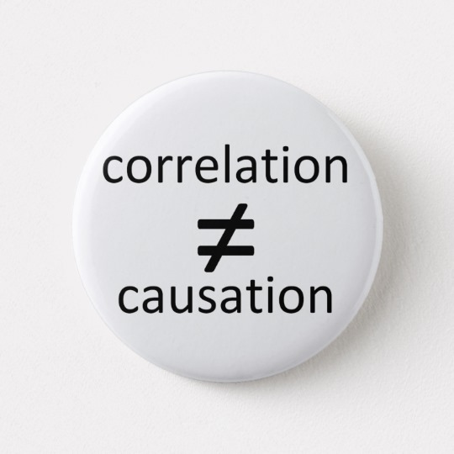
Statistics
Let's look at two faces and two pixels.
Grab a random face.
Is the brightness of the specified pixels positively or negatively correlated ?
Positive because if one pixel is bright in a picture, the other is more likely to be.
Statistics on data:
$Exp\left(x_{i}\right)= \overline{x_{i}}= \frac{1}{D}\sum_{d}{x_{\text{⟨}\text{d}\text{,}\text{i}\text{⟩}}}$
Var$\left(x_{i}\right)=Exp\left({\left(x_{i}−\overline{x_{i}}\right)}^{2}\right)$
StandardDeviation$\left(x_{i}\right)=$ $\sqrt{\text{V}\text{ar}\left(x_{i}\right)}$
$\text{Covar}\left(x_{1},x_{2}\right)$ $= Exp\left(\left(x_{1}−\overline{x_{1}}\right)×\left(x_{2}−\overline{x_{2}}\right)\right)$
= -uv
pixel x₂
u
v
v
u
pixel x₁

Slide 48
Statistics
Let's look at two faces and two pixels.
More than two pixels, gives more then two dimensions.
For every pair of pixels, we compute the covariance between them.
We form the covariance martrix M.
M =$\left[\begin{matrix} u^{2} & −uv \\ −uv & { v}^{2}\end{matrix}\right]$
pixel x₂
$\text{Covar}\left(x_{1},x_{2}\right)$ $= Exp\left(\left(x_{1}−\overline{x_{1}}\right)×\left(x_{2}−\overline{x_{2}}\right)\right)$
= -uv
u
M _{i,j} =
v
v
= M_{j,i}
u
pixel x₁

Slide 49
Statistics
Let's look at two faces and two pixels.
More than two pixels, gives more then two dimensions.
For every pair of pixels, we compute the covariance between them.
We form the covariance martrix M.
M =$\left[\begin{matrix} u^{2} & −uv \\ −uv & { v}^{2}\end{matrix}\right]$
pixel x₂
$\text{Covar}\left(x_{1},x_{2}\right)$ $= Exp\left(\left(x_{1}−\overline{x_{1}}\right)×\left(x_{2}−\overline{x_{2}}\right)\right)$
= u²
= $\text{V}\text{ar}\left(x_{i}\right)$
u
M _{i,i} =
v
v
u
pixel x₁

Slide 50
Statistics
Let's look at two faces and two pixels.
More than two pixels, gives more then two dimensions.
For every pair of pixels, we compute the covariance between them.
We form the covariance martrix M.
M =$\left[\begin{matrix} u^{2} & −uv \\ −uv & { v}^{2}\end{matrix}\right]$
pixel x₂
These covariants helps to give rotation to the ellipse.
pixel x₁

Slide 51
Statistics
Maximum Likelihood:
Given our data,
$Exp\left(x_{i}\right)= \overline{x_{i}}= \frac{1}{D}\sum_{d}{x_{i,d}}$
Covarience Matrix: M_{i,j} = $\text{Covar}\left(x_{i},x_{j}\right)$
$$= Exp\left(\left(x_{i}−\overline{x_{i}}\right)×\left(x_{j}−\overline{x_{j}}\right)\right)$$
Given any vector v,
The variance of the data in that direction is given by
v^{T}Mv.
pixel x₂
v^{T}
M
v
=
pixel x₁

Slide 52
Statistics
Maximum Likelihood:
Given our data,
$Exp\left(x_{i}\right)= \overline{x_{i}}= \frac{1}{D}\sum_{d}{x_{i,d}}$
Covarience Matrix: M_{i,j} = $\text{Covar}\left(x_{i},x_{j}\right)$
$$= Exp\left(\left(x_{i}−\overline{x_{i}}\right)×\left(x_{j}−\overline{x_{j}}\right)\right)$$
Given any vector v,
The variance of the data in that direction is given by
This is maximized by M’s first eigen vector:
v^{T}Mv.
pixel x₂
$$Mv=v$$
$$$$
M
v
=
v
pixel x₁

Slide 53
Maximum Likelihood Normal
Maximum Likelihood:
Given our data,
$Exp\left(x_{i}\right)= \overline{x_{i}}= \frac{1}{D}\sum_{d}{x_{i,d}}$
Covarience Matrix: M_{i,j} = $\text{Covar}\left(x_{i},x_{j}\right)$
$$= Exp\left(\left(x_{i}−\overline{x_{i}}\right)×\left(x_{j}−\overline{x_{j}}\right)\right)$$
Given any vector v,
The variance of the data in that direction is given by
This is maximized by M’s first eigen vector:
v^{T}Mv.
pixel x₂
$$Mv=v$$
This is the major axis of the ellipse.
Its eigen value $\sqrt{λ}$gives its length.
The remaining eigen vectors $v$ $g$ive the other axes.
pixel x₁

Slide 54
Maximum Likelihood Normal
Maximum Likelihood:
How much data do we need to get each of the n² values in this matrix to an accuracy of 1%?
M
n?
With n dimensions is it
…. or 2^{n}?
Let D = # of training data
Standard deviation = $\sqrt{D}$ out of D
= $1/{\sqrt{D}}$ out of 1
Pr[deviating $c/{\sqrt{D}}$] ≤ $e^{−c^{2}}$
Need $c/{\sqrt{D}}$ ≤ 1%
Need D ≥ (100c)²
Pr[one of n² values deviating $c/{\sqrt{D}}$] ≤ n²‧$e^{−c^{2}}$
Need D ≥ (100c)²
≤ p
c² ≥2log(n)+log(¹/_{p})
≥ 20,000 log(n)+10,00 log(¹/_{p})

Slide 55
Maximum Likelihood Normal
Locate lot of faces.
This helps us understand the distribution of faces better
By finding simple a model explaining where this data may have come from.
Say by “fitting” the data with a multi-dimensional ellipse.
pixel x₂
pixel x₁

Slide 56
Dimension Reduction
Delete the information in the direction of the smaller axis by projecting against the remaining plane.
Instead of a face being defined by ⟨x₁,…,x_{10,000}⟩. it is defined by ⟨z₁,…,z₁₀₀⟩.
i.e. We project from the 10,000 dimensional space to a 100 dimensional subspace.
pixel x₂
z₁
pixel x₁

Slide 57
Dimension Reduction
Delete the information in the direction of the smaller axis by projecting against the remaining plane.
Instead of a face being defined by ⟨x₁,…,x_{10,000}⟩. it is defined by ⟨z₁,…,z₁₀₀⟩.
i.e. We project from the 10,000 dimensional space to a 100 dimensional subspace.
This point in
10,000 dim-space
represents this image.
pixel x₂
z₁
This point is in a
100 dim-sub-space.
It is also still in
10,000 dim-space
and as such can be
displayed as an image.
pixel x₁

Slide 58
Dimension Reduction
Described by 10,000 numbers
Described by 100 numbers
Then recognize the face using these 100 numbers

Slide 59
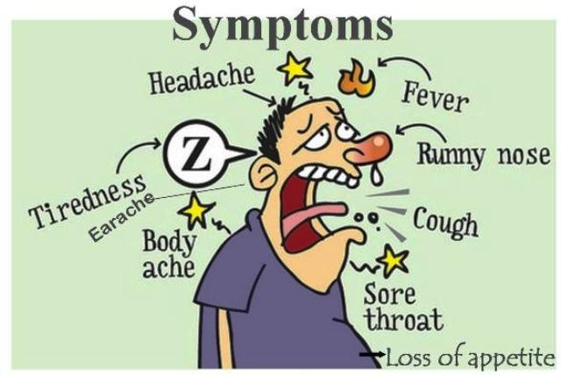
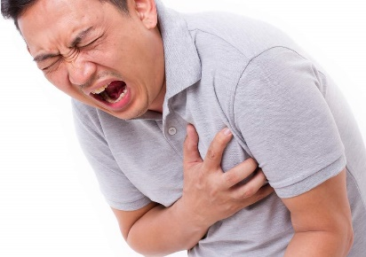
Bayesian Inference
Disease
0.8
Common cold
0.7
0.8
0.9
0.3
0.1
Heart attack
0.95
Given that you have a common cold the probability that you have a sore throat is 0.9
Pr( sore throat | common cold ) = 0.9

Slide 60
Bayesian Inference
Disease
Common cold
?
?
Heart attack
Given that you have a common cold the probability that you have a sore throat is 0.9
Pr( sore throat | common cold ) = 0.9
Determine Pr( common cold | sore throat )
Pr( heart attack | sore throat )

Slide 61
Bayesian Inference
Disease
A
0.9
B
Heart attack
$Pr⁡(A)$
$\operatorname{Pr}\left(B\right)$
$\operatorname{Pr}\left(A\&B\right)$
A
B

Slide 62
Bayesian Inference
Disease
A
0.9
?
B
Heart attack
$Pr⁡(B|A) =\frac{Pr⁡(A\&B)}{Pr⁡(A)}$
$Pr⁡(A|B) =\frac{Pr⁡(A\&B)}{Pr⁡(B)}$
$=\frac{Pr⁡(A)}{Pr⁡(B)} Pr⁡(B|A)$
Prior information you know about A & B
A
B

Slide 63
Women men
Nursing 100 $110 10 $90
Doctor 10 $1100 100 $9

Slide 64
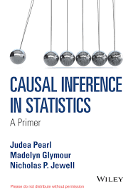
Bayesian Inference
Causal Graph
A (Disease)
B (Symptoms)
I have a whole set of slides on this if you want.
https://www.eecs.yorku.ca/~jeff/courses/fun/ Calculating probabilities differently to handle causality

Slide 65
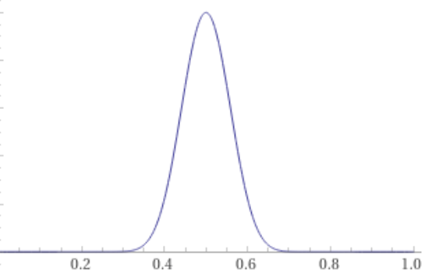
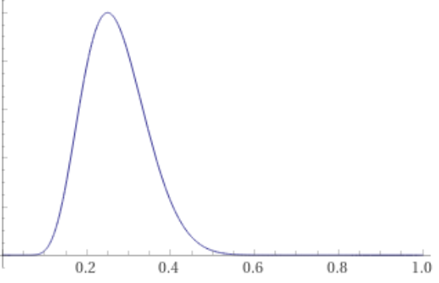
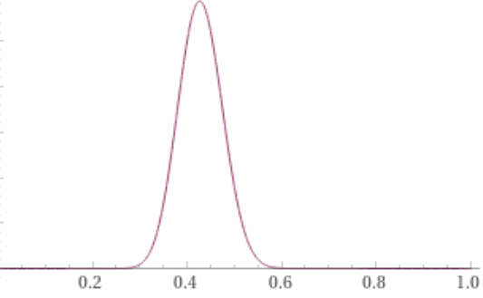
Bayesian Statistics & Machine Learning
Prior belief
about w
Example:
Suppose we have a coin with Pr(x=heads) = w.
Our prior knowledge about w. i.e. likely more or less fair.
We sample it four times $\vec{x}$ = {$x_{1},x_{2}$,${ x}_{3},x_{4}$} = $\{T,H,T,T\}$
This is a little evidence that w = ¼.
$Pr⁡( \vec{x}$ | $w$), plotted as a function of w.
What is our new belief about w?
→ machine learning
w
$Pr⁡( \vec{x}$ | $w$)
w
New belief
about w.
$Pr⁡( w$ | $\vec{x}$ ) = $\frac{Pr⁡( w\text{)}}{Pr⁡(\vec{x}\text{ )}}$ $Pr⁡( \vec{x}$ | $w$)
w

Slide 66
Bayesian Statistics
Regularization:
${\vec{w}}_{opt}= {ArgMin}_{\vec{w}} E\left(\vec{w}\right)$ + λ Complexity(M$\vec{w}$)
Find me weights $\vec{w}$ for which:
The training data error is small
The machine is reasonably simple.
Hopefully its general input error is small.
% Errors
Trade
off
m measures complexity of Machines {$M_{\vec{w}}$}

Slide 67
Bayesian Statistics
Prior belief
about w
Complexity(M$\vec{w}$)
This acts a prior knowledge
that the distribution of our data must be “simple”.
w
Similarly, Bayesian Statistics
uses similar prior knowledge

Slide 68
End
Thanks
for coming
Do you have any questions?
Please give me feedback so that I can better serve you.
Notes:
68

Slide 69
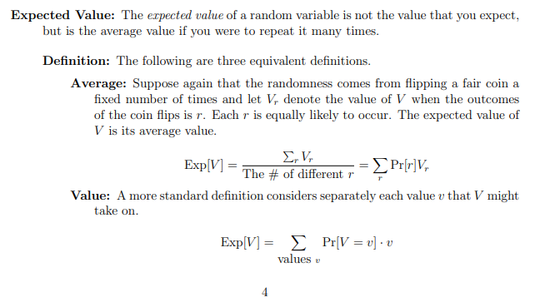
Probabilities
https://www.eecs.yorku.ca/~jeff/courses/6111/syllabus/6111-21-probTheory.pdf

Slide 70
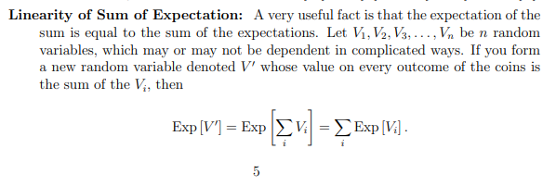
Probabilities

Slide 71
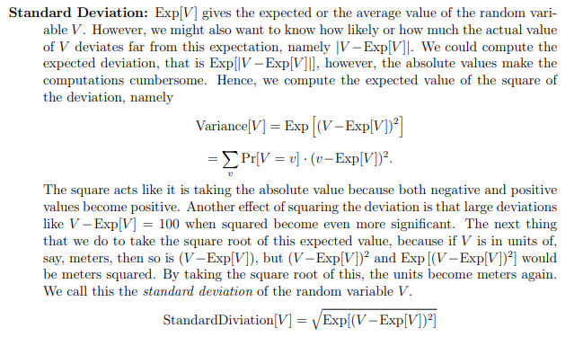
Probabilities

Slide 72
Probabilities

Slide 73
Probabilities
Flip a coin n times
Exp(# heads) = µ = ½n
StandDev(# heads) = σ = $\sqrt{n}$
Normal/Gaussian Distribution
Pr(# coin heads = V)
µ =½n
h
σ = $\sqrt{n}$ for #
$1/{\sqrt{n}}$ for %
Chernoff
εµ

Slide 74
Probabilities
Flip a coin n times
Exp(# heads) = µ = ½n
StandDev(# heads) = σ = $\sqrt{n}$
Normal/Gaussian Distribution
Pr(# coin heads = V)
µ =½n
h
σ = $\sqrt{n}$ for #
$1/{\sqrt{n}}$ for %
Chernoff
εµ

Slide 75
Probabilities
Flip a coin n times
Exp(# heads) = µ = ½n
StandDev(# heads) = σ = $\sqrt{n}$
Normal/Gaussian Distribution
Pr(# coin heads = V)
µ =½n
h
σ = $\sqrt{n}$ for #
$1/{\sqrt{n}}$ for %
Chernoff
εµ
cσ

Slide 76
Probabilities
Flip a coin n times
Exp(# heads) = µ = ½n
StandDev(# heads) = σ = $\sqrt{n}$
Normal/Gaussian Distribution
Pr(# coin heads = V)
µ =½n
h
σ = $\sqrt{n}$ for #
$1/{\sqrt{n}}$ for %
Chernoff
εµ
cσ
Law of large numbers

Slide 78
Maximum Likelihood Model
When I first took Statistics, I hated it because it seemed so arbitrary.
Now I see it can all be formally defined and proved using one simple concept.

Slide 79
Maximum Likelihood Model
$\vec{w}$ = ArgMax Pr[our data | $\vec{w}$ ]
$$\vec{w}$$
Suppose that the answers given by the machine $M_{\vec{w}}$were correct.
Randomly generate training data:
For each data point ${\vec{x}}_{d}$, choose $y_{d}$randomly
normal distribution with mean $M_{\vec{w}}\left(\vec{x}\right)$and variance 1.
Pr(choose $y_{d}$) ≈ $e^{{−error}^{2}}$ = $e^{{−\left(y_{d}−M_{\vec{w}}\left(\vec{x}\right) \right)}^{2}}$
Pr($y_{1}$,…,$y_{D}$) ≈ $\prod_{d=1..D}{e^{{−\left(y_{d}−M_{\vec{w}}\left(\vec{x}\right) \right)}^{2}}}$
~ -Log(Pr($y_{1}$,…,$y_{D}$)) ≈ $\sum_{d=1..D}{{\left(y_{d}−M_{\vec{w}}\left(\vec{x}\right) \right)}^{2}}$
= Error(𝑤 ⃗)
{ ⟨${\vec{x}}_{1},y_{1}$⟩, ⟨${\vec{x}}_{2},y_{2}$⟩, …, ⟨${\vec{x}}_{D},y_{D}$⟩ }
Both Maximum Likelihood & Machine Learning choose $\vec{w}$ to optimize this.
Output y
$$\text{y}\text{d}$$
$$M_{\vec{w}}\left({\vec{x}}_{d}\right)$$
$$M_{\vec{w}}\left(\vec{x}\right)$$
Input $\vec{x}$
Error
$${\vec{x}}_{d}$$

Slide 80
Maximum Likelihood Model
Categorical Cross Entropy
Machine’s
answer
Supervisor's
answer
M_{d,1} = 0.01
cat
M_{d,2} = 0.02
dog
E(w₁,…,w_{m})
M_{d,3} = 0.95
y_{d} = 3
face
M_{d,4} = 0.02
fish
Both Categorical Cross Entropy Error & Maximum Likelihood
are looking for the best probability distribution to explain the training data
M_{d,j} = Machine’s estimated “probability” that input d is of category j: cat, dog, …
y_{d} = Supervisor’s answer.
Error: E($\vec{w}$) = -log( Pr( getting $\vec{y}$ when chosen wrt M_{d,j} ))
= -$log( \prod_{d=1..D}{\text{Pr}\text{( }\text{getting} \text{y}\text{d} \text{when} \text{chosen} \text{wrt} \text{M}\text{d}\text{,}\text{j} \text{)}})$
=$\sum_{d=1..D}{−log⁡(M_{d,y_{d}}}$)
{ ⟨${\vec{x}}_{1},y_{1}$⟩, ⟨${\vec{x}}_{2},y_{2}$⟩, …, ⟨${\vec{x}}_{D},y_{D}$⟩ }

Slide 82
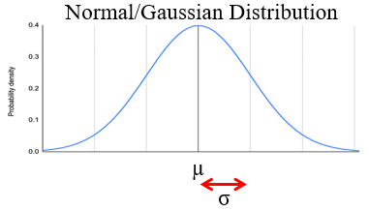
Bias & Standard Error
Suppose the world defines a distribution D on $\vec{x}$.
But we do not know its parameters $\vec{w}$.
Randomly choose Training data {${\vec{x}}_{1},{\vec{x}}_{2}$, …$,{\vec{x}}_{D}$}.
We try to “learn” $\vec{w}$.
$$\vec{w}$$
ˆ
w = learning($\vec{x}$).
ˆ
How good of an estimate is w of w?
ˆ
ˆ
Bias(w) = Exp(w)-w
ˆ
Standard Error (SE)
SandDev(w)
ˆ
w is expected to be off by Bias(w) + a few SD(w).
ˆ
ˆ
ˆ
ˆ
ˆ
Exp[(w-w)²] = Bias(w)² + StandDev(w)²

Slide 83
Bias & Standard Error
ˆ
ˆ
ˆ
Exp[(w-w)²]
= Bias(w)² + StandDev(w)²
Example: D = Gaussian with unknown parameters $\vec{w}$ = ⟨mean,variance ⟩ = ⟨µ,σ²⟩.
$$\vec{w}$$
ˆ
µ = $Exp\left(x_{d}\right)=1/D\sum_{d}{x_{d}}$
Sample Mean
µ is distributed according to the Student's t-distribution
ˆ
ˆ
ˆ
Exp(µ)
SandDev(µ)
= µ
ˆ
Bias(µ) = Exp(µ)-µ = 0
ˆ
= ¹/$\sqrt{D}$ σ
σ² = $Var\left(x_{d}\right)=Exp\left({\left(\text{µ} x_{d}\right)}^{2}\right)$
σ² = ^{D}/_{D-1} $Var\left(x_{d}\right)=1/\text{(}\text{D}\text{−1}\text{)}\sum_{d}{{\left(\text{µ} x_{d}\right)}^{2}}$
ˆ
-
ˆ
Sample Variance
~
-
ˆ
Unbiased Sample Var.
ˆ
ˆ
ˆ
= σ²
Bias(σ²) = Exp(σ²)-σ² = big
Bias(σ²) = Exp(σ²)-σ² = 0
= ^{D-1}/_{D} σ²
Exp(σ²)
Exp(σ²)
StandDev(σ²)
Oops
~
= σ²
~
~
~
= ??

Slide 84
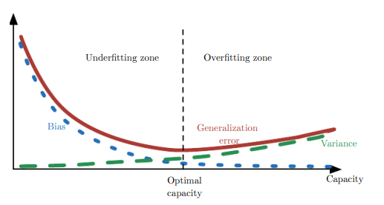
Bias & Standard Error
Generalization
Error
ˆ
ˆ
ˆ
Exp[(w-w)²]
= Bias(w)² + StandDev(w)²
StandDev
ˆ
If w is close to w, then we learned the world correctly.
Hence, we should be able to generalize to new data.

Slide 85
Bias & Standard Error
Generalization
Error
ˆ
ˆ
ˆ
= Bias(w)² + StandDev(w)²
StandDev
If the machine is not very complicated,
then there are not that many different values of w.
So we can’t expect w to be close to w
But small changes in the training data won’t affect w much.
Hence, StandDev will be small.
ˆ
ˆ
& the hence bias will be big.
ˆ

Slide 86
Bias & Standard Error
Generalization
Error
ˆ
ˆ
ˆ
= Bias(w)² + StandDev(w)²
StandDev
If the machine is complicated,
then we can expect w to be close to w
& the hence bias will be small.
But small changes in the training data will affect w a lot.
Hence, will be StandDev large.
ˆ
ˆ

Slide 87
Bias & Standard Error
Generalization
Error
ˆ
ˆ
ˆ
= Bias(w)² + StandDev(w)²
StandDev
Cross-validation or regularization
will help find the best trade-off is to use.

Slide 89
Bayesian Statistics
Example:
Suppose we have a coin with D = Pr(x=heads) = w.
Our prior knowledge is that the coin is most likely fair (ie w=½) but it might not be. Say w ≈ Gaussian.
We sample it four times {$x_{1},x_{2}$,${ x}_{3},x_{4}$} = $\{T,H,T,T\}$
This is a little evidence that w = ¼.
What is our new belief about w?
$\vec{w}$
Prior belief
about w
w
×
$Pr⁡( \vec{x}$ | $w$)
$Pr⁡( \vec{x}$ | $w$) is a plot of the prob of getting $\vec{x}$
not as a function of #heads
but as a function of w.
w
w
New belief
about w.
$Pr⁡( w$ | $\vec{x}$ ) = $\frac{Pr⁡( w\text{)}}{Pr⁡(\vec{x}\text{ )}}$ $Pr⁡( \vec{x}$ | $w$)
Pr($w$∉[0,1]) = 0
w
×
×

Slide 90
Bayesian Statistics
Suppose the world defines a distribution D on x.
But we do not know its parameters $\vec{w}$.
But we do “know” that the distribution must be “simple”.
This gives us prior knowledge that $\vec{w}$ is drawn from distribution that we know.
eg $\vec{w}$ ≈ Gaussian.
Randomly choose Training data: {$x_{1},x_{2}$, …$,x_{D}$}
ie $\vec{w}$ ≈ Gaussian and then independently each $x_{d}$ ≈ D .
How does this new information change what we know about $\vec{w}$?
Bayesian Inference gives it to us.
$\vec{w}$
$\vec{w}$
ie $Pr⁡( \vec{w}$ | $\vec{x}$ ) = $\frac{Pr⁡( \vec{w}\text{)}}{Pr⁡(\vec{x}\text{ )}}$ $Pr⁡( \vec{x}$ | $\vec{w}$ )
This is simply D .
$\vec{w}$
This is our prior knowledge about about $\vec{w}$.
This combines these two.
This is what we now know about $\vec{w}$.

Slide 91
Bayesian Statistics
Suppose the world defines a distribution D on x.
But we do not know its parameters $\vec{w}$.
But we do “know” that the distribution must be “simple”.
This gives us prior knowledge that $\vec{w}$ is drawn from distribution that we know.
eg $\vec{w}$ ≈ Gaussian.
Randomly choose Training data: {$x_{1},x_{2}$, …$,x_{D}$}
ie $\vec{w}$ ≈ Gaussian and then independently each $x_{d}$ ≈ D .
How does this new information change what we know about $\vec{w}$?
We use this to generalize to data that we have not seen before.
$\vec{w}$
$\vec{w}$
ie $Pr⁡($ x | $\vec{x}$ ) = $\int_{\vec{w}}{Pr⁡(\text{x} \text{| }\vec{w}\text{ )} Pr⁡( \vec{w} \text{|} \vec{x} \text{)} ∂\vec{w}}$
This is what we just computed.
This is simply D .
$\vec{w}$
We have to consider every possible $\vec{w}$.
This is what we now know about a new x.

Slide 92
Bayesian Statistics
Suppose the world defines a distribution D on x.
But we do not know its parameters $\vec{w}$.
But we do “know” that the distribution must be “simple”.
This gives us prior knowledge that $\vec{w}$ is drawn from distribution that we know.
eg $\vec{w}$ ≈ Gaussian.
$\vec{w}$
This prior knowledge about $\vec{w}$
can have the same effect that regularization has.
ie both push our solution $\vec{w}$ to be simple.

Slide 93
Bayesian Statistics
Regularization:
${\vec{w}}_{opt}= {ArgMin}_{\vec{w}} E\left(\vec{w}\right)$ + λ Complexity(M$\vec{w}$)
Find me weights $\vec{w}$ for which:
The training data error is small
The machine is reasonably simple.
Hopefully its general input error is small.
% Errors
Trade
off
m measures complexity of Machines {$M_{\vec{w}}$}

Slide 94
Bayesian Statistics
Example:
Suppose we have a coin with D = Pr(x=heads) = w.
Our prior knowledge is that the coin is most likely fair (ie w=½) but it might not be. Say w ≈ Gaussian.
We sample it four times {$x_{1},x_{2}$,${ x}_{3},x_{4}$} = $\{T,H,T,T\}$
This is a little evidence that w = ¼.
What is our new belief about w?
$\vec{w}$
Prior belief
about w
w
×
$Pr⁡( \vec{x}$ | $w$)
$Pr⁡( \vec{x}$ | $w$) is a plot of the prob of getting $\vec{x}$
not as a function of #heads
but as a function of w.
w
w
New belief
about w.
$Pr⁡( w$ | $\vec{x}$ ) = $\frac{Pr⁡( w\text{)}}{Pr⁡(\vec{x}\text{ )}}$ $Pr⁡( \vec{x}$ | $w$)
Pr($w$∉[0,1]) = 0
w
×
×

