Slide 1
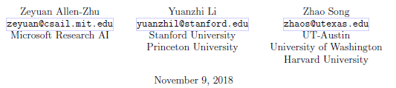
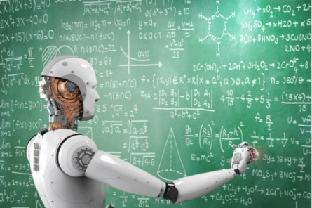



A Convergence Theory for Deep Learning
via Over-Parameterization
Model
Hope
Ball around random weights
Bound progress
Expected blow up
Expected dirivatives
Shifting within ball
Other Models
Jeff Edmonds, Comp. Sci.
www.eecs.yorku.ca/~jeff/courses/machine-learning
Notes:
4*1.5hrs - not Example …, not unsupervised.

Slide 2
Abstract of talk
When over parameterized, gradient decent converges quickly.
Some have argued that it is not interesting because it requires so many parameters.
But Jeff was shocked that there was any theory about it.
Let the number of parameters of your neural net > (# training data)^{O(1)}
ie table lookup over fits the data just fine.
Starting with random setting of the weights.
Do gradient decent.
Jeff assumed that there was no theory about how quickly it will converge
and whether it will get stuck in a local minimum.
However, this paper proves that whp it will converge in time (# training data)^{O(1)}
to epsilon error on the training data.
The weights change very little from their initial weights.
Hence, such optimal neural networks look random and are as abundant as the stars.
This is why the weight space needs to be so much bigger than the space of train data.
Jeff will also sketch the proof of PAC-Learnable (Probably Approximately Correct)
Let the number of parameters of your neural net < ԑ^2 (# training data)
If on the randomly chosen training data, a machine is found that gives good answers,
then whp this same machine will also work (1-ԑ) well on never seen
before instances.
This gap is necessary because if the labels are random then
the number of weights needed is more than # training data
and the machine cannot generalize to unseen data.

Slide 3
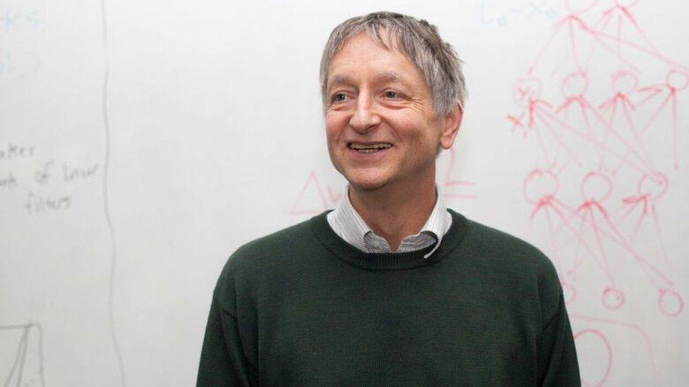

A Convergence Theory for Deep Learning
via Over-Parameterization
With enough data and parameters
chatgpt and self driving cars emerge.
But what do we understand?

Slide 4
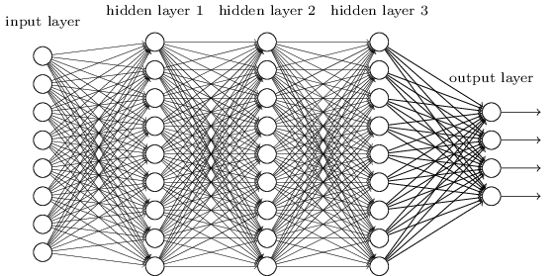

A Convergence Theory for Deep Learning
via Over-Parameterization
m
Training Data { ⟨${\vec{x}}_{1},y_{1}$⟩, ⟨${\vec{x}}_{2},y_{2}$⟩, …, ⟨${\vec{x}}_{D},y_{D}$⟩ }
m = # parameters >> (# training data)^{O(1)} = D²⁴
Maybe not interesting:
Network of depth 2 give correct answers with table lookup
If input is ${\vec{x}}_{1}$ output $y_{1}$
If input is ${\vec{x}}_{2}$ output $y_{2}$
…
Over fitting → Does not generalize well.
Let's worry about this later.

Slide 5
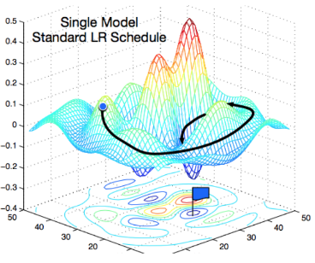
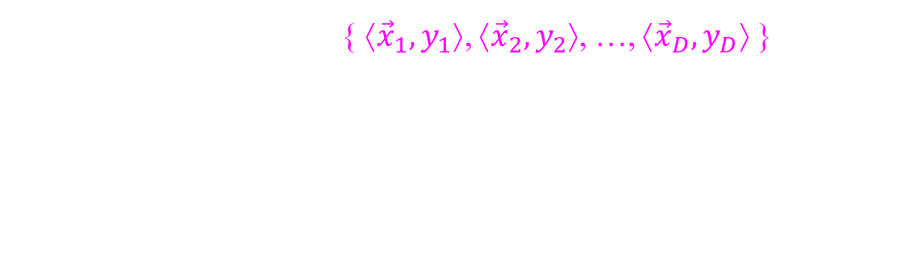
A Convergence Theory for Deep Learning
via Over-Parameterization
m
Training Data { ⟨${\vec{x}}_{1},y_{1}$⟩, ⟨${\vec{x}}_{2},y_{2}$⟩, …, ⟨${\vec{x}}_{D},y_{D}$⟩ }
m = # parameters >> (# training data)^{O(1)} = D²⁴
How well does gradient decent find a solution?
How quickly it will converge?
Will get stuck in a local minimum?

Slide 6
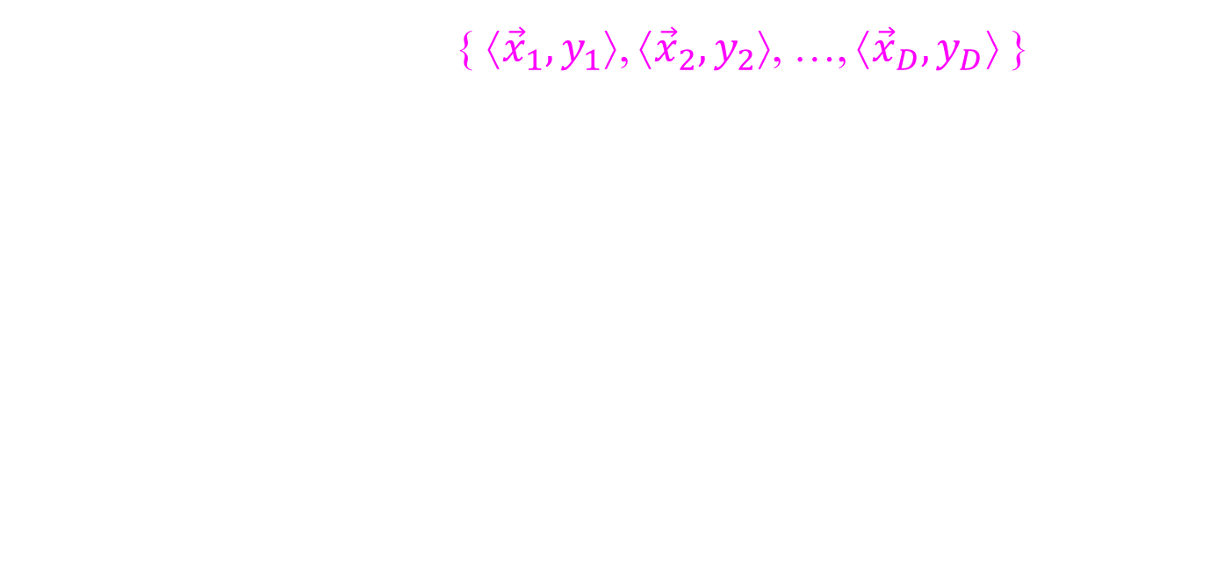
A Convergence Theory for Deep Learning
via Over-Parameterization
m
Training Data { ⟨${\vec{x}}_{1},y_{1}$⟩, ⟨${\vec{x}}_{2},y_{2}$⟩, …, ⟨${\vec{x}}_{D},y_{D}$⟩ }
m = # parameters >> (# training data)^{O(1)} = D²⁴
This paper proves converges whp
Error(training data) = ε
Time = (# training data)^{O(1)} = D⁷
Weights = random + small change
Hence,
Optimal neural networks look random, ie not explainable.
In this large space, are as abundant as the stars.

Slide 7

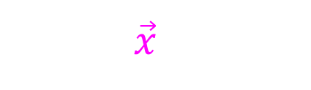

A Convergence Theory for Deep Learning
via Over-Parameterization
m
Model discussed here:
Regression (real values)
Our goal is to learn a function.
Output y
$$\text{y}\text{d}$$
is the answer given by the supervisor.
Input $\vec{x}$
${\vec{x}}_{d}$ is the d^{th} training input.

Slide 8



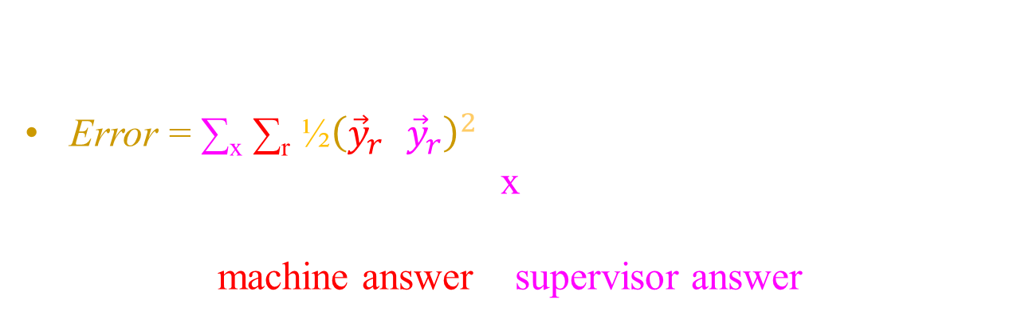

A Convergence Theory for Deep Learning
via Over-Parameterization
$${\vec{y}}_{r}$$
$${\vec{y}}_{r}$$
x
m
Model discussed here:
Regression (real values)
Error = ∑_{x} ∑_{r} $\text{½}{\left({\vec{y}}_{r}\text{−}{\vec{y}}_{r}\right)}^{2}$
= Sum over training data x.
Sum over the output provided
(machine answer – supervisor answer)²

Slide 9
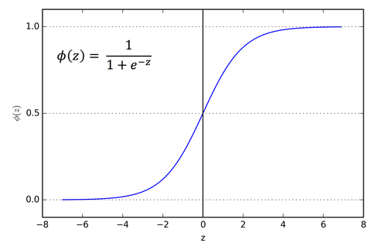
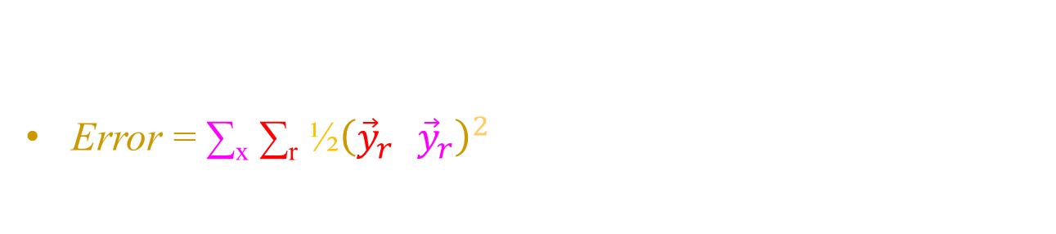
A Convergence Theory for Deep Learning
via Over-Parameterization
$${\vec{y}}_{r}$$
x
m
Model discussed here:
Regression (real values)
Error = ∑_{x} ∑_{r} $\text{½}{\left({\vec{y}}_{r}\text{−}{\vec{y}}_{r}\right)}^{2}$
ReLU activation
Rectilinear (ReLU)

Slide 10

A Convergence Theory for Deep Learning
via Over-Parameterization
$${\vec{y}}_{r}$$
x
m
Model discussed here:
Regression (real values)
Error = ∑_{x} ∑_{r} $\text{½}{\left({\vec{y}}_{r}\text{−}{\vec{y}}_{r}\right)}^{2}$
ReLU activation
The paper proves the result for many more models
And we will hide lots of details of the 53 page paper
under the rug.

Slide 11
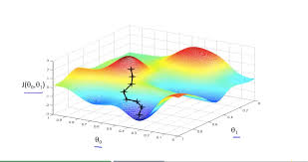
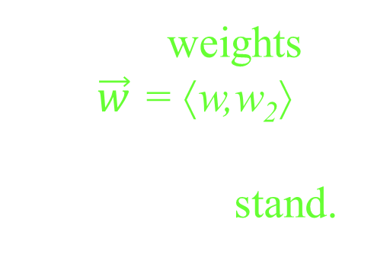

A Convergence Theory for Deep Learning
Method for finding weights ⟨w₁,..,w_{m}⟩ that minimize error E(w₁,..,w_{m}):
  Start with random ⟨w₁,..,w_{m}⟩.
  Repeat:
  Find the direction and slope of steepest descent.
  Change ⟨w₁,..,w_{m}⟩ by a small step in this direction.
  Stop when at the bottom of a valley.
  Hope that this is a particularly low location.
The weights
$\vec{w}$ = ⟨w,w₂⟩ specifies
where we stand.
E(w₁,…,w_{m})
The Error specifies
our altitude.
$${\vec{w}}_{opt}$$
w₂
w₁

Slide 12
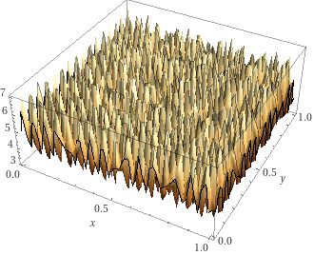
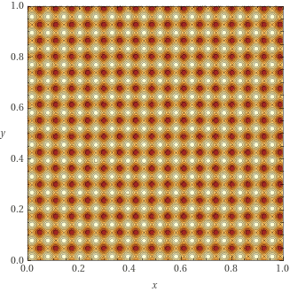





A Convergence Theory for Deep Learning
The worst case scenario is:
There are lots of local minimum
One is slightly better
Takes exponential time to find this best one.
E(w₁,…,w_{m})
E(w₁,…,w_{m})
Aaaaah
w₂
$${\vec{w}}_{opt}$$
5
w₂
w₁
$${\vec{w}}_{opt}$$
w₁

Slide 13





















































A Convergence Theory for Deep Learning
The best case scenario is:
There are lots of local minimum
They are all learn perfectly with zero error.
Starting from a random place
one can be found in time ≤ (# training data)^{O(1)}
There is an optimal solution within
a very tiny ball around w_{rand}.
E(w₁,…,w_{m})
E(w₁,…,w_{m})
$${\vec{w}}_{opt}$$
$${\vec{w}}_{opt}$$
$${\vec{w}}_{opt}$$
$${\vec{w}}_{opt}$$
$${\vec{w}}_{opt}$$
$${\vec{w}}_{opt}$$
$${\vec{w}}_{opt}$$
$${\vec{w}}_{opt}$$
$${\vec{w}}_{opt}$$
$${\vec{w}}_{opt}$$
$${\vec{w}}_{opt}$$
$${\vec{w}}_{opt}$$
$${\vec{w}}_{opt}$$
$${\vec{w}}_{opt}$$
$${\vec{w}}_{opt}$$
Easy
$${\vec{w}}_{opt}$$
$${\vec{w}}_{opt}$$
$${\vec{w}}_{opt}$$
$${\vec{w}}_{opt}$$
$${\vec{w}}_{opt}$$
$${\vec{w}}_{opt}$$
$${\vec{w}}_{opt}$$
$${\vec{w}}_{opt}$$
$${\vec{w}}_{opt}$$
$${\vec{w}}_{opt}$$
$${\vec{w}}_{opt}$$
$${\vec{w}}_{opt}$$
$${\vec{w}}_{opt}$$
$${\vec{w}}_{opt}$$
$${\vec{w}}_{opt}$$
w₂
$${\vec{w}}_{opt}$$
$${\vec{w}}_{opt}$$
$${\vec{w}}_{opt}$$
$${\vec{w}}_{opt}$$
$${\vec{w}}_{opt}$$
$${\vec{w}}_{opt}$$
$${\vec{w}}_{opt}$$
$${\vec{w}}_{opt}$$
$${\vec{w}}_{opt}$$
0
$${\vec{w}}_{opt}$$
$${\vec{w}}_{opt}$$
$${\vec{w}}_{opt}$$
$${\vec{w}}_{opt}$$
$${\vec{w}}_{opt}$$
5
$${\vec{w}}_{opt}$$
$${\vec{w}}_{opt}$$
$${\vec{w}}_{opt}$$
$${\vec{w}}_{opt}$$
$${\vec{w}}_{opt}$$
$${\vec{w}}_{opt}$$
w₂
$${\vec{w}}_{opt}$$
$${\vec{w}}_{opt}$$
$${\vec{w}}_{opt}$$
$${\vec{w}}_{opt}$$
$${\vec{w}}_{opt}$$
$${\vec{w}}_{opt}$$
$${\vec{w}}_{opt}$$
w₁
$${\vec{w}}_{opt}$$
w₁

Slide 14
A Convergence Theory for Deep Learning
via Over-Parameterization
The best case scenario is:
There are lots of local minimum
They are all learn perfectly with zero error.
Starting from a random place
one can be found in time ≤ (# training data)^{O(1)}
There is an optimal solution within
a very tiny ball around w_{rand}.
E(w₁,…,w_{m})
E(w₁,…,w_{m})
Easy
w₂
0
5
w₂
w₁
w₁

Slide 15
A Convergence Theory for Deep Learning
via Over-Parameterization
The algorithm does gradient decent starting from random weights W_{rand}.
After a small amount of time,
weights ∈ Ball( W_{rand} +W' | |W'| < small )
Let an adversary choose where
algorithm goes.
E(w₁,…,w_{m})
w₂
w₁

Slide 16
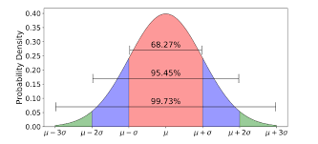
A Convergence Theory for Deep Learning
via Over-Parameterization
The algorithm does gradient decent starting from random weights W_{rand}.
We understand a neural net with random weights W_{rand}
because high prob on "average" they behave they should.
They should make exponential progress each gradient decent step.
If you shift by a very small amount
to weights (W_{rand} +W'),
then the behavior does not
change by all that much.
E(w₁,…,w_{m})
w₂
w₁

Slide 17

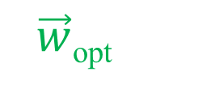









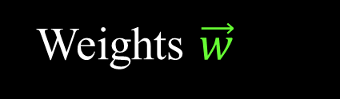
A Convergence Theory for Deep Learning
via Over-Parameterization
The algorithm does gradient decent starting from random weights W_{rand}.
It is surprising to me that one gradient decent step provably
decreases the error by a constant factor,
leading to a perfect solution in time log(E).
(or close enough)
E decreases 0.4%
E(w₁,…,w_{m})
Error E
$$\vec{w}$$
$$\vec{w}$$
w₂
$$\vec{w}$$
$$\vec{w}$$
$$\vec{w}$$
w₂
$$\vec{w}$$
$$\vec{w}$$
$$\vec{w}$$
$\vec{w}$_{opt}
w₁
$${\vec{w}}_{opt}$$
w₁
Weights $\vec{w}$

Slide 18

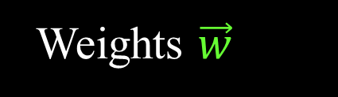

A Convergence Theory for Deep Learning
via Over-Parameterization
  The direction of steepest assent is computed as
∇E(⟨w₁,..,w_{m}⟩)= ⟨^{δE}/_{δw1} ,…, ^{δE}/_{δwm} ⟩
new $\vec{w}$= $\vec{w}$
γ ×
-
∇E($\vec{w}$)
Error E
$$\vec{w}$$
Weights $\vec{w}$
δw = - γ × ^{δE}/_{δwi}

Slide 19
A Convergence Theory for Deep Learning
via Over-Parameterization
E(w +δw) ≅ E(w) + ^{δE}/_{δw} × δw
+ curvature O(δw²) terms
+ ugly terms
when the activation function
is not smooth.
Sigmoid
Rectilinear (ReLU)
which will be small
for small changes δw.
Error E
This is why:
Step size γ = small = (# training data)⁻⁵
Time = (# training data)⁷
Weights $\vec{w}$
^{smaller}
$$\vec{w}$$
δw = - γ × ^{δE}/_{δwi}

Slide 20
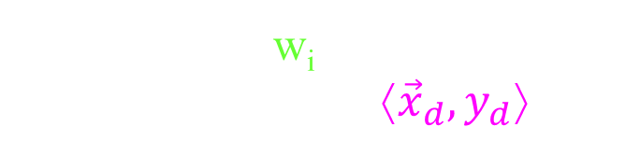
A Convergence Theory for Deep Learning
via Over-Parameterization
E(w +δw) ≅ E(w) + ^{δE}/_{δw} × δw
= E(w) + ^{δE}/_{δw} × (-γ × ^{δE}/_{δwi})
= E(w) -γ ( ^{δE}/_{δwi})²
∑_{i∈[m]}
∑_{x}
Each weight w_{i} changes.
Each training data ⟨${\vec{x}}_{d},y_{d}$⟩.
Error E
$$\vec{w}$$
Weights $\vec{w}$
δw = - γ × ^{δE}/_{δwi}

Slide 21
A Convergence Theory for Deep Learning
via Over-Parameterization
E(w +δw) ≅ E(w) + ^{δE}/_{δw} × δw
= E(w) + ^{δE}/_{δw} × (-γ × ^{δE}/_{δwi})
= E(w) -γ ( ^{δE}/_{δwi})²
∑_{i∈[m]}
∑_{x}
Lemma: ≥ Ω( E(w) )
≤ (1-σ) E(w)
E(w^{t}) ≤ (1-σ)^{t} E(w⁰)
E decreases .4%
Error E
$$\vec{w}$$
Weights $\vec{w}$
δw = - γ × ^{δE}/_{δwi}

Slide 22
A Convergence Theory for Deep Learning
via Over-Parameterization
E(w +δw) ≅ E(w) + ^{δE}/_{δw} × δw
= E(w) + ^{δE}/_{δw} × (-γ × ^{δE}/_{δwi})
= E(w) -γ ( ^{δE}/_{δwi})²
∑_{i∈[m]}
∑_{x}
Lemma: ≥ Ω( E(w) )
≤ O( E(w) )
Weights can’t leave the ball.
E(w₁,…,w_{m})
w₂
δw = - γ × ^{δE}/_{δwi}
≤ ?
w₁

Slide 23
A Convergence Theory for Deep Learning
via Over-Parameterization
E(w +δw) ≅ E(w) + ^{δE}/_{δw} × δw
= E(w) + ^{δE}/_{δw} × (-γ × ^{δE}/_{δwi})
= E(w) -γ ( ^{δE}/_{δwi})²
∑_{i∈[m]}
∑_{x}
Lemma: ≥ Ω( E(w) )
≤ O( E(w) )
× # of training data
Not hard to bound for a fixed x.

Slide 24




A Convergence Theory for Deep Learning
via Over-Parameterization
E(w +δw) ≅ E(w) + ^{δE}/_{δw} × δw
= E(w) + ^{δE}/_{δw} × (-γ × ^{δE}/_{δwi})
= E(w) -γ ( ^{δE}/_{δwi})²
We wont cover this.
∑_{i∈[m]}
∑_{x}
Lemma: ≥ Ω( E(w) )
× δ )
≤ O( E(w) )
× # of training data
Challenge is proving these don’t cancel for different training data x_{d}.
If two "different" training data have same x_{d} and different y_{d},
then learning is impossible.
Our goal is to learn a function.
Output y
$$\text{y}\text{d}$$
is the answer given by the supervisor.
$$\text{y}\text{d}\text{′}$$
is a conflicting answer.
δ
Input $\vec{x}$
${\vec{x}}_{d}$ is the d^{th} training input.
Require |x_{d}-x_{d'}| ≥ δ.

Slide 25
A Convergence Theory for Deep Learning
via Over-Parameterization
∑_{i∈[m]}
(^{δE}/_{δwi})²
Lemma: ≥ Ω( E(w) )
≤ O( E(w) )
We will try to sketch the proof
for one input x.

Slide 26
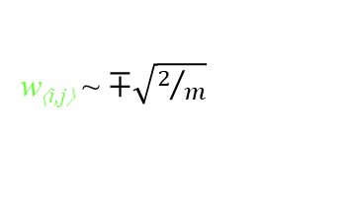
A Convergence Theory for Deep Learning
via Over-Parameterization
w_{⟨i,j⟩}
m
The algorithm starts with random weights w_{rand}
w_{⟨i,j⟩} ~ normal(0,²/_{m}).
w_{⟨i,j⟩} ~ $∓\sqrt{2/m}$

Slide 27
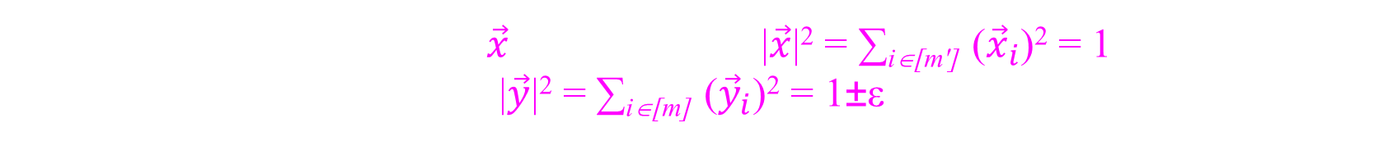

A Convergence Theory for Deep Learning
via Over-Parameterization
$$\vec{y}$$
w_{⟨i,j⟩}
x
m
w_{⟨i,j⟩} ~ normal(0,²/_{m}).
Consider one training input $\vec{x}$normalized so |$\vec{x}$|² = ∑_{i∈[m']} (${\vec{x}}_{i}$)² = 1.
Lemma: WHP at each layer, |$\vec{y}$|² = ∑_{i∈[m]} (${\vec{y}}_{i}$)² = 1±ε.

Slide 28



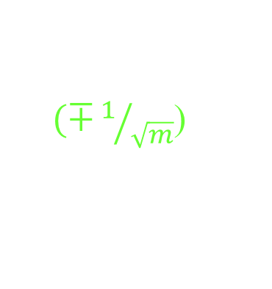
A Convergence Theory for Deep Learning
via Over-Parameterization
$$\vec{y}$$
$$\vec{z}$$
w_{⟨i,j⟩}
x
m
w_{⟨i,j⟩} ~ normal(0,²/_{m}).
Consider one training input $\vec{x}$normalized so |$\vec{x}$|² = ∑_{i∈[m']} (${\vec{x}}_{i}$)² = 1.
Lemma: WHP at each layer, |$\vec{y}$|² = ∑_{i∈[m]} (${\vec{y}}_{i}$)² = 1±ε.
Proof:
By way of induction, assume |$\vec{y}$|² = ∑_{i∈[m]} (${\vec{y}}_{i}$)² = 1.
Intuition: ${\vec{z}}_{j}$= ∑_{i∈[m]} ${\vec{y}}_{i}$ × w_{⟨i,j⟩}
~ $\text{}$ $(∓1/{\sqrt{m}}$) = ($∓1/{\sqrt{m}}$)
m step random walk (#positive)-(#negative) ~ $\sqrt{m}$.
m
× $(∓1/{\sqrt{m}}$)
$\sqrt{m}$

Slide 29

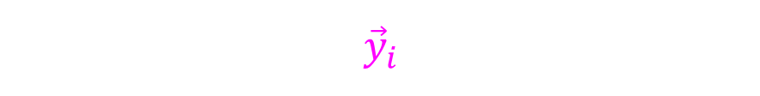
A Convergence Theory for Deep Learning
via Over-Parameterization
$$\vec{y}$$
$$\vec{z}$$
w_{⟨i,j⟩}
x
m
w_{⟨i,j⟩} ~ normal(0,²/_{m}).
Consider one training input $\vec{x}$normalized so |$\vec{x}$|² = ∑_{i∈[m']} (${\vec{x}}_{i}$)² = 1.
Lemma: WHP at each layer, |$\vec{y}$|² = ∑_{i∈[m]} (${\vec{y}}_{i}$)² = 1±ε.
Proof:
By way of induction, assume |$\vec{y}$|² = ∑_{i∈[m]} (${\vec{y}}_{i}$)² = 1.
w_{⟨i,j⟩} ~ normal(0,²/_{m}).
${\vec{y}}_{i}$×w_{⟨i,j⟩} ~ normal(0, (${\vec{y}}_{i}$)² × ²/_{m}).
${\vec{z}}_{j}$= ∑_{i∈[m]} ${\vec{y}}_{i}$×w_{⟨i,j⟩}
~ normal(0, 1× ²/_{m}).
Exp((${\vec{z}}_{j}$)²) = ²/_{m}.
~ normal(0, ∑_{i∈[m]} (${\vec{y}}_{i}$)² × ²/_{m})

Slide 30


A Convergence Theory for Deep Learning
via Over-Parameterization
$$\vec{z}$$
$$\vec{y}$$
w_{⟨i,j⟩}
x
m
w_{⟨i,j⟩} ~ normal(0,²/_{m}).
Consider one training input $\vec{x}$normalized so |$\vec{x}$|² = ∑_{i∈[m']} (${\vec{x}}_{i}$)² = 1.
Lemma: WHP at each layer, |$\vec{y}$|² = ∑_{i∈[m]} (${\vec{y}}_{i}$)² = 1±ε.
Proof:
Exp((${\vec{z}}_{j}$)²) = ²/_{m}.
${\vec{y}}_{j}$ = max(0,${\vec{z}}_{j}$)
Exp((${\vec{y}}_{j}$)²) = ¹/_{m}.
Exp(|$\vec{y}$|²) = ∑_{i∈[m]} Exp((${\vec{y}}_{i}$)²) = ∑_{i∈[m]} ¹/_{m} = 1.
With high probability, this is the case ±ε.
Done proof by induction.
Rectilinear (ReLU)

Slide 31



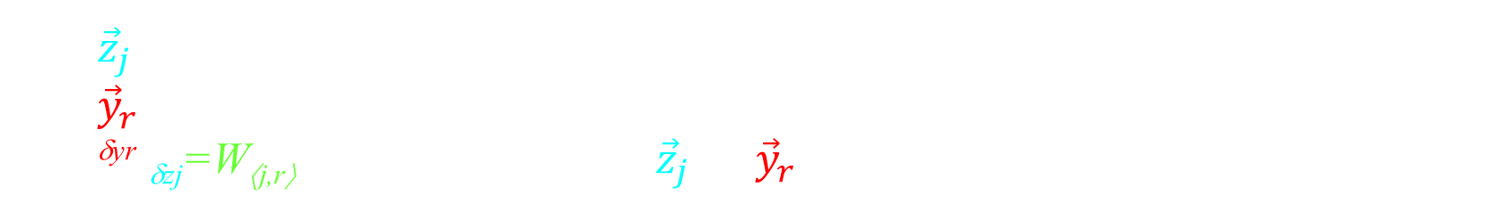
A Convergence Theory for Deep Learning
via Over-Parameterization
$${\vec{z}}_{j}$$
$$\text{W}\text{⟨}\text{j}\text{,}\text{r}\text{⟩}$$
$${\vec{y}}_{r}$$
m
w_{⟨i,j⟩} ~ normal(0,²/_{m}).
Let ${\vec{z}}_{j}$ be the pre activation value of one hidden node.
Let ${\vec{y}}_{r}$be the value of one of the output nodes.
Let ^{δyr}/_{δzj}=W_{⟨j,r⟩} be the influence of ${\vec{z}}_{j}$on ${\vec{y}}_{r}$ (i.e. weight of super edge).

Slide 32
A Convergence Theory for Deep Learning
via Over-Parameterization
$${\vec{z}}_{j}$$
$$\text{W}\text{⟨}\text{j}\text{,}\text{r}\text{⟩}$$
$${\vec{y}}_{r}$$
m
m
w_{⟨i,j⟩} ~ normal(0,²/_{m}).
W_{⟨j,r⟩} = ∑_{jr paths} Product of weights in path
Unless the path is zeroed by a ReLU max(0,z)
By "independence"
Var(W_{⟨j,r⟩}) = ∑_{jr paths} product Var(weights)
= ∑_{jr paths} (²/_{m})^{length of path}
= ¹/_{m}
( ¹/₂)^{length of path}
# of such paths
is m^{length of path-1}
But each edge has a ¹/₂ chance
of being zeroed by a ReLU max(0,z)

Slide 33
A Convergence Theory for Deep Learning
via Over-Parameterization
$${\vec{z}}_{j}$$
$$\text{W}\text{⟨}\text{j}\text{,}\text{r}\text{⟩}$$
$${\vec{y}}_{r}$$
m
m
Var(W_{⟨j,r⟩}) = ¹/_{m}.
W_{⟨j,r⟩} = ∑_{jr paths} Product of weights in path
Unless the path is zeroed by a ReLU max(0,z)
By "independence"
Var(W_{⟨j,r⟩}) = ∑_{jr paths} product Var(weights)
= ∑_{jr paths} (²/_{m})^{length of path}
= ¹/_{m}
( ¹/₂)^{length of path}
This is similar/same as what we computed before
with values not growing with depth.

Slide 34

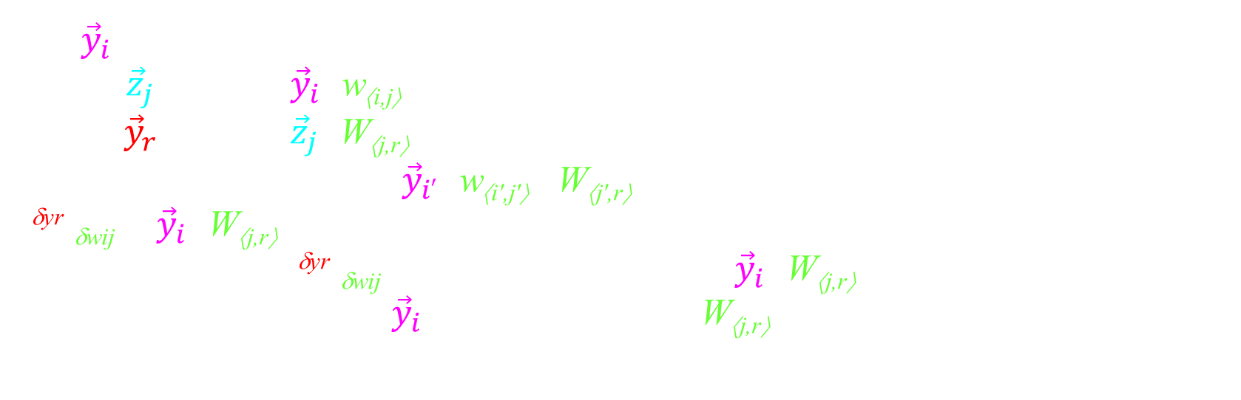

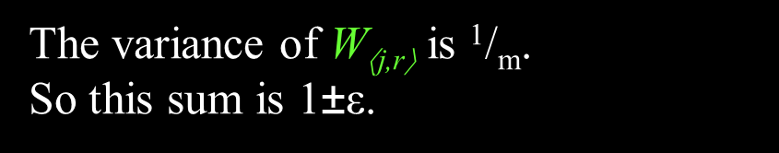
A Convergence Theory for Deep Learning
via Over-Parameterization
$$\vec{y}$$
$${\vec{y}}_{i}$$
$$\text{w}\text{⟨}\text{i}\text{,}\text{j}\text{⟩}$$
$${\vec{z}}_{j}$$
$$\text{W}\text{⟨}\text{j}\text{,}\text{r}\text{⟩}$$
$${\vec{y}}_{r}$$
m
Var(W_{⟨j,r⟩}) = ¹/_{m}.
Let ${\vec{y}}_{i}$be the value of a hidden node at the previous layer.
Recall ${\vec{z}}_{j}$= ∑_{i∈[m]} ${\vec{y}}_{i}$×w_{⟨i,j⟩}
${\vec{y}}_{r}$= ∑_{j∈[m]} ${\vec{z}}_{j}$×W_{⟨j,r⟩}
= ∑_{i'∈[m]} ∑_{j'∈[m]} ${\vec{y}}_{i′}$×w_{⟨i',j'⟩} ×W_{⟨j',r⟩}
^{δyr}/_{δwij} = ${\vec{y}}_{i}$×W_{⟨j,r⟩}
Exp(∑_{i∈[m]} ∑_{j∈[m]} (^{δyr}/_{δwij})²) = ∑_{i∈[m]} ∑_{j∈[m]} Exp((${\vec{y}}_{i}$×W_{⟨j,r⟩})² )
= [Exp(∑_{i∈[m]} (${\vec{y}}_{i}$)²)] × [∑_{j∈[m]} Exp((W_{⟨j,r⟩})²)]
= (1±ε)
× (1±ε)
We proved these internal
vectors have length 1±ε.
(1±ε)
The variance of $\text{W}\text{⟨}\text{j}\text{,}\text{r}\text{⟩}$ is ¹/_{m}.
So this sum is 1±ε.

Slide 35
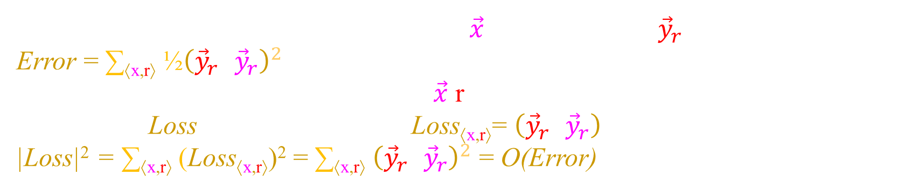
A Convergence Theory for Deep Learning
via Over-Parameterization
w_{⟨i,j⟩}
$${\vec{y}}_{r}$$
x
m
Loss
|Loss|² = Error
So far we have only considered one input $\vec{x}$ and one output ${\vec{y}}_{r}$.
Error = ∑_{⟨x,r⟩} $\text{½}{\left({\vec{y}}_{r}\text{−}{\vec{y}}_{r}\right)}^{2}$
Let's make a vector space indexed by ⟨$\vec{x}$,r⟩.
Let's define Loss to be a vector with Loss_{⟨x,r⟩}= $\left({\vec{y}}_{r}\text{−}{\vec{y}}_{r}\right)$
|Loss|² = ∑_{⟨x,r⟩} (Loss_{⟨x,r⟩})² = ∑_{⟨x,r⟩} ${\left({\vec{y}}_{r}\text{−}{\vec{y}}_{r}\right)}^{2}$ = O(Error)

Slide 36
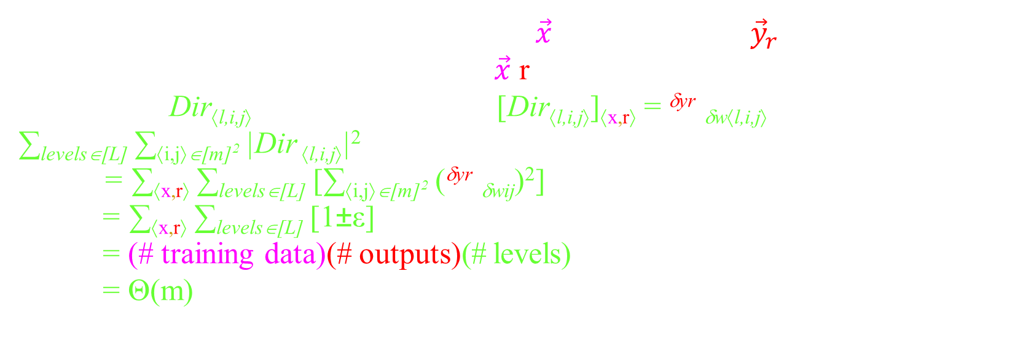
A Convergence Theory for Deep Learning
via Over-Parameterization
$$\text{w}\text{⟨}\text{i}\text{,}\text{j}\text{⟩}$$
$${\vec{y}}_{r}$$
Dir_{⟨l,i,j⟩}
x
m
Loss
|Loss|² = Error
So far we have only considered one input $\vec{x}$ and one output ${\vec{y}}_{r}$.
Let's make a vector space indexed by ⟨$\vec{x}$,r⟩.
Let's define Dir_{⟨l,i,j⟩} to be a vector with [Dir_{⟨l,i,j⟩}]_{⟨x,r⟩} = ^{δyr}/_{δw⟨l,i,j⟩}
∑_{levels∈[L]} ∑_{⟨i,j⟩∈[m]}2 |Dir _{⟨l,i,j⟩}|²
= ∑_{⟨x,r⟩} ∑_{levels∈[L]} [∑_{⟨i,j⟩∈[m]}2 (^{δyr}/_{δwij})²]
= ∑_{⟨x,r⟩} ∑_{levels∈[L]} [1±ε]
= (# training data)(# outputs)(# levels)
= Θ(m)

Slide 37
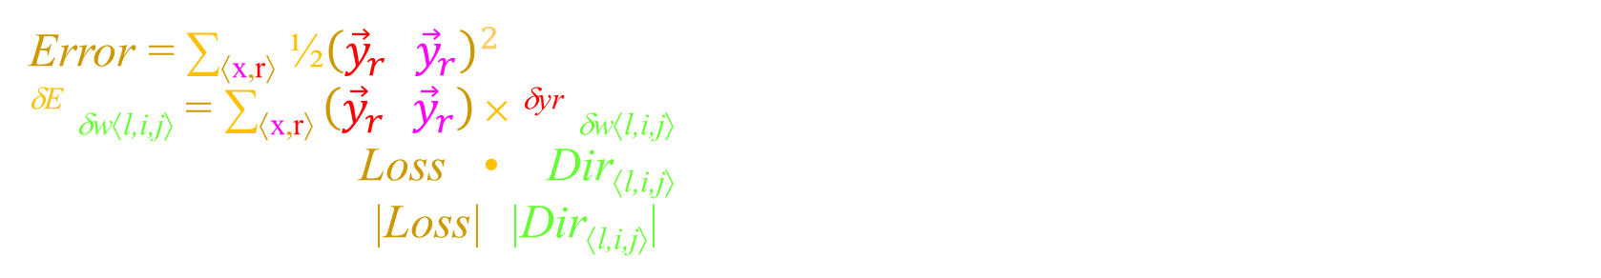
A Convergence Theory for Deep Learning
via Over-Parameterization
$$\text{w}\text{⟨}\text{i}\text{,}\text{j}\text{⟩}$$
$${\vec{y}}_{r}$$
Dir_{⟨l,i,j⟩}
x
m
θ
Loss
Error = ∑_{⟨x,r⟩} $\text{½}{\left({\vec{y}}_{r}\text{−}{\vec{y}}_{r}\right)}^{2}$
^{δE}/_{δw⟨l,i,j⟩} = ∑_{⟨x,r⟩} $\left({\vec{y}}_{r}\text{−}{\vec{y}}_{r}\right)$ × ^{δyr}/_{δw⟨l,i,j⟩}
= Loss • Dir_{⟨l,i,j⟩}
= cos(θ)×|Loss|×|Dir_{⟨l,i,j⟩}|
cos(θ) could be 1
or zero
But there is so much independent randomness,
let’s hope that it is Θ(1).

Slide 38
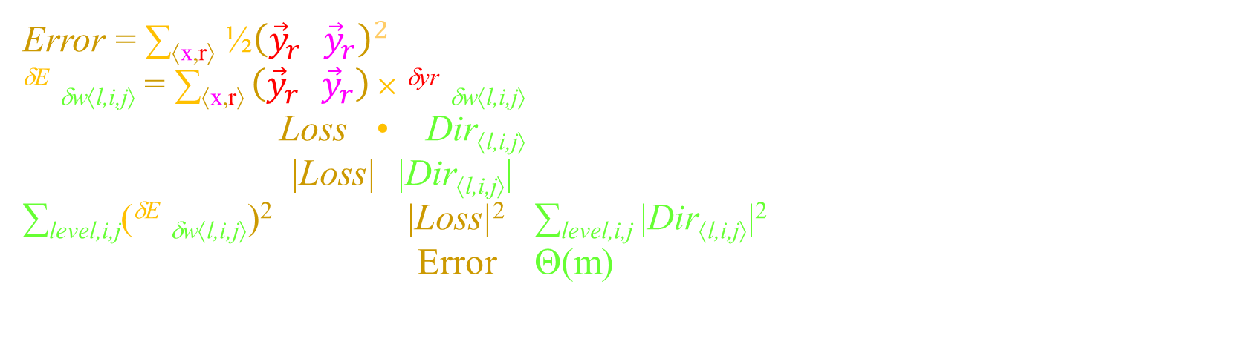
A Convergence Theory for Deep Learning
via Over-Parameterization
$$\text{w}\text{⟨}\text{i}\text{,}\text{j}\text{⟩}$$
$${\vec{y}}_{r}$$
Dir_{⟨l,i,j⟩}
x
m
θ
Loss
Error = ∑_{⟨x,r⟩} $\text{½}{\left({\vec{y}}_{r}\text{−}{\vec{y}}_{r}\right)}^{2}$
^{δE}/_{δw⟨l,i,j⟩} = ∑_{⟨x,r⟩} $\left({\vec{y}}_{r}\text{−}{\vec{y}}_{r}\right)$ × ^{δyr}/_{δw⟨l,i,j⟩}
= Loss • Dir_{⟨l,i,j⟩}
= cos(θ)×|Loss|×|Dir_{⟨l,i,j⟩}|
∑_{level,i,j}(^{δE}/_{δw⟨l,i,j⟩})² = Θ(1)×|Loss|²× ∑_{level,i,j} |Dir_{⟨l,i,j⟩}|²
= Θ(1)× Error × Θ(m)
This is what we needed to prove!

Slide 39
A Convergence Theory for Deep Learning
via Over-Parameterization
The algorithm does gradient decent starting from random weights w_{rand}.
We understand a neural net with random weights w_{rand}
because high prob on "average" they behave they should.
E(w₁,…,w_{m})
w₂
w₁

Slide 40
A Convergence Theory for Deep Learning
via Over-Parameterization
If you shift by a very small amount to weights (w_{rand} +w'),
then the behavior does not change by all that much.
The first step is to show that very few neurons
shift between the zero and the linear part of the ReLU gate.
When the ReLU do not shift sides,
the NN is just a linear function.
Hence, little changes.
or
E(w₁,…,w_{m})
Rectilinear (ReLU)
w₂
This is all we will say about this.
w₁

Slide 41
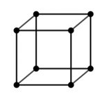
A Convergence Theory for Deep Learning
via Over-Parameterization
0
1
As an aside, parity is very non linear.
If you flip one input bit,
in a NN with random weights,
¹/_{√n} fraction of the neurons
shift between the zero and the linear part of the ReLU gate.
1
0
1
0
0
1
Rectilinear (ReLU)

Slide 42

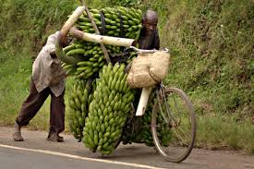
A Convergence Theory for Deep Learning
via Over-Parameterization
Model discussed here:
Regression (real values)
Paper also considers
Labels
m
face
bicycle

Slide 43
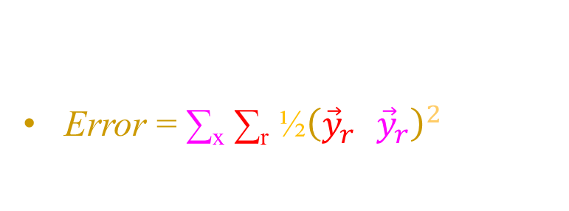
A Convergence Theory for Deep Learning
via Over-Parameterization
Model discussed here:
Regression (real values)
Error = ∑_{x} ∑_{r} $\text{½}{\left({\vec{y}}_{r}\text{−}{\vec{y}}_{r}\right)}^{2}$
ReLU activation
Paper also considers
Labels
General Errors
General activations
m
Rectilinear (ReLU)
Sigmoid

Slide 44
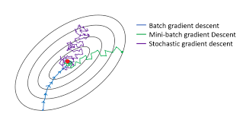
A Convergence Theory for Deep Learning
via Over-Parameterization
Model discussed here:
Regression (real values)
Error = ∑_{x} ∑_{r} $\text{½}{\left({\vec{y}}_{r}\text{−}{\vec{y}}_{r}\right)}^{2}$
ReLU activation
Paper also considers
Labels
General Errors
General activations
Stochastic,
i.e. Small batch sizes
m
Training Data

Slide 45

A Convergence Theory for Deep Learning
via Over-Parameterization
Model discussed here:
Regression (real values)
Error = ∑_{x} ∑_{r} $\text{½}{\left({\vec{y}}_{r}\text{−}{\vec{y}}_{r}\right)}^{2}$
ReLU activation
Full layers fixed width
Paper also considers
Labels
General Errors
General activations
Stochastic,
i.e. Small batch sizes
Different layers
different widths
m
x₁
w₁
w₂
cat
pixel_{i,j}
dog
face
bicycle.
x_{n}
w_{m}
E(w₁,…,w_{m})

Slide 46
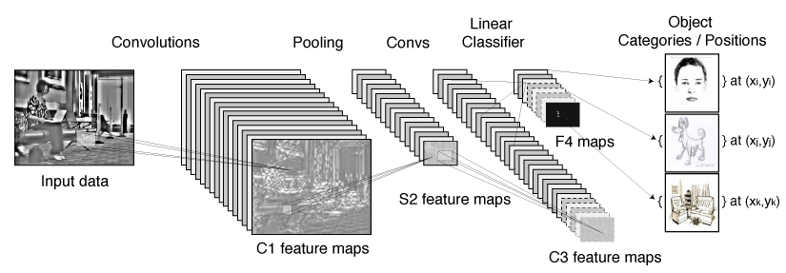
A Convergence Theory for Deep Learning
via Over-Parameterization
Model discussed here:
Regression (real values)
Error = ∑_{x} ∑_{r} $\text{½}{\left({\vec{y}}_{r}\text{−}{\vec{y}}_{r}\right)}^{2}$
ReLU activation
Full layers fixed width
Paper also considers
Labels
General Errors
General activations
Stochastic,
i.e. Small batch sizes
Different layers
different widths
Convolutional nets
m

Slide 47
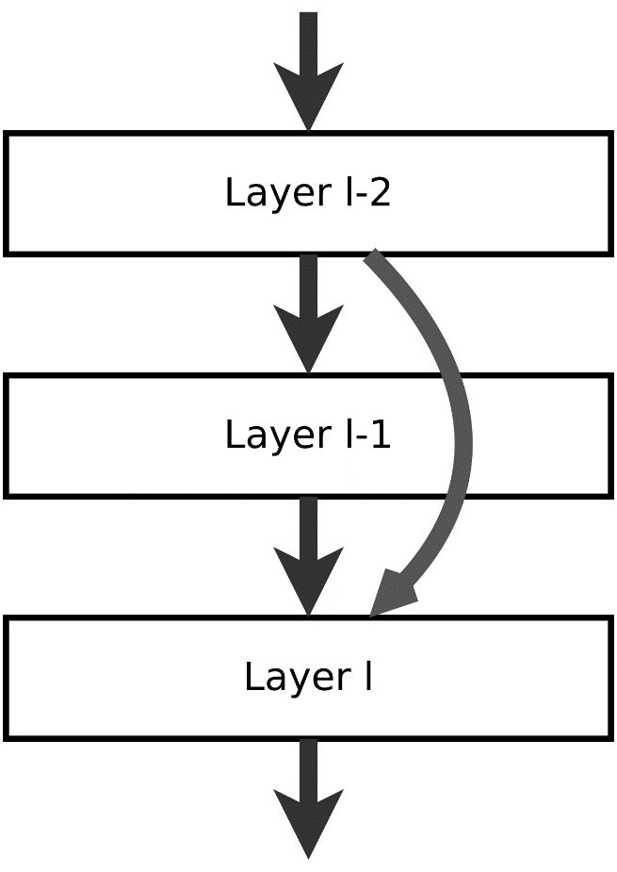
A Convergence Theory for Deep Learning
via Over-Parameterization
Model discussed here:
Regression (real values)
Error = ∑_{x} ∑_{r} $\text{½}{\left({\vec{y}}_{r}\text{−}{\vec{y}}_{r}\right)}^{2}$
ReLU activation
Full layers fixed width
Paper also considers
Labels
General Errors
General activations
Stochastic,
i.e. Small batch sizes
Different layers
different widths
Convolutional nets
Residual nets
m

Slide 48
A Convergence Theory for Deep Learning
via Over-Parameterization
Done
m

Slide 49

A Convergence Theory for Deep Learning
via Over-Parameterization
They say they can make all of these polynomials smaller - especially when the activation function is smooth.

Slide 50


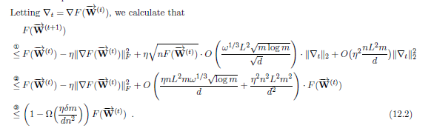
A Convergence Theory for Deep Learning
via Over-Parameterization

Slide 51
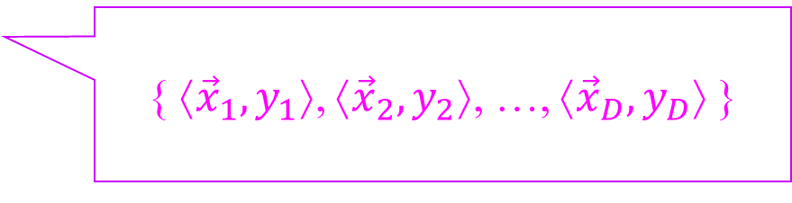
Big Picture
Given training data
{ ⟨${\vec{x}}_{1},y_{1}$⟩, ⟨${\vec{x}}_{2},y_{2}$⟩, …, ⟨${\vec{x}}_{D},y_{D}$⟩ }
I only want two things.
I want to learn weights
so the training data
is computed perfectly.
I want my machine to generalize
to new random data.
In practice you can get both.
Poly time if
# weights >> # training data
PAC-Learning assures this if
# weights << # training data

Slide 52
Big Picture
Just wait a minute.
After fixing the initial random weights,
only consider machines
within a VERY small ball .
{W_{rand} +W' | for fixed W_{rand} and |W'|₂ < ¹/_{m}O(1) }
Maybe they generalize well.
No
W' still has too many weights (though small)
And any function can be learned within this ball.
PAC-Learning assures this if
# weights << # training data
log(# machines)

Slide 53
Big Picture
Given training data
{ ⟨${\vec{x}}_{1},y_{1}$⟩, ⟨${\vec{x}}_{2},y_{2}$⟩, …, ⟨${\vec{x}}_{D},y_{D}$⟩ }
I only want two things.
I want to learn weights
so the training data
is computed perfectly.
I want my machine to generalize
to new random data.
Poly time if
# weights >> # training data
PAC-Learning assures this if
# weights << # training data
I want both!
Sorry. If the data y labels are random,
Then the smallest machine to compute the training data is
> # training data
The labels of the new data are also random and hence your machine can't know them.
This proves that your approach cannot work for such a hard function.

Slide 55
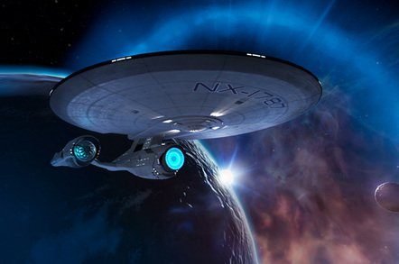
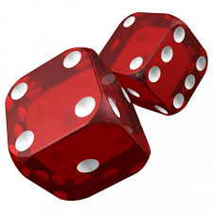

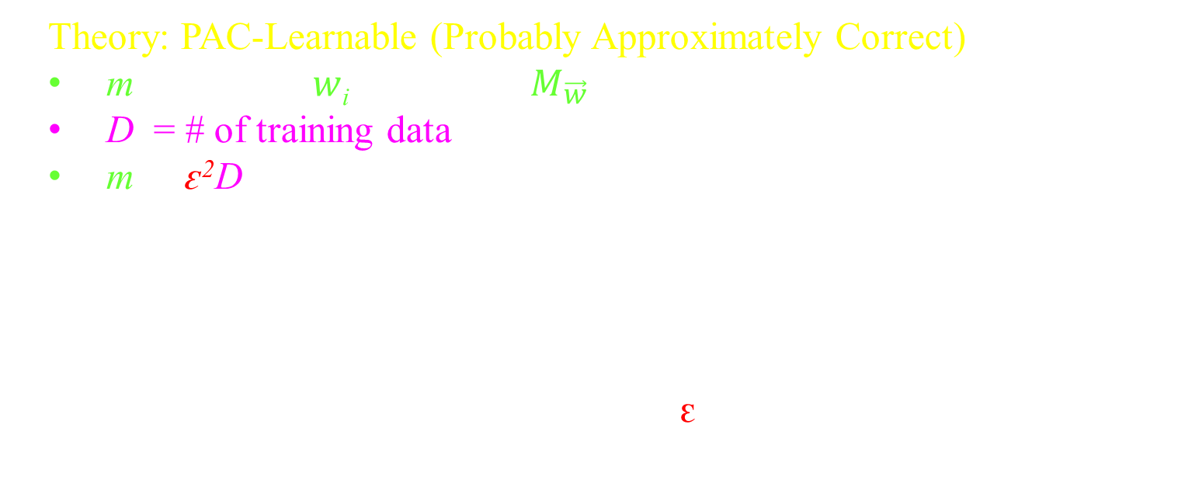
Generalizing from Training Data
Theory: PAC-Learnable (Probably Approximately Correct)
m = # of bits $w$_{i} describing $M_{\vec{w}}$
D = # of training data
m ≤ ԑ²D
If on the randomly chosen training data,
a machine is found that gives good answers,
without simply memorizing,
then we can prove that with high probability
this same machine will also work (1-ԑ) well
on never seen before instances.

Slide 56



Generalizing from Training Data
% Errors
Overfitting
Compression
General Inputs
Underfitting
≤ ԑ
m < ԑ²D
m = # of bits $w$_{i} describing $M_{\vec{w}}$
Skip Proof

Slide 57
Generalizing from Training Data
Proof (PAC-Learnable):
Consider one of the many machines $M_{\vec{w}}$.
Randomly choose the training data.
( )
Randomly chosen training data
fails to give us an accurate picture of how well this machine $M_{\vec{w}}$does on general inputs.
Pr
Goal is to bound this
=
$e^{−2ε^{2}D}$
Set of all inputs
ԑ′ fraction on which machine gives the wrong answer.
Exp(frac of D inputs bad) = ԑ′
Let ԑ′′ = Obtained frac of D inputs bad
Prob( for this $M_{\vec{w}}$, |ԑ′′- ԑ′| > ԑ ) ≈ $e^{−2ε^{2}D}$

Slide 58
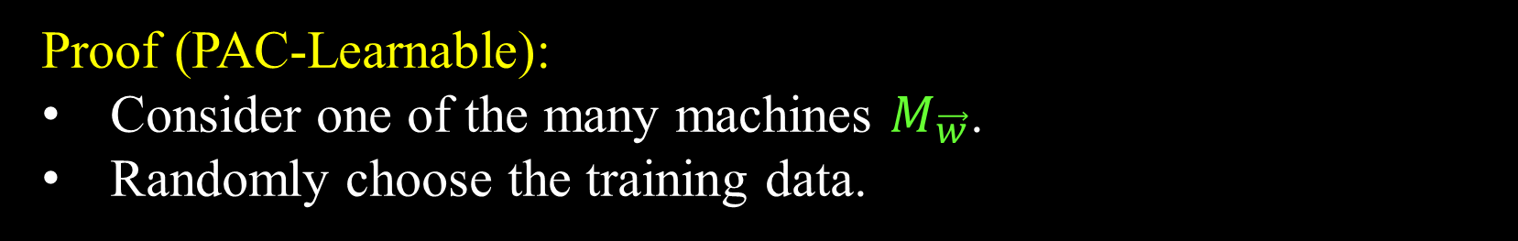



Generalizing from Training Data
Proof (PAC-Learnable):
Consider one of the many machines $M_{\vec{w}}$.
Randomly choose the training data.
( )
Randomly chosen training data
fails to give us an accurate picture of how well this machine $M_{\vec{w}}$does on general inputs.
Pr
=
$e^{−2ε^{2}D}$
×2^{m}
each
(Union bound)
There are not so many machines.
m < ԑ²D
m = # of bits describing $M_{\vec{w}}$.
|{$M_{\vec{w}}$}| ≤ 2^{m}
< w.h.p.

Slide 59
Generalizing from Training Data
Proof (PAC-Learnable):
for all machines
|
-
|
fraction ԑ′′ of
wrong training inputs
fraction ԑ′ of
wrong general inputs
≤ ԑ
We find a good machine
for the training data
ie works for all but an
ԑ′′ fraction.
It will be good
for general inputs
ie works for all but an
ԑ′ ≤ ԑ′′+ԑ fraction.
It will be good
for the training data
ie works for all but an
ԑ′′ ≤ ԑ′+ԑ fraction.
There is a good machine
for general inputs
ie works for all but an
ԑ′ fraction.
Hopefully gradient decent finds it
or a sufficiently good one.

Slide 60

Generalizing from Training Data
% Errors
General Inputs
≤ ԑ
D Training Inputs
Complexity m of Machines {$M_{\vec{w}}$}
m = VC-Dimension({$M_{\vec{w}}$})
(Vapnik–Chervonenkis)
(# of degrees of freedom like dimension.)

Slide 61


Generalizing from Training Data
Generally, the VC-Dimension {$M_{\vec{w}}$} is much smaller
than the number of bits to specify a machine.
And the same results go through.
ie need m ≤ ԑ²D = amount of training data.
I have the proof here, but read it at your own risk.
% Errors
General Inputs
≤ ԑ
D Training Inputs
Complexity m of Machines {$M_{\vec{w}}$}
m = VC-Dimension({$M_{\vec{w}}$})
= maximum size m of a set of training data
∃ { ${\vec{x}}_{1}, {\vec{x}}_{2}$, …,${\vec{x}}_{m}$ }
∀ of the 2^{m} answers { $y_{1}y_{2}$, …, ,$y_{m}$ }
∃ a machine $M_{\vec{w}}$ producing them.

Slide 62

Big Picture
PAC-Learning assures this if
# weights << # training data
# bits
In practice, you can count
# reals ≈ # bits
# weights = m
# bits = ∞
$\vec{x}$∈{-1,1}^{n} ➔ |{$\vec{x}$}| = 2^{n}
$\vec{x}$∈[-1,1]^{n} ➔ |{$\vec{x}$}| = ∞
VC-Dim = ∞
<< # training data.
w_{⟨i,j⟩}
x
m

Slide 63



Big Picture
Suppose your class of machines is infinite so that for every possible function f,
there is a machine M_{w} that compute it.
Then even with an infinite amount of training data,
you could find machine M_{w}
that is perfect on the training data
and still have no idea about the correct answer
on x between the training inputs.
If f is "smooth"
^{δf}/_{δxi} = Lipschitz ≤ L
1998
If f is "low bandwidth"
ie only B non-zero
fourier coefficients
Hui Jiang 2019
Some amount >> 2^{n}
of training data suffices.
Not very useful

Slide 64
Big Picture
In practice,
machines generalize better if
they have small Lipschitz (derivative)
In practice,
machines do have small Lipschitz.

Slide 65


Big Picture
In practice,
machines generalize better if
they have small Lipschitz (derivative)
Maybe it is ok that
# weights >> # training data
Three Lemmas:
Lipschitz(worst NN) = m^{depth/2}
Lipschitz(returned by over parametrized) = $1/{\sqrt{m}}$
Lipschitz(best under parametrized)
≥ $\sqrt{\frac{(\# dim problem)(\# training data)}{(\# weights)}}$= $\sqrt{\frac{nD}{m}}$
ie if you want your model to be smooth then
# weights ≥ (# dim of problem)(# training data)

Slide 66




A Convergence Theory for Deep Learning
via Over-Parameterization
$$\text{W}\text{⟨}\text{i}\text{,}\text{r}\text{⟩}$$
$${\vec{y}}_{r}$$
$${\vec{x}}_{i}$$
m
w_{⟨i,j⟩} ~ normal(0,²/_{m}).
^{δyr}/_{δxi} = W_{⟨i,r⟩} which is the influence of ${\vec{x}}_{i}$on ${\vec{y}}_{r}$
(i.e. weight of super edge).
W_{⟨i,r⟩} = ∑_{ir paths} Product of weights in path
Unless the path is zeroed by a ReLU max(0,z)
By independence
Var(W_{⟨i,r⟩}) = ∑_{ir paths} product Var(weights)
= m^{length of path-1} (²/_{m})^{length of path} ( ¹/₂)^{length of path}
= ¹/_{m}

Slide 67


A Convergence Theory for Deep Learning
via Over-Parameterization
$$\text{W}\text{⟨}\text{i}\text{,}\text{r}\text{⟩}$$
$${\vec{y}}_{r}$$
$${\vec{x}}_{i}$$
m
w_{⟨i,j⟩} = +$1/{\sqrt{m}}$
^{δyr}/_{δxi} = W_{⟨i,r⟩} which is the influence of ${\vec{x}}_{i}$on ${\vec{y}}_{r}$
(i.e. weight of super edge).
W_{⟨i,r⟩} = ∑_{ir paths} Product of weights in path
Unless the path is zeroed by a ReLU max(0,z)
= m^{length of path-1} (+$1/{\sqrt{m}}$)^{length of path}
= m^{depth/2 -1}

Slide 68
Big Picture
Given training data
{ ⟨${\vec{x}}_{1},y_{1}$⟩, ⟨${\vec{x}}_{2},y_{2}$⟩, …, ⟨${\vec{x}}_{D},y_{D}$⟩ }
I only want two things.
I want to learn weights
so the training data
is computed perfectly.
I want my machine to generalize
to new random data.
Poly time if
# weights >> # training data
PAC-Learning assures this if
# weights << # training data
I want both!
Sorry. If the data y labels are random,
Then the smallest machine to compute the training data is
> # training data
The labels of the new data are also random and hence your machine can't know them.
This proves that your approach cannot work for such a hard function.

Slide 69
End

Slide 71
Big Picture
Given training data
{ ⟨${\vec{x}}_{1},y_{1}$⟩, ⟨${\vec{x}}_{2},y_{2}$⟩, …, ⟨${\vec{x}}_{D},y_{D}$⟩ }
I only want two things.
I want to learn weights
so the training data
is computed perfectly.
I want my machine to generalize whp
to new random data.
You are guaranteed if
# weights >> # training data
PAC-Learning assures this if
# weights << # training data
I want both!
Can we prune our large NN to be a small circuit?
Small circuits
(having a small description)
generalize well.
People are working on that.

Slide 72






Small Circuit
Let's learn a circuit
for a computable function.
compute
with
Neural Networks can do the same.

Slide 73


Small Circuit
Let's learn a circuit
for a computable function.
AND
Or
Not
x₂
z>0
z<0
x₂
z>0
z>0
z<0
z<0
x₁
x₁
x₁
z = -3 + 2 x₁ + 2 x₂
z = -1 + 2 x₁ + 2 x₂
z = 1 + -2 x₁
or
y = Sigmoid(z)

Slide 74


Small Circuit
Small Circuit: Let f: {0,1}^{n}→{0,1} be a function
that can be computed by a small unknown binary circuit
described by N = n^{O(1)} bits.
Generalizing:
Because such circuits have an N-bit description
if you find one that does well on
on O(^{N}/_{ε}2) random training data { ⟨${\vec{x}}_{1},y_{1}$⟩, ⟨${\vec{x}}_{2},y_{2}$⟩, …, ⟨${\vec{x}}_{D},y_{D}$⟩ }
then WHP it generalizes to work to have only ε-error on all inputs.
You could then "answer" P vs NP
by trying to learn a circuit
that solves SAT.
Learning:
Can we use gradient decent to find whp
a binary circuit in (^{N}/_{ε})^{O(1)} time that does well on the training data?

Slide 75
Small Circuit
Gates: For each of a grid of "binary gates"
a neural net can learn whether it should compute And, Or, or Not.

Slide 76

Small Circuit
Wires: For each input wire, we must learn which output feeds it.
One could use a multiplexor, but learning binary codes is hard.

Slide 77
Small Circuit
Wires: For each input wire, we must learn which output feeds it.
Better to fill in all possible connections.
To be a circuit: weights are w = ⟨0,0,1,0,0,0⟩.
Requiring ∑_{i} w_{ij} = 1 is easy.
Requiring w_{ij}∈{0,1} is hard.
0
0
1
0
0
0

Slide 78
Small Circuit
Regularization: Adds error when
It could equally punish
for being non 0/1
weights are big non-zeros.
Requiring w_{ij}∈{0,1} is hard.
0
1
w_{ij}
0
1
w_{ij}
This one has
2 local minimum.
And 2^{n} with n of them.
But this function has
1 local minimum.

Slide 79
Small Circuit
The worst case scenario is:
There are lots of local minimum
One is slightly better
Takes exponential time to find this best one.
E(w₁,…,w_{m})
E(w₁,…,w_{m})
Aaaaah
w₂
$${\vec{w}}_{opt}$$
5
w₂
w₁
$${\vec{w}}_{opt}$$
w₁

Slide 80
Small Circuit
Connections: For each input wire, we must learn which output feeds it.
Better to fill in all possible connections.
To be a circuit: weight are w = ⟨0,0,1,0,0,0⟩.
Requiring ∑_{i} w_{⟨i,j⟩} = 1 is easy.
Requiring w_{⟨i,j⟩} ∈{0,1} is hard.
0.024
0.012
0.045
0.010
0.002
0.015

Slide 81
Small Circuit
Learning: This is a reasonable architecture, so should be able to learn.
Need # parameters neural net > (# training data)^{O(1)}
> (# parameters to describe the circuit)^{O(1)}
For each gate input we replaced 1 edge with W edges.
Maybe this is enough.
0.024
0.012
0.045
0.010
0.002
0.015

Slide 82
Small Circuit
Generalizing:
Because such circuits have an N bit description
if you find one that does well on
on O(^{N}/_{ε}2) random training data
then WHP it generalizes to work to have only ε-error on all inputs.
0.024
0.012
0.045
0.010
0.002
0.015
Our machine is no longer a small circuit.
So it might not generalizes well ☹.

Slide 83

Small Circuit
Gates:
Let's reexamine each gate.
The drawing is wrong – It does not need a hidden layer.
AND
x₂
z>0
z<0
₁
w₀
x₁
x₁
w₁
z = -3 + 2 x₁ + 2 x₂
w₂
x₂
z = w₀ + w₁x₁ + w₂ x₂

Slide 84
Small Circuit
Gates:
Let's reexamine each gate.
If the inputs are 0/1, then these are the ONLY functions.
x₁ and x₂
x₁ or x₂
not x₁ and x₂
not x₁
true
The details don’t matter.
x₁ nand x₂
x₁ nor x₂
x₁ or not x₂
x₁
false
₁
w₀
x₁
x₁ parity x₂
w₁
w₂
Not possible.
x₂
z = w₀ + w₁x₁ + w₂ x₂

Slide 85
Small Circuit
Connections: For each input wire, we must learn which output feeds it.
Better to fill in all possible connections.
₁
x₁
w₀
w₁
w₂
x₂
z = w₀ + w₁x₁ + w₂ x₂

Slide 86
Small Circuit
Connections: For each input wire, we must learn which output feeds it.
Better to fill in all possible connections.
y_{i}
w_{⟨i,j,1⟩}
₁
x₁
w₀
w_{⟨i,j,2⟩}
w₁
w₂
x₂
z = w₀ + w₁ x₁ + w₂ x₂
= w₀ + w₁ (y_{i} w_{⟨i,j,1⟩}) + w₁ (y_{i} w_{⟨i,j,1⟩})
= w₀ + (w₁ w_{⟨i,j,1⟩} + w₁ w_{⟨i,j,1⟩}) y_{i}

Slide 87
Small Circuit
Connections: For each input wire, we must learn which output feeds it.
Better to fill in all possible connections.
y_{i}
w_{⟨i,j⟩}
₁
w₀
z = w₀ + w₁ x₁ + w₂ x₂
= w₀ + w₁ (y_{i} w_{⟨i,j,1⟩}) + w₁ (y_{i} w_{⟨i,j,1⟩})
= w₀ + (w₁ w_{⟨i,j,1⟩} + w₁ w_{⟨i,j,1⟩}) y_{i}
= w₀ + w_{⟨i,j⟩} y_{i}

Slide 88
Small Circuit
Connections: For each input wire, we must learn which output feeds it.
Better to fill in all possible connections.
y_{i}
w_{⟨i,j⟩}
₁
w₀
z = w₀ + w_{⟨i,j⟩} y_{i} + w_{⟨i'',j⟩} y_{i'}
This gate still needs two inputs.

Slide 89
Small Circuit
Connections: For each input wire, we must learn which output feeds it.
Better to fill in all possible connections.
y_{i}
w_{⟨i,j⟩}
₁
w₀
z = w₀ + ∑_{i∈[m]} w_{⟨i,j⟩} y_{i}
This is now a normal full level neural network.
So it should learn our training data just fine.

Slide 90

Small Circuit
Experiment:
Choose a random small W×L boolean circuit.
Get enough training data to learn this circuit.
{ ⟨${\vec{x}}_{1},y_{1}$⟩, ⟨${\vec{x}}_{2},y_{2}$⟩, …, ⟨${\vec{x}}_{D},y_{D}$⟩ }
Learn this neural net.
0.224
₁
w₀
-0.012
0.045
0.010
0.302
0.015

Slide 91
Small Circuit
Experiment:
Fixed some of the smaller weights to zero
0.224
₁
w₀
-0.012
0.045
0.010
0.302
0.015

Slide 92
Small Circuit
Experiment:
Loop
Fixed some of the smaller weights to zero
and continue to learn from there
0.238
0.224
₁
w₀
0.041
0.045
0.439
0.302
0.015
0.015

Slide 93
Small Circuit
Experiment:
Loop
Fixed some of the smaller weights to zero
and continue to learn from there
Exit when each gate has two inputs.
0.238
0.335
₁
w₀
0.041
0.439
0.593
0.015

Slide 94
Small Circuit
Experiment:
Turn each neural net gate into a binary gate.
This is now a Boolean circuit!
x₁ and x₂
z = -3/2 + 1 x₁ + 1 x₂
1
0.335
₁
-3/2
w₀
1
0.593

Slide 95

Small Circuit
Experiment:
Hopefully it still does well on the training data?
{ ⟨${\vec{x}}_{1},y_{1}$⟩, ⟨${\vec{x}}_{2},y_{2}$⟩, …, ⟨${\vec{x}}_{D},y_{D}$⟩ }
Generalizing:
Because such circuits have an N-bit description
WHP it generalizes well to the original circuit!
1
₁
-3/2
1

Slide 96
Conjecture
Label the nodes of binary tree
with arbitrary functions f_{i}: {0,1}²→{0,1}
There are 2⁴ choices for each f_{i}.
There are (2⁴)^{n} choices for all n.
Conj: The number of randomly chosen
inputs to distinguish this composed F
is O(log(2⁴)^{n}) = O(n)
Fix this training data.
f₈
f₄
f₉
f₂
f₁₀
f₅
f₁₁
f₁₂
f₁
f₆
f₁₃
f₁₄
f₃
f₇
f₁₅

Slide 97
A Convergence Theory for Deep Learning
via Over-Parameterization
Here the neural net has
- n = # of training data items
- m = width of each layer - this is the number made big so that it is over parameterized.
Full m^2 edges edges between layers
- Each weight is normal(0,2/m)
- L = # of layers
- Phi(x) = max(0,x) to denote the ReLU function
(In appendix they change any smooth function.)
- d = # of y outputs. These are real values
- delta = minimum distance between between two training data x values. ie You cant have the same x have two different y values.
- F(W) = Error function = regression sum of square error
(In appendix they change this to getting labled data perfectly)
- (In appendix they also do it for batch stocastic gradiant decent,
and convolution networks, and those skip layered ones.)

Slide 98
∇E(⟨w_{⟨l,1,1⟩},..,w_{⟨l,i,j⟩},..,w_{⟨L,m,m⟩} ⟩)= ⟨^{δE}/_{δw⟨l,1,1⟩},…,^{δE}/_{δw⟨l,i,j⟩},…,^{δE}/_{δw⟨L,m,m⟩} ⟩
Our main thing to bound is ∑_{x} ∑_{r} ∑_{level,i,j} (^{δE}/_{δwlij})²

Slide 99

Neural Responding Machine e (NRM)
for Short-Text Conversation (STC) post→resonse
2015
encoder decoder
Post → h hidden rep → response
Both are
Recurrent Neural Network (RNN)
= next ouput is function of state and next input

Slide 100
x = (x1, · · · , xT ) = the input sequence ie post
h = (h1, · · · , hT ) = a set of high-dimensional hidden representations
αt = the attention signal at time t
determines which part of the hidden representation h
should be emphasized during the generation process
ct = the context
built from h and αt
input to decoder.
L = matrix transforming ct into (?? Except done with states)
yt = the t-th word of response
yt is a one-hot word representation
ie (000010000) indexed by words
computed by soft max ie probs summing to 1.

Slide 101


Slide 102

Decoder
Solid lines g = soft max
p(yt |yt−1, · · · , y1, x) = g(yt−1, st , ct),
Dashd lines f
st = f(yt−1, st−1, ct) = non-linear + L
(+ long term memory)

Slide 103

tj = q(hj , st−1),

Slide 104
long short-term memory (LSTM) unit (Hochreiter and Schmidhuber, 1997),
gated recurrent unit (GRU) (Chung et al., 2014; Cho et al., 2014). Compared to “ungated” logistic function,
LSTM and GRU are specially designed for its long term memory: it can store information over extended time steps without too much decay. W

Slide 105
There are multi-verse of ideas that are 100% true
Even if they contradict each other.
Sometimes science is wrong.
Black lives do matter.
I don't want all 8 billion living in my bedroom.
White supremist love themselves a little too much.
Humanity does not want any woman to have 10 babies.
Honesty is everything.
Enter
You sent
It is all part of the multi-verse.

