Slide 1
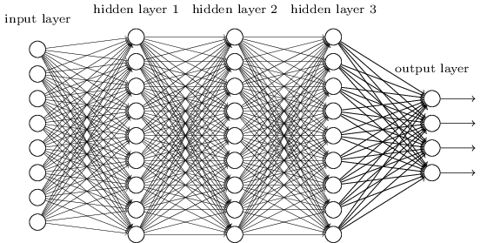
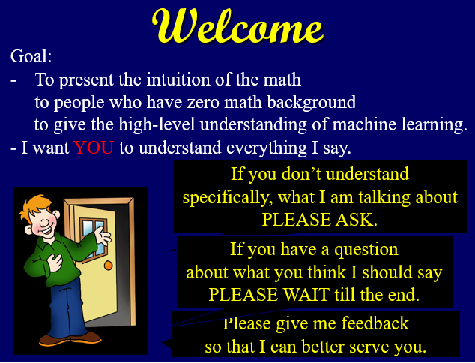
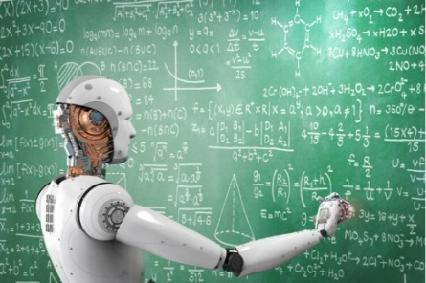
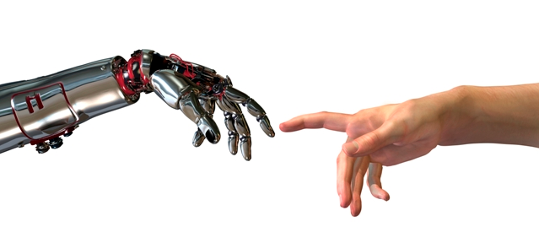




Machine Learning
Generalizing from Training Data
Under and Over Fitting
Theorem
Proof
Over Parametrized
Compression
VC-Dimension
Just because your learned machine works well on the training data, why should it generalize to work on examples never seen before?
Jeff Edmonds, Comp. Sci.
www.eecs.yorku.ca/~jeff/courses/machine-learning
Notes:
4*1.5hrs - not Example …, not unsupervised.

Slide 2
Generalizing from Training Data:
Just because your learned machine works well on the training data,
why should it generalize to work on examples never seen before?
There is some theory. If a machine is found that gives the correct
answers on the randomly chosen training data without simply
memorizing, then we can prove that with high probability this same
machine will also work well on never seen before instances drawn from
the same distribution. The easy proof requires D>m, where m is the
number of bits needed to describe your learned machine and D is the
number of train data items. A much harder proof (which we likely won't
cover) requires only D>VC, where VC is VC-dimension
(Vapnik–Chervonenkis) of your machine. The second requirement is
easier to meet because VC<m.

Slide 3
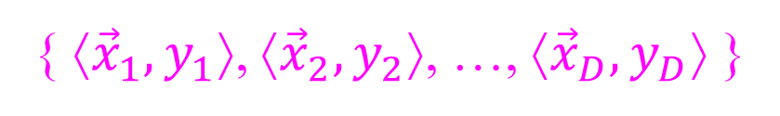


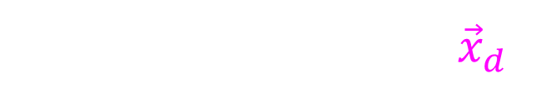

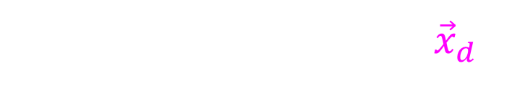

Generalizing from Training Data
{ ⟨${\vec{x}}_{1},y_{1}$⟩, ⟨${\vec{x}}_{2},y_{2}$⟩, …, ⟨${\vec{x}}_{D},y_{D}$⟩ }
Training data:
Machine Learning:
This machine is optimized for the training data.
But how well does it generalize to other inputs?
${\vec{w}}_{opt}= {ArgMin}_{\vec{w}} E\left(\vec{w}\right)$
Output y
$$\text{y}\text{d}$$
Supervisor's answer for ${\vec{x}}_{d}$.
$$M_{\vec{w}}\left({\vec{x}}_{d}\right)$$
Machine's answer for ${\vec{x}}_{d}$.
$${\vec{x}}_{d}$$
Input

Slide 4
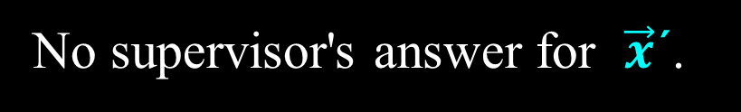

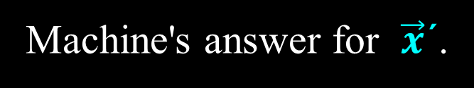

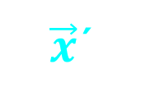
Generalizing from Training Data
{ ⟨${\vec{x}}_{1},y_{1}$⟩, ⟨${\vec{x}}_{2},y_{2}$⟩, …, ⟨${\vec{x}}_{D},y_{D}$⟩ }
Training data:
Machine Learning:
This machine is optimized for the training data.
But how well does it generalize to other inputs?
${\vec{w}}_{opt}= {ArgMin}_{\vec{w}} E\left(\vec{w}\right)$
$$\text{y}$$
No supervisor's answer for $\vec{x}$´.
Output y
$$M_{\vec{w}}\left(\vec{x}\text{´}\right)$$
Machine's answer for $\vec{x}$´.
Input
$\vec{x}$´

Slide 5
Generalizing from Training Data
{ ⟨${\vec{x}}_{1},y_{1}$⟩, ⟨${\vec{x}}_{2},y_{2}$⟩, …, ⟨${\vec{x}}_{D},y_{D}$⟩ }
Training data:
Machine Learning:
This machine is optimized for the training data.
But how well does it generalize to other inputs?
${\vec{w}}_{opt}= {ArgMin}_{\vec{w}} E\left(\vec{w}\right)$
Which of these three gives the best answers on
The training inputs?
General inputs?
There is a “no free lunch” theorem
that says that no one method works in all cases.
But there are a few principles.

Slide 6

Generalizing from Training Data
Underfitting:
If you just don’t have the capacity
you cant learn the material.

Slide 7
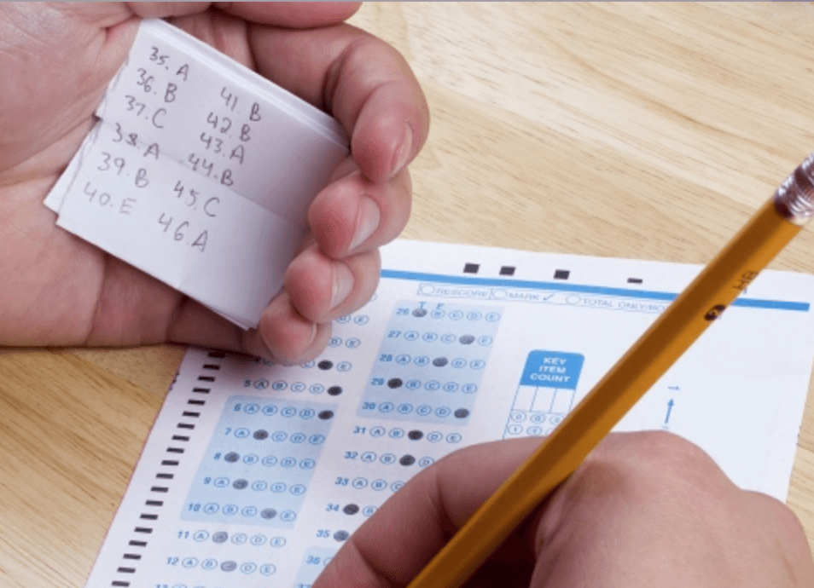
Generalizing from Training Data
Overfitting:
If you cheat by making a table of all the answers,
then you learn nothing
and are stuck when a new question comes.
Any m points can be fit exactly by
m lines of table look up
m-degree polynomial
Neural Networks with
~m hidden units

Slide 8

Generalizing from Training Data
Compression:
If you summarize the material,
then hopefully you understand it
and do well when a new question comes.

Slide 9
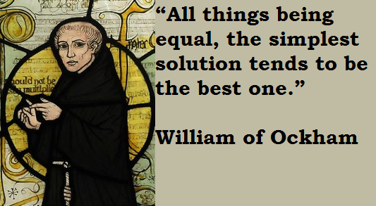
Generalizing from Training Data
Compression:

Slide 10
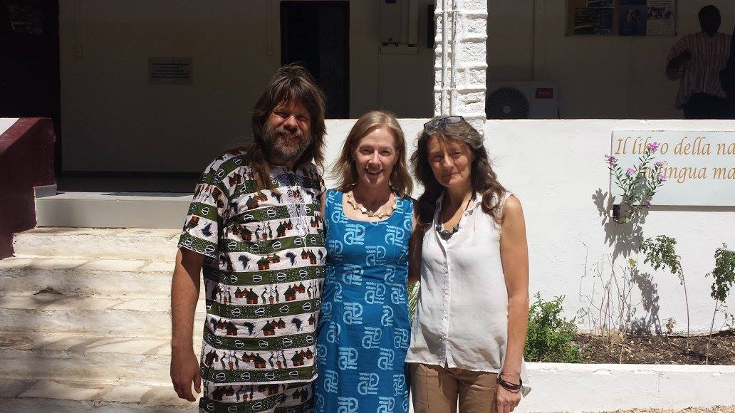
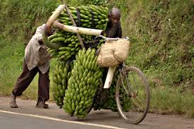
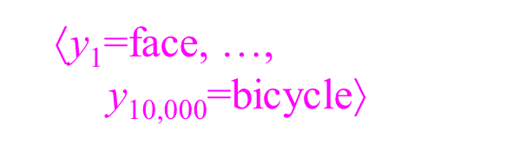
Generalizing from Training Data
Compression:
  Because answers {y₁, y₁,…,y_{10,000}}
  can be reproduced from the weights ⟨w₁,..,w_{m}⟩,
  this is compressing 10,000 numbers into m.
Given training data
learn weights w_{k}.
⟨w₁,..,w_{m}⟩
Encode
Compress
w_{k}
⟨y₁=face, …,
$\text{y}\text{10,000}$=bicycle⟩
Decode
m measures complexity of Machines {$M_{\vec{w}}$}
m=100
m=1,000
m=20,000
Too much Compression
Compression
No Compression

Slide 11

Generalizing from Training Data
% Errors
Overfitting
Compression
General Inputs
Underfitting
D Training Inputs
m measures complexity of Machines {$M_{\vec{w}}$}
m=100
m=1,000
m=20,000
Too much Compression
Compression
No Compression

Slide 12
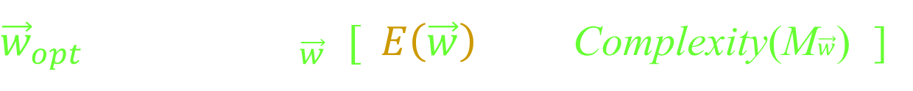
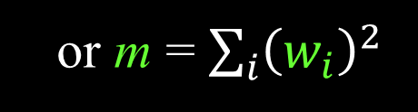
Generalizing from Training Data
Regularization:
${\vec{w}}_{opt}= {ArgMin}_{\vec{w}} [ E\left(\vec{w}\right)$ + λ Complexity(M$\vec{w}$) ]
Find me weights w for which:
The training data error is small
The machine is reasonably simple.
Hopefully its general input error is small.
% Errors
Trade
off
m measures complexity of Machines {$M_{\vec{w}}$}
m=100
or m = $\sum_{i}{{\left(w_{i}\right)}^{2}}$
(Differentiable)
m=1,000
m=20,000
Too much Compression
Compression
No Compression

Slide 13

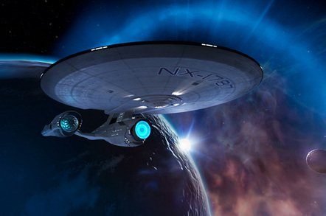
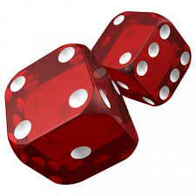
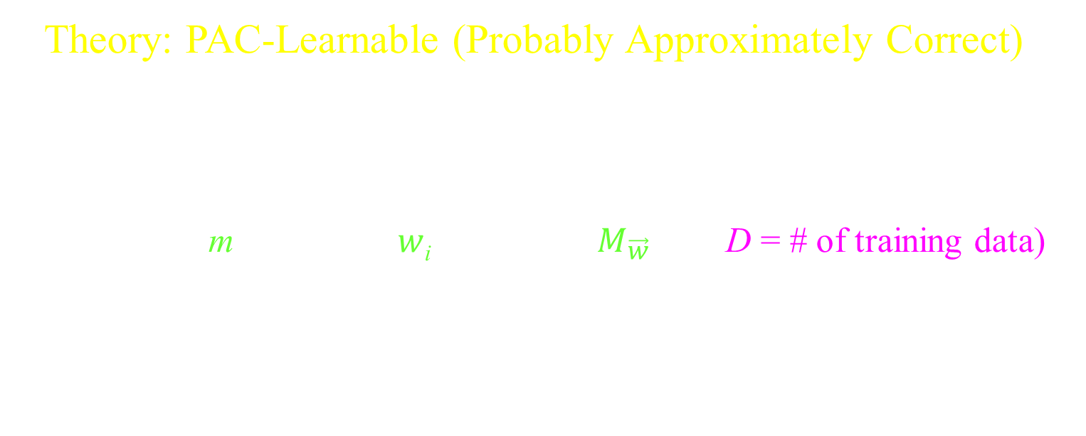
Generalizing from Training Data
Theory: PAC-Learnable (Probably Approximately Correct)
If on the randomly chosen training data,
a machine is found that gives good answers,
without simply memorizing,
(because m = # of bits $w$_{i} describing $M_{\vec{w}}$ << D = # of training data)
then we can prove that with high probability
this same machine will also work well
on never seen before instances.

Slide 14
Generalizing from Training Data
Theory: PAC-Learnable (Probably Approximately Correct)
Game:
I like to convert every ∀/∃ statement into a game.
  I prove ∀x, by having an adversary give me an arbitrary x.
  I prove ∃y, by constructing a suitable y.
  I flip coins to get any randomly chosen objects.
  And then proving the statement for these objects.
  https://www.eecs.yorku.ca/~jeff/courses/1090/syllabus/1090-2-informal-understanding-proofs.pptx

Slide 15
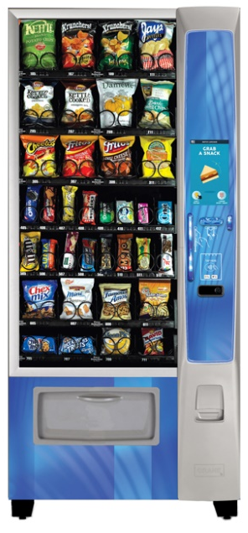
Generalizing from Training Data
Theory: PAC-Learnable (Probably Approximately Correct)
Game:
As an adversary:
I chooses some worst-case distribution U on ⟨x,y⟩ pairs
that the universe provides.
Here x is say an image of a cat
and y is the label that it is a "cat".
U is a black box like a vending machine.
  When you put in a quarter and push the button
  it gives you a random ⟨x,y⟩ pair.
  The adversary chooses for each possible ⟨x,y⟩
  a real number p_{⟨x,y⟩}.
  giving the probability Pr(⟨x,y⟩).
U
⟨x,y⟩

Slide 16
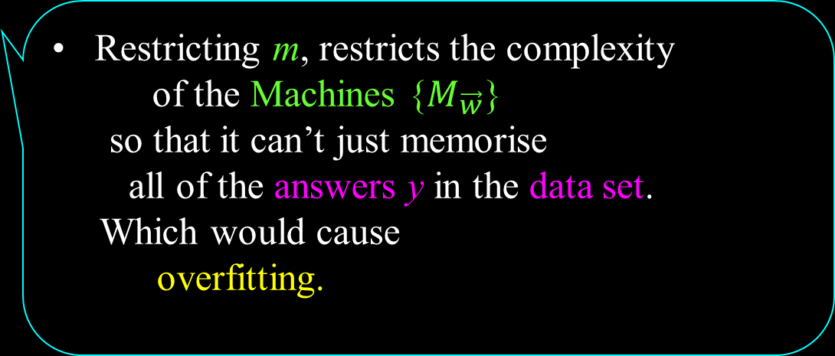
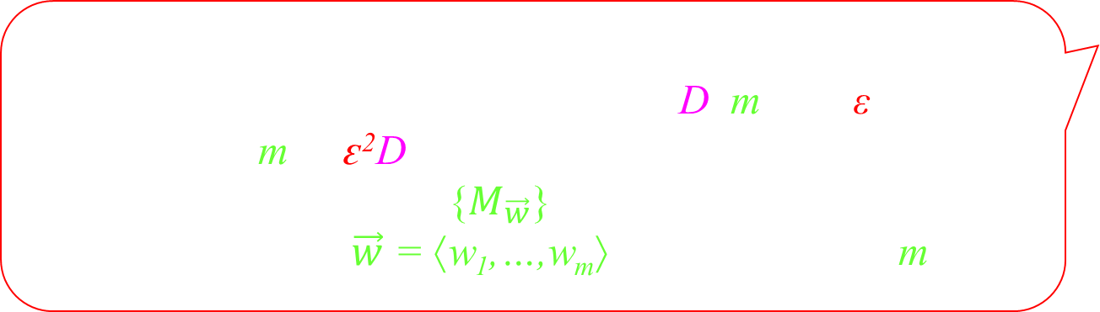
Generalizing from Training Data
Theory: PAC-Learnable (Probably Approximately Correct)
Game:
As an adversary:
I chooses some worst-case integers D, m, and ε,
such that m ≤ ԑ²D.
I choose some family {$M_{\vec{w}}$} of neural networks
whose weights $\vec{w}$ = ⟨w₁,…,w_{m}⟩ are specified by m bits.
U
Restricting m, restricts the complexity
of the Machines {$M_{\vec{w}}$}
so that it can’t just memorise
all of the answers y in the data set.
Which would cause
overfitting.
w_{k}
⟨x,y⟩

Slide 17


Generalizing from Training Data
Theory: PAC-Learnable (Probably Approximately Correct)
Game:
As an adversary:
I chooses some worst-case integers D, m, and ε,
such that m ≤ ԑ²D.
I choose some family {$M_{\vec{w}}$} of neural networks
whose weights $\vec{w}$ = ⟨w₁,…,w_{m}⟩ are specified by m bits.
U
Restricting m, restricts the complexity
of the Machines {$M_{\vec{w}}$}
Instead, the machine must compress the data
which might force it to learn the data
which might mean that
it can genialize to data
never seen before.
w_{k}
⟨x,y⟩

Slide 18
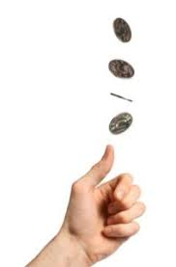

Generalizing from Training Data
Theory: PAC-Learnable (Probably Approximately Correct)
Game:
As a prover:
Using the universe’s distribution U,
I randomly choose a set of D data pairs.
{ ⟨${\vec{x}}_{1},y_{1}$⟩, ⟨${\vec{x}}_{2},y_{2}$⟩, …, ⟨${\vec{x}}_{D},y_{D}$⟩ }.
As random coins, I help.
⟨x,y⟩
⟨x,y⟩
⟨x,y⟩
⟨x,y⟩
⟨x,y⟩
⟨x,y⟩
w_{k}

Slide 19

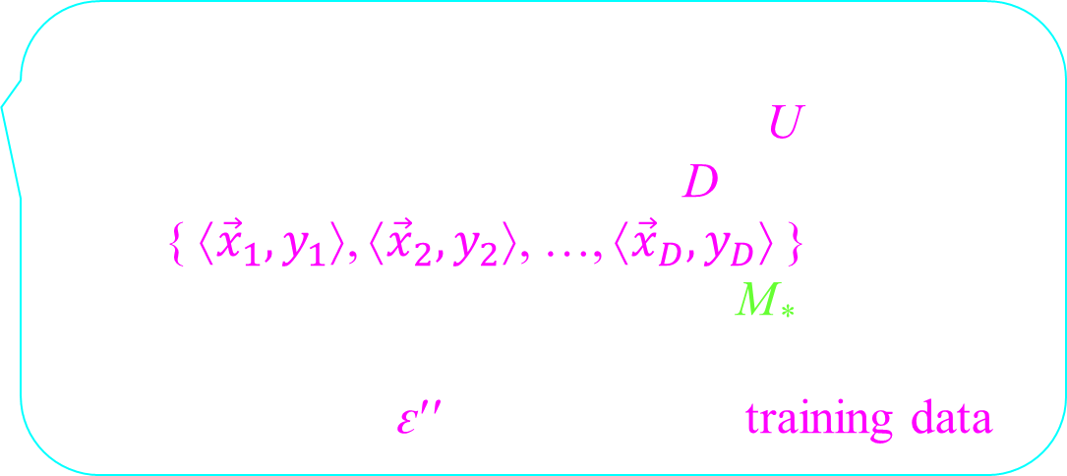
Generalizing from Training Data
Theory: PAC-Learnable (Probably Approximately Correct)
Game:
As a prover:
Using the universe’s distribution U,
I randomly choose a set of D data pairs.
{ ⟨${\vec{x}}_{1},y_{1}$⟩, ⟨${\vec{x}}_{2},y_{2}$⟩, …, ⟨${\vec{x}}_{D},y_{D}$⟩ }.
Suppose I find a good machine M*
that gets the right answer
for all but an ԑ′′ fraction of the training data.
i.e. machine M* is chosen from {$M_{\vec{w}}$} such that
on some (1-ԑ′′)D of the data pairs
its outputM*(${\vec{x}}_{i}$) on input ${\vec{x}}_{i}$ is ${\vec{y}}_{i}$.
w_{k}

Slide 20
Generalizing from Training Data
Theory: PAC-Learnable (Probably Approximately Correct)
Game:
As a prover:
Using the universe’s distribution U,
I randomly choose a set of D data pairs.
{ ⟨${\vec{x}}_{1},y_{1}$⟩, ⟨${\vec{x}}_{2},y_{2}$⟩, …, ⟨${\vec{x}}_{D},y_{D}$⟩ }.
Suppose I find a good machine M*
that gets the right answer
for all but an ԑ′′ fraction of the training data.
Actually, from those machines that have this property,
I get to choose the worst-case machine M*.
w_{k}

Slide 21
Generalizing from Training Data
Theory: PAC-Learnable (Probably Approximately Correct)
Game:
As a prover:
Using the universe’s distribution U,
I randomly choose one more data pair ⟨x*,y*⟩.
I note whether my same chosen machine M*
generalizes to this new unseen data pair ⟨x*,y*⟩.
i.e. whether machine M*(x*)
on input x* outputs y*!
⟨x*,y*⟩
w_{k}

Slide 22
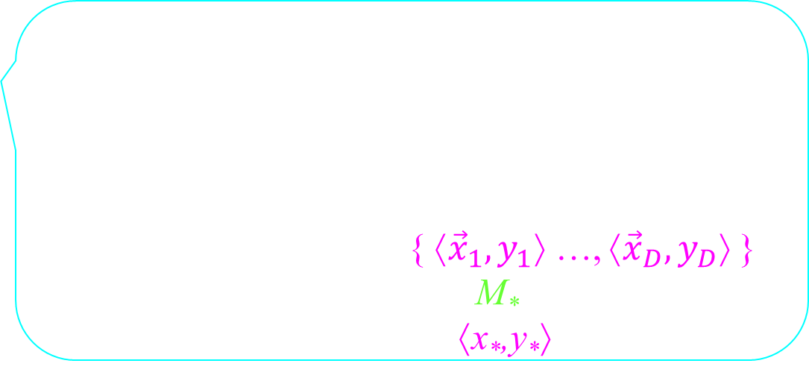
Generalizing from Training Data
Theory: PAC-Learnable (Probably Approximately Correct)
Game:
As a prover:
This same experiment is repeated many times.
ie rechoosing
the training data { ⟨${\vec{x}}_{1},y_{1}$⟩ …, ⟨${\vec{x}}_{D},y_{D}$⟩ },
the selected machine M*,
and the unseen data ⟨x*,y*⟩.
Using independent coin flips.
I prove that my same machineM*
generalizes to this new unseen data pair ⟨x*,y*⟩
in at least a ԑ′′+ԑ fraction
of these experiments.
w_{k}
m ≤ ԑ²D.
M* work ԑ′′ of training data.

Slide 23
Generalizing from Training Data
Theory: PAC-Learnable (Probably Approximately Correct)
Game:
Surely as the adversary, I can mess this up for you!
Here x* is some crazy image that we have never seen before.
How will some machine recognize this as y* = “bicycle”?
x* =
w_{k}

Slide 24
Generalizing from Training Data
Theory: PAC-Learnable (Probably Approximately Correct)
Game:
Surely as the adversary, I can mess this up for you!
Here x* is some crazy image that we have never seen before.
Or even worse as y* = “cat”?
x* =
Sorry no. You must specify your Universe
distribution U at the beginning.
The training data and ⟨x*,y*⟩
are randomly chosen from the SAME distribution.
In which, I am as likely
to train on x* =
y* = “cat”
w_{k}

Slide 25

Generalizing from Training Data
Theory: PAC-Learnable (Probably Approximately Correct)
Game:
Ok. I will make the neural network M* so bad
that it can’t compute anything.
But M* is the best from {$M_{\vec{w}}$}.
If all machines {$M_{\vec{w}}$} are bad, then I can’t find a
good machine M* that gets the right answer
for all but an ԑ′′ fraction of the training data.
The result is conditional on this.
Hence, if you fail to do this for me,
then you automatically lose.
Oh dear.
Maybe this crazy result is true.
w_{k}

Slide 26
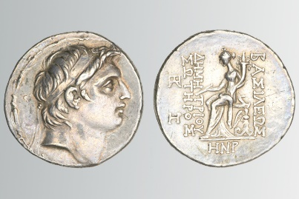
Proof Generalizing from Training Data
Consider one of many coins.
Let ԑ′ denote the probability
of it coming up on its bad side.
How do I learn ԑ′?
Clearly by flipping it a few times.
We need to try it enough times to make ԑ small.
|ԑ′′- ԑ′| ≤ ԑ
Fraction of bad flips I tried.
Actual prob of bad flip.
Difference.

Slide 27
Proof Generalizing from Training Data
Consider one of many machines.
Let ԑ′ denote the probability of it giving
the wrong answer on a random input.
How do I learn ԑ′?
Clearly by testing it on random inputs a few times.
We need to try it enough times to make ԑ small.
w_{k}
⟨x,y⟩
Set of all inputs
ԑ′ fraction on which machine gives the wrong answer.
|ԑ′′- ԑ′| ≤ ԑ
Fraction of bad inputs I tried.
Actual prob of bad input in general.
Difference.

Slide 28
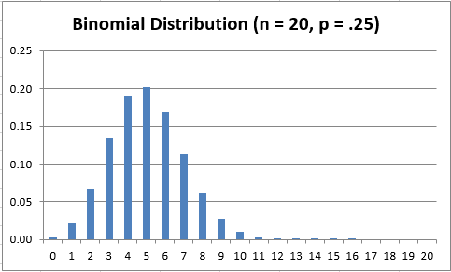

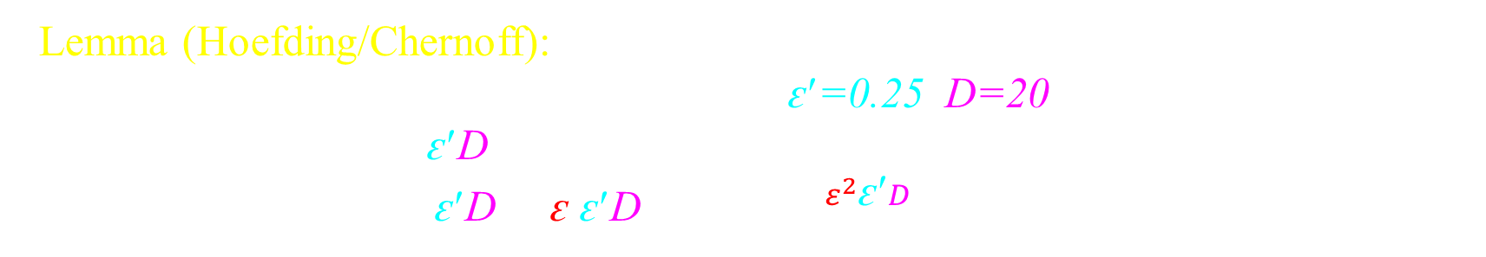
Proof Generalizing from Training Data
Lemma (Hoefding/Chernoff):
If you flip a coin with head probability ԑ′=0.25 D=20 times,
Exp(# of heads) = ԑ′D = 5.
Prob( |# of heads - ԑ′D| > ԑ ԑ′D ) ≤ 2 $e^{−\text{½}ε^{2}\text{ԑ}\text{′}D}$
(But we don’t know $\text{ԑ}\text{′}$.)
(D=20,ԑ=.25)

Slide 29
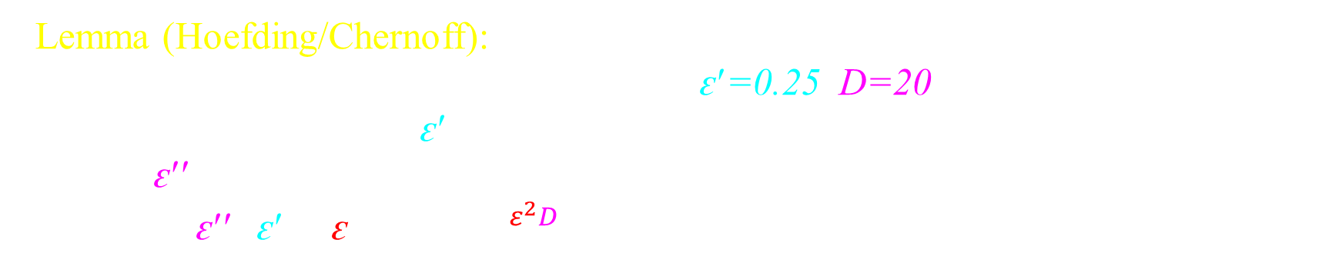
Proof Generalizing from Training Data
Lemma (Hoefding/Chernoff):
If you flip a coin with head probability ԑ′=0.25 D=20 times,
Exp(frac of heads) = ԑ′.
Let ԑ′′ = Obtained frac of heads
Prob( |ԑ′′- ԑ′| > ԑ ) ≤ 2 $e^{−2ε^{2}D}$
https://www.eecs.yorku.ca/~jeff/courses/6111/syllabus/6111-21-probTheory.pdf
(D=20,ԑ=.25)

Slide 30

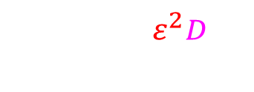
Proof Generalizing from Training Data
Lemma (Hoefding/Chernoff):
If you flip a coin with head probability ԑ′=0.25 D=20 times,
Exp(frac of heads) = ԑ′.
Let ԑ′′ = Obtained frac of heads
Prob( |ԑ′′- ԑ′| > ԑ ) ≤ 2 $e^{−2ε^{2}D}$
I choose the accuracy ԑ with which I want to learn ԑ′.
I choose the amount of risk p= 2 $e^{−2ε^{2}D}$
that I am willing to take.
I solve for the number of times D that I need to flip the coin.
( )
My estimation ԑ′′ of ԑ′
is off by more than ԑ
≤
Pr
2 $e^{−2ε^{2}D}$
|ԑ′′- ԑ′| ≤ ԑ
Fraction of bad inputs I tried.
Actual prob of bad input in general.
Difference.

Slide 31
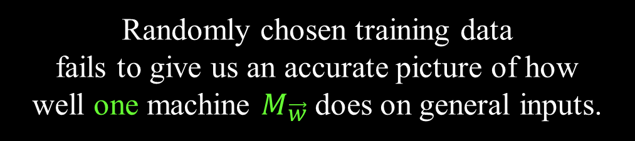

Proof Generalizing from Training Data
Lemma (Hoefding/Chernoff):
If you flip a coin with head probability ԑ′=0.25 D=20 times,
Exp(frac of heads) = ԑ′.
Let ԑ′′ = Obtained frac of heads
Prob( |ԑ′′- ԑ′| > ԑ ) ≤ 2 $e^{−2ε^{2}D}$
I choose the accuracy ԑ with which I want to learn ԑ′.
I choose the amount of risk p= 2 $e^{−2ε^{2}D}$
that I am willing to take.
I solve for the number of times D that I need to flip the coin.
( )
My estimation ԑ′′ of ԑ′
is off by more than ԑ
≤
Pr
2 $e^{−2ε^{2}D}$
( )
Randomly chosen training data
fails to give us an accurate picture of how well one machine $M_{\vec{w}}$does on general inputs.
Pr
≤
${2 e}^{−2ε^{2}D}$

Slide 32
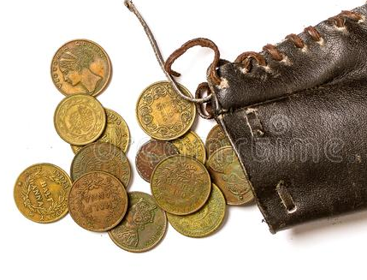
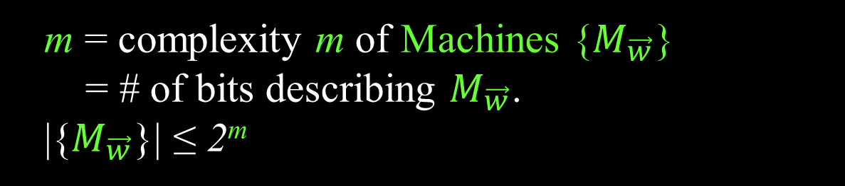
Proof Generalizing from Training Data
I want to learn ԑ′ for each of coins/machines.
|ԑ′′- ԑ′| ≤ ԑ
Fraction of bad inputs I tried.
Actual prob of bad input in general.
Difference.
w_{k}
w_{k}
w_{k}
There are not so many.
w_{k}
m = complexity m of Machines {$M_{\vec{w}}$}
= # of bits describing $M_{\vec{w}}$.
|{$M_{\vec{w}}$}| ≤ 2^{m}

Slide 33
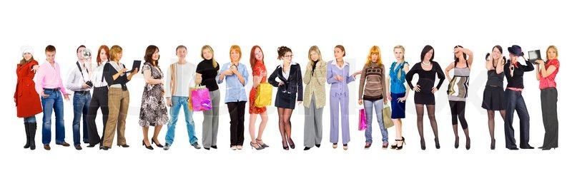
Proof Generalizing from Training Data
Lemma (Union Bound):
If there are M=100 people,
each person gets sick with probability ¹/₁₀₀₀,
then the probability that at least one gets sick is
≤ 100 × ¹/₁₀₀₀ = ¹/₁₀

Slide 34
Proof Generalizing from Training Data
Lemma (Union Bound):
If there are M=100 people,
each person gets sick with probability ¹/₁₀₀₀,
then the probability that at least one gets sick is
≤ 100 × ¹/₁₀₀₀ = ¹/₁₀
Set of possible universes
area = 1
Those on which the first person gets sick.
area = ¹/₁₀₀₀
And second person. …
Probability somebody is sick
= total area covered
≤ 100 × ¹/₁₀₀₀
The worst case is when the circles don’t over lap at all.

Slide 35


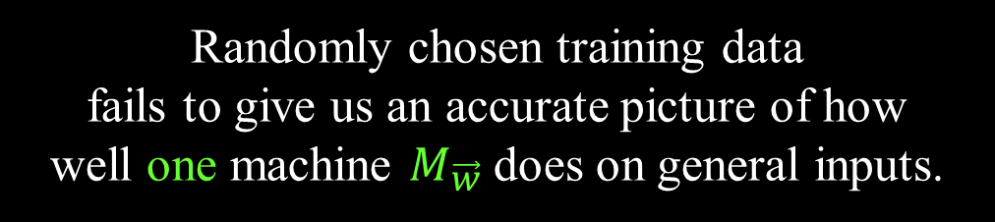
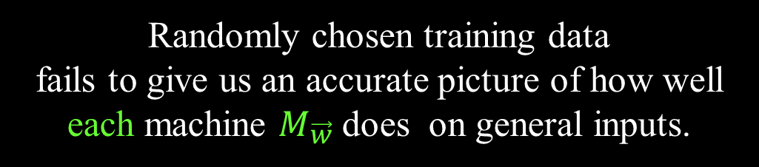
Proof Generalizing from Training Data
( )
Randomly chosen training data
fails to give us an accurate picture of how well each machine $M_{\vec{w}}$does on general inputs.
Pr
( )
Randomly chosen training data
fails to give us an accurate picture of how well one machine $M_{\vec{w}}$does on general inputs.
≤
Pr
× |{machines}|
≤
$${2 e}^{−{2 ε}^{2}D}$$
× 2^{m}
Recall m < ԑ²D.
≤
$${2 e}^{−ε^{2}D}$$
Very unikey

Slide 36
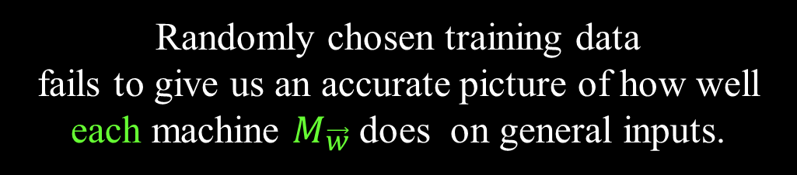


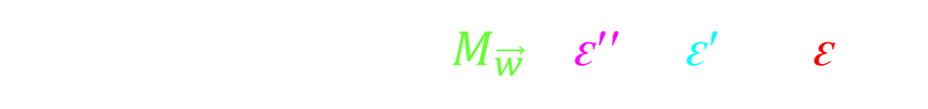
Proof Generalizing from Training Data
Randomly chosen training data
fails to give us an accurate picture of how well each machine $M_{\vec{w}}$does on general inputs.
does
i.e. for all machines $M_{\vec{w}}$, |ԑ′′ - ԑ′ | ≤ ԑ
$$M_{\vec{w}}$$
$$M_{\vec{w}}$$
Called uniform convergence.
Hence, the training data accurately points us
to the best machine

Slide 37
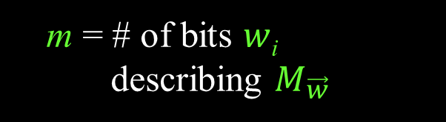
Proof Generalizing from Training Data
Without simply memorizing
<
D = # of training
data
m = # of bits $w$_{i}
describing $M_{\vec{w}}$
If
% Errors
General Inputs
if and only if
ԑ′′
ԑ′
Training Inputs
Complexity m of Machines {$M_{\vec{w}}$}
|
-
|
fraction ԑ′′ of
wrong training inputs
fraction ԑ′ of
wrong general inputs
≤ ԑ
The training data accurately represents the general data.

Slide 38
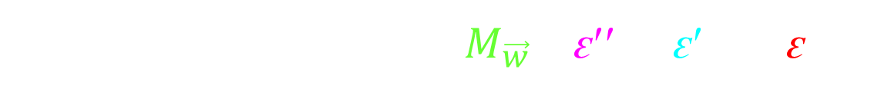


Proof Generalizing from Training Data
Design your machine to be described by some m bits.
Choose D training samples from universe.
We need D ≥ 1/ԑ² m.
Likely for all machines $M_{\vec{w}}$, |ԑ′′ - ԑ′ | ≤ ԑ
$$M_{\vec{w}}$$
$$M_{\vec{w}}$$

Slide 39
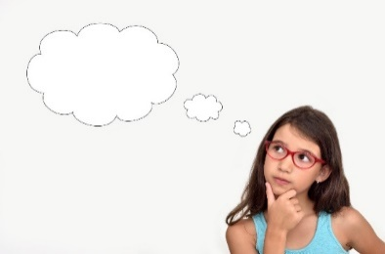

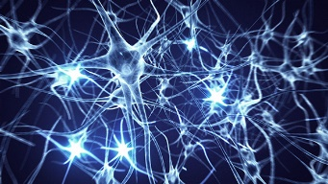
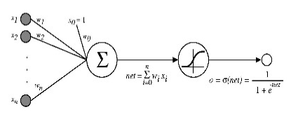
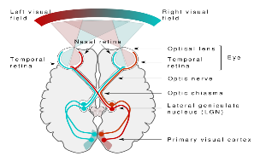
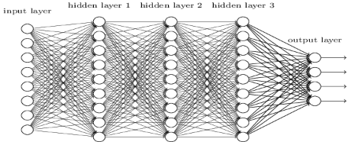




Proof Generalizing from Training Data
Likely for all machines $M_{\vec{w}}$, |ԑ′′ - ԑ′ | ≤ ԑ
$$M_{\vec{w}}$$
$$M_{\vec{w}}$$
We find a good machine
for the training data
ie works for all but an
ԑ′′ fraction.
It will be good
for general inputs
ie works for all but an
ԑ′ ≤ ԑ′′+ԑ fraction.
The human brain can distinguish between faces and bicycles.
with some ԑ′ fraction of general inputs.
$$y$$
≈
$$z= \sum_{i=0..n}{w_{i}}x_{i}$$
y $=φ\left(z\right)= \frac{1}{1+e^{−z}}$

Slide 40
Proof Generalizing from Training Data
Likely for all machines $M_{\vec{w}}$, |ԑ′′ - ԑ′ | ≤ ԑ
$$M_{\vec{w}}$$
$$M_{\vec{w}}$$
We find a good machine
for the training data
ie works for all but an
ԑ′′ fraction.
It will be good
for general inputs
ie works for all but an
ԑ′ ≤ ԑ′′+ԑ fraction.
The human brain can distinguish between faces and bicycles.
with some ԑ′ fraction of general inputs.
It will be good
for the training data
ie works for all but an
ԑ′′ ≤ ԑ′+ԑ fraction.
There is a good machine
for general inputs
ie works for all but an
ԑ′ fraction.
Hopefully gradient decent finds it
or a sufficiently good one.

Slide 41
Generalizing from Training Data (VC-Dimension) (Harder)

Slide 42

Generalizing from Training Data (VC-Dimension) (Harder)
% Errors
D Training Inputs
Complexity m of Machines {$M_{\vec{w}}$}
m = VC-Dimension({$M_{\vec{w}}$})
(Vapnik–Chervonenkis)
(# of degrees of freedom like dimension.)

Slide 43


Generalizing from Training Data (VC-Dimension) (Harder)
Generally, the VC-Dimension {$M_{\vec{w}}$} is much smaller
than the number of bits to specify a machine.
And the same results go through.
ie need m ≤ ԑ²D = amount of training data.
I have the proof here, but read it at your own risk.
% Errors
D Training Inputs
Complexity m of Machines {$M_{\vec{w}}$}
m = VC-Dimension({$M_{\vec{w}}$})
= maximum size m of a set of training data
∃ { ${\vec{x}}_{1}, {\vec{x}}_{2}$, …,${\vec{x}}_{m}$ }
∀ of the 2^{m} answers { $y_{1}y_{2}$, …, ,$y_{m}$ }
∃ a machine $M_{\vec{w}}$ producing them.

Slide 44



Big Picture
Given training data
{ ⟨${\vec{x}}_{1},y_{1}$⟩, ⟨${\vec{x}}_{2},y_{2}$⟩, …, ⟨${\vec{x}}_{D},y_{D}$⟩ }
I only want two things.
I want to learn weights
so the training data
is computed perfectly.
I want my machine to generalize
to new random data.
In practice you can get both.
Poly time if
# weights >> # training data
PAC-Learning assures this if
# weights << # training data

Slide 45
Big Picture
Given training data
{ ⟨${\vec{x}}_{1},y_{1}$⟩, ⟨${\vec{x}}_{2},y_{2}$⟩, …, ⟨${\vec{x}}_{D},y_{D}$⟩ }
I only want two things.
I want to learn weights
so the training data
is computed perfectly.
I want my machine to generalize
to new random data.
Poly time if
# weights >> # training data
PAC-Learning assures this if
# weights << # training data
I want both!
Sorry. If the data y labels are random,
Then the smallest machine to compute the training data is
> # training data
The labels of the new data are also random and hence your machine can't know them.
This proves that your approach cannot work for such a hard function.

Slide 46


Big Picture
PAC-Learning assures this if
# weights << # training data
# bits
In practice, you can count
# reals ≈ # bits
# weights = m
# bits = ∞
$\vec{x}$∈{-1,1}^{n} ➔ |{$\vec{x}$}| = 2^{n}
$\vec{x}$∈[-1,1]^{n} ➔ |{$\vec{x}$}| = ∞
VC-Dim = ∞
<< # training data.
w_{⟨i,j⟩}
x
m

Slide 47



Big Picture
Suppose your class of machines is infinite so that for every possible function f,
there is a machine M_{w} that compute it.
Then even with an infinite amount of training data,
you could find machine M_{w}
that is perfect on the training data
and still have no idea about the correct answer
on x between the training inputs.
If f is "smooth"
^{δf}/_{δxi} = Lipschitz ≤ L
1998
If f is "low bandwidth"
ie only B non-zero
fourier coefficients
Hui Jiang 2019
Some amount >> 2^{n}
of training data suffices.
Not very useful

Slide 48
Big Picture
In practice,
machines generalize better if
they have small Lipschitz (derivative)
In practice,
machines do have small Lipschitz.
Zhang et al. Theoretically principled trade-off between robustness and accuracy. ICML 2019.

Slide 49


Big Picture
In practice,
machines generalize better if
they have small Lipschitz (derivative)
Maybe it is ok that
# weights >> # training data
Three Lemmas:
Lipschitz(worst NN) = m^{depth/2}
Lipschitz(returned by over parametrized) = $1/{\sqrt{m}}$
Lipschitz(best under parametrized)
≥ $\sqrt{\frac{(\# dim problem)(\# training data)}{(\# weights)}}$= $\sqrt{\frac{nD}{m}}$
ie if you want your model to be smooth then
# weights ≥ (# dim of problem)(# training data)

Slide 50
Big Picture
Given training data
{ ⟨${\vec{x}}_{1},y_{1}$⟩, ⟨${\vec{x}}_{2},y_{2}$⟩, …, ⟨${\vec{x}}_{D},y_{D}$⟩ }
I only want two things.
I want to learn weights
so the training data
is computed perfectly.
I want my machine to generalize
to new random data.
Poly time if
# weights >> # training data
PAC-Learning assures this if
# weights << # training data
I want both!
Sorry. If the data y labels are random,
Then the smallest machine to compute the training data is
> # training data
The labels of the new data are also random and hence your machine can't know them.
This proves that your approach cannot work for such a hard function.

Slide 51
Compression
I never understood this.

Slide 52
Generalizing from Training Data
% Errors
Overfitting
Compression
General Inputs
Underfitting
D Training Inputs
Complexity m of Machines {$M_{\vec{w}}$}

Slide 53

Compression
I want to send you
a message.
Eg: “Hello Friend”
I want to receive it.
“Hello Friend”
I want to send as few bits as possible.
Decode
Encode
For each letter H e l l o …
send the 8 bit ASCII code.

Slide 54

Compression
I want to send you
a message.
Eg:
I want to receive it.
I want to send as few bits as possible.
Decode
Encode
I could just say “truck”.
But the world has so many trucks,
the message might not be clear.
Suppose the world contained N objects.
I would need log₂N bits
to assign each a distinct name.
But he is my brother, so he knows I am likely talking about my favorite truck.
So I will give it the short code “old red”.
This takes very few bits.
Compression

Slide 55

Compression
I want to send you
a message.
Eg:
I want to receive it.
010100100001101110110 ...
010100100001101110110 ...
I want to send as few bits as possible.
Decode
Encode
Shannon proves that communicating
a random n bit string
requires the communication of at least n bits
NO compression!
Compression is only possible
when the message has a pattern

Slide 56
Compression
I want to send you
a message.
Eg:
I want to receive it.
11.00100100001111110110 ...
11.00100100001111110110 ...
I want to send as few bits as possible.
Decode
Encode
short Java code
Is this string random or patterned?
This one is π in binary.
Its bits are “random.”
But Newton could write
short Java code that prints its bits.
Very patterned.
Compression

Slide 57
Compression
I want to send you
a message.
Eg:
I want to receive it.
11.00100100001111110110 ...
11.00100100001111110110 ...
I want to send as few bits as possible.
Decode
Encode
A string has Kolmogorov complexity r
if there is a Java program
described by r bits
that outputs it.
short Java code
Compression

Slide 58
Compression
I want to send you
a message.
Eg:
I want to receive it.
11.00100100001111110110 ...
11.00100100001111110110 ...
I want to send as few bits as possible.
Decode
Encode
A string has Kolmogorov complexity r
if there is a Java program
described by r bits
that outputs it.
There are 2^{n}
n bit message strings
There are 2^{n-k}
n-k bit Java programs
The fraction of message strings can be compressed by k bits is .
Only 2^{-n/2} ≈ 0 fraction of strings can be compressed by half.
2^{n}/2^{n-k} = 2^{-k}
Compression

Slide 59
Compression
I want to send you
a message.
Eg:
I want to receive it.
I want to send as few bits as possible.
Decode
Encode
Suppose this is an image with LOTS of pixels.
Each pixel has three color components
so requires log₂(256³) = 3×8 bits.
This is a LOT of bits.
But each pixel was not chosen randomly.
There is structure to the image.
Eg there are big areas of the same green.
Hence, something like JPEG can compress it
into a file with far fewer bits.
Compression

Slide 60
Compression
I want to send you
a message.
Eg:
I want to receive it.
face, bicycle, face, …
face, bicycle, face, …
10,000
I want to send as few bits as possible.
10,000
Decode
Encode
Suppose this sequence contains 10,000
copies of “face” or “bicycle”
chosen randomly.
No compression is possible.
10,000 bits will be needed to be sent.
NO Compression

Slide 61
Compression
I want to send you
a message.
Eg:
I want to receive it.
face, bicycle, face, …
face, bicycle, face, …
10,000
I want to send as few bits as possible.
10,000
fixed:
…
fixed:
…
Suppose the boys agreed a head of time
on a sequence of 10,000 images
of faces and bikes.
Suppose the message face, bicycle, face, …
is the correct label given by the supervisor.
Now how many bits need to be sent?
None???
Well maybe some instructions
need to be given.

Slide 62
Compression
I want to send you
a message.
Eg:
I want to receive it.
face, bicycle, face, …
face, bicycle, face, …
10,000
I want to send as few bits as possible.
10,000
fixed:
…
fixed:
…
Suppose the boys agreed a head of time
on a sequence of 10,000 images
of faces and bikes.
Suppose the message face, bicycle, face, …
is the correct label given by the supervisor.
Now how many bits need to be sent?
I could simply say,
“If the image is of a face, then say “face”.
If of a bicycle, then say “bicycle””.
Effectively
no bits

Slide 63

Compression
I want to send you
a message.
Eg:
I want to receive it.
face, bicycle, face, …
face, bicycle, face, …
10,000
I want to send as few bits as possible.
10,000
fixed:
…
fixed:
…
But what if the receiver is a robot
that does not know the difference between faces and bikes.
Then how many bits need to be communicated to him?
I could send the 10,000 labels.
Or I could teach him to recognize images of faces and bicycles.
Then, knowing the images,
he would know the label sequence.

Slide 64

Compression
I want to send you
a message.
Eg:
I want to receive it.
face, bicycle, face, …
face, bicycle, face, …
10,000
I want to send as few bits as possible.
10,000
fixed:
…
fixed:
…
But what if the receiver is a robot
that does not know the difference between faces and bikes.
Then how many bits need to be communicated to him?
Hey I could send the weights ${\vec{w}}_{opt}$
that define the best machine for recognizing faces and bicycles.

Slide 65
Compression
I want to send you
a message.
Eg:
I want to receive it.
face, bicycle, face, …
10,000
I want to send as few bits as possible.
fixed:
Encode
…
fixed:
…
The supervisor is not giving us random face/bicycle labels,
There is a pattern to them
because images of faces are different than of bicycles.

Slide 66


Compression
I want to send you
a message.
Eg:
I want to receive it.
face, bicycle, face, …
face, bicycle, face, …
10,000
I want to send as few bits as possible.
10,000
fixed:
…
fixed:
Decode
…
Encode
Given training data
learn weights w_{k}.
⟨w₁,..,w_{1,000}⟩
Encode
Compress
⟨y₁=face, …,
$\text{y}\text{10,000}$=bicycle⟩
w_{k}
Decode
With the weights w_{k},
the machine will
give $\text{y}\text{d}$ for most $\text{x}\text{d}$.

Slide 67

End
Thanks
for coming
Do you have any questions?
Please give me feedback
so that I can better serve you.
Notes:
67

Slide 68


Generalizing from Training Data (VC-Dimension) (Harder)
m = complexity of Machines {$M_{\vec{w}}$}
= # of bits describing $M_{\vec{w}}$
= VC-Dimension({$M_{\vec{w}}$})

Slide 69
Generalizing from Training Data (VC-Dimension) (Harder)
% Errors
D Training Inputs
Complexity m of Machines {$M_{\vec{w}}$}
m = VC-Dimension({$M_{\vec{w}}$})
(Vapnik–Chervonenkis)
(# of degrees of freedom like dimension.)

Slide 70
Generalizing from Training Data (VC-Dimension) (Harder)
Generally, the VC-Dimension {$M_{\vec{w}}$} is much smaller
than the number of bits to specify a machine.
And the same results go through.
ie need m ≤ ԑ²D = amount of training data.
I have the proof here, but read it at your own risk.
% Errors
D Training Inputs
Complexity m of Machines {$M_{\vec{w}}$}
m = VC-Dimension({$M_{\vec{w}}$})
= maximum size m of a set of training data
∃ { ${\vec{x}}_{1}, {\vec{x}}_{2}$, …,${\vec{x}}_{m}$ }
∀ of the 2^{m} answers { $y_{1}y_{2}$, …, ,$y_{m}$ }
∃ a machine $M_{\vec{w}}$ producing them.

Slide 71

Generalizing from Training Data (VC-Dimension) (Harder)
Proof (PAC-Learnable):
Consider one of the machines $M_{\vec{w}}$.
Suppose it gives the wrong answer on
an ԑ′ fraction of the general inputs.
Each of the D inputs we randomly choose has prob
ԑ′ of being one of the ones with the wrong answer.
Exp(frac of D inputs bad) = ԑ′
Let ԑ′′ = Obtained(frac of D inputs bad)
Prob( for this $M_{\vec{w}}$, |ԑ′′- ԑ′| > ԑ ) ≈ $e^{−2ε^{2}D}$
Set of all inputs
ԑ′ fraction on which machine gives the wrong answer.

Slide 72

Generalizing from Training Data (VC-Dimension) (Harder)
Proof (PAC-Learnable):
Consider one of the machines $M_{\vec{w}}$.
Suppose it gives the wrong answer on
an ԑ′ fraction of the general inputs.
Each of the D inputs we randomly choose has prob
ԑ′ of being one of the ones with the wrong answer.
Exp(frac of D inputs bad) = ԑ′
Let ԑ′′ = Obtained(frac of D inputs bad)
Prob( for this $M_{\vec{w}}$, |ԑ′′- ԑ′| > ԑ ) ≈ $e^{−2ε^{2}D}$
Let S′′ = set of D inputs chosen
when ԑ′′ is determined.
Let S′ = a set of D inputs chosen
when ԑ′ is “determined”.
|S| = 2D
Let S = S′ ∪ S′′

Slide 73


Generalizing from Training Data (VC-Dimension) (Harder)
Proof (PAC-Learnable):
Consider one of the machines $M_{\vec{w}}$.
Prob( for this $M_{\vec{w}}$, |ԑ′′- ԑ′| > ԑ ) ≈ $e^{−2ε^{2}D}$
We can use the same S′ and S′′ for each $M_{\vec{w}}$, because the union bound does not mind dependence between the $M_{\vec{w}}$events.
Let S′′ = set of D inputs chosen
when ԑ′′ is determined.
Let S′ = a set of D inputs chosen
when ԑ′ is “determined”.
|S| = 2D
Let S = S′ ∪ S′′

Slide 74




Generalizing from Training Data (VC-Dimension) (Harder)
Proof (PAC-Learnable):
Prob( for this $M_{\vec{w}}$, |ԑ′′- ԑ′| > ԑ ) ≈ $e^{−2ε^{2}D}$
Prob( for some $M_{\vec{w}}$, |ԑ′′- ԑ′| > ԑ ) ≤
|{$M_{\vec{w}}$}| × $e^{−2ε^{2}D}$
(Union Bound)
|{$M_{\vec{w}}$|_{S}}|
Note that only care about the value of $M_{\vec{w}}$ on input in S.
Define |{$M_{\vec{w}}$|_{S}}| to be the number of different ways
one of our machines allocates answers to inputs in S.
Let S′′ = set of D inputs chosen
when ԑ′′ is determined.
Let S′ = a set of D inputs chosen
when ԑ′ is “determined”.
|S| = 2D
Let S = S′ ∪ S′′

Slide 75


Generalizing from Training Data (VC-Dimension) (Harder)
Proof (PAC-Learnable):
Prob( for this $M_{\vec{w}}$, |ԑ′′- ԑ′| > ԑ ) ≈ $e^{−2ε^{2}D}$
Prob( for some $M_{\vec{w}}$, |ԑ′′- ԑ′| > ԑ ) ≤
|{$M_{\vec{w}}$}| × $e^{−2ε^{2}D}$
(Union Bound)
|{$M_{\vec{w}}$|_{S}}|
≤ ${\left(\frac{e 2D}{m}\right)}^{m}$ × $e^{−2ε^{2}D}$
m ≈ c ԑ²D,
≤ δ
Lemma (Sauer-Shelah-Perles)
If m = VC-Dimension({$M_{\vec{w}}$}), then
|{$M_{\vec{w}}$|_{S}}| ≤ ${\left(\frac{e|S|}{m}\right)}^{m}$
Hard Proof
(We will give intuition)

Slide 76

Generalizing from Training Data (VC-Dimension) (Harder)
Proof (PAC-Learnable):
Prob( for this $M_{\vec{w}}$, |ԑ′′- ԑ′| > ԑ ) ≈ $e^{−2ε^{2}D}$
Prob( for some $M_{\vec{w}}$, |ԑ′′- ԑ′| > ԑ ) ≤
|{$M_{\vec{w}}$}| × $e^{−2ε^{2}D}$
(Union Bound)
|{$M_{\vec{w}}$|_{S}}|
≤ ${\left(\frac{e 2D}{m}\right)}^{m}$ × $e^{−2ε^{2}D}$
m ≈ c ԑ²D,
≤ δ
Hence, with probability 1-δ
for all machines
|
-
|
fraction of
wrong general inputs
fraction of
wrong training inputs
≤ ԑ
We say that the machines {$M_{\vec{w}}$}
satisfy uniform convergence

Slide 77

Generalizing from Training Data (VC-Dimension) (Harder)
(ԑ,δ)-PAC Learnable (Probably Approximately Correct)
If m < ԑ²D, eg ԑ=0.01 (i.e. compression),
If the D training data is chosen randomly
If a good machine for training data is found,
ie working for all but an ԑ′ fraction
➔ Then it will generalize to be good for general inputs.
ie working for all but an ԑ′+ԑ fraction.
(with probability 1-δ),
Complexity m of Machines {$M_{\vec{w}}$}
m = VC-Dimension({$M_{\vec{w}}$})

Slide 78
Generalizing from Training Data (VC-Dimension) (Harder)
(ԑ,δ)-PAC Learnable (Probably Approximately Correct)
If m < ԑ²D, eg ԑ=0.01 (i.e. compression),
If the D training data is chosen randomly
If there is a good machine working for
all but an ԑ′ fraction of the general inputs,
➔ Then the best machine for the training data
(hopefully gradient decent finds it)
works for all but a ԑ′+ԑ fraction
of the general inputs.
(with probability 1-δ),
Complexity m of Machines {$M_{\vec{w}}$}
m = VC-Dimension({$M_{\vec{w}}$})

Slide 79

Generalizing from Training Data (VC-Dimension) (Harder)
Lemma (Sauer-Shelah-Perles)
My first paper ever
(1991)
used this lemma

Slide 80









Generalizing from Training Data (VC-Dimension) (Harder)
Lemma (Sauer-Shelah-Perles)
Claim: Every such set
|{$M_{\vec{w}}$|_{S}}| is small.
Instead: Construct one
such set and argue
it cant be bigger.
Complexity m of Machines {$M_{\vec{w}}$}
m = VC-Dimension({$M_{\vec{w}}$})
= maximum size m of training data
∃ { ${\vec{x}}_{1}, {\vec{x}}_{2}$, …,${\vec{x}}_{m}$ }
∀ of the 2^{m} answers { $y_{1}y_{2}$, …, ,$y_{m}$ }
∃ a machine $M_{\vec{w}}$ producing them.
We say {$M_{\vec{w}}$} shatters
{ ${\vec{x}}_{1}, {\vec{x}}_{2}$, …,${\vec{x}}_{m}$ }
Construction of {$M_{\vec{w}}$}:
{ ${\vec{x}}_{1}, {\vec{x}}_{2}$, …,${\vec{x}}_{m}$ } ⊆
S ={ ${\vec{x}}_{1}, {\vec{x}}_{2}$, …,${\vec{x}}_{|S|}$ } ⊆
$x$ ={ ${\vec{x}}_{1}, {\vec{x}}_{2}$, …,${\vec{x}}_{2^{n}}$ }
The set of inputs for which all possible answers are represented in{$M_{\vec{w}}$}.
The set of inputs whose answers we care about.
The set of
all inputs ${\vec{x}}_{i}$.
We don’t care about these.

Slide 81




Generalizing from Training Data (VC-Dimension) (Harder)
Lemma (Sauer-Shelah-Perles)
Claim: Every such set
|{$M_{\vec{w}}$|_{S}}| is small.
Instead: Construct one
such set and argue
it cant be bigger.
Complexity m of Machines {$M_{\vec{w}}$}
m = VC-Dimension({$M_{\vec{w}}$})
= maximum size m of training data
∃ { ${\vec{x}}_{1}, {\vec{x}}_{2}$, …,${\vec{x}}_{m}$ }
∀ of the 2^{m} answers { $y_{1}y_{2}$, …, ,$y_{m}$ }
∃ a machine $M_{\vec{w}}$ producing them.
We say {$M_{\vec{w}}$} shatters
{ ${\vec{x}}_{1}, {\vec{x}}_{2}$, …,${\vec{x}}_{m}$ }
Construction of {$M_{\vec{w}}$}:
∀ Y ⊆
{ ${\vec{x}}_{1}, {\vec{x}}_{2}$, …,${\vec{x}}_{m}$ } ⊆
S ={ ${\vec{x}}_{1}, {\vec{x}}_{2}$, …,${\vec{x}}_{|S|}$ }
|Y| ≤ m
Define machine $M_{Y}$ such that $M_{Y}\left(\vec{x}\right)=1 iff \vec{x}∈Y$
|{$M_{\vec{w}}$|_{S}}| = $2^{m}$
{$M_{\vec{w}}$} shatters set { ${\vec{x}}_{1}, {\vec{x}}_{2}$, …,${\vec{x}}_{m}$ }
What about other subsets of size m?
$$M_{Y}\left(\vec{x}\right)=0 if other \vec{x}∈$$
$x$ ={ ${\vec{x}}_{1}, {\vec{x}}_{2}$, …,${\vec{x}}_{2^{n}}$ }

Slide 82

Generalizing from Training Data (VC-Dimension) (Harder)
Lemma (Sauer-Shelah-Perles)
Claim: Every such set
|{$M_{\vec{w}}$|_{S}}| is small.
Instead: Construct one
such set and argue
it cant be bigger.
Complexity m of Machines {$M_{\vec{w}}$}
m = VC-Dimension({$M_{\vec{w}}$})
= maximum size m of training data
∃ { ${\vec{x}}_{1}, {\vec{x}}_{2}$, …,${\vec{x}}_{m}$ }
∀ of the 2^{m} answers { $y_{1}y_{2}$, …, ,$y_{m}$ }
∃ a machine $M_{\vec{w}}$ producing them.
∀
We say {$M_{\vec{w}}$} shatters
{ ${\vec{x}}_{1}, {\vec{x}}_{2}$, …,${\vec{x}}_{m}$ }
Construction of {$M_{\vec{w}}$}:
∀ Y ⊆
S ={ ${\vec{x}}_{1}, {\vec{x}}_{2}$, …,${\vec{x}}_{|S|}$ }
|Y| ≤ m
Define machine $M_{Y}$ such that $M_{Y}\left(\vec{x}\right)=1 iff \vec{x}∈Y$
|{$M_{\vec{w}}$|_{S}}| =
{$M_{\vec{w}}$} shatters set { ${\vec{x}}_{1}, {\vec{x}}_{2}$, …,${\vec{x}}_{m}$ }
$\sum_{i=0}^{m}{\left(\begin{matrix}|S| \\ i\end{matrix}\right)}$ ≤ ${\left(\frac{e|S|}{m}\right)}^{m}$
every

Slide 83

Generalizing from Training Data (VC-Dimension) (Harder)
Lemma (Sauer-Shelah-Perles)
Claim: Every such set
|{$M_{\vec{w}}$|_{S}}| is small.
Instead: Construct one
such set and argue
it cant be bigger.
Complexity m of Machines {$M_{\vec{w}}$}
m = VC-Dimension({$M_{\vec{w}}$})
= maximum size m of training data
∃ { ${\vec{x}}_{1}, {\vec{x}}_{2}$, …,${\vec{x}}_{m}$ }
∀ of the 2^{m} answers { $y_{1}y_{2}$, …, ,$y_{m}$ }
∃ a machine $M_{\vec{w}}$ producing them.
We say {$M_{\vec{w}}$} shatters
{ ${\vec{x}}_{1}, {\vec{x}}_{2}$, …,${\vec{x}}_{m}$ }
Construction of {$M_{\vec{w}}$}:
∀ Y ⊆
S ={ ${\vec{x}}_{1}, {\vec{x}}_{2}$, …,${\vec{x}}_{|S|}$ }
|Y| ≤ m
Define machine $M_{Y}$ such that $M_{Y}\left(\vec{x}\right)=1 iff \vec{x}∈Y$
|{$M_{\vec{w}}$|_{S}}| =
{$M_{\vec{w}}$} does not shatter { ${\vec{x}}_{1}, {\vec{x}}_{2}$, …,${\vec{x}}_{m+1}$ }
because there is not a machine $M_{\vec{w}}$that is $1$for m+1 values of ${\vec{x}}_{i}$.
But if |{$M_{\vec{w}}$|_{S}}| were any bigger then it would.
$\sum_{i=0}^{m}{\left(\begin{matrix}|S| \\ i\end{matrix}\right)}$ ≤ ${\left(\frac{e|S|}{m}\right)}^{m}$

Slide 84

Generalizing from Training Data (VC-Dimension) (Harder)
Lemma (Sauer-Shelah-Perles)
Claim: Every such set
|{$M_{\vec{w}}$|_{S}}| is small.
Instead: Construct one
such set and argue
it cant be bigger.
Complexity m of Machines {$M_{\vec{w}}$}
m = VC-Dimension({$M_{\vec{w}}$})
= maximum size m of training data
∃ { ${\vec{x}}_{1}, {\vec{x}}_{2}$, …,${\vec{x}}_{m}$ }
∀ of the 2^{m} answers { $y_{1}y_{2}$, …, ,$y_{m}$ }
∃ a machine $M_{\vec{w}}$ producing them.
We say {$M_{\vec{w}}$} shatters
{ ${\vec{x}}_{1}, {\vec{x}}_{2}$, …,${\vec{x}}_{m}$ }
Lemma (Sauer-Shelah-Perles)
If {$M_{\vec{w}}$} shatters no set { ${\vec{x}}_{1}, {\vec{x}}_{2}$, …,${\vec{x}}_{m+1}$ },
then |{$M_{\vec{w}}$|_{S}}| ≤ ${\left(\frac{e|S|}{m}\right)}^{m}$
Hard Proof
(But the extreme example gave some intuition)

