Slide 1
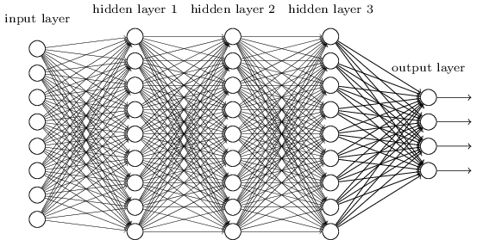
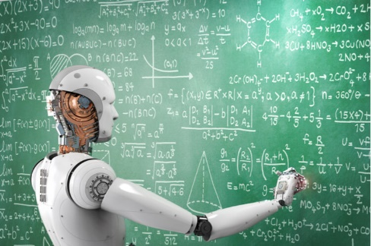
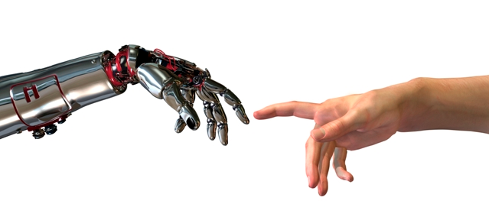


Machine
Learning
Practical
Step Size, Local Min, Momentum, Batches,
Formating Data, k-fold, Dimensions,
Convolution, Drop out
Support Vector Machine
Example
Jeff Edmonds
www.eecs.yorku.ca/~jeff/courses
Notes:
4*1.5hrs - not Example …, not unsupervised.

Slide 2
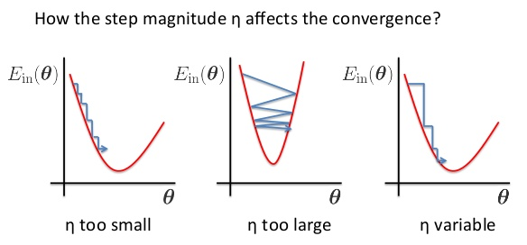
Practical Considerations
Step Size
  γ indicates how far to step each iteration.
  Too small → too much time.
  Too big → steepest direction could change too much.
  Often decreases with time.
w_{k} = w_{k} - γ × ^{δE}/_{δwk}
γ
E
E
E
w
w
w
γ
γ
γ

Slide 3
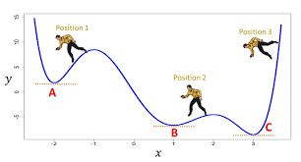
Practical Considerations
Local Minimum
  Hill climbing finds a local not a global minimum.
E
w

Slide 4
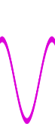
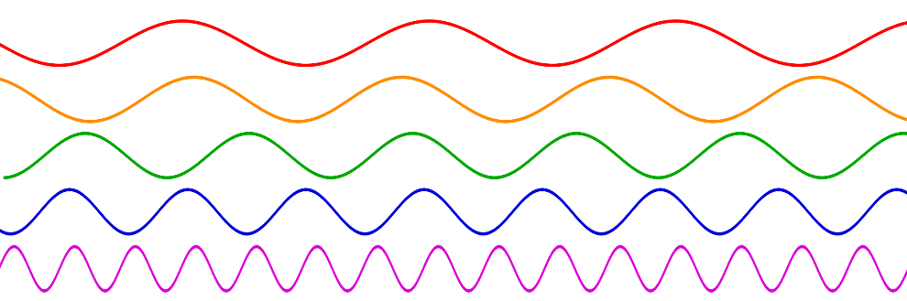
Practical Considerations
Local Minimum
  If the one good valley is hidden amongst an exponential number of bad ones
  then all hope is lost.
E
w

Slide 5

Practical Considerations
But when the data has an underling pattern, this seems to not t be the case
E
w

Slide 6
Practical Considerations
Local Minimum
  C has minimum error.
  B might be better because its wide basin
  might mean it is more robust to changes in the input.
E
w

Slide 7
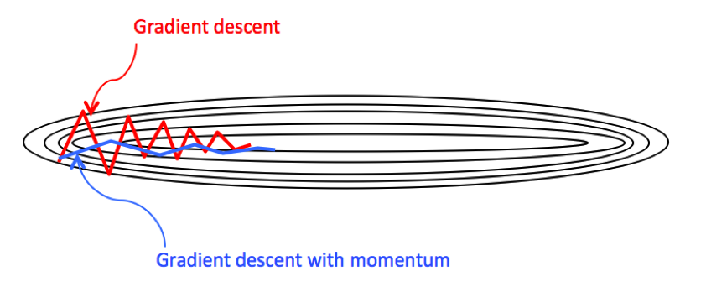
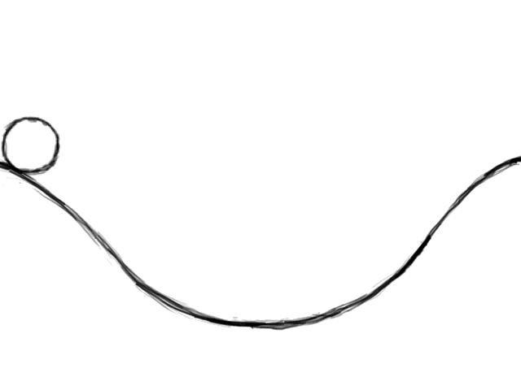
Practical Considerations
Momentum
  If there is a river bed with steep sides,
  then the steepest decent may over shoot the bottom of the bed
  and go up the opposite bank.
  Instead, let your velocity accelerate
  in the direction of steepest descent.
  Back-and-forth effects cancel.
  While building up momentum in the steady direction.

Slide 8
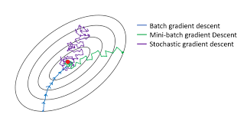
Practical Considerations
  Each step of gradient decent decides which direction to head
  by computing the gradient ∇E(⟨w₁,..,w_{m}⟩)= ⟨^{δE}/_{δw1} ,…, ^{δE}/_{δwm} ⟩
  But looking at ALL the training data requires too much time.
Training Data

Slide 9
Practical Considerations
Batches:
  Each step of gradient decent decides which direction to head
  To save computational time,
    head in a direction as indicated by not all test data
    but by a single input or a small batch of it.
    One cycle through all the data is called an Epoch
    ie here we did 2.1 epochs.
Training Data

Slide 10
Practical Considerations
Batches:
  Each step of gradient decent
    But because the step direction was decided by only a little data,
    the direction taken is not perfect.
    The smaller the batch:
    the more random the directions taken
    and the faster the computation.
Training Data

Slide 11
Practical Considerations
    the more random the directions taken
Stochastic Gradient descent
  It works fine to go in a random direction
  whose expected direction is more or less right
Training Data

Slide 12


Practical Considerations
Formatting Data
  An input x_{d} has many fields x_{⟨d,i⟩}.
  Each needs to be a real number so that it can be fed
  into the neural net.
i
d^{th} training
input
i
cat
d
dog
x_{⟨d,i⟩}
face
fish

Slide 13
Practical Considerations
Formatting Data
  Suppose your data has a field
  like price x_{⟨d,i⟩} = 3928.
  3928 and 3929 being one apart,
  the math in the neural net would be about the same
  and their meaning is about the same.
  This works fine.
i
d^{th} training
input
i
cat
d
dog
x_{⟨d,i⟩}
face
fish
3928

Slide 14
Practical Considerations
Formatting Data
  Suppose your data has a text field
  like street x_{⟨d,i⟩} = “Steels”
  It would be easy to map each such text to an integer.
  “Steels” = 3928 and “Finch” = 3929
  But here 3928 and 3929 have completely different meanings!
  It would be very hard for the neural net to learn this.
i
d^{th} training
input
i
cat
d
dog
x_{⟨d,i⟩}
face
fish
“Steels” = 3928

Slide 15
Practical Considerations
Vectorize/Categorize
  Instead, give each street name is own 0-1 field,
  indicating whether or not that is the street.
  x_{⟨d,Jane⟩} = 0, x_{⟨d,Steels⟩} = 1, x_{⟨d,Finch⟩} = 0, x_{⟨d,keel⟩} = 0
  The neural net can learn this meaning.
i
d^{th} training
input
x_{⟨d,Jane⟩} = 0
x_{⟨d,Steels⟩} = 1
x_{⟨d,Funch⟩} = 0
x_{⟨d,keel⟩} = 0
cat
d
dog
face
fish

Slide 16
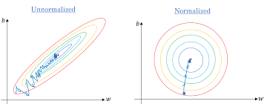
Recognize Digits I/O
Normalizing Data
  Preprocess your data to have mean zero, variance one
  by subtracting the mean and dividing by the standard deviation.
Gradient Decent: It is hard not to overstep narrow river valleys.
Y-values: Scaling up the y values, scales up the error,
which should not matter,
  except it throws off the regularization balance.

Slide 17
Generalizing from Training Data
Regularization:
${\vec{w}}_{opt}= {ArgMin}_{\vec{w}} [ E\left(\vec{w}\right)$ + λ Complexity(M$\vec{w}$) ]
Find me weights w for which:
The training data error is small
The machine is reasonably simple.
Hopefully its general input error is small.
% Errors
Trade
off
m measures complexity of Machines {$M_{\vec{w}}$}
m=100
m=1,000
m=20,000
Too much Compression
Compression
No Compression

Slide 18
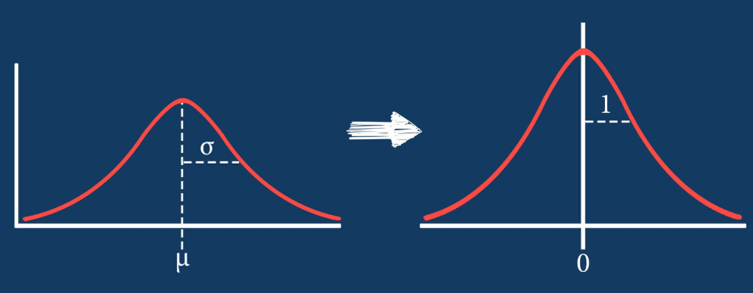
Practical Considerations
Normalizing Data
  Preprocess your data to have mean zero, variance one
  by subtracting the mean and
  dividing by the standard deviation.

Slide 19

Practical Considerations
Normalizing Data
  Preprocess your data to have mean zero, variance one.
  Eg x₁ = { 2, 3, 1, 6 }
  Mean(x₁) = Avg(x₁) = Exp(x₁) = $\overline{x_{1}}=\frac{2+3+1+6}{4}=3$
  Variance(x₁) = Exp( (deviation from mean)² )
  = $\frac{{(2−3)}^{2}+{(3−3)}^{2}+{(1−3)}^{2}+{(6−3)}^{2}}{4}$
  = $\frac{{(−1)}^{2}+{(0)}^{2}+{(−2)}^{2}+{(3)}^{2}}{4}$ = $\frac{1+0+4+9}{4}$ = $\frac{14}{4}$ = 3.5
  StandDev(x₁) = $\sqrt{Var(\text{x}\text{1})}$ = $\sqrt{3.5}$ = 1.87
  ${\tilde{x}}_{1}$ = $\frac{x_{1}−Mean}{SD}$ = $\frac{x_{1}−3}{1.87}$ = $\left\{\frac{−1}{1.87},\frac{0}{1.87},\frac{−2}{1.87},\frac{3}{1.87}\right\}$

Slide 20

Practical Considerations
Normalizing Data
  Preprocess your data to have mean zero, variance one.
  Eg ${\tilde{x}}_{1}$ == $\left\{\frac{−1}{1.87},\frac{0}{1.87},\frac{−2}{1.87},\frac{3}{1.87}\right\}$
  Mean(${\tilde{x}}_{1}$) = Avg(${\tilde{x}}_{1}$) = $\overline{x_{1}}=\frac{−1+0−2+3}{1.87\text{×}4}=0$
  Variance(x₁) = Exp( (deviation from mean)² )
  = $\frac{{(\frac{−1}{1.87}−0)}^{2}+{(\frac{0}{1.87}−0)}^{2}+{\frac{−0}{1.87}−0)}^{2}+{(\frac{3 }{1.87}−0)}^{2}}{4}$
  = $\frac{{(−1)}^{2}+{(0)}^{2}+{(−2)}^{2}+{(3)}^{2}}{4\text{×}3.5}$ = $1$
See “Reducing Dimensions”

Slide 21

Practical Considerations
Playing with the data
  The more different data instances you have,
  the better the machine learns.
  It is sometimes hard to get lots of labeled data.
  Generate more “new” instances
  by changing the data you have
    shifting
    stretching
    rotating

Slide 22
Practical Considerations
Trying Things
  In learning, there are many parameters to set
    # of levels, size of each level, batch size, # of epochs
    activation methods, error measures, ……
  You may not know how to choose between them.
  One option is to simply try all combinations.
    If p₁, p₂, and p₃ are chosen from the range {0,…,99}
    then the number of combinations to try is
  100×100×100 = million.
    i.e. lots of computation!
  You might have three types of data:
  The training data use for each setting of the parameters
  Data for validating/comparing the result from different settings.
  Test data to see how well your final machine does
  on data that it has never seen before.

Slide 23
Practical Considerations
K-fold cross-validation
  If you do not have a lot of labeled data, stretch it out.
  Results may depend on which data is chosen
  for training vs validating.
  Splitting the available data into k partitions (typically k=4 or 5).
  Instantiating k identical models
  Train on k-1 of the data parts
  and evaluate on the remaining one.
Data
Training Data
Validation Data
  These K scores
  can be averaged.

Slide 24

Smooth vs Hierarchical
Smoothness: f (x) ≈ f (x+ε)
➔ Distinguishing O(k) regions
requires O(k) training examples.
Hierarchical: The composition of features at multiple levels
➔ Distinguish 2^{O(K)} regions
with O(k) training examples.
Boys
Boy
Head
Eye

Slide 25
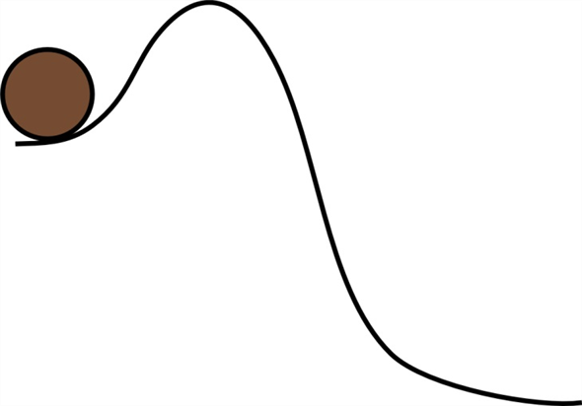
Practical Considerations
Higher Dimensions:
How can this ball get over this obstacle???
Gradient descent needs to move a minimum Error
without ever going to higher Error.
In 1-dim space,
getting around a higher Error obstacle is impossible.

Slide 26
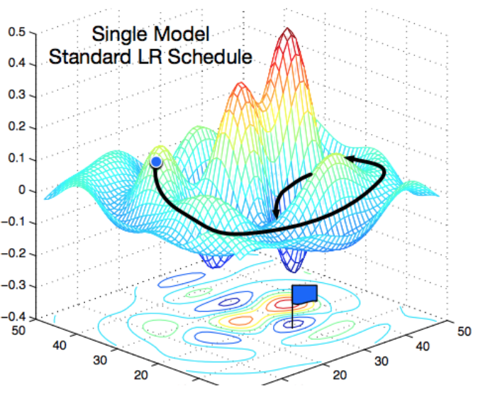
Practical Considerations
Higher Dimensions:
How can this ball get over this obstacle???
Gradient descent needs to move a minimum Error
without ever going to higher Error.
In 2-dim space,
getting around these obstacles is easier.

Slide 27
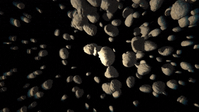
Practical Considerations
Higher Dimensions:
How can this ball get over this obstacle???
Gradient descent needs to move a minimum Error
without ever going to higher Error.
In 3-dim space,
getting around these obstacles is even easier.

Slide 28

Practical Considerations
Higher Dimensions:
Having more weights gives
a higher dimension search space.
There is some evidence that this allows
the gradient descent to move around obstacles.

Slide 29
Practical Considerations
Higher Dimensions:
Having more weights gives
a higher dimension search space.
Careful! It can also cause over fitting.
% Errors
General Inputs
D Training Inputs
Complexity of Machine
Eg number of values m describing it.

Slide 30
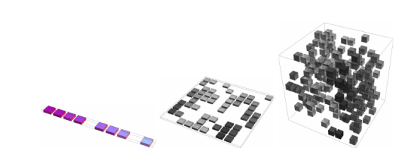
Practical Considerations
Higher Dimensions:
The Curse of Dimensionality
10^{n}

Slide 31
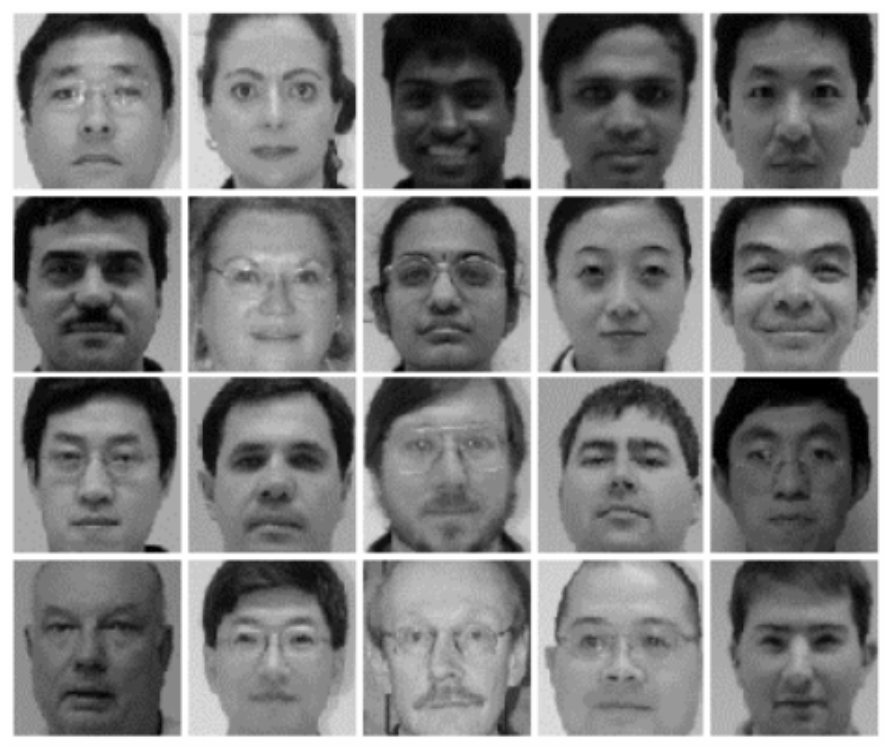
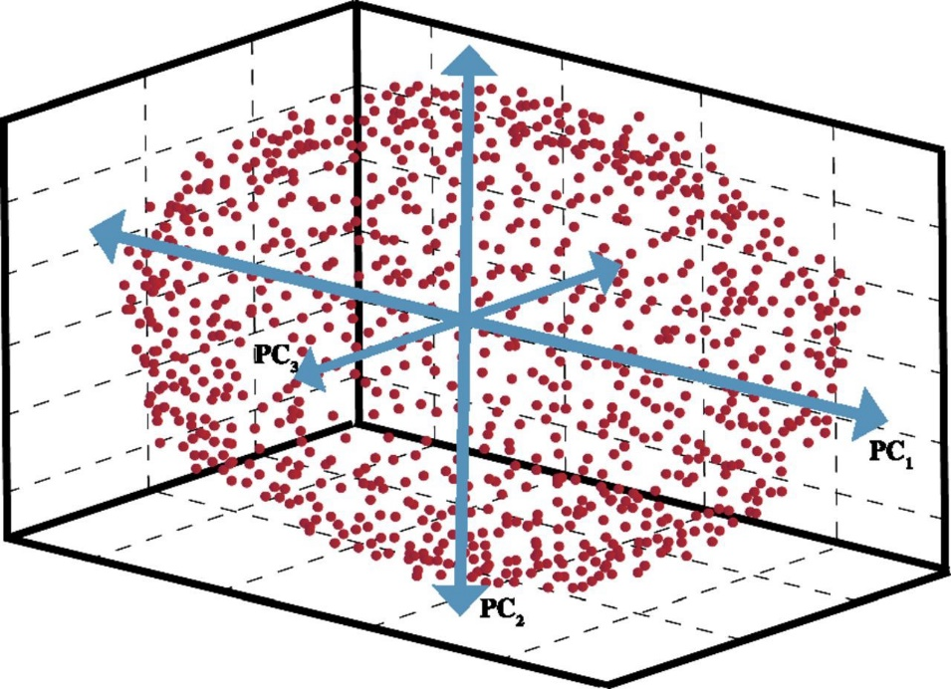
Practical Considerations
Dimension Reduction:
Let us understand the distribution
of faces better
By finding a simple a model
explaining where this data may
have come from.
Say by “fitting” the data
with a multi-dimensional ellipse.
pixel x₂
pixel x₁

Slide 32
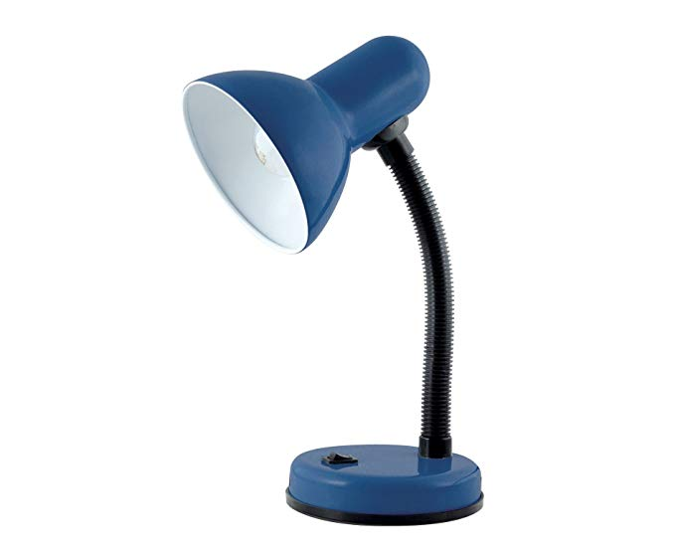
Practical Considerations
Dimension Reduction:
Delete the information in the direction of the smaller axis
by projecting against the remaining plane.
Instead of a face being defined by ⟨x₁,…,x_{10,000}⟩.
it is defined by ⟨z₁,…,z₁₀₀⟩.
i.e. We project from the 10,000 dimensional space
to a 100 dimensional subspace.
pixel x₂
z₁
pixel x₁

Slide 33
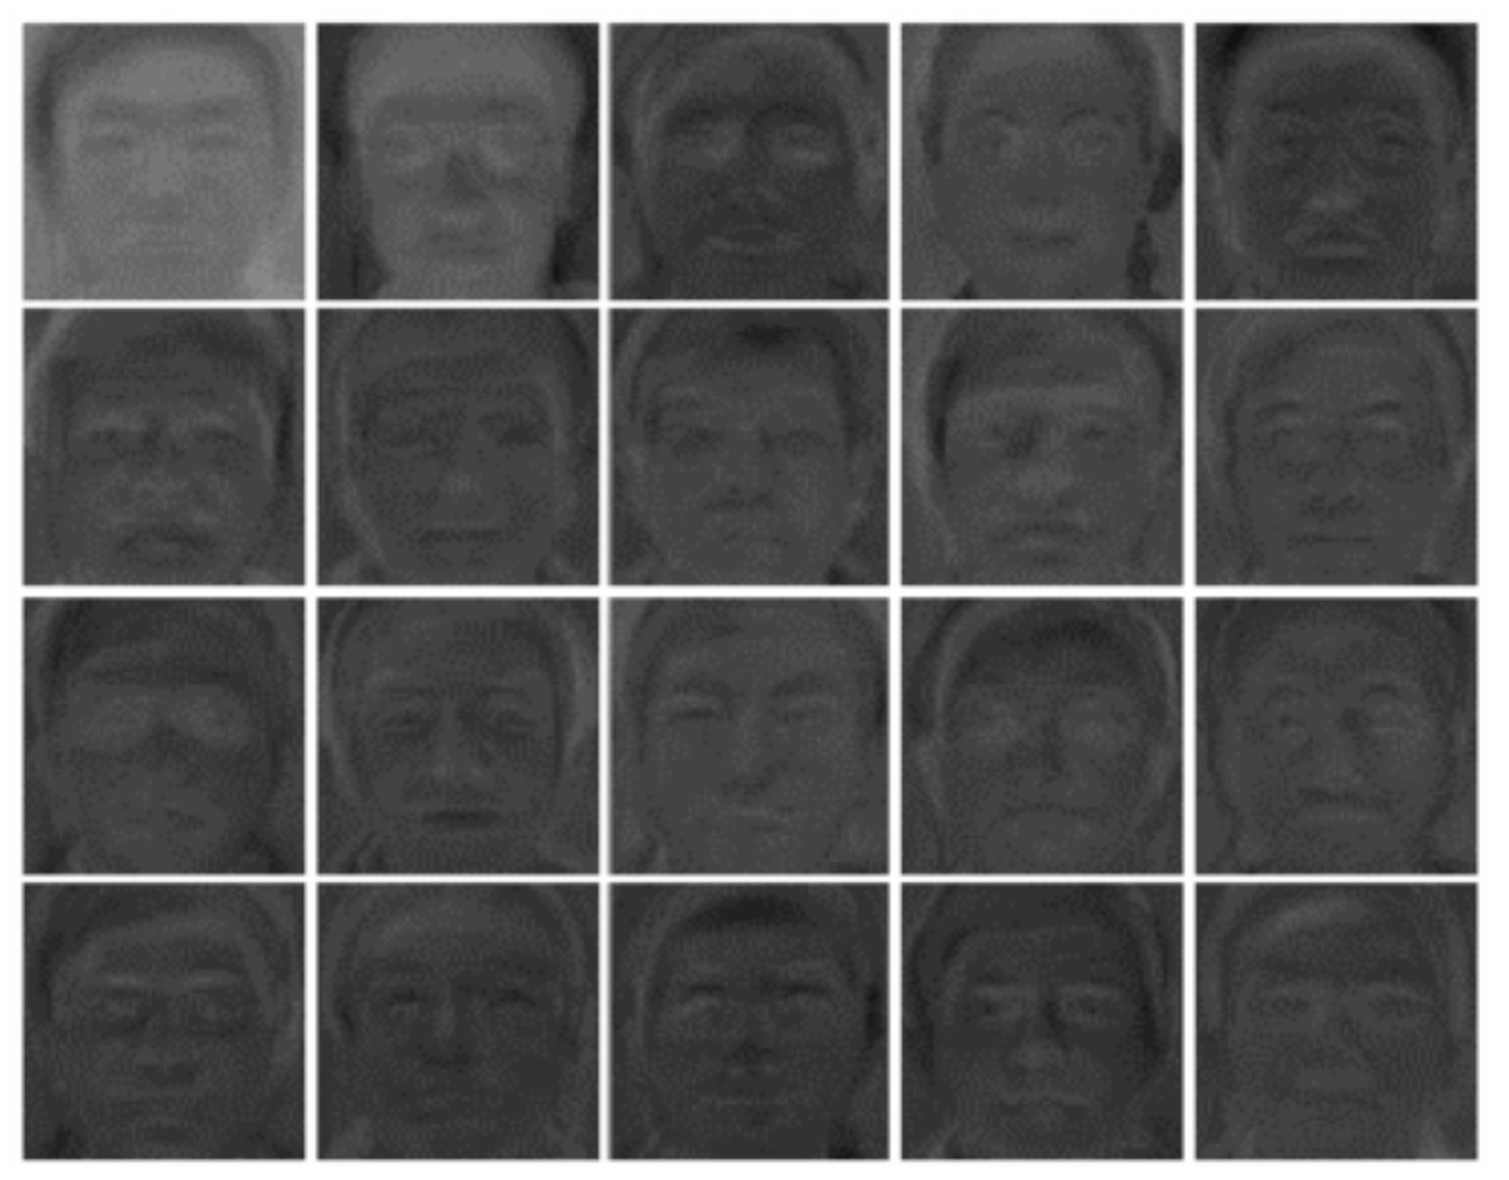
Practical Considerations
Dimension Reduction:
Described by
10,000 numbers
Described by
100 numbers
Then recognize the face using these 100 numbers

Slide 34
Practical Considerations
Non-Dense layers
A layer in the neural net is called dense
if there is a complete graph of n×m edges
between the n nodes at one layer and the m at the next.
We might want fewer weights.
  To decrease our computation time.
  To decrease the over fitting.
We could impose the constraints:
  Two edges are forced to have the same weight, ie w_{⟨i,j⟩} = w_{⟨i’,j’⟩}.
  Or some edge weight to be zero, ie w_{⟨i,j’⟩} = 0.
w_{⟨i,j⟩}
w_{⟨i,j’⟩}
w_{⟨i’,j’⟩}

Slide 35
Practical Considerations
Non-Dense layers
A layer in the neural net is called dense
if there is a complete graph of n×m edges
between the n nodes at one layer and the m at the next.
We might want fewer weights.
  To decrease our computation time.
  To decrease the over fitting.
We could impose the constraints:
  Two edges are forced to have the same weight, ie w_{⟨i,j⟩} = w_{⟨i’,j’⟩}.
  Or some edge weight to be zero, ie w_{⟨i,j’⟩} = 0.
Eg Convolution and Recurrent Nets with Space and Time Invariants.

Slide 36
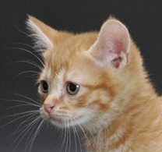
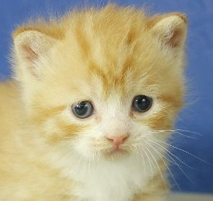

Practical Considerations
This is a cat, no mater how it is
located
sized
rotated
Eg Convolution and Recurrent Nets with Space and Time Invariants.

Slide 37
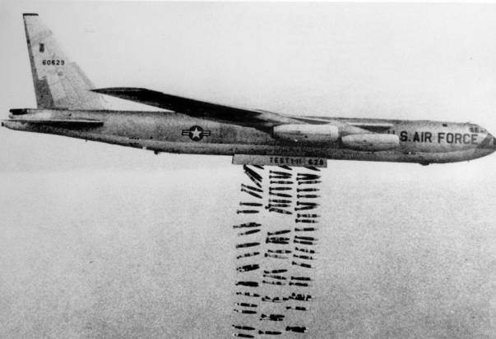

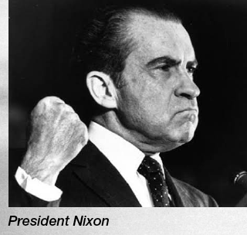
Practical Considerations
Dropout (dropping neurons):
The Americans dropped so many bombs on Vienam!
Lets hope it does not happen again.

Slide 38

Practical Considerations
Dropout (dropping neurons):
The Americans dropped so many bombs on Vienam!
Lets hope it does not happen again.

Slide 39
Practical Considerations
Dropout (dropping neurons):
Just in case, you want to build infrastructure
so that it is robust,
ie still works when you bomb it.

Slide 40

Practical Considerations
Dropout (dropping neurons):
Every step in training a neural net
try delete a random subset of the neurons.
Maybe this will make it more robust to “change”.
Maybe this will make it more robust to

Slide 41

Practical Considerations
Dropout (dropping neurons):
Every step in training a neural net
try delete a random subset of the neurons.
Maybe this will make it more robust to “change”.
Maybe this will make it more robust to
work better on never seen before instances.

Slide 42
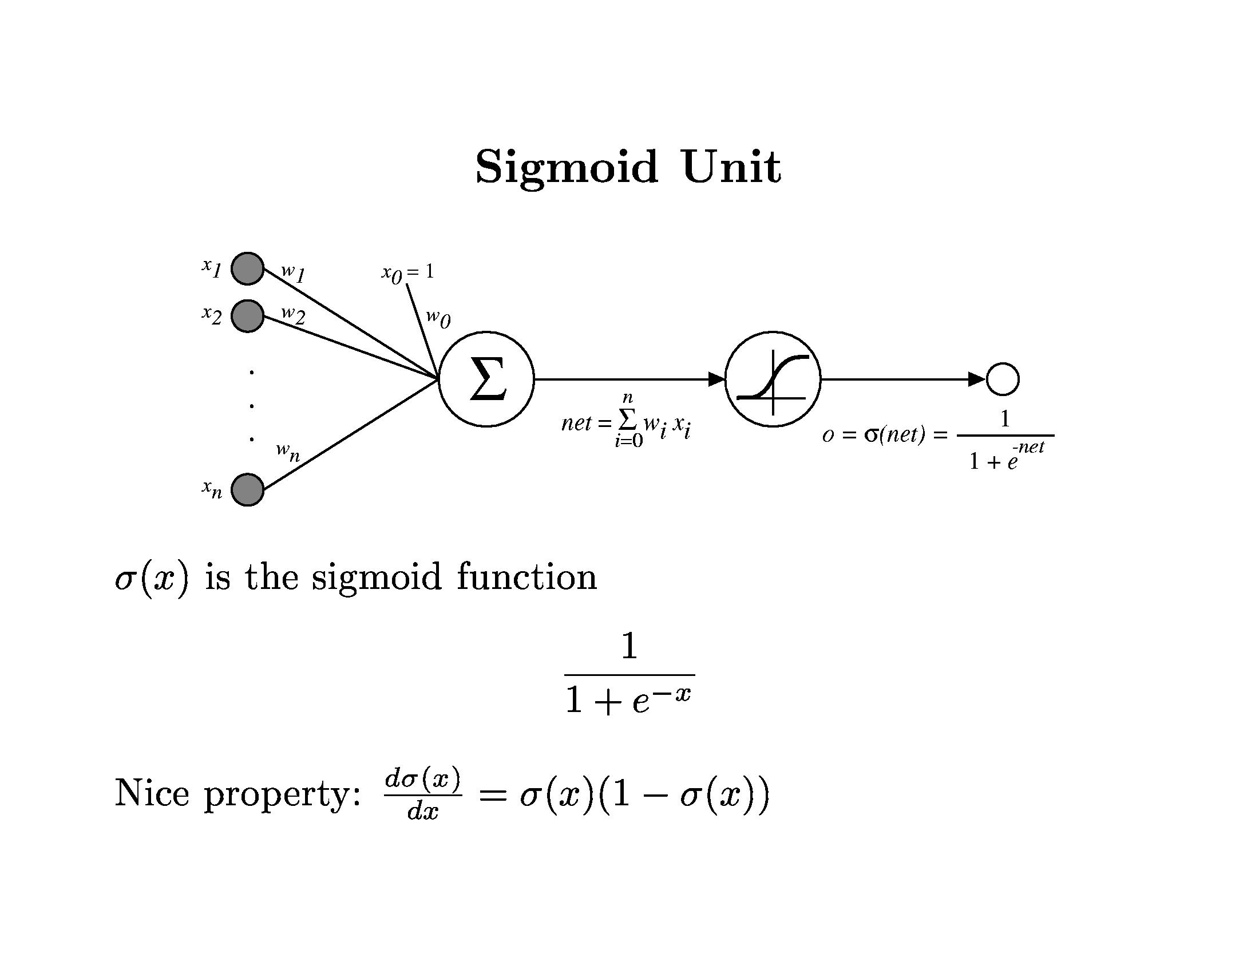
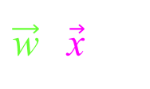
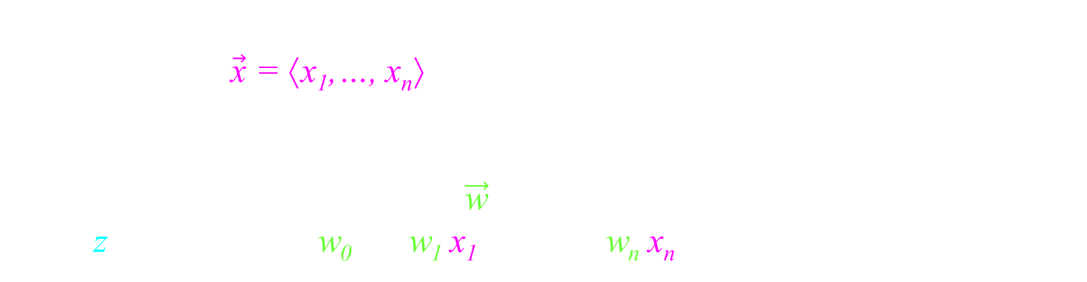



Linear Regression
x₁
w₁
x₂
w₂
w₀
$$z$$
$$y$$
w_{n}
$$z = \sum_{i=0..n}{w_{i}}x_{i}$$
x_{n}
The input $\vec{\text{x}}$ = ⟨x₁,…, x_{n}⟩
Machine define by weight $\vec{\text{w}}$.
z = = w₀ + w₁ x₁ + … + w_{n} x_{n}
$\vec{\text{w}}$‧ $\vec{\text{x}}$

Slide 43

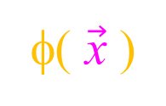
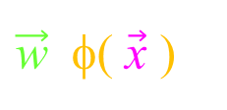




Linear Regression
x₁
x₁
w₁
…
…
x_{n}
x_{n}
w_{n}
w₀
x₁²
w_{n+1}
Preprocess input
$$z$$
x₁× x₂
w_{n_2}
$$y$$
w_{N}
$$z= \sum_{i=0..n}{w_{i}}x_{i}$$
e^{x}
$\vec{\text{x}}$
φ( $\vec{\text{x}}$ )
The input $\vec{\text{x}}$ = ⟨x₁,…, x_{n}⟩
Preprocessing can produce features φ( $\vec{\text{x}}$ ) of the input.
These are hand chosen by human.
Machine define by weight $\vec{\text{w}}$.
z = = w₀ + w₁ x₁ + … + w_{n} x_{n}
+ w_{m-2} x₁² + w_{m-1} x₁× x₂ + w_{m} e^{x}
$\vec{\text{w}}$‧φ( $\vec{\text{x}}$ )
$\vec{\text{w}}$‧ $\vec{\text{x}}$
E($\vec{w}$) = $\sum_{d=1..D}{{ ( y_{d} − M_{\vec{w}}\left({\vec{x}}_{d}\right) )}^{2}}$
There are formulas that will give you the optimal ${\vec{w}}_{opt}$.

Slide 44
Linear Regression
Linear Separator
x₁
x₁
Vector Machine
w₁
…
…
x_{n}
x_{n}
w_{n}
w₀
x₁²
w_{n+1}
Preprocess input
$$z$$
x₁× x₂
w_{n_2}
$$y$$
w_{N}
$$z= \sum_{i=0..n}{w_{i}}x_{i}$$
e^{x}
$\vec{\text{x}}$
φ( $\vec{\text{x}}$ )
The input $\vec{\text{x}}$ = ⟨x₁,…, x_{n}⟩
Preprocessing can produce features φ( $\vec{\text{x}}$ ) of the input.
These are hand chosen by human.
Machine define by weight $\vec{\text{w}}$.
z = = w₀ + w₁ x₁ + … + w_{n} x_{n}
+ w_{m-2} x₁² + w_{m-1} x₁× x₂ + w_{m} e^{x}
$\vec{\text{w}}$‧φ( $\vec{\text{x}}$ )
Answer y=Yes when z is positive.

Slide 45
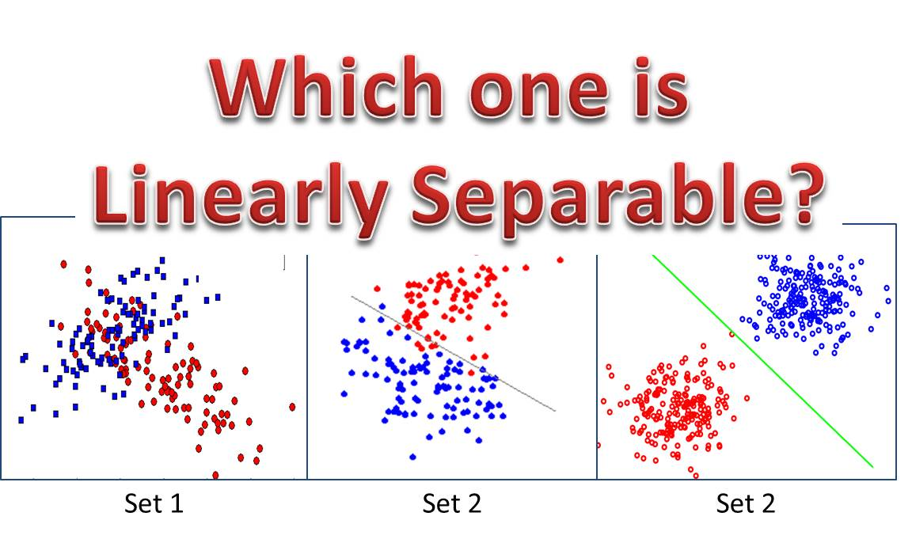
Linear Regression
Linear Separator
x₁
x₁
Vector Machine
w₁
…
…
x_{n}
x_{n}
w_{n}
w₀
x₁²
w_{n+1}
Preprocess input
$$z$$
x₁× x₂
w_{n_2}
$$y$$
w_{N}
$$z= \sum_{i=0..n}{w_{i}}x_{i}$$
e^{x}
$\vec{\text{x}}$
φ( $\vec{\text{x}}$ )
The input $\vec{\text{x}}$ = ⟨x₁,…, x_{n}⟩
Preprocessing can produce features φ( $\vec{\text{x}}$ ) of the input.
These are hand chosen by human.
Machine define by weight $\vec{\text{w}}$.
z = = w₀ + w₁ x₁ + … + w_{n} x_{n}
+ w_{m-2} x₁² + w_{m-1} x₁× x₂ + w_{m} e^{x}
$\vec{\text{w}}$‧φ( $\vec{\text{x}}$ )
Answer y=Yes when z is positive.

Slide 46
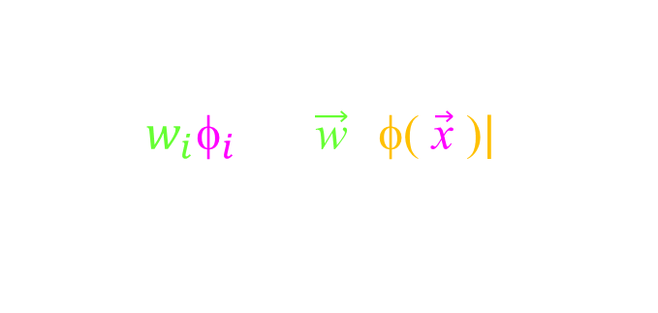
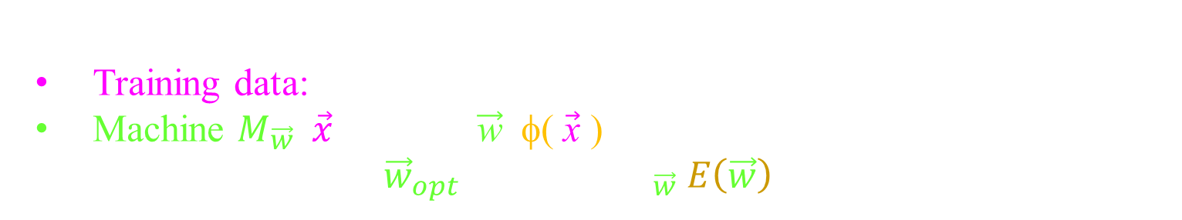

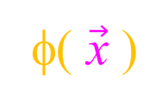
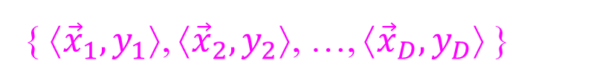
Vector Machine
Machine learning with a supervisor to help.
Training data:
Machine $M_{\vec{w}}\left(\vec{x}\right)$ = sign( $\vec{\text{w}}$‧φ( $\vec{\text{x}}$ ) )
Machine learning: ${\vec{w}}_{opt}= {ArgMin}_{\vec{w}} E\left(\vec{w}\right)$
{ ⟨${\vec{x}}_{1},y_{1}$⟩, ⟨${\vec{x}}_{2},y_{2}$⟩, …, ⟨${\vec{x}}_{D},y_{D}$⟩ }
$\vec{\text{w}}$‧φ( $\vec{\text{x}}$ ) measures the “distance” between vectors $\vec{\text{w}}$and φ( $\vec{\text{x}}$ )
$=\sum_{i}{w_{i}{\text{φ}}_{i}}=\left|\vec{\text{w}}\right||\text{φ}\text{(} \vec{\text{x}} \text{)}|cos\left(θ\right)$
$$\vec{\text{w}}$$
ɵ
φ( $\vec{\text{x}}$ )

Slide 47
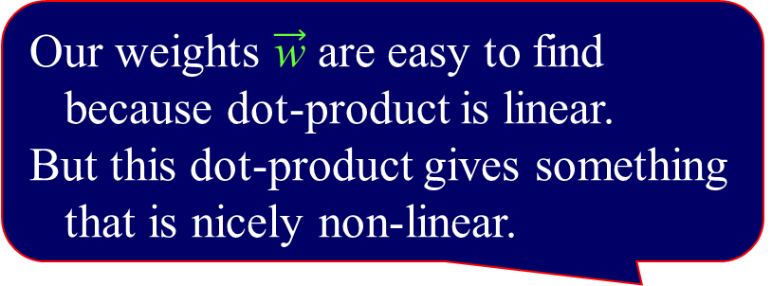
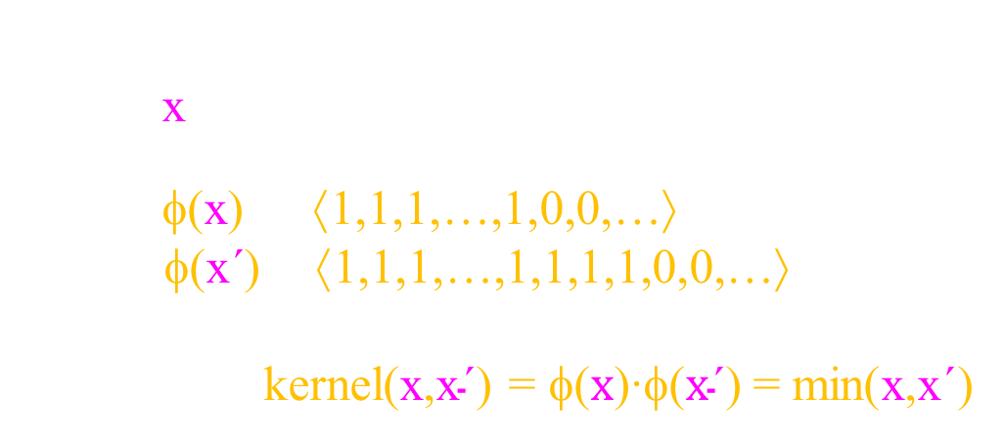

Support
Vector Machine
Machine learning with a supervisor to help.
Training data:
Machine $M_{\vec{w}}\left(\vec{x}\right)$ = sign( $\vec{\text{w}}$‧φ( $\vec{\text{x}}$ ) )
Machine learning: ${\vec{w}}_{opt}= {ArgMin}_{\vec{w}} E\left(\vec{w}\right)$
{ ⟨${\vec{x}}_{1},y_{1}$⟩, ⟨${\vec{x}}_{2},y_{2}$⟩, …, ⟨${\vec{x}}_{D},y_{D}$⟩ }
Feature vectors φ($\vec{\text{x}}$) can live in a much higher dimension
and be too complex to handle.
Define: kernel(${\vec{x}}_{d}$,${\vec{x}}_{d\text{´}}$) = φ(${\vec{x}}_{d}$)‧φ(${\vec{x}}_{d\text{´}}$)
to be the “distance” between the features of the training vectors.
Example:
Let x be an integer.
Let φ(x) = ⟨1,1,1,…,1,0,0,…⟩
φ(x´) = ⟨1,1,1,…,1,1,1,1,0,0,…⟩
Then kernel(x,x$\text{´}$) = φ($x$)‧φ($x\text{´}$) = min(x,x$\text{´}$)
Our weights $\vec{\text{w}}$ are easy to find
because dot-product is linear.
But this dot-product gives something
that is nicely non-linear.
x
x´

Slide 48

Support
Vector Machine
Machine learning with a supervisor to help.
Training data:
Machine $M_{\vec{w}}\left(\vec{x}\right)$ = sign( $\vec{\text{w}}$‧φ( $\vec{\text{x}}$ ) )
Machine learning: ${\vec{w}}_{opt}= {ArgMin}_{\vec{w}} E\left(\vec{w}\right)$
{ ⟨${\vec{x}}_{1},y_{1}$⟩, ⟨${\vec{x}}_{2},y_{2}$⟩, …, ⟨${\vec{x}}_{D},y_{D}$⟩ }
Feature vectors φ($\vec{\text{x}}$) can live in a much higher dimension
and be too complex to handle.
Define: kernel(${\vec{x}}_{d}$,${\vec{x}}_{d\text{´}}$) = φ(${\vec{x}}_{d}$)‧φ(${\vec{x}}_{d\text{´}}$)
to be the “distance” between the features of the training vectors.
For a new input $\vec{\text{x}}$, z can be expressed as z = ∑_{d} w_{d} kernel($\vec{\text{x}}$,${\vec{x}}_{d}$)
Hence, if one has an easier way to compute kernel($\vec{\text{x}}$,${\vec{x}}_{d}$)
then one never needs to actually handle the feature vector φ($\vec{\text{x}}$).
The problem is Time = O(# training data)
Often the function only depends on a few support vectors ${\vec{x}}_{i}$.
Then the time is less.

Slide 49
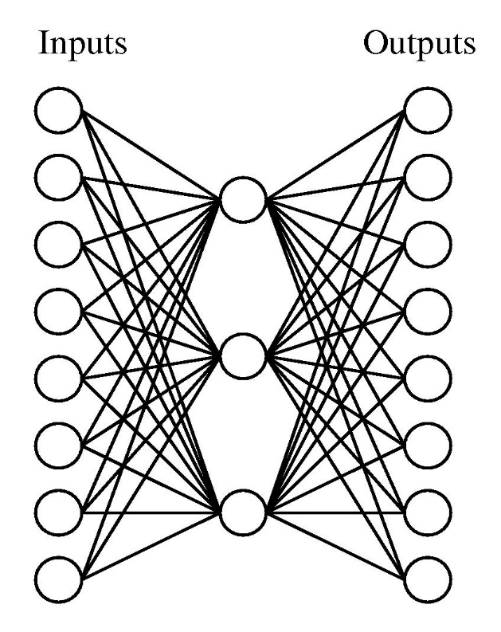

Example with Compression
Compression:
The input is 8 bits.
This gets sent to 3 hidden units.
The required output is an unchanged
copy of the input.
Imagine the input player communicating 8 bits to the hidden player who communicates 3 bits to the output player.
2⁸=256 inputs but only 2³=8 hidden messages.
Two inputs get the same hidden
message. The output will be wrong.
0
1
1
0
1
0
1
1
0
1
1
0
1
0
1
1
0
1
0
8bits
8bits
3bits
Is this possible?
No!

Slide 50
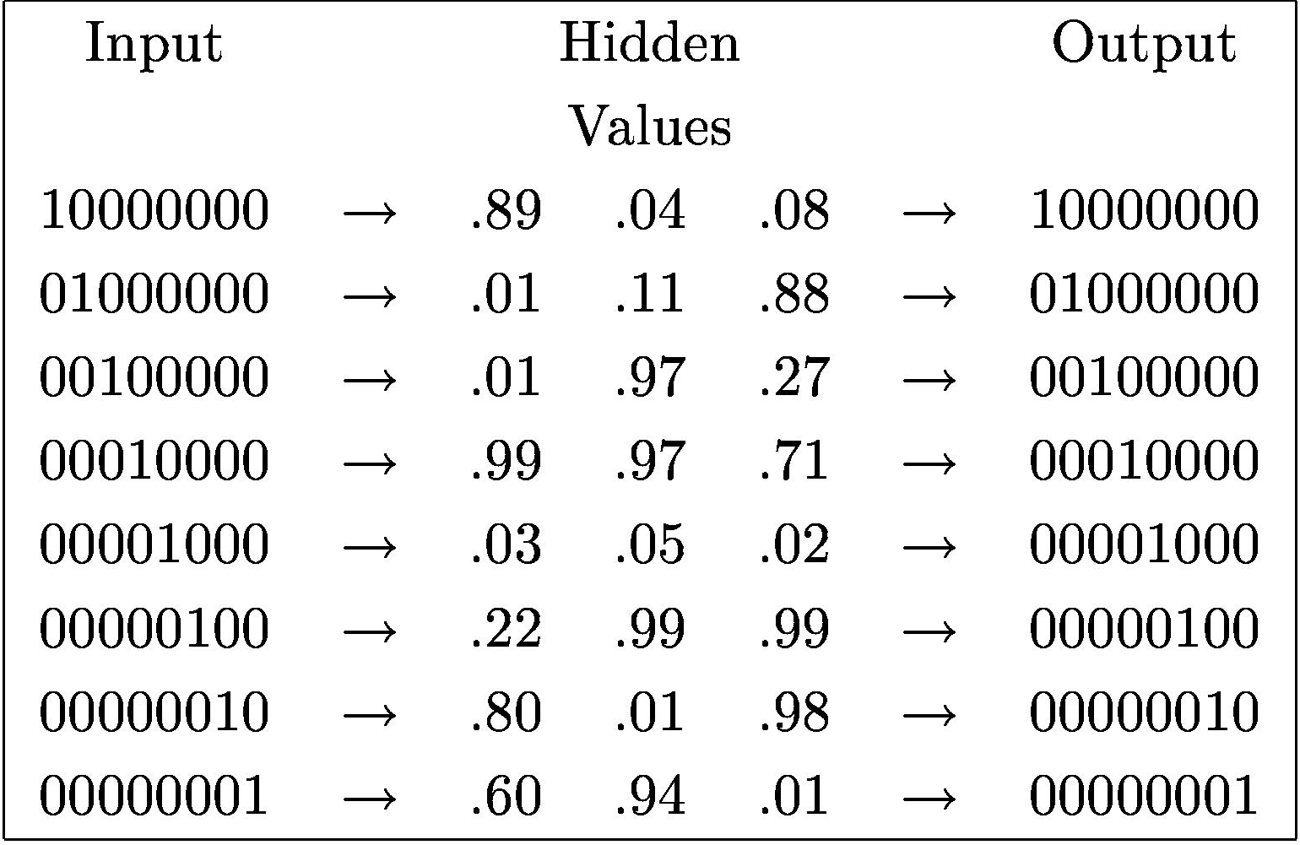
Example with Compression
0 1 2 3 4 5 6 7
0
1
2
3
4
5
6
7
0
0
0
1
0
0
0
0
0
0
0
1
0
0
0
0
0
1
2
3
4
5
6
7
0
1
0
1
1
1
Compression:
We restrict to only 8 different inputs.
For i=0,…,7, on input i only the i^{th} bit is 1.
Now can you do it?
Let’s try to design the neural network by hand.

Slide 51
Example with Compression
0 1 2 3 4 5 6 7
0
1
2
3
4
5
6
7
0
1
2
3
4
5
6
7
0
0
0
0
0
1
0
1
0
0
1
1
1
0
0
1
0
1
1
1
0
1
1
1
Compression:
How do you represent 0,…,7 with 3 bits.?
The hidden units must learn binary notation.

Slide 52
Example with Compression
0 1 2 3 4 5 6 7
0
1
2
3
4
5
6
7
0
1
2
3
4
5
6
7
0
0
0
0
0
1
0
1
0
0
1
1
1
0
0
1
0
1
1
1
0
1
1
1
Compression:
Because the hidden units have fewer bits than the inputs,
they must do some compression of information,
and must somehow capture meaning/pattern of data.

Slide 53

Example with Compression
0 1 2 3 4 5 6 7
0
1
2
3
4
5
6
7
0
1
2
3
4
5
6
7
0
0
0
1
0
0
1
0
1
0
1
0
0
1
1
1
0
0
1
1
0
1
1
1
0
1
1
1
First hidden unit:
1 if input is 4, 5, 6, or 7.
0 else
y =

Slide 54

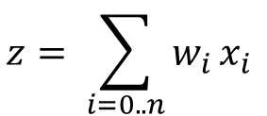


Example with Compression
0
-1
$$z$$
$$y$$
2
0 1 2 3 4 5 6 7
0 1 2 3 4 5 6 7
$$z= \sum_{i=0..n}{w_{i}}x_{i}$$
0
1
2
3
4
5
6
7
0
1
2
3
4
5
6
7
0
0
0
y $=φ\left(z\right)= \frac{1}{1+e^{−z}}$
0
1
0
0
1
0
1
0
0
1
1
2
1
0
0
1
1
0
1
1
1
0
1
1
1
First hidden unit:
z = 0 x₀ + 0 x₁ + 0 x₂ + 0 x₃ + 2 x₄ + 2 x₅ + 2 x₆ + 2 x₇ – 1
1 = 0×0 + 0×0 + 0×0 + 0×0 + 2×0 + 2×0 + 2×1 + 2×0 – 1
1 if
0 else
1 if input is 4, 5, 6, or 7.
-1 else
y =
z =

Slide 55
Example with Compression
0
-1
$$z$$
$$y$$
2
$$z= \sum_{i=0..n}{w_{i}}x_{i}$$
0
1
2
3
4
5
6
7
0
1
2
3
4
5
6
7
0
0
0
y $=φ\left(z\right)= \frac{1}{1+e^{−z}}$
0
0
0
0
1
0
1
0
1
0
1
1
2
1
0
0
1
0
1
1
1
0
1
1
1
First hidden unit:
z = 0 x₀ + 0 x₁ + 0 x₂ + 0 x₃ + 2 x₄ + 2 x₅ + 2 x₆ + 2 x₇ – 1
-1= 0×0 + 0×0 + 0×0 + 0×1 + 2×0 + 2×0 + 2×0 + 2×0 – 1
1 if
0 else
1 if input is 4, 5, 6, or 7.
-1 else
y =
z =

Slide 56
Example with Compression
0 1 2 3 4 5 6 7
0
1
2
3
4
5
6
7
0
1
2
3
4
5
6
7
0
0
0
1
0
0
1
1
0
1
0
1
0
1
1
0
1
0
0
0
1
1
0
1
0
0
1
1
0
Output 6:
1
1
1
1 if is 1 1 0
0 else
y =

Slide 57

Example with Compression
-3
2
w₂
x₂
2
$$z$$
$$y$$
0 1 2 3 4 5 6 7
w₃
-2
$$z= \sum_{i=0..n}{w_{i}}x_{i}$$
0
1
2
3
4
5
6
7
0
1
2
3
4
5
6
7
0
0
0
y $=φ\left(z\right)= \frac{1}{1+e^{−z}}$
1
0
0
1
0
1
0
1
2
0
1
1
2
1
0
0
0
-2
1
1
0
1
1
1
0
1
1
1
Output 6:
z = 2 x₁ + 2 x₂ - 2 x₃ – 3
1 = 2×1 + 2×1 - 2×0 – 3
1 if
0 else
1 if is 1 1 0
neg else
y =
z =

Slide 58
Example with Compression
-3
2
w₂
x₂
2
$$z$$
$$y$$
w₃
-2
$$z= \sum_{i=0..n}{w_{i}}x_{i}$$
0
1
2
3
4
5
6
7
0
1
2
3
4
5
6
7
0
0
0
y $=φ\left(z\right)= \frac{1}{1+e^{−z}}$
1
0
0
1
0
1
0
0
2
0
1
1
2
1
0
0
0
-2
0
1
0
1
1
1
0
1
1
1
Output 6:
z = 2 x₁ + 2 x₂ - 2 x₃ – 3
-1 = 2×1 + 2×0 - 2×0 – 3
1 if
0 else
1 if is 1 1 0
neg else
y =
z =

Slide 59
Example with Compression
0 1 2 3 4 5 6 7
0
1
2
3
4
5
6
7
0
1
2
3
4
5
6
7
0
0
0
0
0
1
0
1
0
0
1
1
1
0
0
1
0
1
1
1
0
1
1
1
Machine Learning:
Hand coding the weights would be a LOT of work.

Slide 60
Example with Compression
0 1 2 3 4 5 6 7
0
1
2
3
4
5
6
7
0
1
2
3
4
5
6
7
Machine Learning:
Hand coding the weights would be a LOT of work.
Machine Learning learns them automatically.

Slide 61
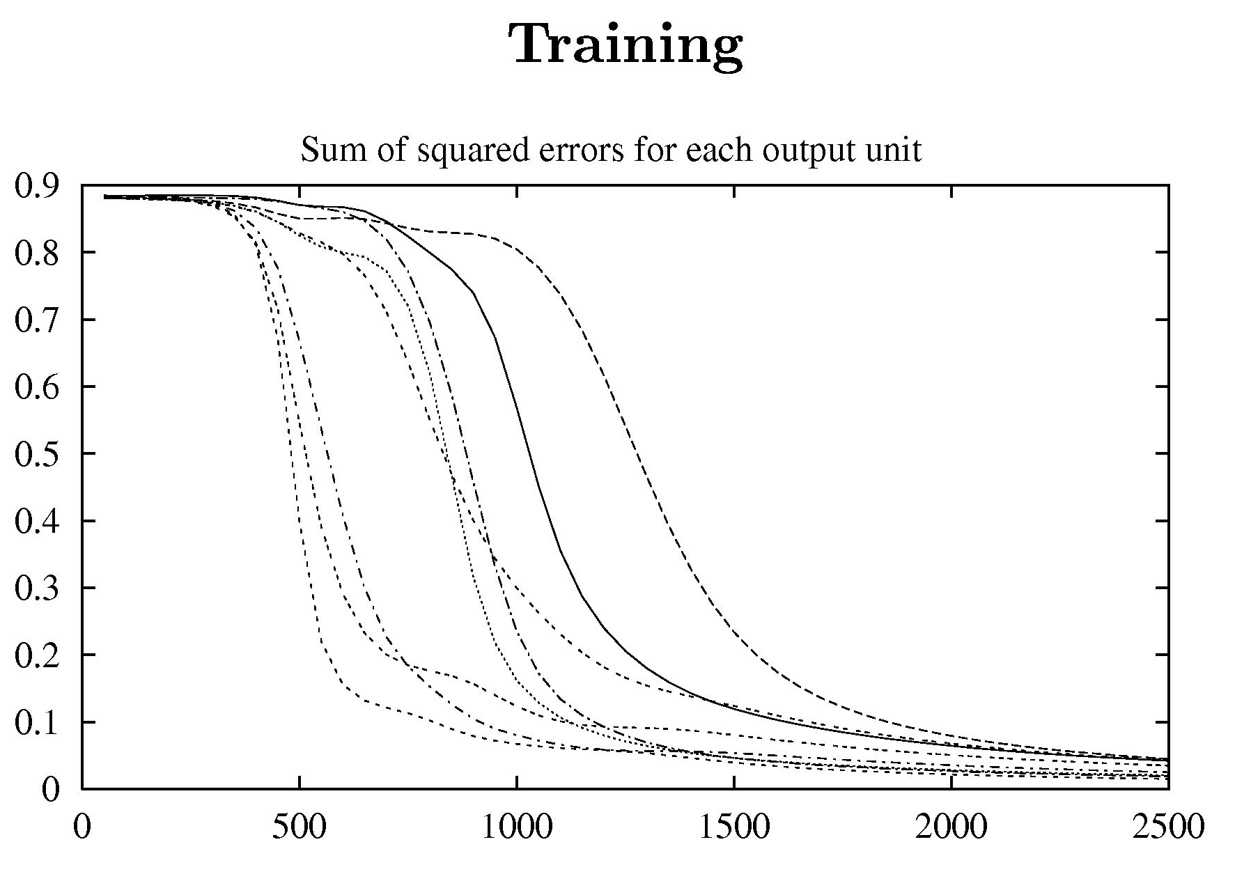
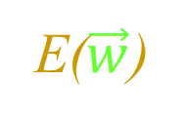
Example with Compression
E($\vec{w}$)
0
1
2
3
4
5
6
7
0
0
0
1
0
0
0
0
Iterations of gradient descent.

Slide 62
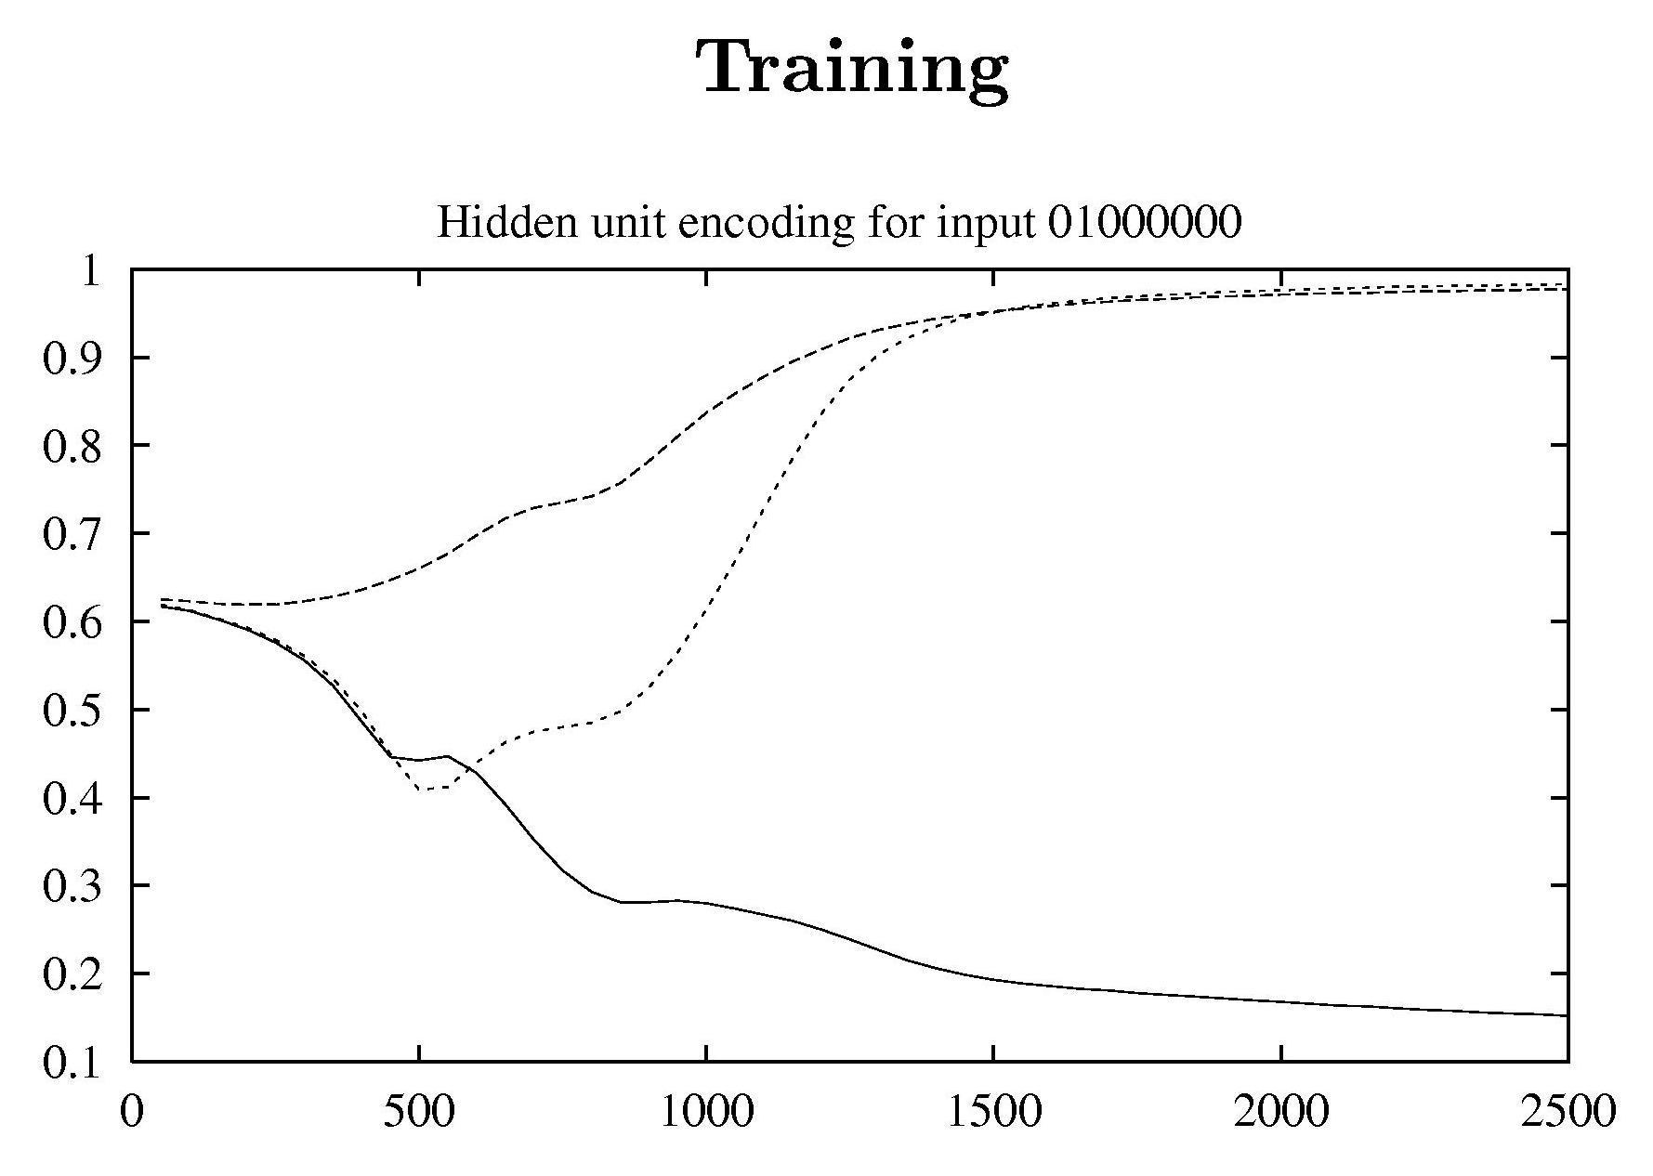
Example with Compression
0
1
2
3
4
5
6
7
1
1
0
Iterations of gradient descent.

Slide 63

End
Thanks
for coming
Do you have any questions?
Please give me feedback
so that I can better serve you.
Notes:
63

Slide 64

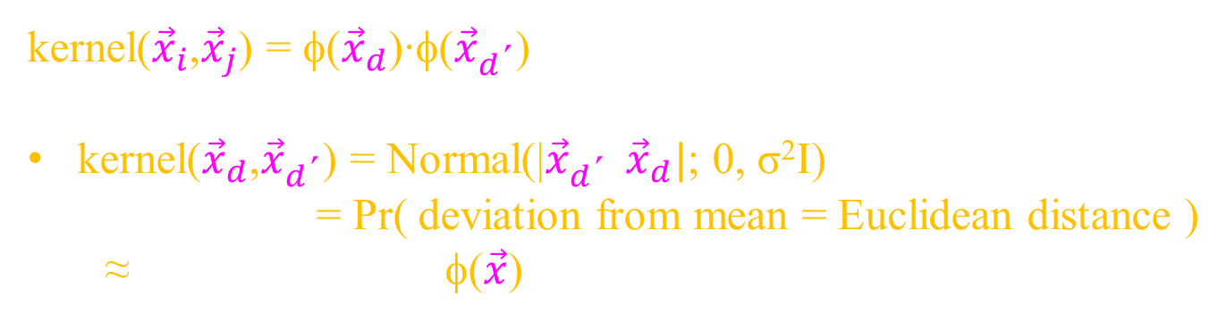



Support
Vector Machine
kernel(${\vec{x}}_{i}$,${\vec{x}}_{j}$) = φ(${\vec{x}}_{d}$)‧φ(${\vec{x}}_{d\text{´}}$)
Example:
kernel(${\vec{x}}_{d}$,${\vec{x}}_{d\text{´}}$) = Normal(|${\vec{x}}_{d\text{´}} {\vec{x}}_{d}|$; 0, σ²I)
= Pr( deviation from mean = Euclidean distance )
≈ to some features φ($\vec{x}$)
$$−$$
1-dim:
Let x be an integer.
Let φ(x$\text{´}$) = ⟨ ⟩
φ(x$\text{´}$´) = ⟨ ⟩
kernel(x$\text{´}$,x$\text{´}\text{´}$) = φ($x\text{´}$)‧φ($x\text{´´}$) = $\int_{x}{f_{x\text{´}}\left(x\right) }×f_{x\text{´´}}\left(x\right)$ =
×
x´
x´
×
x
x$\text{´}$´
x
large
small
=
0 |$x\text{´´}$-x´|
Proof by Fourie Transforms.

