Slide 1
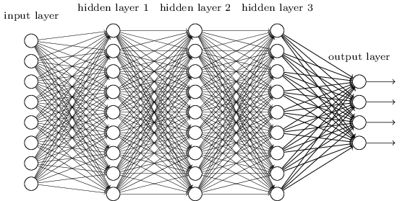
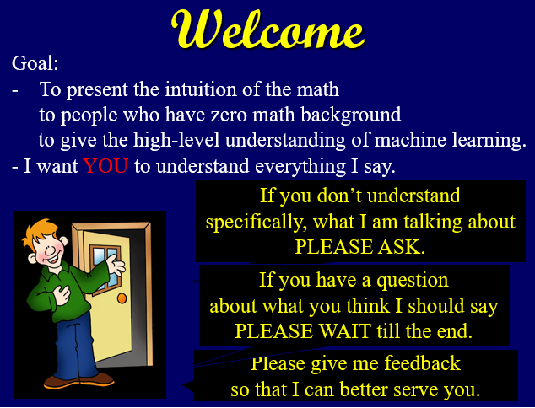
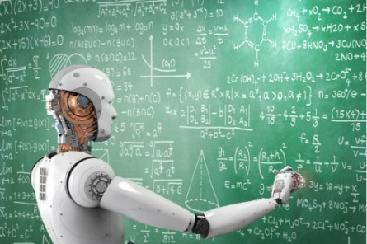
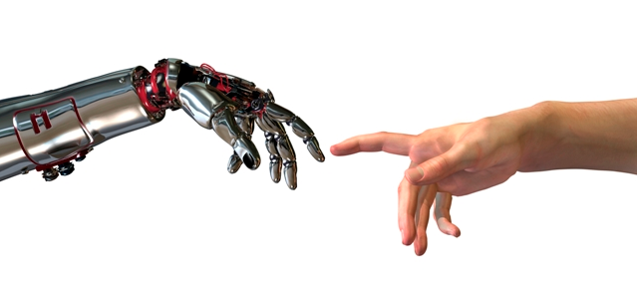




Machine Learning
Algebra
How does one best think about all of these numbers.
Dot Product
Linear Separator
Neural Networks
Training Data as Points
Matrix Multiplication
Abstract Representations
Gradient Decent
Vector Algebra and Contour Lines
Steepest Direction
Back Propagation
“Prob” of face and Error
Sigmoid
Jeff Edmonds, Comp. Sci.
www.eecs.yorku.ca/~jeff/courses/machine-learning
Notes:
4*1.5hrs - not Example …, not unsupervised.

Slide 2
Algebra Review
Algebra Review : How does one best think about all of these numbers.
An input data item, eg a image of a cat, is just a large tuple of real
values. As such it can be thought as a point in some high dimensional
vector space. Whether the image is of a cat or a dog partitions this
vector space into regions. Classifying your image amounts to knowing
which region the corresponding point is in.
The dot product of two vectors tell us: whether our data scaled by
coefficients meets a threshold; how much two lists of properties
correlate; the cosine of the angle between to directions; and which
side of a hyperplane your points is on.

Slide 3
Algebra Review
A novice reading a machine learning paper might not get that many of
the symbols are not real numbers but are matrices. Hence the product
of two such symbols is matrix multiplication. Computing the output of
your current neural network on each of your training data items
amounts to an alternation of such a matrix multiplications and of some
non-linear rounding of your numbers to be closer to being 0-1 valued.
Similarly, back propagation computes the direction of steepest decent
using a similar alternation, except backwards.
The matrix way of thinking about a neural network also helps us
understand how a neural network effectively performs a sequence linear
and non-linear transformations changing the representation of our
input until the representation is one for which the answer can be
determined based which side of a hyperplane your point is on.
Though people say that it is "obvious", it was never clear to me which
direction to head to get the steepest decent.

Slide 4
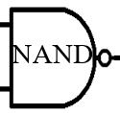
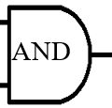


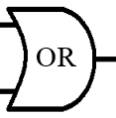
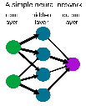
Computing
Let's compute the Boolean function
f(x₁, …, x_{n})
ie x_{i}∈{0,1}
compute
with
Neural Networks can do the same.

Slide 5
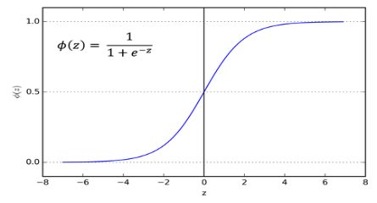

Computing
Let's compute the Boolean function
f(x₁, …, x_{n})
ie x_{i}∈{0,1}
AND
Or
Not
x₂
z>0
z<0
x₂
z>0
z>0
z<0
z<0
x₁
x₁
x₁
z = -3 + 2 x₁ + 2 x₂
z = -1 + 2 x₁ + 2 x₂
z = 1 + -2 x₁
or
y = Sigmoid(z)

Slide 6
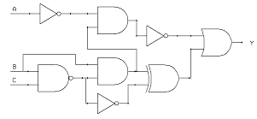
Computing
Let's compute the Boolean function
f(x₁, …, x_{n})
ie x_{i}∈{0,1}
Counting: Most f require 2^{n} gates.
This is the "curse of dimensionality".
Hastad: The parity of n Boolean variables
can be computed with a O(n) sized binary tree of depth log(n)
but requires 2^{Ω(n)} gates when the depth is less.

Slide 7
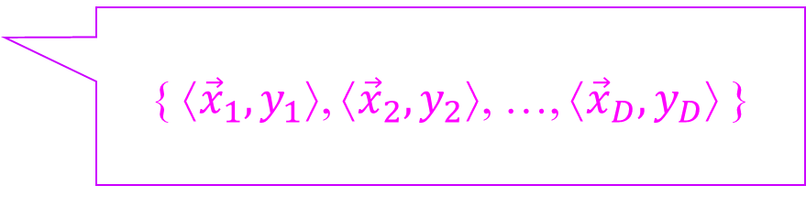
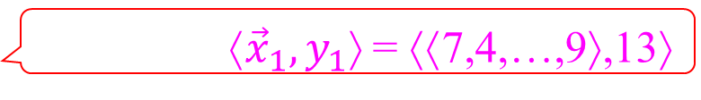
Computing
Given training data
{ ⟨${\vec{x}}_{1},y_{1}$⟩, ⟨${\vec{x}}_{2},y_{2}$⟩, …, ⟨${\vec{x}}_{D},y_{D}$⟩ }
Let's compute by table look-up.
Start with ⟨${\vec{x}}_{1},y_{1}$⟩ = ⟨⟨7,4,…,9⟩,13⟩
1
-7
Positive if x₁>7
x₁
1
One if x₁>7
y = Sigmoid(z)

Slide 8
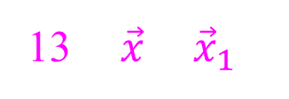
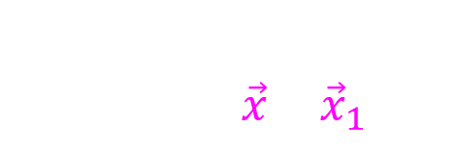

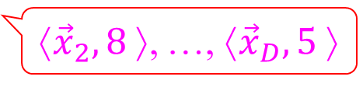
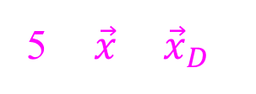
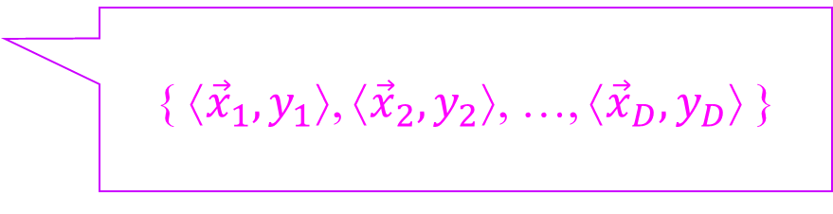
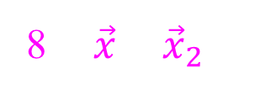
Computing
Given training data
{ ⟨${\vec{x}}_{1},y_{1}$⟩, ⟨${\vec{x}}_{2},y_{2}$⟩, …, ⟨${\vec{x}}_{D},y_{D}$⟩ }
Let's compute.
Start with ⟨${\vec{x}}_{1},y_{1}$⟩ = ⟨⟨7,4,…,9⟩,13⟩
1
-7
⟨${\vec{x}}_{2},8$⟩, …, ⟨${\vec{x}}_{D},5$⟩
x₁
One if x₁>7
1
Depth =
Size = (# training data) (dim of x)
k
1
7
2
x₁
One if x₁<7
+
-1
1
/k
-2n
1
1
Positive if all true
if $\vec{x}$ = ${\vec{x}}_{1}$
…
1
One if $\vec{x}$ = ${\vec{x}}_{1}$
1
13
13 if $\vec{x}$ = ${\vec{x}}_{1}$
1
-9
0 else.
x_{n}
One if x_{n}>9
1
8
8 if $\vec{x}$ = ${\vec{x}}_{2}$
1
9
…
x_{n}
One if x_{n}<9
-1
5
5 if $\vec{x}$ = ${\vec{x}}_{D}$

Slide 9
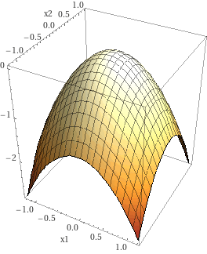
Computing
ε-approximating a real function
f(x₁, …, x_{n}) where |x_{i}|≤L and f'≤L

Slide 10

Computing
ε-approximating a real function
f(x₁, …, x_{n}) where |x_{i}|≤L and f'≤L
with size O(^{nL}/_{ε})^{n}
Evaluate f on the points of the ^{ε}/_{nL} grid.
^{ε}/_{nL}

Slide 11
Computing
ε-approximating a real function
f(x₁, …, x_{n}) where |x_{i}|≤L and f'≤L
with size O(^{nL}/_{ε})^{n}
Evaluate f on the points of the ^{ε}/_{nL} grid.
Because f'≤L,
if you move ^{ε}/_{nL}
in n dimensions
f does not change by more that ε.
^{ε}
Build a neural net
of size O(^{nL}/_{ε})^{n}
on these grid
O(^{nL}/_{ε})^{n} points.

Slide 12
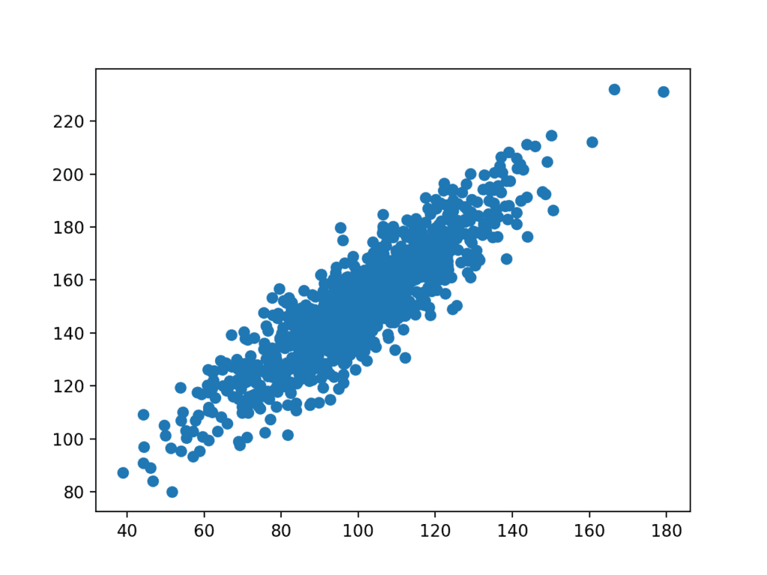
Dot Product
Machine Learning is all about finding
complex correlations.
Let's start there.

Slide 13
Dot Product
I am going to start a dating service.
For each client I will collect properties.
For each pair, we measure how compatible they are.
 | Likes animals | Extrovert | Partier | Likes movies | Likes nature | Likes music
 | -10 | -20 | -20 | 15 | 3 | -9
 | -9 | 30 | 20 | 20 | 2 | 30
 | -8 | -10 | -15 | 10 | 30 | -10
vs
15×20
= 300
They both like movies a lot.
This adds to their compatibility:
15×20 = 300

Slide 14
Dot Product
I am going to start a dating service.
For each client I will collect properties.
For each pair, we measure how compatible they are.
 | Likes animals | Extrovert | Partier | Likes movies | Likes nature | Likes music
 | -10 | -20 | -20 | 15 | 3 | -9
 | -9 | 30 | 20 | 20 | 2 | 30
 | -8 | -10 | -15 | 10 | 30 | -10
3×2
= 6
vs
15×20
= 300
They are both neutral on nature.
This adds to their compatibility:
3×2 = 6

Slide 15
Dot Product
I am going to start a dating service.
For each client I will collect properties.
For each pair, we measure how compatible they are.
 | Likes animals | Extrovert | Partier | Likes movies | Likes nature | Likes music
 | -10 | -20 | -20 | 15 | 3 | -9
 | -9 | 30 | 20 | 20 | 2 | 30
 | -8 | -10 | -15 | 10 | 30 | -10
3×2
= 6
vs
(-20)×30
= -600
15×20
= 300
They differ on being extroverted.
This adds to their compatibility:
(-20)×30 = -600

Slide 16
Dot Product
I am going to start a dating service.
For each client I will collect properties.
For each pair, we measure how compatible they are.
 | Likes animals | Extrovert | Partier | Likes movies | Likes nature | Likes music
 | -10 | -20 | -20 | 15 | 3 | -9
 | -9 | 30 | 20 | 20 | 2 | 30
 | -8 | -10 | -15 | 10 | 30 | -10
3×2
= 6
vs
(-10)×(-9)
= +90
(-20)×30
= -600
15×20
= 300
They both dislike animals a lot.
This adds to their compatibility:
(-10)×(-9) = +90

Slide 17
Dot Product
I am going to start a dating service.
For each client I will collect properties.
For each pair, we measure how compatible they are.
 | Likes animals | Extrovert | Partier | Likes movies | Likes nature | Likes music
 | -10 | -20 | -20 | 15 | 3 | -9
 | -9 | 30 | 20 | 20 | 2 | 30
 | -8 | -10 | -15 | 10 | 30 | -10
3×2
= 6
vs
(-10)×(-9)
= +90
(-20)×30
= -600
(-20)×20
= -400
15×20
= 300
(-9)×30
= -270
Total compatibility:
= -874
Total: -874

Slide 18
Dot Product
I am going to start a dating service.
For each client I will collect properties.
For each pair, we measure how compatible they are.
 | Likes animals | Extrovert | Partier | Likes movies | Likes nature | Likes music
 | -10 | -20 | -20 | 15 | 3 | -9
 | -9 | 30 | 20 | 20 | 2 | 30
 | -8 | -10 | -15 | 10 | 30 | -10
3×2
= 6
vs
(-10)×(-9)
= +90
(-20)×30
= -600
(-20)×20
= -400
15×20
= 300
(-9)×30
= -270
Total: -874
3×30
= 90
vs
(-10)×(-8)
= 80
(-20)×(-10)
= 200
(-20)×(-15)
= 300
15×10
= 150
(-9)×(-10)
= 90
Much more compatible.
Total: 910

Slide 19
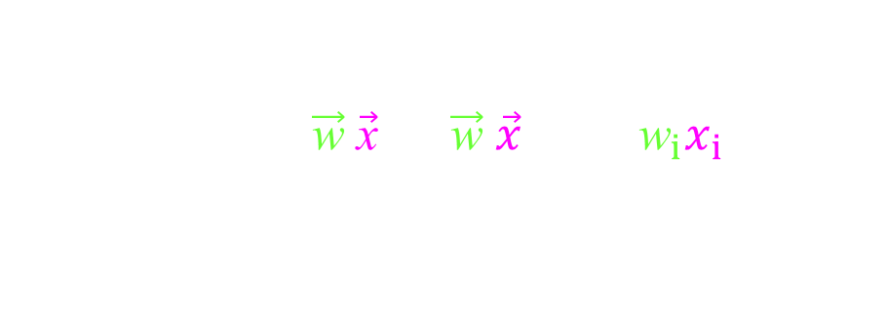


Dot Product
Think of each client's values as a vector
in a high dimensional space.
 | Likes animals | Extrovert | Partier | Likes movies | Likes nature | Likes music
 | -10 | -20 | -20 | 15 | 3 | -9
 | -9 | 30 | 20 | 20 | 2 | 30
 | -8 | -10 | -15 | 10 | 30 | -10
$$\vec{\text{w}}$$
$$\vec{\text{x}}$$
3×30
= 90
vs
(-10)×(-8)
= 80
(-20)×(-10)
= 200
(-20)×(-15)
= 300
15×10
= 150
(-9)×(-10)
= 90
Compatibility($\vec{\text{w}}$,$\vec{\text{x}}$) = $\vec{\text{w}}$‧$\vec{x}$ $=\sum_{i}{{\text{w}}_{i}x_{i}}$ = 910
Total: 910

Slide 20

Dot Product
Think of each client's values as a vector
in a high dimensional space.
C² = A² + B² – 2AB $cos\left(θ\right)$
B
ɵ
A
3×30
= 90
vs
(-10)×(-8)
= 80
(-20)×(-10)
= 200
(-20)×(-15)
= 300
15×10
= 150
(-9)×(-10)
= 90
Compatibility($\vec{\text{w}}$,$\vec{\text{x}}$) = $\vec{\text{w}}$‧$\vec{x}$ $=\sum_{i}{{\text{w}}_{i}x_{i}}$ = 910
Total: 910

Slide 21
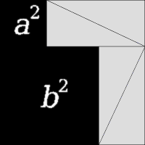
Dot Product
Think of each client's values as a vector
in a high dimensional space.
C² =
$$\left|\vec{\text{w}}\right|2+\left|\vec{x}\right|2−2 \left|\vec{\text{w}}\right|\left|\vec{x}\right| cos\left(θ\right)$$
$$\vec{\text{x}}$$
4 (½ ab) + c² =
(a+b)²
= a² + 2ab + b²
ɵ
$$\vec{\text{w}}$$
rearrange
“correlation” =
$\vec{\text{w}}$‧$\vec{x}=\sum_{i}{{\text{w}}_{i}x_{i}}=\left|\vec{\text{w}}\right|\left|\vec{x}\right| cos\left(θ\right)$
3×30
= 90
vs
(-10)×(-8)
= 80
(-20)×(-10)
= 200
(-20)×(-15)
= 300
15×10
= 150
(-9)×(-10)
= 90
Compatibility($\vec{\text{w}}$,$\vec{\text{x}}$) = $\vec{\text{w}}$‧$\vec{x}$ $=\sum_{i}{{\text{w}}_{i}x_{i}}$ = 910
Total: 910

Slide 22
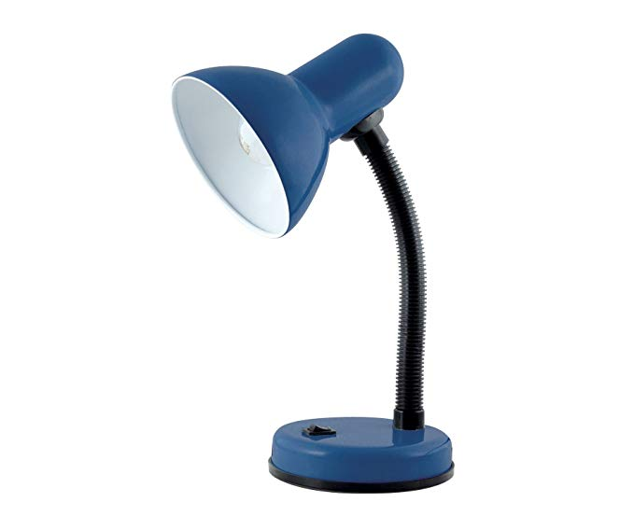
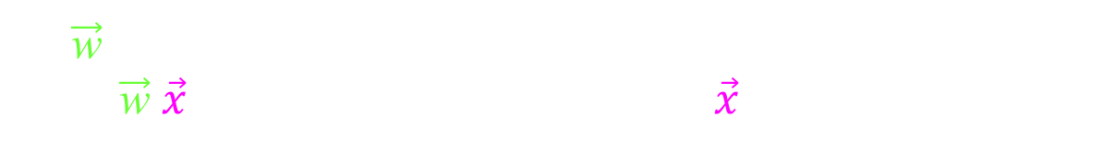
Dot Product
Think of each client's values as a vector
in a high dimensional space.
$$\vec{\text{x}}$$
$\vec{\text{w}}$‧$\vec{x}=\sum_{i}{{\text{w}}_{i}x_{i}}=\left|\vec{\text{w}}\right|\left|\vec{x}\right| cos\left(θ\right)$
ɵ
$$\vec{\text{w}}$$
= “correlation”
projection = $\left|\vec{x}\right| cos\left(θ\right) = \vec{\text{w}}$‧$\vec{x} /\left|\vec{\text{w}}\right|$
If $\vec{\text{w}}$ is one of set of orthogonal unit length bases vectors,
then $\vec{\text{w}}$‧$\vec{x}$ gives you the coefficient of $\vec{x}$ in this basis.
3×30
= 90
vs
(-10)×(-8)
= 80
(-20)×(-10)
= 200
(-20)×(-15)
= 300
15×10
= 150
(-9)×(-10)
= 90
Compatibility($\vec{\text{w}}$,$\vec{\text{x}}$) = $\vec{\text{w}}$‧$\vec{x}$ $=\sum_{i}{{\text{w}}_{i}x_{i}}$ = 910
Total: 910

Slide 23

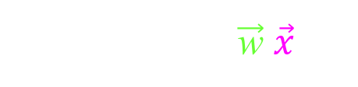



Dot Product
Think of each client's values as a vector
in a high dimensional space.
$$\vec{\text{x}}$$
$$\vec{\text{w}}$$
projection ∝ $\vec{\text{w}}$‧$\vec{x}$
$$\text{> 0}$$
$$\text{> 0}$$
3×30
= 90
vs
(-10)×(-8)
= 80
(-20)×(-10)
= 200
(-20)×(-15)
= 300
15×10
= 150
(-9)×(-10)
= 90
Compatibility($\vec{\text{w}}$,$\vec{\text{x}}$) = $\vec{\text{w}}$‧$\vec{x}$ $=\sum_{i}{{\text{w}}_{i}x_{i}}$ = 910
Total: 910

Slide 24
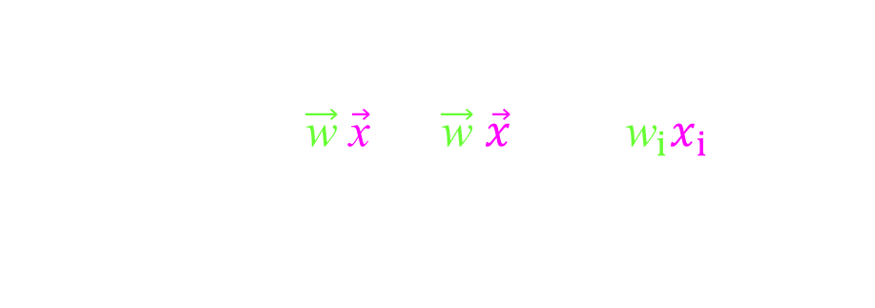



Dot Product
Think of each client's values as a vector
in a high dimensional space.
$$\vec{\text{w}}$$
$$\vec{\text{x}}$$
projection ∝ $\vec{\text{w}}$‧$\vec{x}$
negative
$$\text{<}\text{ 0}$$
$$\text{<}\text{ 0}$$
3×2
= 6
vs
(-10)×(-9)
= +90
(-20)×30
= -600
(-20)×20
= -400
15×20
= 300
(-9)×30
= -270
Compatibility($\vec{\text{w}}$,$\vec{\text{x}}$) = $\vec{\text{w}}$‧$\vec{x}$ $=\sum_{i}{{\text{w}}_{i}x_{i}}$ = -874
Total: -874

Slide 25
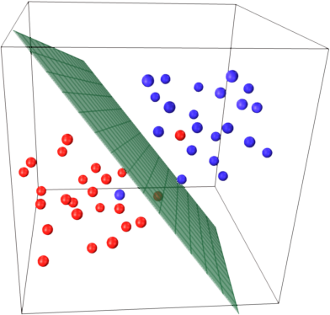
Dot Product
Consider the set of all people
who have compatibility zero
with our first client.
$$\vec{\text{x}}$$
$$\vec{\text{w}}$$
zero
We just need test
sign($\vec{\text{w}}$‧$\vec{x}$)
projection ∝ $\vec{\text{w}}$‧$\vec{x}$
$$\text{=}\text{ 0}$$
$$\text{=} \text{0}$$
$$\vec{\text{w}}$$
This set forms
an (n-1)-dimensional hyperplane
partitioning the space into
compatible and incompatible people.

Slide 26
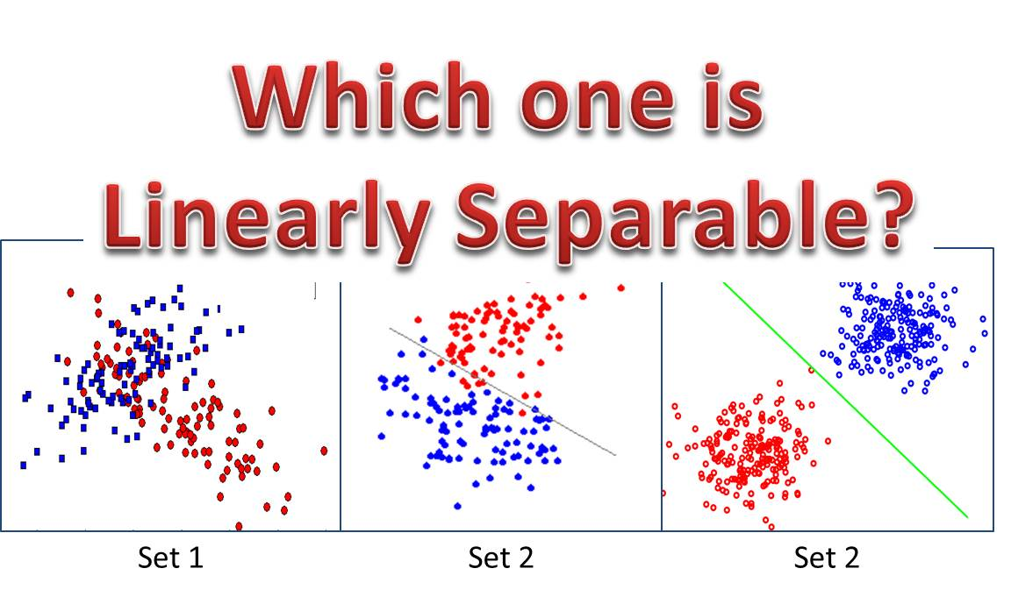
Linear Separator

Slide 27
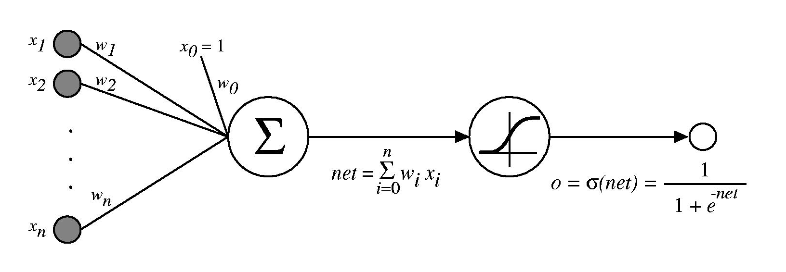
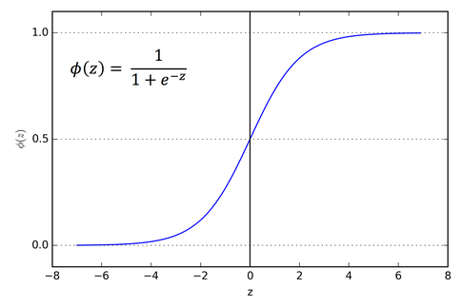




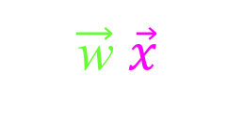


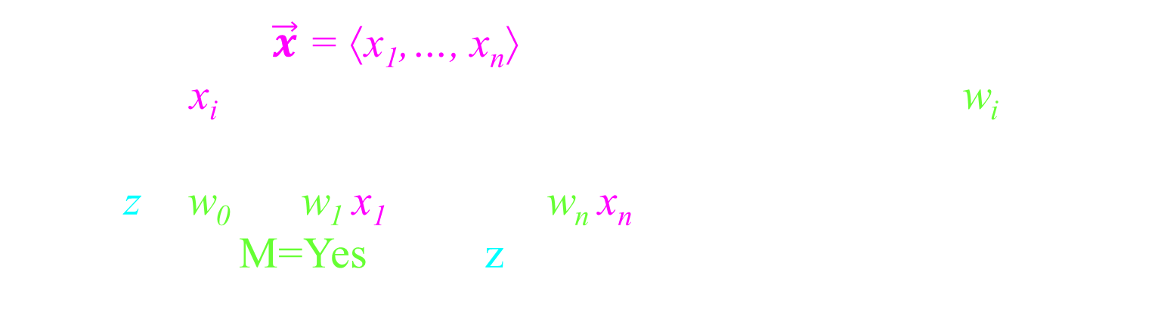
Linear Separator
x₁
w₁
x₂
w₂
w₀
$$z$$
$$z$$
$$M$$
$$y$$
w_{n}
1 if z ≥ 0
0 else
$$z= \sum_{i=0..n}{w_{i}}x_{i}$$
y $=φ\left(z\right)= \frac{1}{1+e^{−z}}$
x_{n}
M =
The input $\vec{x}$ = ⟨x₁,…, x_{n}⟩
Each x_{i} is multiplied by its corresponding weight w_{i}.
These products are summed up, giving
z = w₀ + w₁ x₁ + … + w_{n} x_{n}
Answer M=Yes when z is positive.
=$\vec{\text{w}}$‧$\vec{x}$

Slide 28
Linear Separator
x₁
w₁
x₂
w₂
w₀
$$z$$
$$z$$
$$M$$
$$y$$
w_{n}
1 if z ≥ 0
0 else
$$z= \sum_{i=0..n}{w_{i}}x_{i}$$
y $=φ\left(z\right)= \frac{1}{1+e^{−z}}$
x_{n}
M =
The set of $\vec{x}$ for which z=0
forms (n-1)-dimensional hyperplane
partitioning the space
M=yes and M=no.
$$\vec{\text{w}}$$

Slide 29
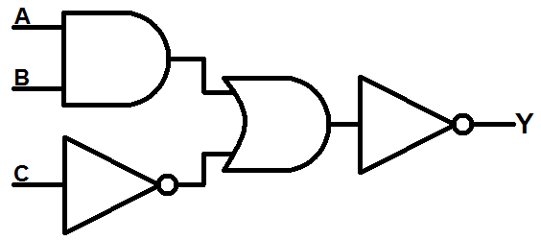
Linear Separator
AND
Or
Not
x₂
z>0
z<0
x₂
z>0
z>0
z<0
z<0
x₁
x₁
x₁
z = -3 + 2 x₁ + 2 x₂
z = -1 + 2 x₁ + 2 x₂
z = 1 + -2 x₁
compute
with
AND
OR
NOT
NOT
Can compute
the same!

Slide 30
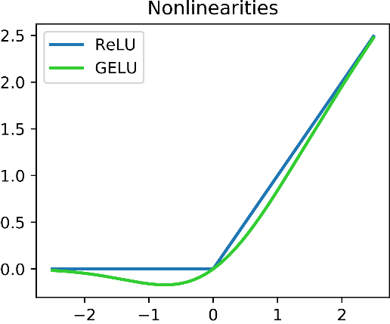
Neural Networks
Ability to Compute
Difficulty
to learn
weak
easy
formula
Linear
impossible
Logical - Threshold
Learns surprisingly well
As strong as circuits
Sigmoid
Slightly better
Rectilinear (ReLU)

Slide 31
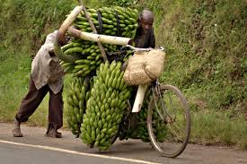
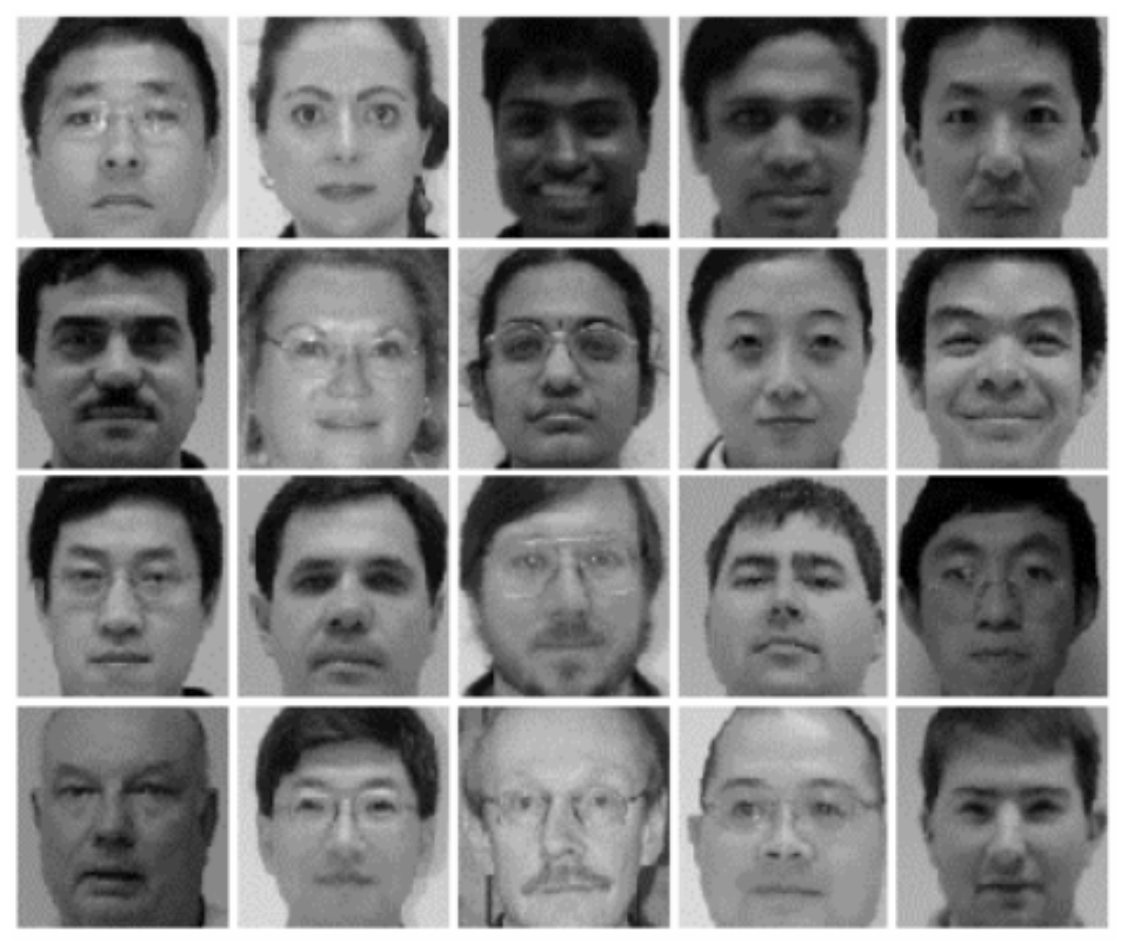
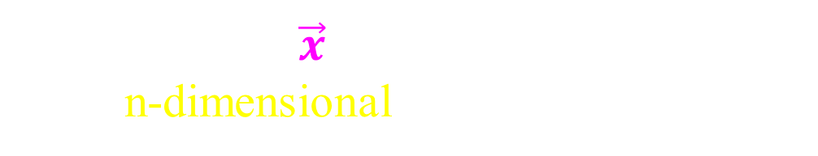
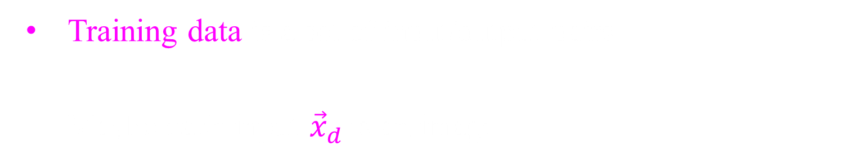

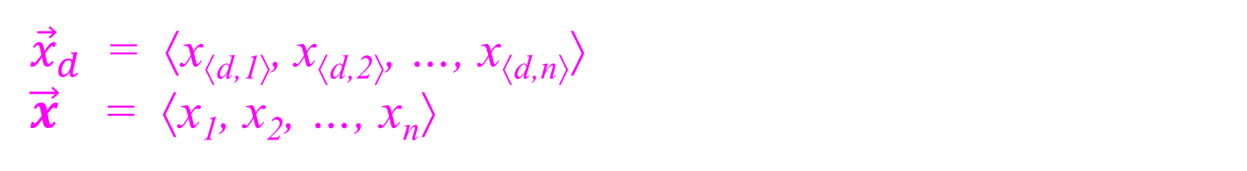
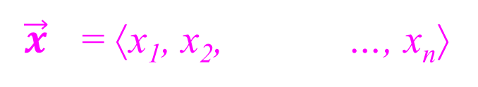
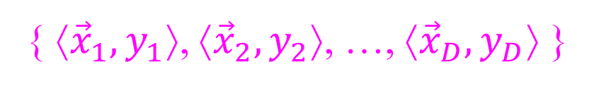

Training Data as Points
Training data is a set of input/output pairs
Maybe each input ${\vec{x}}_{d}$ is an image
{ ⟨${\vec{x}}_{1},y_{1}$⟩, ⟨${\vec{x}}_{2},y_{2}$⟩, …, ⟨${\vec{x}}_{D},y_{D}$⟩ }
or three
Note ${\vec{x}}_{d}$ is a vector of a value for each pixel.
${\vec{x}}_{d}$ = ⟨x_{⟨d,1⟩}, x_{⟨d,2⟩}, …, x_{⟨d,n⟩}⟩
$\vec{x}$ = ⟨x₁, x₂, …, x_{n}⟩ when understood which data item.
Such a vector $\vec{x}$of values can be placed
in n-dimensional space.
x₃
x₂
$\vec{x}$ = ⟨x₁, x₂, …, x_{n}⟩
$$\vec{x}$$
x₁

Slide 32

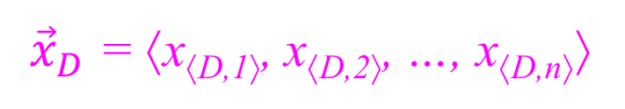
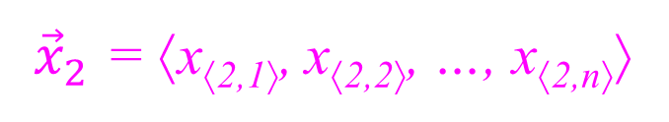
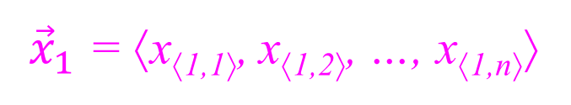
Training Data as Points
Training data is a set of input/output pairs
Maybe each input ${\vec{x}}_{d}$ is an image
{ ⟨${\vec{x}}_{1},y_{1}$⟩, ⟨${\vec{x}}_{2},y_{2}$⟩, …, ⟨${\vec{x}}_{D},y_{D}$⟩ }
or three
Note ${\vec{x}}_{d}$ is a vector of a value for each pixel.
${\vec{x}}_{d}$ = ⟨x_{⟨d,1⟩}, x_{⟨d,2⟩}, …, x_{⟨d,n⟩}⟩
$\vec{x}$ = ⟨x₁, x₂, …, x_{n}⟩ when understood which data item.
Training data
has D images.
pixel₁
pixel_{i}
pixel_{n}
${\vec{x}}_{1}$ = ⟨x_{⟨1,1⟩}, x_{⟨1,2⟩}, …, x_{⟨1,n⟩}⟩
x₃
${\vec{x}}_{2}$ = ⟨x_{⟨2,1⟩}, x_{⟨2,2⟩}, …, x_{⟨2,n⟩}⟩
x₂
$\vec{x}$ = ⟨x₁, x₂, …, x_{n}⟩
$$\vec{x}$$
…
${\vec{x}}_{D}$ = ⟨x_{⟨D,1⟩}, x_{⟨D,2⟩}, …, x_{⟨D,n⟩}⟩
x₁

Slide 33
Training Data as Points
Training data is a set of input/output pairs
Maybe each input ${\vec{x}}_{d}$ is an image
{ ⟨${\vec{x}}_{1},y_{1}$⟩, ⟨${\vec{x}}_{2},y_{2}$⟩, …, ⟨${\vec{x}}_{D},y_{D}$⟩ }
or three
Note ${\vec{x}}_{d}$ is a vector of a value for each pixel.
${\vec{x}}_{d}$ = ⟨x_{⟨d,1⟩}, x_{⟨d,2⟩}, …, x_{⟨d,n⟩}⟩
$\vec{x}$ = ⟨x₁, x₂, …, x_{n}⟩ when understood which data item.
Training data
has D images.
pixel₁
pixel_{i}
pixel_{n}
${\vec{x}}_{1}$ = ⟨x_{⟨1,1⟩}, x_{⟨1,2⟩}, …, x_{⟨1,n⟩}⟩
x₃
x₂
${\vec{x}}_{2}$ = ⟨x_{⟨2,1⟩}, x_{⟨2,2⟩}, …, x_{⟨2,n⟩}⟩
$$\vec{x}$$
…
${\vec{x}}_{D}$ = ⟨x_{⟨D,1⟩}, x_{⟨D,2⟩}, …, x_{⟨D,n⟩}⟩
x₁

Slide 34
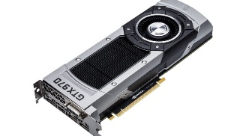
Matrix
Multiplication
Evaluating the Neural Network:
Given Training data has D images.
Given the weights of neural network
Determine the output for each image.
Do it FAST.
w_{⟨i,j⟩}
face
Graphics processing unit (GPU),
built video game playing
are fast at matrix multiplying and other parallel operations.

Slide 35



Matrix
Multiplication
If you read any paper on machine learning,
it writes
j
i
j
z
=
x
×
w
d
d
i
nobody tells you what these are,
but these are all matrices.
We must understand how this works.

Slide 36
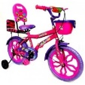

Matrix
Multiplication
d^{th} training
input
cat
d
dog
face
fish
Training data = { ⟨${\vec{x}}_{1},y_{1}$⟩, ⟨${\vec{x}}_{2},y_{2}$⟩, …, ⟨${\vec{x}}_{d},y_{d}$⟩, …, ⟨${\vec{x}}_{D},y_{D}$⟩ }
d^{th} training
input
$${\vec{x}}_{d}$$
We are assuming this input is an image.
d
This is fed into the neural net.

Slide 37
i
Matrix
Multiplication
d^{th} training
input
i
cat
d
dog
x_{⟨d,i⟩}
face
fish
d^{th} training
input
$${\vec{x}}_{d}$$
= ⟨x_{⟨d,1⟩}, x_{⟨d,2⟩},…, x_{⟨d,i⟩},…, x_{⟨d,n⟩}⟩
Images are composed of pixels.
Consider the i^{th} pixel.
i
d
This is fed into the i^{th} input neuron.

Slide 38
i
Matrix
Multiplication
d^{th} training
input
i
cat
d
dog
x_{⟨d,i⟩}
face
fish
d^{th} training
input
i^{th} pixel
of input
i
d
This is fed into the i^{th} input neuron.
x_{⟨d,i⟩}
In the d^{th} training input,
the value of the i^{th} pixel.

Slide 39
i
j
Matrix
Multiplication
d^{th} training
input
j
i
cat
d
dog
x_{⟨d,i⟩}
face
fish
d^{th} training
input
i^{th} pixel
of input
j^{th} hidden
unit
This has no human
designated meaning
i
j
d

Slide 40
i
j
Matrix
Multiplication
d^{th} training
input
j
i
y_{⟨d,j⟩}
cat
d
dog
x_{⟨d,i⟩}
face
fish
d^{th} training
input
i^{th} pixel
of input
j^{th} hidden
unit
i
j
d
Indicates the firing
of this j^{th} hidden unit
on the d^{th} training input.
y_{⟨d,j⟩}

Slide 41
i
j
Matrix
Multiplication
d^{th} training
input
j
i
z_{⟨d,j⟩}
cat
d
dog
x_{⟨d,i⟩}
face
fish
d^{th} training
input
i^{th} pixel
of input
j^{th} hidden
unit
i
j
d
Determined by
the pre-activation level
of this j^{th} hidden unit
on the d^{th} training input.
z_{⟨d,j⟩}

Slide 42
i
j
Matrix
Multiplication
d^{th} training
input
j
i
w_{⟨i,j⟩}
z_{⟨d,j⟩}
cat
d
dog
x_{⟨d,i⟩}
face
fish
d^{th} training
input
i^{th} pixel
of input
j^{th} hidden
unit
i
j
Between these two units
is an activation edge.
d
w_{⟨i,j⟩}
This is its weight.

Slide 43
i
j
Matrix
Multiplication
d^{th} training
input
j
i
w_{⟨i,j⟩}
z_{⟨d,j⟩}
cat
d
dog
x_{⟨d,i⟩}
face
fish
z_{⟨d,j⟩} =
× w_{⟨i,j⟩}
x_{⟨d,i⟩}
The activation of the i^{th} input unit
is multiplied by the weight of the ⟨i,j⟩ edge
to give the pre-activation level of j^{th} hidden

Slide 44
i
j
Matrix
Multiplication
d^{th} training
input
j
i
w_{⟨i,j⟩}
z_{⟨d,j⟩}
cat
d
dog
x_{⟨d,i⟩}
face
fish
z_{⟨d,j⟩} =
× w_{⟨i,j⟩}
x_{⟨d,i⟩}
∑_{i}
= x_{⟨d,1⟩} × w_{⟨1,j⟩} + x_{⟨d,2⟩} × w_{⟨2,j⟩} + … + x_{⟨d,I⟩} × w_{⟨I,j⟩}
All input units contribute to this pre-activation.

Slide 45
i
j
Matrix
Multiplication
d^{th} training
input
j
i
w_{⟨i,j⟩}
z_{⟨d,j⟩}
cat
d
dog
x_{⟨d,i⟩}
face
fish
z_{⟨d,j⟩} = x_{⟨d,i⟩} × w_{⟨i,j⟩}
∑_{i}
= x_{⟨d,1⟩} × w_{⟨1,j⟩} + x_{⟨d,2⟩} × w_{⟨2,j⟩} + … + x_{⟨d,I⟩} × w_{⟨I,j⟩}
j
i
j
z_{⟨d,j⟩}
=
×
w_{⟨1,j⟩}
d
d
x_{⟨d,1⟩} ,…, x_{⟨d,I⟩}
w_{⟨2,j⟩}
…
Dot product
of two vectors
i
w_{⟨I,j⟩}

Slide 46
i
j
Matrix
Multiplication
d^{th} training
input
j
i
w_{⟨i,j⟩}
z_{⟨d,j⟩}
cat
d
dog
x_{⟨d,i⟩}
face
fish
z_{⟨d,j⟩} = x_{⟨d,i⟩} × w_{⟨i,j⟩}
∑_{i}
Same for all hidden units at this level.
j
i
j
z_{⟨d,j⟩}
=
×
w_{⟨1,j⟩}
d
d
x_{⟨d,1⟩} ,…, x_{⟨d,I⟩}
w_{⟨2,j⟩}
…
Dot product
of two vectors
i
w_{⟨I,j⟩}

Slide 47


i
j
Matrix
Multiplication
d^{th} training
input
i
w_{⟨i,j´⟩}
j´
cat
d
dog
x_{⟨d,i⟩}
face
z_{⟨d,j´⟩}
fish
z_{⟨d,j⟩} = x_{⟨d,i⟩} × w_{⟨i,j⟩}
∑_{i}
Same for all hidden units at this level.
j
j
´
i
´
z_{⟨d,j´⟩}
=
×
w_{⟨1,j´⟩}
d
d
x_{⟨d,1⟩} ,…, x_{⟨d,I⟩}
w_{⟨2,j´⟩}
Dot product
of two vectors
i
w_{⟨I,j´⟩}

Slide 48
i
j
Matrix
Multiplication
d^{th} training
input
j
i
w_{⟨i,j´⟩}
z_{⟨d,j⟩}
cat
d
dog
x_{⟨d,i⟩}
face
fish
z_{⟨d,j⟩} = x_{⟨d,i⟩} × w_{⟨i,j⟩}
∑_{i}
Same for all hidden units at this level.
j
i
j
z_{⟨d,1⟩} , ..., z_{⟨d,J⟩}
×
w_{⟨1,1⟩} , ..., w_{⟨1,J⟩}
d
=
d
x_{⟨d,1⟩} ,…, x_{⟨d,I⟩}
w_{⟨2,1⟩} , ..., w_{⟨2,J⟩}
…
i
w_{⟨I,1⟩} , ..., w_{⟨I,J⟩}

Slide 49
i
j
Matrix
Multiplication
d^{th} training
input
j
i
w_{⟨i,j´⟩}
z_{⟨d,j⟩}
cat
d
dog
x_{⟨d,i⟩}
face
fish
z_{⟨d,j⟩} = x_{⟨d,i⟩} × w_{⟨i,j⟩}
∑_{i}
Same for all training data.
j
i
j
z_{⟨d,1⟩} , ..., z_{⟨d,J⟩}
×
w_{⟨1,1⟩} , ..., w_{⟨1,J⟩}
d
=
d
x_{⟨d,1⟩} ,…, x_{⟨d,I⟩}
w_{⟨2,1⟩} , ..., w_{⟨2,J⟩}
…
i
w_{⟨I,1⟩} , ..., w_{⟨I,J⟩}

Slide 50
i
j
Matrix
Multiplication
d´^{th} training
input
j
i
w_{⟨i,j´⟩}
z_{⟨d,j⟩}
cat
d
dog
´
x_{⟨d,i⟩}
face
fish
z_{⟨d,j⟩} = x_{⟨d,i⟩} × w_{⟨i,j⟩}
∑_{i}
Same for all training data.
j
i
j
w_{⟨1,1⟩} , ..., w_{⟨1,J⟩}
w_{⟨2,1⟩} , ..., w_{⟨2,J⟩}
…
z_{⟨d´,1’} , ..., z_{⟨d´,J⟩}
=
×
i
d
x_{⟨d´,1⟩} ,…, x_{⟨d´,I⟩}
´
d
´
w_{⟨I,1⟩} , ..., w_{⟨I,J⟩}

Slide 51
i
j
Matrix
Multiplication
d^{th} training
input
j
i
w_{⟨i,j´⟩}
z_{⟨d,j⟩}
cat
d
dog
x_{⟨d,i⟩}
face
fish
z_{⟨d,j⟩} = x_{⟨d,i⟩} × w_{⟨i,j⟩}
∑_{i}
Same for all training data.
j
i
j
z_{⟨1,1⟩} , ..., z_{⟨1,J⟩}
x_{⟨1,1⟩} ,…, x_{⟨1,I⟩}
w_{⟨1,1⟩} , ..., w_{⟨1,J⟩}
z_{⟨2,1⟩} , ..., z_{⟨2,J⟩}
x_{⟨2,1⟩} ,…, x_{⟨2,I⟩}
w_{⟨2,1⟩} , ..., w_{⟨2,J⟩}
=
×
d
d
…
…
…
i
w_{⟨I,1⟩} , ..., w_{⟨I,J⟩}
z_{⟨D,1⟩} , ..., z_{⟨D,J⟩}
x_{⟨D,1⟩} ,…, x_{⟨D,I⟩}

Slide 52
i
j
Matrix
Multiplication
d^{th} training
input
j
i
w_{⟨i,j´⟩}
z_{⟨d,j⟩}
cat
d
dog
x_{⟨d,i⟩}
face
fish
z_{⟨d,j⟩} = x_{⟨d,i⟩} × w_{⟨i,j⟩}
∑_{i}
Actually, this is the definition of matrix multiplication.
j
i
j
z_{⟨1,1⟩} , ..., z_{⟨1,J⟩}
x_{⟨1,1⟩} ,…, x_{⟨1,I⟩}
w_{⟨1,1⟩} , ..., w_{⟨1,J⟩}
z_{⟨2,1⟩} , ..., z_{⟨2,J⟩}
x_{⟨2,1⟩} ,…, x_{⟨2,I⟩}
w_{⟨2,1⟩} , ..., w_{⟨2,J⟩}
=
×
d
d
…
…
…
i
w_{⟨I,1⟩} , ..., w_{⟨I,J⟩}
z_{⟨D,1⟩} , ..., z_{⟨D,J⟩}
x_{⟨D,1⟩} ,…, x_{⟨D,I⟩}

Slide 53
Matrix
Multiplication
cat
x
w
z
dog
face
fish
z_{⟨d,j⟩} = x_{⟨d,i⟩} × w_{⟨i,j⟩}
∑_{i}
j
i
j
z
=
x
×
w
d
d
i

Slide 54
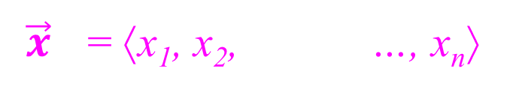
Abstract Representations of our Data
Note each dot here is one pixel in one data item.
cat
dog
face
fish
This pixel representation of the training data
is inputted into the neural network.
$\vec{x}$ = ⟨x₁, x₂, …, x_{n}⟩
x₃
Note each dot here is one data item
in the space of all data items.
$$\vec{x}$$
x₂
x₁

Slide 55
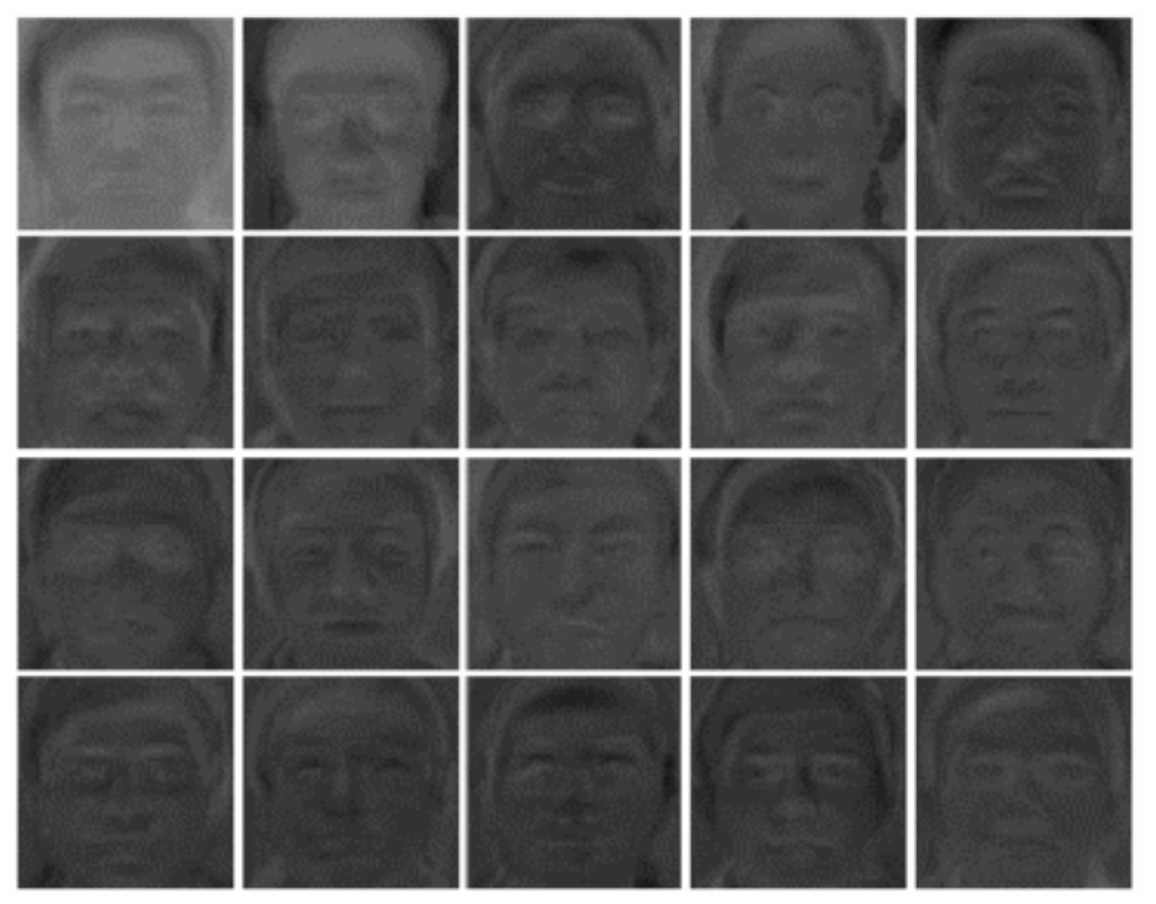

Abstract Representations of our Data
cat
dog
face
fish
This pixel representation of the training data
is inputted into the neural network.
Each layer of hidden nodes also holds a vector of numbers
and holds an abstract representation of the same data.
x₃
y₃
$$\vec{x}$$
x₂
$$\vec{y}$$
y₂
x₁
y₁

Slide 56
Abstract Representations of our Data
cat
dog
face
fish
Training data
has D images.
x₃
$$\vec{x}$$
x₂
x₁

Slide 57
Abstract Representations of our Data
cat
dog
face
fish
Each hidden layer transforms
our abstract representation of the same data.
Until it can categorize it.

Slide 58
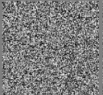


Abstract Representations of our Data
Huge Space: Each n pixel image lies in n-dim spaces
with 2^{O(n)} possibilities.
Manifold: But images of interest lay in small connected regions
As this face moves,
the image changes gradually within this manifold.
Transformations: Machine Learning tries to transform these manifolds
into shapes that are easier to understand.

Slide 59

Abstract Representations of our Data
cat
x
w
z
dog
face
fish
What does multiplying by a matrix do?
Rotates the space
Stretches it.
z
=
x
×
w

Slide 60

Abstract Representations of our Data
cat
x
w
z
dog
$$z$$
face
fish
$$y$$
$$z= \sum_{i=1..n}{w_{i}}x_{i} +{1 w}_{0}$$
What does multiplying by a matrix do?
Transposes/Shifts the space, ie moves the origin.
z
=
x
×
w

Slide 61
Abstract Representations of our Data
cat
x
w
z
dog
face
fish
What does multiplying by a matrix do?
If the resulting layer has more hidden nodes,
then this places our space into a larger subspace.
z
=
x
×
w

Slide 62
Abstract Representations of our Data
cat
x
w
z
dog
face
fish
What does multiplying by a matrix do?
If the resulting layer has more hidden nodes,
then this places our space into a larger subspace.
Gives your network more freedom
to learn complex representations.
But is computationally expensive.
May lead to over fitting
ie improve performance
on training but not test data.
w

Slide 63
Abstract Representations of our Data
cat
x
w
z
dog
face
fish
What does multiplying by a matrix do?
If the resulting layer has fewer hidden nodes,
then this projects our space into a smaller subspace.
z
=
x
×
w

Slide 64

Abstract Representations of our Data
cat
x
w
z
dog
face
fish
What does multiplying by a matrix do?
If the resulting layer has fewer hidden nodes,
then this projects our space into a smaller subspace.
pixel x₂
z₁
pixel x₁

Slide 65

Abstract Representations of our Data
cat
x
w
z
dog
face
fish
Described by 10,000 numbers
Described by 100 numbers
➔
The key its to filter out only the “important” information.

Slide 66
Abstract Representations of our Data
cat
x
w
z
dog
face
fish
What does multiplying by a matrix do?
Multiplying twice: × w × w´
is that same as multiplying once by × (w×w´).
z
=
x
×
w
×
w´

Slide 67
Abstract Representations of our Data
cat
x
w
z
dog
face
fish
What does multiplying by a matrix do?
Multiplying twice: × w × w´
is that same as multiplying once by × (w×w´).
Hence, we need to do something nonlinear in between.
=
x
w
z
×
w´
×

Slide 68
Abstract Representations of our Data
Sigmoid
cat
z
dog
face
fish
$$z$$
$$y$$
y $=φ\left(z\right)= \frac{1}{1+e^{−z}}$
z

Slide 69
Abstract Representations of our Data
Sigmoid
cat
z
dog
face
fish
$$z$$
$$y$$
y $=φ\left(z\right)= \frac{1}{1+e^{−z}}$
φ(z_{⟨1,1⟩}),...,φ(z_{⟨1,J⟩})
φ(z_{⟨2,1⟩}),...,φ(z_{⟨2,J⟩})
y
=
φ(z)
=
…
φ(z_{⟨D,1⟩}),...,φ(z_{⟨D,J⟩})

Slide 70

Abstract Representations of our Data
Sigmoid
cat
z
dog
face
fish
$$z$$
$$y$$
y $=φ\left(z\right)= \frac{1}{1+e^{−z}}$
Sigmoid pushes all positive z to 1 and negative z to 0.
$$$$

Slide 71


Abstract Representations of our Data
Rectilinear
cat
z
dog
face
fish
$$z$$
$$y$$
y $=φ\left(z\right)= \frac{1}{1+e^{−z}}$
Rectilinear (ReLU) keeps positive and zeros negative values.
$$$$

Slide 72

ℓ^{th}
w_{ℓ+1}
w_{L}
cat
cat
= 0.02
dog
d
x₀
y₁
w₂
x₂
x_{ℓ+1}
z_{L}
dog
= 0.01
w₁
x₂
x_{L-1}
z_{L}
x₁
y₁
x_{ℓ}
face
face
= 0.92
fish
fish
= 0.05
Sum = 1
x₀ = ⟨Input₁,…,Input_{D}⟩^{T}
Loop ℓ = 1…L-1
z_{ℓ} = x_{ℓ-1} × w_{ℓ}
y_{ℓ} = φ(z_{ℓ})
x_{ℓ+1} = y_{ℓ}
z_{L} = x_{L-1} × w_{L}
$M_{j}= \frac{e^{z_{j}^{}}}{\sum_{k=1..c}{e^{z_{k}}}}$
Because of lack of time, we will skip this.
But you can read about it here.

Slide 73






Gradient Decent
I am a machine
and I want to learn
to identify
faces and bicycles.
Here is a
measure of
your error.
w_{k}
face
My current
weights ⟨w₁,…,w_{m}⟩.
⟨w₁,…,w_{m}⟩ visualized here
by my location.
I choose a direction
and take a small step.
w₁
w₂

Slide 74

Gradient Decent
I am a machine
and I want to learn
to identify
faces and bicycles.
Here is a
measure of
your error.
w_{k}
face
My current
weights ⟨w₁,…,w_{m}⟩.
⟨w₁,…,w_{m}⟩ visualized here
by my location.
I choose a direction
and take a small step.
Steepest Decent
is the direction
water flows

Slide 75




Vector Algebra and Contour Lines
  A contour map shows the same error surface.
  Each point represents my “location” $\vec{w}$ = ⟨w₁,w₂⟩.
  Each brown curve is the set of points
  that have the same height/error.
  If I walk perpendicular to the brown curve
  then I go steepest up/down.
w2
$$\vec{w}$$
w1

Slide 76



Vector Algebra and Contour Lines
  The direction of steepest assent is computed as
∇E(⟨w₁,..,w_{m}⟩)= ⟨^{δE}/_{δw1} ,…, ^{δE}/_{δwm} ⟩
(vector notation)
(explained later)
Step, eg γ = 0.01.
Vector Algebra:
Add each coordinate
loop i = 1..m
w_{i} = w_{i} - γ × ^{δE}/_{δwi}
new $\vec{w}$= $\vec{w}$
γ ×
-
∇E($\vec{w}$)
w2
$$\vec{w}$$
$$\vec{w}$$
w1

Slide 77
Steepest Direction
  The direction of steepest assent is computed as
∇E(⟨w₁,..,w_{m}⟩)= ⟨^{δE}/_{δw1} ,…, ^{δE}/_{δwm} ⟩
(vector notation)
(explained later)
???
What does this
even mean?
w2
$$\vec{w}$$
w1

Slide 78
Steepest Direction
Computing ^{δE}/_{δw} for each k.
k
  We know where we are ⟨w₁,..,w_{m}⟩.
  Forward propagation calculates our height E(w₁,..,w_{m}).
  Loop k = 1..m
    Change w_{k} a small amount to w_{k} +δw_{k}.
    Do not change other weights w_{k’} .
    Forward propagation calculates new height
    E(w₁,..., w_{k}+δw_{k} , ..., w_{m}).
    Let δE denote the change in E.
    ie δE = E(w₁,..., w_{k}+δw_{k} , ..., w_{m}) - E(w₁,..., w_{k}, ..., w_{m}).
    ^{δE}/_{δw} is the ratio of these.
    This tells us the “influence” w_{k} has on the error E.
k
This takes too much time.

Slide 79
Steepest Direction
Computing ^{δE}/_{δw} for each k.
k
In an earlier slide, we computed these as follows.
  We know where we are ⟨w₁,..,w_{m}⟩.
  Forward propagation calculates our height E(w₁,..,w_{m}).
  Back propagation takes actual derivatives
  just like learned in high school.
  ∇E(⟨w₁,..,w_{m}⟩) = ⟨^{δE}/_{δw1} ,…, ^{δE}/_{δwm} ⟩

Slide 80



Steepest Direction
f(x+h)
f(x)
$$\frac{\text{df}}{dx}=\lim_{h→0}\frac{f\left(x+h\right)−f(x)}{h}$$
x
x+h

Slide 81

Steepest Direction
Distance North
Imagine looking down
on the stair case
from above.
w₂=4
Our location
⟨w₁,w₂⟩ = ⟨East,North⟩
= ⟨w₁,w₂⟩
= weights
for our machine.
Height = error E.
= ⟨5,3⟩
w₂=3
E=20
w₁=5
w₁=6
Distance East

Slide 82
Steepest Direction
Imagine looking down
on the stair case
from above.
E=43
w₂=4
Our location
⟨w₁,w₂⟩ = ⟨East,North⟩
= ⟨w₁,w₂⟩
= weights
for our machine.
Height = error E.
Each contour lines
raises us a foot.
w₂=3
E=8
E=20
w₁=5
w₁=6

Slide 83
Steepest Direction
E=43
E=24
4
E=20
w₂=4
1
w₁=5
w₁=6
We make a small
change in w₁
and see what the effective change in E will be.
δw₁ = 6-5 =1
δE = 24-20 =4
Slope of surface
in w₁ direction =
^{δE}/_{δw} = ⁴/₁ = 4
w₂=3
E =24
E=8
E=20
4
w₁=5
w₁=6
1
₁

Slide 84
Steepest Direction
E=27
E=43
7
E=20
w₂=4
1
w₂=3
w₂=4
1
We make a small
change in w₂
and see what the effective change in E will be.
δw₂ = 4-3 =1
δE = 27-20 =7
Slope of surface
in w₂ direction =
^{δE}/_{δw} = ⁷/₁ = 7
w₂=3
E=27
7
E=8
E=20
w₁=5
w₁=6
₂

Slide 85

Steepest Direction
E=27
E=43
E=20
w₂=4
Which direction
is the steepest?
^{δE}/_{δw} = 4
^{δE}/_{δw} = 7
w₂=3
₁
E=27
₂
E=24
E=8
E=20
w₁=5
w₁=6

Slide 86

Steepest Direction
E=27
E=43
E=20
w₂=4
Which direction
is the steepest?
Which one step gets you the highest?
w₂=3
E=8
E=20
w₁=5
w₁=6

Slide 87
Steepest Direction
E=27
E=20
w₂=4
Which direction
is the steepest?
δw₂
change in w₁
needed to get
same δE
change in E.
δw₁
change in w₁
needed to get
some δE
change in E.
E=8
E=20
w₁=5
w₁=6

Slide 88
Steepest Direction
E=27
E=20
w₂=4
×^{δE}/_{δw δw}
δw₁
Which direction
is the steepest?
δw₂
₁
₂
δw₁
×^{δE}/_{δw δw}
Scale
δw₂
Similar triangle.
₁
₂
E=8
E=20
w₁=5
w₁=6

Slide 89




Steepest Direction
E=27
8.06
E=20
w₂=4
^{δE}/_{δw}
Which direction
is the steepest?
₂
The gradient
i.e. the vector of derivatives:
∇E($\vec{w}$) = ⟨ ^{δE}/_{δw} , ^{δE}/_{δw} ⟩
= ⟨4,7⟩
^{δE}/_{δw}
₁
₂
₁
Slope = $\frac{\text{∆}\text{E}}{\text{∆}\text{w}}$
E=8
E=20
= ||∇E($\vec{w}$)||
w₁=5
w₁=6
= $\sqrt{4^{2}+{\text{7}}^{2}}$
= 8.06
Bigger than 4 and 7.

Slide 90
Back Propagation
Computing ^{δE}/_{δw} for each k.
k
Working forwards,
a quadratic number of derivatives are needed.
^{δE}/_{δw}
cat
dog
E
k
face
fish

Slide 91
Back Propagation
Computing ^{δE}/_{δw} for each k.
k
Working backwards,
a linear number of derivatives are needed.
^{δE}/_{δw}
cat
dog
E
k
face
fish

Slide 92

Back Propagation
Computing ^{δE}/_{δw} for each k.
k
    Given current weights $\vec{w}$,
    Propagate inputs $\vec{x}$forward to compute answers y
    and error E.
cat
d
x₀
w₂
x₂
x_{ℓ+1}
z_{L}
dog
w_{ℓ+1}
w_{L}
M
E
x₀
w₁
y₁
x_{ℓ}
x_{L-1}
z_{L}
M
x₁
face
fish

Slide 93


Back Propagation
Computing ^{δE}/_{δw} for each k.
k
    Given current weights $\vec{w}$,
    Propagate inputs $\vec{x}$forward to compute answers y
    and error E.
    Back propagate back to compute derivatives.
∇E(⟨w₁,..,w_{m}⟩)= ⟨^{δE}/_{δw1} ,…, ^{δE}/_{δwm} ⟩
cat
$${E}/{M}$$
dog
E
face
fish

Slide 94

Back Propagation
Computing ^{δE}/_{δw} for each k.
k
    Given current weights $\vec{w}$,
    Propagate inputs $\vec{x}$forward to compute answers y
    and error E.
    Back propagate back to compute derivatives.
∇E(⟨w₁,..,w_{m}⟩)= ⟨^{δE}/_{δw1} ,…, ^{δE}/_{δwm} ⟩
cat
$${E}/{{δz}_{\text{L}}}$$
dog
E
face
fish

Slide 95


Back Propagation
Computing ^{δE}/_{δw} for each k.
k
    Given current weights $\vec{w}$,
    Propagate inputs $\vec{x}$forward to compute answers y
    and error E.
    Back propagate back to compute derivatives.
∇E(⟨w₁,..,w_{m}⟩)= ⟨^{δE}/_{δw1} ,…, ^{δE}/_{δwm} ⟩
cat
$${E}/{xL}$$
w_{L}
dog
E
face
$$−$$
fish

Slide 96

Back Propagation
Computing ^{δE}/_{δw} for each k.
k
    Given current weights $\vec{w}$,
    Propagate inputs $\vec{x}$forward to compute answers y
    and error E.
    Back propagate back to compute derivatives.
∇E(⟨w₁,..,w_{m}⟩)= ⟨^{δE}/_{δw1} ,…, ^{δE}/_{δwm} ⟩
cat
$${E}/{xℓ}$$
w_{ℓ+1}
dog
E
face
fish

Slide 97

Back Propagation
Computing ^{δE}/_{δw} for each k.
k
    Given current weights $\vec{w}$,
    Propagate inputs $\vec{x}$forward to compute answers y
    and error E.
    Back propagate back to compute derivatives.
∇E(⟨w₁,..,w_{m}⟩)= ⟨^{δE}/_{δw1} ,…, ^{δE}/_{δwm} ⟩
cat
$${E}/{wℓ}$$
dog
E
face
fish

Slide 98
i
Back Propagation
d^{th} training
input
i
cat
d
dog
x_{⟨d,i⟩}
face
fish
i^{th} hidden
unit
level ℓ-1
d^{th} training
input
i
d
Indicates the firing
of this i^{th} hidden unit
on the d^{th} training input.
x_{⟨d,i⟩}

Slide 99




i
j
Back Propagation
d^{th} training
input
j
i
y_{⟨d,j⟩}
cat
d
dog
x_{⟨d,i⟩}
face
fish
i^{th} hidden
unit
level ℓ-1
j^{th} hidden
unit
level ℓ
d^{th} training
input
i
j
d
$$z$$
$$y$$
$$z= \sum_{i=0..n}{w_{i}}x_{i}$$
y $=φ\left(z\right)= \frac{1}{1+e^{−z}}$
Indicates the firing
of this i^{th} hidden unit
on the d^{th} training input.
z_{⟨d,j⟩}
y_{⟨d,j⟩}

Slide 100
i
j
Back Propagation
d^{th} training
input
j
i
w_{⟨i,j⟩}
z_{⟨d,j⟩}
cat
d
dog
x_{⟨d,i⟩}
face
fish
i^{th} hidden
unit
level ℓ-1
j^{th} hidden
unit
level ℓ
d^{th} training
input
i
j
Between these two units
is an activation edge.
d
w_{⟨i,j⟩}
This is its weight.

Slide 101





i
j
Back Propagation
d^{th} training
input
$${E}/{{δw}_{\text{⟨}\text{i}\text{,}\text{j}\text{⟩}}}$$
j
i
w_{⟨i,j⟩}
z_{⟨d,j⟩}
cat
$${E}/{{δz}_{\text{⟨}\text{d}\text{,}\text{j}\text{⟩}}}$$
dog
d
E
face
fish
$${E}/{{δw}_{\text{⟨}\text{i}\text{,}\text{j}\text{⟩}}}$$
=
$${E}/{{δz}_{\text{⟨}\text{d}\text{,}\text{j}\text{⟩}}}$$
×
$${{z}_{\text{⟨}\text{d}\text{,}\text{j}\text{⟩}}}/{{δw}_{\text{⟨}\text{i}\text{,}\text{j}\text{⟩}}}$$
Goal
Suppose already computed using back propagation
induces
Change w_{⟨i,j⟩}
→ change z_{⟨d,j⟩}
→ change E.
Chain Rule

Slide 102

i
j
Back Propagation
d^{th} training
input
$${E}/{{δw}_{\text{⟨}\text{i}\text{,}\text{j}\text{⟩}}}$$
j
i
w_{⟨i,j⟩}
cat
$${E}/{{δz}_{\text{⟨}\text{d}\text{,}\text{j}\text{⟩}}}$$
dog
d
E
d
face
d
d
fish
d
d
d
$${E}/{{δw}_{\text{⟨}\text{i}\text{,}\text{j}\text{⟩}}}$$
=
∑_{d}
$${E}/{{δz}_{\text{⟨}\text{d}\text{,}\text{j}\text{⟩}}}$$
×
$${{z}_{\text{⟨}\text{d}\text{,}\text{j}\text{⟩}}}/{{δw}_{\text{⟨}\text{i}\text{,}\text{j}\text{⟩}}}$$
$$\text{d}$$
→ change z_{⟨1,j⟩}
Which d?
…
Change w_{⟨i,j⟩}
→ change z_{⟨d,j⟩}
→ change E.
…
→ change z_{⟨D,j⟩}

Slide 103





Back Propagation
w_{⟨i,j⟩}
$$z$$
$$y$$
$$\text{x}\text{⟨}\text{d}\text{,}\text{i}\text{⟩}$$
$$z= \sum_{i=0..n}{w_{i}}x_{i}$$
y $=φ\left(z\right)= \frac{1}{1+e^{−z}}$
∑_{d}
$${{z}_{\text{⟨}\text{d}\text{,}\text{j}\text{⟩}}}/{{δw}_{\text{⟨}\text{i}\text{,}\text{j}\text{⟩}}}$$
$${E}/{{δw}_{\text{⟨}\text{i}\text{,}\text{j}\text{⟩}}}$$
=
$${E}/{{δz}_{\text{⟨}\text{d}\text{,}\text{j}\text{⟩}}}$$
×
x_{⟨d,i⟩}
z_{⟨d,j⟩}
= x_{⟨d,1⟩} × w_{⟨1,j⟩} + … + x_{⟨d,i⟩} × w_{⟨i,j⟩} + … + x_{⟨d,I⟩} × w_{⟨I,j⟩}
Change w_{⟨i,j⟩} by 1
→ change z_{⟨d,j⟩} by x_{⟨d,i⟩.}
$${{z}_{\text{⟨}\text{d}\text{,}\text{j}\text{⟩}}}/{{δw}_{\text{⟨}\text{i}\text{,}\text{j}\text{⟩}}}$$
=
x_{⟨d,i⟩}

Slide 104


Back Propagation
w_{⟨i,j⟩}
$$z$$
$$y$$
$$\text{x}\text{⟨}\text{d}\text{,}\text{i}\text{⟩}$$
$$z= \sum_{i=0..n}{w_{i}}x_{i}$$
y $=φ\left(z\right)= \frac{1}{1+e^{−z}}$
$${E}/{{δw}_{\text{⟨}\text{i}\text{,}\text{j}\text{⟩}}}$$
=
∑_{d}
$${E}/{{δz}_{\text{⟨}\text{d}\text{,}\text{j}\text{⟩}}}$$
×
x_{⟨d,i⟩}
i
d
i
j
$${E}/{{δw}_{\text{⟨}\text{i}\text{,}\text{j}\text{⟩}}}$$
=
j
×
x_{⟨d,i⟩}
$${E}/{{δz}_{\text{⟨}\text{d}\text{,}\text{j}\text{⟩}}}$$
d

Slide 105

Back Propagation
d^{th} training
input
z_{⟨d,j⟩}
cat
$${E}/{{δz}_{\text{⟨}\text{d}\text{,}\text{j}\text{⟩}}}$$
dog
d
E
face
fish
$${E}/{{δz}_{\text{⟨}\text{d}\text{,}\text{j}\text{⟩}}}$$
Now we need already computed using back propagation

Slide 106




i
j
Back Propagation
d^{th} training
input
j
i
w_{⟨i,j⟩}
y_{⟨d,j⟩}
cat
$${E}/{{δy}_{\text{⟨}\text{d}\text{,}\text{j}\text{⟩}}}$$
dog
d
E
x_{⟨d,i⟩}
face
$${E}/{{δx}_{\text{⟨}\text{d}\text{,}\text{i}\text{⟩}}}$$
fish
$${E}/{{δx}_{\text{⟨}\text{d}\text{,}\text{i}\text{⟩}}}$$
$${E}/{{δy}_{\text{⟨}\text{d}\text{,}\text{j}\text{⟩}}}$$
Assume by way of induction
To compute
next
Already computed using
back propagation
Change x_{⟨d,i⟩}
→ change y_{⟨d,j⟩}
→ change E.

Slide 107


i
j
Back Propagation
d^{th} training
input
j
i
w_{⟨i,j⟩}
cat
$${E}/{{δy}_{\text{⟨}\text{d}\text{,}\text{j}\text{⟩}}}$$
dog
d
E
$${E}/{{δx}_{\text{⟨}\text{d}\text{,}\text{i}\text{⟩}}}$$
face
fish
×
$${{y}_{\text{⟨}\text{d}\text{,}\text{j}\text{⟩}}}/{{δz}_{\text{⟨}\text{d}\text{,}\text{j}\text{⟩}}}$$
$${{z}_{\text{⟨}\text{d}\text{,}\text{j}\text{⟩}}}/{{δx}_{\text{⟨}\text{d}\text{,}\text{i}\text{⟩}}}$$
$${E}/{{δx}_{\text{⟨}\text{d}\text{,}\text{i}\text{⟩}}}$$
=
$${E}/{{δy}_{\text{⟨}\text{d}\text{,}\text{j}\text{⟩}}}$$
×
Change x_{⟨d,i⟩}
→ change y_{⟨d,j⟩}
→ change E.
Chain Rule

Slide 108

i
j
Back Propagation
d^{th} training
input
j
i
w_{⟨i,j⟩}
cat
w_{⟨i,j⟩}
$${E}/{{δy}_{\text{⟨}\text{d}\text{,}\text{j}\text{⟩}}}$$
d
dog
E
$${E}/{{δx}_{\text{⟨}\text{d}\text{,}\text{i}\text{⟩}}}$$
face
fish
×
$${{y}_{\text{⟨}\text{d}\text{,}\text{j}\text{⟩}}}/{{δz}_{\text{⟨}\text{d}\text{,}\text{j}\text{⟩}}}$$
$${{z}_{\text{⟨}\text{d}\text{,}\text{j}\text{⟩}}}/{{δx}_{\text{⟨}\text{d}\text{,}\text{i}\text{⟩}}}$$
$${E}/{{δx}_{\text{⟨}\text{d}\text{,}\text{i}\text{⟩}}}$$
=
∑_{j}
$${E}/{{δy}_{\text{⟨}\text{d}\text{,}\text{j}\text{⟩}}}$$
×
$$\text{j}$$
→ change y_{⟨d,1⟩}
Which j?
…
Change x_{⟨d,i⟩}
→ change y_{⟨d,j⟩}
→ change E.
…
→ change y_{⟨d,J⟩}

Slide 109

Back Propagation
w_{⟨i,j⟩}
$$z$$
$$y$$
$$\text{x}\text{⟨}\text{d}\text{,}\text{i}\text{⟩}$$
$$z= \sum_{i=0..n}{w_{i}}x_{i}$$
y $=φ\left(z\right)= \frac{1}{1+e^{−z}}$
$${{y}_{\text{⟨}\text{d}\text{,}\text{j}\text{⟩}}}/{{δz}_{\text{⟨}\text{d}\text{,}\text{j}\text{⟩}}}$$
$${{z}_{\text{⟨}\text{d}\text{,}\text{j}\text{⟩}}}/{{δx}_{\text{⟨}\text{d}\text{,}\text{i}\text{⟩}}}$$
$${E}/{{δx}_{\text{⟨}\text{d}\text{,}\text{i}\text{⟩}}}$$
=
∑_{j}
$${E}/{{δy}_{\text{⟨}\text{d}\text{,}\text{j}\text{⟩}}}$$
×
×
w_{⟨i,j⟩}
z_{⟨d,j⟩}
= x_{⟨d,1⟩} × w_{⟨1,j⟩} + … + x_{⟨d,i⟩} × w_{⟨i,j⟩} + … + x_{⟨d,I⟩} × w_{⟨I,j⟩}
Change x_{⟨d,i⟩} by 1
→ change z_{⟨d,j⟩} by w_{⟨i,j⟩.}
$${{z}_{\text{⟨}\text{d}\text{,}\text{j}\text{⟩}}}/{{δx}_{\text{⟨}\text{d}\text{,}\text{i}\text{⟩}}}$$
=
w_{⟨i,j⟩}

Slide 110


Back Propagation
w_{⟨i,j⟩}
$$z$$
$$y$$
$$\text{x}\text{⟨}\text{d}\text{,}\text{i}\text{⟩}$$
$$z= \sum_{i=0..n}{w_{i}}x_{i}$$
y $=φ\left(z\right)= \frac{1}{1+e^{−z}}$
×
$${{y}_{\text{⟨}\text{d}\text{,}\text{j}\text{⟩}}}/{{δz}_{\text{⟨}\text{d}\text{,}\text{j}\text{⟩}}}$$
w_{⟨i,j⟩}
$${E}/{{δx}_{\text{⟨}\text{d}\text{,}\text{i}\text{⟩}}}$$
=
∑_{j}
$${E}/{{δy}_{\text{⟨}\text{d}\text{,}\text{j}\text{⟩}}}$$
y_{⟨d,j⟩}(1-y_{⟨d,j⟩})
×
when y≈1
$${y}/{z}$$
≈ 0
y
= y(1-y)
when y≈0
Z

Slide 111

i
j
Back Propagation
d^{th} training
input
j
i
w_{⟨i,j⟩}
cat
w_{⟨i,j⟩}
$${E}/{{δy}_{\text{⟨}\text{d}\text{,}\text{j}\text{⟩}}}$$
d
dog
E
$${E}/{{δx}_{\text{⟨}\text{d}\text{,}\text{i}\text{⟩}}}$$
face
fish
[
]
$${E}/{{δx}_{\text{⟨}\text{d}\text{,}\text{i}\text{⟩}}}$$
=
∑_{j}
$${E}/{{δy}_{\text{⟨}\text{d}\text{,}\text{j}\text{⟩}}}$$
×
y_{⟨d,j⟩}(1-y_{⟨d,j⟩})
×
w_{⟨i,j⟩}
i
j
i
$${E}/{{δy}_{\text{⟨}\text{d}\text{,}\text{j}\text{⟩}}}$$
w_{⟨i,j⟩}
=
×
d
$${E}/{{δx}_{\text{⟨}\text{d}\text{,}\text{i}\text{⟩}}}$$
d
×
y_{⟨d,j⟩}(1-y_{⟨d,j⟩})
j

Slide 112





















Back Propagation
w₀ = -3
w₁ = 2
w₂ = 1.5
$$−=\text{γ }\text{×} \frac{∂E}{{∂w}_{0}}$$
$−=$ γ×(-0.01)
$$z$$
$$M$$
$$z= \sum_{i=0..n}{w_{i}}x_{i}$$
M $=φ\left(z\right)= \frac{1}{1+e^{−z}}$
$$−=\text{γ }\text{×} \frac{∂E}{{∂w}_{1}}$$
$−=$ γ×(-0.07)
$$−=\text{γ }\text{×} \frac{∂E}{{∂w}_{2}}$$
$−=$ γ×(-0.12)
$$\frac{∂E}{{∂w}_{2}} =$$
$\frac{.2488−.25}{1.51−1.5}$ = -0.12
Back propagation
is faster.
z = w₀ + w₁x₁ + w₂x₂
$\frac{∂E}{{∂w}_{2}}$ = $\frac{∂E}{∂M}×\frac{∂M}{∂z}×\frac{∂z}{{∂w}_{2}}$
$\frac{∂E}{{∂w}_{1}}$ = $\frac{∂E}{∂M}×\frac{∂M}{∂z}×\frac{∂z}{{∂w}_{1}}$
$\frac{∂E}{∂M}$ = -2($y−M$)
$\frac{∂E}{{∂w}_{0}}$ = $\frac{∂E}{∂M}×\frac{∂M}{∂z}×\frac{∂z}{{∂w}_{0}}$
E =${ (y−M)}^{2}$
$\frac{∂M}{∂z}$ =$M$(1$−M$)
correct y
$M$ = φ(z)
$\frac{∂z}{{∂w}_{1}}$ = $x_{1}$
x₁
x₂
0 | 0 | -3 | 0.05 | 0 | 0.00 | 0.09 | 0.05 | 0 | 0.00 | 0.00 | 0.00
0 | 1 | -1.5 | 0.18 | 0 | 0.03 | 0.36 | 0.15 | 0 | 0.05 | 0.00 | 0.05
1 | 0 | -1 | 0.27 | 0 | 0.07 | 0.54 | 0.20 | 1 | 0.11 | 0.11 | 0.00
1 | 1 | 0.5 | 0.62 | 1 | 0.14 | -0.76 | 0.24 | 1 | -0.18 | -0.18 | -0.18
Total |  |  |  |  | 0.25 |  |  |  | -0.01 | -0.07 | -0.12

Slide 113
Back Propagation
Computing ^{δE}/_{δw} for each k.
This has been automated:
  Write a program that computes E
  from ⟨x₁,..,x_{n}⟩ and ⟨w₁,..,w_{m}⟩
  This can be “compiled” into a program that computes ^{δE}/_{δw} for each k.
k
k
w_{k}
cat
dog
E
face
fish

Slide 114
Back Propagation
Computing ^{δE}/_{δw} for each k.
This has been automated:
  Write a program that computes E
  from ⟨x₁,..,x_{n}⟩ and ⟨w₁,..,w_{m}⟩
  This can be “compiled” into a program that computes ^{δE}/_{δw} for each k.
k
k
Strange Example:
Let ⟨y₁,..,y_{n}⟩ = Sort(x₁,..,x_{n}).
If x₇ is the 3rd in order, then here y₃ = x₇.
And ^{δy}/_{δx} = 1.
3
7

Slide 115

End
Thanks
for coming
Do you have any questions?
Please give me feedback
so that I can better serve you.
Notes:
115

Slide 116

“Probability” of face and Error
Soft Max
z₁
M₁
cat
z₂
$M_{j}= \frac{e^{z_{j}^{}}}{\sum_{k=1..c}{e^{z_{k}}}}$
M₂
dog
z₃
M₃
face
z₄
M₄
fish
Probabilities require 0 ≤ M_{j} ≤1 and ∑_{j=1..c} M_{j} = 1
This layer coverts the values z_{j} to these.
  Turns z= 10 into e¹⁰ = 2,206
  z=-10 into e⁻¹⁰ = 0.00004
  Divides by the total so that the total becomes one.

Slide 117


“Probability” of face and Error
Jeff’s Soft Max
z
M₁
$M_{}=log⁡(\sum_{k=1..c}{e^{z_{k}})}$
0
M
${}_{}=log⁡(e^{z}+1+1+1$)
≈ z
0
M₃
0
M
Personally, I think a “Max” should return
one number close to the maximum.
Not a 1 indicating which is the maximum.

Slide 118

“Probability” of face and Error
Jeff’s Soft Max
z
M₁
$M_{}=log⁡(\sum_{k=1..c}{e^{z_{k}})}$
z
M
${}_{}=log⁡(e^{z}+e^{z}+e^{z}+e^{z}$)
≈ z + log(4)
z
M₃
z
M
Personally, I think a “Max” should return
one number close to the maximum.
Not a 1 indicating which is the maximum.

Slide 119

“Probability” of face and Error
Categorical Cross Entropy
Machine’s
answer
Supervisor's
answer
M_{d,1} = 0.01
y_{d,1} = 0
cat
M_{d,2} = 0.02
y_{d,2} = 0
dog
E(w₁,…,w_{m})
M_{d,3} = 0.95
y_{d,3} = 1
face
M_{d,4} = 0.02
y_{d,4} = 0
fish
Error:
M_{d,j} = Machine’s estimated “probability”
that input d is of category j: cat, dog, …
y_{d,j} = Supervisor’s 0-1 answer.
Error:
E($\vec{w}$) = $\sum_{d=1..D}{{ ( y_{d} − M_{\vec{w}}\left({\vec{x}}_{d}\right) )}^{2}}$

Slide 120

“Probability” of face and Error
Categorical Cross Entropy
Machine’s
answer
Supervisor's
answer
M_{d,1} = 0.01
cat
M_{d,2} = 0.02
dog
E(w₁,…,w_{m})
M_{d,3} = 0.95
y_{d} = 3
face
M_{d,4} = 0.02
fish
Error:
M_{d,j} = Machine’s estimated probability
that input d is of category j: cat, dog, …
y_{d} = Supervisor’s index answer.
$M_{d,y_{d}}$is “prob" M gives to the correct ans for d^{th} data item

Slide 121




“Probability” of face and Error
Categorical Cross Entropy
Error:
$M_{d,y_{d}}$is “prob" M gives to the correct ans for d^{th} data item
${\text{p}\text{M}=M}_{1,y_{1}}{× M}_{2,y_{2}}$ ${ …  M}_{D,y_{D}}$
is “prob" M gives that all data items are correct.
(Assuming we had a distribution, and it was independent.)
We want to choose $M$ to maximize this measure.
Maximizing p_{M} is the same as minimizing
E($\vec{w}$) = -log(p_{M})
$${\text{=}−log(M}_{1,y_{1}}{)−log⁡(M}_{2,y_{2}}{)−…−log⁡(M}_{D,y_{D}})$$
= $\sum_{d=1..D}{{−log{M_{d,y_{d}}} }_{}}$
= $\sum_{d=1..D}{{\sum_{i=1..\#outputs}{{−y_{d,i} log{M_{d,i}} }_{}}}_{}}$

Slide 122



“Probability” of face and Error
Categorical Cross Entropy
Error:
E($\vec{w}$) = $\sum_{d=1..D}{{−log{M_{d,y_{d}}} }_{}}$
Advantages:
It is a sum over the data items
The log might counter
$M_{j}= \frac{e^{z_{j}^{}}}{\sum_{k=1..c}{e^{z_{k}}}}$
$$M_{d,y_{d}}$$
$$−log10{M_{d,y_{d}}}$$
1
0.1
0.01
0.001
0.0000001
0
1
2
3
7
Perfect Ans ➔ No Error
Wrong Ans ➔ Error
“Close”
real numbers
Different
Error Measure

Slide 123



“Probability” of face and Error
Categorical Cross Entropy
Error:
E($\vec{w}$) = $\sum_{d=1..D}{{−log{M_{d,y_{d}}} }_{}}$
Funny! This measure error
is oddly similar to mean square error.
2
E($\vec{w}$) =
$\sum_{d=1..D}{}$
$${\left(\text{y}\text{d}\text{−}M_{\vec{w}}\left(\vec{x}\right) \right)}^{}$$
See Conditional Log-Likelihood
and Mean Squared Error

Slide 124







Sigmoid
Sigmoid Function
$$y= φ\left(z\right)= \frac{1}{1+e^{−z}}$$
y
I love this function.
Z
$\frac{δy}{δz}=$y(1-y)
When z=-big ➔ $y \text{≈} e^{z}$≈ 0
≈ 0
When z=0 ➔ y=0.5
≈ 1/4
When z=big ➔ y ≈ 1-$e^{−z}$ ≈ 1
≈ 0
Symmetry will tell us that the right is the flip of the left.

Slide 125




Sigmoid
Sigmoid Function
$$y= φ\left(z\right)= \frac{1}{1+e^{−z}}$$
y
$$\left(z\right)$$
= 1 - $\left(−z\right)$
I love this function.
Z
flip
y
1 - $\left(−z\right)$
y
flip
1 - $\left(z\right)$
Z
Z
Symmetry will tell us that the right is the flip of the left.

Slide 127
A linear separator
z
$$z$$
M
$$z= \sum_{i=0..n}{w_{i}}x_{i}$$
We will use a linear function
z = w₀ + w₁x₁ + w₂x₂
to separate yes&no answers
M = f(x₁ ,x₂ )
z = neg ➔ M = no
z = pos ➔ M = yes
1 if z ≥ 0
0 else
M =

Slide 128
A linear separator
=2
= -3
AND (example)
$$z$$
=2
$$z= \sum_{i=0..n}{w_{i}}x_{i}$$
z starts at -3 and goes up by two
for each one in the input.
Both inputs need to be one
for z to be positive.
= -3 + 2 x₁ + 2 x₂
z = w₀ + w₁x₁ + w₂x₂
correct y
x₁
x₂
A linear
separator
0 | 0
0 | 1
1 | 0
1 | 1
neg
neg
neg
pos
0
0
0
1
x₂
z>0
z<0
x₁

Slide 129

A linear separator
AND (example)
1 if z ≥ 0
0 else
M =
= -3 + 2 x₁ + 2 x₂
z = w₀ + w₁x₁ + w₂x₂
$M$ = Threshold(z)
correct y
x₁
x₂
A linear
separator
0 | 0
0 | 1
1 | 0
1 | 1
neg
neg
neg
pos
0
0
0
1
0
0
0
1
x₂
z>0
z<0
x₁

Slide 130



A linear separator
AND (example)
= -3 + 2 x₁ + 2 x₂
z = w₀ + w₁x₁ + w₂x₂
$M$ = Threshold(z)
$M$ = φ(z)
E =${ (y−M)}^{2}$
correct y
x₁
x₂
A linear
separator
0
0
0
1
0.05
0.27
0.27
0.73
0.00
0.07
0.07
0.07
0.22
z>0
0 | 0 | -3 |  |  | 0
0 | 1 | -1 |  |  | 0
1 | 0 | -1 |  |  | 0
1 | 1 | 1 |  |  | 1
x₂
z<0
x₁
Total

Slide 131
A linear separator
Or (example)
= -1 + 2 x₁ + 2 x₂
z = w₀ + w₁x₁ + w₂x₂
$M$ = Threshold(z)
$M$ = φ(z)
E =${ (y−M)}^{2}$
correct y
x₁
x₂
A linear
separator
0 | 0 | -1 | 0 | 0.27 | 0 | 0.07
0 | 1 | 1 | 1 | 0.73 | 0 | 0.53
1 | 0 | 1 | 1 | 0.73 | 0 | 0.53
1 | 1 | 3 | 1 | 0.95 | 1 | 0.00
Total |  |  |  |  |  | 1.14
x₂
z>0
z<0
x₁

Slide 132
A linear separator
Not (example)
= 1 + -2 x₁
z = w₀ + w₁x₁ + w₂x₂
$M$ = Threshold(z)
$M$ = φ(z)
E =${ (y−M)}^{2}$
correct y
x₂
0 | 1 | 1 | 0.73 | 1 | 0.07
1 | -1 | 0 | 0.27 | 0 | 0.07
Total |  |  |  |  | 0.14
A linear
separator
x₁
z>0
z<0

Slide 134






Back Propagation
w₀ = -3
w₁ = 2
w₂ = 1.5
$$−=\text{γ }\text{×} \frac{∂E}{{∂w}_{0}}$$
$$z$$
$$M$$
$$z= \sum_{i=0..n}{w_{i}}x_{i}$$
M $=φ\left(z\right)= \frac{1}{1+e^{−z}}$
$$−=\text{γ }\text{×} \frac{∂E}{{∂w}_{1}}$$
$$−=\text{γ }\text{×} \frac{∂E}{{∂w}_{2}}$$
$−=$ γ×(-0.12)
$$\frac{∂E}{{∂w}_{2}} =$$
$\frac{.2488−.25}{1.51−1.5}$ = -0.12
Back propagation
is faster.
1.51
z = w₀ + w₁x₁ + w₂x₂
E =${ (y−M)}^{2}$
correct y
$M$ = φ(z)
x₁
x₂
0 | 0 | -3 | 0.05 | 0 | 0.00 | 0.09 | 0.05 | 0 | 0.00 | 0.00 | 0.00
0 | 1 | -1.5 | 0.18 | 0 | 0.03 | 0.36 | 0.15 | 0 | 0.05 | 0.00 | 0.05
1 | 0 | -1 | 0.27 | 0 | 0.07 | 0.54 | 0.20 | 1 | 0.11 | 0.11 | 0.00
1 | 1 | 0.5 | 0.62 | 1 | 0.14 | -0.76 | 0.24 | 1 | -0.18 | -0.18 | -0.18
Total |  |  |  |  | 0.25 |  |  |  | -0.01 | -0.07 | -0.12
.2488

Slide 135






Back Propagation
w₀ = -3
w₁ = 2
w₂ = 1.5
$$−=\text{γ }\text{×} \frac{∂E}{{∂w}_{0}}$$
$−=$ γ×(-0.01)
$$z$$
$$M$$
$$z= \sum_{i=0..n}{w_{i}}x_{i}$$
M $=φ\left(z\right)= \frac{1}{1+e^{−z}}$
$$−=\text{γ }\text{×} \frac{∂E}{{∂w}_{1}}$$
$−=$ γ×(-0.07)
$$−=\text{γ }\text{×} \frac{∂E}{{∂w}_{2}}$$
$−=$ γ×(-0.12)
$$\frac{∂E}{{∂w}_{2}} =$$
$\frac{.2488−.25}{1.51−1.5}$ = -0.12
Back propagation
is faster.
1.51
z = w₀ + w₁x₁ + w₂x₂
$\frac{∂E}{{∂w}_{2}}$ = $\frac{∂E}{∂M}×\frac{∂M}{∂z}×\frac{∂z}{{∂w}_{2}}$
$\frac{∂E}{{∂w}_{1}}$ = $\frac{∂E}{∂M}×\frac{∂M}{∂z}×\frac{∂z}{{∂w}_{1}}$
$\frac{∂E}{∂M}$ = -2($y−M$)
$\frac{∂E}{{∂w}_{0}}$ = $\frac{∂E}{∂M}×\frac{∂M}{∂z}×\frac{∂z}{{∂w}_{0}}$
E =${ (y−M)}^{2}$
$\frac{∂M}{∂z}$ =$M$(1$−M$)
correct y
$M$ = φ(z)
$\frac{∂z}{{∂w}_{1}}$ = $x_{1}$
x₁
x₂
0 | 0 | -3 | 0.05 | 0 | 0.00 | 0.09 | 0.05 | 0 | 0.00 | 0.00 | 0.00
0 | 1 | -1.5 | 0.18 | 0 | 0.03 | 0.36 | 0.15 | 0 | 0.05 | 0.00 | 0.05
1 | 0 | -1 | 0.27 | 0 | 0.07 | 0.54 | 0.20 | 1 | 0.11 | 0.11 | 0.00
1 | 1 | 0.5 | 0.62 | 1 | 0.14 | -0.76 | 0.24 | 1 | -0.18 | -0.18 | -0.18
Total |  |  |  |  | 0.25 |  |  |  | -0.01 | -0.07 | -0.12
.2488
link

Slide 136



Back Propagation
w₀ = -3
w₁ = 2
w₂ = 2
$$−=\text{γ }\text{×} \frac{∂E}{{∂w}_{0}}$$
$−=$ γ×(-0.11)
$$z$$
$$M$$
$$z= \sum_{i=0..n}{w_{i}}x_{i}$$
M $=φ\left(z\right)= \frac{1}{1+e^{−z}}$
$$−=\text{γ }\text{×} \frac{∂E}{{∂w}_{1}}$$
$−=$ γ×0
$$−=\text{γ }\text{×} \frac{∂E}{{∂w}_{2}}$$
$−=$ γ×0
More symmetric weights.
Oops derivative is zero ➔ No learning.
z = w₀ + w₁x₁ + w₂x₂
$\frac{∂E}{{∂w}_{2}}$ = $\frac{∂E}{∂M}×\frac{∂M}{∂z}×\frac{∂z}{{∂w}_{2}}$
$\frac{∂E}{{∂w}_{1}}$ = $\frac{∂E}{∂M}×\frac{∂M}{∂z}×\frac{∂z}{{∂w}_{1}}$
$\frac{∂E}{∂M}$ = -2($y−M$)
$\frac{∂E}{{∂w}_{0}}$ = $\frac{∂E}{∂M}×\frac{∂M}{∂z}×\frac{∂z}{{∂w}_{0}}$
E =${ (y−M)}^{2}$
$\frac{∂M}{∂z}$ =$M$(1$−M$)
correct y
$M$ = φ(z)
$\frac{∂z}{{∂w}_{1}}$ = $x_{1}$
x₁
x₂
0 | 0 | -3 | 0.05 | 0 | 0.00 | 0.09 | 0.05 | 0 | 0.00 | 0.00 | 0.00
0 | 1 | -1 | 0.27 | 0 | 0.07 | 0.54 | 0.20 | 0 | 0.11 | 0.00 | 0.11
1 | 0 | -1 | 0.27 | 0 | 0.07 | 0.54 | 0.20 | 1 | 0.11 | 0.11 | 0.00
1 | 1 | 1 | 0.73 | 1 | 0.07 | -0.54 | 0.20 | 1 | -0.11 | -0.11 | -0.11
Total |  |  |  |  | 0.22 |  |  |  | 0.11 | 0.00 | 0.00

Slide 137



Back Propagation
w₀ = -300
w₁ = 200
w₂ = 150
$−=$ γ×(10⁻⁸⁷)
$$z$$
$$M$$
$$z= \sum_{i=0..n}{w_{i}}x_{i}$$
M $=φ\left(z\right)= \frac{1}{1+e^{−z}}$
$−=$ γ×(10⁻⁸⁷)
$−=$ γ×(10⁻¹³⁰)
Bigger weights ➔ Larger z spread.
Oops derivative ≈ zero ➔ No learning.
One reason to keep weights small.
Better answer
z = w₀ + w₁x₁ + w₂x₂
$\frac{∂E}{{∂w}_{2}}$ = $\frac{∂E}{∂M}×\frac{∂M}{∂z}×\frac{∂z}{{∂w}_{2}}$
$\frac{∂E}{{∂w}_{1}}$ = $\frac{∂E}{∂M}×\frac{∂M}{∂z}×\frac{∂z}{{∂w}_{1}}$
$\frac{∂E}{∂M}$ = -2($y−M$)
$\frac{∂E}{{∂w}_{0}}$ = $\frac{∂E}{∂M}×\frac{∂M}{∂z}×\frac{∂z}{{∂w}_{0}}$
E =${ (y−M)}^{2}$
$\frac{∂M}{∂z}$ =$M$(1$−M$)
correct y
$M$ = φ(z)
$\frac{∂z}{{∂w}_{1}}$ = $x_{1}$
x₁
x₂
0 | 0 | -300 | 5.E-131 | 0 | 3.E-261 | 1.E-130 | 5.E-131 | 0.E+00 | 5.E-261 | 0.E+00 | 0.E+00
0 | 1 | -150 | 7.E-66 | 0 | 5.E-131 | 1.E-65 | 7.E-66 | 0.E+00 | 1.E-130 | 0.E+00 | 1.E-130
1 | 0 | -100 | 4.E-44 | 0 | 1.E-87 | 7.E-44 | 4.E-44 | 1.E+00 | 3.E-87 | 3.E-87 | 0.E+00
1 | 1 | 50 | 1-E-152 | 1 | 0.E+00 | 0.E+00 | 0.E+00 | 1.E+00 | 0.E+00 | 0.E+00 | 0.E+00
Total |  |  |  |  | 1.E-87 |  |  |  | 3.E-87 | 3.E-87 | 1.E-130

