Slide 1
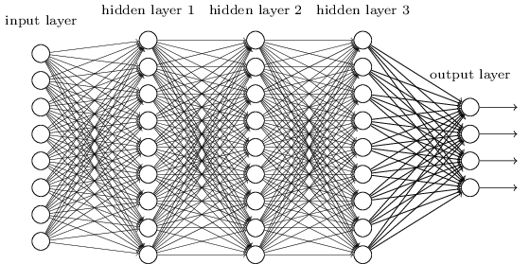
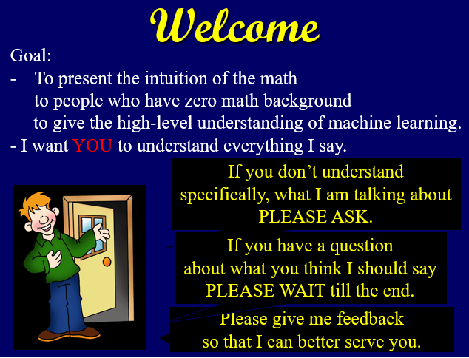
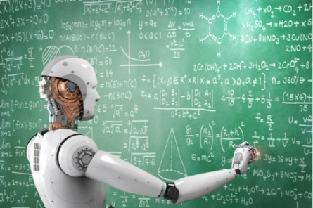
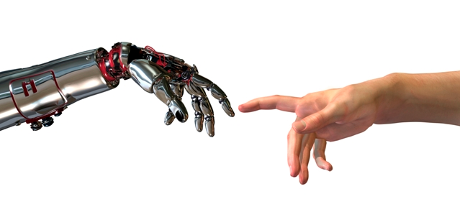




Machine Learning
1) Introduction
Magic
Overview
Abstract Thinking
List of Topics
Training Data
Machine
Neural Networks
Error Surface
Learning
Gradient Descent
Generalizing
Singularity
Jeff Edmonds, Comp. Sci.
www.eecs.yorku.ca/~jeff/courses/machine-learning
Notes:
4*1.5hrs - not Example …, not unsupervised.

Slide 2


Magic
Coding:
Neural Nets:
While( banking )
if( money is owed )
add interest and fees
w_{k}
- The instructions are
painstakingly written by
humans.
- Work great for simple
repetitive tasks.
The instructions are 100%
dictated by weights ⟨w₁,…,w_{m}⟩.
- Too hard to understand.
- They are learned using
a simple algorithm.
- Finding patterns in lots of data.

Slide 3
Magic
Coding:
Neural Nets:
While( running )
if( foot is here )
move it there
w_{k}
- Expert systems
of the 80’s failed.
- Though we are able to walk,
it is hard to explaining
how to do it!!!
- Walking has enough of a
pattern that machine learning
can copy it.

Slide 4

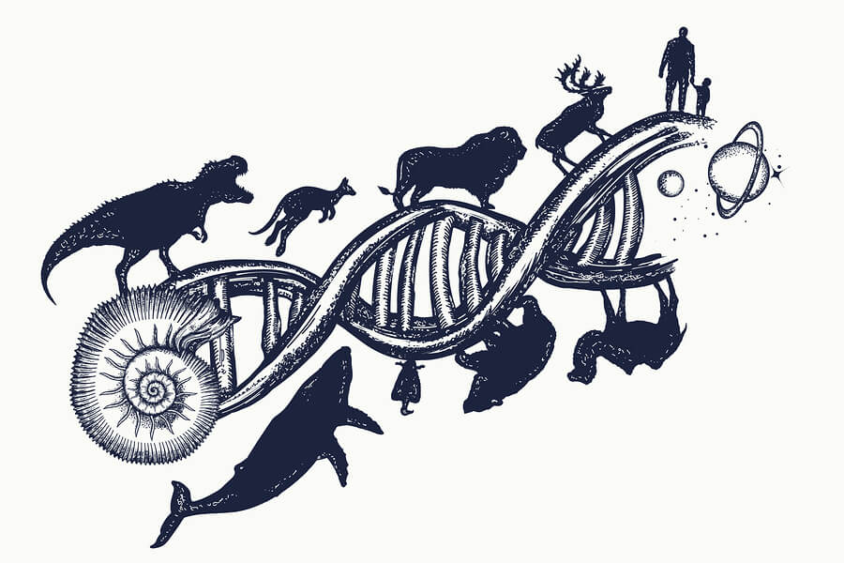
Magic
Add just a little random change
that is encouraged
by some feed back
to go in the right direction.
Emergent Complexity
And what arises
is awe inspiring

Slide 5

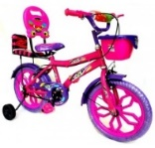
Magic
Add just a little random change
that is encouraged just a little
by some feed back
to go in the right direction.
No. That is not a face.
Emergent Complexity
And what arises
is awe inspiring

Slide 6
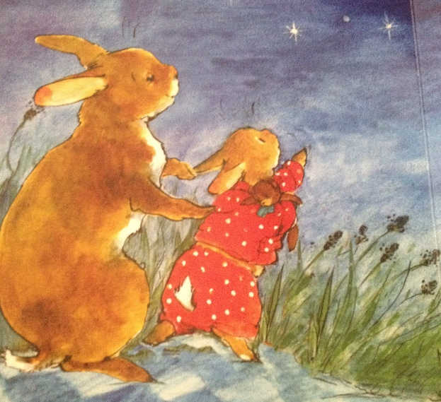
Magic
I find it oddly spiritual.
Emergent Complexity
And what arises
is awe inspiring

Slide 7
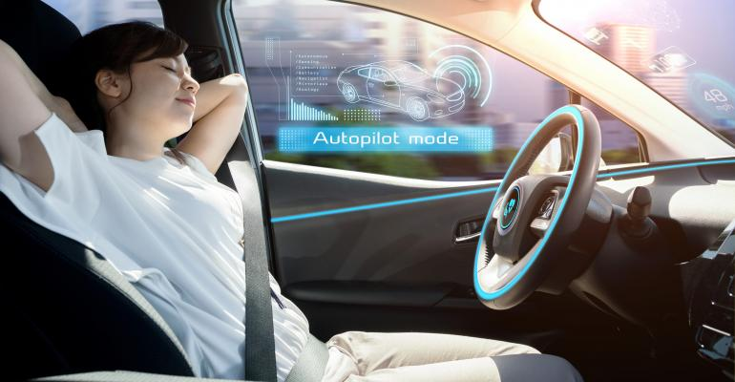
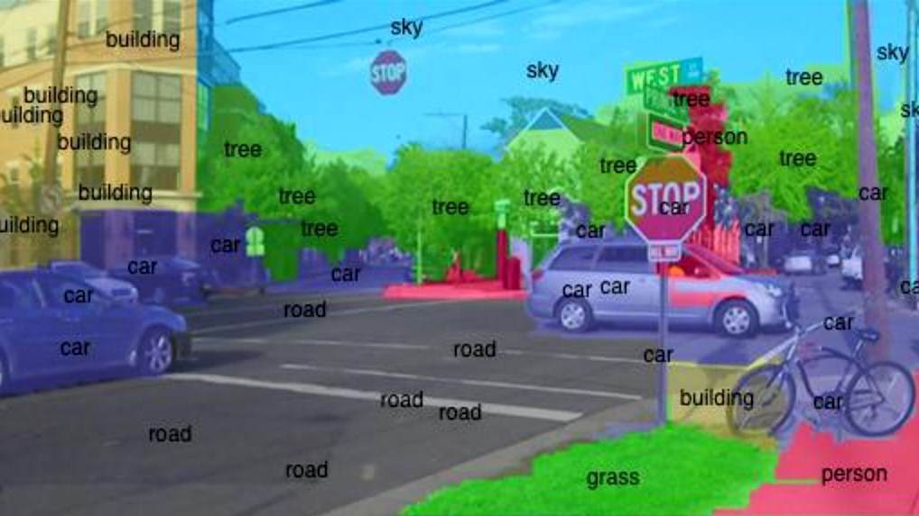
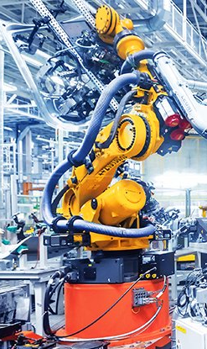
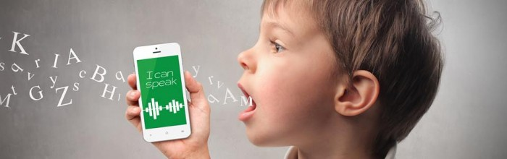
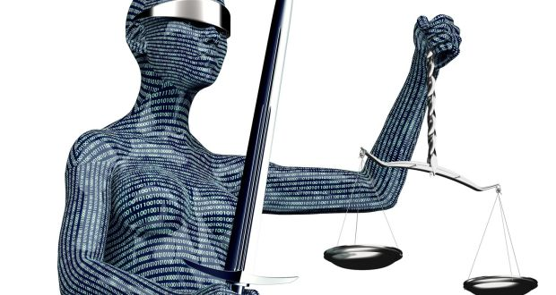

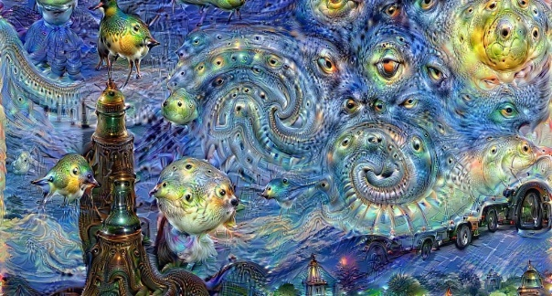
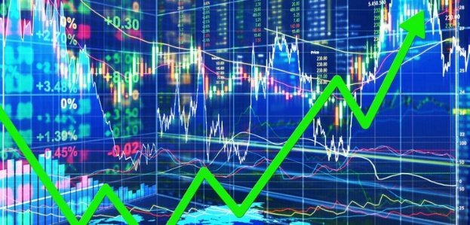
Hopeful Applications
Image processing
Self diving cars
Speech processing
  May make the world much
  better.
Art
Robots
Financial,
Medical Experts
Legal and

Slide 8
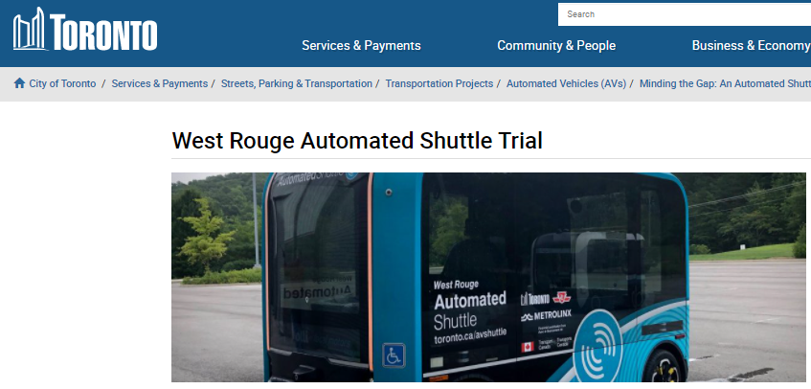
Hopeful Applications

Slide 9


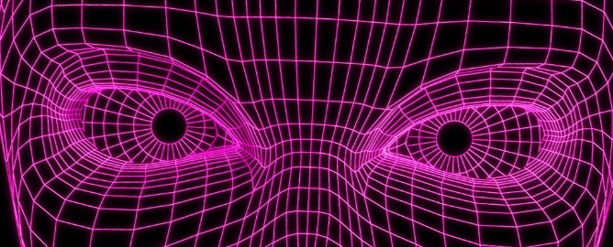
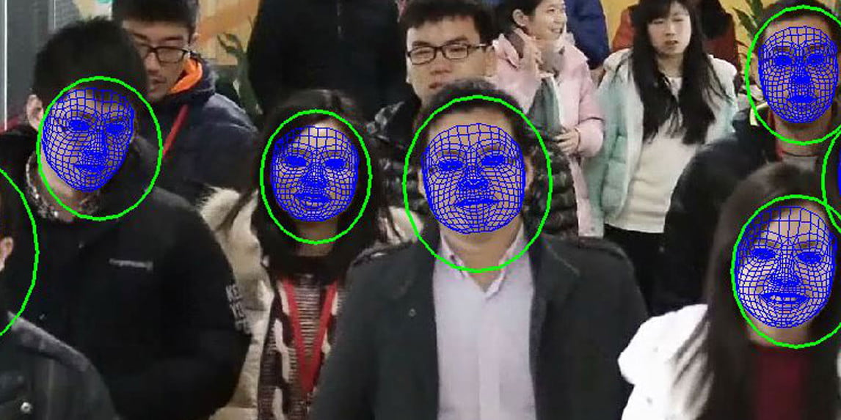

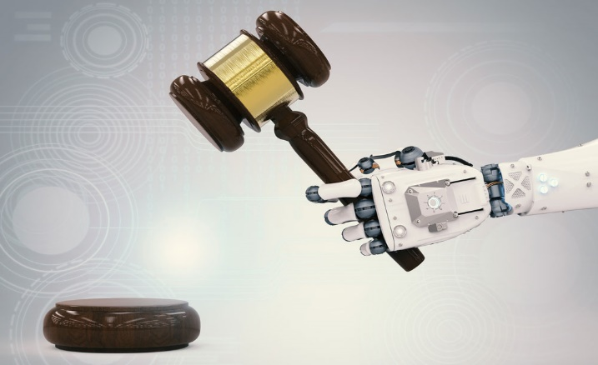
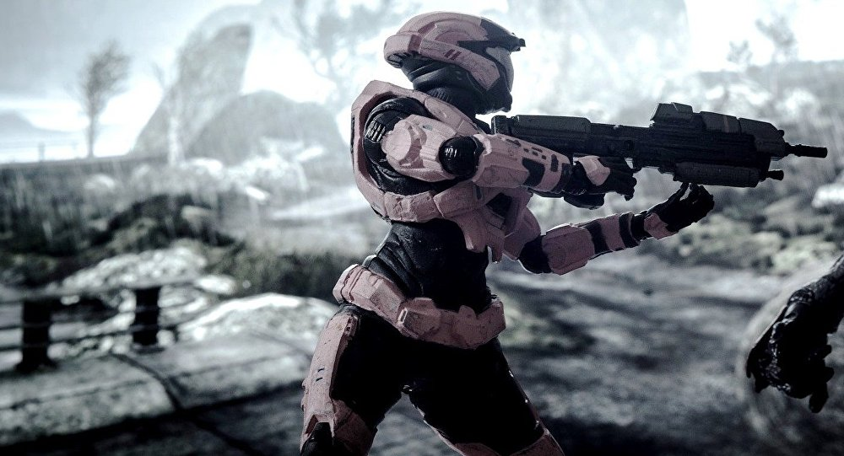
Scary Applications
By Watching You
  Customizing your world
  Pick out “criminals”
  in a crowd
Cyber Security
  Killing machines
  Judges

Slide 10
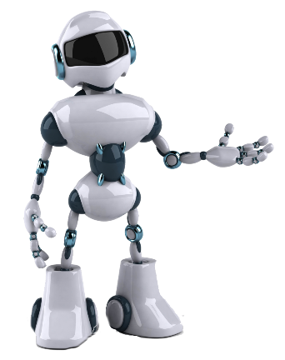
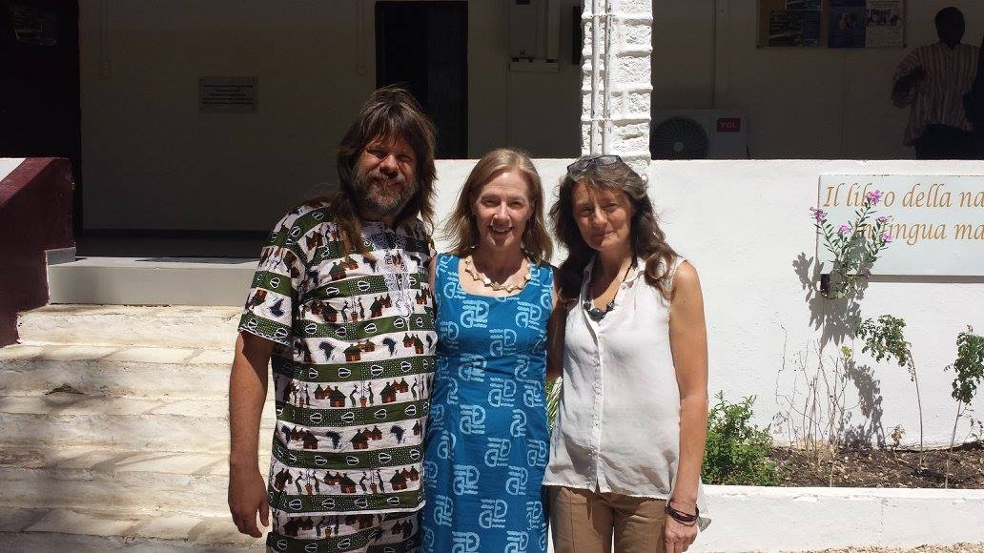
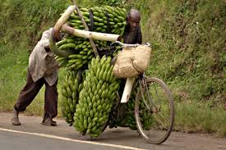
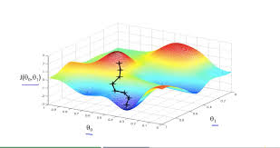


Overview
Good first try!
I am a machine
and I want to learn
to identify
faces and bicycles.
As your supervisor,
I give you
labeled training data
Goal
Here is a
measure of
your error.
face
bicycle
w_{k}
bicycle
face
bicycle
face
My current
weights ⟨w₁,…,w_{m}⟩.
⟨w₁,…,w_{m}⟩ visualized here
by my location.
How I answer questions
is 100% dictated by these.
w₁
w₂

Slide 11
Overview
Much better!
I am a machine
and I want to learn
to identify
faces and bicycles.
As your supervisor,
I give you
labeled training data
Here is a
measure of
your error.
face
bicycle
w_{k}
face
face
face
I learn by changing
my weights ⟨w₁,…,w_{m}⟩.
⟨w₁,…,w_{m}⟩ visualized here
by my location.
I increase weights w_{k} influencing
correct answers
and decrease those influencing
incorrect answers.
w₁
w₂

Slide 12
Overview
Much better!
I am a machine
and I want to learn
to identify
faces and bicycles.
As your supervisor,
I give you
labeled training data
Here is a
measure of
your error.
face
bicycle
w_{k}
face
face
face
This defines
the error surface.
⟨w₁,…,w_{m}⟩ visualized here
by my location.
I move in the direction and speed of steepest decent.
I hope to find
a deep valley
where the error is small.

Slide 13
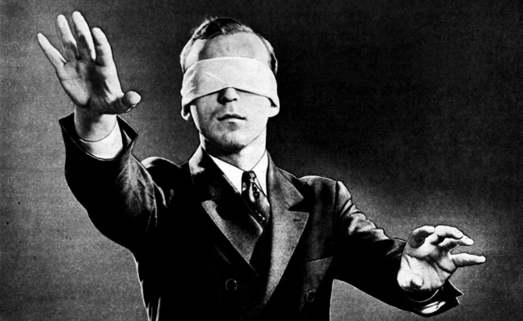
Overview
Much better!
I am a machine
and I want to learn
to identify
faces and bicycles.
As your supervisor,
I give you
labeled training data
Here is a
measure of
your error.
face
bicycle
w_{k}
face
face
face
⟨w₁,…,w_{m}⟩ visualized here
by my location.
We can’t really see
the whole
10000 dimensional
error functions.
w₁
w₂

Slide 14
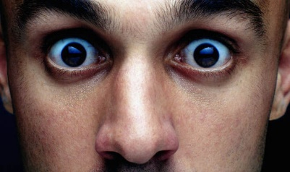
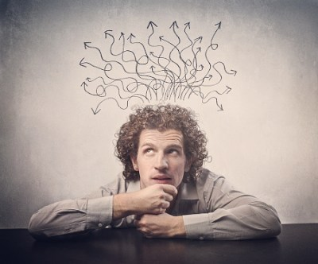

Abstract Thinking
We can talk about many aspects of Machine Learning,
without needing to know
The nature of machine $M_{\vec{w}}\left(\vec{x}\right)$
The nature of $\vec{x}$ and y.
We talk of knowing if image $\vec{x}$ is a face
without mentioning noses.
This simplicity lets us focus on what is important.
And ensures that what we say works for
any model of machine
any computational problem.

Slide 15
Abstract Thinking
We can talk about many aspects of Machine Learning,
without needing to know
The nature of machine $M_{\vec{w}}\left(\vec{x}\right)$
The nature of $\vec{x}$ and y.
We talk of knowing if image $\vec{x}$ is a face
without mentioning noses.
Trust me to tell you in each moment
what you need to know.
Try to understand what I do tell you.
Not what you think I should.

Slide 16
List of Topics
We will now give a list of the topics.
Don’t panic if you don’t fully understand it.
We will discuss each one separately.

Slide 17

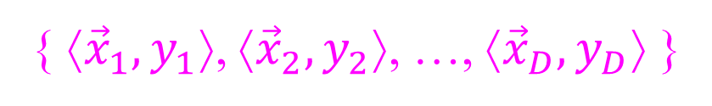


List of Topics
Machine learning with a supervisor to help.
Training data:
{ ⟨${\vec{x}}_{1},y_{1}$⟩, ⟨${\vec{x}}_{2},y_{2}$⟩, …, ⟨${\vec{x}}_{D},y_{D}$⟩ }
face
face
bicycle
Our goal is to learn a function.
Output y
$$\text{y}\text{d}$$
is the answer given by the supervisor.
Input $\vec{x}$
${\vec{x}}_{d}$ is the d^{th} training input.

Slide 18
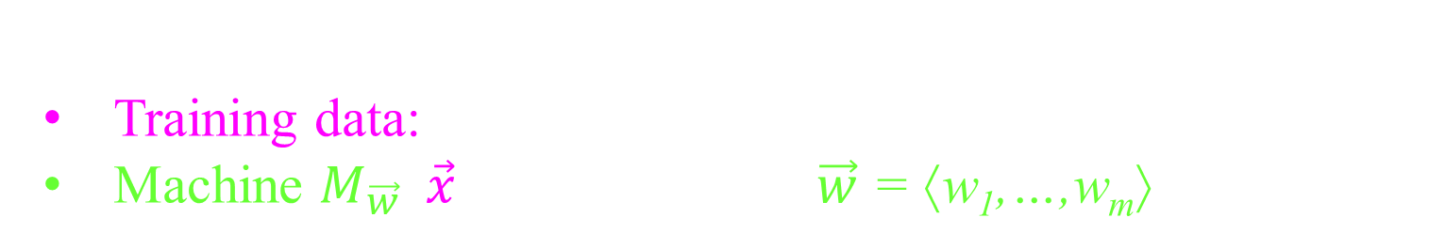

List of Topics
Machine learning with a supervisor to help.
Training data:
Machine $M_{\vec{w}}\left(\vec{x}\right)$ specified with $\vec{w}$ = ⟨w₁,…,w_{m}⟩.
{ ⟨${\vec{x}}_{1},y_{1}$⟩, ⟨${\vec{x}}_{2},y_{2}$⟩, …, ⟨${\vec{x}}_{D},y_{D}$⟩ }
x₁
w₁
w₂
cat
pixel_{i,j}
dog
face
bicycle.
x_{n}
w_{m}
E(w₁,…,w_{m})
Output y
$$\text{y}\text{d}$$
is the answer given by the supervisor.
$$M_{\vec{w}}\left({\vec{x}}_{d}\right)$$
is the answer given by machine.
Input $\vec{x}$
${\vec{x}}_{d}$ is the d^{th} training input.

Slide 19
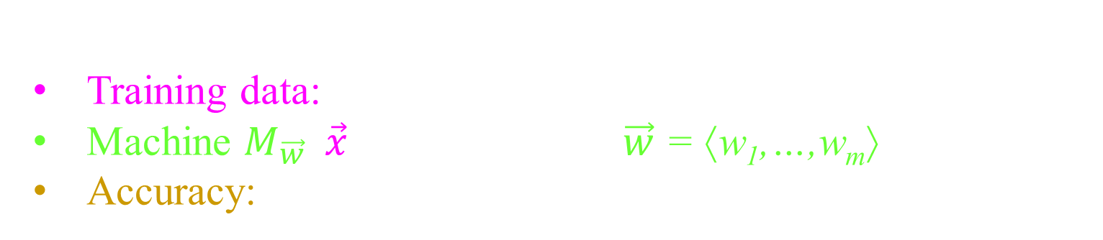

List of Topics
Machine learning with a supervisor to help.
Training data:
Machine $M_{\vec{w}}\left(\vec{x}\right)$ specified with $\vec{w}$ = ⟨w₁,…,w_{m}⟩.
Accuracy:
{ ⟨${\vec{x}}_{1},y_{1}$⟩, ⟨${\vec{x}}_{2},y_{2}$⟩, …, ⟨${\vec{x}}_{D},y_{D}$⟩ }
fraction data set for which the machine
got the correct answer.
Output y
$$\text{y}\text{d}$$
$$M_{\vec{w}}\left({\vec{x}}_{d}\right)$$
Input $\vec{x}$

Slide 20
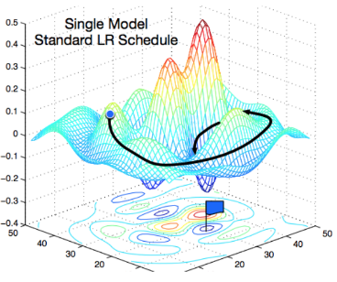
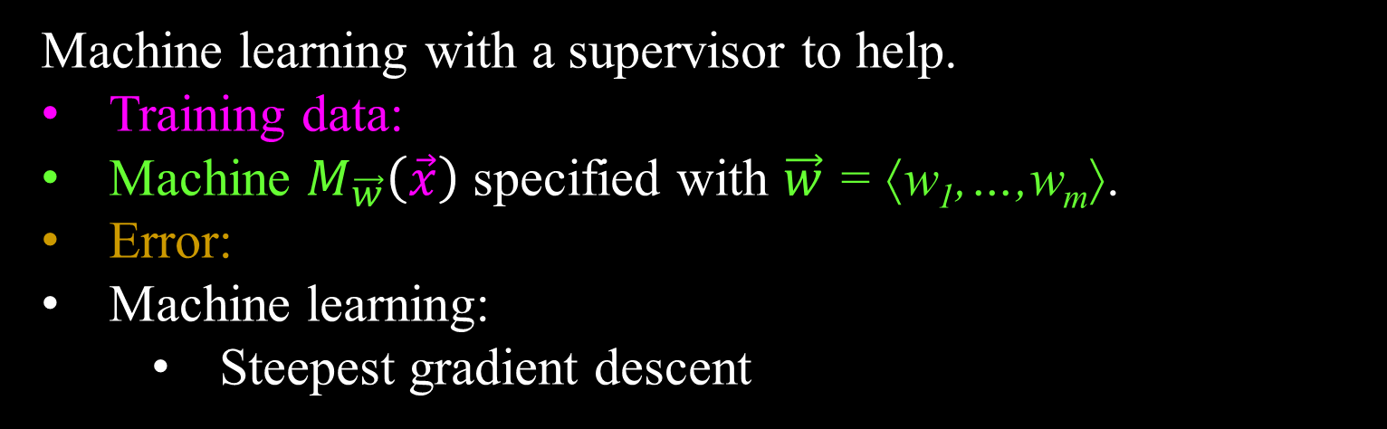
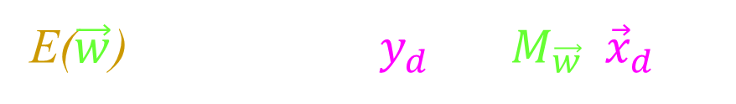

List of Topics
Machine learning with a supervisor to help.
Training data:
Machine $M_{\vec{w}}\left(\vec{x}\right)$ specified with $\vec{w}$ = ⟨w₁,…,w_{m}⟩.
Error:
Machine learning:
  Steepest gradient descent
{ ⟨${\vec{x}}_{1},y_{1}$⟩, ⟨${\vec{x}}_{2},y_{2}$⟩, …, ⟨${\vec{x}}_{D},y_{D}$⟩ }
E($\vec{w}$) = $\sum_{d=1..D}{{ ( y_{d} − M_{\vec{w}}\left({\vec{x}}_{d}\right) )}^{2}}$
${\vec{w}}_{opt}= {ArgMin}_{\vec{w}} E\left(\vec{w}\right)$
Output y
$$\text{y}\text{d}$$
Error
$$M_{\vec{w}}\left({\vec{x}}_{d}\right)$$
Input $\vec{x}$

Slide 21
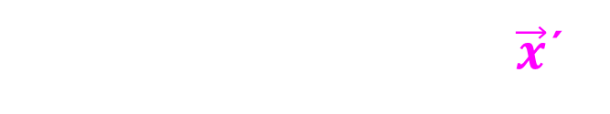
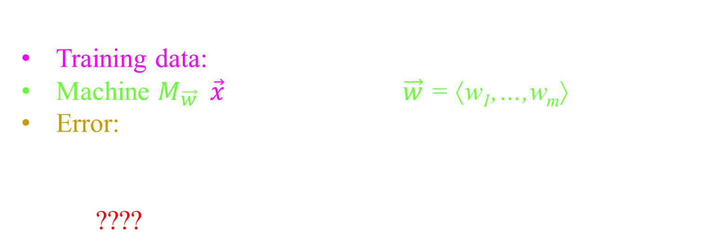

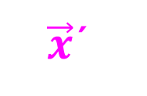
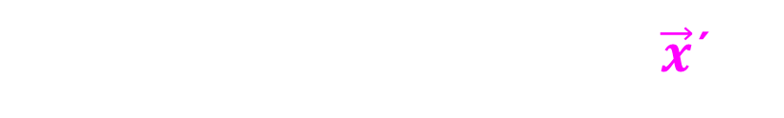

List of Topics
Machine learning with a supervisor to help.
Training data:
Machine $M_{\vec{w}}\left(\vec{x}\right)$ specified with $\vec{w}$ = ⟨w₁,…,w_{m}⟩.
Error:
Machine learning:
Generalising to other inputs
????
{ ⟨${\vec{x}}_{1},y_{1}$⟩, ⟨${\vec{x}}_{2},y_{2}$⟩, …, ⟨${\vec{x}}_{D},y_{D}$⟩ }
E($\vec{w}$) = $\sum_{d=1..D}{{ ( y_{d} − M_{\vec{w}}\left({\vec{x}}_{d}\right) )}^{2}}$
${\vec{w}}_{opt}= {ArgMin}_{\vec{w}} E\left(\vec{w}\right)$
$$\text{y}\text{d}$$
No supervisor's answer for $\vec{x}$´.
Output y
$$M_{\vec{w}}\left(\vec{x}\text{´}\right)$$
Machine's answer for $\vec{x}$´.
Input
$\vec{x}$´

Slide 22
Now we will go over
each topic slower.

Slide 23

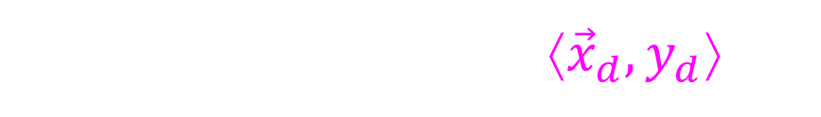
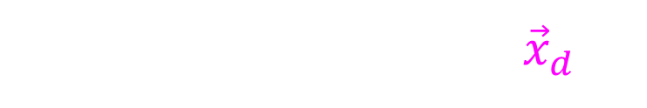



Supervised Training Data
Training data is a set of input/output pairs
{ ⟨${\vec{x}}_{1},y_{1}$⟩, ⟨${\vec{x}}_{2},y_{2}$⟩, …, ⟨${\vec{x}}_{D},y_{D}$⟩ }
For the graph we pretend ${\vec{x}}_{d} \text{and} y_{d}$ real numbers.
Each dot is a data item ⟨${\vec{x}}_{d},y_{d}$⟩.
Output y
$$\text{y}\text{d}$$
Supervisor's answer for ${\vec{x}}_{d}$.
Input
$$\vec{x}$$
$${\vec{x}}_{d}$$
The d^{th} training input.

Slide 24
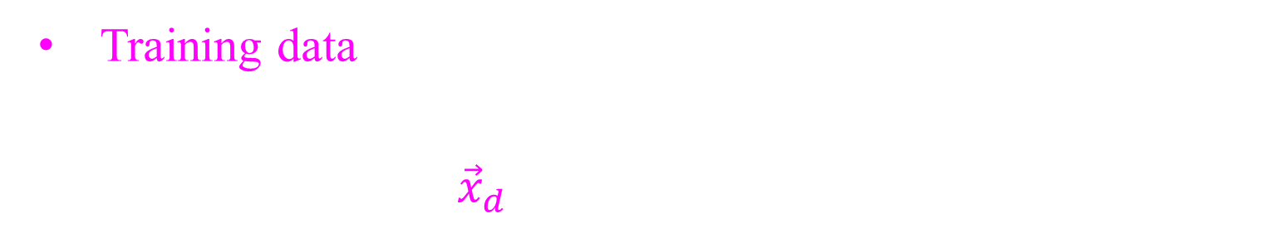
Supervised Training Data
Training data is a set of input/output pairs
Maybe each input ${\vec{x}}_{d}$ is an image
{ ⟨${\vec{x}}_{1},y_{1}$⟩, ⟨${\vec{x}}_{2},y_{2}$⟩, …, ⟨${\vec{x}}_{D},y_{D}$⟩ }
Each output y_{d} (provided by the supervisor)
Regression: y_{d} is a real value.
Categorizing: y_{d} labels it as a cat, dog, face, or bicycle.
Output y
$$\text{y}\text{d}$$
Supervisor's answer for ${\vec{x}}_{d}$.
Input
$${\vec{x}}_{d}$$
The d^{th} training input.

Slide 25


Supervised Training Data
Training data is a set of input/output pairs
Maybe each input ${\vec{x}}_{d}$ is an image
{ ⟨${\vec{x}}_{1},y_{1}$⟩, ⟨${\vec{x}}_{2},y_{2}$⟩, …, ⟨${\vec{x}}_{D},y_{D}$⟩ }
Each output y_{d} (provided by the supervisor)
Regression: y_{d} is a real value.
Categorizing: y_{d} labels it as a cat, dog, face, or bicycle.
Here is another way of visualizing it.
Each training data ${\vec{x}}_{d}$is a point in some space.
The Supervisor's answer $\text{y}\text{d}$is indicated with , ,vs .
Output y
$$\text{y}\text{d}$$
Input
$${\vec{x}}_{d}$$
$${\vec{x}}_{d}$$

Slide 26
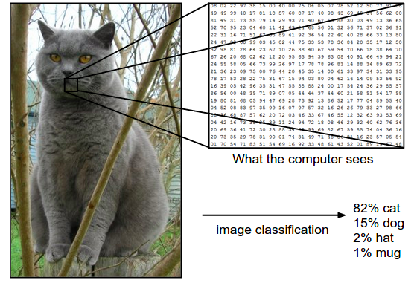
Supervised Training Data
Training data is a set of input/output pairs
Maybe each input ${\vec{x}}_{d}$ is an image
{ ⟨${\vec{x}}_{1},y_{1}$⟩, ⟨${\vec{x}}_{2},y_{2}$⟩, …, ⟨${\vec{x}}_{D},y_{D}$⟩ }
Each output y_{d} (provided by the supervisor)
Regression: y_{d} is a real value.
Categorizing: y_{d} labels it as a cat, dog, face, or bicycle.
The computer just
sees a big matrix of
numbers.
From this,
meaning must
be extracted.

Slide 27
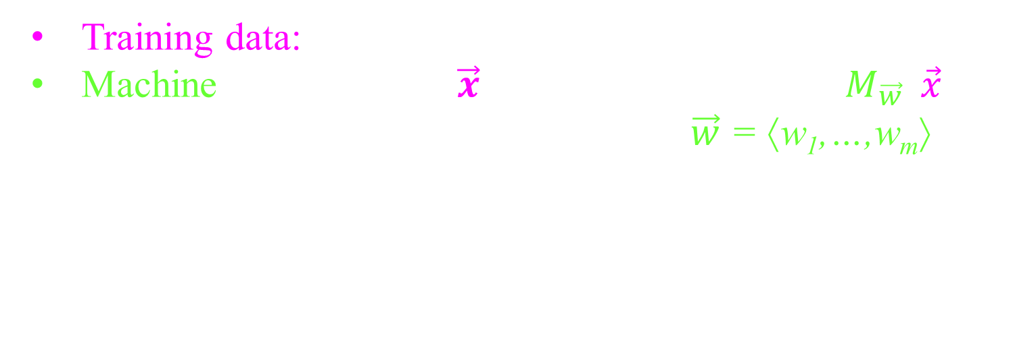
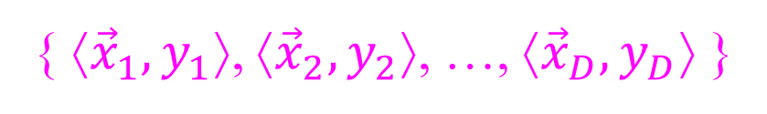
Machine
{ ⟨${\vec{x}}_{1},y_{1}$⟩, ⟨${\vec{x}}_{2},y_{2}$⟩, …, ⟨${\vec{x}}_{D},y_{D}$⟩ }
Training data:
Machine takes an input $\vec{x}$ and returns an answer $M_{\vec{w}}\left(\vec{x}\right)$.
  It is represented with m-weights: $\vec{w}$ = ⟨w₁,…,w_{m}⟩.
These are real value parameters.
This includes anything like that the learning process learns and remembers about the data and uses later to make predictions.
Output y
$$M_{\vec{w}}\left(\vec{x}\text{´}\right)$$
Machine's answer for $\vec{x}$´.
Input
$\vec{x}$´

Slide 28

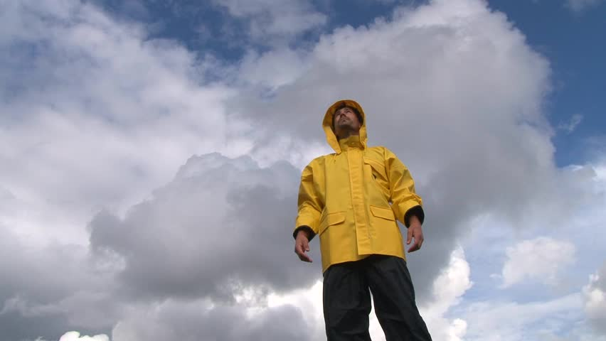
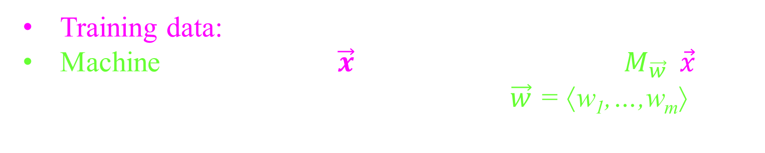
Machine
{ ⟨${\vec{x}}_{1},y_{1}$⟩, ⟨${\vec{x}}_{2},y_{2}$⟩, …, ⟨${\vec{x}}_{D},y_{D}$⟩ }
Training data:
Machine takes an input $\vec{x}$ and returns an answer $M_{\vec{w}}\left(\vec{x}\right)$.
  It is represented with m-weights: $\vec{w}$ = ⟨w₁,…,w_{m}⟩.
Example: linear
Maybe
y_{d} is likelihood of rain on day d.
x_{⟨d,1⟩} is whether there are clouds.
x_{⟨d,2⟩} the shirt the man is wearing.
w₁ and w₂ are their level of effect on rain.
?
$M_{\vec{w}}\left(\vec{x}\text{d}\right)$= w₀ + w₁ x_{⟨d,1⟩} + w₂ x_{⟨d,2⟩} + … + w_{n} x_{⟨d,n⟩}
Output y
Input $\vec{x}$

Slide 29
Machine
{ ⟨${\vec{x}}_{1},y_{1}$⟩, ⟨${\vec{x}}_{2},y_{2}$⟩, …, ⟨${\vec{x}}_{D},y_{D}$⟩ }
Training data:
Machine takes an input $\vec{x}$ and returns an answer $M_{\vec{w}}\left(\vec{x}\right)$.
  It is represented with m-weights: $\vec{w}$ = ⟨w₁,…,w_{m}⟩.
polynomial
Example: linear,
$M_{\vec{w}}\left(\vec{x}\text{d}\right)$= w₀ + w₁ x_{⟨d,1⟩} + w₂ x_{⟨d,2⟩} + … + w_{n} x_{⟨d,n⟩}
+ w_{m-1} x_{⟨d,1⟩} ² + w_{m} x_{⟨d,2⟩} ²
Output y
Hand picked
precomputed features
that we do linear regression on.
Input $\vec{x}$

Slide 30
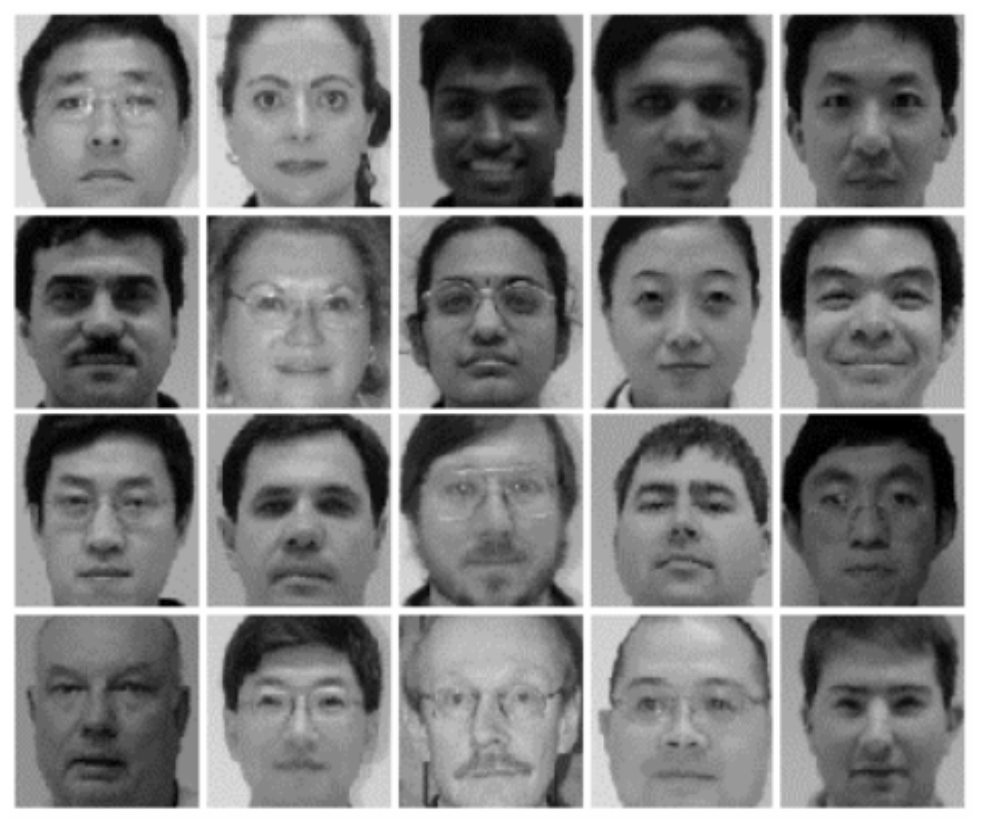
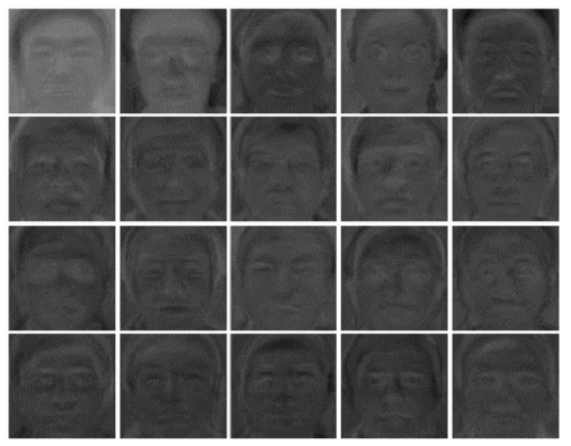

Machine
{ ⟨${\vec{x}}_{1},y_{1}$⟩, ⟨${\vec{x}}_{2},y_{2}$⟩, …, ⟨${\vec{x}}_{D},y_{D}$⟩ }
Training data:
Machine takes an input $\vec{x}$ and returns an answer $M_{\vec{w}}\left(\vec{x}\right)$.
  It is represented with m-weights: $\vec{w}$ = ⟨w₁,…,w_{m}⟩.
polynomial,
Neural Networks, …
Example: linear,
x₁
w₁
w₂
cat
pixel_{i,j}
dog
face
bicycle.
x_{n}
w_{m}
E(w₁,…,w_{m})
Each layer of the NN transforms the data.
Output y
$${\vec{x}}_{d}$$
Until it can categorize it.

Slide 31
Machine
{ ⟨${\vec{x}}_{1},y_{1}$⟩, ⟨${\vec{x}}_{2},y_{2}$⟩, …, ⟨${\vec{x}}_{D},y_{D}$⟩ }
Training data:
Machine takes an input $\vec{x}$ and returns an answer $M_{\vec{w}}\left(\vec{x}\right)$.
  It is represented with m-weights: $\vec{w}$ = ⟨w₁,…,w_{m}⟩.
polynomial,
Neural Networks, …
Example: linear,
x₁
w₁
w₂
cat
pixel_{i,j}
dog
face
bicycle.
x_{n}
w_{m}
E(w₁,…,w_{m})
Each layer of the NN transforms the data.
Output y
$${\vec{x}}_{d}$$
Until it can categorize it.

Slide 32
Machine
{ ⟨${\vec{x}}_{1},y_{1}$⟩, ⟨${\vec{x}}_{2},y_{2}$⟩, …, ⟨${\vec{x}}_{D},y_{D}$⟩ }
Training data:
Machine takes an input $\vec{x}$ and returns an answer $M_{\vec{w}}\left(\vec{x}\right)$.
  It is represented with m-weights: $\vec{w}$ = ⟨w₁,…,w_{m}⟩.
polynomial,
Neural Networks, …
Example: linear,
x₁
w₁
w₂
cat
pixel_{i,j}
dog
face
bicycle.
x_{n}
w_{m}
E(w₁,…,w_{m})
Each layer of the NN transforms the data.
Output y
Input $\vec{x}$
Set of all inputs:
Until it can categorize it.

Slide 33
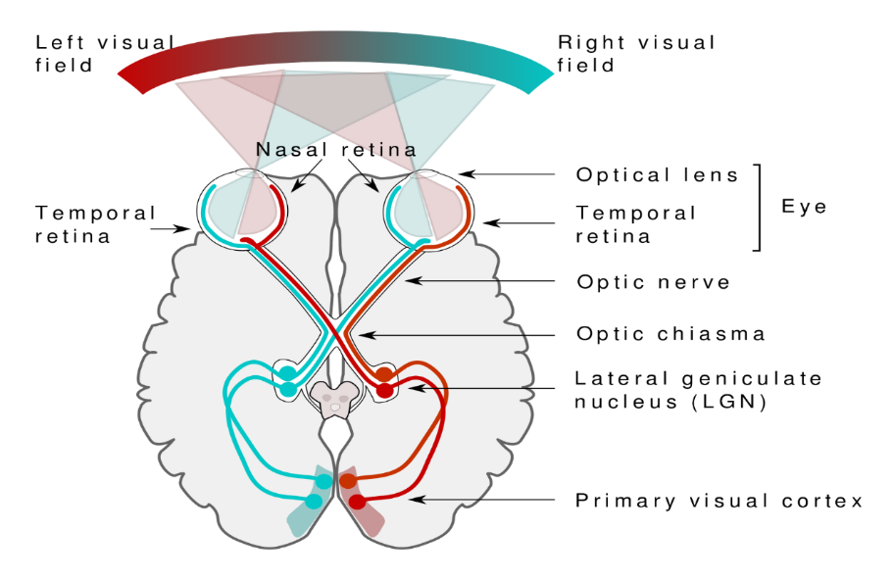
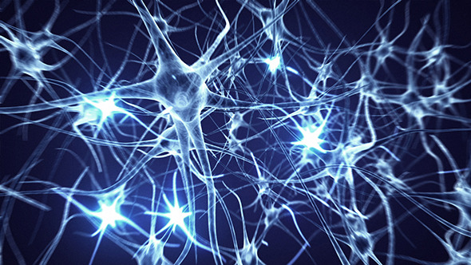
Neural Networks
A neuron:
When a neuron fires, it sends a signal to its neighbors across its synapses.
These synapses have different weights in their influence.
When a neuron’s incoming signal
reaches a threshold
it fires.

Slide 34

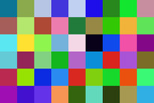







Neural Networks
An artificial neuron:
Input: $\vec{x}$= = ⟨x₁,…, x_{n}⟩.
x_{i} = = brightness of i^{th} pixel.
Eg: x₁=0.5, x₂=0.3, …, x_{n}=0.4.
Edge Weights $\vec{w}$ = ⟨w₀,w₁,…,w_{n}⟩.
w_{i} = influence of i^{th} pixel on neuron.
Eg: w₀=8, w₁=4, w₂=-2, …, w_{n}=9.
Total incoming signal: z = x₁×w₁ + x₂×w₂ +…+ x_{n}×w_{n}
= 0.5×4 + 0.3×(-2) +…+ 0.4×9
i
Don’t worry about colour
0.0=dark … 1.0=bright
×
+
w₀ +
8 +
i
= 18.2
0.5=
=4
0.3=
=-2
=8
$$z$$
= 18.2
$$y$$
=9
$$z= \sum_{i=0..n}{w_{i}}x_{i}$$
0.4=
y $=φ\left(z\right)= \frac{1}{1+e^{−z}}$

Slide 35

Neural Networks
An artificial neuron:
Total incoming signal: z = 18.2
y is the activation of the right unit.
In a brain, a neuron either fires or it doesn’t.
The picture is either a cat or not.
One might model this by
1 if z ≥ 0
0 else
y =
= 18.2
$$z$$
= -18.2
= 0
$$y$$
= 1
$$z= \sum_{i=0..n}{w_{i}}x_{i}$$
Linear Separator
y $=φ\left(z\right)= \frac{1}{1+e^{−z}}$

Slide 36





Neural Networks
An artificial neuron:
Total incoming signal: z = 18.2
y is the activation of the right unit.
In a brain, a neuron either fires or it doesn’t.
The picture is either a cat or not.
One might model this by
1 if z ≥ 0
0 else
y =
$$z$$
= 0
$$y$$
= 1
$$z= \sum_{i=0..n}{w_{i}}x_{i}$$
Linear Separator
These neurons can compute
AND
y $=φ\left(z\right)= \frac{1}{1+e^{−z}}$
OR
NOT
NOT

Slide 37
Neural Networks
So we can later hill climb,
we want change
to happen gracefully.
An artificial neuron:
Total incoming signal: z = 18.2
y is the activation of the right unit.
In a brain, a neuron either fires or it doesn’t.
The picture is either a cat or not.
One might model this by
Instead of YES/NO
allow maybe so.
1 if z ≥ 0
0 else
0.98
y =
0.02
$$z$$
= 0
$$y$$
= 1
$$z= \sum_{i=0..n}{w_{i}}x_{i}$$
y $=φ\left(z\right)= \frac{1}{1+e^{−z}}$

Slide 38
Neural Networks
So we can later hill climb,
we want change
to happen gracefully.
An artificial neuron:
Total incoming signal: z = 18.2
y is the activation of the right unit.
In a brain, a neuron either fires or it doesn’t.
The picture is either a cat or not.
One might model this by
Instead of YES/NO
allow maybe so.
y = Sigmoid(z)
= 0
= 18.2
$$z$$
= -18.2
= 0.5
= 0.02
$$y$$
= 0.98
$$z= \sum_{i=0..n}{w_{i}}x_{i}$$
y $=φ\left(z\right)= \frac{1}{1+e^{−z}}$

Slide 39

Neural Networks
So we can later hill climb,
we want change
to happen gracefully.
An artificial neuron:
Total incoming signal: z = 18.2
y is the activation of the right unit.
In a brain, a neuron either fires or it doesn’t.
The picture is either a cat or not.
One might model this by
Instead of YES/NO
allow maybe so.
y = Rectilinear(z)
(ReLU)
= -18.2
= 18.2
$$z$$
= -18.2
= -1.82
= 18.2
$$y$$
= 0
$$z= \sum_{i=0..n}{w_{i}}x_{i}$$
y $=φ\left(z\right)= \frac{1}{1+e^{−z}}$

Slide 40

Neural Networks
So we can later hill climb,
we want change
to happen gracefully.
An artificial neuron:
Total incoming signal: z = 18.2
y is the activation of the right unit.
In a brain, a neuron either fires or it doesn’t.
The picture is either a cat or not.
One might model this by
Instead of YES/NO
allow maybe so.
y = G??linear(z)
(GeLU)
$$z$$
$$y$$
$$z= \sum_{i=0..n}{w_{i}}x_{i}$$
y $=φ\left(z\right)= \frac{1}{1+e^{−z}}$

Slide 41
Neural Networks
$$y$$
$$z= \sum_{i=0..n}{w_{i}}x_{i}$$
y $=φ\left(z\right)= \frac{1}{1+e^{−z}}$

Slide 42

Neural Networks
Neural Network:
A layered network of artificial neurons (nodes/units).
Input: $\vec{x}$= = ⟨x₁,…, x_{n}⟩.
Desired Output y = “bike.”
Machine specified with $\vec{w}$ = ⟨w₁,…,w_{m}⟩ and input $\vec{x}$outputs $M_{\vec{w}}\left(\vec{x}\right)$.
i
Output
$$M_{\vec{w}}\left(\vec{x}\right)$$
cat
= 0.02
dog
= 0.01
x_{i}
face
= 0.05
bike
= 0.92
The machine says that the probability
that the input is a bike is 0.92

Slide 43


Neural Networks
Neural Network:
A layered network of artificial neurons (nodes/units).
Input: $\vec{x}$= = ⟨x₁,…, x_{n}⟩.
Edge Weights $\vec{w}$ = ⟨…, w_{⟨i,j⟩}, …⟩.
w_{⟨i,j⟩} = influence of i^{th} pixel j^{th} hidden node.
Desired Output y = “bike.”
Machine specified with $\vec{w}$ = ⟨w₁,…,w_{m}⟩ and input $\vec{x}$outputs $M_{\vec{w}}\left(\vec{x}\right)$.
j
Hidden layers
i
Output
$$M_{\vec{w}}\left(\vec{x}\right)$$
j
w_{⟨i,j⟩}
cat
= 0.02
dog
= 0.01
x_{i}
face
= 0.05
bike
= 0.92
Hidden layers have no human designated meaning.
Meaning is “learned” by choosing weights w_{⟨i,j⟩}.

Slide 44







Error Surface
{ ⟨${\vec{x}}_{1},y_{1}$⟩, ⟨${\vec{x}}_{2},y_{2}$⟩, …, ⟨${\vec{x}}_{D},y_{D}$⟩ }
Training data:
Machine $M_{\vec{w}}\left(\vec{x}\right)$ specified with $\vec{w}$ = ⟨w₁,…,w_{m}⟩.
Error of machine $M_{\vec{w}}$on this input ${\vec{x}}_{d}$:
E($\vec{w}$) = fraction data set
for which the machine
got the correct answer
$M_{\vec{w}}\left({\vec{x}}_{d}\right)$ = $\text{y}\text{d}$
But this E($\vec{w}$) is not smooth/differentiable with respect to $\vec{w}$.
Output y
$$\text{y}\text{d}$$
Supervisor's answer for ${\vec{x}}_{d}$.
$$M_{\vec{w}}\left({\vec{x}}_{d}\right)$$
Machine's answer for ${\vec{x}}_{d}$.
Input
$${\vec{x}}_{d}$$
The d^{th} training input.

Slide 45


Error Surface
{ ⟨${\vec{x}}_{1},y_{1}$⟩, ⟨${\vec{x}}_{2},y_{2}$⟩, …, ⟨${\vec{x}}_{D},y_{D}$⟩ }
Training data:
Machine $M_{\vec{w}}\left(\vec{x}\right)$ specified with $\vec{w}$ = ⟨w₁,…,w_{m}⟩.
Error of machine $M_{\vec{w}}$on this input ${\vec{x}}_{d}$:
$${\left(\text{y}\text{d}\text{−}M_{\vec{w}}\left({\vec{x}}_{d}\right) \right)}^{}$$
9.4-7.1 = 2.3
2.3
Output y
$$\text{y}\text{d}$$
= 9.4
= 7.1
Error
$$M_{\vec{w}}\left({\vec{x}}_{d}\right)$$
Input
$${\vec{x}}_{d}$$
The d^{th} training input.

Slide 46


Error Surface
{ ⟨${\vec{x}}_{1},y_{1}$⟩, ⟨${\vec{x}}_{2},y_{2}$⟩, …, ⟨${\vec{x}}_{D},y_{D}$⟩ }
Training data:
Machine $M_{\vec{w}}\left(\vec{x}\right)$ specified with $\vec{w}$ = ⟨w₁,…,w_{m}⟩.
Error of machine $M_{\vec{w}}$on this input ${\vec{x}}_{d}$:
$${\left(\text{y}\text{d}\text{−}M_{\vec{w}}\left({\vec{x}}_{d}\right) \right)}^{}$$
6.2-7.5 = -1.3
-1.3
2.3
Output y
$$M_{\vec{w}}\left({\vec{x}}_{d}\right)$$
= 7.5
$$\text{y}\text{d}$$
= 6.2
Error
Input
$${\vec{x}}_{d}$$
The d^{th} training input.

Slide 47


Error Surface
{ ⟨${\vec{x}}_{1},y_{1}$⟩, ⟨${\vec{x}}_{2},y_{2}$⟩, …, ⟨${\vec{x}}_{D},y_{D}$⟩ }
Training data:
Machine $M_{\vec{w}}\left(\vec{x}\right)$ specified with $\vec{w}$ = ⟨w₁,…,w_{m}⟩.
Error of machine $M_{\vec{w}}$on this input ${\vec{x}}_{d}$:
Square it:
  To make it positive.
  To punish big errors even more.
  Absolute values make the math near impossible.
2
$${\left(\text{y}\text{d}\text{−}M_{\vec{w}}\left({\vec{x}}_{d}\right) \right)}^{}$$
1.69
5.29
(+1)² = (-1) ² = 1
10² = 100
2
2
-1.3
2.3
Output y
$$\text{y}\text{d}$$
Error
$$M_{\vec{w}}\left({\vec{x}}_{d}\right)$$
Input
$${\vec{x}}_{d}$$
The d^{th} training input.

Slide 48



Error Surface
{ ⟨${\vec{x}}_{1},y_{1}$⟩, ⟨${\vec{x}}_{2},y_{2}$⟩, …, ⟨${\vec{x}}_{D},y_{D}$⟩ }
Training data:
Machine $M_{\vec{w}}\left(\vec{x}\right)$ specified with $\vec{w}$ = ⟨w₁,…,w_{m}⟩.
Error of machine $M_{\vec{w}}$on this input ${\vec{x}}_{d}$:
Square it.
Sum over all data items.
totaled over all the training data.
289.34
2
E($\vec{w}$) =
$\sum_{d=1..D}{}$
$${\left(\text{y}\text{d}\text{−}M_{\vec{w}}\left({\vec{x}}_{d}\right) \right)}^{}$$
+
1.69
5.29
2.75
4.52
3.95
2
2
2
2
2
-1.99
-1.3
2.3
1.67
2.12
Output y
Input $\vec{x}$

Slide 49

Error Surface
{ ⟨${\vec{x}}_{1},y_{1}$⟩, ⟨${\vec{x}}_{2},y_{2}$⟩, …, ⟨${\vec{x}}_{D},y_{D}$⟩ }
Training data:
Machine $M_{\vec{w}}\left(\vec{x}\right)$ specified with $\vec{w}$ = ⟨w₁,…,w_{m}⟩.
Error of machine $M_{\vec{w}}$on this input ${\vec{x}}_{d}$:
Square it.
Sum over all data items.
totaled over all the training data.
2
289.34 =
E($\vec{w}$) =
$\sum_{d=1..D}{}$
$${\left(\text{y}\text{d}\text{−}M_{\vec{w}}\left({\vec{x}}_{d}\right) \right)}^{}$$
Output y
Error E
289.34
Input $\vec{x}$
Weights $\vec{w}$

Slide 50





Error Surface
Different weights, i.e. $\vec{w}$ vs $\vec{w}$.
➔ the machine gives different answers
given same training data
Output
$$M_{\vec{w}}\left(\vec{x}\right)$$
w_{⟨i,j⟩}
cat
= 0.02
x_{i}
dog
= 0.01
face
= 0.05
bike
= 0.92
Output
$$M_{\vec{w}}\left(\vec{x}\right)$$
2
289.34 =
E($\vec{w}$) =
$\sum_{d=1..D}{}$
$${\left(\text{y}\text{d}\text{−}M_{\vec{w}}\left({\vec{x}}_{d}\right) \right)}^{}$$
w_{⟨i,j⟩}
cat
= 0.04
x_{i}
dog
= 0.07
face
= 0.03
bike
= 0.86
Output y
Error E
289.34
Input $\vec{x}$
Weights $\vec{w}$
vs $\vec{w}$

Slide 51





Error Surface
Different weights, i.e. $\vec{w}$ vs $\vec{w}$.
➔ the machine gives different answers
given same training data
➔ whose total error is different
Clearly we want to use the
machine with the better weights!
Note we think of this
error as a function
of the weights $\vec{w}$.
2
289.34 =
E($\vec{w}$) =
$\sum_{d=1..D}{}$
$${\left(\text{y}\text{d}\text{−}M_{\vec{w}}\left({\vec{x}}_{d}\right) \right)}^{}$$
2
437.52 =
E($\vec{w}$) =
$\sum_{d=1..D}{}$
$${\left(\text{y}\text{d}\text{−}M_{\vec{w}}\left({\vec{x}}_{d}\right) \right)}^{}$$
Output y
437.52
Error E
289.34
Input $\vec{x}$
Weights $\vec{w}$
vs $\vec{w}$

Slide 52



Error Surface
{ ⟨${\vec{x}}_{1},y_{1}$⟩, ⟨${\vec{x}}_{2},y_{2}$⟩, …, ⟨${\vec{x}}_{D},y_{D}$⟩ }
Training data:
Machine $M_{\vec{w}}\left(\vec{x}\right)$ specified with $\vec{w}$ = ⟨w₁,…,w_{m}⟩.
Error:
Machine Learning:
Given the training data,
find the weights $\vec{w}$,
that minimizes the error.
E($\vec{w}$) = $\sum_{d=1..D}{{ ( y_{d} − M_{\vec{w}}\left({\vec{x}}_{d}\right) )}^{2}}$
Note we think of this
error as a function
of the weights $\vec{w}$.
Output y
Error E
Input $\vec{x}$
Weights $\vec{w}$
vs $\vec{w}$

Slide 53

Error Surface
{ ⟨${\vec{x}}_{1},y_{1}$⟩, ⟨${\vec{x}}_{2},y_{2}$⟩, …, ⟨${\vec{x}}_{D},y_{D}$⟩ }
Training data:
Machine $M_{\vec{w}}\left(\vec{x}\right)$ specified with $\vec{w}$ = ⟨w₁,…,w_{m}⟩.
Error:
Machine Learning:
Given the training data,
find the weights $\vec{w}$,
that minimizes the error.
E($\vec{w}$) = $\sum_{d=1..D}{{ ( y_{d} − M_{\vec{w}}\left({\vec{x}}_{d}\right) )}^{2}}$
Note we think of this
error as a function
of the weights $\vec{w}$.
Error E
Minimum error
Weights
$${\vec{w}}_{opt}$$

Slide 54



Error Surface
{ ⟨${\vec{x}}_{1},y_{1}$⟩, ⟨${\vec{x}}_{2},y_{2}$⟩, …, ⟨${\vec{x}}_{D},y_{D}$⟩ }
Training data:
Machine $M_{\vec{w}}\left(\vec{x}\right)$ specified with $\vec{w}$ = ⟨w₁,…,w_{m}⟩.
Error:
Machine Learning:
E($\vec{w}$) = $\sum_{d=1..D}{{ ( y_{d} − M_{\vec{w}}\left({\vec{x}}_{d}\right) )}^{2}}$
${\vec{w}}_{opt}= {ArgMin}_{\vec{w}} E\left(\vec{w}\right)$
Note we think of this
error as a function
of the weights $\vec{w}$.
Find me the argument ${\vec{w}}_{opt}$that
gives the minimum error.
Error E
Minimum error
Weights
$${\vec{w}}_{opt}$$

Slide 55

Error Surface
{ ⟨${\vec{x}}_{1},y_{1}$⟩, ⟨${\vec{x}}_{2},y_{2}$⟩, …, ⟨${\vec{x}}_{D},y_{D}$⟩ }
Training data:
Machine $M_{\vec{w}}\left(\vec{x}\right)$ specified with $\vec{w}$ = ⟨w₁,…,w_{m}⟩.
Error:
Machine Learning:
E($\vec{w}$) = $\sum_{d=1..D}{{ ( y_{d} − M_{\vec{w}}\left({\vec{x}}_{d}\right) )}^{2}}$
${\vec{w}}_{opt}= {ArgMin}_{\vec{w}} E\left(\vec{w}\right)$
This graph pretends $\vec{w}$ = ⟨w₁⟩ is one real number.
Output
$$M_{\vec{w}}\left(\vec{x}\right)$$
w_{⟨i,j⟩}
cat
= 0.02
x_{i}
dog
= 0.01
face
= 0.05
bike
= 0.92
Error E
Minimum error
Weights
$${\vec{w}}_{opt}$$

Slide 56



Error Surface
{ ⟨${\vec{x}}_{1},y_{1}$⟩, ⟨${\vec{x}}_{2},y_{2}$⟩, …, ⟨${\vec{x}}_{D},y_{D}$⟩ }
Training data:
Machine $M_{\vec{w}}\left(\vec{x}\right)$ specified with $\vec{w}$ = ⟨w₁,…,w_{m}⟩.
Error:
Machine Learning:
E($\vec{w}$) = $\sum_{d=1..D}{{ ( y_{d} − M_{\vec{w}}\left({\vec{x}}_{d}\right) )}^{2}}$
${\vec{w}}_{opt}= {ArgMin}_{\vec{w}} E\left(\vec{w}\right)$
Lets pretend that $\vec{w}$ = ⟨w₁,w₂⟩ consists of two of real numbers
Error Surface
The weights
$\vec{w}$ = ⟨w₁,w₂⟩ specifies
where we stand.
E(w₁,…,w_{m})
$$\vec{w}$$
$$\vec{w}$$
The Error specifies
our altitude.
w₂
w₁

Slide 57

Error Surface
{ ⟨${\vec{x}}_{1},y_{1}$⟩, ⟨${\vec{x}}_{2},y_{2}$⟩, …, ⟨${\vec{x}}_{D},y_{D}$⟩ }
Training data:
Machine $M_{\vec{w}}\left(\vec{x}\right)$ specified with $\vec{w}$ = ⟨w₁,…,w_{m}⟩.
Error:
Machine Learning:
E($\vec{w}$) = $\sum_{d=1..D}{{ ( y_{d} − M_{\vec{w}}\left({\vec{x}}_{d}\right) )}^{2}}$
${\vec{w}}_{opt}= {ArgMin}_{\vec{w}} E\left(\vec{w}\right)$
Lets pretend that $\vec{w}$ = ⟨w₁,w₂⟩ consists of two of real numbers
Error Surface
The weights
$\vec{w}$ = ⟨w₁,w₂⟩ specifies
where we stand.
E(w₁,…,w_{m})
E(w₁,…,w_{m})
$$\vec{w}$$
$$\vec{w}$$
The Error specifies
our altitude.
w₂
$${\vec{w}}_{opt}$$
w₂
w₁
w₁

Slide 58

Error Surface
{ ⟨${\vec{x}}_{1},y_{1}$⟩, ⟨${\vec{x}}_{2},y_{2}$⟩, …, ⟨${\vec{x}}_{D},y_{D}$⟩ }
Training data:
Machine $M_{\vec{w}}\left(\vec{x}\right)$ specified with $\vec{w}$ = ⟨w₁,…,w_{m}⟩.
Error:
Machine Learning:
E($\vec{w}$) = $\sum_{d=1..D}{{ ( y_{d} − M_{\vec{w}}\left({\vec{x}}_{d}\right) )}^{2}}$
${\vec{w}}_{opt}= {ArgMin}_{\vec{w}} E\left(\vec{w}\right)$
Weights $\vec{w}$ = ⟨w₁,…,w_{m}⟩ consist of thousands of real numbers!
Error Surface
With 10,000 weights
with values 0..9
There are 10^{10,000} settings.
The weights
$\vec{w}$ = ⟨w₁,…,w_{m}⟩ specifies
where we stand.
A super computer
on each atom
of the universe
working for the age
of the universe
couldn’t dent this list!
We can’t really see
the whole
10,000 dimensional
error functions.
The Error specifies
our altitude.

Slide 59



Error Surface
{ ⟨${\vec{x}}_{1},y_{1}$⟩, ⟨${\vec{x}}_{2},y_{2}$⟩, …, ⟨${\vec{x}}_{D},y_{D}$⟩ }
Training data:
Machine $M_{\vec{w}}\left(\vec{x}\right)$ specified with $\vec{w}$ = ⟨w₁,…,w_{m}⟩.
Error:
Machine Learning:
E($\vec{w}$) = $\sum_{d=1..D}{{ ( y_{d} − M_{\vec{w}}\left({\vec{x}}_{d}\right) )}^{2}}$
${\vec{w}}_{opt}= {ArgMin}_{\vec{w}} E\left(\vec{w}\right)$
Weights $\vec{w}$ = ⟨w₁,…,w_{m}⟩ consist of thousands of real numbers!
Error Surface
This surface is smooth/differentiable:
An infinitesimally small change in $\vec{w}$
causes an infinitesimally small one in
$z= \sum_{i=0..n}{w_{i}}x_{i}$
$M_{\vec{w}}\left(\vec{x}\right)$
E($\vec{w}$)

Slide 60

Learning
{ ⟨${\vec{x}}_{1},y_{1}$⟩, ⟨${\vec{x}}_{2},y_{2}$⟩, …, ⟨${\vec{x}}_{D},y_{D}$⟩ }
Training data:
Machine $M_{\vec{w}}\left(\vec{x}\right)$ specified with $\vec{w}$ = ⟨w₁,…,w_{m}⟩.
Error:
Machine Learning:
Linear Regression:
If the “machines” are lines or polynomials,
then there are formulas that will give you ${\vec{w}}_{opt}$.
Note that these are linear in w₁,…,w_{m.}
E($\vec{w}$) = $\sum_{d=1..D}{{ ( y_{d} − M_{\vec{w}}\left({\vec{x}}_{d}\right) )}^{2}}$
${\vec{w}}_{opt}= {ArgMin}_{\vec{w}} E\left(\vec{w}\right)$
y_{d} = w₀ + w₁ x_{⟨d,1⟩} + w₂ x_{⟨d,2⟩} + … + w_{n} x_{⟨d,n⟩}
+ w_{m-1} x_{⟨d,1⟩} ² + w_{m} x_{⟨d,2⟩} ²
Output y
Input $\vec{x}$

Slide 61

Learning
{ ⟨${\vec{x}}_{1},y_{1}$⟩, ⟨${\vec{x}}_{2},y_{2}$⟩, …, ⟨${\vec{x}}_{D},y_{D}$⟩ }
Training data:
Machine $M_{\vec{w}}\left(\vec{x}\right)$ specified with $\vec{w}$ = ⟨w₁,…,w_{m}⟩.
Error:
Machine Learning:
Neural Networks:
It is much harder to find the weights ${\vec{w}}_{opt}$.
E($\vec{w}$) = $\sum_{d=1..D}{{ ( y_{d} − M_{\vec{w}}\left({\vec{x}}_{d}\right) )}^{2}}$
${\vec{w}}_{opt}= {ArgMin}_{\vec{w}} E\left(\vec{w}\right)$
  Weights w_{k} that influence correct answers are increased
  and those that influence wrong answers are decreased.
Output y
x₁
w₁
w₂
cat
pixel_{i,j}
dog
face
bicycle.
Input $\vec{x}$
x_{n}
w_{m}
E(w₁,…,w_{m})

Slide 62
Learning
{ ⟨${\vec{x}}_{1},y_{1}$⟩, ⟨${\vec{x}}_{2},y_{2}$⟩, …, ⟨${\vec{x}}_{D},y_{D}$⟩ }
Training data:
Machine $M_{\vec{w}}\left(\vec{x}\right)$ specified with $\vec{w}$ = ⟨w₁,…,w_{m}⟩.
Error:
Machine Learning:
Neural Networks:
It is much harder to find the weights ${\vec{w}}_{opt}$.
E($\vec{w}$) = $\sum_{d=1..D}{{ ( y_{d} − M_{\vec{w}}\left({\vec{x}}_{d}\right) )}^{2}}$
${\vec{w}}_{opt}= {ArgMin}_{\vec{w}} E\left(\vec{w}\right)$
  Weights w_{k} that influence correct answers are increased
  and those that influence wrong answers are decreased.
Output y
  This is called
  gradient descent
Input $\vec{x}$

Slide 63

Learning
{ ⟨${\vec{x}}_{1},y_{1}$⟩, ⟨${\vec{x}}_{2},y_{2}$⟩, …, ⟨${\vec{x}}_{D},y_{D}$⟩ }
Training data:
Machine $M_{\vec{w}}\left(\vec{x}\right)$ specified with $\vec{w}$ = ⟨w₁,…,w_{m}⟩.
Error:
Machine Learning:
Neural Networks:
It is much harder to find the weights ${\vec{w}}_{opt}$.
E($\vec{w}$) = $\sum_{d=1..D}{{ ( y_{d} − M_{\vec{w}}\left({\vec{x}}_{d}\right) )}^{2}}$
${\vec{w}}_{opt}= {ArgMin}_{\vec{w}} E\left(\vec{w}\right)$
We find a local optimal
not a global one.
E
Output y
w
  This is called
  gradient descent
Input $\vec{x}$

Slide 64





Gradient Descent
Machine Learning:
${\vec{w}}_{opt}= {ArgMin}_{\vec{w}} E\left(\vec{w}\right)$
We find ${\vec{w}}_{opt}$using gradient descent.
Which direction is steepest?
The direction
water flows

Slide 65

Gradient Descent
Machine Learning:
${\vec{w}}_{opt}= {ArgMin}_{\vec{w}} E\left(\vec{w}\right)$
We find ${\vec{w}}_{opt}$using gradient descent.
Error Surface
The weights
$\vec{w}$ = ⟨w,w₂⟩ specifies
where we stand.
E(w₁,…,w_{m})
$$\vec{w}$$
The Error specifies
our altitude.
w₂
w₁

Slide 66

Gradient Descent
The way to find the bottom of the valley
is to keep going down.
Error Surface
The weights
$\vec{w}$ = ⟨w,w₂⟩ specifies
where we stand.
E(w₁,…,w_{m})
The Error specifies
our altitude.
w₂
w₁

Slide 67

Gradient Descent
Method for finding weights ⟨w₁,..,w_{m}⟩ that minimize error E(w₁,..,w_{m}):
  Start with random ⟨w₁,..,w_{m}⟩.
  Repeat:
  Find the direction and slope of steepest descent.
  Change ⟨w₁,..,w_{m}⟩ by a small step in this direction.
  Stop when at the bottom of a valley.
  Hope that this is a particularly low location.
The weights
$\vec{w}$ = ⟨w,w₂⟩ specifies
where we stand.
E(w₁,…,w_{m})
The Error specifies
our altitude.
$${\vec{w}}_{opt}$$
w₂
w₁

Slide 68
Gradient Descent
Method for finding weights ⟨w₁,..,w_{m}⟩ that minimize error E(w₁,..,w_{m}):
  Start with random ⟨w₁,..,w_{m}⟩.
  Repeat:
  We know where we are ⟨w₁,..,w_{m}⟩.
  Calculate our height E(w₁,..,w_{m}).
  Calculate the direction and slope of steepest descent.
  Change ⟨w₁,..,w_{m}⟩ by a small step in this direction & speed.
  Stop when every direction is up.
E(w₁,…,w_{m})
But we can’t see
the whole
10000 dimensional
error functions.
w₂
w₁

Slide 69
Gradient Descent
  Calculate our height E(w₁,..,w_{m})
using Forward Propagation.
cat
= 0.02
dog
= 0.01
E(w₁,..,w_{m})
face
= 0.05
bike
= 0.92

Slide 70
Gradient Descent
  Calculate the direction of steepest descent
using Backward Propagation.
cat
= 0.02
dog
= 0.01
E(w₁,..,w_{m})
face
= 0.05
bike
= 0.92

Slide 71




Generalizing from Training Data
{ ⟨${\vec{x}}_{1},y_{1}$⟩, ⟨${\vec{x}}_{2},y_{2}$⟩, …, ⟨${\vec{x}}_{D},y_{D}$⟩ }
Training data:
Machine Learning:
This machine is optimized for the training data.
But how well does it generalize to other inputs?
${\vec{w}}_{opt}= {ArgMin}_{\vec{w}} E\left(\vec{w}\right)$
Output y
$$\text{y}\text{d}$$
Supervisor's answer for ${\vec{x}}_{d}$.
$$M_{\vec{w}}\left({\vec{x}}_{d}\right)$$
Machine's answer for ${\vec{x}}_{d}$.
$${\vec{x}}_{d}$$
Input

Slide 72





Generalizing from Training Data
{ ⟨${\vec{x}}_{1},y_{1}$⟩, ⟨${\vec{x}}_{2},y_{2}$⟩, …, ⟨${\vec{x}}_{D},y_{D}$⟩ }
Training data:
Machine Learning:
This machine is optimized for the training data.
But how well does it generalize to other inputs?
${\vec{w}}_{opt}= {ArgMin}_{\vec{w}} E\left(\vec{w}\right)$
$$\text{y}$$
No supervisor's answer for $\vec{x}$´.
Output y
$$M_{\vec{w}}\left(\vec{x}\text{´}\right)$$
Machine's answer for $\vec{x}$´.
Input
$\vec{x}$´

Slide 73
Generalizing from Training Data
{ ⟨${\vec{x}}_{1},y_{1}$⟩, ⟨${\vec{x}}_{2},y_{2}$⟩, …, ⟨${\vec{x}}_{D},y_{D}$⟩ }
Training data:
Machine Learning:
This machine is optimized for the training data.
But how well does it generalize to other inputs?
${\vec{w}}_{opt}= {ArgMin}_{\vec{w}} E\left(\vec{w}\right)$
Which of these three gives the best answers on
The training inputs?
General inputs?
There is a “no free lunch” theorem
that says that no one method works in all cases.
But there are a few principles.

Slide 74

Generalizing from Training Data
Underfitting:
If you just don’t have the capacity
you cant learn the material.

Slide 75

Generalizing from Training Data
Overfitting:
If you cheat by making a table of all the answers,
then you learn nothing
and are stuck when a new question comes.
Any m points can be fit exactly by
m lines of table look up
m-degree polynomial
Neural Networks with
~m hidden units

Slide 76

Generalizing from Training Data
Compression:
If you summarize the material,
then hopefully you understand it
and do well when a new question comes.

Slide 77

Generalizing from Training Data
Compression:

Slide 78

Generalizing from Training Data
Compression:
  Because answers {y₁, y₁,…,y_{10,000}}
  can be reproduced from the weights ⟨w₁,..,w_{m}⟩,
  this is compressing 10,000 numbers into m.
Given training data
learn weights w_{k}.
⟨w₁,..,w_{m}⟩
Encode
Compress
w_{k}
⟨y₁=face, …,
$\text{y}\text{10,000}$=bicycle⟩
Decode
m measures complexity of Machines {$M_{\vec{w}}$}
m=100
m=1,000
m=20,000
Too much Compression
Compression
No Compression

Slide 79

Generalizing from Training Data
% Errors
Overfitting
Compression
General Inputs
Underfitting
D Training Inputs
m measures complexity of Machines {$M_{\vec{w}}$}
m=100
m=1,000
m=20,000
Too much Compression
Compression
No Compression

Slide 80


Generalizing from Training Data
Regularization:
${\vec{w}}_{opt}= {ArgMin}_{\vec{w}} [ E\left(\vec{w}\right)$ + λ Complexity(M$\vec{w}$) ]
Find me weights w for which:
The training data error is small
The machine is reasonably simple.
Hopefully its general input error is small.
% Errors
Trade
off
m measures complexity of Machines {$M_{\vec{w}}$}
m=100
or m = $\sum_{i}{{\left(w_{i}\right)}^{2}}$
(Differentiable)
m=1,000
m=20,000
Too much Compression
Compression
No Compression

Slide 81



Generalizing from Training Data
Theory: PAC-Learnable (Probably Approximately Correct)
If on the randomly chosen training data,
a machine is found that gives good answers,
without simply memorizing,
then we can prove that with high probability
this same machine will also work well
on never seen before instances.

Slide 82
Generalizing from Training Data
Theory: PAC-Learnable (Probably Approximately Correct)
The proof does not measure the quality of the machine
but of the training data.
If the data is chosen randomly then with high probability
it is representative of the entire universe of possible data.

Slide 83


The Singularity
What does life
look like here?
12:00pm

Slide 84
Machine Learning
Seven IEEE Talks
1: Introduction to Machine Learning
2: Algebra Review
3: Generalizing from Training Data
4: Reinforcement Learning Game Tree / Markoff Chains
5: Dimension Reduction & Maximum Likelihood
6: Generative Adversarial Networks
7: Ethics
Jeff Edmonds, Comp. Sci.
www.eecs.yorku.ca/~jeff/courses
Notes:
4*1.5hrs - not Example …, not unsupervised.

Slide 85


Slide 86
Overview
Much better!
I am a machine
and I want to learn
to identify
faces and bicycles.
As your supervisor,
I give you
labeled training data
Here is a
measure of
your error.
face
bicycle
w_{k}
face
face
face
This defines
the error surface.
⟨w₁,…,w_{m}⟩ visualized here
by my location.
I move in the direction and speed of steepest decent.
I hope to find
a deep valley
where the error is small.

Slide 87




2: Algebra Review
Way too much information for one talk.
While other talks are have too little.

Slide 88
3: Generalizing from Training Data
% Errors
Overfitting
Compression
General Inputs
Underfitting
D Training Inputs
Complexity m of Machines {$M_{\vec{w}}$}

Slide 89




4: Reinforcement Learning
Game Tree / Markoff Chains
    Learn from future rewards what steps to take

Slide 90

5: Dimension Reduction & Maximum Likelihood
Described by
10,000 numbers
Described by
100 numbers
pixel x₂
z₁
pixel x₁

Slide 91


6: Generative Adversarial Networks
Unsupervised Machine Learning
Lets just try to mimic the true distribution.
w₁
A distribution
of random bits
01001011
w_{m}
Discerner tries to tell if its input came
from the true distribution
or the mimic
w₁
A distributions
on legal inputs
Mimic
w_{m}
Wrong

Slide 92
7: Ethics
By Watching You
  Customizing your world
  Pick out “criminals”
  in a crowd
Cyber Security
  Killing machines
  Judges

Slide 93

Bayesian Inference
Causal Graph
A (Disease)
B (Symptoms)
https://www.eecs.yorku.ca/~jeff/courses/fun/
Calculating probabilities differently to handle causality

Slide 94








Building a Computer
From Sand
GCD(a,b) = GCD(x,y)
<x,y>
⇒ <y,x mod y>
https://www.eecs.yorku.ca/~jeff/courses/fun/Building_Computer.pptx

Slide 95

End
Thanks
for coming
Do you have any questions?
Please give me feedback
so that I can better serve you.
Notes:
95

Slide 97

Machine
Learning
Introduction
Magic
Overview
Training Data
Machine
Neural Networks
Error Surface
Learning
Gradient Descent
Generalizing
Singularity
Jeff Edmonds
www.eecs.yorku.ca/~jeff/courses
Notes:
4*1.5hrs - not Example …, not unsupervised.

Slide 98
Welcome
Goal:
To present the intuition of the math
to people who have zero math background
to give the high-level understanding of machine learning.
- I want YOU to understand everything I say.
If you don’t understand
specifically, what I am talking about
PLEASE ASK.
If you have a question
about what you think I should say
PLEASE WAIT till the end.
Please give me feedback
so that I can better serve you.
Notes:
98

