Slide 1
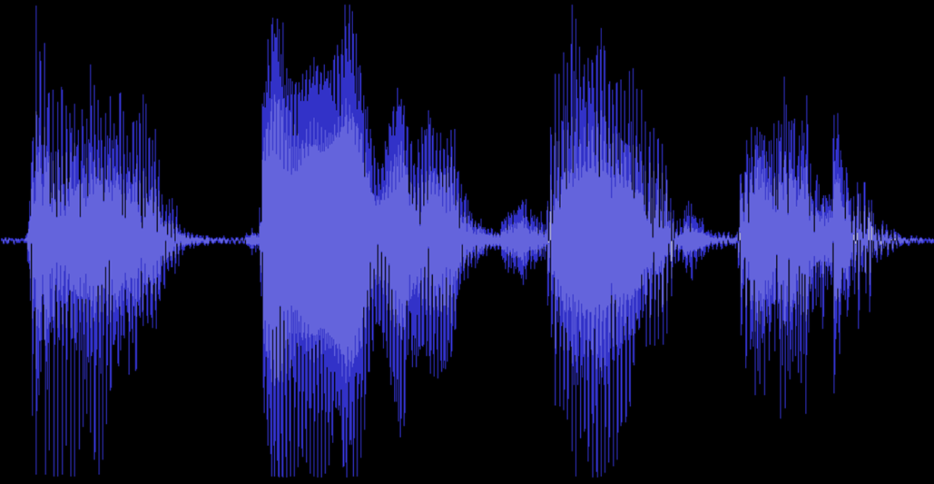
Grad Algorithms
Fourier Transformations
Fourier Transformation (sine)
Fourier Transformation (JPEG)
Change from Time to Polynomial Basis
Evaluating & Interpolating
FFT in nlogn Time
Roots of Unity
Same FFT Code & Butterfly
Inverse FFT
Sin and Cos Basis
FFT Butterfly
Polynomial Multiplication
Integer Multiplication
Jeff Edmonds
York University
COSC 6111

Slide 2
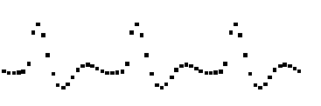

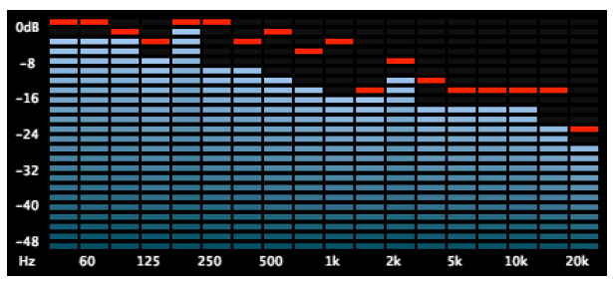
Fourier Transformation
A discrete periodic function
y[j]
j
Find the contribution
of each frequency
Swings, capacitors, and inductors
all resonate at a given frequency,
which is how the circuit picks out
the contribution of a given frequency.
Expressing a function as a sum of sine and cosine functions.

Slide 3
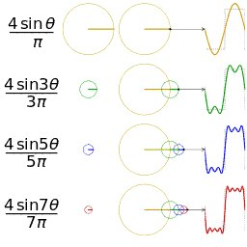
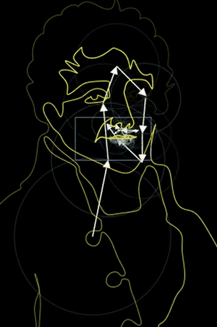
Fourier Transformation
Sum of sine waves gives anything

Slide 4
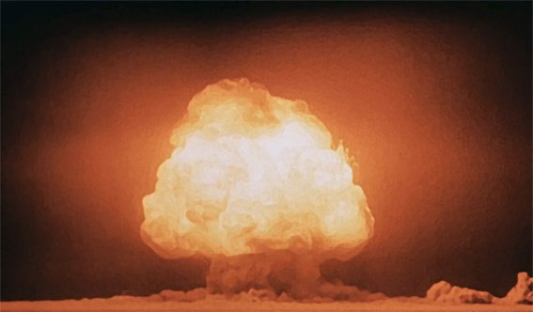
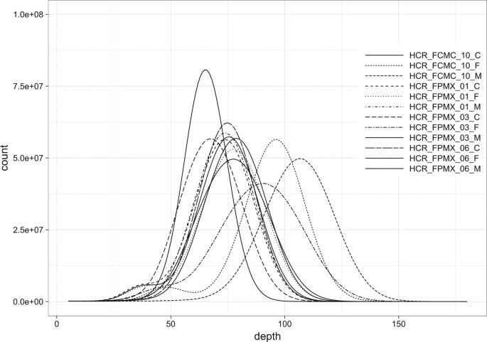
Fourier Transformation
It they had know that FTP
can detect underground nuclear testing
there may not have been an arms race.

Slide 5
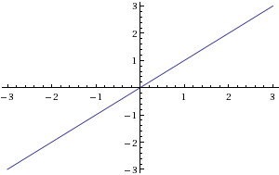
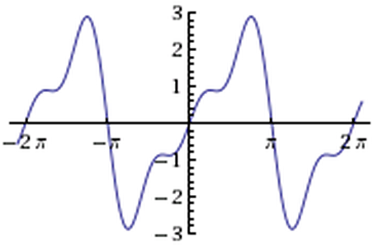
Fourier Transformation
y(x) = x
Surely this can’t be expressed
as sum of sines and cosines.
y(x) ≈ 2 sin(x) - sin(2x) + 2/3 sin(3x)

Slide 6
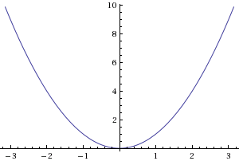
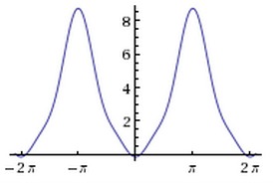
Fourier Transformation
y(x) = x²
y(x) ≈ -4 sin(x) + sin(2x) - 4/9 sin(3x)

Slide 7
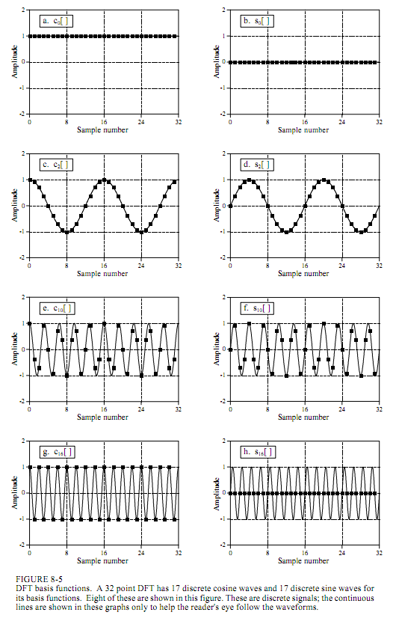
Sine & Cos
Frequency Domain
  w_{f}
´
Function = Vector
Time Domain
A discrete periodic function
The time basis
  v
  w_{j}
y[j]
I_{j}[j’]
  a_{j}
one
zero
j
j
j’
    v = a₁w₁+a₂w₂ +… + a_{d}w_{d}
    v = a₁w₁+a₂w₂ +… + a_{d}w_{d}
´
´
´
´
´
´
a_{t} = value at time t.
a_{f} = amount of frequency f.
´
Standard
Strange
  Basis = ⟨w₁,w₂⟩
  = ⟨ , ⟩
Change of Basis
  Basis = ⟨w₁,w₂⟩
  = ⟨ , ⟩
v =
v =
⟨a₁,a₂⟩ =
  ⟨3,-1⟩
  ⟨a₁,a₂⟩ =
  ⟨3,4⟩
´
´
Notes:
7

Slide 8
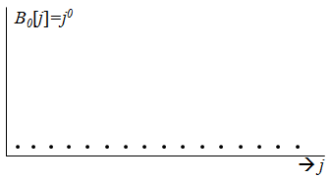
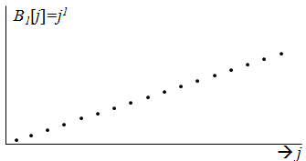
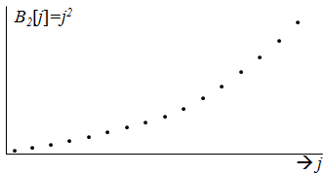
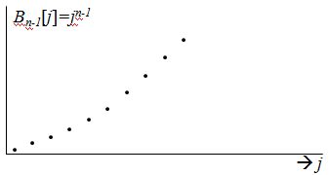
Polynomials
Polynomial Domain
w₀=1
Function = Vector
´
Time Domain
A discrete periodic function
w₁=x
The time basis
´
  w_{j}
  v
I_{j}[j’]
y[j]
  a_{j}
one
w₂=x²
zero
´
j
j
j’
w₃=x³
´
    v = a₁w₁+a₂w₂ +… + a_{d}w_{d}
v = a₀+a₁x +a₂x² + … + a_{n-1}x^{n-1}
´
´
´
´
a_{t} = value at time t.
a_{i} = coefficient of x^{i}.
´
Standard
Strange
  Basis = ⟨w₁,w₂⟩
  = ⟨ , ⟩
Change of Basis
  Basis = ⟨w₁,w₂⟩
  = ⟨ , ⟩
v =
v =
⟨a₁,a₂⟩ =
  ⟨3,-1⟩
  ⟨a₁,a₂⟩ =
  ⟨3,4⟩
´
´
Notes:
8

Slide 9
Polynomials
Polynomial Domain
w₀=1
Function = Vector
´
Time Domain
A discrete periodic function
w₁=x
The time basis
´
  w_{j}
  v
I_{j}[j’]
y[j]
  a_{j}
one
w₂=x²
zero
´
j
j
j’
w₃=x³
´
    v = a₁w₁+a₂w₂ +… + a_{d}w_{d}
v = a₀+a₁x +a₂x² + … + a_{n-1}x^{n-1}
´
´
´
´
a_{t} = value at time t.
a_{i} = coefficient of x^{i}.
´
Evaluating f at these points.
Interpolation
Fitting polynomial to data.
Notes:
9

Slide 10
Integer Multiplication
Polynomial Domain
w₀=1
Function = Vector
´
Time Domain
A discrete periodic function
w₁=x
The time basis
´
  w_{j}
  v
I_{j}[j’]
y[j]
  a_{j}
one
w₂=x²
zero
´
j
j
j’
w₃=x³
´
    v = a₁w₁+a₂w₂ +… + a_{d}w_{d}
v = a₀+a₁x +a₂x² + … + a_{n-1}x^{n-1}
´
´
´
´
a_{t} = value at time t.
a_{i} = coefficient of x^{i}.
´
u = 93824
v = 42738
Goal: Multiply u×v
´
Normally takes O(n²) time!
n = 5 = # of digits
O(nlogn) time!
Notes:
10

Slide 11
Integer Multiplication
Polynomial Domain
w₀=1
Function = Vector
´
Time Domain
A discrete periodic function
w₁=x
The time basis
´
  w_{j}
  v
I_{j}[j’]
y[j]
  a_{j}
one
w₂=x²
zero
´
j
j
j’
w₃=x³
´
    v = a₁w₁+a₂w₂ +… + a_{d}w_{d}
v = a₀+a₁x +a₂x² + … + a_{n-1}x^{n-1}
´
´
´
´
a_{t} = value at time t.
a_{i} = coefficient of x^{i}.
´
Over here multiplying is easy.
FFT Fast Fourier Transform in O(nlogn) time!
v = 42738
= ⟨ 4, 2, 7, 3, 8 ⟩
= ⟨a₄,a₃,a₂,a₁,a₀ ⟩
= a₄x⁴ +a₃x³ +a₂x² +a₁x +a₀
= 4‧10⁴ +2‧10³ +7‧10 ² + 3‧10 + 8
= 42738
´
´
´
´
´
´
´
´
´
´
´
product of two numbers
Notes:
11

Slide 12
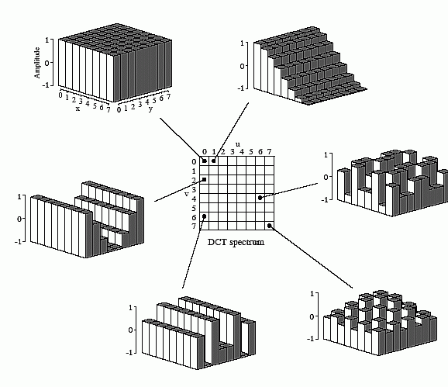

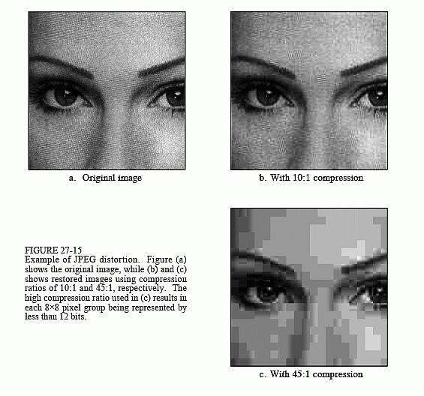
JPEG
Frequency Domain
Image
Pixel Domain
    v = a₁w₁+a₂w₂ +… + a_{d}w_{d}
    v = a₁w₁+a₂w₂ +… + a_{d}w_{d}
´
´
´
´
´
´
a_{f} = amount of frequency f.
a_{ij} = brightness of pixel ⟨ij⟩.
´
Standard
Strange
  Basis = ⟨w₁,w₂⟩
  = ⟨ , ⟩
Change of Basis
  Basis = ⟨w₁,w₂⟩
  = ⟨ , ⟩
v =
v =
⟨a₁,a₂⟩ =
  ⟨3,-1⟩
  ⟨a₁,a₂⟩ =
  ⟨3,4⟩
´
´
Notes:
12

Slide 13
JPEG
Frequency Domain
Image
Pixel Domain
FTP compression
    v = a₁w₁+a₂w₂ +… + a_{d}w_{d}
´
´
´
´
´
´
a_{f} = amount of frequency f.
´
Strange
  Basis = ⟨w₁,w₂⟩
  = ⟨ , ⟩
v =
⟨a₁,a₂⟩ =
  ⟨3,-1⟩
´
´
Notes:
13

Slide 14
Fourier Transformation
Fourier Transform
are a change of basis from the time basis to
  sine/cosine basis
  JPG
  or polynomial basis
Applications
  Signal Processing
  Compressing data (eg images with .jpg)
  Multiplying integers in n logn loglogn time.
  ….
Purposes:
  Some operations on the data are cheaper in new format
  Some concepts are easier to read from the data in new format
  Some of the bits of the data in the new format are less significant
  and hence can be dropped.

Slide 15
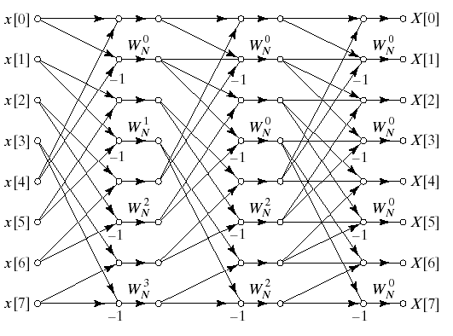
Fourier Transformation
FFT
Butterfly
Fast Fourier Transform
takes O(nlogn) time! (See Recursive Slides)
O(log(n)) levels

Slide 16
Fast Fourier Transformation
FFT
nlogn Time
Divide & Conquer - Friends - Recursion.
Trust your friends to solve any subinstance:
  as long as smaller and
  is an instance to the same problem.
My instance
My
friend’s
Instance
My
friend’s
Instance
My
friend’s
Instance

Slide 17
Fast Fourier Transformation
FFT
nlogn Time
My input: (start with one x)
  (a₀,a₁,a₂,…,a_{n-1}) & x
My output:
  f(x) = a₀+a₁x +a₂x² + … + a_{n-1}x^{n-1}
1st friend’s input?
  f_{even}: (a₀,a₂,a₄,…,a_{n-2}) & ?
2nd friend’s input?
  f_{odd}: (a₁,a₃,a₅,…,a_{n-1}) & ?
f_{even}(z) = a₀+a₂z+a₄z²+a₆z³+ … + a_{n-2}z^{n/2-1}
f(x) = a₀+a₁x +a₂x² + … + a_{n-1}x^{n-1}
= a₀+a₂x²+a₄x⁴ + … + a_{n-2}x^{n-2}
+ a₁x+a₃x³+a₅x⁵ + … + a_{n-1}x^{n-1}
= a₀+a₂x²+a₄x⁴ + … + a_{n-2}x^{n-2}
+ x( a₁+a₃x²+a₅x⁴ + … + a_{n-1}x^{n-2} )
= f_{even}(x²)
+ x( f_{odd}(x²) )
f(x) = f_{even}(x²) + x f_{odd}(x²)

Slide 18
Fast Fourier Transformation
FFT
nlogn Time
My input: (start with one x)
  (a₀,a₁,a₂,…,a_{n-1}) & x
My output:
  f(x) = a₀+a₁x +a₂x² + … + a_{n-1}x^{n-1}
1st friend’s input?
  f_{even}: (a₀,a₂,a₄,…,a_{n-2}) & x²
2nd friend’s input?
  f_{odd}: (a₁,a₃,a₅,…,a_{n-1}) & x²
1st friend’s output:
  y_{even} = f_{even}(x²)
^{2nd} friend’s output:
  y_{odd} = f_{odd}(x²)
My output:
  f(x) = y_{even} + x y_{odd}
T(n) = 2 T(n/2) + O(1)
= O(n)
Ok. So it takes O(n) time to evaluate.
f(x) = f_{even}(x²) + x f_{odd}(x²)

Slide 19
Fast Fourier Transformation
FFT
nlogn Time
My input:
  (a₀,a₁,a₂,…,a_{n-1})
  (x₀,x₁,x₂,…,x_{n-1})
My output:
  (y₀,y₁,y₂,…,y_{n-1})
  y_{i} = f(x_{i})
1st friend’s input?
  f_{even}: (a₀,a₂,a₄,…,a_{n-2})
  (x₀²,x₁²,x₂²,…,x_{n-1}²)
2nd friend’s input?
  f_{odd}: (a₁,a₃,a₅,…,a_{n-1})
  (x₀²,x₁²,x₂²,…,x_{n-1}²)
1st friend’s output:
  ∀i y_{<even,i>} = f_{even}(x_{i}²)
2nd friend’s output:
  ∀i y_{<odd,i>} = f_{odd}(x_{i}²)
My output:
  ∀i f(x_{i}) = y_{<even,i>} + x_{i} y_{<odd,i>}
T(n) = 2 T(n/2) + O(n)
= O(n log n)
Wow!
That was easy.

Slide 20
Fast Fourier Transformation
FFT
nlogn Time
My input:
  (a₀,a₁,a₂,…,a_{n-1})
  (x₀,x₁,x₂,…,x_{n-1})
n coefficients
n values of x
1st friend’s input?
  f_{even}: (a₀,a₂,a₄,…,a_{n-2})
  (x₀²,x₁²,x₂²,…,x_{n-1}²)
^{n}/₂ coefficients
n values of x
Does not meet precondition!
Oops

Slide 21
Fast Fourier Transformation
FFT
nlogn Time
My input:
  (a₀,a₁,a₂,…,a_{n-1})
  (x₀,x₁,x₂,…,x_{n-1})
My output:
  (y₀,y₁,y₂,…,y_{n-1})
  y_{i} = f(x_{i})
1st friend’s input?
  f_{even}: (a₀,a₂,a₄,…,a_{n-2})
  (x₀²,x₁²,x₂²,…,x_{n/2-1}²)
2nd friend’s input?
  f_{odd}: (a₁,a₃,a₅,…,a_{n-1})
  (x₀²,x₁²,x₂²,…,x_{n/2-1}²)
3rd friend’s input?
  f_{even}: (a₀,a₂,a₄,…,a_{n-2})
  (x_{n/2}²,x_{n/2+1}²,…,x_{n-1}²)
4th friend’s input?
  f_{odd}: (a₁,a₃,a₅,…,a_{n-1})
  (x_{n/2}²,x_{n/2+1}²,…,x_{n-1}²)
My output:
  ∀i f(x_{i}) = y_{<even,i>} + x_{i} y_{<odd,i>}
T(n) = 4 T(n/2) + O(n)
That’s no good.
= O(n²)

Slide 22
Fast Fourier Transformation
Roots of
Unity
The values (x₀,x₁,x₂,…,x_{n-1}) are said to be special if:
  There are n distinct values.
  When you square each of them:
    The set collapses to ^{n}/₂ distinct values.
Eg:
…, -3, -2, -1, 1, 2, 3, …
square each of them
…, 9, 4, 1, 1, 4, 9, …
collapse the set
1, 4, 9, …
half as many elements.

Slide 23
Fast Fourier Transformation
Roots of
Unity
My input:
  (a₀,a₁,a₂,…,a_{n-1})
  Special (x₀,x₁,x₂,…,x_{n-1})
My output:
  (y₀,y₁,y₂,…,y_{n-1})
  y_{i} = f(x_{i})
-3 3
1st friend’s input?
  f_{even}: (a₀,a₂,a₄,…,a_{n-2})
  (x₀²,x₁²,x₂²,…,x_{n-1}²)
  ^{n}/₂ distinct values
2nd friend’s input?
  f_{odd}: (a₁,a₃,a₅,…,a_{n-1})
  (x₀²,x₁²,x₂²,…,x_{n-1}²)
  ^{n}/₂ distinct values
9
9
1st friend’s output:
  ∀i y_{<even,i>} = f_{even}(x_{i}²)
2nd friend’s output:
  ∀i y_{<odd,i>} = f_{odd}(x_{i}²)
f_{even}(9)
f_{odd}(9)
My output:
  ∀i f(x_{i}) = y_{<even,i>} + x_{i} y_{<odd,i>}
T(n) = 2 T(n/2) + O(n)
= O(n log n)
f(3)
f(-3)
f_{even}(9)
f_{odd}(9)
3
-3
That’s better

Slide 24
Fast Fourier Transformation
Roots of
Unity
My input:
  (a₀,a₁,a₂,…,a_{n-1})
  Special (x₀,x₁,x₂,…,x_{n-1})
My output:
  (y₀,y₁,y₂,…,y_{n-1})
  y_{i} = f(x_{i})
1st friend’s input?
  f_{even}: (a₀,a₂,a₄,…,a_{n-2})
  (x₀²,x₁²,x₂²,…,x_{n-1}²)
  ^{n}/₂ distinct values
2nd friend’s input?
  f_{odd}: (a₁,a₃,a₅,…,a_{n-1})
  (x₀²,x₁²,x₂²,…,x_{n-1}²)
  ^{n}/₂ distinct values
To meet precondition
these also need to be special

Slide 25
Fast Fourier Transformation
Roots of
Unity
The values (x₀,x₁,x₂,…,x_{n-1}) are said to be special if:
  There are n distinct values.
  When you square each of them:
    The set collapses to ^{n}/₂ distinct values.
    Which are also special
Eg:
…, -3, -2, -1, 1, 2, 3, …
square each of them
…, 9, 4, 1, 1, 4, 9, …
collapse the set
1, 4, 9, …
square each of them
2, 16, 81, …
But these are not special.

Slide 26
Fast Fourier Transformation
Roots of
Unity
The values (x₀,x₁,x₂,…,x_{n-1}) are said to be special if:
  There are n distinct values.
  When you square each of them:
    The set collapses to ^{n}/₂ distinct values.
    Which are also special
Eg:
-i, -1, 1, i
square each of them
ω = -i,-1, 1, i
are said to be
4th roots of unity
Because ω⁴ = 1
-1, 1, 1, -1
collapse the set
-1, 1
square each of them
1, 1
collapse the set
1

Slide 27
Fast Fourier Transformation
Roots of
Unity
ω is said to be an n^{th} root of unity (in a field) if ω^{n} = 1
  (There should be n solutions of this polynomial)

Slide 28
Fast Fourier Transformation
Roots of
Unity
16th roots of unity
(ω^{n/4})² = ω^{n/2} = -1
i
ω₁₆⁴
×ω
ω₁₆⁵
ω₁₆³
ω₁₆⁶
rr
ω₁₆²
ω₁₆⁷
ω₁₆¹
(ω^{n/2})² = 1
r
ω₁₆⁸
θ
-1 =
ω₁₆⁰
= ω₁₆¹⁶ = 1
ω₁₆⁹
ω₁₆¹⁵
ω₁₆¹⁰
ω₁₆¹⁴
ω₁₆¹¹
ω₁₆¹³
ω₁₆¹²
re^{θi} = rcosθ + i⋅rsinθ
(ω^{3n/4})² = ω^{n/2} = -1
-i

Slide 29
Fast Fourier Transformation
Roots of
Unity
16th roots of unity
ω₁₆⁴
ω₁₆⁵
ω₁₆³
ω₁₆⁶
ω₁₆²
3θ
θ = 2π/n
ω₁₆⁷
2θ
ω₁₆¹
ω = e^{2πi/n}
θ
r=1
ω₁₆⁸
ω₁₆⁰
ω₁₆⁹
ω₁₆¹⁵
ω₁₆¹⁰
ω₁₆¹⁴
ω₁₆¹¹
ω₁₆¹³
ω₁₆¹²
re^{θi} = rcosθ + i⋅rsinθ
e^{θi} × e^{αi} = e^{(θ+α)i}

Slide 30
Fast Fourier Transformation
Roots of
Unity
16th roots of unity
square each of them
and collapse
ω₁₆⁴
ω₁₆⁵
ω₁₆³
ω₁₆⁶
ω₁₆²
ω₁₆⁷
ω₁₆¹
ω₁₆⁸
ω₁₆⁰
ω₁₆⁹
ω₁₆¹⁵
ω₁₆¹⁰
ω₁₆¹⁴
ω₁₆¹¹
ω₁₆¹³
ω₁₆¹²

Slide 31
Fast Fourier Transformation
Roots of
Unity
16th roots of unity
square each of them
and collapse
ω₁₆⁴
Are these special?
ω₁₆⁶
ω₁₆²
ω₁₆⁸
ω₁₆⁰
ω₁₆¹⁰
ω₁₆¹⁴
ω₁₆¹²

Slide 32
Fast Fourier Transformation
Roots of
Unity
8th roots of unity
square each of them
and collapse
ω₈²
Are these special?
ω₈³
ω₈¹
ω₈⁴
ω₈⁰
ω₈⁵
ω₈⁷
ω₈⁶

Slide 33
Fast Fourier Transformation
Roots of
Unity
4th roots of unity
square each of them
and collapse
ω₄¹
Are these special?
ω₄²
ω₄⁰
ω₄³

Slide 34
Fast Fourier Transformation
Roots of
Unity
2th roots of unity
square each of them
and collapse
Are these special?
ω₂¹
ω₂⁰
= 1

Slide 35
Fast Fourier Transformation
Roots of
Unity
My input:
  (a₀,a₁,a₂,…,a_{n-1})
  (n^{th} roots of unity ω_{n}^{i})
My output:
  (y₀,y₁,y₂,…,y_{n-1})
  y_{i} = f(ω_{n}^{i})
1st friend’s input?
  f_{even}: (a₀,a₂,a₄,…,a_{n-2})
  (^{n}/₂th roots of unity ω_{n/2}^{i})
2nd friend’s input?
  f_{odd}: (a₁,a₃,a₅,…,a_{n-1})
  (^{n}/₂th roots of unity ω_{n/2}^{i})
1st friend’s output:
  ∀i y_{<even,i>} = f_{even}(ω_{n/2}^{i})
2nd friend’s output:
  ∀i y_{<odd,i>} = f_{odd}(ω_{n/2}^{i})
My output:
  ∀i f(x_{i}) = y_{<even,i>} + x_{i} y_{<odd,i>}
T(n) = 2 T(n/2) + O(n)
= O(n log n)
Excellent

Slide 36
Fourier Transformation
FFT
Code
Algorithm FFT(y, ω, n):
  Input: y = [a₀,a₁,a₂,…,a_{n-1}] (Time Domain)
  ω= e^{2πi 1/n} (n^{th} root of unity)
  n = # of samples (2^{r})
  Output: Y = [y₀,y₁,y₂,…,y_{n-1}] (Frequency Domain)
  % Separate even and odd indices
  a^{even} = [a₀,a₂,a₄,…,a_{n-2}]
  a^{odd} = [a₁,a₁,a₅,…,a_{n-1}]
  % Recurse
  y^{even} =FFT(a^{even}, ω², ^{n}/₂) (ω² = e^{2πi 2/n} )
  y^{odd} =FFT(a^{odd} , ω², ^{n}/₂)
  %Combining
  For i = 0 to ^{n}/₂-1
  y[i] = y^{even}[i] + ω^{i} ∙y^{odd}[i]
  y[i+^{n}/₂] = y^{even}[i] + ω^{i+n/2} ∙y^{odd}[i]
  Return(Y)

Slide 37
Fourier Transformation
Polynomial
Basis
Basis: sin(2π f t/n), . cos(2π f t/n)
Basis: 1, x, x², x³,…
Notes:
37

Slide 38
Fourier Transformation
Polynomial
Basis
Basis: sin(2π f t/n), . cos(2π f t/n)
The f^{th} basis “vector”
has frequency f.
As t=0..n,
t/n = 0..1,
2π f t/n = 0.. 2π f ,
cos(2π f t/n) does f full cycles.
Notes:
38

Slide 39
Fourier Transformation
Polynomial
Basis
Basis: 1, x, x², x³,…
Notes:
39

Slide 40
Fourier Transformation
Polynomial
Basis
Basis: 1, x, x², x³,…
f^{th} basis “vectors” is x^{f}
We compute this on
x₀, x₁, x₂, x₃, ….
t^{th} value is x_{t}
x_{t} = ω^{t}
f^{th} basis on t^{th} value is
(x_{t}) ^{f} = (ω^{t}) ^{f} = ω^{ft}
Notes:
40

Slide 41
Fast Fourier Transformation
Roots of
Unity
16th roots of unity
ω₁₆⁴
×ω
ω₁₆⁵
ω₁₆³
ω₁₆⁶
rr
ω₁₆²
ω₁₆⁷
ω₁₆¹
re^{θi} = rcosθ + irsinθ
r = 1, θ = 2π/n
ω = e^{2πi/n}
r
ω₁₆⁸
θ
ω₁₆⁰
ω₁₆⁹
ω₁₆¹⁵
ω₁₆¹⁰
ω₁₆¹⁴
ω₁₆¹¹
ω₁₆¹³
ω₁₆¹²

Slide 42
Fourier Transformation
Polynomial
Basis
Basis: 1, x, x², x³,…
f^{th} basis “vectors” is x^{f}
We compute this on
x₀, x₁, x₂, x₃, ….
t^{th} value is x_{t}
x_{t} = ω^{t}
f^{th} basis on t^{th} value is
(x_{t}) ^{f} = (ω^{t}) ^{f} = ω^{ft}
= [e^{2πi/n}] ^{ft} = e^{2π f t/n i}
= cos(2π f t/n) + i sin(2π f t/n)
re^{θi} = rcosθ + irsinθ
r = 1, θ = 2π/n
ω = e^{2πi/n}
Notes:
42

Slide 43
Fourier Transformation
Polynomial
Basis
Basis: sin(2π f t/n), . cos(2π f t/n)
Basis: 1, x, x², x³,… “vectors”
f^{th} basis “vectors” is x^{f}
We compute this on
x₀, x₁, x₂, x₃, ….
t^{th} value is x_{t}
x_{t} = ω^{t}
f^{th} basis on t^{th} value is
(x_{t}) ^{f} = (ω^{t}) ^{f} = ω^{ft}
= [e^{2πi/n}] ^{ft} = e^{2π f t/n i}
= cos(2π f t/n) + i sin(2π f t/n)
Notes:
43

Slide 44
Fourier Transformation
Polynomial
Basis
Basis: sin(2π f t/n), . cos(2π f t/n)
Basis: 1, x, x², x³,…
Notes:
44

Slide 45
Fourier Transformation
FFT
Butterfly
Fast Fourier Transform
takes O(nlogn) time! (See Recursive Slides)
O(log(n)) levels

