Slide 1


Building a Computer
From Sand
History of Computing
Layers of Abstraction
Building an AND Gate
AND/OR/NOT Circuits
Building a CPU
Parsing/Compiling
Abstract Data Types
Algorithms
AI
Jeff Edmonds
York University

Slide 2
Please feel free
to ask questions!
Notes:
2

Slide 3
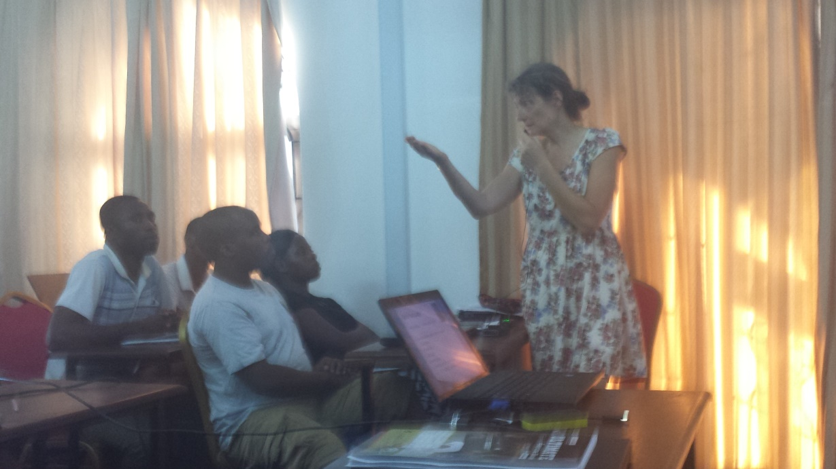
Yesterday,
this talk had no intro.
Fran’s lecture
inspired me
to make an engaging one.

Slide 4
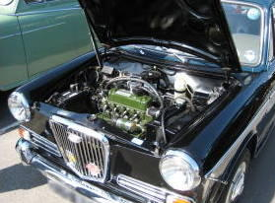



Do you know the basics
of how the things in your world
work?

Slide 5
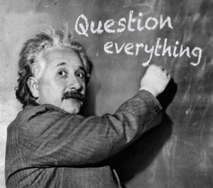
Do you know the basics
of how the things in your world
work?

Slide 6
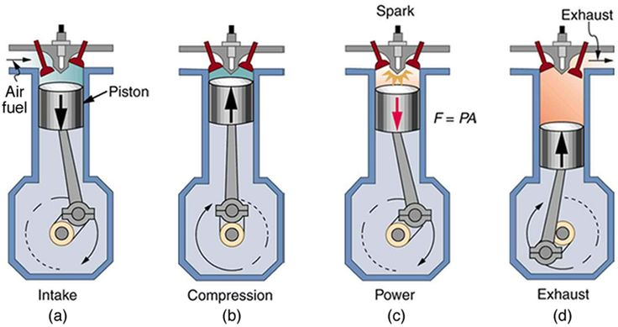
Do you know the basics
of how the things in your world
work?

Slide 7
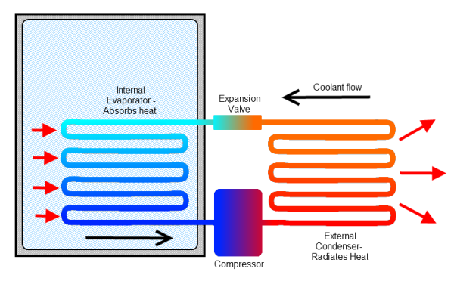
Do you know the basics
of how the things in your world
work?

Slide 8
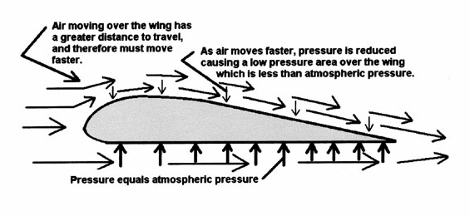
Do you know the basics
of how the things in your world
work?

Slide 9
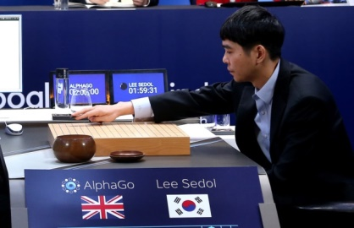
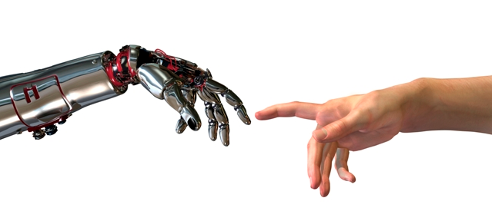
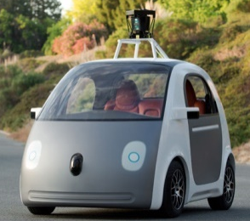



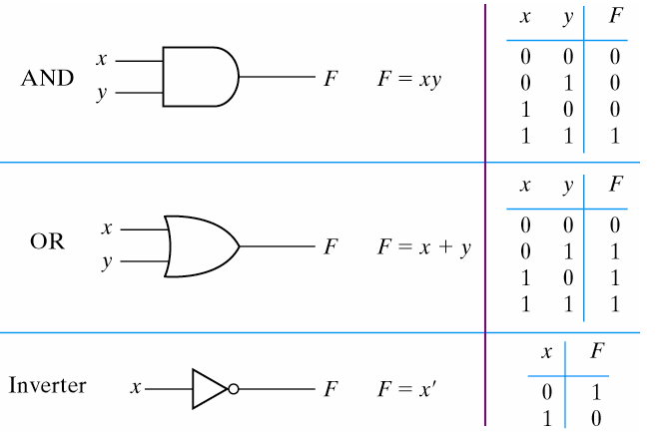
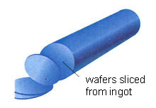

Emergent Intelligence
Do you know the basics
of how the things in your world
work?
GCD(a,b) = GCD(x,y)
<x,y>
⇒ <y,x mod y>

Slide 10
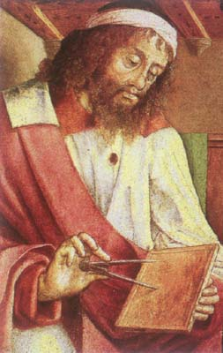
History of Computability
In the beginning:
Euclid said,
“ Let there be an algorithm for GCD”
Emergent
Complexity
And so it was.
GCD(a,b) = GCD(x,y)
<x,y>
⇒ <y,x mod y>
Low level
instructions
Euclid (300 BC)

Slide 11
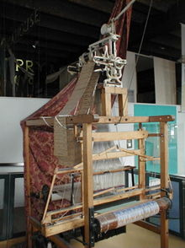
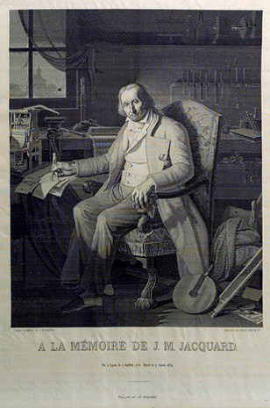
History of Computability
Low level
instructions
Emergent
Complexity
The Jacquard loom (1801) was one of the first programmable devices.
Weaves complex patterns in textiles.
Controlled by punched cards
This portrait of Jacquard was woven in silk on a Jacquard loom and required 24,000 punched cards to create (1839).

Slide 12
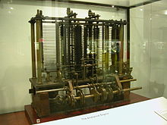
History of Computability
Low level
instructions
Never actually
worked
Charles Babbage’s Analytical Engine (1837)
  Memory
  An arithmetical unit,
  Conditional branching and loops,
Making it the first general-purpose computer.

Slide 13
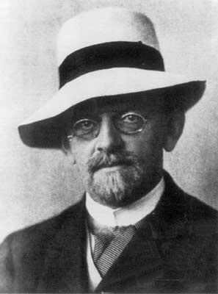
History of Computability
Can every problem be computed?
Or are some Uncomputable?
One of his 23 influential
open problems (1900)
Hilbert
Need to formally define
“Algorithm”

Slide 14
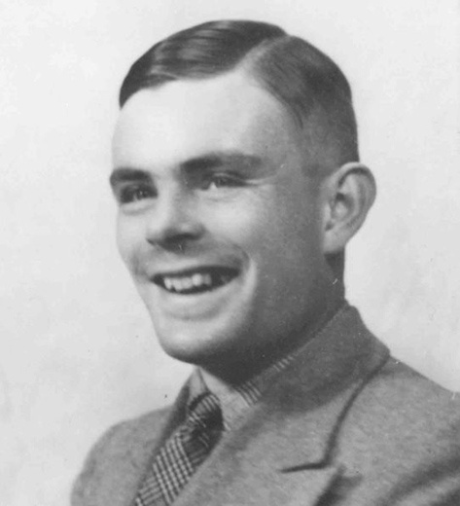
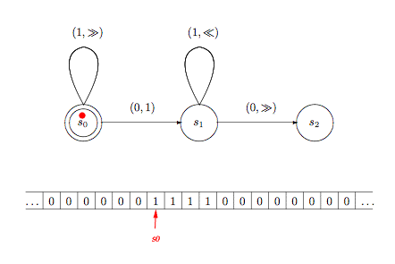
History of Computability
TM
Computable
Halting
Problem
A problem is Computable
if it can be computed by a
Turing Machine. (1936)
Turing
Need to formally define
“Algorithm”

Slide 15

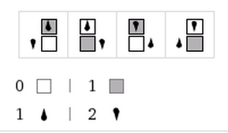
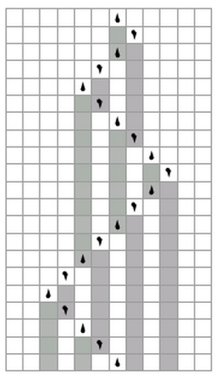
contents of tape
current state
Time
Simple rules like these
produce complex patterns.
TM step:
Current state & cell content at head
determines which rule to use giving:
  how cell contents changes
  how head moves
  how state changes
Tape Cells
Low level
instructions

Slide 16
History of Computability
TM
Computable
Java
Computable
Are these definitions
equivalent?
Church says “Yes”
All reasonable models
of computation are equivalent
as far as what they can compute.
And within a polynomial in time
(except for Quantum Machines)
Turing
Though not intended to be
practical, the Turing Machine
hugely helped develop
and understand
the power and limits
of mechanical computation.
Need to formally define
“Algorithm”
Emergent
Complexity

Slide 17
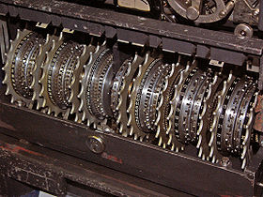
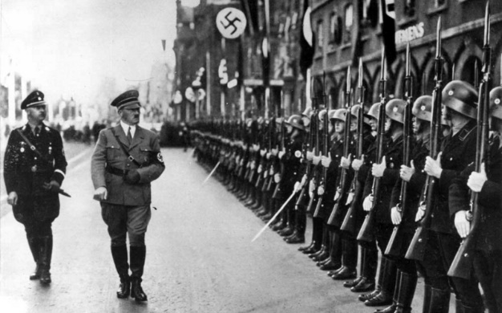
History of Computability
Helped breaking German code
Persecuted being gay.
And killed himself ☹
Turing

Slide 18
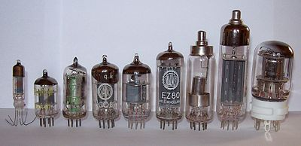

History of Computability
Vacuum tubes made electronic computing possible
  Colossus (1943) 2,400 tubes, ENIAC (1946) 17,000 tubes
  5,000 characters per second
  $500,000 ($6 million with inflation).
  Tube failure (every two days, 15 min to locate)
  First “bug” was a moth in a tube.

Slide 19
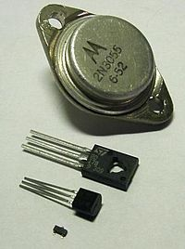
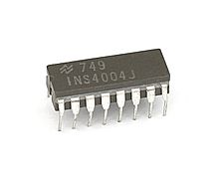
History of Computability
The first transistorised computer (1953)
Integrated circuits (1968)
Intel 4004 Microprocessors (1971)

Slide 20
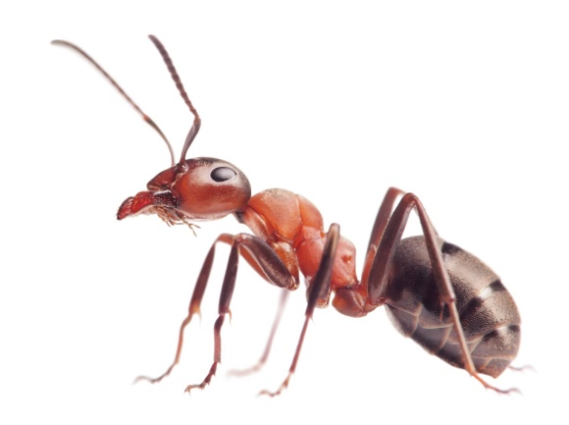
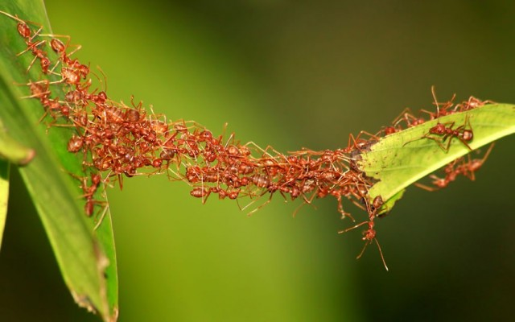
Layers of Abstraction
Low level
instructions
Emergent
Complexity
Emergent Intelligence

Slide 21
Layers of Abstraction
Low level
instructions
Emergent
Complexity
The psychological profiling of a successful person is mostly the ability to shift levels of abstraction, from low level to high level.
To understand the detailed workings.
To understand the big picture.
Donald Kunth
Emergent Intelligence

Slide 22
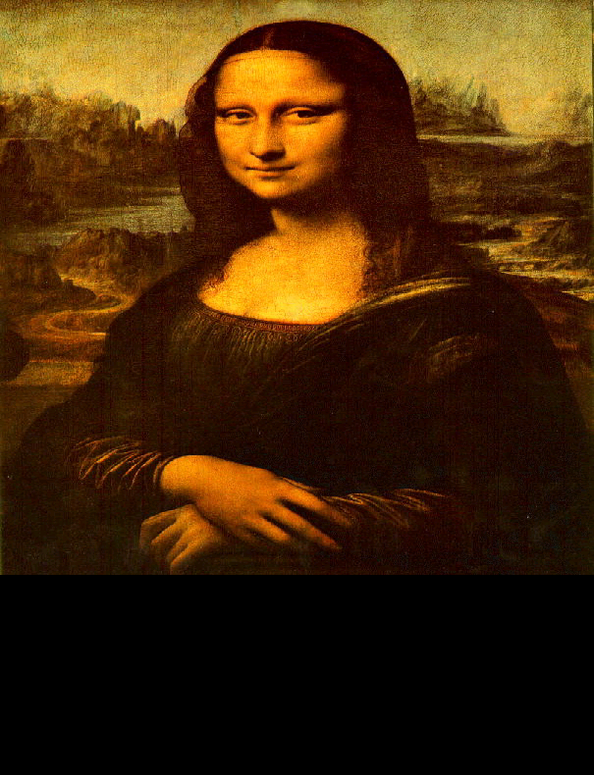
Layers of Abstraction
Low level
instructions
Emergent
Complexity
The psychological profiling of a successful person is mostly the ability to shift levels of abstraction, from low level to high level.
To understand the detailed workings.
To understand the big picture.
To understand complex things
in simple ways.
Donald Kunth
=

Slide 23
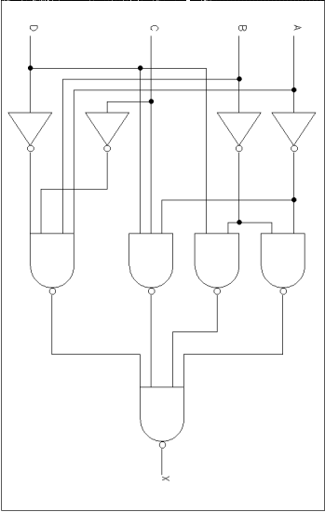
Layers of Abstraction
It is hard to think of love
in terms of the firing of neurons.
vs
Software developers view subsystems as entities with separate personalities, roles, and interactions,
not details of code.
vs

Slide 24
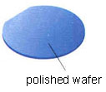
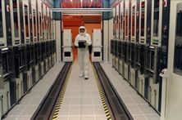
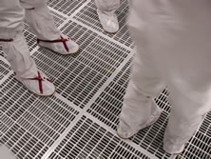
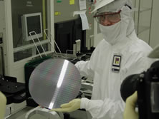

Slide 25

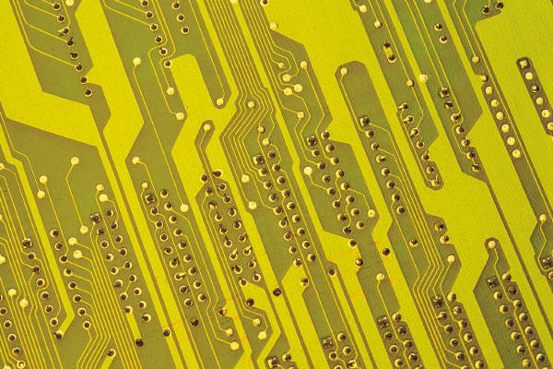


Semiconductor

Slide 26


Slide 27
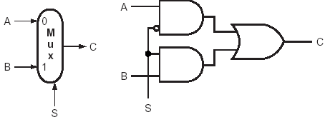
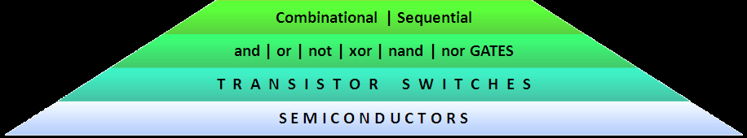
Select between two alternatives A and B

Slide 28
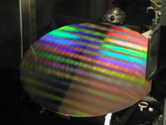
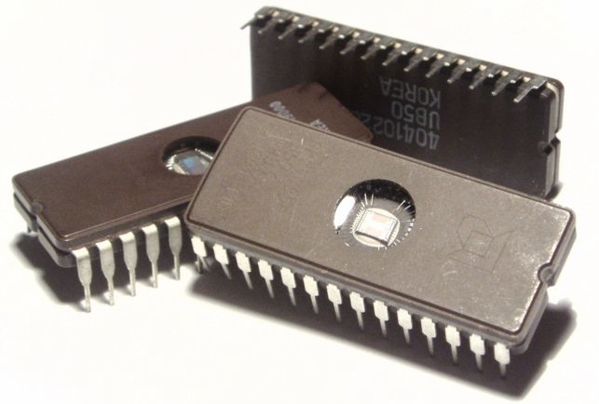
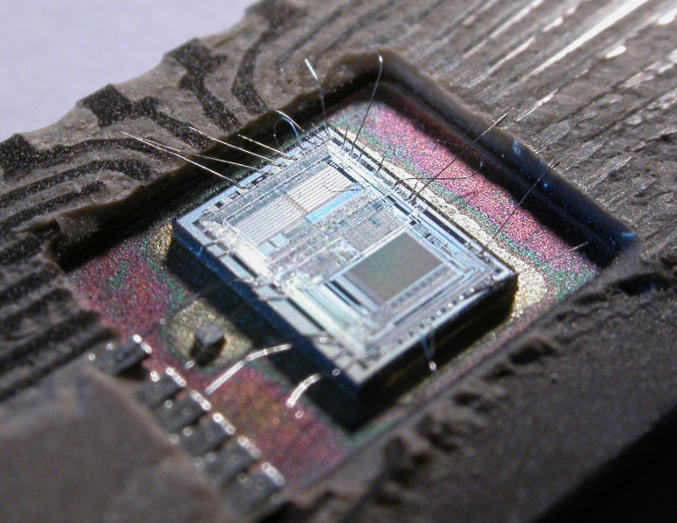
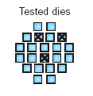
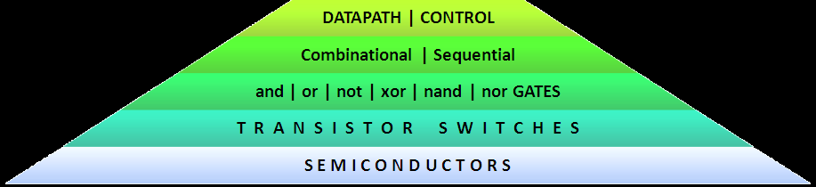
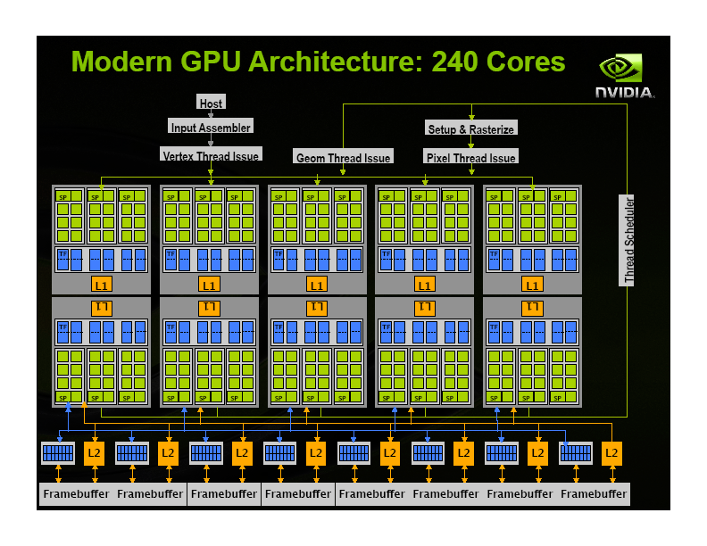

Slide 29
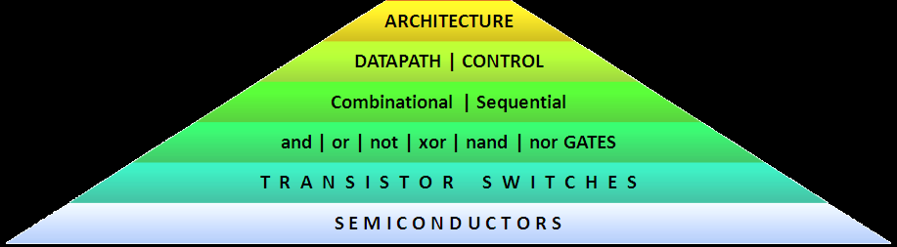
CPU
I/O
DRAM

Slide 30
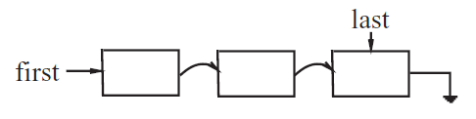




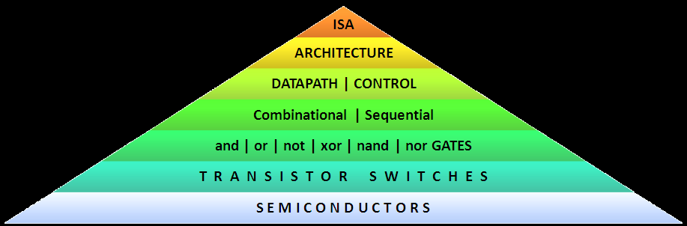
boolean found = list.contains(target);
Vision | Robotics | AI | HCI | DB | Sim | Bio | DC | QC
la $a0, yes
addi $s0, $0, 550
add $t0, $0, $0
add $t1, $0, $0
lbl: lw $t2, list($t1)
beq $t2, $s0, ok
addi $t1, $t1, 4
slti $t2, $t1, 40
bne $t2, $0, lbl
la $a0, no
ok: addi $v0, $0, 4
syscall
jr $ra
0x3c011001
0x34240028
0x20100226
0x00004020
0x00004820
0x3c011001
0x00290821
0x8c2a0000
0x51500006
0x21290004
0x292a0028
0x1540fffa
0x3c011001
0x34240031
0x20020004
0x0000000c
0x03e00008
Loader
Linker
Memory Manager
I/O Controller
Process Manager
boolean found = false;
for (int i = 0; i < 10 && !found; i++)
{
found = (target == list[i]);
}

Slide 31
Lets do it again more slowly.

Slide 32
Layers of Abstraction

Slide 33
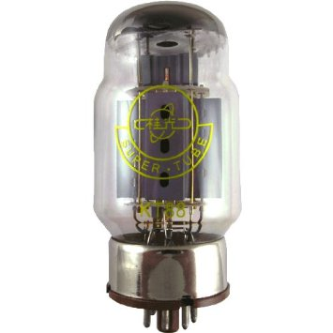
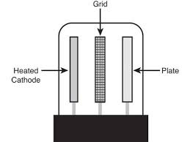
Building an AND Gate
y
x
AND
z
Electricity can’t jump large gap from Cathode to Plate.
It can jump from Cathode to Grid.
And if it starts flying, then it keeps going to the Plate.
Large jump happens iff power
to Grid AND to Plate

Slide 34
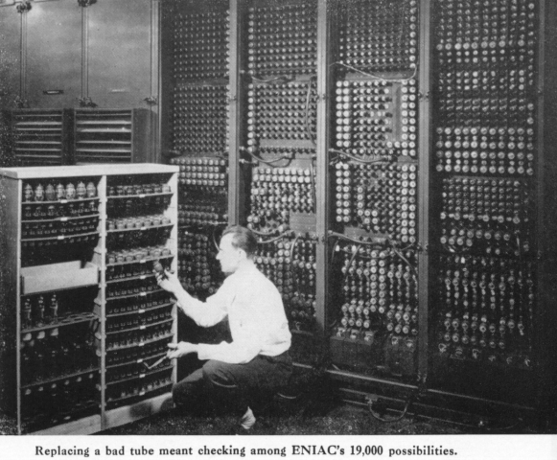
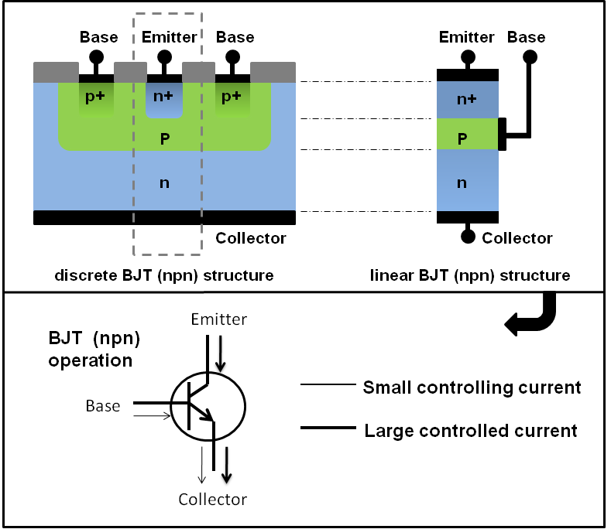
Building an AND Gate
y
x
AND
z

Slide 35
Building an AND Gate
y
x
AND
z

Slide 36
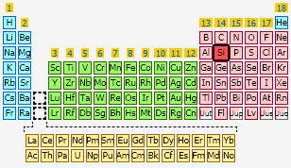


Building an AND Gate

Slide 37

Building an AND Gate
Same as Carbon
Four
electrons
in the
outer ring.
Four
holes
in the
outer ring.

Slide 38


Building an AND Gate
Same as Carbon

Slide 39


Building an AND Gate
Same as Carbon

Slide 40
Building an AND Gate
Same as Carbon
Each Carbon/Silicon
bonds with four others.

Slide 41

Building an AND Gate
Same as Carbon

Slide 42


Building an AND Gate
Same as Carbon

Slide 43


Building an AND Gate
Electricity does not flow through it
because all the electrons are happy.

Slide 44
Building an AND Gate
Dope it with what is one to
the right in the periotic table,
i.e. one extra electron.
Called N
Electricity flows through it
because this extra electron
moves.

Slide 45
Building an AND Gate
Dope it with what is one to
the left in the periotic table,
i.e. one extra hole.
Called P
Electricity flows through it
because this extra hole
moves.

Slide 46

Building an AND Gate
N
P
Electricity flows from N to P
extra electron to extra hole.
Electricity does not flow from P to N
extra hole to extra electron

Slide 47

Building an AND Gate
N
P
N
Once the electricity starts
the electrons keep tunneling through!!!

Slide 48

Building an AND Gate
N
P
N
Tunneling happens
iff power
across PN
AND
across PNP

Slide 49
Building an AND Gate
y
x
AND
z
Tunneling happens
iff power
across PN
AND
across PNP

Slide 50

Building an AND Gate
y
x
AND
z

Slide 51
Building an AND Gate
y
x
AND
z

Slide 52
And/Or/Not Circuits (acyclic)

Slide 53
And/Or/Not Circuits (acyclic)
A circuit is a directed acyclic graph of and/or/not gates
An input X assigns a bit to each incoming wire.
x₁
x₂
x₃
The bits percolate
down to the output wires.
0
1
0
AND
AND
OR
0
0
1
OR
NOT
  The Size of a circuit:
    is the number of gates.
    It relates to sequential
    computation time.
0
0
OR
0

Slide 54
And/Or/Not Circuits (acyclic)
x₁
x₂
x₃
0
1
0
AND
AND
OR
0
0
1
NOT
OR
  The depth of a circuit:
    is the length of the longest path
    from an input to an output.
    It indicates evaluation time.
    It relates to parallel
    computation time.
0
0
OR
0

Slide 55
And/Or/Not Circuits (acyclic)
5 volts
open
true
yes
1
0 volts
closed
false
no
0

Slide 56
And/Or/Not Circuits (acyclic)
Decimal
Binary
Hexidecimal
9273₁₀
= 3 ×10⁰
+ 7 ×10¹
+ 2 ×10²
+ 9 ×10³
1011₂
= 1 × 2⁰
+ 1 × 2¹
+ 0 × 2²
+ 1 × 2³
9F73₁₆
= 3 ×16⁰
+ 7 ×16¹
+ 15 ×16²
+ 9 ×16³

Slide 57
Add 2 n-bit numbers
And/Or/Not Circuits (acyclic)
*
*
*
*
*
*
*
*
*
*
*
*
*
*
*
*
*
*
*
*
*
*
+

Slide 58
Add 2 n-bit numbers
And/Or/Not Circuits (acyclic)
*
*
*
*
*
*
*
*
*
*
*
*
*
*
*
*
*
*
*
*
*
*
*
*
+

Slide 59
Add 2 n-bit numbers
And/Or/Not Circuits (acyclic)
*
*
*
*
*
*
*
*
*
*
*
*
*
*
*
*
*
*
*
*
*
*
*
*
*
*
+

Slide 60
Add 2 n-bit numbers
And/Or/Not Circuits (acyclic)
*
*
*
*
*
*
*
*
*
*
*
*
*
*
*
*
*
*
*
*
*
*
*
*
*
*
*
*
+

Slide 61
Add 2 n-bit numbers
And/Or/Not Circuits (acyclic)
*
*
*
*
*
*
*
*
*
*
*
*
*
*
*
*
*
*
*
*
*
*
*
*
*
*
*
*
*
*
+

Slide 62
Add 2 n-bit numbers
And/Or/Not Circuits (acyclic)
*
*
*
*
*
*
*
*
*
*
*
*
*
*
*
*
*
*
*
*
*
*
*
*
*
*
*
*
*
*
*
*
*
*
*
*
*
*
*
*
*
*
*
*
*
+

Slide 63
Add 2 n-bit numbers
And/Or/Not Circuits (acyclic)
x₀ y₀ c₀
*
*
*
*
*
*
*
*
*
*
*
*
*
*
*
*
*
*
*
*
*
*
*
*
*
*
*
*
*
*
*
*
*
*
*
*
*
*
*
*
*
*
*
*
*
+
x₁ y₁
+
c₁
z₀
x₂ y₂
+
c₂
z₁
x₃ y₃
+
c₃
z₂
x₄ y₄
+
c₄
z₃
x₅ y₅
+
c₅
z₄
+
n size and n and depth.
x₅ y₅
c₅
z₅
With more care
can be done in log n depth.
+
z₇
z₆

Slide 64
And/Or/Not Circuits (acyclic)
Multiplexor
log r bits
forms address x
x₁
x_{logr}
y₁
Multiplexor
r bits to be addressed
y_{r}
y_{x}
The addressed bit

Slide 65
And/Or/Not Circuits (acyclic)
Multiplexor
¬x₁¬x₂ ¬x₃ …x_{logr}
¬x₁ ¬x₂ ¬x₃ x₄ … ¬x_{logr}
x₁ x₂ ¬x₃ … ¬x_{logr}
AND
AND
…
AND
y₁
y_{i}
y_{r}
AND
AND
AND
All r value that
might get addressed.
OR
Get the bit addressed.
Multiplexor outputs addressed bit y_{x}.
Circuit Size ≈ 2^{logr} = r = size of table.

Slide 66

And/Or/Not Circuits (acyclic)
If a TM can compute
something in time T(n),
a circuit can T²(n) size
and T(n) depth.
q_{start}
H
01001000
E
01000011
L
01001101
L
01001101
O
00110100
Some small
circuit
Some small
circuit
Some small
circuit
Some small
circuit
Some small
circuit
q₅
I
01001001
E
01000011
L
01001101
L
01001101
O
00110100

Slide 67
And/Or/Not Circuits (acyclic)

Slide 69
CPU
I/O
DRAM

Slide 70

Building a CPU

Slide 71
Building a CPU
Clock:
5 volts/ 0 volts
open/closed
high/low
2.5 GHz = 2,500,000,000 cycles/sec
Clock

Slide 72
Building a CPU
When clock is low, it remembers previous value.
When clock is high, new value is stored.
x_{t+1}
¬c
c
x_{t}
if clock=1
AND
AND
z_{t} =
y_{t}
if clock=0
cycle
OR
x_{t}
y_{t}
x_{t-1}
x_{t}
Memory
y_{t}
Clock
x_{t-1}
x_{t}
z_{t}

Slide 73
Building a CPU
State of CPU & Computer at time t.
RAM
accumulator
A
program counter
PC
register
B
10
Add *B
to A
38

Slide 74
Building a CPU
State of CPU & Computer at time t.
RAM
accumulator
A
program counter
PC
register
B
10
Add *B
to A
Command
Add *B
to A
Multiplexor
38

Slide 75
Building a CPU
State of CPU & Computer at time t.
RAM
accumulator
A
program counter
PC
register
B
10
Add *B
to A
*B
Command
Add *B
to A
Multiplexor
38
38

Slide 76
Building a CPU
State of CPU & Computer at time t.
RAM
accumulator
A
program counter
PC
register
B
10
Add *B
to A
*B
Command
Add *B
to A
38
Multiplexor
38
38

Slide 77
Building a CPU
State of CPU & Computer at time t.
RAM
accumulator
A
program counter
PC
register
B
10
Add *B
to A
*B
Command
Add *B
to A
38
Multiplexor
10
38
38

Slide 78
Building a CPU
State of CPU & Computer at time t.
RAM
accumulator
A
program counter
PC
register
B
10
Add *B
to A
Command
Add *B
to A
10
38
38
Add
New A
48

Slide 79
Building a CPU
State of CPU & Computer at time t.
RAM
accumulator
A
program counter
PC
register
B
10
Add *B
to A
Save A
to *B
38
Inc
New A
New B
New PC
48

Slide 80
Building a CPU
State of CPU & Computer at time t.
RAM
accumulator
A
program counter
PC
register
B
register
B
Clock
4 8
10
Add *B
to A
Save A
to *B
38
New A
New B
New PC
48

Slide 81
Building a CPU
State of CPU & Computer at time t.
RAM
accumulator
A
program counter
PC
register
B
register
B
48
Add *B
to A
Command
Save A
to *B
Reverse
Multiplexor
Save A
to *B
38
48

Slide 82
Building a CPU
State of CPU & Computer at time t.
RAM
accumulator
A
program counter
PC
register
B
48
Add *B
to A
Save A
to *B
38
48
Much slower
Clock

Slide 83
Building a CPU

Slide 84
boolean found = false;
for (int i = 0; i < 10 && !found; i++)
{
found = (target == list[i]);
}
la $a0, yes
addi $s0, $0, 550
add $t0, $0, $0
add $t1, $0, $0
lbl: lw $t2, list($t1)
beq $t2, $s0, ok
addi $t1, $t1, 4
slti $t2, $t1, 40
bne $t2, $0, lbl
la $a0, no
ok: addi $v0, $0, 4
syscall
jr $ra
0x3c011001
0x34240028
0x20100226
0x00004020
0x00004820
0x3c011001
0x00290821
0x8c2a0000
0x51500006
0x21290004
0x292a0028
0x1540fffa
0x3c011001
0x34240031
0x20020004
0x0000000c
0x03e00008
Loader
Linker
Memory Manager
I/O Controller
Process Manager

Slide 85
Compiling Java into Machine Code

Slide 86


Compiling Java into Machine Code
Java Model:
fancy data structures
loops
recursions
object oriented
Machine Model:
one line of simple instructions.

Slide 87


Compiling Java into Machine Code
(3+4)×7
exp
term
fact
×
fact
×
(
exp
)
7
+
term
+
term
fact
fact
3
4

Slide 88


Algorithm: GetExp( s, i )
A simple
recursive
algorithm!
Exp
p_{<term,1>}
p_{<term,2>}
…
p_{<term,k>}
+
+
+

Slide 89
Compiling Java into Machine Code

Slide 90
Abstract Data Types
boolean found = list.contains(target);

Slide 91



Abstract Data Types

Slide 92







Abstract Data Types
Set: Collects a bunch of elements together.
List: A set with an order on the elements
Stack: A list, but elements can only be
pushed onto and popped from the top.
Queue: A list, but elements can only be
added at the end and removed from
the front.
Priority Queue: The “highest priority” element
is handled next.
Tree: A hierarchal structure
Graph: Edges between
the elements/nodes

Slide 93

Abstract Data Types
Pointers: Store the address of more data.
tree

Slide 94
Abstract Data Types

Slide 95
Thinking Abstractly About Algorithms

Slide 96
Thinking Abstractly About Algorithms
In the beginning:
Euclid said,
“ Let there be an algorithm for GCD”
And so it was.
GCD(a,b) = GCD(x,y)
<x,y>
⇒ <y,x mod y>
Euclid (300 BC)

Slide 97

<preCond>
codeA
loop
<loop-invariant>
exit when <exit Cond>
codeB
codeC
<postCond>
Iterative Algorithms
I implored you to not worry
about the entire computation.
A loop invariant is a statement/picture
about the state of your computation
to make sure it does not get lost.
Your algorithm must only maintain it
while making progress
5 km
9 km

Slide 98

Graph Search
Iterative Algorithms

Slide 99



Recursive Algorithms
A recursive algorithm is one that calls itself.

Slide 100
Recursive Algorithms
A recursive algorithm is one that calls itself.
MULT(X,Y):
If |X| = |Y| = 1 then return( XY )
Break X into a,b and Y into c,d
e = MULT(a,c) and f =MULT(b,d)
return( e 10^{n} + (MULT(a+b, c+d)
– e - f) 10^{n/2} + f )
I implored you to not worry
about the entire computation.
X = 2133
Y = 2312
ac = 483
bd = 396
(a+b)(c+d) = 1890
XY = 4931496
X = 21
Y = 23
ac = 4
bd = 3
(a+b)(c+d) = 15
XY = 483
X = 33
Y = 12
ac = 3
bd = 6
(a+b)(c+d) = 18
XY = 396
X = 54
Y = 35
ac = 15
bd = 20
(a+b)(c+d) = 72
XY = 1890
X = 2
Y = 2
XY=4
X = 1
Y = 3
XY=3
X = 3
Y = 5
XY=15
X = 3
Y = 1
XY=3
X = 3
Y = 2
XY=6
X = 6
Y = 3
XY=18
X = 5
Y = 3
XY=15
X = 4
Y = 5
XY=20
X = 9
Y = 8
XY=72

Slide 101

Recursive Algorithms
A recursive algorithm is one that calls itself.
MULT(X,Y):
If |X| = |Y| = 1 then return( XY )
Break X into a,b and Y into c,d
e = MULT(a,c) and f =MULT(b,d)
return( e 10^{n} + (MULT(a+b, c+d)
– e - f) 10^{n/2} + f )
You can give your “friend”
any instance that is
  smaller
  meets the precondition
Trust her to give you
the answer.
X = 2133
Y = 2312
ac = 483
bd = 396
(a+b)(c+d) = 1890
XY = 4931496

Slide 102



Recursive Algorithms
Fourier Transformations
O(nlogn) time!

Slide 103
Thinking Abstractly About Algorithms

Slide 104
Artificial Intellegence

Slide 105



Neural Nets

Slide 106
Neural Nets
Threshold Gate
Binary Inputs
Real Weights
possibly negative
Real Threashold
Binary Output
x₁ x₂ x₃ … x_{n}
w₁ w₂ w₃ … w_{n}
Threshold
T
y
  y = 1 iff Σ_{i} w_{i}×x_{i} ≥ T

Slide 107




Neural Nets
Bicycle
Bicycle
Face
Bicycle
  The neural net learns
  by adjusting weights w_{i}.
  The neural net learns
  by adjusting weights w_{i}.
  The neural net learns
  by adjusting weights w_{i}.
Wrong
Right
Right
Right

Slide 108


Genetic Algorithms
Loop
Given a population of solutions.
Randomly cross two.
Keep best.

Slide 109

Quantum Machines
What about Quantum Machines?
  A quantum TM is in the super-position of states.
  Factoring can be done in poly-time, ie 6➔2×3.
  Not that much more.

Slide 110

Human
What about the human brain?
  Science:
    The brain is just an elaborate machine (neural net).
  New Age:
    The brain has quantum mechanic and vibrations
    > machine
  Religion:
    The human has a soul
    >> machine

Slide 111
Emergent Intelligence
Do you know the basics
of how the things in your world
work?
GCD(a,b) = GCD(x,y)
<x,y>
⇒ <y,x mod y>

Slide 112
Areas of Study
Vision | Robotics | AI | HCI | DB | Sim | Bio | DC | QC

Slide 113
End
Notes:
113

Slide 114
Building a Computer from Sand
I will give a brief history of computing; outline the layers of abstraction within which one thinks about computing; discuss how to build an AND gate from silicon, circuits from AND gates, and a CPU from circuits; sketch how to compile a high level program into machine code; mention the basic data structures; and the paradigms of algorithms; closing with some thoughts on artificial intelligence.
I don't know if there is too much here for an hour. But can stop when an hour is up.

