Slide 1



Building a Computer
From Sand
History of Computing
Layers of Abstraction
Building an AND Gate from Silcon
AND/OR/NOT Circuits
Building a CPU
Parsing/Compiling
Abstract Data Types
Algorithms
AI
Jeff Edmonds
York University

Slide 2
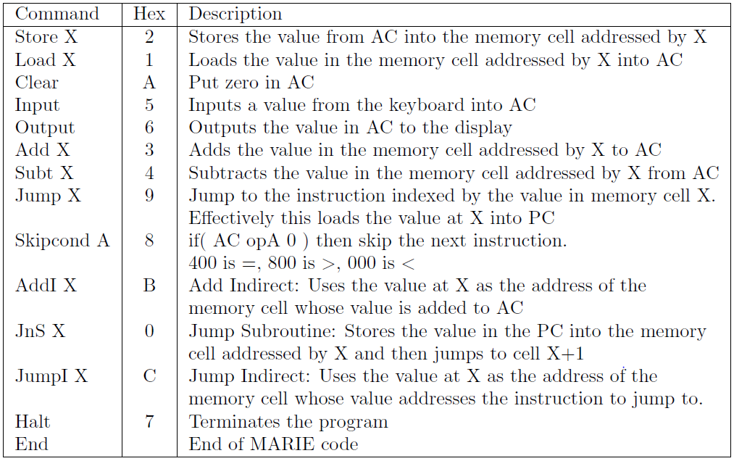
Parsing/Compiling
Input:
Java Code
Output:
Machine Code
simulating the Java code.
See https://www.eecs.yorku.ca/~jeff/courses/fun/compiler/

Slide 3
Parsing/Compiling
Input:
Java Code
Output:
Machine Code
simulating the Java code.
Challenge: Keep track of three algorithms simultaneously
  The compiler
  The Java code being compiled
  The MARIE code being produced.
This is my favorite algorithm.
So I teach it in 2001, 3101, and 6111

Slide 4
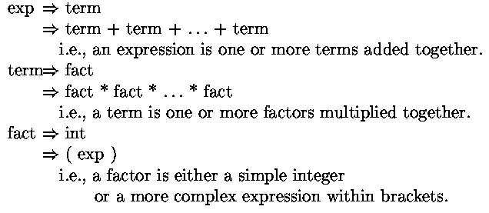
Parsing/Compiling
Input : (3+4)×7
Context Free Grammar:
  NonTerminals: exp, term, fact,…
  Each generates a class of substrings.
  Rules: exp → term + term + … + term
    Says “An expression is a sum of terms”
    “A term is a product of factors”
    “A factor is either an integer
    or an expression in brackets.”

Slide 5
Parsing/Compiling
Input : (3+4)×7
exp
term
fact
×
fact
Context Free Grammar:
  NonTerminals: exp, term, fact,…
  Each generates a class of substrings.
  Rules: exp → term + term + … + term
    Says “An exp is a sum of terms”
    One can replace exp with term + term
  Terminals: +, *, 37, …
    characters in the final string
(
exp
)
7
term
+
term
fact
fact
3
4

Slide 6
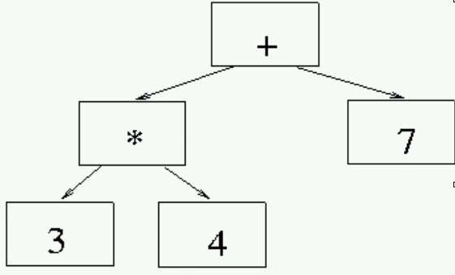
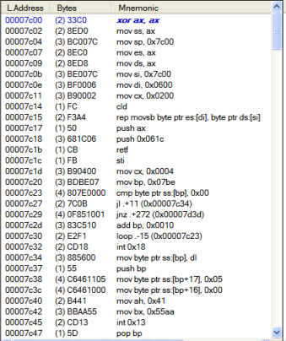
Parsing/Compiling
(3+4)×7
exp
term
fact
×
fact
Syntax: Do the characters in the input
form a valid “exp”?
Semantics: The Parse Tree adds “meaning”
order of operations to evaluate it
machine code to evaluate it.
(
exp
)
7
term
+
term
×
fact
fact
+
3
4

Slide 7
Parsing/Compiling

Slide 8
Union, Concat, Spew & Plop
All a CFG can do is
  union,
  concatenate,
  and spew & plop.
spew: to vomit, to ooze out, to come forth in a ﬂood or gush with violence or in great quantity.
plop: to drop suddenly with a sound like that of something dropping into water

Slide 9
Union, Concat, Spew & Plop
Grammar for union L₁ ∪ L₂:
  S→ S₁
  → S₂
S
S
or
S₁
S₂
L₁
L₂

Slide 10
Union, Concat, Spew & Plop
Grammar for concatenation L₁ ⋅ L₂:
  S→ S₁ S₂
S
S₁
S₂
L₁
L₂

Slide 11
Union, Concat, Spew & Plop
Grammar for spew & plop a^{n} # b^{n}:
  Spew: S→aSb
  Plop: S→ #
S
aSb
aaSbb
aaaSbbb
aaaaSbbbb
aaaaaSbbbbb
aaaaa#bbbbb
…
Linked

Slide 12
Union, Concat, Spew & Plop
Look for links and concatenations
S →
begin Alg
  x = 5
  begin loop
    x = ( [ { 3 } ] )
  exit loop
  return x
end Alg
Concatenation
Linked
These were spewed out
by grammar.
Plopped
This is what CFG is really good at!

Slide 13
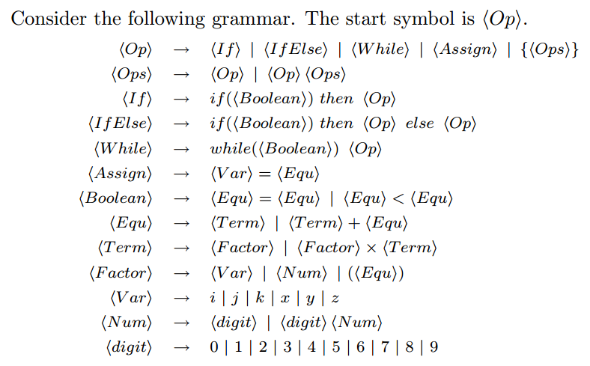
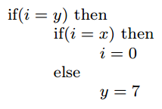
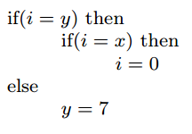
Java like Example
⟨Op⟩
⟨IfElse⟩
if (⟨Boolean⟩) then ⟨Op⟩ else ⟨Op⟩
i=y
⟨If⟩
if (⟨Boolean⟩) then ⟨Op⟩
i=x
i=0
y=7
{
{
}
}
There is a second parsing.
Brackets help.

Slide 14





On Step At a Time
Precondition
Postcondition
It can be difficult to understand
where computation go.
I implored you to not worry
about the entire computation.
Strange(x,y):
x₁ = ⎣x/4⎦; y1 = 3y; f₁ = Strange( x₁, y₁ );
x₂ = x - 3×x1; y₂ = y; f₂ = Strange( x₂, y₂ );
return( f₁+f₂ );
next
⎣x/4⎦ × 3y
(x-3×x₁) × y
0
T+1
i-1
i
i
i
next

Slide 15
Recursion
Friends & Strong Induction
MULT(X,Y):
If |X| = |Y| = 1 then return( XY )
Break X into a,b and Y into c,d
e = MULT(a,c) and f =MULT(b,d)
return( e 10^{n} + (MULT(a+b, c+d)
– e - f) 10^{n/2} + f )
Know Precond:
Postcond:
ints x,y
product x×y
Consider your input instance
If it is small enough solve it on your own.
Allocate work
  Construct one or more sub-instances
    Each must be smaller
    and meet the precondition
  Assume by magic your friends
  give you the answer for these.
Use this help to solve your own instance.
Do not worry about anything else.
      ie do not Micro-manage friends by tracing out what they and their friend’s friends do.
      or who your boss is.
X = 33
Y = 12
ac = 3×1
bd = 3×2
(a+b)(c+d) =6×3
= 3
= 6
=18
XY = 396
X = 3
Y = 1
XY = 3
X = 3
Y = 2
XY = 6
X = 6
Y = 3
XY = 18

Slide 16

Parsing
Algorithm: GetExp( s, i )
Input: s is a string of tokens
i is a start index
Output: p is a parsing of the longest valid expression
j is the end index
s=6*8+((2+42)*(5+12)+987*7*123+15*54)

Slide 17

Parsing
Algorithm: GetTerm( s, i )
Input: s is a string of tokens
i is a start index
Output: p is a parsing of the longest valid term
j is the end index
s=6*8+((2+42)*(5+12)+987*7*123+15*54)

Slide 18
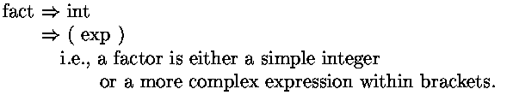
Parsing
Algorithm: GetFact( s, i )
Input: s is a string of tokens
i is a start index
Output: p is a parsing of the longest valid factor
j is the end index
s=6*8+((2+42)*(5+12)+987*7*123+15*54)

Slide 19
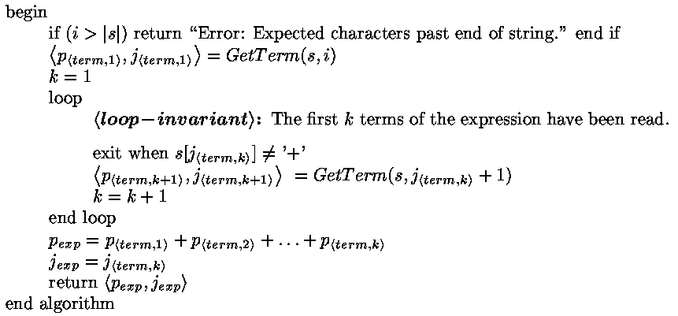
Algorithm: GetExp( s, i )
s=6*8+((2+42)*(5+12)+987*7*123+15*54)
p_{<term,1>}
p_{<term,2>}
p_{<term,3>}

Slide 20
Algorithm: GetExp( s, i )
Exp
p_{<term,1>}
p_{<term,2>}
…
p_{<term,k>}
+
+
+

Slide 21
Algorithm: GetExp( s, i )
Machine code for evaluating expression term₁+ term₂+term₃+term₄
and storing the value in cell 8
Machine code for evaluating term₁ and storing the value in cell 8
Machine code for evaluating term₂ and storing the value in cell 9
Load cell 8 into the accumulator
Add cell 9
Store cell 8
Machine code for evaluating term₃ and storing the value in cell 9
Load cell 8
Add cell 9
Store cell 8
Machine code for evaluating term₄ and storing the value in cell 9
Load cell 8
Add cell 9
Store cell 8

Slide 22
Algorithm: GetExp( s, i )
Where to store value of exp
,m)
,m)
,m+1)
Include code:
Load cell m
Add cell m+1
Store cell m

Slide 23
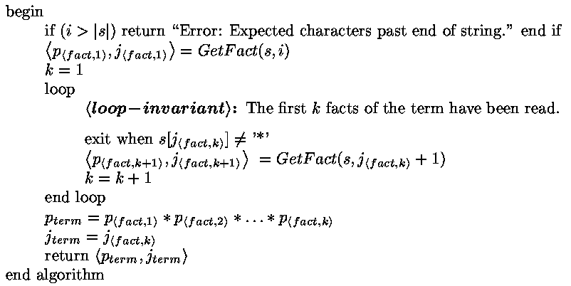
Algorithm: GetTerm( s, i )
s=6*8+((2+42)*(5+12)+987*7*123+15*54)
p_{<fact,1>}
p_{<fact,2>}

Slide 24
Algorithm: GetTerm( s, i )
Term
p_{<fact,1>}
p_{<fact,2>}
…
p_{<fact,k>}
*
*
*

Slide 25
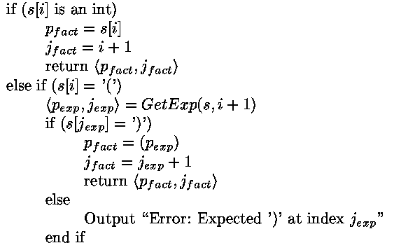
Parsing
Algorithm: GetFact( s, i )
s=6*8+((2+42)*(5+12)+987*7*123+15*54)

Slide 26
Parsing
Algorithm: GetFact( s, i )
Fact
42

Slide 27
Algorithm: GetFact( s, i )
s=6*8+((2+42)*(5+12)+987*7*123+15*54)
p_{<exp>}

Slide 28
Algorithm: GetFact( s, i )
Fact
(
p_{<exp>}
)

Slide 29

Stack of Stack Frames
RoutineA(exp₁,exp₂)
Algorithm: GetFact( s, i )
Data for
current routine
x
…
x = RoutineA(23,58)
* ….
RoutineA(a,b)
…
v[1] = 8
…
return 9
= 9
return to *
a = 23
b = 58
x other local vars
v[0]
v[1]
return
= 8
= 9
Stack Frame:
A particular execution
of one routine
on one particular input instance.

Slide 30
Stack of Stack Frames
RoutineA(exp₁,exp₂)
Algorithm: GetFact( s, i )
x = RoutineA(23,58)
* ….
Data for
current routine
x
Machine code for evaluating factor RoutineA(exp₁,exp₂)
and storing the value in cell 11
= 9
Machine code for evaluating exp₁
return to *
a = 23
b = 58
x other local vars
v[0]
v[1]
return
Machine code for evaluating exp₂
Push on to Stack Frame
- Address * of code to return to when routine returns
- value of exp₁,exp₂ being passed in.
- enough space for other local variables.
Jump to start of code for RoutineA.
* return address to jump to
Copy returned value out of Stack Frame to cell 11.
Pop Stack frame
= 8
= 9

Slide 31
Stack of Stack Frames
RoutineA(exp₁,exp₂)
v[exp]
Load
Algorithm: GetFact( s, i )
q=385
Execute this “data”
as “code”
x = v[1]
Data for
current routine
x
Machine code for evaluating factor v[1]
and storing the value in cell 11
Calculate memory address of v[1]
Start with memory address
of start of current stack frame
Add on the space between it and v[0]
Add on the value exp to get address of v[exp]
Assume that this address 385 is stored in variable q
Load the value in the cell addressed
by the value in variable q (i.e. indirect addressing)
Store in cell 11
return to *
a = 23
b = 58
x other local vars
v[0]
v[1]
return
Machine code for evaluating exp
385
= 8
Oops. My machine code language did not have indirect addressing so I faked it.

Slide 32
Parsing/Compiling
This parsing algorithm only works for Look Ahead One Grammars.
Look Ahead One: A grammar is said to be look ahead one if,
given any two rules for the same non-terminal,
the ﬁrst place that the rules diﬀer in actual characters.
A ⇒ B ’u’ C ’w’ E
A ⇒ B ’u’ C ’x’ F
A ⇒ B ’u’ C
A ⇒ B ’v’ G H
?
(and next character is not ‘w’ or ‘x’)
A ⇒ F G
(Ok if first character(s) within a B
is different than in a F.)
This feature allows our parsing algorithm to look only
at the next token in order to decide what to do next.
Thus the algorithm runs in linear time.

Slide 33
Parsing/Compiling
This parsing algorithm only works for Look Ahead One Grammars.
A ⇒ ( A )
A ⇒ ε
A ⇒ a A a
A ⇒ ε
? (next character is ‘a’)
Generates (((())))
Generates aaaaaaaa
GetA(s,i)
if( s[i] = ‘(‘ )
⟨p_{A},j_{A}⟩, = GetA(s,i+1)
if( s[j_{A}] = ‘)‘ )
return( ⟨ ‘(‘ p_{A} ’)’⟩, j_{A}+1)
else
return( error )
else
return(ε,i)
Not Look Ahead One
Parser can’t find middle.
A ⇒ A B
A ⇒ A C
Recurses forever.

Slide 34
Parsing/Compiling
This parsing algorithm only works for Look Ahead One Grammars.
A ⇒ BC
A ⇒ DE
B ⇒ b ....
D ⇒ d ....
A ⇒ BC
A ⇒ DE
B ⇒ bbb ....
D ⇒ bbb ....
GetA(s,i)
if( s[i] = ‘b‘ )
⟨p_{B},j_{B}⟩, = GetB(s,i)
⟨p_{C},j_{C}⟩, = GetC(s,j_{B})
return( ⟨ p_{B} p_{C} ⟩, j_{C} )
elseif( s[i] = ‘d‘ )
⟨p_{D},j_{D}⟩, = GetD(s,i)
⟨p_{E},j_{E}⟩, = GetE(s,j_{D})
return( ⟨ p_{D} p_{E} ⟩, j_{E} )
Not Look Ahead One
Don’t know whether to call
GetB or GetD

Slide 35
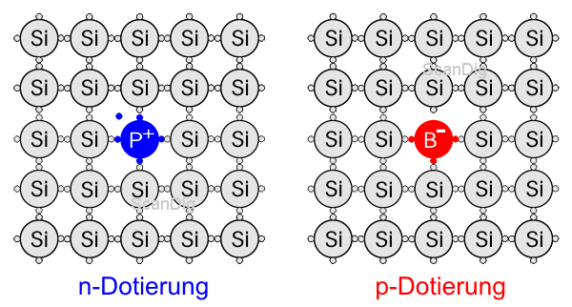
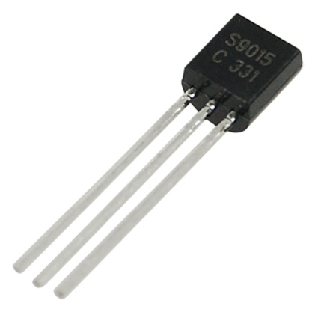
Building an AND Gate
N
P
N
Once the electricity starts
the electrons keep tunneling through!!!

Slide 36
Building a CPU
State of CPU & Computer at time t.
RAM
accumulator
A
program counter
PC
register
B
10
Add *B
to A
*B
Command
Add *B
to A
Multiplexor
38
38

Slide 37
Iterative Algorithms
Loop Invariants
Max( A )
“preCond:
Input is array A[1..n]
of n values.”
i = 1
m = A[1]
loop
“loop-invariant:
m is max in {A[1]..A[i]}”
exit when (i=n)
m = max(m,A[i+1])
i = i + 1
endloop
return(m)
“postCond:
return max in {A[1]..A[n]}”
Establishing the loop invariant:
⟨preCond⟩
code
⟨loop-invariant⟩
Exit
Maintaining the loop invariant:
⟨loop-invariant_{t-1}⟩
¬⟨exit Cond⟩
codeB
⟨loop-invariant_{t}⟩
⟨make progress⟩
Exit
Obtaining Postcondition:
⟨loop-invariant ⟩
⟨exit Cond⟩
code
⟨postCond⟩

Slide 38




Fairy God Mother
Precond:
Postcond:
I’m in somewhere in the lake.
He runs 4× I swim.
Get to shore without him there.
He runs back and forth to catch me.
And I change my direction to avoid him.
Can I get away?

Slide 39
n in a Row
Precondition: Infinite line. Int n. Opponent skips every 10th move.
PostConditions: Continuous block of n whites.
How 1/10 extra moves help?
b
w
w
b
b
w
w
b
b
w
w
b
b
w
w
b
b
w
w
w
b
Black skip every 10th move.
But I want n=1000000 in a row!

