Slide 1


Building a Computer
From Sand
Jeff Edmonds
York University
History of Computing
Layers of Abstraction
Building an AND Gate from Silcon
AND/OR/NOT Circuits
Building a CPU
Parsing/Compiling
Abstract Data Types
Algorithms
AI
Loop Invariants: Lake & maybe n in a row.
Fast Fourier Transformations
Greedy Algs, Communication & Entropy
Logic: Game with prover, adversary and oracle
Halting Problem, Godel's Incompleteness and Completeness
https://www.eecs.yorku.ca/
~jeff/courses/fun/
Building_Computer.pptx

Slide 2

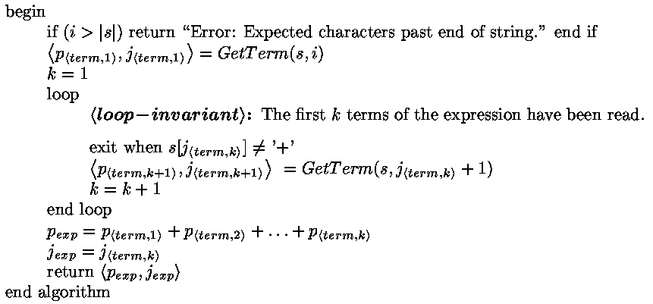
Parsing/Compiling
Algorithm: GetExp( s, i )
Exp
p_{<term,1>}
p_{<term,2>}
…
p_{<term,k>}
+
+
+

Slide 3
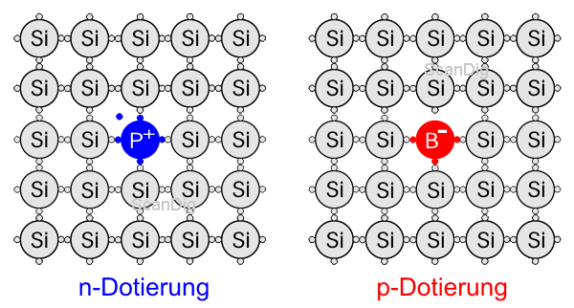

Building an AND Gate
N
P
N
Once the electricity starts
the electrons keep tunneling through!!!

Slide 4
Building a CPU
State of CPU & Computer at time t.
RAM
accumulator
A
program counter
PC
register
B
10
Add *B
to A
*B
Command
Add *B
to A
Multiplexor
38
38

Slide 5




<preCond>
codeA
loop
<loop-invariant>
exit when <exit Cond>
codeB
codeC
<postCond>
Iterative Algorithms
I implored you to not worry
about the entire computation.
0
T+1
Trust who passes you
the baton
and go around once
i-1
i
next
i
i

Slide 6
Iterative Algorithms
Loop Invariants
Max( A )
“preCond:
Input is array A[1..n]
of n values.”
i = 1
m = A[1]
loop
“loop-invariant:
m is max in {A[1]..A[i]}”
exit when (i=n)
m = max(m,A[i+1])
i = i + 1
endloop
return(m)
“postCond:
return max in {A[1]..A[n]}”
Establishing the loop invariant:
⟨preCond⟩
code
⟨loop-invariant⟩
Exit
Maintaining the loop invariant:
⟨loop-invariant_{t-1}⟩
¬⟨exit Cond⟩
codeB
⟨loop-invariant_{t}⟩
⟨make progress⟩
Exit
Obtaining Postcondition:
⟨loop-invariant ⟩
⟨exit Cond⟩
code
⟨postCond⟩

Slide 7

On Step At a Time
Precondition
Postcondition
It can be difficult to understand
where computation go.
I implored you to not worry
about the entire computation.
Strange(x,y):
x₁ = ⎣x/4⎦; y1 = 3y; f₁ = Strange( x₁, y₁ );
x₂ = x - 3×x1; y₂ = y; f₂ = Strange( x₂, y₂ );
return( f₁+f₂ );
next
⎣x/4⎦ × 3y
(x-3×x₁) × y
0
T+1
i-1
i
i
i
next

Slide 8

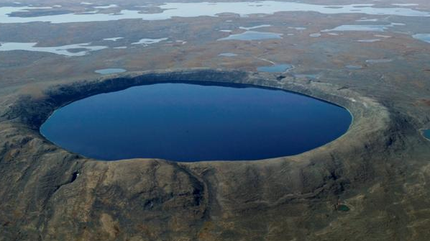


Fairy God Mother
Precond:
Postcond:
I’m in somewhere in the lake.
He runs 4× I swim.
Get to shore without him there.
He runs back and forth to catch me.
And I change my direction to avoid him.
Can I get away?

Slide 9
n in a Row
Precondition: Infinite line. Int n. Opponent skips every 10th move.
PostConditions: Continuous block of n whites.
How 1/10 extra moves help?
b
w
w
b
b
w
w
b
b
w
w
b
b
w
w
b
b
w
w
w
b
Black skip every 10th move.
But I want n=1000000 in a row!

Slide 10
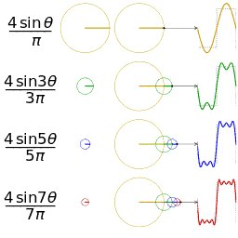
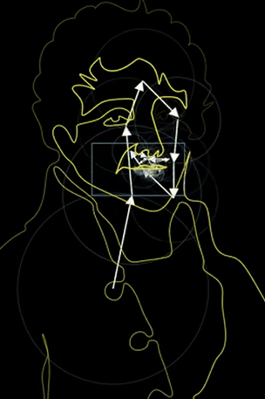
Fourier Transformation
Sum of sine waves gives anything

Slide 11
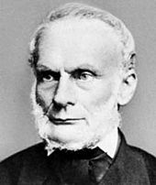
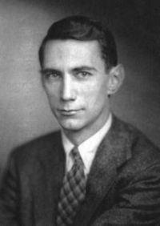
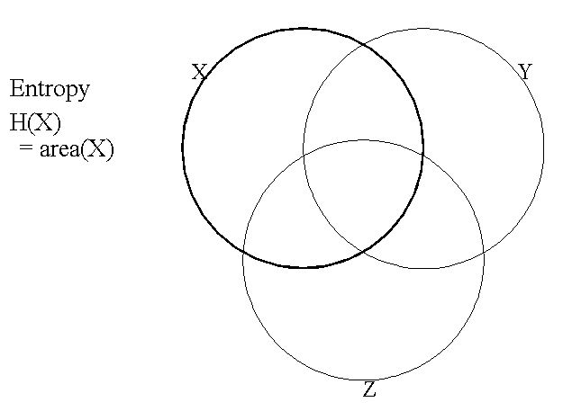

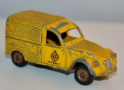
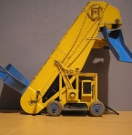




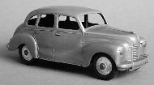
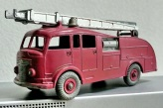



Greedy Algs, Communication & Entropy
In thermodynamics, entropy is a measure of disorder.
Lazare Carnot
(1803)
Shannon Communicates with bits
Claude Shannon
(1948)
0
1
0
1
0
1
0
1
0
1
0
0
0
0
1
0
1
1
1
1

Slide 12
Vector Spaces
∀ basis = ⟨w₁,w₂,…,w_{d} ⟩ of vectors (linearly independent)
∀ vector v in the entire space
  ∃ real coefficients ⟨a₁,a₂,…,a_{d} ⟩
    v = a₁w₁+a₂w₂ +… + a_{d}w_{d}
    = a₁w₁+a₂w₂ +… + a_{d}w_{d}
Ok that is more cool.
Every basis
can be used to reach every place.
´
´
´
´
´
´
Standard
Strange
  Basis = ⟨w₁,w₂⟩
  = ⟨ , ⟩
  Basis = ⟨w₁,w₂⟩
  = ⟨ , ⟩
v =
v =
⟨a₁,a₂⟩ =
  ⟨3,-1⟩
  ⟨a₁,a₂⟩ =
  ⟨3,4⟩
´
´
Notes:
12

Slide 13
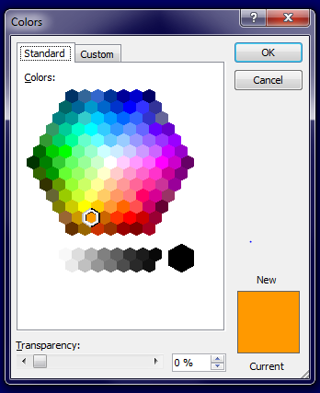
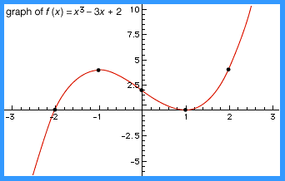



Vector Spaces
∀ basis = ⟨w₁,w₂,…,w_{d} ⟩ of vectors (linearly independent)
∀ vector v in the entire space
  ∃ real coefficients ⟨a₁,a₂,…,a_{d} ⟩
    v = a₁w₁+a₂w₂ +… + a_{d}w_{d}
    = a₁w₁+a₂w₂ +… + a_{d}w_{d}
A vector v could be:
Arrow
knapsack
Colour
Error Correcting
Codes
Function
Image
Probabilities
& Quantum
Notes:
13

Slide 14

Quantifiers and Games
Assuring
Proving
In Predicate logic,
we can state that I win the game:
∀x, ∃y, y>x
∀ ⎝
∃ ⎝
all
exist
all
exist
I will prove ∀x, [∃y, y>x].
I choose a x∀ = trillion trillion.
exist
I will prove ∃y, y>x∀.
I construct y∃ = trillion trillion and one
all
exist
I will prove y∃>x∀.
The proof of ∀x, ∃y, y>x.
Let x∀ be an arbitrary integer.
Let y∃ = x∀+1
Note y∃ = x∀+1 >x∀
And this completes the proof.
Surprisingly that completes the proof.

Slide 15
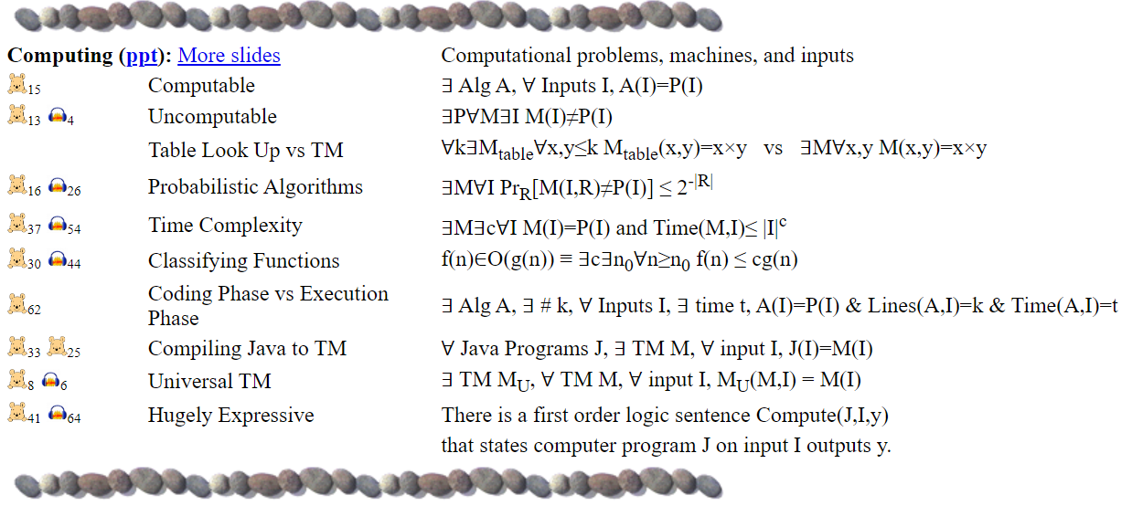

Slide 16
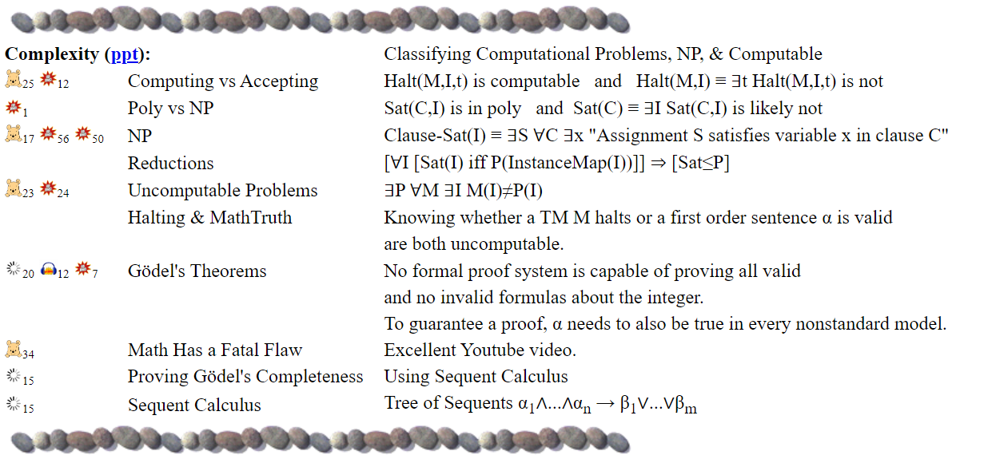

Slide 17
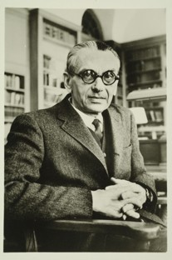
Gödel’s Completeness and Incompleteness Theorems
(1931)
Any math statements Φ
which is true in every universe
has a proof in your standard
proof system.
For every proof system S,
there are math statements Φ
which are either not proved
or proved incorrectly!
Gödel

Slide 18
Knowing Mud
1
1
1
1
1
8
2
8
2
8
2
8
2
8
2
7
3
7
3
7
3
7
3
7
k=0
3
6
4
6
4
6
4
6
4
6
4
5
4
5
3
5
2
5
1
5
On the other hand, if boy₃
does not learn that he has mud.
Do you know whether you have mud
No, I don’t know.
It becomes common knowledge that k≥4.

