Slide 1
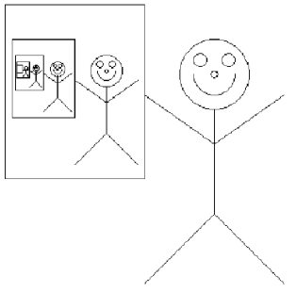
Recursion
Thinking about Algorithms Abstractly
Jeff Edmonds
York University
Lecture 3
COSC 3101

Slide 2

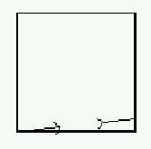
Recursive Images
if n=1
if n=0, draw
n=0
else draw
And recursively
Draw here with n-1

Slide 3
Recursive Images
if n=2
if n=0, draw
n=1
else draw
And recursively
Draw here with n-1

Slide 4
Recursive Images
if n=3
if n=0, draw
n=2
else draw
And recursively
Draw here with n-1

Slide 5
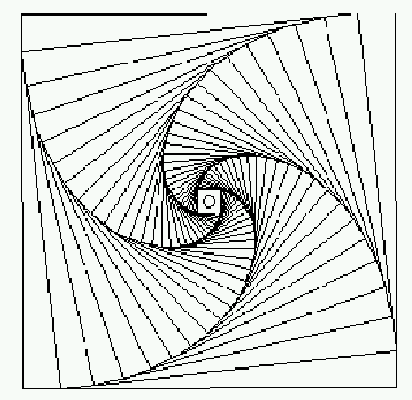
Recursive Images
if n=30
if n=0, draw
else draw
And recursively
Draw here with n-1

Slide 6
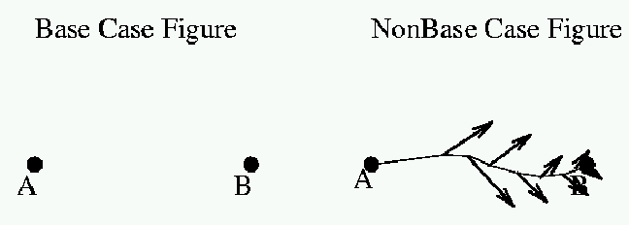
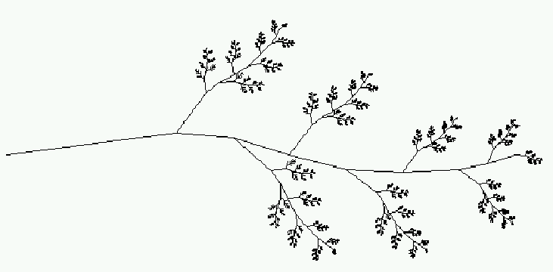
Recursive Images
if n=0
if n=5
if n=1
if n=2
if n=3
if n=4

Slide 7
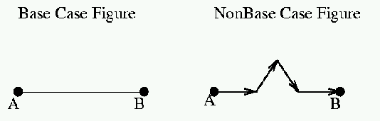
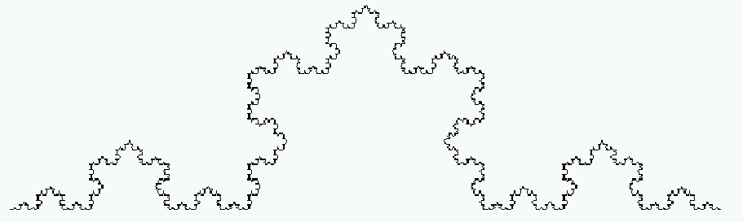
Recursive Images
if n=0
if n=1
if n=2
if n=3
if n=4
if n=5

Slide 8
Recursive Images
⇒ ∞
L(n) = ⁴/₃ L(n-1)
= (⁴/₃)^{n}

Slide 9
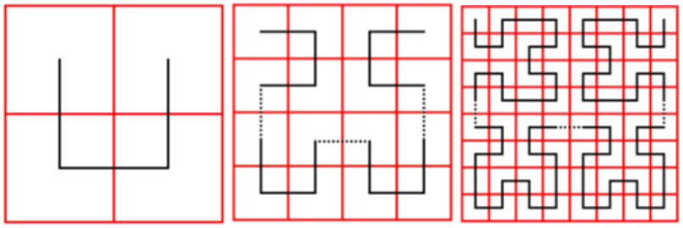
Recursive Images
A Hilbert Space-filling Curve is a 1-dim line
that “fills” a 2D plane,
then a 3D cube.

Slide 10
