Slide 1
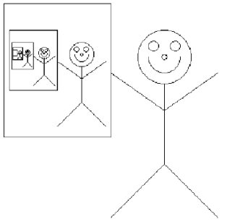
Recursion
Thinking about Algorithms Abstractly
Jeff Edmonds
York University
Lecture 3
COSC 3101

Slide 2
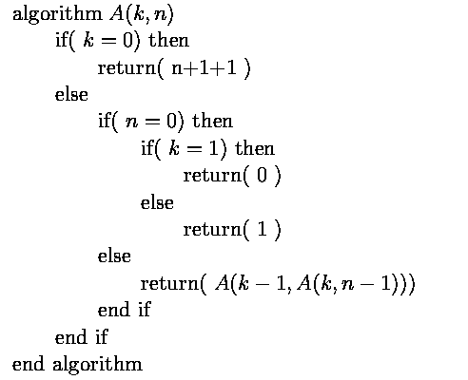
Ackermann’s Function
How big is A(5,5)?
n applications
Notes:
2

Slide 3
Ackermann’s Function
n applications
n applications
Notes:
3

Slide 4
Ackermann’s Function
n applications
n applications
Notes:
4

Slide 5

Ackermann’s Function
n applications
Notes:
5

Slide 6


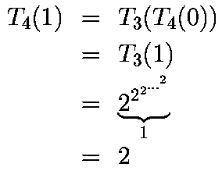
Ackermann’s Function

Slide 7

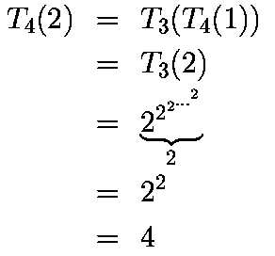
Ackermann’s Function

Slide 8

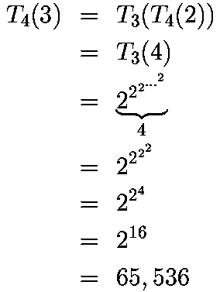
Ackermann’s Function

Slide 9
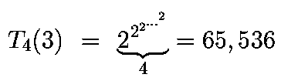
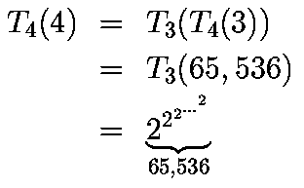
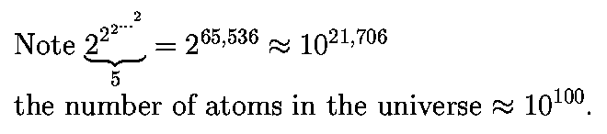
Ackermann’s Function

Slide 10
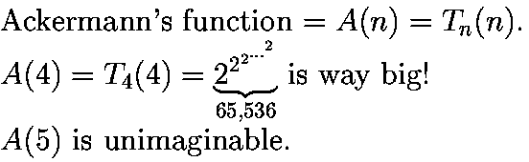
Ackermann’s Function
Notes:
10

