Slide 1




<preCond>
codeA
loop
<loop-invariant>
exit when <exit Cond>
codeB
codeC
<postCond>
Iterative Algorithms
I implored you to not worry
about the entire computation.
0
T+1
Trust who passes you
the baton
and go around once
i-1
i
next
i
i

Slide 2

<preCond>
codeA
loop
<loop-invariant>
exit when <exit Cond>
codeB
codeC
<postCond>
Iterative Algorithms
I implored you to not worry
about the entire computation.
Trying to understand
the entire algorithm at once is the most common reason for panicking and drowning.

Slide 3

Iterative Algorithms
Loop Invariants
Paradigm Shift

Slide 4






Iterative Algorithms
Loop Invariants
An Algorithm viewed
as a sequence of
Actions:
Landmarks:
ie an Assertion
of the static picture
of what is true
at that moment
in the journey.
.. Straight
.. Right
.. Straight
.. Left …..
I can get lost!!!

Slide 5
Iterative Algorithms
Loop Invariants
Max( A )
“preCond:
Input is array A[1..n]
of n values.”
i = 1
m = A[1]
loop
“loop-invariant:
m is max in {A[1]..A[i]}”
exit when (i=n)
m = max(m,A[i+1])
i = i + 1
endloop
return(m)
“postCond:
return max in {A[1]..A[n]}”
A loop invariant is
any assumptions
(picture)
that must be true
at the top of the loop.
Not just to please the prof.
Not just to prove correctness.
Use them to think about your algorithm!
Before you start coding.
What do you want to be
true in the middle of your computation?
  You need to know.
  Let your reader know.

Slide 6
Iterative Algorithms
Loop Invariants
Max( A )
“preCond:
Input is array A[1..n]
of n values.”
i = 1
m = A[1]
loop
“loop-invariant:
m is max in {A[1]..A[i]}”
exit when (i=n)
m = max(m,A[i+1])
i = i + 1
endloop
return(m)
“postCond:
return max in {A[1]..A[n]}”
Definition of Correctness
<preCond>
<any conditions>
code
<postCond>

Slide 7
Iterative Algorithms
Loop Invariants
Max( A )
“preCond:
Input is array A[1..n]
of n values.”
i = 1
m = A[1]
loop
“loop-invariant:
m is max in {A[1]..A[i]}”
exit when (i=n)
m = max(m,A[i+1])
i = i + 1
endloop
return(m)
“postCond:
return max in {A[1]..A[n]}”
Establishing the loop invariant:
⟨preCond⟩
code
⟨loop-invariant⟩
Exit
Maintaining the loop invariant:
⟨loop-invariant_{t-1}⟩
¬⟨exit Cond⟩
codeB
⟨loop-invariant_{t}⟩
⟨make progress⟩
Exit
Obtaining Postcondition:
⟨loop-invariant ⟩
⟨exit Cond⟩
code
⟨postCond⟩

Slide 8
Game of Life
Life( me)
“preCond:
I am born.”
Hopefully my parents help
loop
“loop-invariant:
I am well
and reasonably on track”
exit when (I die)
Maintain the loop invariant
Make a little progress
Make the world a little better.
endloop
“postCond:
It was a well spent and good life”
One day at a time.
next

Slide 9
Typical Types of Loop Invariants
Fairy God Mother
  I have arrived from Mars, some amount of progress has been made already and my Fairy God Mother has set the state of the computation to be just what I want so that I feel as comfortable as I could be given the amount of progress that has been made.
More of the input
More of the output
Narrowing the search space
Shrinking Input Instance
Data Structure (System) Invariant

Slide 10
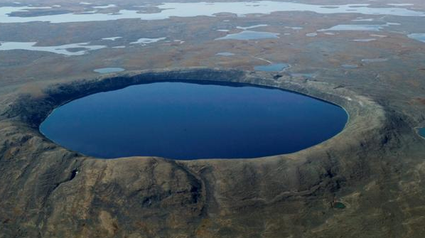


Fairy God Mother
I run infinitely faster than the monster.
so my only goal is to get to
shore without him there.
The only problem is that
he runs 4 times faster than I swim.
Me: Radius 1, speed 1, time 1.
Him: Half circ., speed 4, time = 3.14/4 < 1
He wins.

Slide 11

Fairy God Mother
Precond:
Postcond:
I’m in somewhere in the lake.
He runs 4× I swim.
Get to shore without him there.
He runs back and forth to catch me.
And I change my direction to avoid him.
Can I get away?

Slide 12
Fairy God Mother
79 km
Measure of Progress:
My distance from center
Loop Invariant:
He is opposite of me.
My progress is the distance
swum from the center.
What is your wish?
It is my job to
establish
maintain
and get the post condition
from this loop invariant

Slide 13
Fairy God Mother
Establishing Loop Invariant
<preCond>
codeA
I’m somewhere
Swim to middle
He is opposite of me
<loop-invariant>
I don’t want to panic and drown
by trying to solve the whole problem.
My goal now is not to escape or to make progress.
My only goal is to establish the loop invariant by ..?
Moving to the center.
Your motto should be:
0 is a fine number and is a fine ∅ set.

Slide 14
Fairy God Mother
Maintain Loop Inv
<loop-inv_{t}>
¬<exit>
codeB
He is opposite of me
¬ (I can’t maintain LI)
Swim opp direc
& outward.
Exit
He is opposite of me
<loop-inv_{t+1}>
I don’t want to panic and drown
by trying to solve the whole problem.
My goal now is not to escape.
My only goal is to make a little progress and
maintain the loop invariant by ..?
by moving opposite him in my circle.
But he moves 4 times faster!!!
How long can I keep doing this?
And I must make progress
by swimming out.
When should I exit my “loop”?
When I can no longer maintain the LI.

Slide 15
Fairy God Mother
Similar Triangles
1
r
rd
His distance
My distance
His time
My Time
Need
= d
= rd
= d/4
= rd
rd < d/4
r < 1/4
d
But he moves 4 times faster!!!
So the circumference of my circle must be ¼ of his.

Slide 16
Fairy God Mother
If I am less than ¼ from the middle,
then I can swim my circle faster
than he can run his.
(Even though he runs 4 times faster.)
Hence, I can maintain the loop invariant,
by moving opposite him
And can use my extra speed
to make progress outward.

Slide 17
Fairy God Mother
Maintain Loop Inv
<loop-inv_{t}>
¬<exit>
codeB
He is opposite of me
I’m at < ¼
Swim opp direc
& outward.
Exit
He is opposite of me
<loop-inv_{t+1}>
I don’t want to panic and drown
by trying to solve the whole problem.
My goal now is not to escape or to make progress.
My only goal is to maintain the loop invariant by ..?
by moving opposite him in my circle.
But he moves 4 times faster!!!
I keep doing this as long as
the circumference of my circle < ¼ his
and then I will exit the “loop”.

Slide 18
Fairy God Mother
Ending
<loop-inv>
<exit>
codeC
He is opposite of me
I’m at = ¼
Swim for it!
I am at the shore without him.
Exit
<post-cond>
When I am ¼ from the middle,
I can no longer maintain the loop invariant.
Hence, I … ?
Swim for it.
Me: ¾ radius, speed 1, time = ¾ = 0.75
Him: Half circ., speed 4, time = 3.14/4 = 0.78
I win!

Slide 19
Fairy God Mother
Maybe I can do better
by taking a different route.
(Allowing a faster monster)
I swim farther.
But I run farther.

Slide 20
We will prove I can get away from a v=4.6 speed monster by
- maintaining the loop inv until I am at the smaller 1/v radius circle
- and then continuing tangentially to the inner circle.

Slide 21
We need to anticipate where the monster will go.
Claim: We can assume that he always runs in the direction
for which the angle to the swimmer is less.

Slide 22
The monster is running clockwise in the direction
for which the angle to the swimmer is less.
Assuming he continues this, swimmer has some planned path.
If the monster turns around,
the swimmer flips his action.
For perspective, flip universe
Wait for monster to catch up or turn around again.
This maintains the loop invariant.
Exit

Slide 23
The monster is running clockwise in the direction
for which the angle to the swimmer is less.
Exit
If I head too far ahead of the monster,
he will go around the other way.
Hence, we do not want to move angularly faster than him.

Slide 24
The monster is running clockwise in the direction
for which the angle to the swimmer is less.
As long as the swimmer stays out of the ¹/_{v} radius circle,
his angle will move clockwise
but the monster’s angle will move further.
This maintains the loop invariant.
And hence the monster will continue to move clockwise.
Exit
¹/_{v}

Slide 25
As long as the swimmer stays out of the ¹/_{v} radius circle.
Consider the last time the swimmer leaves the ¹/_{v} circle.
(Note he will never enter it again.)
¹/_{v}

Slide 26
As long as the monster continues to move clockwise,
I don’t have to fool him by going a funny path.
I might as well go in the shortest path to the same endpoint.
¹/_{v}
But this is not allowed
because it enters the ¹/_{v} circle.
But this is also a line from
the ¹/_{v} circle.

Slide 27
Which line is better?
Farther lines are longer for the swimmer.
But also farther for the monster.
¹/_{v}

Slide 28




Which line is better?
Calculous shows that a further line is always better
as it increases the monster’s time by more than the swimmers.
$$\left\langle \sin\left(θ\right),\cos\left(θ\right)\right\rangle$$
Exit
Time of swimmer
= distance L swum by swimmer
=$\sqrt{{\sin\left(θ\right)}^{2}+{\left(\cos\left(θ\right)−1/v\right)}^{2}}$
=$\sqrt{1−{2cos\left(θ\right)}/v+1/{v^{2}}}$
${δT}/{δθ}= \frac{{\sin\left(θ\right)}/v}{L} ≤ 1/v$
L
1
This line is better
than all earlier ones.
¹/_{v}
$$θ$$
Distances run by monster
$=π+θ$
$Time= \frac{π+θ}{v}$
$${δT}/{δθ}= 1/v$$

Slide 29
Which line is better?
So the tangential line is best.
¹/_{v}
This one is not allowed.

Slide 30



What speed can the monster go with this strategy?
Time of swimmer
= distance swum by swimmer
=$\sqrt{1^{2}−1/{v^{2}}}$
¹/_{v}
$$θ$$
$$\cos\left(θ\right)= \frac{1/v}{1}$$
Distances run by monster
$=π+θ$
$=π+ \cos^{−1}\left(1/v\right)$
$Time= \frac{π+ \cos^{−1}\left(1/v\right)}{v}$

Slide 31
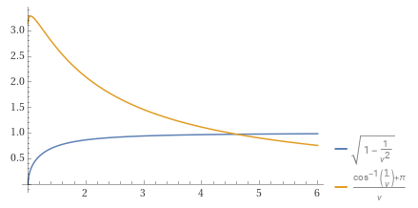
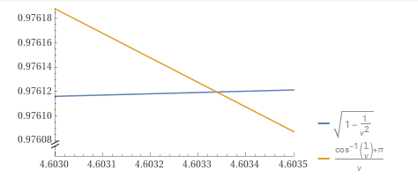
What speed can the monster go with this strategy?
v=4.6034 balances the two times.
Time of swimmer
= distance swum by swimmer
=$\sqrt{1^{2}−1/{v^{2}}}$
¹/_{v}
$$θ$$
$$\cos\left(θ\right)= \frac{1/v}{1}$$
Distances run by monster
$=π+θ$
$=π+ \cos^{−1}\left(1/v\right)$
$Time= \frac{π+ \cos^{−1}\left(1/v\right)}{v}$

Slide 32
n in a Row
Precondition: Infinite line. Int n. Opponent skips every 10th move.
PostConditions: Continuous block of n whites.
How 1/10 extra moves help?
b
w
w
b
b
w
w
b
b
w
w
b
b
w
w
b
b
w
w
w
b
Black skip every 10th move.
But I want n=1000000 in a row!

Slide 33
n in a Row
Precondition: Infinite line. Int n. Opponent skips every 10th move.
PostConditions: Continuous block of n whites.
b
w
w
w
w
w
w
w
w
w
w
w
Garbage that is ignored
w
w
w
w
w
w
This “garbage” might help white because it does not have a black on one side.
It might hurt black because he might waste his time putting a black on the other side.
But it is too confusing for us to keep track of.
We want a clean picture/loop invariant.
So we ignore it.
w
w
w
w
w
w
w
w
w
w
w
w
w
w
w
w
w
w
f(i)
w
w
w
w
w
w
w
w
w
w
w
w
w
w
w
w
w
w
w
w
w
w
w
w
w
w
w
w
w
w
i

Slide 34

n in a Row
Precondition: Infinite line. Int n. Opponent skips every 10th move.
PostConditions: Continuous block of n whites.
w
w
w
w
w
w
w
w
w
w
w
w
w
w
w
w
w
w
w
w
w
w
w
w
w
w
w
w
w
w
f(i)
w
w
w
w
w
w
w
w
w
w
w
w
w
w
w
w
w
w
w
w
w
w
w
w
w
w
w
w
w
w
i

Slide 35
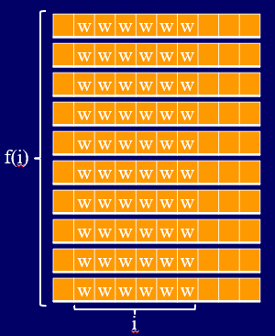
n in a Row
Precondition: Infinite line. Int n. Opponent skips every 10th move.
PostConditions: Continuous block of n whites.
<loop-invariant>
<exit Cond>
i=n
, f(n)=1
codeC:
Done
f(n)
= 1
w
w
w
w
w
w
w
w
<PostConditions>
n

Slide 36

n in a Row
Precondition: Infinite line. Int n. Opponent skips every 10th move.
PostConditions: Continuous block of n whites.

Slide 37
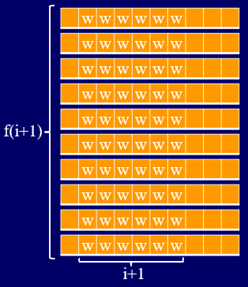
n in a Row
Precondition: Infinite line. Int n. Opponent skips every 10th move.
PostConditions: Continuous block of n whites.
<loop-invariant_{t}>
¬<exit Cond>
i<n
codeB:
We need to make each block one longer
<loop-invariant_{t+1}>

Slide 38
n in a Row
Precondition: Infinite line. Int n. Opponent skips every 10th move.
PostConditions: Continuous block of n whites.
w
w
w
w
w
w
w
b
w
w
w
w
w
w
I think black will go here.
w
w
w
w
w
w
w
w
w
w
w
w
But it can be really hard to know where black will go.
He could do a move that looks stupid and then win because of it.
How do you KNOW he does not have a better move?
We have to assume he is SMART.
w
w
w
w
w
w
f(i)
w
w
w
w
w
w
w
w
w
w
w
w
w
w
w
w
w
w
w
w
w
w
w
w
w
w
w
w
w
w
i

Slide 39
n in a Row
Precondition: Infinite line. Int n. Opponent skips every 10th move.
PostConditions: Continuous block of n whites.
w
w
w
w
w
w
w
w
w
w
w
w
w
b
w
w
w
w
w
b
w
w
w
w
w
w
Garbage that is ignored
w
w
w
w
w
w
Remember the garbage?
He might go there.
But this would be good for white because white has decided to ignore this block.
Because white told black that it will be ignored, we don’t have to worry about black going there.
w
w
w
w
w
w
f(i)
w
w
w
w
w
w
w
w
w
w
w
w
w
w
w
w
w
w
w
w
w
w
w
w
w
w
w
w
w
w
i

Slide 40
n in a Row
Precondition: Infinite line. Int n. Opponent skips every 10th move.
PostConditions: Continuous block of n whites.
w
w
w
w
w
w
w
w
w
w
w
w
w
Black could go here,
but it is a shorter block.
w
w
w
w
w
w
b
w
w
w
w
w
w
w
w
w
w
w
w
f(i)
w
w
w
w
w
w
w
w
w
w
w
w
w
w
w
w
w
w
w
w
w
w
w
w
w
w
w
w
w
w
i

Slide 41
n in a Row
Precondition: Infinite line. Int n. Opponent skips every 10th move.
PostConditions: Continuous block of n whites.
b
w
w
w
w
w
w
w
w
w
w
w
w
w
w
w
w
w
w
w
Black could go here,
but this is basically the same.
w
w
w
w
w
w
w
w
w
w
w
w
The key is that black can kill one of our “special” blocks.
f(i)
w
w
w
w
w
w
w
w
w
w
w
w
w
w
w
w
w
w
w
w
w
w
w
w
w
w
w
w
w
w
i

Slide 42
n in a Row
Precondition: Infinite line. Int n. Opponent skips every 10th move.
PostConditions: Continuous block of n whites.
w
w
w
w
w
w
w
b
w
w
w
w
w
w
w
b
This really does feel like black’s best move.
w
w
w
w
w
w
w
b
w
w
w
w
w
w
w
b
w
w
w
w
w
w
w
b
Garbage
f(i)
w
w
w
w
w
w
w
b
w
w
w
w
w
w
w
b
w
w
w
w
w
w
w
b
w
w
w
w
w
w
w
b
w
w
w
w
w
w
w
f(i)/10
Black skip every 10th move.
i

Slide 43
n in a Row
Precondition: Infinite line. Int n. Opponent skips every 10th move.
PostConditions: Continuous block of n whites.
Because f(i) goes down by a factor of 10 each iteration,
f(i) = c/10^{i}
After n iterations, we need f(n)=1 block of length n.
f(n) = c/10^{n} = 1
c =10^{n}
f(i) = 10^{n}/10^{i} = 10^{n-i}
i+1
w
w
w
w
w
w
w
f(i)/10
= f(i+1)
i

Slide 44

n in a Row
Precondition: Infinite line. Int n. Opponent skips every 10th move.
PostConditions: Continuous block of n whites.
When, i=1, you need f(1) = 10^{n-1}
single whites away from any black.
How are you going to do that!
My favorite number is i=0.
Then I need f(0) = 10^{n}
blocks of length zero
away from any black.

Slide 45
n in a Row
Precondition: Infinite line. Int n. Opponent skips every 10th move.
PostConditions: Continuous block of n whites.
f(0)
Done
0

Slide 46
n in a Row
Precondition: Infinite line. Int n. Opponent skips every 10th move.
PostConditions: Continuous block of n whites.
w
b
w
b
This really does feel like black’s best move.
w
b
w
b
w
b
Garbage
f(0)
w
b
w
b
w
b
w
b
Black skip every 10th move.
w
f(0)/10
= f(1)
0

Slide 47
n in a Row
Precondition: Infinite line. Int n. Opponent skips every 10th move.
PostConditions: Continuous block of n whites.
I still don’t believe it is possible.
Do you believe in the steps?
Yes.
Did you follow the steps?
Yes.
So then the algorithm works
Yes.
And
I still don’t believe it is possible.
Ok. Let trace it out.

Slide 48
n in a Row
Precondition: Infinite line. Int n. Opponent skips every 10th move.
PostConditions: Continuous block of n whites.
Let n=5.
Build 10⁵ blocks of length 0.
Just by planning where they go.
Extend them to 10⁵ blocks of length 1.
10⁴ blocks of length 1 survive.
Extend them to 10⁴ blocks of length 2.
10³ blocks of length 2 survive.
Extend them to 10³ blocks of length 3.
10² blocks of length 3 survive.
Extend them to 10² blocks of length 4.
10¹ blocks of length 4 survive.
Extend them to 10¹ blocks of length 5.
10⁰=1 block of length 5 survives.
Extend it to a block of length 6. (one extra)

