Slide 1
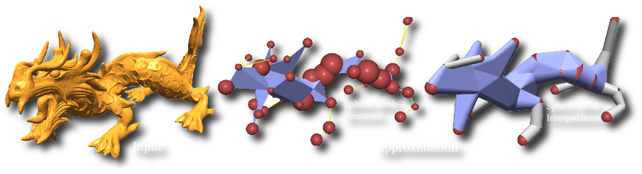
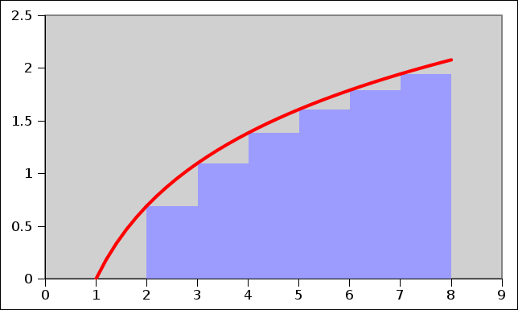
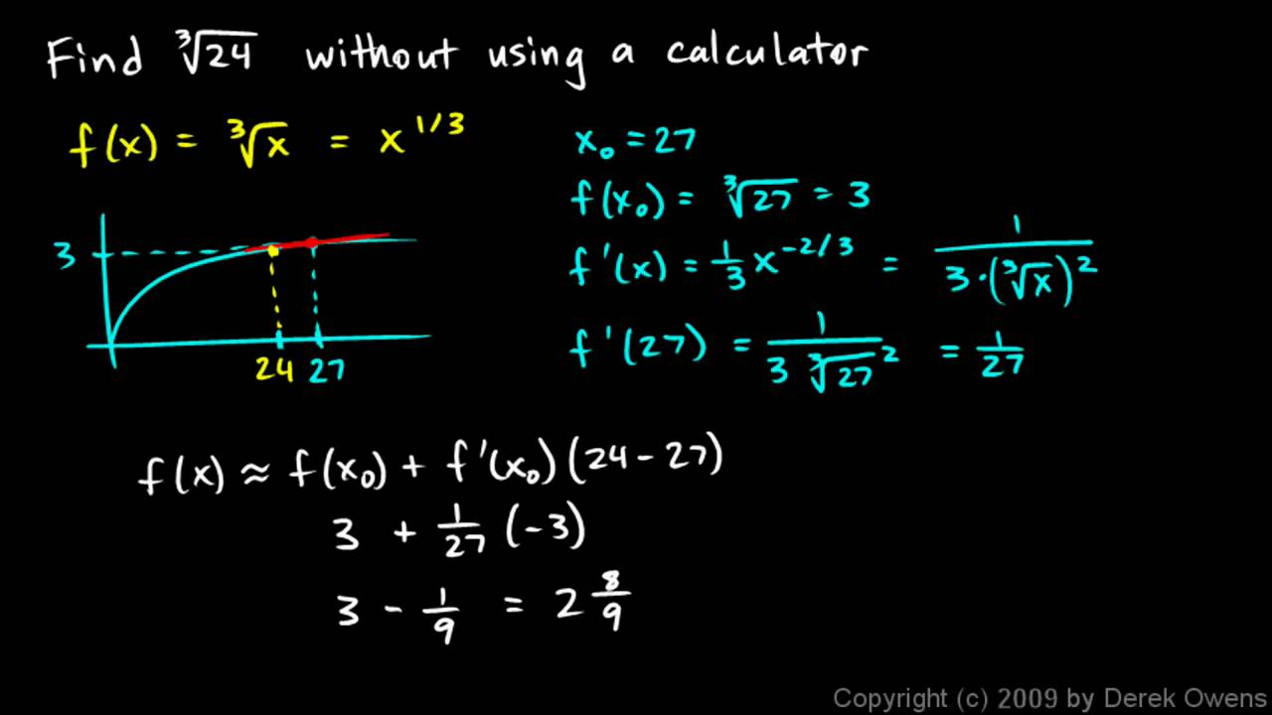
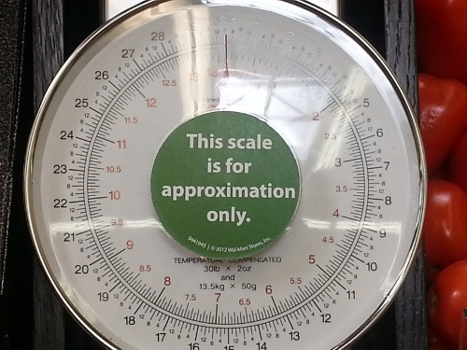
Approximate Algorithms

Slide 2
Approximate Greedy
For some problems, the obvious greedy algorithm does not give always give the most optimal solution, but may guarantee that it gives one that is within say a factor of 2 of optimal.
Max Cut: A random cut expects to have half the edges cross it.

Slide 3
Approximate Knapsack
Get as much value
as you can
into the knapsack

Slide 4
Approximate Knapsack
Ingredients:
  Instances: The volume V of the knapsack.
  The volume and price of n objects
  <<v₁,p₁>,<v₂,p₂>,… ,<v_{n},p_{n}>>.
  Solutions: A set of objects that fit in the knapsack.
    i.e. ∑_{i∈S} v_{i} ≤ V
  Cost of Solution: The total value of objects in set.
    i.e. ∑_{i∈S} p_{i}
  Goal: Get as much value as you can
  into the knapsack.

Slide 5
Approximate Knapsack
Dynamic Programming
Running time = Θ( V × n )
= Θ( 2^{#bits in V} × n )
  Poly time if size of knapsack is small
  Exponential time if size is an arbitrary integer.

Slide 6
Approximate Knapsack
Dynamic Programming
Running time = Θ( V × n )
= Θ( 2^{#bits in V} × n )
NP-Complete
Approximate Algorithm
  In poly-time Θ(n³/ε),
  solution can be found
  that is perfect in ∑_{i∈S} v_{i} ≤ V
  (1+ε) as good as optimal wrt ∑_{i∈S} p_{i}
  Eg, ε = .001, Time is 1000n³

Slide 7
Approximate Knapsack
Subinstance: ∀ V’∈[0..V], ∀i∈[0..n],
knapsack(V’,i) = maximize ∑_{i∈S} p_{i}
  subject to S ⊆ {1..i} and ∑_{i∈S} v_{i} ≤ V
Recurrence Relation
  knapsack(V’,i)
  = max( knapsack(V’,i-1),
  knapsack(V’-v_{i},i-1)+p_{i} )
No
Yes

Slide 8
Approximate Knapsack
∀ V’∈[0..V], ∀i∈[0..n], knapsack(V’,i)
0
1
2
V’-v_{i}
V’
V
OptSol price
0
1
2
same + p_{i}
No
i-1
same
Yes
i
Take best
of best.
Our price?
n

Slide 9
Approximate Knapsack
∀ V’∈[0..V], ∀i∈[0..n], knapsack(V’,i)
0
1
2
V’
V
OptSol price
0
1
2
i-1
i
Time = O(nV)
n

Slide 10
Approximate Knapsack
Ingredients: (strange version)
  Instances: The price P wanted from the knapsack.
  The volume and price of n objects
  <<v₁,p₁>,<v₂,p₂>,… ,<v_{n},p_{n}>>.
  Solutions: A set of objects with total value P.
    i.e. ∑_{i∈S} p_{i} ≥ P
  Cost of Solution: The total volume of objects in set.
    i.e. ∑_{i∈S} v_{i}
  Goal: Minimize the volume needed
  to obtain this value P.
  into the knapsack.

Slide 11
Approximate Knapsack
Subinstance: ∀ P’∈[0..P], ∀i∈[0..n],
knapsack’(P’,i) = minimize ∑_{i∈S} v_{i}
  subject to S ⊆ {1..i} and ∑_{i∈S} p_{i} ≥ P
Recurrence Relation
  knapsack’(P’,i)
  = min( knapsack’(P’,i-1),
  knapsack’(P’-p_{i},i-1)+v_{i} )
No
Yes

Slide 12
Approximate Knapsack
∀ V’∈[0..V], ∀i∈[0..n], knapsack’(P’,i)
0
1
2
P’-p_{i}
P’
P
OptSol volume
0
1
2
same + v_{i}
No
i-1
same
Yes
i
Take best
of best.
Our volume?
n

Slide 13
Approximate Knapsack
Original problem knapsack(V,n)
0
1
2
P’
P
OptSol volume
0
1
2
i
Find largest price
not using more than V volume
Time = O(nP)
P = ∑_{i} p_{i}
n

Slide 14
Approximate Knapsack
Dynamic Programming
Running time = Θ( V × n )
= Θ( 2^{#bits in V} × n )
  Poly time if size of knapsack is small
  Exponential time if size is an arbitrary integer.
Strange Dynamic Programming
Running time = Θ( P × n )
= Θ( 2^{#bits in P} × n )
  Poly time if prices are small
  Exponential time if prices are arbitrary integers.

Slide 15
Approximate Knapsack
Approximation Algorithm:
Given V, <<v₁,p₁>,<v₂,p₂>,… ,<v_{n},p_{n}>>, & ε
Lose precision in prices.
  eg p_{i} = 101101101011₂
  p’_{i} = p_{i} with low k bits removed
  = 10110110₂
  p’_{i} = p_{i} with low k bits zeroed
  = 101101100000₂
  Solve knapsack using the strange algorithm.
10110110
k=4 (k chosen later)
= p_{i} / ₂^{k}
or
≥ p_{i} - ₂^{k}

Slide 16
Approximate Knapsack
Original problem knapsack(V,n)
0
1
2
P’
P
OptSol volume
0
1
2
i
Time
= O(n P)
= O(n P/2^{k})
n

Slide 17
Approximate Knapsack
Approximation Algorithm:
  Let S_{alg} be the set of items selected by our alg.
  Let S_{opt} be the set of items in the optimal sol.
Let P_{alg} =
∑p_{i}
  be the price returned by our alg.
i∈S_{alg}
Let P_{opt} =
∑p_{i}
  be the price returned by our alg.
i∈S_{opt}
Need P_{alg} ≥ P_{opt} (1-ε)

Slide 18
Approximate Knapsack
P_{alg}
= ∑p_{i}
i∈S_{alg}
because rounded down
≥ ∑p’_{i}
i∈S_{alg}
because S_{alg} is an optimal solution
for the <v_{i},p’_{i}> problem
≥ ∑p’_{i}
i∈S_{opt}
because rounded by at most 2^{k}.
≥ ∑(p_{i} -2^{k})
i∈S_{opt}
= P_{opt} – n 2^{k}

Slide 19
Approximate Knapsack
P_{alg}
≥ P_{opt} – n2^{k}
(need)
n2^{k}
= 1 - ε
= 1 -
P_{opt}
P_{opt}
P_{opt}
ε P_{opt}
2^{k}
=
n
Time = O(n P/2^{k})
= O( n² P )
ε P_{opt}
P = ∑_{i} p_{i}
P_{opt} ≥
max_{i} p_{i} ≥
P
n
Time
= O( n³)
ε
done

Slide 20
Approximate Clique
Clique: Given <G,k>, does G contains a k-clique?
Brute Force: Try out all n choose k possible subsets.
If k = Θ(n) then 2^{Θ(n)} subsets to check
If k=3 then
only O(n³)
NP-Complete: ie, if there is a poly time algorithm for it,
then there is one for many important problems.

Slide 21
Approximate Clique
Clique: Given <G,k>, does G contains a k-clique?
Given a graph G, how well can you approximate
the size of the largest clique?
Not at all.
It is NP-complete to know
if the largest clique is of size n^{ε} or n^{1-ε}

