Slide 1
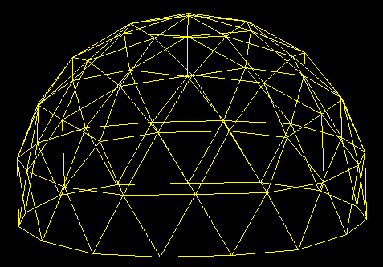
Linear Programming
Thinking about Algorithms Abstractly
Def and Hot Dog Example
Network Flow Def^{n}
Matrix View of Linear Programming
Hill Climbing Simplex Method
Dual Solution Witness to Optimality
Define Dual Problem
Buy Fruit or Sell Vitamines Duality
Primal-Dual Hill Climbing
Jeff Edmonds York University
Lecture 5
COSC 3101

Slide 2

Linear Programming
Linear Program: An optimization problem whose constraints and cost function are linear functions
Goal: Find a solution which optimizes the cost.
E.g.
Maximize Cost Function :
21x₁ - 6x₂ – 100x₃ - 100x₄
Constraint Functions:
5x₁ + 2x₂ +31x₃ - 20x₄ ≤ 21
1x₁ - 4x₂ +3x₃ + 10x₁ ≥ 56
6x₁ + 60x₂ - 31x₃ - 15x₄ ≤ 200
…..
Applied in various industrial fields: Manufacturing,
Supply-Chain, Logistics, Marketing…
To save money and increase profits !

Slide 3
A Hotdog
A combination of pork, grain, and sawdust, …

Slide 4
Constraints:
  Amount of moisture
  Amount of protein,
  …

Slide 5
The Hotdog Problem
Given today’s prices,
what is a fast algorithm
to find the cheapest hotdog?

Slide 6
Abstract Out Essential Details
sawdust
grain
pork
water
Amount to add: x₁, x₂, x₃, x₄
Cost: 29, 8, 1, 2
Cost of Hotdog:
29x₁ + 8x₂ + 1x₃ + 2x₄
Constraints:
  moisture
  protein,
  …
3x₁ + 4x₂ – 7x₃ + 8x₄ ≤ 12
2x₁ - 8x₂ + 4x₃ - 3x₄ ≤ 24
-8x₁ + 2x₂ – 3x₃ - 9x₄ ≤ 8
x₁ + 2x₂ + 9x₃ - 3x₄ ≤ 31

Slide 7
Abstract Out Essential Details
Minimize:
29x₁ + 8x₂ + 1x₃ + 2x₄
Subject to:
3x₁ + 4x₂ – 7x₃ + 8x₄ ≤ 12
2x₁ - 8x₂ + 4x₃ - 3x₄ ≤ 24
-8x₁ + 2x₂ – 3x₃ - 9x₄ ≤ 8
x₁ + 2x₂ + 9x₃ - 3x₄ ≤ 31

Slide 8
Network Flow as a
Linear Program
Given an instance of Network Flow: <G,c_{<u,v>}>
express it as a Linear Program:
  The variables:
  Maximize:
  Subject to:
  Flows f_{<u,v>} for each edge.
rate(F) = ∑_{u} F_{<u,t>} - ∑_{v} F_{<t,v>}
∀<u,v>: F_{<u,v>} ≤ c_{<u,v>}. (Flow can't exceed capacity)
∀v: ∑_{u} F_{<u,v>} = ∑_{w} F_{<v,w>} (flow in = flow out)

Slide 9
Do all Linear Programs have optimal solutions ? No !
Three types of Linear Programs:
  1. Has an optimal solution with a finite cost value: e.g. hotdog problem
  2. Unbounded: e.g maximize x, x ≥ 5, x ≥ 0
  3. Infeasible: e.g maximize x, x ≤ 3, x ≥ 5 , x ≥ 0

Slide 10
Linear Programming
Linear Program
Minimize: C^{T}⋅X
Subject to: M⋅X ≥ N
minimize
subject to
C_{j}
X_{j}
M_{i,j}
X_{j}
N_{i}
≥
X_{j}
≥
0
n variable x_{j} that we are looking for values of.
An optimization function
  Each has a variable has a coefficient c_{j}.
  The dot product C^{T}⋅X gives one value to minimize.
m constraints:
  Some linear combination of the variables
  must be at least some set value.
  ∀i M_{i}⋅X ≥ N_{i}
Generally implied that variables are positive.

Slide 11
Linear Programming
Linear Program
Minimize: C^{T}⋅X
Subject to: M⋅X ≥ N
minimize
subject to
C_{j}
X_{j}
M_{i,j}
X_{j}
N_{i}
≥
≤
=
Maximize: C^{T}⋅X
Subject to: M⋅X ≤ N
maximize
subject to
C_{j}
X_{j}
M_{i,j}
X_{j}
N_{i}
≤
≥
=
These are the linear programs in “standard” form
  Minimize C^{T}⋅X hence X subject to X ≥
  Maximize C^{T}⋅X hence X subject to X ≤
But you could mix and match.

Slide 12
Simplex Algorithm
Invented by George Dantzig in 1947
A hill climbing algorithm
Global Max
Local Max

Slide 13
Simplex Algorithm
Invented by George Dantzig in 1947
A hill climbing algorithm
Guaranteed to find an global optimal solution for Linear Programs
Global Max

Slide 14

Simplex Algorithm
Computes solution to a Linear Program by evaluating vertices where constraints intersect each other.
The feasible region defined by the constraints is convex
and is called a “simplex”.
Worst case exponential time
because with n equations and m constraints there are $\left(\begin{matrix}n \\ m\end{matrix}\right)≈{\left(\frac{en}{m}\right)}^{n}$vertexes.
Practically very fast.
Ellisoid algorithm (1979)
First poly time O(n⁴L) algorithm.

Slide 15
Simplex
Algorithm
With n variables, x₁, x₂, … , x_{n}, there are n dimensions.
(Here n=2)
Each constraint is an n-1 dimensional plain.
(Here the 1-dim line)
Each point in this space, is a solution.
It is a valid solution if it is on the correct side of each constraint plain
x₂
Minimize
Cost = 5x₁ + 7x₂
Constraint Functions
C1: 2x₁ + 4x₂ ≥ 100
C2: 3x₁ + 3x₂ ≥ 90
x₁, x₂ ≥ 0
C1
(0,0)
C2
x₁

Slide 16
Simplex
Algorithm
Solutions on this line have one value of the objective function
This has another
These are not valid
This is the optimal value
x₂
Cost Function
Cost = 5x₁ + 7x₂
Constraint Functions
C1: 2x₁ + 4x₂ ≥ 100
C2: 3x₁ + 3x₂ ≥ 90
x₁, x₂ ≥ 0
C1
(0,0)
C2
x₁

Slide 17

Simplex
Algorithm
The arrow tells the direction that the optimal function increases.
Note that the solution is a vertex.
Each vertex is the intersection of n constraints.
(Here n = #of variables = 2)
This is why there are $\left(\begin{matrix}n \\ m\end{matrix}\right)≈{\left(\frac{en}{m}\right)}^{n}$vertexes.
x₂
Cost Function
Cost = 5x₁ + 7x₂
Constraint Functions
C1: 2x₁ + 4x₂ ≥ 100
C2: 3x₁ + 3x₂ ≥ 90
x₁, x₂ ≥ 0
C1
(0,0)
C2
x₁

Slide 18
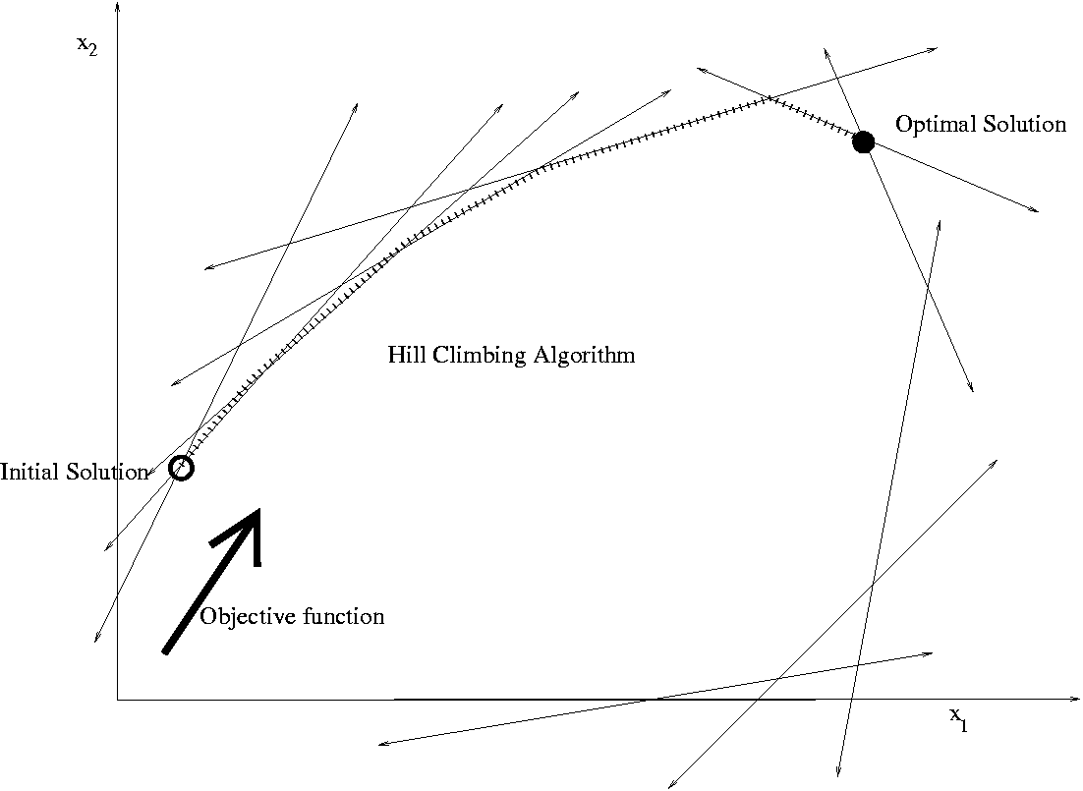
vertex
Algorithm
The arrow tells the direction that the optimal function increases.
Note that the solution is a vertex.
Each vertex is the intersection of n constraints.
(Here n = #of variables = 2)
The simplex method takes hill climbing steps,
from one vertex (valid solution) to another.

Slide 19
Simplex
Algorithm
With n variables, x₁, x₂, x₃ … , x_{n}, there are n dimensions.
(Here n=3)
Each constraint is an n-1 dimensional plain.
(Here the 2-dim triangles)
Each vertex is the intersection of n such constraints.
(Here looks like 6 but generally only n=3)
Maximize Cost :
21x₁ - 6x₂ – 100x₃
Constraint Functions:
5x₁ + 2x₂ +31x₃ ≤ 21
1x₁ - 4x₂ +3x₃ ≤ 56
6x₁ + 60x₂ - 31x₃ ≤ 200
⁞
-5x₁ + 3x₂ +4x₃ ≤ 8
⁞
x₁, x_{2,} x₃ ≥ 0
A vertex is specified
by a subset of n
of the m tight (=) constraints.
=
=
=
All other constraints must be satisfied.

Slide 20
Simplex
Algorithm
If we slacken one of our n tight constrains,
our solution slides along a 1-dim edge.
Head in the direction that increases the potential function.
Maximize Cost :
21x₁ - 6x₂ – 100x₃
Constraint Functions:
5x₁ + 2x₂ +31x₃ ≤ 21
1x₁ - 4x₂ +3x₃ ≤ 56
6x₁ + 60x₂ - 31x₃ ≤ 200
⁞
-5x₁ + 3x₂ +4x₃ ≤ 8
⁞
x₁, x_{2,} x₃ ≥ 0
A vertex is specified
by a subset of n
of the m tight (=) constraints.
=
=
=

Slide 21
Simplex
Algorithm
If we slacken one of our n tight constrains,
our solution slides along a 1-dim edge.
Head in the direction that increases the potential function.
Keep sliding until we tighten some constraint.
This is one hill climbing step.
Maximize Cost :
21x₁ - 6x₂ – 100x₃
Constraint Functions:
5x₁ + 2x₂ +31x₃ ≤ 21
1x₁ - 4x₂ +3x₃ ≤ 56
6x₁ + 60x₂ - 31x₃ ≤ 200
⁞
-5x₁ + 3x₂ +4x₃ ≤ 8
⁞
x₁, x_{2,} x₃ ≥ 0
A vertex is specified
by a subset of n
of the m tight (=) constraints.
=
=
=

Slide 22
Simplex
Algorithm
If we slacken one of our n tight constrains,
our solution slides along a 1-dim edge.
Head in the direction that increases the potential function.
Keep sliding until we tighten some constraint.
This is one hill climbing step.
Maximize Cost :
21x₁ - 6x₂ – 100x₃
Constraint Functions:
5x₁ + 2x₂ +31x₃ ≤ 21
1x₁ - 4x₂ +3x₃ ≤ 56
6x₁ + 60x₂ - 31x₃ ≤ 200
⁞
-5x₁ + 3x₂ +4x₃ ≤ 8
⁞
x₁, x_{2,} x₃ ≥ 0
A vertex is specified
by a subset of n
of the m tight (=) constraints.

Slide 23

Simplex
Algorithm
But practically it tends to be fast.
Bread and butter of optimization in industry.
Maximize Cost :
21x₁ - 6x₂ – 100x₃
Constraint Functions:
5x₁ + 2x₂ +31x₃ ≤ 21
1x₁ - 4x₂ +3x₃ ≤ 56
6x₁ + 60x₂ - 31x₃ ≤ 200
⁞
-5x₁ + 3x₂ +4x₃ ≤ 8
⁞
x₁, x_{2,} x₃ ≥ 0
A vertex is specified
by a subset of n
of the m tight (=) constraints.

Slide 24
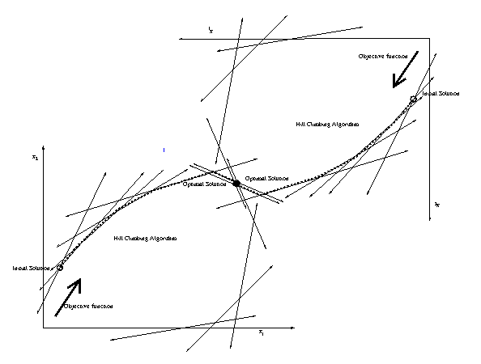
Dual
Primal

Slide 25

Hill Climbing
We have a valid solution.
(not necessarily optimal)
measure
progress
Value of our solution.
Take a step that goes up.
Make small local changes to your solution to
construct a slightly better solution.
Initially have the “zero
Global Max
Exit
Can't take a step that goes up.
Local Max
Problems:
Running time?
Can our Simplex
Algorithm get stuck
in a local maximum?
If you take small step,
could be exponential time.

Slide 26
Hill Climbing
Avoiding getting stuck
in a local maximum
Bad Execution
Good Execution
Made better choices of direction
  Hard
Back up an retry
  Exponential time
Define a bigger step

Slide 27
Network Flow
Can our Simplex Algorithm
get stuck in local max?
No!
Need to prove
  for every linear program
  for every choice of steps
an optimal solution is found!
How?

Slide 28
Primal-Dual Hill Climbing
Mars settlement has hilly landscape
and many layers of roofs.

Slide 29
Primal-Dual Hill Climbing
Primal Problem:
Exponential # of locations to stand.
Find a highest one.
Dual problem:
Exponential # of roofs.
Find a lowest one.

Slide 30
Primal-Dual Hill Climbing
Prove:
Every roof is above every location to stand.
∀ R ∀ L height(R) ≥ height(L)
⇒ height(R_{min}) ≥ height(L_{max})
Is there a gap?

Slide 31
Primal-Dual Hill Climbing
Prove:
For every location to stand either:
  the alg takes a step up or
  the alg gives a reason that explains why not
  by giving a roof of equal height.
  i.e. ∀ L [∃ L’ height(L’) ≥ height(L) or
∃ R height(R) = height(L)]
or
No Gap
But ∀ R ∀ L height(R) ≥ height(L)

Slide 32
Primal-Dual Hill Climbing
Prove:
For every location to stand either:
  the alg takes a step up or
  the alg gives a reason that explains why not
  by giving a roof of equal height.
  i.e. ∀ L [∃ L’ height(L’) ≥ height(L) or
∃ R height(R) = height(L)]
or
?
Can't go up from this location
and no matching roof.
Can't happen!

Slide 33
Primal-Dual Hill Climbing
Prove:
For every location to stand either:
  the alg takes a step up or
  the alg gives a reason that explains why not
  by giving a roof of equal height.
  i.e. ∀ L [∃ L’ height(L’) ≥ height(L) or
∃ R height(R) = height(L)]
or
No local maximum!

Slide 34
Primal-Dual Hill Climbing
Exit
Claim: Primal and dual have the same optimal value.
height(R_{min}) = height(L_{max})
Proved: ∀ R ∀ L, height(R) ≥ height(L)
Proved: Alg runs until it provides L_{alg} and R_{alg}
height(R_{alg}) = height(L_{alg})
height(R_{min}) ≤
height(R_{alg}) =
height(L_{alg}) ≤
height(L_{max})
height(R_{min}) ≥
height(L_{max})
No Gap
L_{alg} witness that height(L_{max}) is no smaller.
R_{alg} witness that height(L_{max}) is no bigger.

Slide 35
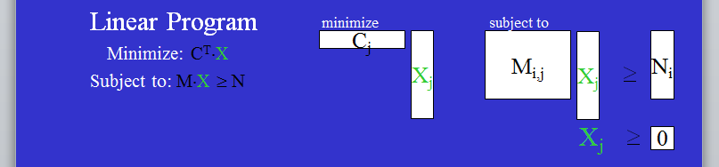
Primal-Dual Hill Climbing
The Primal problem (where to stand)
is a linear program.
What is the Dual problem (roofs)?
R_{alg} witness that height(L_{max}) is no bigger.

Slide 36
Duality
Linear Program
Minimize: C^{T}⋅X
Subject to: M⋅X ≥ N
minimize
subject to
C_{j}
X_{j}
M_{i,j}
X_{j}
N_{i}
≥
X_{j}
≥
0
n variable x_{j} that we are looking for values of.
An optimization function
  Each has a variable has a coefficient c_{j}.
  The dot product C^{T}⋅X gives one value to minimize.
m constraints:
  Some linear combination of the variables
  must be at least some set value.
  ∀i M_{i}⋅X ≥ N_{i}
Generally implied that variables are positive.

Slide 37
Duality
For every primal linear program,
we define its dual linear program.
Key parameters
Primal Linear Program
Minimize: C^{T}⋅X
Subject to: M⋅X ≥ N
C_{j}
Y_{i}
M_{i,j}
N_{i}
X_{j}
Dual Linear Program
N_{i}
X_{j}
M^{T}_{j,i}
C_{j}
Everything is turned upside down.
Y_{i}

Slide 38
Duality
For every primal linear program,
we define its dual linear program.
Primal Linear Program
Minimize: C^{T}⋅X
Subject to: M⋅X ≥ N
minimize
subject to
C_{j}
X_{j}
M_{i,j}
X_{j}
N_{i}
≥
X_{j}
≥
Dual Linear Program
subject to
0
?
Y_{i}
M^{T}_{j,i}
N_{i}
Y_{i}
Everything is turned upside down.
The matrix of coefficients is transposed
For each constraint, a variable.
  Form the objective function vector from the constraint vector.
Y_{i}
≥
0

Slide 39
Duality
For every primal linear program,
we define its dual linear program.
Primal Linear Program
Minimize: C^{T}⋅X
Subject to: M⋅X ≥ N
minimize
subject to
C_{j}
X_{j}
M_{i,j}
X_{j}
N_{i}
≥
X_{j}
≥
Dual Linear Program
subject to
0
N_{i}
Y_{i}
M^{T}_{j,i}
Y_{i}
C_{j}
?
Everything is turned upside down.
The matrix of coefficients is transposed
For each constraint, a variable.
For each variable, a constraint.
  Form constraint vector from the objective function vector.
Y_{i}
≥
0

Slide 40
Duality
For every primal linear program,
we define its dual linear program.
Primal Linear Program
Minimize: C^{T}⋅X
Subject to: M⋅X ≥ N
minimize
subject to
C_{j}
X_{j}
M_{i,j}
X_{j}
N_{i}
≥
X_{j}
≥
Dual Linear Program
maximize
subject to
0
Maximize N^{T} Y
Subject to: M^{T} Y ≤ C
N_{i}
Y_{i}
M^{T}_{j,i}
Y_{i}
C_{j}
≤
Everything is turned upside down.
The matrix of coefficients is transposed
For each constraint, a variable.
For each variable, a constraint.
Max ⇔ Min and ≥ ⇔ ≤
Y_{i}
≥
0

Slide 41
Duality
For every primal linear program,
we define its dual linear program.
Primal Linear Program
Minimize: C^{T}⋅X
Subject to: M⋅X ≥ N
minimize
subject to
C_{j}
X_{j}
M_{i,j}
X_{j}
N_{i}
≥
=
N_{i′}
X_{j}
≥
Dual Linear Program
maximize
subject to
0
Maximize N^{T} Y
Subject to: M^{T} Y ≤ C
N_{i}
Y_{i}
M^{T}_{j,i}
Y_{i}
C_{j}
≤
Everything is turned upside down.
The matrix of coefficients is transposed
For each constraint, a variable.
For each variable, a constraint.
Max ⇔ Min and ≥ ⇔ ≤
  If a constraint is ‘=’, then the variable Y_{i′} is unconstrained.
Y_{i}
≥
0
Y_{i′}
≥
0

Slide 42
Duality
For every primal linear program,
we define its dual linear program.
Primal Linear Program
Minimize: C^{T}⋅X
Subject to: M⋅X ≥ N
minimize
subject to
C_{j}
X_{j}
M_{i,j}
X_{j}
N_{i}
≥
X_{j′}
≥
X_{j}
≥
Dual Linear Program
maximize
0
0
subject to
Maximize N^{T} Y
Subject to: M^{T} Y ≤ C
N_{i}
Y_{i}
M^{T}_{j,i}
Y_{i}
C_{j}
≤
=
C_{j′}
Everything is turned upside down.
The matrix of coefficients is transposed
For each constraint, a variable.
For each variable, a constraint.
Max ⇔ Min and ≥ ⇔ ≤
  If a variable X_{j′} is unconstrained, then the constraint is ‘=’.
Y_{i}
≥
0

Slide 43
Duality
For every primal linear program,
we define its dual linear program.
Primal Linear Program
Minimize: C^{T}⋅X
Subject to: M⋅X ≥ N
minimize
subject to
C_{j}
X_{j}
M_{i,j}
X_{j}
N_{i}
≥
X_{j}
≥
Dual Linear Program
maximize
subject to
0
Maximize N^{T} Y
Subject to: M^{T} Y ≤ C
N_{i}
Y_{i}
M^{T}_{j,i}
Y_{i}
C_{j}
≤
Everything is turned upside down.
The matrix of coefficients is transposed
For each constraint, a variable.
For each variable, a constraint.
Max ⇔ Min and ≥ ⇔ ≤
Dual of the dual is ?
Y_{i}
≥
0
itself!

Slide 44
Duality
For every primal linear program,
we define its dual linear program.
Primal Linear Program
Minimize: C^{T}⋅X
Subject to: M⋅X ≥ N
minimize
subject to
C_{j}
X_{j}
M_{i,j}
X_{j}
N_{i}
≥
X_{j}
≥
Dual Linear Program
maximize
subject to
0
Maximize N^{T} Y
Subject to: M^{T} Y ≤ C
N_{i}
Y_{i}
M^{T}_{j,i}
Y_{i}
C_{j}
≤
Everything is turned upside down.
Max Location ⇔
Max Flow ⇔
Y_{i}
≥
0
Min Roof
Min Cut
We saw this linear program.
Simple to understand.
Oops.
Quite complicated

Slide 45
Duality
For every primal linear program,
we define its dual linear program.
Primal Linear Program
Minimize: C^{T}⋅X
Subject to: M⋅X ≥ N
minimize
subject to
C_{j}
X_{j}
M_{i,j}
X_{j}
N_{i}
≥
X_{j}
≥
Dual Linear Program
maximize
subject to
0
Maximize N^{T} Y
Subject to: M^{T} Y ≤ C
N_{i}
Y_{i}
M^{T}_{j,i}
Y_{i}
C_{j}
≤
Everything is turned upside down.
Max Location ⇔
Max Flow ⇔
Buyer of nutrients ⇔
in fruit
Y_{i}
≥
0
Min Roof
Min Cut
Seller of nutrients
in vitamins

Slide 46
Primal-Dual Hill Climbing
Prove:
Every roof is above every location to stand.
∀ R ∀ L height(R) ≥ height(L)
⇒ height(R_{min}) ≥ height(L_{max})
Is there a gap?

Slide 47
Duality
For every primal linear program,
we define its dual linear program.
Primal Linear Program
Minimize: C^{T}⋅X
Subject to: M⋅X ≥ N
minimize
subject to
C_{j}
X_{j}
M_{i,j}
X_{j}
N_{i}
≥
Dual Linear Program
maximize
subject to
Maximize N^{T}⋅ Y
Subject to: M^{T}⋅Y ≤ C
N_{i}
Y_{i}
M^{T}_{j,i}
Y_{i}
C_{j}
≤
Every solution X of the primal is
above every solution Y of the primal.
∀X ∀Y
C^{T}⋅X =
X^{T}⋅C
C_{j}
X_{j}
X_{j}
C_{j}
=
=
≥ N^{T}⋅Y

Slide 48
Duality
For every primal linear program,
we define its dual linear program.
Primal Linear Program
Minimize: C^{T}⋅X
Subject to: M⋅X ≥ N
minimize
subject to
C_{j}
X_{j}
M_{i,j}
X_{j}
N_{i}
≥
Dual Linear Program
maximize
subject to
Maximize N^{T}⋅ Y
Subject to: M^{T}⋅Y ≤ C
N_{i}
Y_{i}
M^{T}_{j,i}
Y_{i}
C_{j}
≤
Every solution X of the primal is
above every solution Y of the primal.
∀X ∀Y
C^{T}⋅X =
(Α⋅Β)^{T} =
Β^{T}⋅ Α^{T}
≥
X^{T}⋅ M^{T} ⋅ Y
X_{j}
M^{T}_{j,i}
≥
N_{i}
X^{T}⋅C
≥ N^{T}⋅Y

Slide 49
Duality
For every primal linear program,
we define its dual linear program.
Primal Linear Program
Minimize: C^{T}⋅X
Subject to: M⋅X ≥ N
minimize
subject to
C_{j}
X_{j}
M_{i,j}
X_{j}
N_{i}
≥
Dual Linear Program
maximize
subject to
Maximize N^{T}⋅ Y
Subject to: M^{T}⋅Y ≤ C
N_{i}
Y_{i}
M^{T}_{j,i}
Y_{i}
C_{j}
≤
Every solution X of the primal is
above every solution Y of the primal.
∀X ∀Y
C^{T}⋅X
≥ N^{T}⋅Y
⇒ C^{T}⋅X_{min} ≥ N^{T}⋅Y_{max}
We will prove equality
using the algorithm.

Slide 50


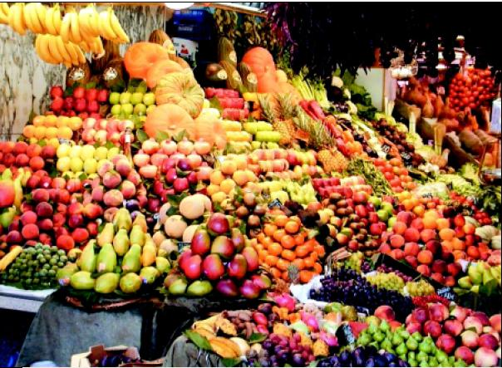
The Nutrition Problem
An apple a day keeps the doctor away – but apples are costly!
A customer’s goal is
to fulfill daily
vitamin requirements
at lowest cost.

Slide 51


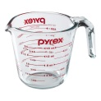


The Nutrition Problem
x₁ | x₂ | x₃
We must find the amount
(fruit eaten)/day of each fruit.
4 | 2 | 3
2 | 3 | 5
4x₁ + 2x₂ + 3x₃
2x₁ + 3x₂ + 5x₂
For each fruit and
each vitamin
we have vit/fruit
This gives us
for each vitamin
vit/day eaten.

Slide 52

The Nutrition Problem
x₁ | x₂ | x₃
Constraints:
4 | 2 | 3
2 | 3 | 5
80
90
4x₁ + 2x₂ + 3x₃
2x₁ + 3x₂ + 5x₂
≥ 80
≥ 90
For vitamin
we have
(vit need)/day
This gives us
for each vitamin
(vit eaten)/day.

Slide 53

The Nutrition Problem
x₁ | x₂ | x₃
Constraints:
4 | 2 | 3
2 | 3 | 5
80
90
4x₁ + 2x₂ + 3x₃
2x₁ + 3x₂ + 5x₂
≥ 80
≥ 90
x₁, x₂ ≥ 0
5 | 7 | 6
Cost = 5x₁ + 7x₂ + 6x₃
For each fruit
we have $/fruit
This gives us
$/day.

Slide 54



The Nutrition Problem
x₁ | x₂ | x₃
Constraints:
M
N
4 | 2 | 3
2 | 3 | 5
80
90
4x₁ + 2x₂ + 3x₃
2x₁ + 3x₂ + 5x₂
≥ 80
≥ 90
x₁, x₂ ≥ 0
C
5 | 7 | 6
Cost = 5x₁ + 7x₂ + 6x₃
This gives us
$/day.
subject to
minimize
M_{i,j}
X_{j}
N_{i}
C_{j}
X_{j}
≥

Slide 55
The Dual Problem
x₁ | x₂ | x₃
subject to
M^{T}_{j,i}
Y_{i}
C_{j}
≤
M
N
4 | 2 | 3
2 | 3 | 5
80
90
C
5 | 7 | 6
maximize
N_{i}
Y_{i}
subject to
minimize
M_{i,j}
X_{j}
N_{i}
C_{j}
X_{j}
≥

Slide 56
The Dual Problem
x₁ | x₂ | x₃
subject to
M^{T}_{j,i}
Y_{i}
C_{j}
≤
M
N
y₁
y₂
4 | 2 | 3
2 | 3 | 5
80
90
vit/fruit
×
$/vit
≤
$/fruit
C
Cost of buying all
the vit in an apple.
Cost of buying
an apple.
5 | 7 | 6
maximize
For each vitamin
a new variable.
Subject to the constraint that it is not cheaper to buy fruit.
N_{i}
Y_{i}
But what does
it mean?
Balance units
(vit need)/day
×
$/vit
A salesman goal is to set a price on each vitamin.
=
($ needed)/day
To maximize
his profits.
Assuming customer buys the required vitamins.

Slide 57
The Dual Problem
Primal Problem: A customer’s goal is to buy fruits in such a quantity that it minimizes cost but fulfills nutrition.
Dual Problem: A salesman goal is to set a price on each vitamin,
so that it maximizes profit
assuming customers buys the required vitamins,
subject to the constraint that it is not cheaper to buy fruit.
Primal (Customer)
Dual (Salesman)

Slide 58
Primal-Dual Hill Climbing
Prove:
For every solution X of the primal either:
  the alg takes a step up to a better primal
  the alg gives a reason that explains why not
  by giving a solution Y of the dual of equal value.
  i.e. ∀X [∃X′ C^{T}⋅X′ > C^{T}⋅X or ∃Y C^{T}⋅X = N^{T}⋅Y]
or
No Gap
But ∀ X ∀ Y C⋅X ≤ N⋅Y

Slide 59
Primal-Dual Hill Climbing
Prove:
For every solution X of the primal either:
  the alg takes a step up to a better primal
  the alg gives a reason that explains why not
  by giving a solution Y of the dual of equal value.
  i.e. ∀X [∃X′ C^{T}⋅X′ > C^{T}⋅X or ∃Y C^{T}⋅X = N^{T}⋅Y]
or
?
Can't go up from this location
and no matching roof.
Can't happen!

Slide 60
Primal-Dual Hill Climbing
Prove:
For every solution X of the primal either:
  the alg takes a step up to a better primal
  the alg gives a reason that explains why not
  by giving a solution Y of the dual of equal value.
  i.e. ∀X [∃X′ C^{T}⋅X′ > C^{T}⋅X or ∃Y C^{T}⋅X = N^{T}⋅Y]
or
No local maximum!

Slide 61
Primal-Dual Hill Climbing
Exit
Claim: Primal and dual have the same optimal value.
C^{T}⋅X_{min} = N^{T}⋅Y_{max}
No Gap
X_{alg} witnesses that C^{T}⋅X_{min} is no smaller.
Y_{alg} witnesses that C^{T}⋅X_{min} is no bigger.

Slide 62
Simplex
Algorithm
Given any solution x of the primal.
Maximize Cost :
21x₁ - 6x₂ – 7x₃
Constraint Functions:
5x₁ + 2x₂ + 9x₃ ≤ 21
1x₁ - 4x₂ + 3x₃ ≤ 56
6x₁ + 6x₂ - 8x₃ ≤ 78
⁞
-5x₁ + 3x₂ +4x₃ ≤ 8
⁞
x₁, x_{2,} x₃ ≥ 0
A vertex is specified
by a subset of n
of the m tight (=) constraints.
=
=
=
All other constraints must be satisfied.

Slide 63
Simplex
Algorithm
Given any solution x of the primal.
If we slacken one of our n tight constrains,
our solution slides along a 1-dim edge.
Head in the direction that increases the potential function.
Maximize Cost :
21x₁ - 6x₂ – 7x₃
Constraint Functions:
5x₁ + 2x₂ + 9x₃ ≤ 21
1x₁ - 4x₂ + 3x₃ ≤ 56
6x₁ + 6x₂ - 8x₃ ≤ 78
⁞
-5x₁ + 3x₂ +4x₃ ≤ 8
⁞
x₁, x_{2,} x₃ ≥ 0
A vertex is specified
by a subset of n
of the m tight (=) constraints.
=
=

Slide 64
Simplex
Algorithm
Given any solution x of the primal.
If we slacken one of our n tight constrains,
our solution slides along a 1-dim edge.
Head in the direction that increases the potential function.
Keep sliding until we tighten some constraint.
Giving new solution x’
Maximize Cost :
21x₁ - 6x₂ – 7x₃
Constraint Functions:
5x₁ + 2x₂ + 9x₃ ≤ 21
1x₁ - 4x₂ + 3x₃ ≤ 56
6x₁ + 6x₂ - 8x₃ ≤ 78
⁞
-5x₁ + 3x₂ +4x₃ ≤ 8
⁞
x₁, x_{2,} x₃ ≥ 0
A vertex is specified
by a subset of n
of the m tight (=) constraints.
=
=
=

Slide 65

Simplex
Algorithm
This is a good constraint to slacken iff
  Decrease the left-hand-side by δ.
  (Equivalently decrease right-hand-sided C_{i} by δ and keep equality.)
  Keep the other n-1 tight equalities tight.
  Such a small change in values should not effect the loose constraints.
  We need the solution value P = C^{T}⋅X to increase.
  We need ${δP}/{{δN}_{i}}<0.$
Choose the constraint where this is most neg.
Maximize Cost :
21x₁ - 6x₂ – 7x₃
Constraint Functions:
5x₁ + 2x₂ + 9x₃ ≤ 21
1x₁ - 4x₂ + 3x₃ ≤ 56
6x₁ + 6x₂ - 8x₃ ≤ 78
⁞
-5x₁ + 3x₂ +4x₃ ≤ 8
⁞
x₁, x_{2,} x₃ ≥ 0
A vertex is specified
by a subset of n
of the m tight (=) constraints.
=
=

Slide 66
Simplex
Algorithm
Given any solution x of the primal.
If we slacken one of our n tight constrains,
our solution slides along a 1-dim edge.
Head in the direction that increases the potential function.
Keep sliding until we tighten some constraint.
Giving new solution x’
Maximize Cost :
21x₁ - 6x₂ – 7x₃
Constraint Functions:
5x₁ + 2x₂ + 9x₃ ≤ 21
1x₁ - 4x₂ + 3x₃ ≤ 56
6x₁ + 6x₂ - 8x₃ ≤ 78
⁞
-5x₁ + 3x₂ +4x₃ ≤ 8
⁞
x₁, x_{2,} x₃ ≥ 0
A vertex is specified
by a subset of n
of the m tight (=) constraints.
=
=
=

Slide 67
Simplex
Algorithm
But practically it tends to be fast.
Bread and butter of optimization in industry.
Maximize Cost :
21x₁ - 6x₂ – 7x₃
Constraint Functions:
5x₁ + 2x₂ + 9x₃ ≤ 21
1x₁ - 4x₂ + 3x₃ ≤ 56
6x₁ + 6x₂ - 8x₃ ≤ 78
⁞
-5x₁ + 3x₂ +4x₃ ≤ 8
⁞
x₁, x_{2,} x₃ ≥ 0
A vertex is specified
by a subset of n
of the m tight (=) constraints.
=
=
=

Slide 68

Simplex
Algorithm
The hill climbing algorithm relaxes the tight constraint
with the most negative ${δP}/{{δN}_{i}}<0.$
It gets stuck when ${δP}/{δN_{i}}≥0$ for each tight equation.
Maximize Cost :
21x₁ - 6x₂ – 7x₃
Constraint Functions:
5x₁ + 2x₂ + 9x₃ ≤ 21
1x₁ - 4x₂ + 3x₃ ≤ 56
6x₁ + 6x₂ - 8x₃ ≤ 78
⁞
-5x₁ + 3x₂ +4x₃ ≤ 8
⁞
x₁, x_{2,} x₃ ≥ 0
A vertex is specified
by a subset of n
of the m tight (=) constraints.
=
=
=

Slide 69
Simplex
Algorithm
Given any solution X of the primal.
Step to another X OR
None of these “steps” increases the potential function.
The alg gives a reason that explains why not
by giving a solution Y of the dual of equal value.
Maximize Cost :
21x₁ - 6x₂ – 7x₃
Constraint Functions:
5x₁ + 2x₂ + 9x₃ ≤ 21
1x₁ - 4x₂ + 3x₃ ≤ 56
6x₁ + 6x₂ - 8x₃ ≤ 78
⁞
-5x₁ + 3x₂ +4x₃ ≤ 8
⁞
x₁, x_{2,} x₃ ≥ 0
A vertex is specified
by a subset of n
of the m tight (=) constraints.
=
=
=

Slide 70
Duality
For every primal linear program,
we define its dual linear program.
Primal Linear Program
maximize
subject to
C^{T}
X
M_{i,j}
X
N_{i}
Maximize: P = C^{T}⋅X
Subject to: M⋅X ≤ N
≤
X ≥ 0
These non-negativity constraints are constraints.
But they don’t get Y dual variables.
For now lets just treat them
as normal constraints by
adding them to M.
x₂
Maximize: P = 1x₁ - 1x₂
Subject to:
C1: 2x₁ + 4x₂ ≤ 100
C2: 3x₁ + 3x₂ ≤ 90
x₁, x₂ ≥0
C1
C2
x₁

Slide 71
Duality
For every primal linear program,
we define its dual linear program.
Primal Linear Program
maximize
subject to
C^{T}
X
M_{i,j}
X
N_{i}
Maximize: P = C^{T}⋅X
Subject to: M⋅X ≤ N
≤
-1
0
-1
0
0
-1
0
0
-1
0
x₂
Maximize: P = 1x₁ - 1x₂
Subject to:
C1: 2x₁ + 4x₂ ≤ 100
C2: 3x₁ + 3x₂ ≤ 90
x₁, x₂ ≥0
For now lets just treat them
as normal constraints by
adding them to M.
This gives us more equations than variables.
C1
C2
x₁

Slide 72
Duality
For every primal linear program,
we define its dual linear program.
Primal Linear Program
maximize
subject to
C^{T}
X
M_{i,j}
X
N_{i}
Maximize: P = C^{T}⋅X
Subject to: M⋅X ≤ N
≤
Sorry for the smaller rectangle.
The X ≥ 0 are in here.
n of these
m constraints
are tight.

Slide 73
Duality
For every primal linear program,
we define its dual linear program.
Primal Linear Program
maximize
subject to
C^{T}
X
X
Maximize: P = C^{T}⋅X
Subject to: M⋅X ≤ N
M₁
=
N₁
M₂
≤
N₂
n of these
m constraints
are tight.

Slide 74
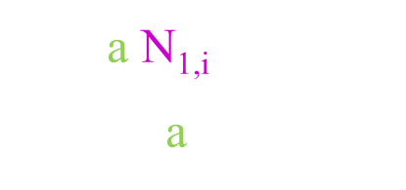

Duality
For every primal linear program,
we define its dual linear program.
Primal Linear Program
maximize
subject to
C^{T}
X
X
Maximize: P = C^{T}⋅X
Subject to: M⋅X ≤ N
M₁
=
N₁
M₂
≤
N₂
M₁⋅X = N₁
X = M₁⁻¹⋅N₁
P = C^{T}⋅X
= C^{T}⋅M₁⁻¹⋅N₁
P
=
C^{T}
N₁
M₁⁻¹
P = a N_{1,i} + b N_{1,i′}
$\frac{δP}{δN_{1,i}}$ = a
$\frac{δP}{δN_{1,i}}$ =
C^{T}
M₁⁻¹

Slide 75

Duality
For every primal linear program,
we define its dual linear program.
Primal Linear Program
maximize
subject to
C^{T}
X
X
Maximize: P = C^{T}⋅X
Subject to: M⋅X ≤ N
M₁
=
N₁
M₂
≤
N₂
M₁⋅X = N₁
X = M₁⁻¹⋅N₁
P = C^{T}⋅X
= C^{T}⋅M₁⁻¹⋅N₁
P
=
C^{T}
N₁
M₁⁻¹
P = a N_{1,i} + b N_{1,i′}
$\frac{δP}{δN_{1,i}}$ = a
$\frac{δP}{δN_{1}}$ =
C^{T}
M₁⁻¹

Slide 76


Duality
For every primal linear program,
we define its dual linear program.
Primal Linear Program
maximize
subject to
C^{T}
X
X
Maximize: P = C^{T}⋅X
Subject to: M⋅X ≤ N
M₁
=
N₁
M₂
≤
N₂
M₁⋅X = N₁
X = M₁⁻¹⋅N₁
P = C^{T}⋅X
= C^{T}⋅M₁⁻¹⋅N₁
P
=
C^{T}
N₁
M₁⁻¹
The hill climbing algorithm relaxes
the tight constraint with the most
negative ${δP}/{{δN}_{i}}<0.$
It gets stuck when ${δP}/{δN_{i}}≥0$
for each tight equation.
$\frac{δP}{δN_{1}}$ =
C^{T}
$$≥0$$
M₁⁻¹

Slide 77


Duality
For every primal linear program,
we define its dual linear program.
Primal Linear Program
maximize
subject to
C^{T}
X
X
Maximize: P = C^{T}⋅X
Subject to: M⋅X ≤ N
M₁
=
N₁
M₂
≤
N₂
M₁⋅X = N₁
X = M₁⁻¹⋅N₁
P = C^{T}⋅X
The alg gives a reason that explains
why stuck by giving a solution Y of the dual of equal value.
= C^{T}⋅M₁⁻¹⋅N₁
i.e. P_{Primal} = P_{Dual}
P
=
C^{T}
N₁
M₁⁻¹
Left-hand-side
= P_{Primal} = C^{T}⋅M₁⁻¹⋅N₁
Right-hand-side
= P_{Dual} = N^{T}⋅Y = Y^{T}⋅N
= Y₁^{T}⋅N₁ + Y₂^{T}⋅N₂
= Y₁^{T}⋅N₁
$\frac{δP}{δN_{1}}$ =
C^{T}
$$≥0$$
M₁⁻¹
Y₁
Y₂
N₁
$\frac{δP}{δN_{1}}$ =
$$≥0$$
^{T}
⁻¹
Y₁ =
= M₁^{T} ⋅C
N₂
Y₁^{T} =
C^{T}⋅M₁⁻¹
M₁⁻¹ ⋅C
Y₂^{T} = 0

Slide 78

Duality
For every primal linear program,
we define its dual linear program.
Primal Linear Program
maximize
subject to
C^{T}
X
X
Maximize: P = C^{T}⋅X
Subject to: M⋅X ≤ N
M₁
=
N₁
M₂
≤
N₂
X = M₁⁻¹ ⋅N₁
⁻¹
$$≥0$$
Y₂ = 0
= M₁^{T} ⋅C
Y₁
Dual Linear Program
minimize
subject to
N₁
N₂
C
Minimize N^{T}⋅ Y
Subject to: M^{T}⋅Y ≤ C
M^{T}₁
Y₁
≥
Y₁
M^{T}₂
Y₂
Y₂
Y ≥ 0
Left-hand-side
= M^{T}₁ ⋅Y₁ + M^{T}₂ ⋅Y₂
Right-hand-side
= C
⁻¹
Strange: This that all the constraints are tight?
That is not right.
= M^{T}₁ ⋅ [M₁^{T} ⋅C] + 0
= C

Slide 79
Duality
For every primal linear program,
we define its dual linear program.
Primal Linear Program
maximize
subject to
C^{T}
X
X
Maximize: P = C^{T}⋅X
Subject to: M⋅X ≤ N
M₁
=
N₁
≤
-1 0 0 0
0
X = M₁⁻¹ ⋅N₁
⁻¹
$$≥0$$
Y₂ = 0
= M₁^{T} ⋅C
Y₁
Dual Linear Program
minimize
subject to
N₁
N₂
y
y
C
Minimize N^{T}⋅ Y
Subject to: M^{T}⋅Y ≤ C
M^{T}₁
Y₁
≥
Y₁
M^{T}₂
Y₂
Y₂
Remember, we added the constraints x≥0 to the matrix,
giving a ⟨-1 0 0 0⟩ row to M.
Its associated dual y variable is unwanted
and must be removed from the dual problem.
Y ≥ 0

Slide 80
Duality
For every primal linear program,
we define its dual linear program.
Primal Linear Program
maximize
subject to
C^{T}
X
X
Maximize: P = C^{T}⋅X
Subject to: M⋅X ≤ N
M₁
=
N₁
≤
-1 0 0 0
0
X = M₁⁻¹ ⋅N₁
⁻¹
$$≥0$$
Y₂ = 0
= M₁^{T} ⋅C
Y₁
Dual Linear Program
minimize
subject to
N₁
N₂
y
y
C
Minimize N^{T}⋅ Y
Subject to: M^{T}⋅Y ≤ C
M^{T}₁
Y₁
≥
Y₁
M^{T}₂
Y₂
Y₂
Remember, we added the constraints x≥0 to the matrix,
giving a ⟨-1 0 0 0⟩ row to M.
If this constraint is not tight, i.e. x>0,
then its associated dual y variable is set to 0 and does no harm.
Y ≥ 0

Slide 81
Duality
For every primal linear program,
we define its dual linear program.
Primal Linear Program
maximize
subject to
C^{T}
X
-1 0 0 0
X
0
Maximize: P = C^{T}⋅X
Subject to: M⋅X ≤ N
M₁
=
N₁
M₂
≤
N₂
X = M₁⁻¹ ⋅N₁
⁻¹
$$≥0$$
Y₂ = 0
= M₁^{T} ⋅C
Y₁
Dual Linear Program
minimize
subject to
N₁
N₂
y
y
C
Minimize N^{T}⋅ Y
Subject to: M^{T}⋅Y ≤ C
M^{T}₁
Y₁
≥
Y₁
M^{T}₂
Y₂
Y₂
Remember, we added the constraints x≥0 to the matrix,
giving a ⟨-1 0 0 0⟩ row to M.
If it is tight, then its associated y variable is positive.
Y ≥ 0

Slide 82
Duality
For every primal linear program,
we define its dual linear program.
Primal Linear Program
maximize
subject to
C^{T}
X
-1 0 0 0
X
0
Maximize: P = C^{T}⋅X
Subject to: M⋅X ≤ N
M₁
=
N₁
M₂
≤
N₂
X = M₁⁻¹ ⋅N₁
⁻¹
$$≥0$$
Y₂ = 0
= M₁^{T} ⋅C
Y₁
Dual Linear Program
minimize
subject to
0
N₁
N₂
y
-1
y
C
Minimize N^{T}⋅ Y
Subject to: M^{T}⋅Y ≤ C
0
M^{T}₁
Y₁
≥
Y₁
0
M^{T}₂
Y₂
0
Y₂
The ⟨-1 0 0 0⟩ row transposes into column.
This adds –y to the right-hand side of one ≥ constraint.
Removing it adds slack to this constraint slack.
Y ≥ 0

Slide 83
Duality
For every primal linear program,
we define its dual linear program.
Primal Linear Program
maximize
subject to
C^{T}
X
-1 0 0 0
X
0
Maximize: P = C^{T}⋅X
Subject to: M⋅X ≤ N
M₁
=
N₁
M₂
≤
N₂
X = M₁⁻¹ ⋅N₁
⁻¹
$$≥0$$
Y₂ = 0
= M₁^{T} ⋅C
Y₁
Dual Linear Program
minimize
subject to
0
N₁
N₂
y
-1
y
C
Minimize N^{T}⋅ Y
Subject to: M^{T}⋅Y ≤ C
0
M^{T}₁
Y₁
≥
Y₁
0
M^{T}₂
Y₂
0
Y₂
Y ≥ 0
The 0 in the N, means that this y does not add to the objective function.

Slide 84
Duality
For every primal linear program,
we define its dual linear program.
Primal Linear Program
maximize
subject to
C^{T}
X
X
Maximize: P = C^{T}⋅X
Subject to: M⋅X ≤ N
M₁
=
N₁
M₂
≤
N₂
X = M₁⁻¹ ⋅N₁
⁻¹
$$≥0$$
Y₂ = 0
= M₁^{T} ⋅C
Y₁
Dual Linear Program
minimize
subject to
N₁
N₂
C
Minimize N^{T}⋅ Y
Subject to: M^{T}⋅Y ≤ C
M^{T}₁
Y₁
≥
Y₁
M^{T}₂
Y₂
Y₂
Y ≥ 0
The alg gives a reason that explains
why stuck by giving a solution Y of the dual of equal value.

Slide 85

Duality
For every primal linear program,
we define its dual linear program.
Primal Linear Program
maximize
subject to
C^{T}
X
X
Maximize: P = C^{T}⋅X
Subject to: M⋅X ≤ N
M₁
=
N₁
M₂
≤
N₂
X = M₁⁻¹ ⋅N₁
⁻¹
$$≥0$$
Y₂ = 0
= M₁^{T} ⋅C
Y₁
The standard algorithm maintains in the loop invariant a table with
“slack variables”,
M₁⁻¹,
X
P
$\frac{δP}{δN_{1}}$.
This makes the computation faster.

Slide 86
End

Slide 87
Simplex
y
Recall we need to evaluate our cost function at the vertices where the constraint functions intersect each other
Cost Function
P = 5x + 7y
Constraint Functions
C1: 2x + 4y ≤ 100
C2: 3x + 3y ≤ 90
Non-Negativity: x,y ≥ 0
C1
(0,0)
C2
x

Slide 88
Simplex (cont’d)
We don’t want to deal with complex inequalities
Our Equations
P = 5x + 7y
C1: 2x + 4y ≤ 100
C2: 3x + 3y ≤ 90
x,y ≥ 0
Can be re-written as:
P = 5x + 7y
s₁ = 100 - 2x - 4y
s₂ = 90 - 3x - 3y
x, y ≥ 0
s_{1,}, s₂ ≥ 0
Slack Form
We introduce 2 new variables called slack variables

Slide 89
Simplex (cont’d)
Cost Function
P = 5x + 7y
s₁ = 100 - 2x - 4y
s₂ = 90 - 3x - 3y
s_{1,} , s₂ , x , y ≥ 0
STEP 1:
We want an initial point
Let’s put x=0, y=0
x=0, y=0
P = 0
Feasible solution

Slide 90
Simplex (cont’d)
Cost Function
P = 5x + 7y
s₁ = 100 - 2x - 4y
s₂ = 90 - 3x - 3y
s_{1,} , s₂ , x , y ≥ 0
STEP 2:
We want next point
Let's try to increase x.
x can be increased maximum to 30 (s₂ becomes zero)
Rewrite equations (Pivoting)
Now put y, s₂ = 0
x = 30 – y – s₂/3
s₁ = 40 + 2/3s₂ – 2y
P = 150 – 5/3s₂ + 2y
x=30, y=0
P = 150
Feasible solution

Slide 91
Simplex (cont’d)
Cost Function
P = 150 – 5/3s₂ + 2y
x = 30 – y – s₂/3
s₁ = 40 + 2/3s₂ – 2y
s_{1,} , s₂ , x , y ≥ 0
STEP 3:
We want next point
Let's try to increase y.
y can be increased maximum to 20 (s₁ becomes zero)
Rewrite equations (Pivoting)
Now put s₁, s₂ = 0
(We don’t increase s₂ because it will decrease P)
y = 20 + 1/3s₂ – 1/2s₁
x = 10 – 1/2s₁ - 2/3s₂
P = 190 - s₁ – s₂
Note that we cannot increase s1 & s2 without decreasing P. So we stop !
?
Is this solution optimal? Or have we run into a local minimum?
x=10, y=20
P = 190
Feasible solution

