Slide 1
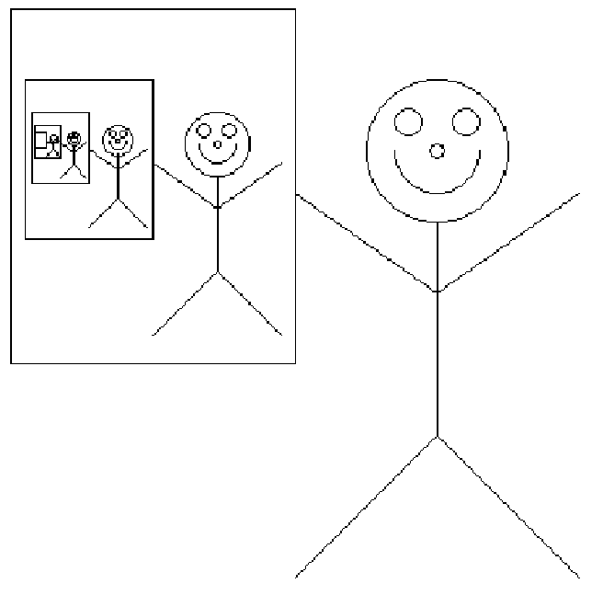
Recursion
Grad Algorithms
Friends & Steps for Recursion
Derivatives
Recursive Images
Multiplying
Parsing
Ackermann
Jeff Edmonds
York University
Lecture 3
COSC 6111

Slide 2
Friends & Strong Induction
MULT(X,Y):
If |X| = |Y| = 1 then RETURN XY
Break X into a;b and Y into c;d
e = MULT(a,c) and f =MULT(b,d)
RETURN
e 10^{n} + (MULT(a+b, c+d) – e - f) 10^{n/2} + f
Consider your input instance
Allocate work
  Construct one or more subinstances
  Assume by magic your friends give you the answer for these.
Use this help to solve your own instance.
Do not worry about anything else.
  Who your boss is.
  How your friends solve their instance.
X = 33
Y = 12
ac = 3
bd = 6
(a+b)(c+d) = 18
XY = 396
X = 3
Y = 1
XY=3
X = 3
Y = 2
XY=6
X = 6
Y = 3
XY=18

Slide 3
I am obsessed with the
Friends - Strong Induction View of Recursion.
Trust your friends to solve subinstances.
The subinstance given must be
  smaller and
  must be an instance to the same problem.
Combine solution given by friend
to construct your own solution for your instance.
Focus on one step.
  Do not talk of their friends friends friends.
Solve small instances on your own.

Slide 4
Input Size
An Measure of Size, Size
  is a function
    that takes as input the computation’s input I
    and that outputs
  Eg Input is <n,m>,
    Size(<n,m>) = n
    or 3n+7m
  Algorithm Designer gets to decide!
  According to this measure
    Your friend’s instance must be smaller than yours.
    You must solve sufficiently small instances on your own.
a real number

Slide 5
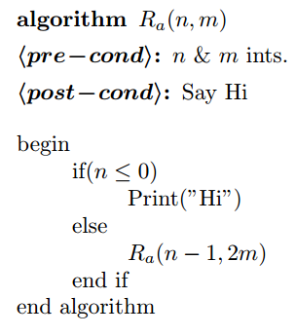
Input Size
Does the program always halt?
m keeps getting bigger!
Algorithm Designer gets to
define the measure of size.
  Size(<n,m>) =
n
I = <3,5>
Size = 3
<2,10>
2
<1,20>
1
<0,30>
0
Sufficiently small to halt.

Slide 6
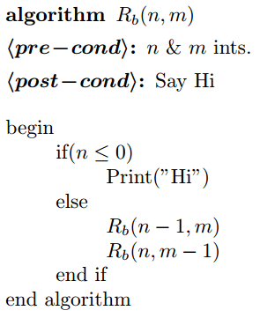
Input Size
Does the program always halt?
Each subinstance is smaller.
But according to what
measure of size?
  Size(<n,m>) =
?
I = <4,2>
<3,2>
<4,1>
<3,1>
<4,0>
<3,1>
<4,-1>
….
There is an infinite path!

Slide 7


Input Size
Does the program always halt?
According to what single measure
of size are both instances smaller?
  Size(<n,m>) = ?
I = <n,m>
<n-1,m+2>
<n+1,m-3>
Every friend’s instance is smaller.
Maximum dept = ?
Or there is an infinite path!

Slide 8
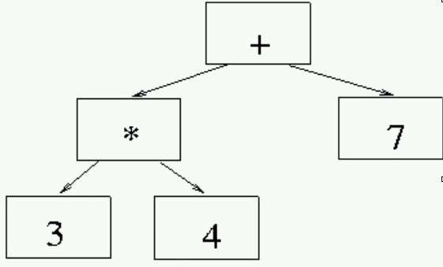
Recursion on Trees
Evaluate Equation Tree = ?
Get help from friends
7
12

Slide 9
Recursion on Trees
Evaluate Equation Tree
= root_{op}( value on left, value on right )
= root_{op}(12,7) = 12 + 7 = 19
7
12

Slide 10
Recursion on Trees
Evaluate Equation Tree
Base Case ?
7

Slide 11
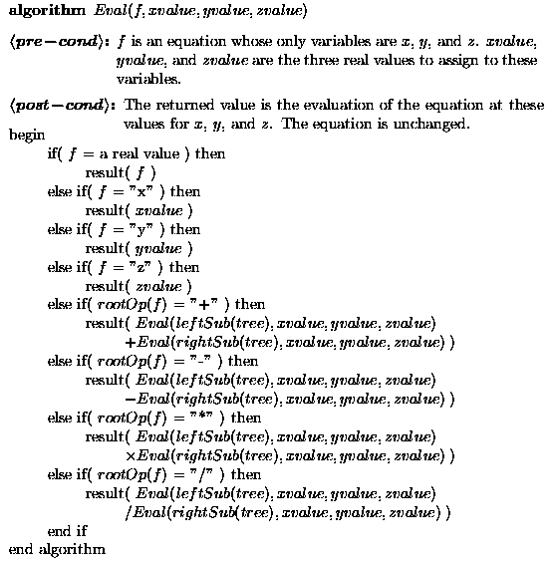
Recursion on Trees

Slide 12
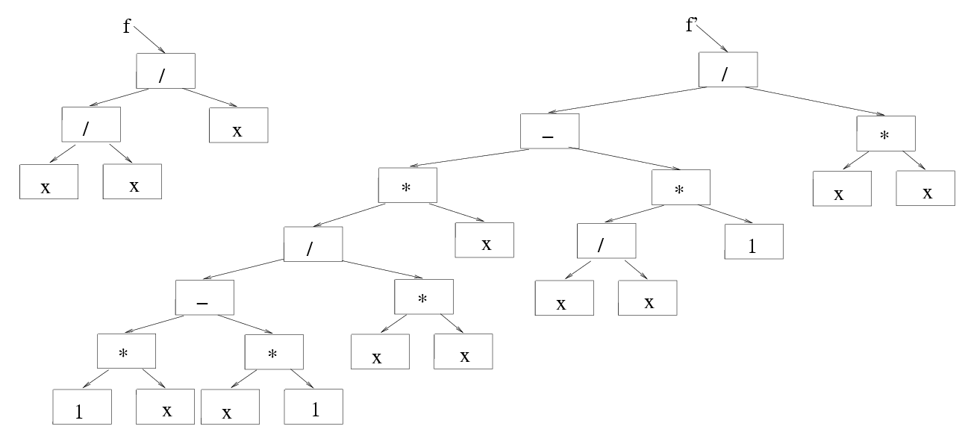
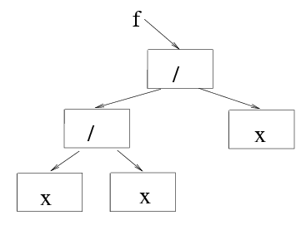
Derivatives
Input: a function f.
Output: Its derivative ^{df}/_{dx}.

Slide 13
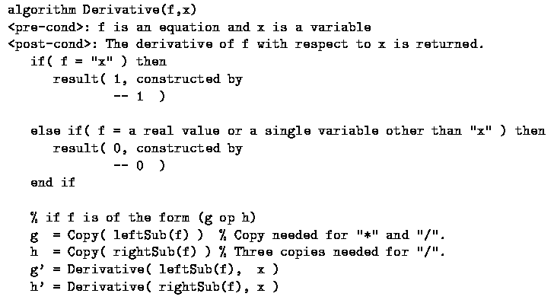
Derivatives

Slide 14
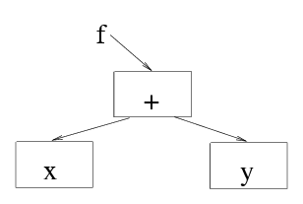
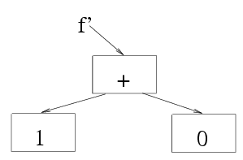
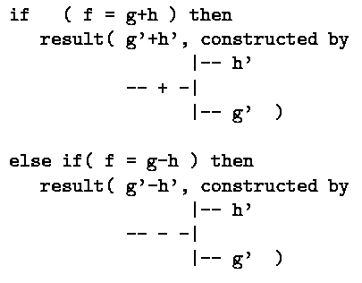
Derivatives
Input: a function f.
Output: Its derivative ^{df}/_{dx}.

Slide 15
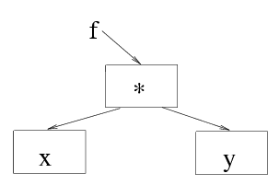
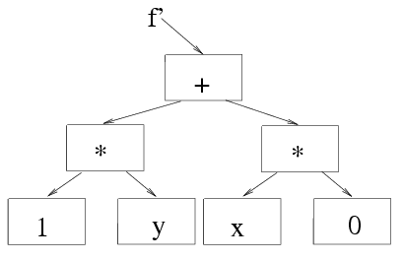
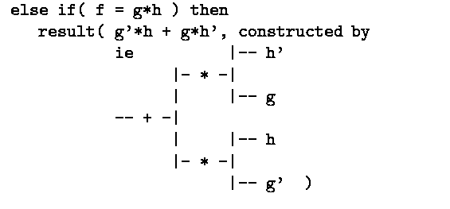
Derivatives
Input: a function f.
Output: Its derivative ^{df}/_{dx}.

Slide 16
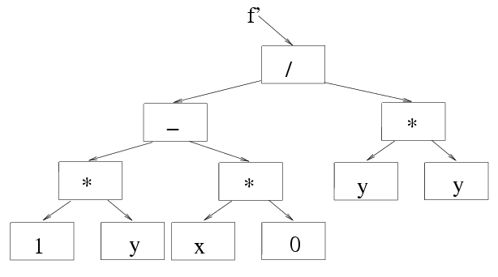
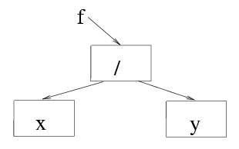
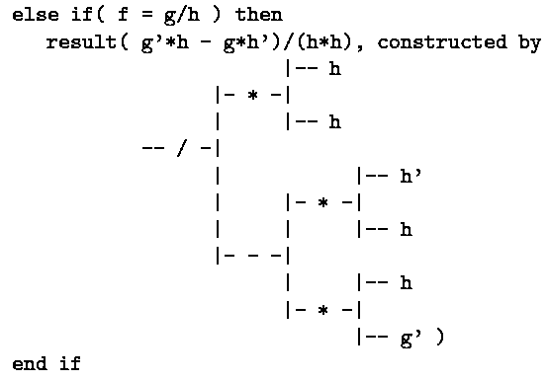
Derivatives
Output: Its derivative ^{df}/_{dx}.
Input: a function f.
g

Slide 17
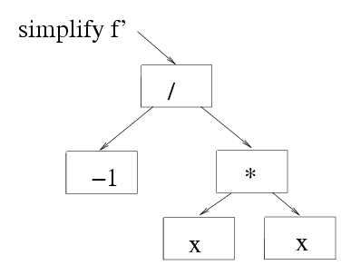
Simplify
Input: a function f.
Output: f simplified.

Slide 18
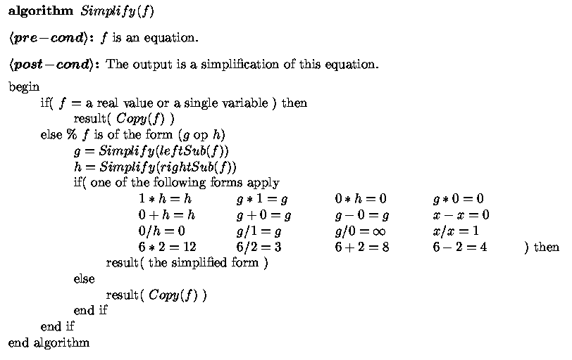
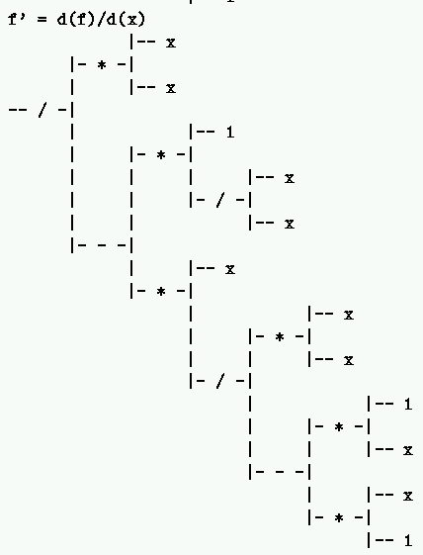
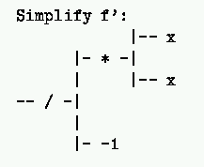
Simplify

Slide 19


Recursive Images
if n=1
if n=0, draw
n=0
else draw
And recursively
Draw here with n-1

Slide 20
Recursive Images
if n=2
if n=0, draw
n=1
else draw
And recursively
Draw here with n-1

Slide 21
Recursive Images
if n=3
if n=0, draw
n=2
else draw
And recursively
Draw here with n-1

Slide 22
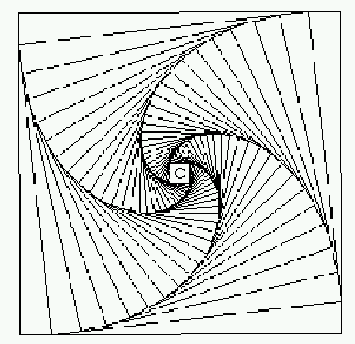
Recursive Images
if n=30
if n=0, draw
else draw
And recursively
Draw here with n-1

Slide 23
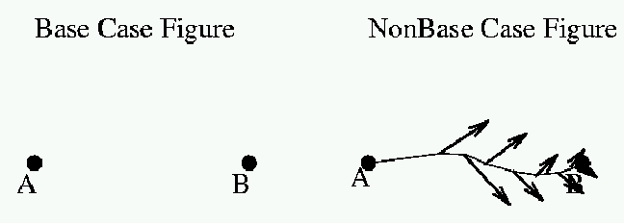
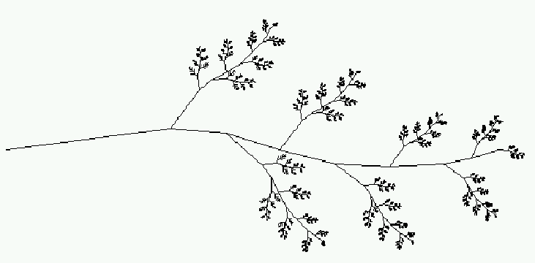
Recursive Images
if n=0
if n=5
if n=1
if n=2
if n=3
if n=4

Slide 24
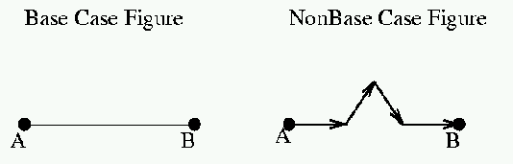

Recursive Images
if n=0
if n=1
if n=2
if n=3
if n=4
if n=5

Slide 25
Recursive Images
⇒ ∞
L(n) = ⁴/₃ L(n-1)
= (⁴/₃)^{n}

Slide 26
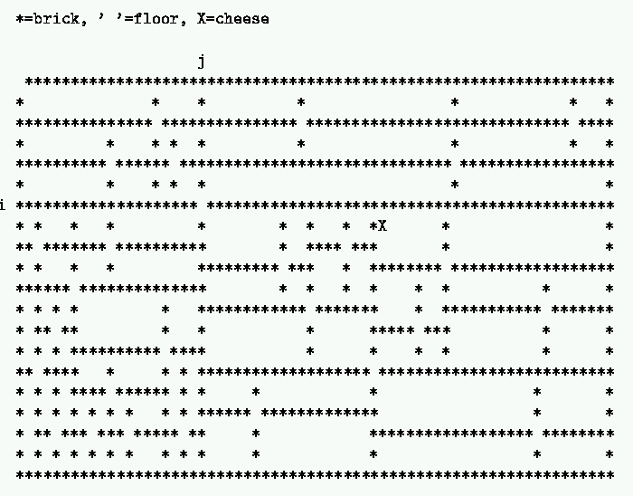

Slide 31
Grade School Revisited:
How To Multiply Two Numbers
A Few Example Algorithms
2 X 2 = 5
Rudich www.discretemath.com

Slide 32
Complex Numbers
Remember how to multiply 2 complex numbers?
(a+bi)(c+di) = [ac –bd] + [ad + bc] i
Input: a,b,c,d Output: ac-bd, ad+bc
If a real multiplication costs 1 and an addition costs a penny. What is the cheapest way to obtain the output from the input?
Can you do better than 4.02?

Slide 33
Gauss’ $3.05 Method:
Input: a,b,c,d Output: ac-bd, ad+bc
m₁ = ac
m₂ = bd
A₁ = m₁ – m₂ = ac-bd
m₃ = (a+b)(c+d) = ac + ad + bc + bd
A₂ = m₃ – m₁ – m₂ = ad+bc

Slide 34
Question:
The Gauss “hack” saves one multiplication out of four. It requires 25% less work.
Could there be a context where performing 3 multiplications for every 4 provides a more dramatic savings?

Slide 35
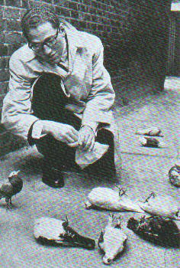

How to add 2 n-bit numbers.
*
*
*
*
*
*
*
*
*
*
*
*
*
*
*
*
*
*
*
*
*
*
+
Tom Lehrer
New Math

Slide 36
How to add 2 n-bit numbers.
*
*
*
*
*
*
*
*
*
*
*
*
*
*
*
*
*
*
*
*
*
*
*
*
+

Slide 37
How to add 2 n-bit numbers.
*
*
*
*
*
*
*
*
*
*
*
*
*
*
*
*
*
*
*
*
*
*
*
*
*
*
+

Slide 38
How to add 2 n-bit numbers.
*
*
*
*
*
*
*
*
*
*
*
*
*
*
*
*
*
*
*
*
*
*
*
*
*
*
*
*
+

Slide 39
How to add 2 n-bit numbers.
*
*
*
*
*
*
*
*
*
*
*
*
*
*
*
*
*
*
*
*
*
*
*
*
*
*
*
*
*
*
+

Slide 40
How to add 2 n-bit numbers.
*
*
*
*
*
*
*
*
*
*
*
*
*
*
*
*
*
*
*
*
*
*
*
*
*
*
*
*
*
*
*
*
*
*
*
*
*
*
*
*
*
*
*
*
*
+

Slide 41
Time complexity of grade school addition
*
*
*
*
*
*
*
*
*
*
*
*
*
*
*
*
*
*
*
*
*
*
*
*
*
*
*
*
*
*
*
*
*
*
*
*
*
*
*
*
*
*
*
*
*
On any reasonable computer adding 3 bits can be done in constant time.
+
T(n) = The amount of time grade school addition uses to add two n-bit numbers
= θ(n) = linear time.

Slide 42
f = θ(n) means that f can be sandwiched between two lines
t
ime
# of bits in numbers

Slide 43
Please feel free
to ask questions!
Rudich www.discretemath.com

Slide 44
Is there a faster way to add?
QUESTION: Is there an algorithm to add two n-bit numbers whose time grows sub-linearly in n?

Slide 45
Any algorithm for addition must read all of the input bits
  Suppose there is a mystery algorithm that does not examine each bit
  Give the algorithm a pair of numbers. There must be some unexamined bit position i in one of the numbers
  If the algorithm is not correct on the numbers, we found a bug
  If the algorithm is correct, flip the bit at position i and give the algorithm the new pair of numbers. It give the same answer as before so it must be wrong since the sum has changed

Slide 46
So any algorithm for addition must use time at least linear in the size of the numbers.
Grade school addition is essentially as good as it can be.

Slide 47
How to multiply 2 n-bit numbers.
X
* * * * * * * *
* * * * * * * *
* * * * * * * *
* * * * * * * *
* * * * * * * *
n²
* * * * * * * *
* * * * * * * *
* * * * * * * *
* * * * * * * *
* * * * * * * *
* * * * * * * * * * * * * * * *

Slide 48
I get it! The total time is bounded by cn².
Can we do it faster?

Slide 49
How to multiply 2 n-bit numbers.
Kindergarten Algorithm
a × b = a + a + a + ... + a
b
T(n) = Time multiply
= θ(b) = linear time.
Fast?
10000000000000000000 × 100000000000000000000
I easily ask the question.
You take a life time to answer it.

Slide 50
How to multiply 2 n-bit numbers.
Kindergarten Algorithm
a × b = a + a + a + ... + a
b
T(n) = Time multiply
two n-bit numbers
= θ(b)
= θ(2^{n}).
Way slow!
10000000000000000000 × 100000000000000000000
Value = b = 100000000000000000000
# bits = n = log₂(b) = 60

Slide 51
Grade School Addition: Linear time
Grade School Multiplication: Quadratic time
Kindergarten Multiplication: Exponential time
t
ime
# of bits in numbers
No matter how dramatic the difference in the constants the quadratic function will eventually dominate the linear function
And all exponential functions are VERY fast growing

Slide 52
Neat! We have demonstrated that as things scale multiplication is a harder problem than addition.
Mathematical confirmation of our common sense.

Slide 53
Don’t jump to conclusions!
We have argued that grade school multiplication uses more time than grade school addition. This is a comparison of the complexity of two algorithms.
To argue that multiplication is an inherently harder problem than addition we would have to show that no possible multiplication algorithm runs in linear time.

Slide 54
Grade School Addition: θ(n) time
Grade School Multiplication: θ(n²) time
Is there a clever algorithm to multiply two numbers in linear time?

Slide 55
Despite years of research, no one knows! If you resolve this question, York will give you a PhD!

Slide 56
Is there a faster way to multiply two numbers than the way you learned in grade school?

Slide 57
Divide And Conquer
(an approach to faster algorithms)
DIVIDE my instance to the problem into smaller instances to the same problem.
Have a friend (recursively) solve them.
Do not worry about it yourself.
GLUE the answers together so as to obtain the answer to your larger instance.

Slide 58
Multiplication of 2 n-bit numbers
X =
Y =
X = a 2^{n/2} + b Y = c 2^{n/2} + d
XY = ac 2^{n} + (ad+bc) 2^{n/2} + bd
a
b
c
d

Slide 59
Multiplication of 2 n-bit numbers
X =
Y =
XY = ac 2^{n} + (ad+bc) 2^{n/2} + bd
a
b
c
d
MULT(X,Y):
If |X| = |Y| = 1 then RETURN XY
Break X into a;b and Y into c;d
RETURN
MULT(a,c) 2^{n} + (MULT(a,d) + MULT(b,c)) 2^{n/2} + MULT(b,d)

Slide 60
Time required by MULT
T(n) = time taken by MULT on two n-bit numbers
What is T(n)?
What is its growth rate?
Is it θ(n²)?

Slide 61
Recurrence Relation
T(1) = k for some constant k
T(n) = 4 T(n/2) + k’ n + k’’ for some constants k’ and k’’
MULT(X,Y):
If |X| = |Y| = 1 then RETURN XY
Break X into a;b and Y into c;d
RETURN
MULT(a,c) 2^{n} + (MULT(a,d) + MULT(b,c)) 2^{n/2} + MULT(b,d)

Slide 62
Let’s be concrete
T(1) = 1
T(n) = 4 T(n/2) + n
How do we unravel T(n) so that we can determine its growth rate?

Slide 63
Technique 1
Guess and Verify
Recurrence Relation:
T(1) = 1 & T(n) = 4T(n/2) + n
Guess: G(n) = 2n² – n
Verify:
Left Hand Side | Right Hand Side
T(1) = 2(1)² – 1 T(n) = 2n² – n | 1 4T(n/2) + n = 4 [2(^{n}/₂)² – (^{n}/₂)] + n = 2n² – n

Slide 64
Technique 2: Decorate The Tree
T(1) = 1
T(1)
=
1
T(n) = n + 4 T(n/2)
T(n) = n + 4 T(n/2)
T(n)
T(n)
n
=
n
=
T(n/2)
T(n/2)
T(n/2)
T(n/2)
T(n/2)
T(n/2)
T(n/2)
T(n/2)

Slide 65
T(n)
=
n
T(n/2)
T(n/2)
T(n/2)
T(n/2)

Slide 66
T(n)
=
n
n/2
T(n/2)
T(n/2)
T(n/2)
T(n/4)
T(n/4)
T(n/4)
T(n/4)

Slide 67
T(n)
=
n
n/2
n/2
n/2
n/2
T(n/4)
T(n/4)
T(n/4)
T(n/4)
T(n/4)
T(n/4)
T(n/4)
T(n/4)
T(n/4)
T(n/4)
T(n/4)
T(n/4)
T(n/4)
T(n/4)
T(n/4)
T(n/4)

Slide 68
T(n)
=
n
n/2
n/2
n/2
n/2
n/4
n/4
n/4
n/4
n/4
n/4
n/4
n/4
n/4
n/4
n/4
n/4
n/4
n/4
n/4
n/4
11111111111111111111111111111111 . . . . . . 111111111111111111111111111111111

Slide 69
n
n/2 + n/2 + n/2 + n/2
Level i is the sum of 4^{i} copies of n/2^{i}
. . . . . . . . . . . . . . . . . . . . . . . . . .
1+1+1+1+1+1+1+1+1+1+1+1+1+1+1+1+1+1+1+1+1+1+1+1+1+1+1+1+1+1+1+1+1+1+1+1+1+1+1+1+1+1+1+1
0
1
2
n/4 + n/4 + n/4 + n/4 + n/4 + n/4 + n/4 + n/4 + n/4 + n/4 + n/4 + n/4 + n/4 + n/4 + n/4 + n/4
i

Slide 70
=1⋅n
= 4⋅(n/2)
= 16⋅(n/4)
= 4^{i} ⋅(n/2^{i})
= 4^{logn}⋅(n/2^{logn})
= n^{log4} ⋅
1
a^{logn}
  = (2^{loga})^{logn}
  = 2^{(loga · logn)}
  = (2^{logn})^{loga}
  = n^{loga}
Total: ?

Slide 71
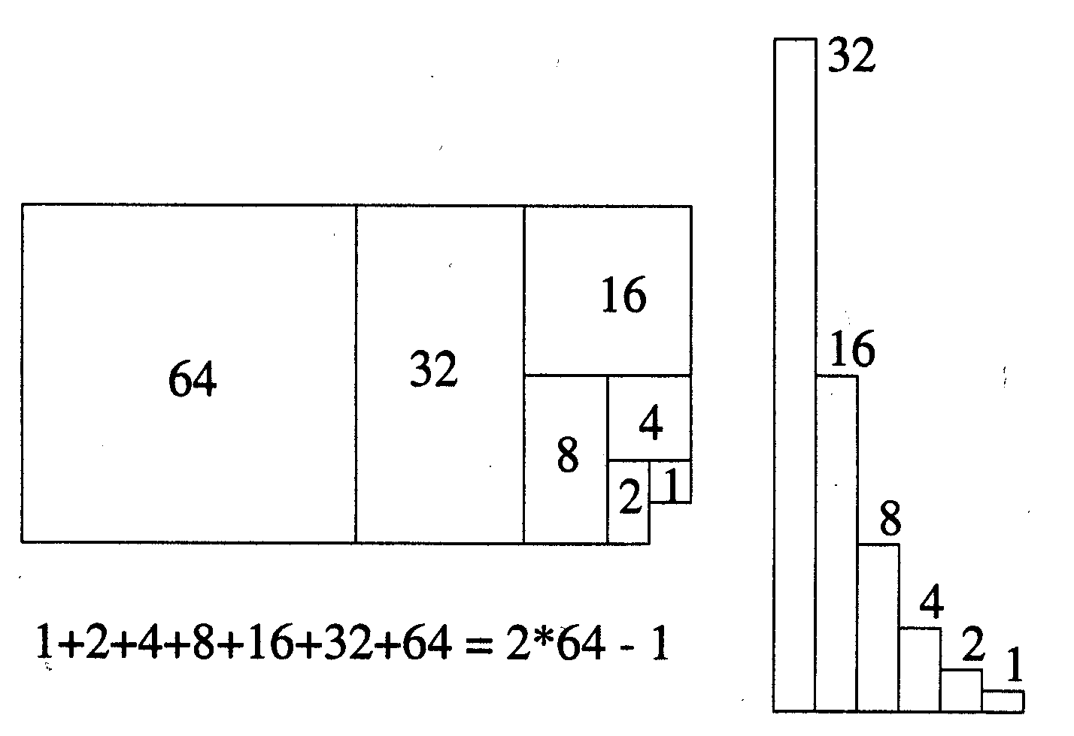
Geometric Sum

Slide 72
Geometric Increasing
∑_{i=0..n} r^{i} = r⁰ + r¹ + r² +. . . + r^{n}
= Θ(biggest term)
True when ever terms increase quickly

Slide 73
=1⋅n
= 4⋅n/2
= 16⋅n/4
= 4^{i} ⋅n/2^{i}
= 4^{logn}⋅n/2^{logn} =n^{log4} ⋅ 1
Total = biggest
Total: θ(n^{log4}) = θ(n²)

Slide 74
Divide and Conquer MULT: θ(n²) time
Grade School Multiplication: θ(n²) time
All that work for nothing!
Let’s understand the math better.

Slide 75
Evaluating: T(n) = aT(n/b)+f(n)
Level
0
1
2
i
h

Slide 76
Evaluating: T(n) = aT(n/b)+f(n)
Level |  | Instance size
0
1
2
i
h

Slide 77
Evaluating: T(n) = aT(n/b)+f(n)
Level |  | Instance size
0 |  | n
1
2
i
h

Slide 78
Evaluating: T(n) = aT(n/b)+f(n)
Level |  | Instance size
0 |  | n
1 |  | n/b
2
i
h

Slide 79
Evaluating: T(n) = aT(n/b)+f(n)
Level |  | Instance size
0 |  | n
1 |  | n/b
2 |  | n/b²
i
h

Slide 80
Evaluating: T(n) = aT(n/b)+f(n)
Level |  | Instance size
0 |  | n
1 |  | n/b
2 |  | n/b²
i |  | n/b^{i}
h |  | n/b^{h}

Slide 81
Evaluating: T(n) = aT(n/b)+f(n)
Level |  | Instance size
0 |  | n
1 |  | n/b
2 |  | n/b²
i |  | n/b^{i}
h |  | n/b^{h}

Slide 82
Evaluating: T(n) = aT(n/b)+f(n)
Level |  | Instance size
0 |  | n
1 |  | n/b
2 |  | n/b²
i |  | n/b^{i}
h |  | n/b^{h} = 1
base case

Slide 83
Evaluating: T(n) = aT(n/b)+f(n)
Level |  | Instance size
0 |  | n
1 |  | n/b
2 |  | n/b²
i |  | n/b^{i}
h |  | n/b^{h} = 1

Slide 84
Evaluating: T(n) = aT(n/b)+f(n)
Level |  | Instance size
0 |  | n
1 |  | n/b
2 |  | n/b²
i |  | n/b^{i}
h = ^{log n}/_{log b} |  | n/b^{h} = 1
b^{h} = n
h log b = log n
h = ^{log n}/_{log b}

Slide 85
Evaluating: T(n) = aT(n/b)+f(n)
Level |  | Instance size | Work in stack frame
0 |  | n
1 |  | n/b
2 |  | n/b²
i |  | n/b^{i}
h = ^{log n}/_{log b} |  | 1

Slide 86
Evaluating: T(n) = aT(n/b)+f(n)
Level |  | Instance size | Work in stack frame
0 |  | n | f(n)
1 |  | n/b | f(n/b)
2 |  | n/b² | f(n/b²)
i |  | n/b^{i} | f(n/b^{i})
h = ^{log n}/_{log b} |  | 1 | T(1)

Slide 87
Evaluating: T(n) = aT(n/b)+f(n)
Level |  | Instance size | Work in stack frame | # stack frames
0 |  | n | f(n)
1 |  | n/b | f(n/b)
2 |  | n/b² | f(n/b²)
i |  | n/b^{i} | f(n/b^{i})
h = ^{log n}/_{log b} |  | n/b^{h} | T(1)

Slide 88
Evaluating: T(n) = aT(n/b)+f(n)
Level |  | Instance size | Work in stack frame | # stack frames
0 |  | n | f(n) | 1
1 |  | n/b | f(n/b) | a
2 |  | n/b² | f(n/b²) | a²
i |  | n/b^{i} | f(n/b^{i}) | a^{i}
h = ^{log n}/_{log b} |  | n/b^{h} | T(1) | a^{h}

Slide 89
Evaluating: T(n) = aT(n/b)+f(n)
Level |  | Instance size | Work in stack frame | # stack frames
0 |  | n | f(n) | 1
1 |  | n/b | f(n/b) | a
2 |  | n/b² | f(n/b²) | a²
i |  | n/b^{i} | f(n/b^{i}) | a^{i}
h = ^{log n}/_{log b} |  | n/b^{h} | T(1) | a^{h}

Slide 90
Evaluating: T(n) = aT(n/b)+f(n)
Level |  | Instance size | Work in stack frame | # stack frames
0 |  | n | f(n) | 1
1 |  | n/b | f(n/b) | a
2 |  | n/b² | f(n/b²) | a²
i |  | n/b^{i} | f(n/b^{i}) | a^{i}
h = ^{log n}/_{log b} |  | n/b^{h} | T(1) | a^{h}
a^{h} = a
= n
^{log n}/_{log b}
^{log a}/_{log b}

Slide 91
Evaluating: T(n) = aT(n/b)+f(n)
Level |  | Instance size | Work in stack frame | # stack frames | Work in Level
0 |  | n | f(n) | 1
1 |  | n/b | f(n/b) | a
2 |  | n/b² | f(n/b²) | a²
i |  | n/b^{i} | f(n/b^{i}) | a^{i}
h = ^{log n}/_{log b} |  | n/b^{h} | T(1)
^{log a}/_{log b}
n

Slide 92
Evaluating: T(n) = aT(n/b)+f(n)
Level |  | Instance size | Work in stack frame | # stack frames | Work in Level
0 |  | n | f(n) | 1 | 1 · f(n)
1 |  | n/b | f(n/b) | a | a · f(n/b)
2 |  | n/b² | f(n/b²) | a² | a² · f(n/b²)
i |  | n/b^{i} | f(n/b^{i}) | a^{i} | a^{i} · f(n/b^{i})
h = ^{log n}/_{log b} |  | n/b^{h} | T(1)
^{log a}/_{log b}
^{log a}/_{log b}
n
n · T(1)
Total Work T(n) = ∑_{i=0..h} a^{i}⋅f(n/b^{i})

Slide 93
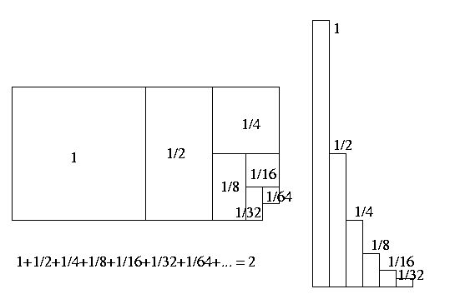
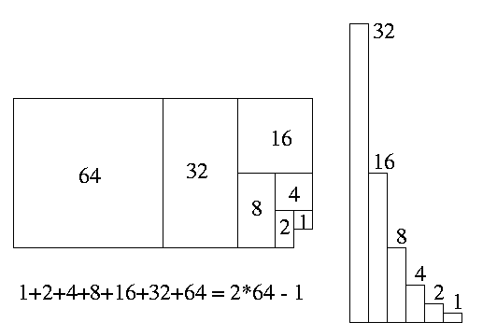
Evaluating: T(n) = aT(n/b)+f(n)
= ∑_{i=0..h} a^{i}⋅f(n/b^{i})
If a Geometric Sum
∑_{i=0..n} x^{i} = θ(max(first term, last term))

Slide 94
Evaluating: T(n) = aT(n/b)+f(n)
Level |  | Instance size | Work in stack frame | # stack frames | Work in Level
0 |  | n | f(n) | 1 | 1 · f(n)
1 |  | n/b | f(n/b) | a | a · f(n/b)
2 |  | n/b² | f(n/b²) | a² | a² · f(n/b²)
i |  | n/b^{i} | f(n/b^{i}) | a^{i} | a^{i} · f(n/b^{i})
h = ^{log n}/_{log b} |  | n/b^{h} | T(1)
^{log a}/_{log b}
^{log a}/_{log b}
n
n · T(1)
Dominated by Top Level or Base Cases

Slide 95
Divide and Conquer MULT: θ(n²) time
Grade School Multiplication: θ(n²) time
All that work for nothing!
Let’s try to multiply faster.

Slide 96
MULT revisited
MULT(X,Y):
If |X| = |Y| = 1 then RETURN XY
Break X into a;b and Y into c;d
RETURN
MULT(a,c) 2^{n} + (MULT(a,d) + MULT(b,c)) 2^{n/2} + MULT(b,d)
MULT calls itself 4 times. Can you see a way to reduce the number of calls?

Slide 97
Gauss’ Hack:
Input: a,b,c,d Output: ac, ad+bc, bd
A₁ = ac
A₃ = bd
m₃ = (a+b)(c+d)
A₂ = m₃ – A₁- A₃ = ad + bc
2 additions and one multiplication
= ac + ad + bc + bd

Slide 98
Gaussified MULT
(Karatsuba 1962)
MULT(X,Y):
If |X| = |Y| = 1 then RETURN XY
Break X into a;b and Y into c;d
e = MULT(a,c) and f =MULT(b,d)
RETURN e2^{n} + (MULT(a+b, c+d) – e - f) 2^{n/2} + f
T(n) = 3 T(n/2) + n
Actually: T(n) = 2 T(n/2) + T(n/2 + 1) + kn

Slide 99
T(n)
=
n
n/2
n/2
n/2
n/2
T(n/4)
T(n/4)
T(n/4)
T(n/4)
T(n/4)
T(n/4)
T(n/4)
T(n/4)
T(n/4)
T(n/4)
T(n/4)
T(n/4)
T(n/4)
T(n/4)
T(n/4)
T(n/4)

Slide 100
T(n)
=
n
T(n/2)
T(n/2)
T(n/2)

Slide 101
T(n)
=
n
n/2
T(n/2)
T(n/2)
T(n/4)
T(n/4)
T(n/4)

Slide 102
T(n)
=
n
n/2
n/2
n/2
T(n/4)
T(n/4)
T(n/4)
T(n/4)
T(n/4)
T(n/4)
T(n/4)
T(n/4)
T(n/4)

Slide 103
n
n/2 + n/2 + n/2
Level i is the sum of 3^{i} copies of n/2^{i}
. . . . . . . . . . . . . . . . . . . . . . . . . .
1+1+1+1+1+1+1+1+1+1+1+1+1+1+1+1+1+1+1+1+1+1+1+1+1+1+1+1+1+1+1+1+1+1+1+1+1+1+1+1+1+1+1+1
0
1
2
n/4 + n/4 + n/4 + n/4 + n/4 + n/4 + n/4 + n/4 + n/4
i

Slide 104
=1⋅n
= 3⋅n/2
= 9⋅n/4
= 3^{i} ⋅n/2^{i}
= 3^{logn}⋅n/2^{logn} =n^{log3}⋅1
Total = biggest
Total: θ(n^{log3}) = θ(n^{1.58..})

Slide 105
Evaluating: T(n) = aT(n/b)+f(n)
Level |  | Instance size | Work in stack frame | # stack frames | Work in Level
0 |  | n | f(n) | 1 | 1 · f(n)
1 |  | n/b | f(n/b) | a | a · f(n/b)
2 |  | n/b² | f(n/b²) | a² | a² · f(n/b²)
i |  | n/b^{i} | f(n/b^{i}) | a^{i} | a^{i} · f(n/b^{i})
h = ^{log n}/_{log b} |  | n/b^{h} | T(1)
^{log a}/_{log b}
^{log a}/_{log b}
n
n · T(1)
Dominated by Top Level or Base Cases

Slide 106
Evaluating: T(n) = aT(n/b) + n^{c}
= 3T(n/2) + n
= n¹
1
n c =
Time for top level:
Time for base cases:
Dominated?: c = 1 < 1.58 = ^{log a}/_{log b}
^{log a}/_{log b}
^{log 3}/_{log 2}
θ(n ) =
θ(n ) = θ(n^{1.58})
^{log a}/_{log b}
Hence, T(n) = ?
= θ(base cases) = θ(n ) = θ(n^{1.58}).

Slide 107
Dramatic improvement for large n
Not just a 25% savings!
θ(n²) vs θ(n^{1.58..})

Slide 108
Cutting into d pieces.
X =
…
a_{d-1}
a₂
a₁
a₀
Y =
…
b_{d-1}
b₂
b₁
b₀
X = Σ_{i=0..d-1}a_{i} 2^{i/d}
Y = Σ_{j=0..d-1}b_{j} 2^{j/d}
XY =
Σ_{i=0..d-1}Σ_{j=0,d-1.}a_{i}b_{j} 2^{(i+j)/d}
Instances for friends?

Slide 109
Cutting into d pieces.
_{Y}\^{X}
a_{i}
a_{d-1}
…
…
a₂
a₁
a₀
b_{d-1}
…
b_{j}
a_{i}b_{j}
…
b₂
b₁
b₀
XY =
Σ_{i=0..d-1}Σ_{j=0,d-1.}a_{i}b_{j} 2^{(i+j)/d}
Instances for friends
Number of friends is
d².

Slide 110
Evaluating: T(n) = aT(n/b) + n^{c}
= T(n/ ) +
Cutting into d pieces.
d²
d
n¹
= n¹
1
n c =
Time for top level:
Time for base cases:
Dominated?: c = 1 < 2 = ^{log a}/_{log b}
^{log a}/_{log b}
^{log d^2}/_{log d}
= θ(n²)
θ(n ) =
θ(n )
^{log a}/_{log b}
Hence, T(n) = ?
= θ(base cases) = θ(n ) = θ(n²).

Slide 111
Cutting into d pieces.
All that work for nothing!

Slide 112
Cutting into d pieces.
_{Y}\^{X}
a_{i}
a_{d-1}
…
…
a₂
a₁
a₀
b_{d-1}
…
b_{j}
a_{i}b_{j}
…
b₂
b₁
b₀
XY =
Σ_{i=0..d-1}Σ_{j=0,d-1.}a_{i}b_{j} 2^{(i+j)/d}
Values needed
= Σ_{k=0..2d-2} (Σ_{j} a_{j} b_{k-j}) 2^{k/d}
Number of friends is
2d-1
Instance for friend
Fancy Gaussian trick

Slide 113
Evaluating: T(n) = aT(n/b) + n^{c}
= T(n/ ) +
Cutting into d pieces.
2d-1
d
n¹
^{log a}/_{log b} =
^{log 2d-1}/_{log d}
≈ ^{log 2d}/_{log d}
= ^{log(d) +1}/_{log d}
→ 1
Say d=logn

Slide 114
Evaluating: T(n) = aT(n/b) + n^{c}
= T(n/ ) +
Cutting into d pieces.
2d-1
d
n¹
= n¹
1
n c =
Time for top level:
Time for base cases:
Dominated?: c = 1 ≈ ^{log a}/_{log b}
^{log a}/_{log b}
θ(n )
≈ θ(n¹)
Hence, T(n) = ?
= θ(n log n).
Actually θ(n log n log log n).

Slide 115
Multiplication Algorithms
Kindergarten ? | n2^{n}
Grade School | n²
Karatsuba | n^{1.58…}
Fastest Known | n logn loglogn
3*4=3+3+3+3
Notes:
115

Slide 116
Parsing/Compiling
Input:
s=6*8+((2+42)*(5+12)+987*7*123+15*54)
Output:

Slide 117
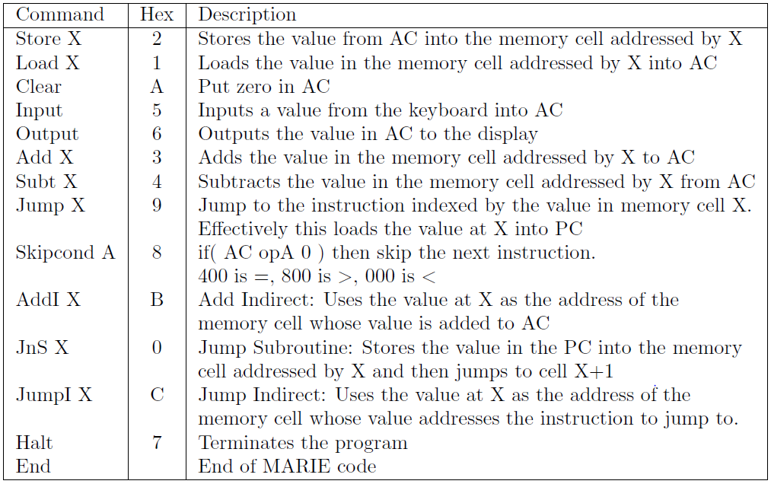
Parsing/Compiling
Input:
Java Code
Output:
MARIE Machine Code
simulating the Java code.

Slide 118
Parsing/Compiling
Input:
Java Code
Output:
MARIE Machine Code
simulating the Java code.
Challenge: Keep track of three algorithms simultaneously
  The compiler
  The Java code being compiled
  The MARIE code being produced.

Slide 119
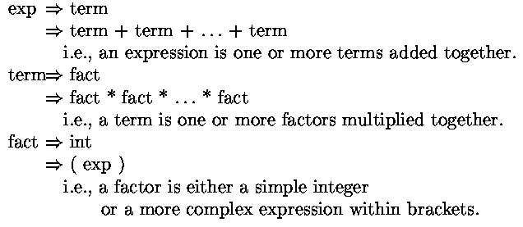
Parsing/Compiling

Slide 120
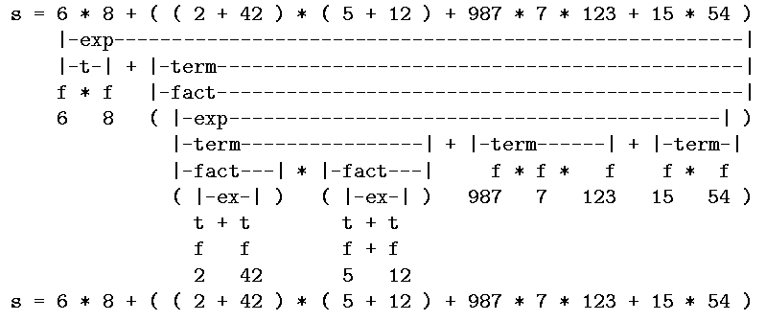
Parsing/Compiling

Slide 121

Parsing/Compiling
Algorithm: GetExp( s, i )
Input: s is a string of tokens
i is a start index
Output: p is a parsing of the longest valid expression
j is the end index
s=6*8+((2+42)*(5+12)+987*7*123+15*54)

Slide 122

Parsing/Compiling
Algorithm: GetTerm( s, i )
Input: s is a string of tokens
i is a start index
Output: p is a parsing of the longest valid term
j is the end index
s=6*8+((2+42)*(5+12)+987*7*123+15*54)

Slide 123
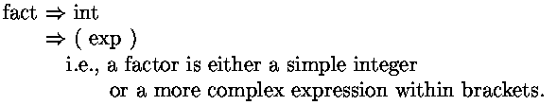
Parsing/Compiling
Algorithm: GetFact( s, i )
Input: s is a string of tokens
i is a start index
Output: p is a parsing of the longest valid factor
j is the end index
s=6*8+((2+42)*(5+12)+987*7*123+15*54)

Slide 124
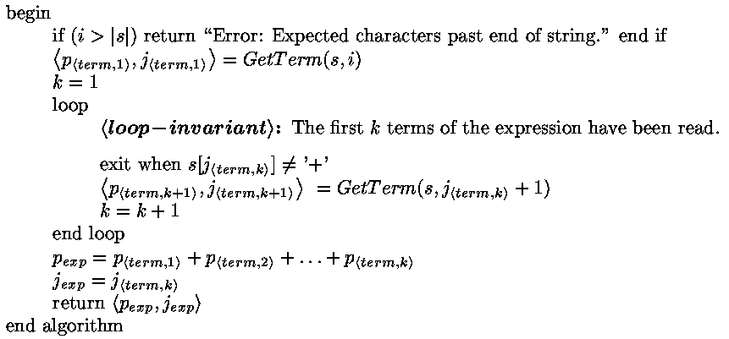
Algorithm: GetExp( s, i )
s=6*8+((2+42)*(5+12)+987*7*123+15*54)
p_{<term,1>}
p_{<term,2>}
p_{<term,3>}

Slide 125
Algorithm: GetExp( s, i )
Exp
p_{<term,1>}
p_{<term,2>}
…
p_{<term,k>}
+
+
+

Slide 126
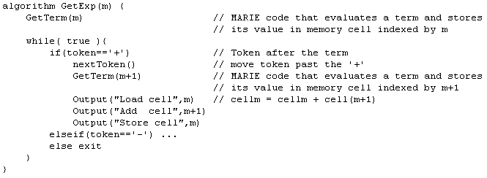
Algorithm: GetExp( m )
Output:
MARIE Machine Code that
evaluates an expression and stores its value
in memory cell indexed by m.

Slide 127
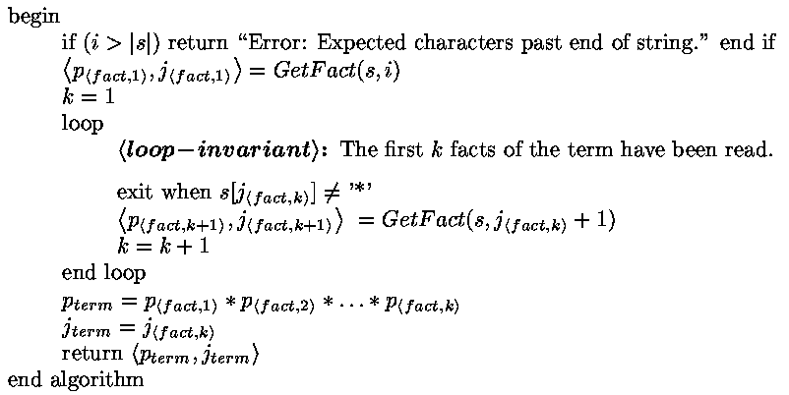
Algorithm: GetTerm( s, i )
s=6*8+((2+42)*(5+12)+987*7*123+15*54)
p_{<fact,1>}
p_{<fact,2>}

Slide 128
Algorithm: GetTerm( s, i )
Term
p_{<fact,1>}
p_{<fact,2>}
…
p_{<fact,k>}
*
*
*

Slide 129
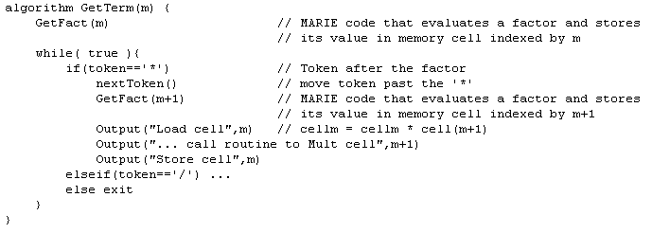
Algorithm: GetTerm( m )
Output:
MARIE Machine Code that
evaluates a term and stores its value
in memory cell indexed by m.

Slide 130
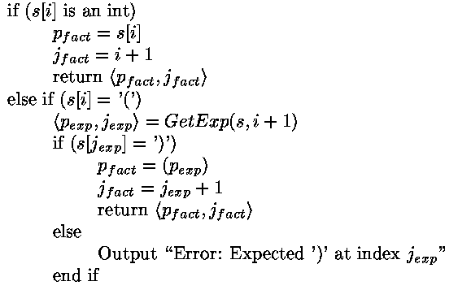
Parsing
Algorithm: GetFact( s, i )
s=6*8+((2+42)*(5+12)+987*7*123+15*54)

Slide 131
Parsing
Algorithm: GetFact( s, i )
Fact
42

Slide 132
Algorithm: GetFact( s, i )
s=6*8+((2+42)*(5+12)+987*7*123+15*54)
p_{<exp>}

Slide 133
Algorithm: GetFact( s, i )
Fact
(
p_{<exp>}
)

Slide 134
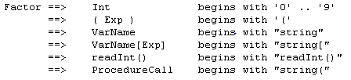
Algorithm: GetFact( m )
Output:
MARIE Machine Code that
evaluates a factor and stores its value
in memory cell indexed by m.
Next token determines which case the factor is.

Slide 135
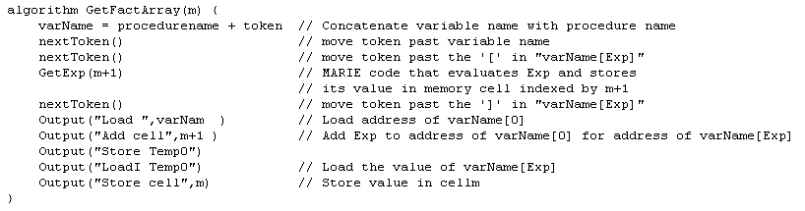
Algorithm: GetFactArray( m )
Output:
MARIE Machine Code that
evaluates a factor and stores its value
in memory cell indexed by m.

Slide 136
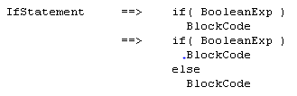
Algorithm: GetIfStatement()
Output:
MARIE Machine Code that
executes an IfStatement

Slide 137

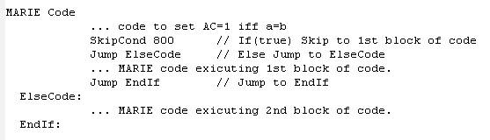
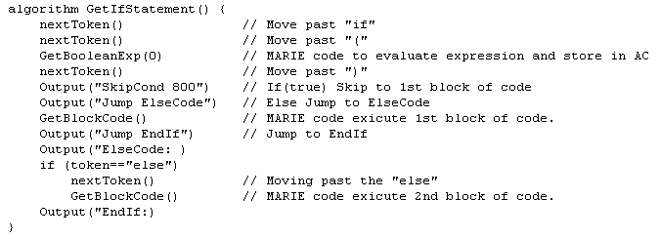

Slide 138
Parsing/Compiling
This parsing algorithm only works for Look Ahead One Grammars.
Look Ahead One: A grammar is said to be look ahead one if,
given any two rules for the same non-terminal,
the ﬁrst place that the rules diﬀer in actual characters.
A ⇒ B ’u’ C ’w’ E
A ⇒ B ’u’ C ’x’ F
A ⇒ B ’u’ C
A ⇒ B ’v’ G H
?
(and next character is not ‘w’ or ‘x’)
A ⇒ F G
(Ok if first character(s) within a B
is different than in a F.)
This feature allows our parsing algorithm to look only
at the next token in order to decide what to do next.
Thus the algorithm runs in linear time.

Slide 139
Parsing/Compiling
This parsing algorithm only works for Look Ahead One Grammars.
A ⇒ ( A )
A ⇒ ε
A ⇒ a A a
A ⇒ ε
? (next character is ‘a’)
Generates (((())))
Generates aaaaaaaa
GetA(s,i)
if( s[i] = ‘(‘ )
⟨p_{A},j_{A}⟩, = GetA(s,i+1)
if( s[j_{A}] = ‘)‘ )
return( ⟨ ‘(‘ p_{A} ’)’⟩, j_{A}+1)
else
return( error )
else
return(ε )
Not Look Ahead One
Parser can’t find middle.
A ⇒ A B
A ⇒ A C
Recurses forever.

Slide 140
Parsing/Compiling
This parsing algorithm only works for Look Ahead One Grammars.
A ⇒ BC
A ⇒ DE
B ⇒ b ....
D ⇒ d ....
A ⇒ BC
A ⇒ DE
B ⇒ bbb ....
D ⇒ bbb ....
GetA(s,i)
if( s[i] = ‘b‘ )
⟨p_{B},j_{B}⟩, = GetB(s,i)
⟨p_{C},j_{C}⟩, = GetC(s,j_{B})
return( ⟨ p_{B} p_{C} ⟩, j_{C} )
elseif( s[i] = ‘d‘ )
⟨p_{D},j_{D}⟩, = GetD(s,i)
⟨p_{E},j_{E}⟩, = GetC(s,j_{D})
return( ⟨ p_{D} p_{E} ⟩, j_{E} )
Not Look Ahead One
Don’t know whether to call
GetB or GetD

Slide 141
Parsing
Stackframes ≈ nodes in parse tree

Slide 142
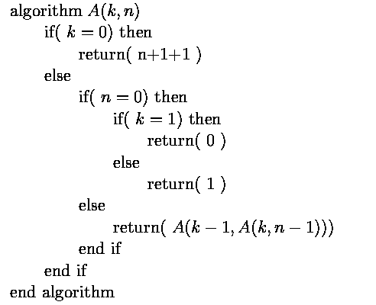
Ackermann’s Function
How big is A(5,5)?
n applications
Notes:
142

Slide 143
Ackermann’s Function
n applications
n applications
Notes:
143

Slide 144
Ackermann’s Function
n applications
n applications
Notes:
144

Slide 145

Ackermann’s Function
n applications
Notes:
145

Slide 146


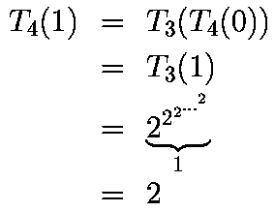
Ackermann’s Function

Slide 147

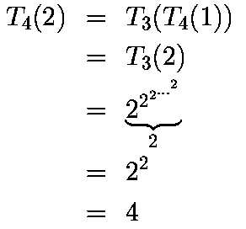
Ackermann’s Function

Slide 148

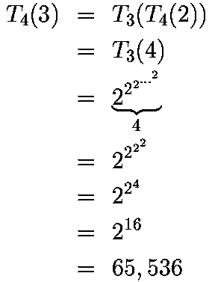
Ackermann’s Function

Slide 149
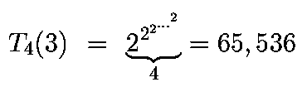
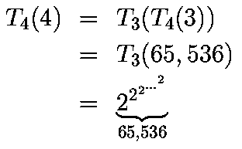

Ackermann’s Function

Slide 150

Ackermann’s Function
Notes:
150

Slide 151



Slide 152
End

