Slide 1
Jeff Edmonds
room: 3044
jeff@cs.yorku.ca

Slide 2
Research Interests
Many Topics in Theory & Mathematics
Scheduling Algorithms
scheduling some shared resource
to a steady stream of incoming jobs
Examples
scheduling jobs on multi-processor machine
regulating the flow of data through a network (TCP)
broadcasting files
Lower Bounds
Greedy/Dynamic Programming model.
Cake Cutting (Resource Allocation)
upper and lower bounds on the # of operations required
Topological Embeddings
Jeff Edmonds

Slide 3
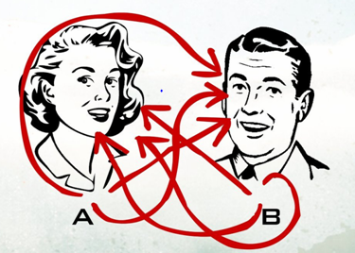
Research Interests
X
Y
f(X,Y)

Slide 4
Mathematical and Theoretical Support
For your favorite topic.
Jeff Edmonds

Slide 5
Machine Learning
I had a life crisis this year.
I am tired of doing research that is too hard and too esoteric.
So I have been studying machine learning.

Slide 6
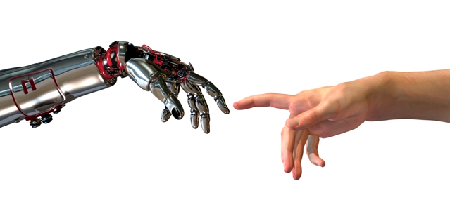
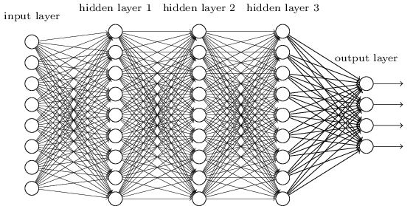
Machine Learning
Machine learning:
Is changing our lives at a rate like never before.
For better or worse
It is where the jobs are.
The few that will be left.
York is starting a whole new grad program in it.
x₁
w₁
w₂
cat
pixel_{i,j}
dog
face
bicycle.
x_{n}
w_{m}
E(w₁,…,w_{m})

Slide 7
Machine Learning
I got addicted to making slides and it may be 4 hours worth.
I want to do is slow so that everyone gets it.
I taught about 4 hours in EECS2001
and 1 hour in EECS101
And 1 hour later this month to BMO CEOs.
x₁
w₁
w₂
cat
pixel_{i,j}
dog
face
bicycle.
x_{n}
w_{m}
E(w₁,…,w_{m})

Slide 8
COSC6111 Advanced Algorithms Design and Analysis
Description:
An advanced theory course (You need one)
Directed at non-theory students
Exposes you to many theory topics
Challenging, but accessible
office hour?? After class or before?
Jeff Edmonds

Slide 9
COSC 3101 Design and Analysis of Algorithms
Think about attending it I find most grad students do not know this material.
Videos of my lectures are all on line.

Slide 10
Prerequisites
You should know the 3101 material to take this advanced graduate course in algorithms.
Existential and Universal Quantifier
Sums and Recurrence relation
Loop Invariants
Recursive Algorithms
Network Flow
Greedy Algorithms
Dynamic Programming
NP-Completeness

Slide 11
Prerequisites
You should know the 3101 material to take this advanced graduate course in algorithms.
We will spend much less time reviewing and I will be more insistent that you know it.
Recommend that you
read my 3101 notes & slides
watch the videos.

Slide 12
Grading
Assignments (30%)
Presentation (30%)
Tests/Exam (30%)
Class Participation (10%)

Slide 13
Topics
Loop Inv: Maximal Rectangles
Divide and Conquer: fast fourier transformations
Recursion: parsing
Network Flow: steepest assent, bipartite matching matching
Linear Programming: what to put in a hotdog
Greedy Algorithms: matroids, union of matroids
Dynamic Programming: point cover, knapsack, parsing CFG
Approximation Algorithms: knapsack
Linear Algebra (FFT)
Lower bounds: In Backtracking model.
NP-completeness: reductions
Randomized Algorithms: chernoff bounds, primes, random walks
Cryptography: RSA
Distributed Systems: mud on forehead & common knowledge
# of prime numbers
Intro to Quantum: Shor's factoring
Amortized Analysis: union find

Slide 14
Jeff Edmonds
room: 3044
jeff@cs.yorku.ca

Slide 15
The Talk
Being able to give a good talk is an important and difficult skill.
In the course evaluation, almost everyone said that giving a talk was very useful, but that hearing them was a big waist of time because no one followed them.

Slide 16
The Talk
Grade
Class understanding and interest 33 1/3% (marked by class)
Quality of material covered 33 1/3% (relevancy, difficulty)
Quality of talk & slides 33 1/3%
You will loose 3% for every minute over 20 mins. (We need a time keeper)

Slide 17
The Talk
Book your date early
Discuss with me the topic
Two week before talk show me the slides

