Slide 1
No Proof System for Number Theory
Reduction to Halting Problem
4111 Computability
History
Gödel's Incompleteness
Halting ≤ Math Truth
Jeff Edmonds
York University
Lecture 3
COSC 4111

Slide 2
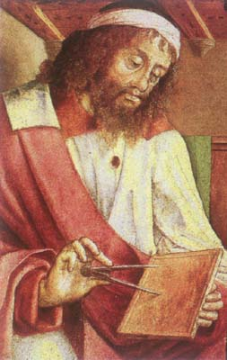
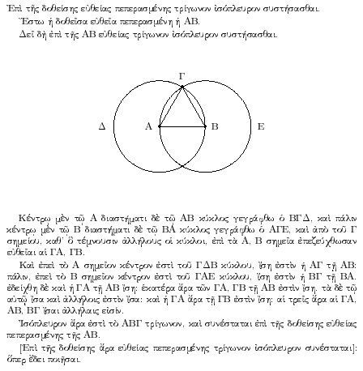
History of Proofs
Euclid said,
“ Let there be proofs”
Euclid (300 BC)
And it was good.

Slide 3
History of Proofs
Euclid said,
“ Let there be proofs”
Clearly everything is either true or false.
Goal: Design a proof system
that proves everything.
Result: “Prove that God exists”
Euclid (300 BC)

Slide 4
History of Proofs
Euclid said,
“ Let there be proofs”
A proof system consists of
A finite set of axioms
(Statements assumed to be true)
Eg. 1) Any two points can be joined
by a straight line
….
5) Parallel lines never meet.
Euclid (300 BC)

Slide 5
History of Proofs
Euclid said,
“ Let there be proofs”
A proof system consists of
A finite set of axioms
(Statements assumed to be true)
A finite set of rules for proving
one statement from previously
proved theorems.
Eg: If statements
A and A ⇒ B
have been proved,
then statement B follows.
Euclid (300 BC)

Slide 6

History of Proofs
To the ancients, the parallel axiom
“5) Parallel lines never meet.”
seemed less obvious than the others.
(God would want a cleaner world)
They wanted to prove it from the other four.
By 1763 at least 28 different proofs
had been published.
They were all false!!!
Euclid (300 BC)
There exist Non-Euclidian (curved) worlds
in which first the four axioms are true
and the fifth is false.
Examples: Earth & Our universe.

Slide 7
History of Proofs
Euclid said,
“ Let there be proofs”
Clearly everything is either true or false.
Oops
Some things have no proof
and whether true or false
depends on your world view.
Euclid (300 BC)

Slide 8
History of Proofs
Euclid said,
“ Let there be proofs”
Clearly everything is either true or false.
Consider only statements in Number Theory
i.e. statements about the integers.
eg: Φ = [∀ a,b,c,r ≥ 3 a^{r}+b^{r} ≠c^{r}]
Clearly each such statement
is either true or false.
Euclid (300 BC)
Goal: Design a proof system
that proves/disproves all of these.

Slide 9
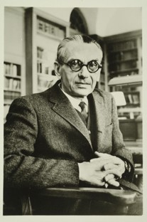
Gödel’s Incompleteness Theorem
Some things have no proof
and whether true or false
depends on your world view.
For every proof system S,
there are math statements Φ
which are either not proved
or proved incorrectly!
Gödel 1931

Slide 10
Gödel’s Incompleteness Theorem
Gödel 1931
Proof System:
If S is a valid proof system,
then Φ is true ⇔ Φ has a valid proof P in S
Number Theory: eg: Φ = [∀ a,b,c,r ≥ 3 a^{r}+b^{r} ≠c^{r}]
Is powerful enough to say
Φ_{true} = “P is a valid proof
of math statement I
in proof system S.”
And hence can a say
Φ_{diagonal} = ∃P “P is a valid proof
of math statement ¬Φ_{diagonal}
in proof system S.”

Slide 11
Gödel’s Incompleteness Theorem
Gödel 1931
Proof System:
If S is a valid proof system,
then Φ is true ⇔ Φ has a valid proof P in S
Number Theory: eg: Φ = [∀ a,b,c,r ≥ 3 a^{r}+b^{r} ≠c^{r}]
Is powerful enough to say
Φ_{diagonal} = ∃P “P is a valid proof
of math statement ¬Φ_{diagonal}
in proof system S.”
Incompleteness Proof:
If S is a valid proof system,
Φ_{diagonal} is true
  ¬Φ_{diagonal} has a valid proof in S
  ¬Φ_{diagonal} is true
  Φ_{diagonal} is false
Oops
Contradiction!

Slide 12
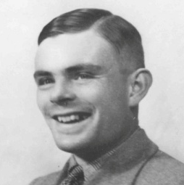
Gödel’s Incompleteness Theorem
Turing 1936
Computational Problem:
MathTruth(Φ) = Math Statement Φ is true.
Proof System:
If S is a valid proof system,
then a proof P of Φ is a witness that Φ is true
& a proof P of ¬Φ is a witness that Φ is true,
making MathTruth computable.
Number Theory eg: I = [∀ a,b,c,r ≥ 3 a^{r}+b^{r} ≠c^{r}]
Is powerful enough to say
Φ_{halt} = “TM M halts on I.”
Hence, HaltingProblem ≤_{poly} MathTruth
Incompleteness Proof:
If S is a valid proof system,
  MathTruth is computable
  HaltingProblem is computable
Oops
Contradiction!

Slide 13
S valid proof system ⇒ MathTruth computable
Alg for MathTruth(Φ):
Loop through all proofs P
if P is a proof in S of Φ or of ¬Φ.
exit with “yes” or “no”
But what if I has no proof?
Then this algorithm runs forever.
Will this algorithm ever stop?
It reminds me of the Halting problem!

Slide 14
S valid proof system ⇒ MathTruth computable
Alg for MathTruth(Φ):
Loop through all proofs P
if P is a proof in S of Φ or of ¬Φ.
exit with “yes” or “no”
If S is a valid proof system, then
  When MathTruth(Φ) = “yes”
    ∃ a proof P witnessing it.
    Alg halts with “yes”.
  When MathTruth(Φ) = “no”
    MathTruth(¬Φ) = “yes”
    ∃ a proof P witnessing it.
    Alg halts with “no”.

Slide 15
S valid proof system ⇒ MathTruth computable
Acceptable
Co-Acceptable
Yes instance
➔ Halt and answer “yes”
No instance
➔ Run forever or answer “no”
Yes instance
➔ Run forever or answer “yes”
No instance
➔ Halt and answer “no”
Computable
Witness of “yes”.
Witness of “no”.
Yes instance
➔ Halt and answer “yes”
No instance
➔ Halt and answer “no”
MathTruth
without Proof System S
MathTruth
with Proof System S
MathTruth
with Proof System S
MathTruth
with Proof System S

Slide 16
Halting problem ≤_{poly} Math Truth
<M,I>
TM M halts
on input I or not
Math statement:
“TM M halts
on input I”
BUILD:
Halting
Oracle
Math statement is true
or not
GIVEN:
Math Proof Oracle

Slide 17
Halting problem ≤_{poly} Math Truth
Math statement:
“TM M halts on input I”
= ∃ C, “C is an integer encoding
a valid halting computation
for TM M on input I”
A valid computation of a TM
Time state Tape Contents Head
1 10₂ [0,1,1,0,0,1,1]
2 1011₂ [1,1,1,0,0,1,1]
i 1101₂ [0,0,1,1,0,0,1,1,0]
i+1 1010₂ [0,0,1,1,1,0,1,1,0]
T 110₂ [0,0,1,1,1,0,1,0,1,0]
Mark Head
with digit 2
…
…

Slide 18
Halting problem ≤_{poly} Math Truth
Math statement:
“TM M halts on input I”
= ∃ C, “C is an integer encoding
a valid halting computation
for TM M on input I”
A valid computation of a TM
Time state Tape Contents Head 2
1 10₂ [2,0,1,1,0,0,1,1]
2 1011₂ [1,2,1,1,0,0,1,1]
i 1101₂ [0,0,1,1,2,0,0,1,1,0]
i+1 1010₂ [0,0,1,2,1,1,0,1,1,0]
T 110₂ [2,0,0,1,1,1,0,1,0,1,0]
Separate blocks
with digits 3,4
Mark Head
with digit 2
…
…

Slide 19
Halting problem ≤_{poly} Math Truth
Math statement:
“TM M halts on input I”
= ∃ C, “C is an integer encoding
a valid halting computation
for TM M on input I”
A valid computation of a TM
Time state Tape Contents Head 2
4 10 3 [2,0,1,1,0,0,1,1]
4 1011 3 [1,2,1,1,0,0,1,1]
4 1101 3 [0,0,1,1,2,0,0,1,1,0]
4 1010 3 [0,0,1,2,1,1,0,1,1,0]
4 110 3 [2,0,0,1,1,1,0,1,0,1,0]
Separate blocks
with digits 3,4
Remove [,]
…
…

Slide 20
Halting problem ≤_{poly} Math Truth
Math statement:
“TM M halts on input I”
= ∃ C, “C is an integer encoding
a valid halting computation
for TM M on input I”
A valid computation of a TM
Time state Tape Contents Head 2
4 10 3 2 0 1 1 0 0 1 1
4 1011 3 1 2 1 1 0 0 1 1
4 1101 3 0 0 1 1 2 0 0 1 1 0
4 1010 3 0 0 1 2 1 1 0 1 1 0
4 110 3 2 0 0 1 1 1 0 1 0 1 0
Remove [,]
Merge Digits
…
…

Slide 21
Halting problem ≤_{poly} Math Truth
Math statement:
“TM M halts on input I”
= ∃ C, “C is an integer encoding
a valid halting computation
for TM M on input I”
An integer C encoding a valid computation of a TM
C = 41032011001141011312110011…
411013001120011041010300121101104…
4110320011101010

Slide 22
Halting problem ≤_{poly} Math Truth
“The initial config is that
for TM M on input I”
Math statement:
“C is an integer encoding
a valid halting computation
for TM M on input I”
=
∀ “time t” “a legal TM
M step is taken”
“The final config is halting
for TM M”
An integer C encoding a valid computation of a TM
C = 41032011001141011312110011…
411013001120011041010300121101104…
4110320011101010

Slide 23
Halting problem ≤_{poly} Math Truth
Math statement:
∀ “time steps t”
indexes i₁<j₁<k₁<i₂<j₂<k₂<i₃“where
the i digits are 4s,
the j digits are 3s,
the k digits are 2s,
and every digit in between is 0 or 1.”
=
An integer C encoding a valid computation of a TM
C = 41032011001141011312110011…
411013001120011041010300121101104…
4110320011101010
i₁
j₁
k₁
i₂
j₂
k₂
i₃

Slide 24
Halting problem ≤_{poly} Math Truth
Math statement:
∀ “time steps t”
indexes i₁<j₁<k₁<i₂<j₂<k₂<i₃
Cut out from index i₁ to j₁.
=
An integer C encoding a valid computation of a TM
C = 41032011001141011312110011…
411013001120011041010300121101104…
4110320011101010
i₁
j₁
k₁
i₂
j₂
k₂
i₃
x = ⎣C/10^{j}⎦
= 41032011001141011312110011…41101
y = ⎣C/10^{i-1}⎦ × 10^{i-j-1}
= 41032011001141011312110011…40000
x-y = 1011

Slide 25
Halting problem ≤_{poly} Math Truth
Math statement:
∀ “time steps t”
indexes i₁<j₁<k₁<i₂<j₂<k₂<i₃
“Cut out state, tape,
head, digit at head”
=
“Cut out next state, tape,
head, digit at old head”
An integer C encoding a valid computation of a TM
C = 41032011001141011312110011…
411013001120011041010300121101104…
4110320011101010
i₁
j₁
k₁
i₂
j₂
k₂
i₃
state_{t} = 1101
tape_{t} = 001100110
digit at head_{t} = 0
state_{t+1} = 1101
tape_{t+1} = 001110110
digit at old head_{t+1} = 1

Slide 26
Halting problem ≤_{poly} Math Truth
Math statement:
“a legal TM
M step is taken”
“Cell at head, head position,
and state change according
to M’s finite rules”
=
index i, “if cell has no
head then no change to cell”
An integer C encoding a valid computation of a TM
C = 41032011001141011312110011…
411013001120011041010300121101104…
4110320011101010
state_{t} = 1101
tape_{t} = 001100110
digit at head_{t} = 0
state_{t+1} = 1101
tape_{t+1} = 001110110
digit at old head_{t+1} = 1

Slide 27
Halting problem ≤_{poly} Math Truth
<M,I>
TM M halts
on input I or not
Math statement:
“TM M halts
on input I”
BUILD:
Halting
Oracle
Math statement is true
or not
GIVEN:
Math Proof Oracle

Slide 28
Gödel’s Incompleteness Theorem
Turing 1936
Computational Problem:
MathTruth(Φ) = Math Statement Φ is true.
Proof System:
If S is a valid proof system,
then a proof P of Φ is a witness that Φ is true
& a proof P of ¬Φ is a witness that Φ is true,
making MathTruth computable.
Number Theory eg: I = [∀ a,b,c,r ≥ 3 a^{r}+b^{r} ≠c^{r}]
Is powerful enough to say
Φ_{halt} = “TM M halts on I.”
Hence, HaltingProblem ≤_{poly} MathTruth
Incompleteness Proof:
If S is a valid proof system,
  MathTruth is computable
  HaltingProblem is computable
Oops
Contradiction!

Slide 29
The End

