Slide 1
Diagonalization
& Uncomputablity
4111 Computability
Countable
Uncountable
A Hierarchy of Objects
History of Classifying Problems
Diagonal Uncomputable via Nemesis
Diagonal Uncomputable via Reals-Integers
Halting Problem
Time Hierarchy
Jeff Edmonds
York University
Lecture 3
COSC 4111

Slide 2
Countable Infinity

Slide 3
Countable Infinity
A finite set contains some integer number of elements.
{ , 4, }
The size of an infinite set is bigger than any integer.
The set of natural numbers N = {1,2,3,4,… }
The set of fractions Q = {¹/₂, ²/₃, ... }
The set of reals R = {2.34323…, 34.2233…, π, e, …}
Are these infinite sets the same “size”?
Two sets have the same size
if there is a mapping between them.
|{ , 4, }|
= |{ 1, 2, 3 }|
= 3

Slide 4
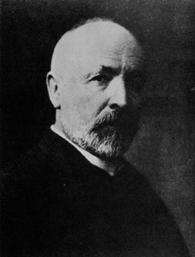
Cantor’s Definition (1874)
Countable Infinity
Two sets are defined to have the same size if and only if they can be placed into a bijection correspondence.

Slide 5
Do these sets have the same size?
Countable Infinity
N = { 0, 1, 2, 3, 4, 5, 6, 7, …. }
E = { 0, 2, 4, 6, 8, 10, 12, 14, …. }
No! E is a proper subset of N
with plenty left over.
The mapping f(x)=x is not a bijection
Yes! The mapping f(x)=2x is.
Lesson: Not all mappings work!

Slide 6
Countable Infinity
The set of integers N = {1,2,3,4,… }
The set of fractions Q = {¹/₂, ²/₃, ... }
Are these infinite sets the same “size”?
Two sets have the same size
if there is a mapping between them.
|{ , 4, }|
= |{ 1, 2, 3 }|
= 3

Slide 7
Countable Infinity
The set of integers N = {1,2,3,4,… }
The set of fractions Q = {¹/₂, ²/₃, ...
Are these infinite sets the same “size”?
Two sets have the same size
if there is a mapping between them.
1,2,3,4,… }
Q looks bigger.
|{ , 4, }|
= |{ 1, 2, 3 }|
= 3

Slide 8
Countable Infinity
No way!
The rationals are dense: between any two there is a third. You can’t list them one by one without leaving out an infinite number of them.

Slide 9
Countable Infinity
Don’t jump to conclusions!
There is a clever way to list the rationals, one at a time, without missing a single one!

Slide 10
Countable Infinity
...
...
6
⁶/₁
⁶/₂
⁶/₃
⁶/₄
⁶/₅
⁶/₆
⁶/₇
⁶/₈
All positive
fractions
5
⁵/₁
⁵/₂
⁵/₃
⁵/₄
⁵/₅
⁵/₆
⁵/₇
⁵/₈
4
⁴/₁
⁴/₂
⁴/₃
⁴/₄
⁴/₅
⁴/₆
⁴/₇
⁴/₈
3
³/₁
³/₂
³/₃
³/₄
³/₅
³/₆
³/₇
³/₈
2
²/₁
²/₂
²/₃
²/₄
²/₅
²/₆
²/₇
²/₈
...
Count them
by mapping.
1
¹/₁
¹/₂
¹/₃
¹/₄
¹/₅
¹/₆
¹/₇
¹/₈
1 2 3 4 5 6 7 8
Oops we never
get to ²/₁!
{ 1, 2, 3, 4, 5, 6, …. }
All positive integers

Slide 11
Countable Infinity
...
...
6
⁶/₁
⁶/₂
⁶/₃
⁶/₄
⁶/₅
⁶/₆
⁶/₇
⁶/₈
All positive
fractions
5
⁵/₁
⁵/₂
⁵/₃
⁵/₄
⁵/₅
⁵/₆
⁵/₇
⁵/₈
4
⁴/₁
⁴/₂
⁴/₃
⁴/₄
⁴/₅
⁴/₆
⁴/₇
⁴/₈
Slightly easier
to prove
|N|≥|Q|
3
³/₁
³/₂
³/₃
³/₄
³/₅
³/₆
³/₇
³/₈
2
²/₁
²/₂
²/₃
²/₄
²/₅
²/₆
²/₇
²/₈
...
Count them
by mapping.
1
¹/₁
¹/₂
¹/₃
¹/₄
¹/₅
¹/₆
¹/₇
¹/₈
1 2 3 4 5 6 7 8
Every rational gets
mapped to some integer!
|N|=|Q|
Q is “Countable”
{ 1, 2, 3, 4, 5, 6, …. }
All positive integers

Slide 12
Countable Infinity
We say that the Natural numbers are listable.
Because the set is infinite we never get to them all.
But for any one, we eventually get to it!
A set S is called listable if its elements can be “listed”
next to the Natural numbers.
|S| = |{ , 4, , ….. }|
4
0
1
2
3
4
5
⁞
  There is a mapping from each object in S
  to an integer unique for that object.
∃ List that lists the elements of S.
∃ List ∀xϵS x appears in the list.
∃ List ∀xϵS ∃iϵN x is at location i in the list.
∃ List ∀xϵS ∃iϵN List(i)=x
This proves that S is countable, i.e. that |S| ≤ |N|

Slide 13
Countable Infinity
Two equivalent definitions of a set S being “Countable”
  There is a mapping from each object in S
  to an integer unique for that object.
|S| = |{ , 4, , ….. }|
≤ |{ 1, 2, 3, … }| = |N|

Slide 14
Countable Infinity
Two equivalent definitions of a set S being “Countable”
  There is a mapping from each object in S
  to an integer unique for that object.
  Each object in S has (at least one) finite description
  such that each description uniquely identifies that object.
|S| = |{ , 4, , ….. }|
apple four chair …
Convert each character
to Hex-Ascii.
61 70 70 6C 65
63 68 61 69 72
Concatenate the Hex
into one Hex integer.
66 6F 75 72
= |{ 1, 2, 3, … }| = |N|
≤ |{ 6170706C65, 666F7572, 6368616972, … }| = |N|

Slide 15
Countable Infinity
Two equivalent definitions of a set S being “Countable”
  There is a mapping from each object in S
  to an integer unique for that object.
  Each object in S has (at least one) finite description
  such that each description uniquely identifies that object.
The set of fractions
|Q| = |{¹/₂, ²/₃, ¹¹/₈ ,... }|
¹/₂ ²/₃ ¹¹/₈
Convert each character
to Hex-Ascii.
31 2F 32
31 31 2F 38
32 2F 32
Concatenate the Hex
into one Hex integer.
≤ |{312F32, 322F32, 31312F38, … }| = |N|

Slide 16
Countable Infinity
Two equivalent definitions of a set S being “Countable”
  There is a mapping from each object in S
  to an integer unique for that object.
  Each object in S has (at least one) finite description
  such that each description uniquely identifies that object.
The set of reals
|R| = |{2.34323…, 34.2233…, π, e, …}|
>>
= |{ 1, 2, 3, … }| = |N|

Slide 17
Countable Infinity
A set S is called listable/countable
if its elements can be “listed” next to the Natural numbers.
∃ List ∀xϵS ∃iϵN List(i)=x
The set of reals
|R| = |{2.34323…, 34.2233…, π, e, …}|
0
1
2
3
4
5
⁞
2.34323…
34.2233…
π
e

Slide 18
Countable Infinity
A set S is called listable/countable
if its elements can be “listed” next to the Natural numbers.
∃ List ∀xϵS ∃iϵN List(i)=x
A set S is called unlistable/uncountable i.e. |S| > |N|
∀List, it fails to list all of S.
∀List, ∃xϵS, x is not in the list.
∀List, ∃xϵS, ∀iϵN, x is not at location i in the list.
∀List, ∃xϵS, ∀iϵN, List(i)≠x
∀List, ∃xϵS, ∀iϵN, ∃dϵN, List(i) and x differ in the
d^{th} digit/character of their description.
∀List, ∃xϵS, ∀iϵN, ∃dϵN, List(i)_{d} ≠ x_{d}

Slide 19

Countable Infinity
A set S is called unlistable/uncountable i.e. |S| > |N|
∀List, ∃xϵS, ∀iϵN, ∃dϵN, List(i)_{d} ≠ x_{d}
Proof by game:
Let List be an arbitrary list, i.e. a mapping N to S.
I construct a value xϵS.
_________________
Let i be an arbitrary natural number.
I choose a value d = ___
I prove that List(i)_{d} ≠ x_{d}
∀dϵN x_{d} =
List(i)_{d}
i
Why?
Why not?
We call it a
diagonal argument.
i’s nemesis is d=i
No thinking
required yet.

Slide 20
Uncountable Infinity
Proof that |R| > |N|
i.e.∀List, ∃xϵS, ∀iϵN, ∃dϵN, List(i)_{d} ≠x_{d}
Let List be an arbitrary mapping from N to R.
i x=List(i)
12.34323834749308477599304 …
8.50949039988484877588487 …
930.93994885783998573895002 …
34.39498837792008948859069 …
0.00343988348757590125473 …
…..
Proof by
Diagonalization
We find a real number x_{diagonal} that is not in the list.
The i^{th} digit will be the i^{th} digit of the i^{th} number List(i)
increased by one (mod 10).
Let i be arbitrary in N.
I prove that List(i)≠x_{diagonal}
They differ in the i^{th} digit
x_{diagonal} = 0.41004 …

Slide 21
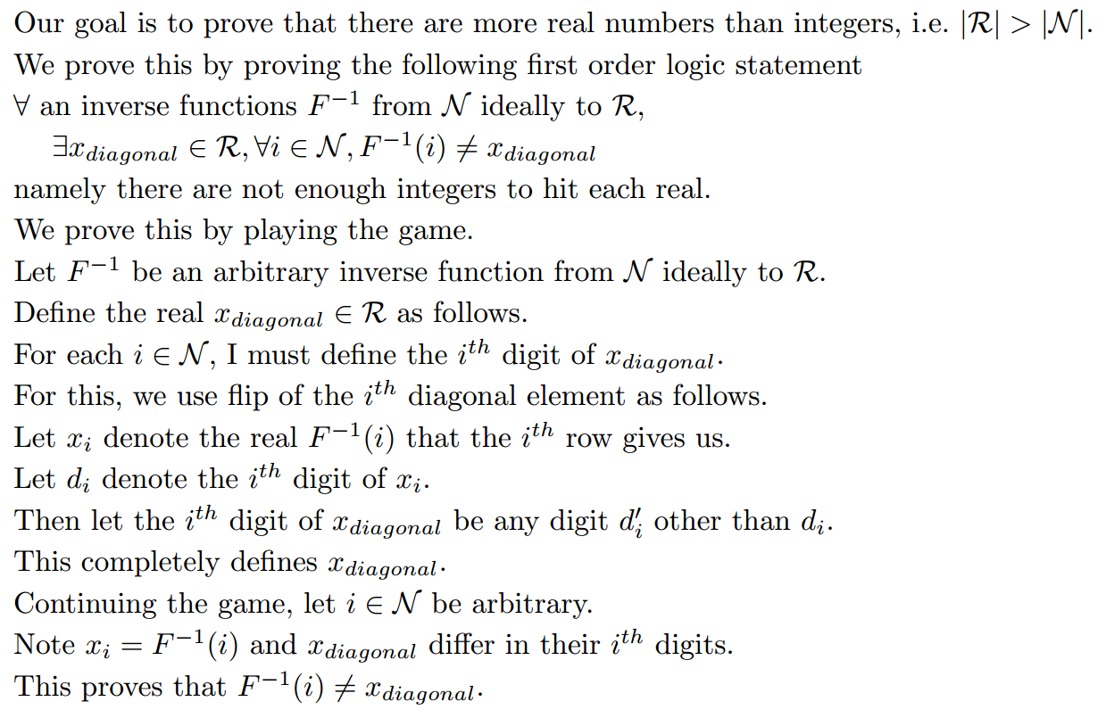
Uncountable Infinity
Proof that |R| > |N|
i.e. ∀List, ∃xϵR, ∀iϵN List(i)≠x

Slide 22
A Hierarchy of Objects
A “Character” Object:
  One of a prespecified finite set of objects.
  Eg:
    A character c ∈ ASCII.
    A bit b ∈ {0,1}
    A digit d ∈ {0,1,..,9}

Slide 23
A Hierarchy of Objects
An “Integer-Like” Object:
  Has a finite description.
  i.e. a finite sequence of “characters”
  with which the object is uniquely identified.
  Eg:
    An integer i, eg 5.
    A string s, eg “Jeff”
    A fraction ⁴/₅
    Something you might hold u, eg “apple”
    A finite set/tuple/list of level 1 objects
    eg {3,5,12}
    eg a list allocating an integer to each person alive.

Slide 24
A Hierarchy of Objects
A “Real-Like” Object:
  Each such x has a countably infinite description “x”.
  i.e. a sequence of “characters”
  with which the object is uniquely identified.
  All of these characters can’t be written down.
  Each character is indexed by an “integer-like” object i.
  Let “x”(i) denote the i^{th} char of the obj’s description.
  Eg:
    There is an real x whose description is
    “x” = “75.31928361899…”
    “x”(1) = ‘7’, “x”(0) = ‘5’, and “x”(-1) = ‘3’.

Slide 25
A Hierarchy of Objects
A “Real-Like” Object:
  Each such x has a countably infinite description “x”.
  i.e. a sequence of “characters”
  with which the object is uniquely identified.
  All of these characters can’t be written down.
  Each character is indexed by an “integer-like” object i.
  Let “x”(i) denote the i^{th} char of the obj’s description.
  Eg:
    A point <x,y> within the plain.
    “<x,y>” = “<75.31928361899… , 4.325643… >”
    If “<x,y>”(1), “<x,y>”(0), “<x,y>”(-1), …
    indexed the characters of “x” ,
    we would run out of indexes before getting to “y”.

Slide 26
A Hierarchy of Objects
A “Real-Like” Object:
  Each such x has a countably infinite description “x”.
  i.e. a sequence of “characters”
  with which the object is uniquely identified.
  All of these characters can’t be written down.
  Each character is indexed by an “integer-like” object i.
  Let “x”(i) denote the i^{th} char of the obj’s description.
  Eg:
    A point <x,y> within the plain.
    “<x,y>” = “<75.31928361899… , 4.325643… >”
    “<x,y>”(<1,1>) = ‘7’, “<x,y>”(<2,0>) = ‘4’, …
    Note i=<2,0> is an “integer-like” object.

Slide 27
A Hierarchy of Objects
A “Real-Like” Object:
  Each such x has a countably infinite description “x”.
  i.e. a sequence of “characters”
  with which the object is uniquely identified.
  All of these characters can’t be written down.
  Each character is indexed by an “integer-like” object i.
  Let “x”(i) denote the i^{th} char of the obj’s description.
  Eg:
    An infinite set/tuple/list of “integer-like” objects
    Eg The set of positive integer N, eg { 0, 1, 2, 3,… }
    Eg A set of integer S with “S” = “{ 3, 6, 7, … }”
    “S”(i) ∈ {yes/no}
    would tell you whether or not i is in S.
i.e. the i^{th} char of the obj’s descr.

Slide 28
A Hierarchy of Objects
A “Real-Like” Object:
  Each such x has a countably infinite description “x”.
  i.e. a sequence of “characters”
  with which the object is uniquely identified.
  All of these characters can’t be written down.
  Each character is indexed by an “integer-like” object i.
  Let “x”(i) denote the i^{th} char of the obj’s description.
  Eg:
    An infinite set/tuple/list of “integer-like” objects
    The size of such a set is said to be countable
    because it’s elements can be indexed by the integers.

Slide 29
A Hierarchy of Objects
A “Real-Like” Object:
  Each such x has a countably infinite description “x”.
  i.e. a sequence of “characters”
  with which the object is uniquely identified.
  All of these characters can’t be written down.
  Each character is indexed by an “integer-like” object i.
  Let “x”(i) denote the i^{th} char of the obj’s description.
  Eg:
    A function f from the integers to the digits {0,…,9}
    Eg f(i) = i²+5 mod 10
    “f”(i) ∈ {0,…,9}
    would tell you f(i).
i.e. the i^{th} char of the obj’s descr.

Slide 30
A Hierarchy of Objects
A “Real-Like” Object:
  Each such x has a countably infinite description “x”.
  i.e. a sequence of “characters”
  with which the object is uniquely identified.
  All of these characters can’t be written down.
  Each character is indexed by an “integer-like” object i.
  Let “x”(i) denote the i^{th} char of the obj’s description.
  Eg:
    A function f from the integers to the
    Eg f(i) = i²+5
    “f”(i) ∈
    would tell you f(i).
    Is this fair to have an integer as a “character”?
integers
{0,1,2,… }

Slide 31
A Hierarchy of Objects
A “Real-Like” Object:
  Each such x has a countably infinite description “x”.
  i.e. a sequence of “characters”
  with which the object is uniquely identified.
  All of these characters can’t be written down.
  Each character is indexed by an “integer-like” object i.
  Let “x”(i) denote the i^{th} char of the obj’s description.
  Eg:
    A function f from the integers to the integers
    Eg f(i) = i²+5
    For each “integer” <i,j>,
    “f”(<i,j>) ∈ {0,…,9}
    would tell you the j^{th} digit of f(i).

Slide 32
A Hierarchy of Objects
A “Real-Like” Object:
  Each such x has a countably infinite description “x”.
  i.e. a sequence of “characters”
  with which the object is uniquely identified.
  All of these characters can’t be written down.
  Each character is indexed by an “integer-like” object i.
  Let “x”(i) denote the i^{th} char of the obj’s description.
  Eg:
    A function f from the integers to the
    Eg f(i) =√ i
    For each “integer” <i,j>,
    “f”(<i,j>) ∈ {0,…,9}
    would tell you the j^{th} digit of f(i).
reals

Slide 33
A Hierarchy of Objects
A “Real-Like” Object:
  Each such x has a countably infinite description “x”.
  i.e. a sequence of “characters”
  with which the object is uniquely identified.
  All of these characters can’t be written down.
  Each character is indexed by an “integer-like” object i.
  Let “x”(i) denote the i^{th} char of the obj’s description.
  Eg:
    A computational decision problem P(I),
    as computed by a TM M(I).
    “P”(I) ∈ {yes,no}
    would tell you P(I).
    Remember a string I is an “integer-like” object.
i.e. the Ith char of the obj’s descr.

Slide 34
A Hierarchy of Objects
A “Set-of-Reals-Like” Object:
  A set of “real-like” objects.
  Eg:
    The set R of all reals
    An arbitrary set of reals S, eg {5.319…, 9.234…, … }
    A set of functions F, eg {f, g, h, … }
  The size of such sets is uncountable.
  The characters in its description need to be indexed by
  real numbers!

Slide 35
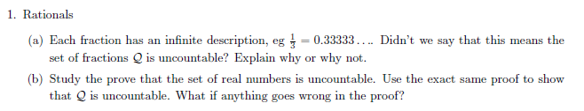
Homework

Slide 36
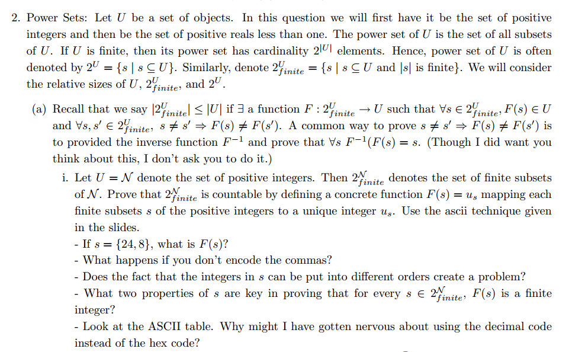
Homework

Slide 37
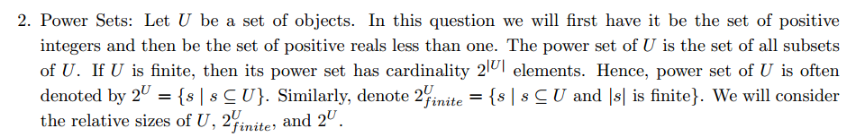
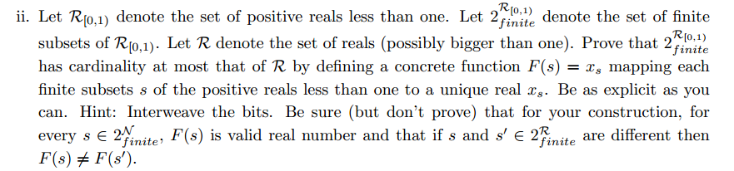
Homework

Slide 38
Uncountable Infinity
|Integers|
=
|Fractions|
<<
|Reals|
Each defined by
a finite string
Each defined by
a finite string
Each defined by
an infinite string
Set of finite subsets of the integers
{{2,3},{1,3,5,6}, … }
Each defined by a finite string
The set is countable in size
Set of possibly infinite subsets of the integers
{{2,3,…},{1,3,…}, … }
Each defined by a infinite string
The set is uncountable in size

Slide 39
Uncountable Infinity
<<
|Reals|
Each defined by
an infinite string
Set of finite subsets of the reals
{{2.394..,3.3563..},{1.982..,3.345..,5.32..}, … }
Each defined by a string of countably infinite length.
The set is same size as the reals
Set of possibly infinite subsets of the reals
{{2.394..,3.3563..,…},{1.982..,3.345..,…}, … }
Each defined by a string of uncountably infinite length.
The set is much bigger than the reals!
There is an infinite hierarchy of infinities!

Slide 40
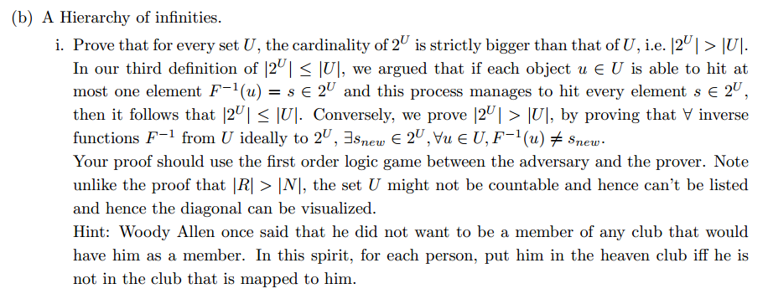
Homework

Slide 41
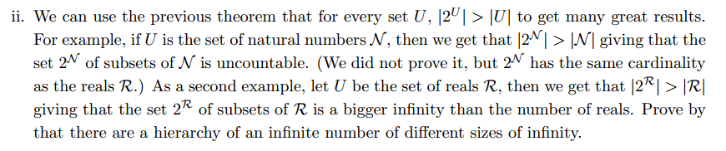
Homework

Slide 42
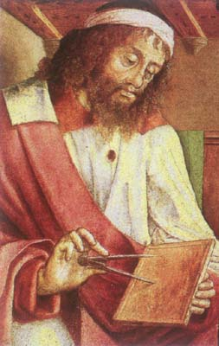

History of Classifying Problems
In the beginning:
Euclid said,
“ Let there be an algorithm for GCD”
And so it was.
GCD(a,b) = GCD(x,y)
<x,y>
⇒ <y,x mod y>
And it was good.
Euclid (300 BC)
He gave a new understanding of
“Algorithm”

Slide 43
History of Classifying Problems
As one gets closer to God,
everything is possible.
We must only learn how to do it.
Unknown
Euclid (300 BC)
Known
GCD

Slide 44
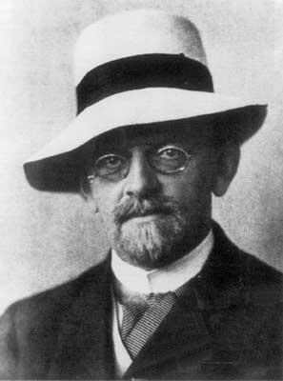
History of Classifying Problems
As one gets closer to God,
everything is possible.
We must only learn how to do it.
Is every thing possible?
Or are some problems
Uncomputable?
Hilbert 1900
Need to formally define
“Algorithm”
Known
GCD

Slide 45
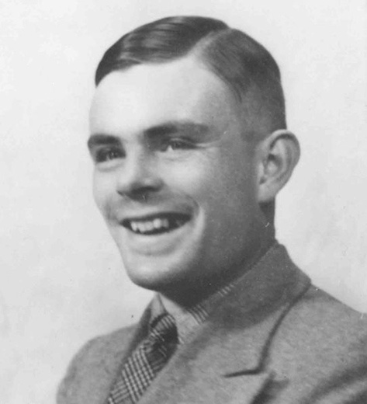
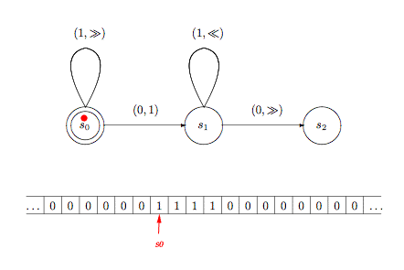
History of Classifying Problems
Computable
A problem is Computable
if it can be computed by a
Turing Machine.
Turing 1936
Need to formally define
“Algorithm”
Known
GCD

Slide 46
History of Classifying Problems
Computable
Halting(M,I)
Turing 1936
Known
Halting Problem:
Does a given algorithm Halt?
GCD

Slide 47
History of Classifying Problems
¬Problem_{diagonal}
Computable
For this, Turing uses only two properties of TMs
Each TM M is described by a finite string “M” (or <M>)
Given a description of a TM M and of an input I,
the output M(I) is well defined,
i.e. M specifies a computational problem P.
Turing 1936
First lets prove that
some other problem
is uncomputable.
Known
GCD

Slide 48
Some Uncomputable Problem
∃P_{hard} ∀M ∃I_{M} M(I_{M})≠P_{hard}(I_{M})
Our goal is to prove that there is
an uncomputable computation problem P_{hard},
i.e. one for which each TM M fails to compute,
because there in an input I_{M} on which
it gives the wrong answer
i.e. M(I_{M})≠P_{hard} (I_{M})
This is stated using the above
first order logic statement.

Slide 49
Some Uncomputable Problem
∃P_{hard} ∀M ∃I_{M} M(I_{M})≠P_{hard}(I_{M})
We give two equivalent proofs:
Proof 1:
  Follow the first order logic game.
  Each TM M is eliminated (wrt P_{hard})
  using its own private nemesis input I_{M}.
Proof 2:
  A TM M is an “integer-like” object.
  A problem P_{hard} is an “real-like” object.
  Hence, we can use the same diagonal proof
  that there are more reals than integers.
Really these two proofs are the same,
so understand one and/or both.

Slide 50
Some Uncomputable Problem
∃P_{hard} ∀M ∃I_{M} M(I_{M})≠P_{hard}(I_{M})
We give two equivalent proofs:
Proof 1:
  How does the first order logic game go?

Slide 51
Some Uncomputable Problem
∃P_{hard} ∀M ∃I_{M} M(I_{M})≠P_{hard}(I_{M})
I give a hard problem P_{hard.}
I have an TM M that I claim solves the problem.
I give an input I_{M}
on which I claim it does not .
I win if M(I_{M})≠P_{hard}(I_{M}).
We say that input I_{M} is
TM M’s nemesis input
eliminating M (wrt P_{hard})

Slide 52
Some Uncomputable Problem
∃P_{hard} ∀M ∃I_{M} M(I_{M})≠P_{hard}(I_{M})
I give a hard problem P_{hard.}
I have an TM M that I claim solves the problem.
Usually I would
choose input I_{M}
after knowing P_{hard} and M.
But instead I am going to choose I_{M} first.

Slide 53
Some Uncomputable Problem
∃P_{hard} ∀M ∃I_{M} M(I_{M})≠P_{hard}(I_{M})
For each TM M,
I choose a nemesis input I_{M}
which will eliminate it
At this point there is nothing special about the choice of I_{M} except it
should be private to M.
The one key property of the TMs
is that each TM M has a finite description “M” identifying it.
It is often dangerous to focus on oneself. Lets make M’s nemesis input be I_{M} =“M”.

Slide 54
Some Uncomputable Problem
∃P_{hard} ∀M ∃I_{M} M(I_{M})≠P_{hard}(I_{M})
Lets make M’s nemesis input be I_{M} =“M”.
I now define the hard problem P_{hard.}
If input I_{M}=“M” is going to eliminating M (wrt P_{hard}),
then we need M(“M”)≠P_{hard}(“M” ).
No problem.
For each input I, I get to design P_{hard}(I).
For I=“M”, I define
P_{hard}(“M”) to be anything but M(“M”)

Slide 55
Some Uncomputable Problem
∃P_{hard} ∀M ∃I_{M} M(I_{M})≠P_{hard}(I_{M})
Enough chat.
Lets actually play proving the game.

Slide 56
Some Uncomputable Problem
∃P_{hard} ∀M ∃I_{M} M(I_{M})≠P_{hard}(I_{M})
I give a hard problem P_{hard.}
For I=“M”, I define
P_{hard}(“M”) to be anything but M(“M”)
I have an TM M that I claim solves the problem.
I give input I_{M} = “M”
on which I claim it does not .
I win because M(“M”)≠P_{hard}(“M”).

Slide 57
Some Uncomputable Problem
∃P_{hard} ∀M ∃I_{M} M(I_{M})≠P_{hard}(I_{M})
Yay! This proves that
there is an uncomputable problem!
Could you now tell me more about
M(“M”) and P_{hard}?

Slide 58
Some Uncomputable Problem
∃P_{hard} ∀M ∃I_{M} M(I_{M})≠P_{hard}(I_{M})
What does TM M do when you feed it a description “M”
of itself as input?
This is not really a problem:
  Compliers can compile themselves.
  Editors can edit the code for the editor.
Run TM M on input “M”.
If M halts and says “yes”, M(“M”) = 1
If M halts and says “no”, M(“M”) = 0
If M runs forever, M(“M”) = 0
Note M “accepts” instead of “decides”.

Slide 59
Some Uncomputable Problem
∃P_{hard} ∀M ∃I_{M} M(I_{M})≠P_{hard}(I_{M})
I define P_{hard} to give the opposite answer:
P_{hard}(“M”) = 0 iff
“M” is a valid description of a TM,
and M on input “M”
halts and says “yes”.
P_{hard}(“M”) = 1 iff
M on input “M” halts and says “no”,
or runs forever
or “M” is not a valid description.
Name this problem ¬Problem_{diagonal}

Slide 60
Some Uncomputable Problem
∃P_{hard} ∀M ∃I_{M} M(I_{M})≠P_{hard}(I_{M})
How is it feasible that a computation problem P_{hard} records what each TM M does on “M”? Is this “well defined”?
We don't have an algorithm that “decides” what M does on“M”, but it is well defined. Because a problem specifies an output for each “integer-like” string, it is a “real-like”
object that can easy record for each “integer-like” TM, what it does on its on description as input.

Slide 61


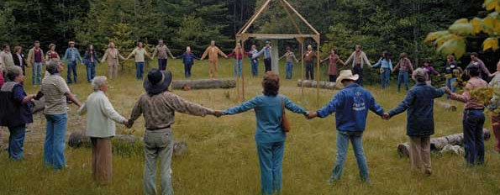
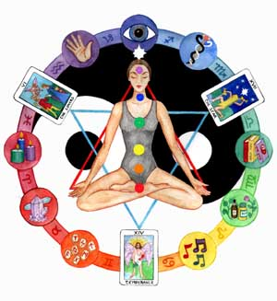
Some Uncomputable Problem
∃P_{hard} ∀M ∃I_{M} M(I_{M})≠P_{hard}(I_{M})
New age people speak of how systems that self reference implode. They are referring to Godel’s incompleteness proof and to this Turing’s uncomputabily proof. What is so special about self reference? In our uncomputability proof, why do we give TM M its own description “M” as input? Could we give it a diﬀerent input instead? What is the relationship we need between M and I_{M}?

Slide 62
Some Uncomputable Problem
∃P_{hard} ∀M ∃I_{M} M(I_{M})≠P_{hard}(I_{M})
I think new age people read too much
into the signiﬁcance of self reference.
For each TM M, we choose a nemesis input I_{M}.
The proof is easier if each M has a private I_{M}.
A property of TMs is that each M has a ﬁnite description “M”.
We use this as I_{M} simply because it is easy.
I_{M} = 2 × “M” would work just as well.

Slide 63
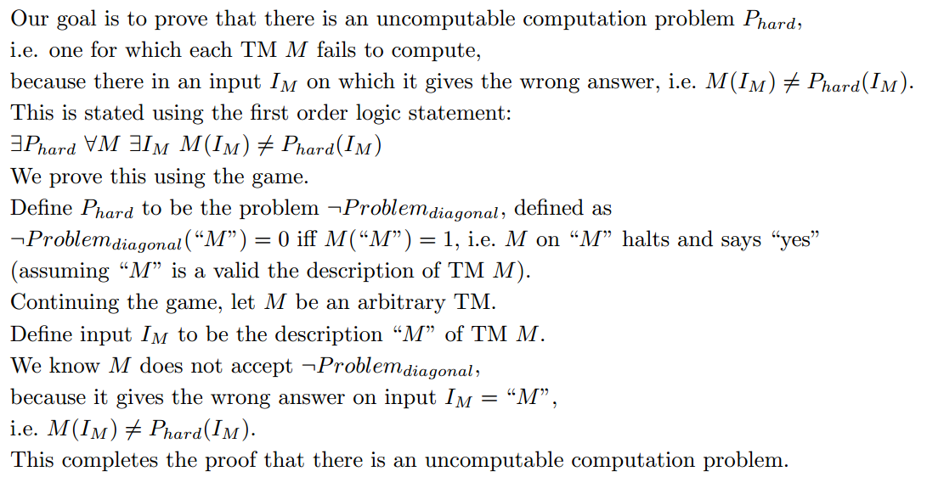
Some Uncomputable Problem
∃P_{hard} ∀M ∃I_{M} M(I_{M})≠P_{hard}(I_{M})

Slide 64
Some Uncomputable Problem
∃P_{hard} ∀M ∃I_{M} M(I_{M})≠P_{hard}(I_{M})
We give two equivalent proofs:
Proof 1:
  Follow the first order logic game.
  Each TM M is eliminated (wrt P_{hard})
  using its own private nemesis input I_{M}.
Proof 2:
  A TM M is an “integer-like” object.
  A problem P_{hard} is an “real-like” object.
  Hence, we can use the same diagonal proof
  that there are more reals than integers.
Really these two proofs are the same,
so understand one and/or both.
Done

Slide 65
Some Uncomputable Problem
∃P ∀M ∃ I M(I)≠P(I)
Construct a computational problem
which no Turing Machine can compute.
or Java program
M₁
M₂
M₃
M₄
M_{i}
Can you list all TM’s M?
Yes, each TM can be described by a finite string.
List them all lexicographically. One per row.
…
…

Slide 66
Some Uncomputable Problem
∃P ∀M ∃ I M(I)≠P(I)
Construct a computational problem
which no Turing Machine can compute.
I₁ I₂ I₃ … I_{i} … I_{j} …
Every input instance can be
described by a finite string.
List them all lexicographically.
One per column.

Slide 67
Some Uncomputable Problem
∃P ∀M ∃ I M(I)≠P(I)
Construct a computational problem
which no Turing Machine can compute.
I₁ I₂ I₃ … I_{i} … I_{j} …
P₁: 0 1 0 … 1 … 0 …
P₂: 1 0 1 … 0 … 0 …
P₃: 0 0 1 … 0 … 1 …
P₄: 1 0 0 … 1 … 0 …
…
A computational problem P
states for every input I_{i}
whether the answer is Yes/No 1/0
Can you list them all?
No, each is defined by an infinite string
and hence there is an uncountable number of them.

Slide 68
Some Uncomputable Problem
∃P ∀M ∃ I M(I)≠P(I)
|Integers|
=
|Fractions|
<<
|Reals|
Each defined by
a finite string
Each defined by
a finite string
Each defined by
an infinite string
<<
Set of TM/Algorithms
Each defined by
a finite string
Countable in size
Set of Comp. Problems
Each defined by
an infinite string
uncountable in set
Most problems
do not have
an algorithm!!!

Slide 69
Some Uncomputable Problem
∃P ∀M ∃ I M(I)≠P(I)
Some problem
Specify one such problem.
Computable
Known
GCD

Slide 70
Some Uncomputable Problem
∃P ∀M ∃ I M(I)≠P(I)
Construct a computational problem
which no Turing Machine can compute.
I₁ I₂ I₃ … I_{i} … I_{j} …
Accepted
P₁: 0 1 0 … 1 … 0 …
Yes instance
➔ Halt and answer “yes”
No instance
➔ Run forever or answer “no”
P₂: 1 0 1 … 0 … 0 …
P₃: 0 0 1 … 0 … 1 …
P₄: 1 0 0 … 1 … 0 …
…
We cannot list all computational problems,
but can we list all those that are “accepted” by a TM?
Yes, the TMs can be listed,
and so can the computable problems.

Slide 71
Some Uncomputable Problem
∃P ∀M ∃ I M(I)≠P(I)
Construct a computational problem
which no Turing Machine can compute.
I₁ I₂ I₃ … I_{i} … I_{j} …
Accepted
M₁ 0 1 0 … 1 … 0 …
Yes instance
➔ Halt and answer “yes”
No instance
➔ Run forever or answer “no”
M₂ 1 0 1 … 0 … 0 …
M₃ 0 0 1 … 0 … 1 …
M₄ 1 0 0 … 1 … 0 …
…
M_{i} 1 0 0 … 1 … 0 …
…
We cannot list all computational problems,
but can we list all those that are “accepted” by a TM?
Yes, the TMs can be listed,
and so can the computable problems.

Slide 72
Some Uncomputable Problem
∃P ∀M ∃ I M(I)≠P(I)
Construct a computational problem
which no Turing Machine can compute.
I₁ I₂ I₃ … I_{i} … I_{j} …
M₁ 0 1 0 … 1 … 0 …
Put a 1 in the matrix
at <i,j> iff
TM M_{i} halts
and says “yes”
on instance I_{j}
M₂ 1 0 1 … 0 … 0 …
M₃ 0 0 1 … 0 … 1 …
M₄ 1 0 0 … 1 … 0 …
…
M_{i} 1 0 0 … 1 … 0 …
…
The i^{th} row is the computation problem “accepted” by TM M_{i}.
All “accepted” problems are listed here.
Our task is to find a problem not listed.

Slide 73
Some Uncomputable Problem
∃P ∀M ∃ I M(I)≠P(I)
Construct a computational problem
which no Turing Machine can compute.
I₁ I₂ I₃ … I_{i} … I_{j} …
M₁ 0 1 0 … 1 … 0 …
Put a 1 in the matrix
at <i,j> iff
TM M_{i} halts
and says “yes”
on instance I_{j}
M₂ 1 0 1 … 0 … 0 …
M₃ 0 0 1 … 0 … 1 …
M₄ 1 0 0 … 1 … 0 …
…
M_{i} 1 0 0 … 1 … 0 …
…
This diagonal defines
a computational problem.
Which?
Problem_{diagonal}(I_{i}) = 1 iff M_{i}(I_{i}) halts and says “yes”

Slide 74
Some Uncomputable Problem
∃P ∀M ∃ I M(I)≠P(I)
Construct a computational problem
which no Turing Machine can compute.
I₁ I₂ I₃ … I_{i} … I_{j} …
M_{i} is the i^{th} TM.
What does this mean?
Let say that it is the one described by the i^{th} string.
If this is not a valid TM,
then assume M_{i} always outputs 0.
M₁ 0 1 0 … 1 … 0 …
M₂ 1 0 1 … 0 … 0 …
M₃ 0 0 1 … 0 … 1 …
M₄ 1 0 0 … 1 … 0 …
…
M_{i} 1 0 0 … 1 … 0 …
…
Problem_{diagonal}(I_{i}) = 1 iff M_{i}(I_{i}) halts and says “yes”

Slide 75
Some Uncomputable Problem
∃P ∀M ∃ I M(I)≠P(I)
Construct a computational problem
which no Turing Machine can compute.
I₁ I₂ I₃ … I_{i} … I_{j} …
I_{i} is the i^{th} input.
It too is described by
the i^{th} string.
M₁ 0 1 0 … 1 … 0 …
M₂ 1 0 1 … 0 … 0 …
M₃ 0 0 1 … 0 … 1 …
M₄ 1 0 0 … 1 … 0 …
…
M_{i} 1 0 0 … 1 … 0 …
…
Problem_{diagonal}(I_{i}) = 1 iff M_{i}(I_{i}) halts and says “yes”

Slide 76
Some Uncomputable Problem
∃P ∀M ∃ I M(I)≠P(I)
Construct a computational problem
which no Turing Machine can compute.
I₁ I₂ I₃ … I_{i} … I_{j} …
M₁ 0 1 0 … 1 … 0 …
Hence, M_{i} and I_{i} are
described by the same string,
one interpreted as a TM
and the other as an input.
M₂ 1 0 1 … 0 … 0 …
M₃ 0 0 1 … 0 … 1 …
M₄ 1 0 0 … 1 … 0 …
…
Let “M” denote the description of TM M.
M_{i} 1 0 0 … 1 … 0 …
…
Problem_{diagonal}(I_{i}) = 1 iff M_{i}(I_{i}) halts and says “yes”
Problem_{diagonal}(“M”) = 1 iff M(“M”) halts and says “yes”

Slide 77
Some Uncomputable Problem
∃P ∀M ∃ I M(I)≠P(I)
Construct a computational problem
which no Turing Machine can compute.
I₁ I₂ I₃ … I_{i} … I_{j} …
M₁ 0 1 0 … 1 … 0 …
Hence, M_{i} and I_{i} are
described by the same string,
one interpreted as a TM
and the other as an input.
M₂ 1 0 1 … 0 … 0 …
M₃ 0 0 1 … 0 … 1 …
M₄ 1 0 0 … 1 … 0 …
…
M_{i} 1 0 0 … 1 … 0 …
…
Problem_{diagonal}(I_{i}) = 1 iff M_{i}(I_{i}) halts and says “yes”
Problem_{diagonal}(“M”) = 1 iff M(“M”) halts and says “yes”
Compliers can compile themselves.
Editors can edit the code for the editor.

Slide 78
Some Uncomputable Problem
∃P ∀M ∃ I M(I)≠P(I)
Surely this computational problem is easy ???
We are able to simulate a TM M on an input I.
i.e. there is a TM Universal_{TM}(“M”,I )
that does whatever M(I) does:
- Halt and say “yes”
- Halt and say “no”
- Run forever.
Time to simulate T(|I|) steps is c|“M”| × T(|I|).
Problem_{diagonal}(“M”) = 1 iff M(“M”) halts and says “yes”
“Accepted” by Universal_{TM}(“M”,“M”)

Slide 79
Halting Problem
Acceptable
∃P ∀M ∃ I M(I)≠P(I)
Co-Acceptable
Yes instance
➔ Halt and answer “yes”
No instance
➔ Run forever or answer “no”
Yes instance
➔ Run forever or answer “yes”
No instance
➔ Halt and answer “no”
Problem_{diagonal}
Computable
Yes instance
➔ Halt and answer “yes”
No instance
➔ Halt and answer “no”
Problem_{diagonal}(“M”) = 1 iff M(“M”) halts and says “yes”
¬ Problem_{diagonal}
“Accepted” by Universal_{TM}(“M”,“M”)

Slide 80
Some Uncomputable Problem
∃P ∀M ∃ I M(I)≠P(I)
Construct a computational problem
which no Turing Machine can compute.
I₁ I₂ I₃ … I_{i} … I_{j} …
1
Claim: No TM “accepts”
¬Problem_{diagonal}
M₁ 0 1 0 … 1 … 0 …
1
M₂ 1 0 1 … 0 … 0 …
0
M₃ 0 0 1 … 0 … 1 …
M₄ 1 0 0 … 1 … 0 …
…
0
M_{i} 1 0 0 … 1 … 0 …
…
Problem_{diagonal}(“M”) = 1 iff M(“M”) halts and says “yes”
Strangely, this problem is listed here.
Its negation is not.

Slide 81
Some Uncomputable Problem
∃P ∀M ∃ I M(I)≠P(I)
Construct a computational problem
which no Turing Machine can compute.
I₁ I₂ I₃ … I_{i} … I_{j} …
1
Claim: No TM “accepts”
¬Problem_{diagonal}
Proof: Continue
the game ∀M ∃ I.
Adversary give TM M.
I give input I=“M”.
M gives the wrong answer
on instance “M”.
M₁ 0 1 0 … 1 … 0 …
1
M₂ 1 0 1 … 0 … 0 …
0
M₃ 0 0 1 … 0 … 1 …
M₄ 1 0 0 … 1 … 0 …
…
0
M_{i} 1 0 0 … 1 … 0 …
…
Problem_{diagonal}(“M”) = 1 iff M(“M”) halts and says “yes”
M(“M”) halts and says “yes”
iff Problem_{diagonal}(“M”) = 1
iff ¬Problem_{diagonal} (“M”) = 0

Slide 82
Halting Problem
Acceptable
∃P ∀M ∃ I M(I)≠P(I)
Co-Acceptable
Yes instance
➔ Halt and answer “yes”
No instance
➔ Run forever or answer “no”
Yes instance
➔ Run forever or answer “yes”
No instance
➔ Halt and answer “no”
Problem_{diagonal}
¬ Problem_{diagonal}
Computable
Yes instance
➔ Halt and answer “yes”
No instance
➔ Halt and answer “no”
Specify one such problem
that is a little nicer.

Slide 83
Some Uncomputable Problem
∃P_{hard} ∀M ∃I_{M} M(I_{M})≠P_{hard}(I_{M})

Slide 84
Some Uncomputable Problem
∃P_{hard} ∀M ∃I_{M} M(I_{M})≠P_{hard}(I_{M})
We give two equivalent proofs:
Proof 1:
  Follow the first order logic game.
  Each TM M is eliminated (wrt P_{hard})
  using its own private nemesis input I_{M}.
Proof 2:
  A TM M is an “integer-like” object.
  A problem P_{hard} is an “real-like” object.
  Hence, we can use the same diagonal proof
  that there are more reals than integers.
Really these two proofs are the same,
so understand one and/or both.
Done

Slide 85
Some Uncomputable Problem
∃P_{hard} ∀M ∃I_{M} M(I_{M})≠P_{hard}(I_{M})
Compare the first order logic of
  there are more reals than integers.
  There is an uncomputable problem.
∀List, ∃xϵR, ∀iϵN ∃dϵN, List(i)_{d} ≠ x_{d}
∃P_{hard} ∀M ∃I_{M} M(I_{M})≠P_{hard}(I_{M})
A problem P_{hard} is an “real-like” object.

Slide 86
Some Uncomputable Problem
∃P_{hard} ∀M ∃I_{M} M(I_{M})≠P_{hard}(I_{M})
Compare the first order logic of
  there are more reals than integers.
  There is an uncomputable problem.
∀List, ∃xϵR, ∀iϵN ∃dϵN, List(i)_{d} ≠ x_{d}
∃P_{hard} ∀M ∃I_{M} M(I_{M})≠P_{hard}(I_{M})
A TM M is an “integer-like” object.

Slide 87
Some Uncomputable Problem
∃P_{hard} ∀M ∃I_{M} M(I_{M})≠P_{hard}(I_{M})
Compare the first order logic of
  there are more reals than integers.
  There is an uncomputable problem.
∀List, ∃xϵR, ∀iϵN ∃dϵN, List(i)_{d} ≠ x_{d}
∃P_{hard} ∀M ∃I_{M} M(I_{M})≠P_{hard}(I_{M})
An input I is an “integer-like” object.

Slide 88
Some Uncomputable Problem
∃P_{hard} ∀M ∃I_{M} M(I_{M})≠P_{hard}(I_{M})
Compare the first order logic of
  there are more reals than integers.
  There is an uncomputable problem.
List maps integers i to reals x.
maps TM M to problems P.
∀List, ∃xϵR, ∀iϵN ∃dϵN, List(i)_{d} ≠ x_{d}
?
∃P_{hard} ∀M ∃I_{M} M(I_{M})≠P_{hard}(I_{M})
∀ model of computation in which
each machine M
specifies a problem P that it accepts
and has a finite description “M”.

Slide 89
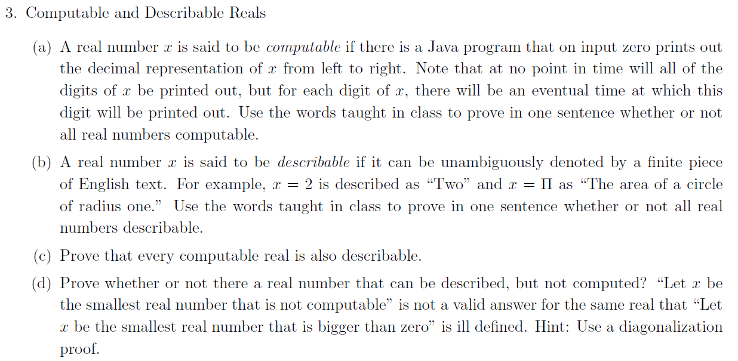
Homework

Slide 90
Halting Problem
You boss asks:
Given a computer program, will it halt?
Everyday industry asks these questions.

Slide 91
Halting Problem
loop a = 1 … 1,000,000
s := s+a
end loop
Halts
loop a > 0
s := s+a
end loop
Does not halt

Slide 92
Halting Problem
loop a,b,c,z > 2
  exit when a^{z} + b^{z} = c^{z}
end loop
Proof of not halting =
Proof of
Fermat’s Last Theorem
loop
  chaotic behavior
  exit when
  special event
end loop
Chaotic behavior =
not knowing what it will do without doing it.
How can we know it will not halt without running it forever?

Slide 93
Halting Problem
loop a,b,c,z > 2
  exit when a^{z} + b^{z} = c^{z}
end loop
Proof of not halting =
Proof of
Fermat’s Last Theorem
F(x,y)
z = x + yi
loop
  z = z² + c
  exit when
  converges
end loop
Chaotic behavior =
not knowing what it will do without doing it.
How can we know it will not halt without running it forever?

Slide 94

Halting Problem
F(x,y)
z = x + yi
loop
  z = z² + c
  exit when
  converges
end loop

Slide 95
Halting Problem
Each “class” of program
can understand programs
from previous class
but not necessity
from its own class.
loop
  chaotic behavior
  exit when
  special event
end loop
loop a,b,c,z > 2
  exit when a^{z} + b^{z} = c^{z}
end loop
Mathematicians
know if these halt
loop a > 0
s := s+a
end loop
TAs
know if these halt
loop a = 1 … 1,000,000
s := s+a
end loop
1st year students
know if these halt

Slide 96
Halting Problem
loop
  chaotic behavior
  exit when
  special event
end loop
For every algorithm
there is some program
for which it
can't know if it halts.
loop a,b,c,z > 2
  exit when a^{z} + b^{z} = c^{z}
end loop
Mathematicians
know if these halt
loop a > 0
s := s+a
end loop
TAs
know if these halt
loop a = 1 … 1,000,000
s := s+a
end loop
1st year students
know if these halt

Slide 97

Halting Problem
∀M ∃ I M(I)≠Halting(I)
Sorry. No algorithm exists that tells you for every computer program whether it halts!
i.e. No program that
on every input
halts and gives
the correct answer.
We give two proofs.
Hopefully you like at least one.

Slide 98
Halting Problem
∀M ∃ I M(I)≠Halting(I)
¬Problem_{diagonal}(“M”) = 0 iff M(“M”) halts and says “yes”
Proof by Reduction that is Halt(“M”,I) undecidable:
Suppose there was a working algorithm:
  Halt(“M”,I) = whether program M halts on input I.
M_{¬Diagonal}(“M”):
if ( Halt(“M”, “M”) ) % Know M halts on “M”
if( Universal_{TM}( M(“M”) )= says “yes” )
return(0)
else return(1)
else return(1)
Claim: M_{¬Diagonal}(“M”) halts for each “M”
and solves ¬Problem_{diagonal}(“M”)
Contradiction!
But we proved that is was undecidable!

Slide 99
Halting Problem
Second,
One page proof.
∀M ∃ I M(I)≠Halting(I)
Suppose there was a working algorithm:
  Halt(M,I) = whether program M halts on input I
Construct from it another algorithm:
  Nhalt(M) = if(Halt(M,M)) loop forever
  else halt
  = halts ↔ program M does not halt on input M.
Paradox: Nhalt(Nhalt) = ?
program Nhalt halts on input Nhalt
↔
program Nhalt does not halt on input Nhalt
Contradiction!

Slide 100
Halting Problem
Acceptable
∃P ∀M ∃ I M(I)≠P(I)
Co-Acceptable
Yes instance
➔ Halt and answer “yes”
No instance
➔ Run forever or answer “no”
Yes instance
➔ Run forever or answer “yes”
No instance
➔ Halt and answer “no”
Problem_{diagonal}
¬ Problem_{diagonal}
Or any other useful thing about what the program does.
Computable
Yes instance
➔ Halt and answer “yes”
No instance
➔ Halt and answer “no”
  Does program P output 5
  on input I
Halting

Slide 101
Halting Problem
∃P ∀M ∃ I M(I)≠P(I)
The proof for ¬Problem_{diagonal} (“M”)
used only two properties of TMs
Each TM M is described by a finite string “M”.
Given a description “M” of a TM and of an input I,
the output M(I) is well defined.
The proof for Halting(“M”,I)
used two more properties of TMs
There is a TM Universal_{TM}(“M”,I ).
You can build one TM from another.
Which models of computation have these properties?
TM, Java, Recursive, Register Machines, ….

Slide 102
Halting Problem
∃P ∀M ∃ I M(I)≠P(I)
The proof for ¬Problem_{diagonal} (“M”)
used only two properties of TMs
Each TM M is described by a finite string “M”.
Given a description “M” of a TM and of an input I,
the output M(I) is well defined.
Yes
Yes
The proof for Halting(“M”,I)
used two more properties of TMs
There is a TM Universal_{TM}(“M”,I ).
You can build one TM from another.
No
Yes
Which models of computation have these properties?
Primitive Recursive Program?

Slide 103
Halting Problem
∃P ∀M ∃ I M(I)≠P(I)
If Universal_{PRP} has k levels of recursion,
then its running time is bounded by Ackermann_{k}(n)
If M_{PRP} has k+1 levels of recursion,
then it must be simulated for time Ackermann_{k+1}(n)
There is a PRP Universal_{PRP}(“M_{PRP}”,I ).
No
Primitive Recursive Program?

Slide 104
Halting Problem
Acceptable
∃P ∀M ∃ I M(I)≠P(I)
Co-Acceptable
Yes instance
➔ Halt and answer “yes”
No instance
➔ Run forever or answer “no”
Yes instance
➔ Run forever or answer “yes”
No instance
➔ Halt and answer “no”
Problem_{diagonal}
¬ Problem_{diagonal}
Computable
Yes instance
➔ Halt and answer “yes”
No instance
➔ Halt and answer “no”
M_{PRP} definitely halts
so the answer is “yes”
Halting_{PRP}( M_{PRP},I ).

Slide 105
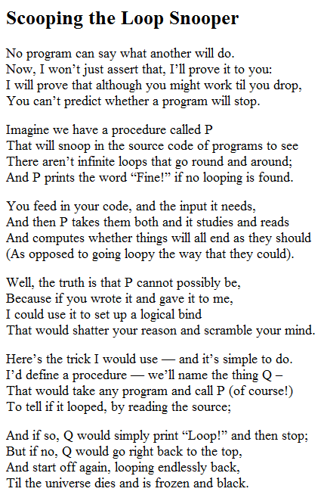
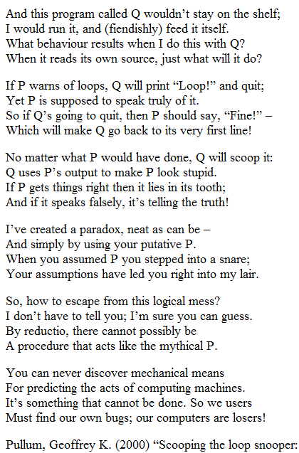
Halting Problem

Slide 106
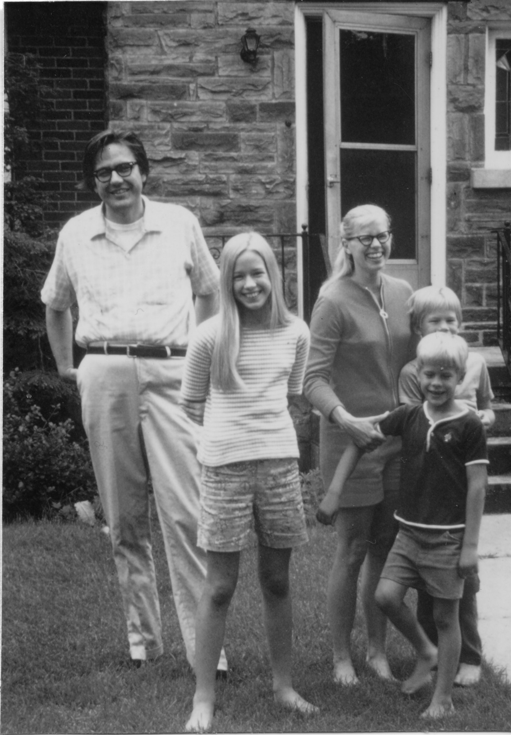
History of Classifying Problems
Computable
Halting
Exp
Time: input size ⇒ running time
For large n, n¹⁰⁰ << 2^{n}
Poly
Jack Edmonds 1965
Known
GCD

Slide 107
Time Hierarchy
The set of computational problems
computable in time T(n).
Computable
Exp
And in time ωT(n)log(T(n)).
ωT(n)log(T(n)) time
T(n) time
Here T(n) is an
arbitrary function.
Poly
Known
GCD

Slide 108
Time Hierarchy
Is there a computational problem
computable in time ωT(n)log(T(n))
but not in time T(n)?
Computable
Exp
ωT(n)log(T(n)) time
Yes!
Some problem
T(n) time
Poly
Known
GCD

Slide 109
Time Hierarchy
Construct a computational problem
for which no Turing Machine computes it in time T(n).
I₁ I₂ I₃ … I_{j} …
M₁
M₂
M₃
M₄
M_{i}
Put a 1 in the matrix at <i,j> iff
TM M_{i} outputs “1” on instance I_{j}
within time T(n).
…
1
…

Slide 110
Time Hierarchy
Construct a computational problem
for which no Turing Machine computes it in time T(n).
I₁ I₂ I₃ … I_{i} …
M₁
M₂
M₃
M₄
M_{i}
Problem_{diagonal} (“M”)=1
iff M(“M”) halts in time T(n)
with “yes”.
But want is n?
The input is the TM “M”.
We want |“M”| to be constant
as n grows.
…
1
…
Problem_{diagonal} (“MI”)=1
iff M(“MI”) halts in time T(n)
with “yes”.
n = |“MI”|

Slide 111
Time Hierarchy
Construct a computational problem
for which no Turing Machine computes it in time T(n).
I₁ I₂ I₃ … I_{i} …
M₁
M₂
M₃
M₄
M_{i}
Problem_{diagonal} (“MI”)=1
iff M(“MI”) halts in time T(n)
with “yes”.
Claim: No TM decides
¬Problem_{diagonal} in time T(n).
…
1
…
Proof: TM M gives the wrong answer on instance M
or takes more than T(n) time.
M(“MI”) halts in time T(n) and says “yes”
➔ Problem_{diagonal}(“MI”) = 1
➔¬Problem_{diagonal} (“MI”) = 0
➔ wrong answer

Slide 112
Time Hierarchy
Construct a computational problem
for which no Turing Machine computes it in time T(n).
I₁ I₂ I₃ … I_{i} …
M₁
M₂
M₃
M₄
M_{i}
Problem_{diagonal} (“MI”)=1
iff M(“MI”) halts in time T(n)
with “yes”.
Claim: No TM decides
¬Problem_{diagonal} in time T(n).
…
1
…
Proof: TM M gives the wrong answer on instance M
or takes more than T(n) time.
M(“MI”) halts in time T(n) and says “no”
➔ Problem_{diagonal}(“MI”) = 0
➔¬Problem_{diagonal} (“MI”) = 1
➔ wrong answer

Slide 113
Time Hierarchy
Construct a computational problem
for which no Turing Machine computes it in time T(n).
I₁ I₂ I₃ … I_{i} …
M₁
M₂
M₃
M₄
M_{i}
Problem_{diagonal} (“MI”)=1
iff M(“MI”) halts in time T(n)
with “yes”.
Claim: No TM decides
¬Problem_{diagonal} in time T(n).
…
1
…
Proof: TM M gives the wrong answer on instance M
or takes more than T(n) time.
M(“MI”) takes more than time T(n).
➔ Uses too much time.

Slide 114
Time Hierarchy
¬Problem_{diagonal} (“MI”)=0
iff M(“MI”) halts in time T(n) with “yes”.
Claim: No TM decides ¬Problem_{diagonal} in time T(n).

Slide 115
Time Hierarchy
¬Problem_{diagonal} (“MI”)=0
iff M(“MI”) halts in time T(n) with “yes”.
Claim: There is a TM that decides ¬Problem_{diagonal}
in time ωT(n)log(T(n)).
On input “MI”,
simulate M on “MI” for T(n) time
and output “no”
iff M has halted and has output “yes”.
Simulation time by TM_{Universal}(“M”,I) is O(|“M”|×T(|I|)).
= ωT(n)
Funny |“M”| does not grow with n,
but neither is it bounded by any fixed constant c.
So we will bound it by ω, which grows faster than c.

Slide 116
Time Hierarchy
¬Problem_{diagonal} (“MI”)=0
iff M(“MI”) halts in time T(n) with “yes”.
Claim: There is a TM that decides ¬Problem_{diagonal}
in time ωT(n)log(T(n)).
On input “MI”,
simulate M on “MI” for T(n) time
and output “no”
iff M has halted and has output “yes”.
Simulation time by TM_{Universal}(“M”,I) is O(|“M”|×T(|I|)).
= ωT(n)
+ O(T(n)log(T(n)))
But TM_{Universal} also takes O(log(T(n))) time
to increment the time counter
for a total of O(T(n)log(T(n))) time.

Slide 117
Time Hierarchy
Specify one such problem
that is a little nicer.
Computable
Exp
No idea!!
ωT(n)log(T(n)) time
Problem_{diagonal}
T(n) time
Poly
Known
GCD

Slide 118
Done

Slide 119
Countable Infinity
A set S is called countable if |S| ≤ |N|
|S| = |{ , 4, , ….. }|
≤ |{ 1, 2, 3, 4, 5, … }| = |N|
Note a finite set is countable.
A set S is called countably infinite if also |S| ≥ |N| .

Slide 120
Countable Infinity
A set S is called countable if |S| ≤ |N|
|S| = |{ , 4, , ….. }|
≤ |{ 1, 2, 3, 4, 5, … }| = |N|
Prove this with a function F from xϵS to the iϵN.
Is it ok that some xϵS is not mapped?
No, or else |S| might be bigger.

Slide 121
Countable Infinity
A set S is called countable if |S| ≤ |N|
|S| = |{ , 4, , ….. }|
≤ |{ 1, 2, 3, 4, 5, … }| = |N|
Prove this with a function F from xϵS to the iϵN.
Is it ok if some iϵN is mapped to twice?
No, or else |S| might be larger.

Slide 122
Countable Infinity
A set S is called countable if |S| ≤ |N|
|S| = |{ , 4, , ….. }|
≤ |{ 1, 2, 3, 4, 5, … }| = |N|
Prove this with a function F from xϵS to the iϵN.
Is it ok if the same xϵS is mapped from more than once?
Yes: as this only makes seem |N| bigger.

Slide 123
Countable Infinity
A set S is called countable if |S| ≤ |N|
|S| = |{ , 4, , ….. }|
≤ |{ 1, 2, 3, 4, 5, … }| = |N|
Prove this with a function F from xϵS to the iϵN.
Is it ok if some iϵN is not mapped to?
Yes, as this only makes seem |N| bigger.

Slide 124
Countable Infinity
A set S is called countable if |S| ≤ |N|
|S| = |{ , 4, , ….. }|
≤ |{ 1, 2, 3, 4, 5, … }| = |N|
Prove this with a function F from xϵS to the iϵN.
Such a function F is called?
Injective
∃F,∀xϵS, F(x)ϵN and ∀x,yϵS, x≠y ⇒ F(x)≠F(y)

Slide 125
Countable Infinity
A set S is called countable if |S| ≤ |N|
|S| = |{ , 4, , ….. }|
≤ |{ 1, 2, 3, 4, 5, … }| = |N|
∃F,∀xϵS, F(x)ϵN and ∀x,yϵS, x≠y ⇒ F(x)≠F(y)
How best to prove
this part?
Typical method is to define the inverse function F⁻¹(i)=x.
∃F, ∃List, ∀xϵS, F(x)ϵN and F⁻¹(F(x)) = x
F⁻¹(F( )) =
F⁻¹(3) =
≠

Slide 126
Countable Infinity
A set S is called countable if |S| ≤ |N|
|S| = |{ , 4, , ….. }|
≤ |{ 1, 2, 3, 4, 5, … }| = |N|
∃F,∀xϵS, F(x)ϵN and ∀x,yϵS, x≠y ⇒ F(x)≠F(y)
∃F, ∃F⁻¹, ∀xϵS, F(x)ϵN and F⁻¹(F(x)) = x
This last one can be simplified by replacing F(x) with i.
∃F⁻¹, ∀xϵS, ∃ iϵN F⁻¹(i) = x

Slide 127
Countable Infinity
A set S is called countable if |S| ≤ |N|
|S| = |{ , 4, , ….. }|
≤ |{ 1, 2, 3, 4, 5, … }| = |N|
∃F,∀xϵS, F(x)ϵN and ∀x,yϵS, x≠y ⇒ F(x)≠F(y)
∃F, ∃F⁻¹, ∀xϵS, F(x)ϵN and F⁻¹(F(x)) = x
∃F⁻¹, ∀xϵS, ∃ iϵN F⁻¹(i) = x
This one is useful.
each integer i is able to hit at most one element xϵS.
If this can hit every element of element xϵS,
then |S| ≤ |N|.
With F⁻¹(i) = x,

Slide 128
Countable Infinity
A set S is called countable if |S| ≤ |N|
|S| = |{ , 4, , ….. }|
≤ |{ 1, 2, 3, 4, 5, … }| = |N|
∃F,∀xϵS, F(x)ϵN and ∀x,yϵS, x≠y ⇒ F(x)≠F(y)
∃F, ∃F⁻¹, ∀xϵS, F(x)ϵN and F⁻¹(F(x)) = x
∃F⁻¹, ∀xϵS, ∃ iϵN F⁻¹(i) = x
So sorry for having three first order logic definition
for the same thing.
Formal definition
Good for proving F(x)≠F(y)
Good for proving no such F.

