Slide 1
4111 Computability
Complexity Classes
Computable_{Halting}
Acceptable, Witness, Enumerable
Computable
Ackermann's Time
Double Exponential Time
E: Exponential Time
Exp Time
PSpace
PH: Poly-Time Hierarchy
NP & Co-NP
Poly-Time
NC: Poly-log depth Circuits
NC2
NL: Non-Det Log Space
L: Log-Space
AC⁰, Thres⁰, Arith⁰: Constant Depth
NC⁰: Constant Fan-out
Jeff Edmonds
York University
Lecture 2
COSC 4111

Slide 2
Complexity Classes
Computable
A complexity class is
a set of computational problems
that have a similar difficulty in computing them.
Design a new class:
Choose some model
  Java or Circuits
Deterministic or Nondeterministic
Limit some resource
  Time or Space
  to Log, Poly, Exp, ….
Exp
NP
Co-NP
Poly

Slide 3
Complexity Classes
Computable
A complexity class is
a set of computational problems
that have a similar difficulty in computing them.
We will start with a small weak class
and work our way up.
Each will be a super set of the previous
Proving C₁ ⊆ C₂ is not too hard.
Prove C₂ can simulate C₁.
Proving C₁ ⊆ C₂ is hard.
Prove P ϵ C₂ and P ϵ C₁.
Exp
NP
Co-NP
(unless pointed out)
Poly

Slide 4
Complexity Classes
Computable
A complexity class is
a set of computational problems
that have a similar difficulty in computing them.
A problem is complete for a class
if being able to solve this problem fast means that you can solve every problem in the class fast.
Exp
NP
Co-NP
complete
Poly

Slide 5
NC⁰
NC⁰ = Set of computational problems computed by
circuits of and/or/not gates each with two inputs
of constant depth.
  Each output bit can only depend on
  a constant number of the input bits.
  But can compute any function of these bits.
constant
x₄₃
x₂₅
x₃₁
AND
AND
OR
constant
OR
NOT
NC is short for
“Nick’s Class”
after Nick Pippenger
OR

Slide 6
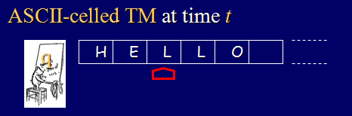
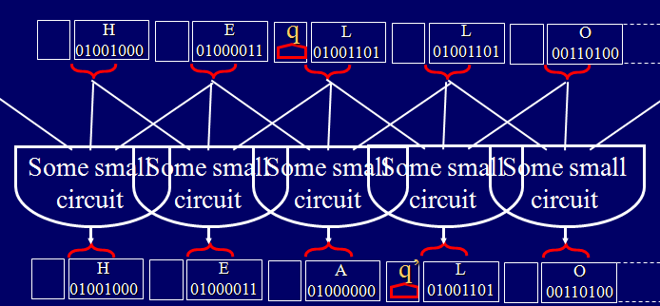
NC⁰
NC⁰ = Set of computational problems computed by
circuits of and/or/not gates each with two inputs
of constant depth.
  Eg: It can compute the next configuration of a TM.

Slide 7
AC⁰
AC⁰ = Set of computational problems computed by
circuits of and/or/not gates each arbitrary fan-in
of constant depth and poly-size.
= circuits of and/or/not gates each with two inputs
any depth
but constant # of alternations between and & or.
  Arbitrary fan-in means can depend on all the input bits.
x₁ ¬x₂ x₃ …¬x_{n}
¬x₁ x₂ ¬x₃ … x_{n}
x₁ x₂ ¬x₃ … ¬x_{n}
AND
AND
…
AND
constant
OR
AC is short for
“Alternations Class”

Slide 8
AC⁰
AC⁰ = Set of computational problems computed by
circuits of and/or/not gates each arbitrary fan-in
of constant depth and poly-size.
  Depth 2 and 2^{n} size can compute any function
  but this needs poly-size.
  It can’t compute the parity of the input bits
  because this requires log n alternations of and & or.
  Parity is needed for counting & adding.
x₁ ¬x₂ x₃ …¬x_{n}
¬x₁ x₂ ¬x₃ … x_{n}
x₁ x₂ ¬x₃ … ¬x_{n}
AND
AND
…
AND
constant
OR

Slide 9
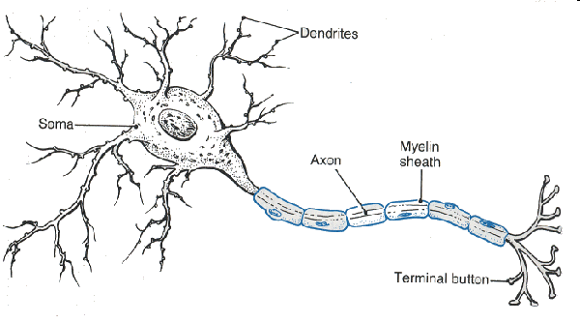
Threshold⁰ (Neural Net)
Threshold⁰ = Set of computational problems computed by
circuits of threshold gates each arbitrary fan-in
of constant depth and poly-size.
  Early AI used them to build neural net
  with a constant number of hidden levels.
  Theoreticians say they are more powerful than and/or/not,
  but they still can’t compute parity.
  But they do manage to predict if your credit card is stolen.
x₁ x₂ x₃ … x_{n}
w₁ w₂ w₃ … w_{n}
constant
Threshold
T
y = 1
iff
Σ_{i} w_{i}×x_{i} ≥ T
y

Slide 10
Arithmetic⁰
Arithmetic⁰ = Set of computational problems computed by
circuits of +, -, ×, /, =, and ≤ gates each arbitrary fan-in
of constant depth and poly-size
real value on each wire.
  What you can do on a calculator
  with a constant number of key strokes.
constant
x₄₃
x₂₅
x₅₁
+
×
+
constant
constant
×
-
/

Slide 11
NC¹
NC¹ = Set of computational problems computed by
circuits of and/or/not gates each with two inputs
of constant O(logn) depth.
  Each output bit can depend on all input bits.
  Can add, multiply, divide, …
all
x₁
x₂
…
x_{n}
AND
AND
OR
O(logn)
OR
NOT
NC^{k} allows depth
O((logn)^{k})
OR

Slide 12
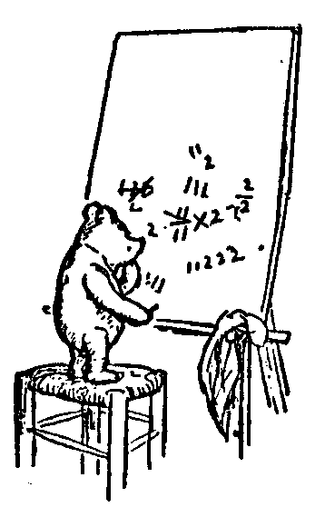
Log-Space
L = Set of computational problems computed by
a TM with a read-only tape for the input
and a O(log(n)) cell work tape.
  clog(n) cells ➔ 2^{clog(n)} = n^{c} configurations
  ➔ at most n^{c} time or cycles forever.
  Often used for to represent low level computation
    Producing inputs for reductions
    Producing the n^{th} uniform circuits.
TM
n
x₁
x₂
x₃
x₄
…
x_{n}
q
O(log(n))
0
1
1
0

Slide 13
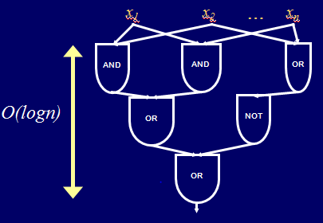
Log-Space
L = Set of computational problems computed by
a TM with a read-only tape for the input
and a O(log(n)) cell work tape.
  Can compute everything in NC₁.
    Do depth first search
    Remember the values
    along the path to the root.
TM
n
x₁
x₂
x₃
x₄
…
x_{n}
q
O(log(n))
0
1
1
0

Slide 14
Log-Space
L = Set of computational problems computed by
a TM with a read-only tape for the input
and a O(log(n)) cell work tape.
  Can compute every regular language, eg 0*1*
    Read input once
    Remember which state the Finite State Automata is in.
    Actually only O(1) space is needed.
TM
n
x₁
x₂
x₃
x₄
…
x_{n}
q
O(1)
O(log(n))
0
1
1
0

Slide 15
Log-Space
L = Set of computational problems computed by
a TM with a read-only tape for the input
and a O(log(n)) cell work tape.
  Can solve undirected st-connectivity
    Use log(n) bits to remember location of “pebble”
    Walk the pebble “randomly” from s looking for t.
s
t

Slide 16
Log-Space
L = Set of computational problems computed by
a TM with a read-only tape for the input
and a O(log(n)) cell work tape.
  Likely cannot solve directed st-connectivity
    Constant number of “pebbles” get stuck.
    This requires O(log²(n)) space
s
t

Slide 17
Non-Deterministic Log-Space
NL = Set of computational problems computed by
a non-deterministic TM
with a read-only tape for the input
and a O(log(n)) cell work tape.
  Fairy Godmother tells you which step to take
  if possible to get to an accepting computation.
TM
n
x₁
x₂
x₃
x₄
…
x_{n}
q
O(log(n))
0
1
1
0

Slide 18
Non-Deterministic Log-Space
NL = Set of computational problems computed by
a non-deterministic TM
with a read-only tape for the input
and a O(log(n)) cell work tape.
  Can solve directed st-connectivity
    Use log(n) bits to remember location of “pebble”
    Fairy Godmother tells you which edge to take
    if possible to get to t.
(NL-complete)
s
t

Slide 19
Non-Deterministic Log-Space
NL = Set of computational problems computed by
a non-deterministic TM
with a read-only tape for the input
and a O(log(n)) cell work tape.
  Directed st-connectivity is complete for NL.
    If I can do directed st-connectivity fast
    ➔ I can do all problems P∈NL fast.

Slide 20

NL Complete
P∈NL ➔ Non-Det Log-Space TM M_{P} computes P
➔ I can compute P fast
using this fast algorithm for directed st-connectivity.
P(I) is true
or not
I
Directed graph G
BUILD:
Oracle for P
GIVEN:
Oracle for directed
st-conn
Yes, there is a path in G
from s to t or not.

Slide 21
NL Complete
P∈NL ➔ Non-Det Log-Space TM M_{P} computes P
➔ I can compute P fast
using this fast algorithm for directed st-connectivity.
I
Directed graph G =
Nodes are the configs of M_{P}
At most clogn cells
➔ at most 2^{clogn} = n^{c} configs
➔ at most 2^{clogn} = n^{c} nodes
BUILD:
Oracle for P
GIVEN:
Oracle for directed
st-conn

Slide 22
NL Complete
P∈NL ➔ Non-Det Log-Space TM M_{P} computes P
➔ I can compute P fast
using this fast algorithm for directed st-connectivity.
I
Directed graph G =
Nodes are the configs of M_{P}
Directed edge <u,v>
M_{P} could transition from u to v
Because non-deterministic,
out degree ≥ 1
BUILD:
Oracle for P
GIVEN:
Oracle for directed
st-conn

Slide 23
NL Complete
P∈NL ➔ Non-Det Log-Space TM M_{P} computes P
➔ I can compute P fast
using this fast algorithm for directed st-connectivity.
P(I) is true
or not
I
Directed graph G =
Nodes are the configs of M_{P}
Directed edge <u,v>
M_{P} could transition from u to v
s is the start configuration
of M on I
t is the accepting configuration
BUILD:
Oracle for P
GIVEN:
Oracle for directed
st-conn
Yes, there is a path in G
from s to t or not.

Slide 24
Non-Deterministic Log-Space
NL = Set of computational problems computed by
a non-deterministic TM
with a read-only tape for the input
and a O(log(n)) cell work tape.
  Directed st-connectivity is complete for NL.
    If I can do directed st-connectivity fast
    ➔ I can do all problems P∈NL fast.

Slide 25
Non-Deterministic Log-Space
NL = Set of computational problems computed by
a non-deterministic TM
with a read-only tape for the input
and a O(log(n)) cell work tape.
  Much more surprisingly (and harder to prove),
  can solve directed non-st-connectivity
    Fairy Godmother tells you a witness
    to prove that there is no st-path.
s
t

Slide 26
Non-Deterministic
Co-Non-Deterministic
Deterministic
Generally,
these classes are different.

Slide 27
Non-Deterministic =
Log Space
Co-Non-Deterministic
Log Space
Deterministic
Here they are the same!

Slide 28
NC²
NC² = Set of computational problems computed by
circuits of and/or/not gates each with two inputs
of constant O((logn)²) depth
and poly-size.
  As a graduate student I helped on a paper
  trying to prove NC¹ < NC².
  (Obvious but very hard to prove)
x₁
x₂
…
x_{n}
AND
AND
OR
O((logn)²)
OR
NOT
NC^{k} allows depth
O((logn)^{k})
OR

Slide 29
NC²
NC² = Set of computational problems computed by
circuits of and/or/not gates each with two inputs
of constant O((logn)²) depth
and poly-size.
  Can solve directed st-connectivity
  Can solve everything in NL.
(NL-complete)
x₁
x₂
…
x_{n}
AND
AND
OR
O((logn)²)
OR
NOT
NC^{k} allows depth
O((logn)^{k})
OR

Slide 30
NC²
NC² = Set of computational problems computed by
circuits of and/or/not gates each with two inputs
of constant O((logn)²) depth
and poly-size.
  Can solve directed st-connectivity
    Each round <u,v>&<v,w> ➔ <u,w>
    (transitive closure)
n different v’
<u,v>
<v,w>
…
<u,v’>
<v’,w>
v
u
AND
AND
w
O(logn)
OR
<u,w>

Slide 31
NC²
NC² = Set of computational problems computed by
circuits of and/or/not gates each with two inputs
of constant O((logn)²) depth
and poly-size.
  Can solve directed st-connectivity
    Each round <u,v>&<v,w> ➔ <u,w>
    (transitive closure)
s
These were
added too.
    log(n) rounds
    Each round takes
    log(n) depth.
    Total (logn)² depth
s and t are
connected.
t

Slide 32
NC
NC = Set of computational problems computed by
circuits of and/or/not gates each with two inputs
of constant O((logn)^{O(1)}) depth
and poly-size.
  What can be done quickly in parallel.
x₁
x₂
…
x_{n}
AND
AND
OR
O((logn)^{O(1)})
OR
NOT
OR

Slide 33
Linear Time
Time(O(n)) = Set of computational problems computed by
a TM in time O(n).
  Time to solve problem ~ Time to read the instance.
  Can add two n-bit numbers.
  (Does not contain NC, because NC need not be linear sized.)
TM
n
…
x₁
x₂
x₃
x₄
…
x_{n}
q
…

Slide 34
Sorting Time
Time(O(nlogn)) = Set of computational problems computed by
a TM in time O(nlogn).
  Can Sort
  Can multiply two n-bit numbers.
TM
n
…
x₁
x₂
x₃
x₄
…
x_{n}
q
…

Slide 35
n^{c} Time
Time(O(n^{c})) = Set of computational problems computed by
a TM in time O(n^{c}).
TM
n
…
x₁
x₂
x₃
x₄
…
x_{n}
q
…

Slide 36
Poly-Time
P = Set of computational problems computed by
a TM in time n^{O(1)}.
  Considered to be a reasonable algorithm.
TM
n
…
x₁
x₂
x₃
x₄
…
x_{n}
q
…

Slide 37
Non-Deterministic Poly-Time
NP = Set of computational problems computed by
a non-deterministic TM in time n^{O(1)}.
  Yes instances have poly-sized witnesses S
  that verify they are yes instances. No instances do not.
  The witness can be found in exponential time
  But verified in polynomial time.
  Considered to be a unreasonable algorithm.
|S| ≤ |I|^{c}
Non-Det TM
n
…
x₁
x₂
x₃
x₄
…
x_{n}
q
…

Slide 38
Non-Deterministic Poly-Time
NP = Set of computational problems computed by
a non-deterministic TM in time n^{O(1)}.
  Yes instances have poly-sized witnesses S
  that verify they are yes instances. No instances do not.
  Eg: Given a circuit, does it have a satisfying assignment
|S| ≤ |I|^{c}
NP
SAT
complete
Poly

Slide 39
Non-Deterministic Poly-Time
NP = Set of computational problems computed by
a non-deterministic TM in time n^{O(1)}.
Formal definition:
  Prob ∈ NP iff ∃ poly time Valid
  such that Prob(I) = ∃ S Valid(I,S)
|S| ≤ |I|^{c}
NP
SAT
complete
Poly

Slide 40
Co-Non-Deterministic Poly-Time
Co-NP = Set of computational problems
whose complement are in NP.
Prob(I)
= ∃S Valid(I,S)
¬Prob(I)
= ∀S ¬Valid(I,S)
NP
CoNP
SAT
not SAT
complete
complete
Poly

Slide 41
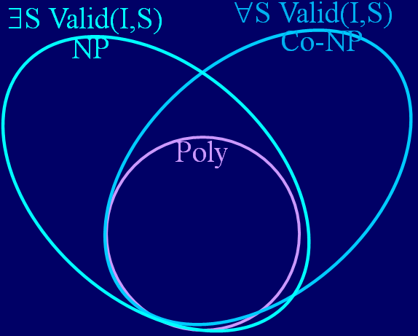
Poly-Time Hierarchy
Ex: Is there an n-character Java program J
that solves Sat on all n-bit instances C
∃J ∀C [X=J(C) & C(X) = 1]
or [0=J(C) & ∀X C(X) = 0]
|S| ≤ |I|^{c}
Σ₂P =
Π₂P =
∃S ∀S’ Valid(I,S,S’)
∀S ∃S’ Valid(I,S,S’)
Σ₁P =
Π₁P =

Slide 42
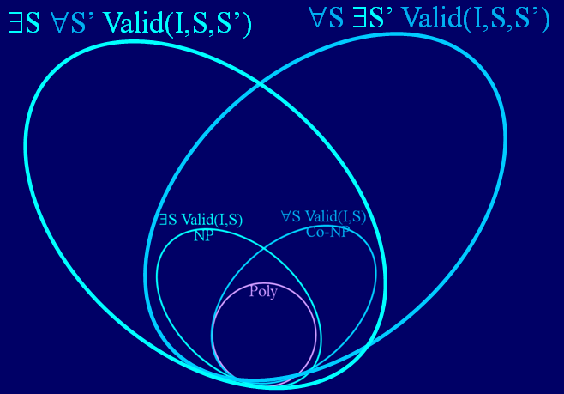
Poly-Time Hierarchy
Σ₃P =
Π₃P =
∃S ∀S’ ∃S’’ Valid(I,S,S’,S’’)
∀S ∃S’ ∀S’’ Valid(I,S,S’,S’’)
Σ₂P =
Π₂P =

Slide 43
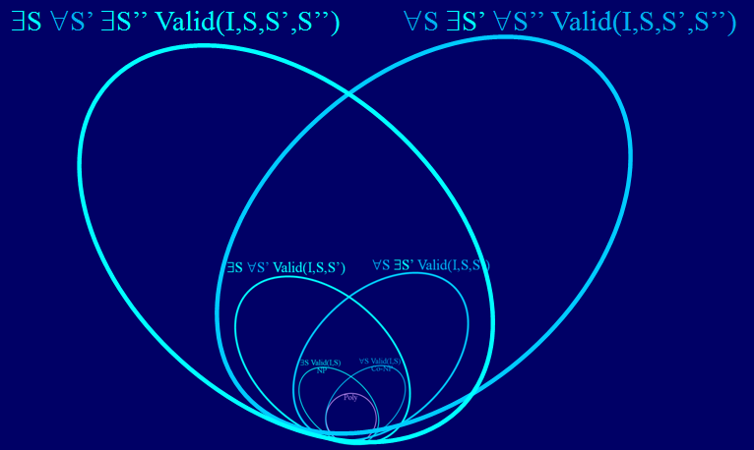
Poly-Time Hierarchy
Ex: Is there a winning n-move strategy for chess
in which my moves are S₁, S₃, …, S_{n-1} and
my opponent's moves are S₂, S₄, …, S_{n}?
PH =
Σ_{n}P =
∃S₁ ∀S₂ ∃S₃ …. ∀S_{n-1} ∃S_{n} Valid(I,S₁,S₂,S₃,…,S_{n-1},S_{n})
Σ₃P =
Π₃P =

Slide 44
Polynomial-Space
PSpace = Set of computational problems computed by
a TM with n^{O(1)} cells of work tape.
  n^{O(1)} cells ➔ 2^{n} configurations
  ➔ at most 2^{n} time or cycles forever.
  ⊆ Exponential Time.
O(1)
O(1)
TM
n^{O(1)}
x₁
x₂
x₃
x₄
…
x_{n}
q

Slide 45
Polynomial-Space
PSpace = Set of computational problems computed by
a TM with n^{O(1)} cell of work tape.
  Can compute everything in PH
  = ∃S₁ ∀S₂ ∃S₃ …. ∀S_{n-1} ∃S_{n} Valid(I,S₁,S₂,S₃,…,S_{n-1},S_{n})
TM
n^{O(1)}
x₁
x₂
x₃
x₄
…
x_{n}
q

Slide 46
Polynomial-Space
PSpace = Set of computational problems computed by
a TM with n^{O(1)} cell of work tape.
  Can solve most problems about games.
    Can understand most things about the game Chess,
    by studying every way of arranging the pieces.
    (one such way can be stored in memory.)
TM
n^{O(1)}
x₁
x₂
x₃
x₄
…
x_{n}
q

Slide 47
Exp-Time
Exp-Time = Set of computational problems computed by
a TM in time 2^{O(n)}.
  Can solve most famous problems in NP,
  because their witnesses have size cn
  and hence there are at most 2^{cn} of them.
  But (likely) can’t solve all of them
TM
n
…
x₁
x₂
x₃
x₄
…
x_{n}
q
…

Slide 48
Exponential-Time
E = Set of computational problems computed by
a TM in time 2^{n}.
  Can solve all problems in NP,
  because their witnesses have size n^{c}
  and hence there are at most 2^{n} of them.
  In fact, as said, can solve all problems in PSpace.
O(1)
c
TM
n
…
x₁
x₂
x₃
x₄
…
x_{n}
q
…

Slide 49
Double Exponential-Time
Double Exponential-Time
= Set of computational problems computed by
a TM in time 2².
n^{O(1)}
TM
n
…
x₁
x₂
x₃
x₄
…
x_{n}
q
…

Slide 50
Ackermann’s Time
Ackermann(5)-Time
= Set of computational problems computed by
a TM in time Ackermann(5).
  But this is only constant time O(1).
TM
n
…
x₁
x₂
x₃
x₄
…
x_{n}
q
…

Slide 51
Ackermann’s Time
Ackermann(n)-Time
= Set of computational problems computed by
a TM in time Ackermann(n).
  This is a lot of time!
TM
n
…
x₁
x₂
x₃
x₄
…
x_{n}
q
…

Slide 52
Computable
Computable
= Set of computational problems computed by
a TM.
TM
n
…
x₁
x₂
x₃
x₄
…
x_{n}
q
…

Slide 53
Acceptable, Witnesses, Enumerable
Acceptable
Computable
A computational problem/language
  is said to be computable/decidable/recursive iff ∃ TM M
    On every input the machine
    halts and gives the correct answer.
  is said to be accepted/semidecided/enumerable iff ∃ TM M
    On every yes input, the machine halts
    and gives the correct answer.
    (A halting computation is a witness of a yes answer)
    On every no input, the machine
    could halt and gives the correct answer
    or could run for ever.

Slide 54
Acceptable, Witnesses, Enumerable
Acceptable
Computable
Is there a language
that can be accepted
but not computed?
Halting
Halting: Given <M,I>
does program halt on I?
Alg: Run it.
  Acceptable iff ∃ TM M
    On every yes input, the machine halts
    and gives the correct answer.
    (A halting computation is a witness of a yes answer)
    On every no input, the machine
    could halt and gives the correct answer
    or could run for ever.

Slide 55
Acceptable, Witnesses, Enumerable
Acceptable
Co-Acceptable
Computable
Halting
Not Halting
A computational problem/language
  is said to be co-accepted/semidecided/enumerable iff ∃ TM M
    On every no input, the machine halts
    and gives the correct answer.
    (A halting computation is a witness of a no answer)
    On every yes input, the machine
    could halt and gives the correct answer
    or could run for ever.

Slide 56
Acceptable, Witnesses, Enumerable
Acceptable
Co-Acceptable
Computable
{<M,I,M’,I’> | M(I) halts ⊕ M(I’) does not}
A computational problem/language
  is said to be accepted/semidecided/enumerable
    On every yes input, the machine halts
    and gives the correct answer.
    On every no input, the machine
    could halt and gives the correct answer
    or could run for ever.

Slide 57
Acceptable, Witnesses, Enumerable
Acceptable
Co-Acceptable
Computable
{<M,I,M’,I’> | M(I) halts ⊕ M(I’) does not}
A computational problem/language
  is said to be co-accepted/semidecided/enumerable
    On every no input, the machine halts
    and gives the correct answer.
    On every yes input, the machine
    could halt and gives the correct answer
    or could run for ever.

Slide 58
Acceptable, Witnesses, Enumerable
Acceptable
Three equivalent definitions for a computational problem/language P
Acceptable: ∃ TM M
  On every yes input, the machine halts
  and gives the correct answer.
  On every no input, the machine
  could halt and gives the correct answer
  or could run for ever.
Witnesses:
  ∃ computable Valid such that P(I) = ∃ S Valid(I,S)
Enumerable: ∃ TM M
  Every yes input I, is eventually printed.
  No no input is ever printed.

Slide 59
Acceptable, Witnesses, Enumerable
Witnesses
If a language has a witness
  ∃ computable Valid such that P(I) = ∃ S Valid(I,S)
If the instance has a valid solution
  A non-deterministic (fairy god mother)
  could prove it to you by giving you
  such a solution as a witness.
  You could check that it is valid.
  You could convince your boss.

Slide 60
Acceptable, Witnesses, Enumerable
Witnesses
If a language has a witness
  ∃ computable Valid such that P(I) = ∃ S Valid(I,S)
If the instance does not have a valid solution
  A non-deterministic (fairy god mother)
  could prove it to you by giving you
  ????
  You have no way to convince your boss.

Slide 61
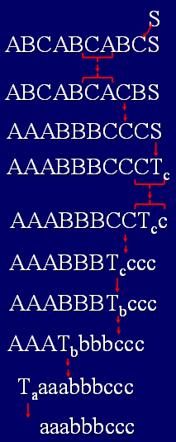
Acceptable, Witnesses, Enumerable
Witnesses
If a language has a witness
  ∃ computable Valid such that P(I) = ∃ S Valid(I,S)
Example: Context Sensitive Grammar G:
Instance: A string I
Solution: A parsing S.
I is a Yes instance if there is such a parsing.
Given a string I and a parsing S,
there is an alg Valid(I,S) to test
whether or not S is a valid solution for I.
aaabbbccc

Slide 62
Acceptable, Witnesses, Enumerable
Witnesses
If a language has a witness
  ∃ computable Valid such that P(I) = ∃ S Valid(I,S)
Example: Context Sensitive Grammar G:
Instance: A string I
Solution: A parsing S.
I is a No instance, if there is not such a parsing. .
?
aaabbbccc

Slide 63
Acceptable, Witnesses, Enumerable
Witnesses
If a language has a witness
  ∃ computable Valid such that P(I) = ∃ S Valid(I,S)
Example: Math Truth:
Instance: A math statement I
Solution: A proof S.
I is a Yes instance if there is such a proof.
Given a math statement I and a proof S,
there is an alg Valid(I,S) to test
whether or not S is a valid solution for I.
I = [∀ a,b,c,r ≥ 3 a^{r}+b^{r} ≠c^{r}]

Slide 64
Acceptable, Witnesses, Enumerable
Witnesses
If a language has a witness
  ∃ computable Valid such that P(I) = ∃ S Valid(I,S)
Example: Math Truth:
Instance: A math statement I
Solution: A proof S.
I is a No instance if there is not such a proof.
?
I = [∀ a,b,c,r ≥ 3 a^{r}+b^{r} ≠c^{r}]

Slide 65
Acceptable, Witnesses, Enumerable
Witnesses
If a language has a witness
  ∃ computable Valid such that P(I) = ∃ S Valid(I,S)
Example: A language accepted by TM M:
Instance: An instance I
Solution: A description S of an accepting computation of M on I.
I is a Yes instance if there is such a computation description.
Given an instance I and a computation description S,
there is an alg Valid(I,S) to test
whether or not S is a valid solution for I.
1011010 q_{start}1011010
I = [∀ a,b,c,r ≥ 3 a^{r}+b^{r} ≠c^{r}]
1011010 qi011010bbbb

Slide 66
Acceptable, Witnesses, Enumerable
Acceptable ➔ Witnesses
If a language is accepted by TM M (says yes on yes)
then there it has a witness
  ∃ computable Valid such that P(I) = ∃ S Valid(I,S)
Example: A language accepted by TM M:
Instance: An instance I
Solution: A description S of an accepting computation of M on I.
I is a Yes instance if there is such a computation description.
Given an instance I and a computation description S,
there is an alg Valid(I,S) to test
whether or not S is a valid solution for I.
1011010 q_{start}1011010
I = [∀ a,b,c,r ≥ 3 a^{r}+b^{r} ≠c^{r}]
1011010 qi011010bbbb

Slide 67
Acceptable, Witnesses, Enumerable
Witness ➔Acceptable
If a language has a witness,
then there is a TM M that accepts it
M(I) =
{
loop over all potential solutions S
accept if Valid(I,S)
}
    on every yes input, the machine halts
    and gives the correct answer.
    on every no input, the machine
    could halt and gives the correct answer
    or could run for ever.

Slide 68
Acceptable, Witnesses, Enumerable
Acceptable ➔ Enumerable
If a language is accepted by TM M (says yes on yes)
then there is a TM M' that enumerates it
  Every yes input I, is eventually printed.
  No no input is ever printed.
All possible inputs
I₁ I₂ I₃ … I_{i} …
1
2
3
4
j
All possible halting times
…
Run M in I_{i} for j time steps.
If it halts at time j, print I_{i}.
…

Slide 69
Acceptable, Witnesses, Enumerable
Acceptable ➔ Enumerable
If a language is accepted by TM M (says yes on yes)
then there is a TM M' that enumerates it
  For every yes input I_{i},
    M halts on it after some j time steps.
    And hence is eventually printed.
I₁ I₂ I₃ … I_{i} …
1
2
3
4
j
…
And hence is eventually printed.
…

Slide 70
Acceptable, Witnesses, Enumerable
Acceptable ➔ Enumerable
If a language is accepted by TM M (says yes on yes)
then there is a TM M' that enumerates it
  For every no input I_{i},
    M never halts on it.
    And hence is never printed.
I₁ I₂ I₃ … I_{i} …
1
2
3
4
j
…
…

Slide 71
Acceptable, Witnesses, Enumerable
Enumerable ➔Acceptable
If a language is enumerated by TM M',
then there is a TM M that accepts it
M(I) =
{
Run M' and halt and accept if I is printed
}
    on every yes input, the machine halts
    and gives the correct answer.
    on every no input, the machine
    could halt and gives the correct answer
    or could run for ever.

Slide 72
Acceptable, Witnesses, Enumerable
Acceptable
Three equivalent definitions for a computational problem/language P
Acceptable: ∃ TM M
  On every yes input, the machine halts
  and gives the correct answer.
  On every no input, the machine
  could halt and gives the correct answer
  or could run for ever.
Witnesses:
  ∃ computable Valid such that P(I) = ∃ S Valid(I,S)
Enumerable: ∃ TM M
  Every yes input I, is eventually printed.
  No no input is ever printed.

Slide 73
Acceptable
Co-Acceptable
Computable
Halting
Not Halting

Slide 74
Computable_{Halting}
Computable_{Halting}
= Set of computational problems computed by
a TM that has access to an oracle that solves
the Halting Problem.
TM
n
…
x₃
x₄
GIVEN:
Oracle for
Halting
x₁
x₂
…
x_{n}
q
…

Slide 75
Computable_{Halting}
Acceptable
Say yes, when Oracle says yes
Say no, when he says no.
I
<M,I>
M(I) halts or not
BUILD:
Oracle for P
GIVEN:
Oracle for
Halting
Problem solved this way are:
Acceptable

Slide 76
Computable_{Halting}
Co-Acceptable
Say no, when Oracle says yes
Say yes, when he says no.
I
<M,I>
M(I) halts or not
BUILD:
Oracle for P
GIVEN:
Oracle for
Halting
Problem solved this way are:
Co-Acceptable

Slide 77
Computable_{Halting}
Ask the oracle as many question as you like
and answer any way you like.
I
<M,I>
M(I) halts or not
BUILD:
Oracle for P
GIVEN:
Oracle for
Halting
Problem solved this way are:
Computable_{Halting}

Slide 78
Computable_{Halting}
Halting_{Halting}
Is there a problem not computable in this class?
Halting_{Halting} = { <M,I> | Does M halt on I
where M is a TM that has access
to an oracle that solves the Halting Problem.
Same digitalization proof proves it. }

Slide 79
End
Notes:
79

