Slide 1

Welcome
CSE4111/5111 Computability and Complexity
Jeff Edmonds
www.cse.yorku.ca\~jeff
jeff@cse.yorku.ca
CSB 3044, ext. 33295
416-538-7413
Jeff Edmonds
York University
Lecture 0
COSC 4111

Slide 2
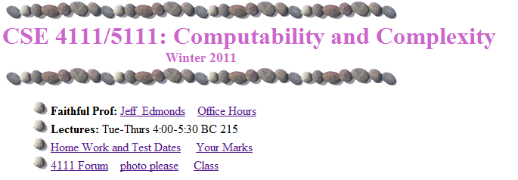
Course Material
www.cse.yorku.ca\~jeff\courses\4111

Slide 3
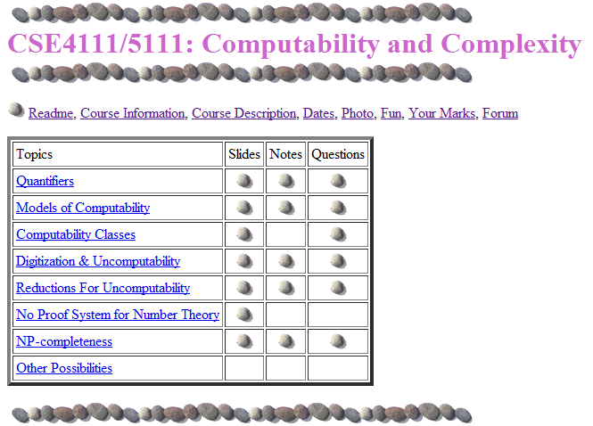
Course Material
www.cse.yorku.ca\~jeff\courses\4111\syllabus

Slide 4
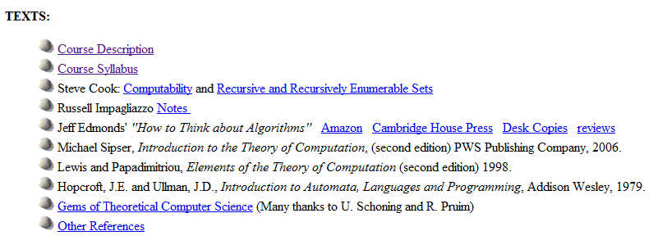
Course Material
www.cse.yorku.ca\~jeff\courses\4111

Slide 5
A Contract to Learn
It deeply saddens me when a third of the class does not learn the material sufficiently to pass.
I will do everything in my power to help you learn this material.
I request that you do everything in your power.
Everyone can learn it.

Slide 6
Tough Love
Last year and this summer,
I threatened them every day.
They performed better than ever before!
And my course evaluations were better.

Slide 7
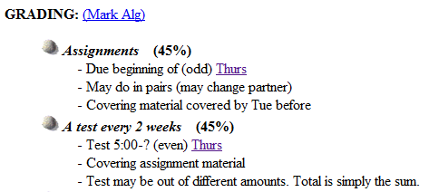
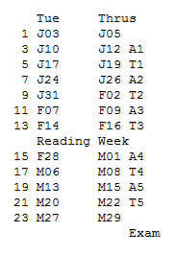
Midterms

Slide 8

Midterms
Each unit test, half the class fails.
“Fail early, fail often”
Then almost everyone starts to listen and passes the exam.
Don’t want to people who fail the midterms to give up
Want people to work on the midterms

Slide 9
Together
I think it is important for people
to not feel isolated
with the material.

Slide 10

Together
You’re cool!
Are you free sometime this weekend?
Yes!
The best way to learn
is to teach each other!

Slide 11
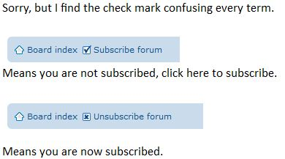
Together
Have an open discussion on the forum.
Get it to email you when there is an update.

Slide 12
Together
Study the text and slides.
Work hard on solving Assignments on your own.
Get help, but not answers from
friends, TA, professor, …

Slide 13
Together
After reading the solutions
to the assignments.
Study the solutions.
Understand the solutions.
Memorize the solutions.
The questions on the tests
will be different.
But the answers
will be surprisingly close.

Slide 14
Together
Please interact with me in class.
Help me know what people
are not understanding
Slow down the slides
(Though we do have
a lot of material to cover)

Slide 15
Together
Please ask questions!

Slide 16
Together
Please ask questions!
To keep the flow going
Wiggly hand:
relevant to current slide.
Stationary hand:
question about past material.

Slide 17
Together
When I ask a question
to the class.
Please don’t shout out answers.
So others can think.

Slide 18
Together
In every class,
there is one student
I don’t like.
The key when talking in class is
Are you trying to
help me and the class
or win some compitition?

Slide 19
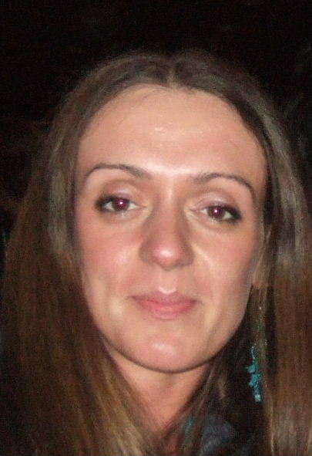
Together
Please ask questions!
Winter 06, the average of one section was much higher
than the average of the other.
(I taught them both)
My theory was that it was because a student,
Gertruda, constantly asked great questions
and everyone learned from them.
Ask questions for everyone’s sake.

Slide 20
Together
Please help me:
Find typos in the slides
and assignments
and tests
Keep track of how many
lectures we spend on each
set of slides.

Slide 21


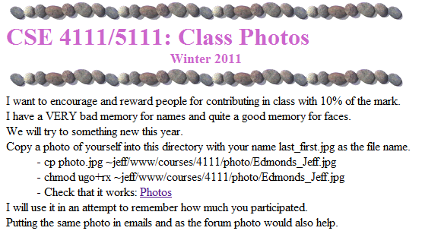
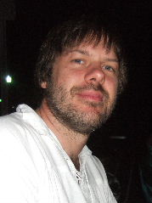
Together

Slide 22

Together
Some students feel too intimidated to talk to the professor.
Actually, he is just a guy
who has been doing this for a while.

Slide 23
Together
Office hours:
After class tend to be the best time.
Longer or private questions, when requested,
can be taken back to my office, CSB 3044.
Notes:
23

Slide 24
Together
We have 27 TA hours.
These will primarily be for marking.
But he may have some extra time for talking to you.

Slide 25
Useful Learning Techniques
Notes:
25

Slide 26
Read Ahead
You are expected to read the lecture notes before the lecture.
This will facilitate more productive discussion during class.
Also please
proof read
assignments
& tests.
Like in an
English class

Slide 27

Explaining
We are going to test you on your ability to explain the material.
Hence, the best way of studying is to explain the material over and over again out loud to yourself, to each other, and to your stuffed bear.

Slide 28

Day Dream
While going along with your day
Mathematics is not all linear thinking.
Allow the essence of the material to seep into your subconscious
Pursue ideas that percolate up and flashes of inspiration that appear.

Slide 29

Be Creative
Ask questions.
Why is it done this way and not that way?

Slide 30
Two years from now:
May I have a letter of reference for grad school?
I find it awkward to write letters for people that I don’t recognize.
Make yourself KNOWN today to SOME professor.

Slide 31
Two years from now:
May I have a letter of reference for grad school?
I find it awkward to write letters for people that I don’t recognize.
Make yourself KNOWN today to SOME professor.
Sorry email does not help as I don’t remember names

