Slide 1

Map-Reduce and the New Software Stack
Note to other teachers and users of these slides: We would be delighted if you found this our material useful in giving your own lectures. Feel free to use these slides verbatim, or to modify them to fit your own needs. If you make use of a significant portion of these slides in your own lecture, please include this message, or a link to our web site: http://www.mmds.org
Mining of Massive Datasets
Jure Leskovec, Anand Rajaraman, Jeff Ullman Stanford University
http://www.mmds.org

Slide 2
MapReduce
Challenges:
  How to distribute computation?
  Distributed/parallel programming is hard
Map-reduce addresses all of the above
  Google’s computational/data manipulation model
  Elegant way to work with big data

Slide 3
Single Node Architecture
CPU
Machine Learning, Statistics
Memory
“Classical” Data Mining
Disk

Slide 4
Motivation: Google Example
20+ billion web pages x 20KB = 400+ TB
1 computer reads 30-35 MB/sec from disk
  ~4 months to read the web
~1,000 hard drives to store the web
Takes even more to do something useful
with the data!
Today, a standard architecture for such problems is emerging:
  Cluster of commodity Linux nodes
  Commodity network (ethernet) to connect them

Slide 5
Cluster Architecture
2-10 Gbps backbone between racks
1 Gbps between
any pair of nodes
in a rack
Switch
Switch
Switch
CPU
CPU
CPU
CPU
Mem
…
Mem
Mem
…
Mem
Disk
Disk
Disk
Disk
Each rack contains 16-64 nodes
In 2011 it was guestimated that Google had 1M machines, http://bit.ly/Shh0RO

Slide 6
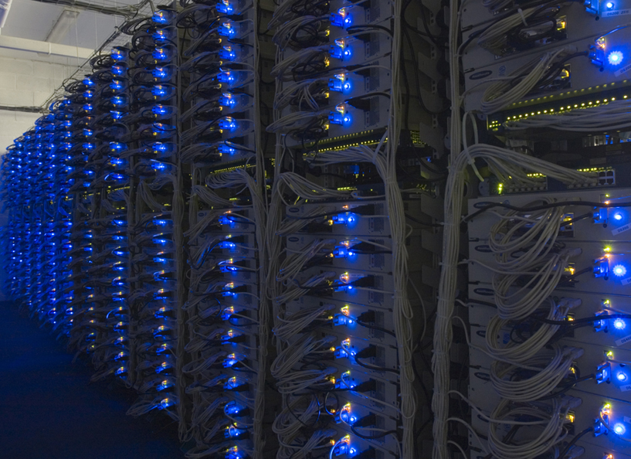

Slide 7
Large-scale Computing
Large-scale computing for data mining
problems on commodity hardware
Challenges:
  Machines failures
  Network bottleneck
  How can we make it easy to write distributed programs?

Slide 8
Machine Failures
    One server may stay up 3 years (1,000 days)
    If you have 1,000 servers, expect to lose 1/day
    People estimated Google had ~1M machines in 2011
      1,000 machines fail every day!
Solution: copy data

Slide 9
Network Bottleneck
Issue: Copying data over a network takes time
Solution:
  Bring computation close to the data
  Store files multiple times for reliability

Slide 10
Programming Challenge
Map-reduce addresses this problem
  Google’s computational/data manipulation model
  Elegant way to work with big data
  Programming model
    Map-Reduce

Slide 11
Storage Infrastructure
Distributed File System:
    Provides global file namespace
    Google GFS; Hadoop HDFS;
  Typical usage pattern
    Huge files (100s of GB to TB)
    Data is rarely updated in place
    Reads and appends are common

Slide 12
Distributed File System
Chunk servers
  File is split into contiguous chunks
  Typically each chunk is 16-64MB
  Each chunk replicated (usually 2x or 3x)
  Try to keep replicas in different racks
Master node
  a.k.a. Name Node in Hadoop’s HDFS
  Stores metadata about where files are stored
  Might be replicated
Client library for file access
  Talks to master to find chunk servers
  Connects directly to chunk servers to access data

Slide 13
Distributed File System
Reliable distributed file system
Data kept in “chunks” spread across machines
Each chunk replicated on different machines
  Seamless recovery from disk or machine failure
C₀
C₁
D₀
C₁
C₂
C₅
C₀
C₅
…
C₅
Chunk server 1
C₂
C₅
Chunk server 2
C₃
D₀
Chunk server 3
D₁
D₀
Chunk server N
C₂
Bring computation directly to the data!
Chunk servers also serve as compute servers
Notes:
13

Slide 14
Programming Model: MapReduce
Warm-up task:
We have a huge text document
Count the number of times each
distinct word appears in the file
Sample application:
  Analyze web server logs to find popular URLs

Slide 15
Task: Word Count
Case 1:
  File too large for memory, but all <word, count> pairs fit in memory
Case 2:
Count occurrences of words:
  words(doc.txt) | sort | uniq -c
    where words takes a file and outputs the words in it, one per a line
Case 2 captures the essence of MapReduce
  Great thing is that it is naturally parallelizable

Slide 16
MapReduce: Overview
Sequentially read a lot of data
Map:
  Scan input file record at a time
  Extract something you care about
Group by key: Sort and Shuffle
Reduce:
  Aggregate, summarize, filter or transform
Write the result
Outline stays the same, Map and Reduce change to fit the problem

Slide 17
MapReduce: The Map Step
Input
key-value pairs
Intermediate
key-value pairs
k
v
map
k
v
k
v
map
k
v
k
v
…
…
k
v
k
v

Slide 18
MapReduce: The Reduce Step
Output
key-value pairs
Intermediate
key-value pairs
Key-value groups
reduce
k
v
k
v
v
v
k
v
Group
by key
reduce
k
v
k
v
v
k
v
k
v
…
…
…
k
v
k
v
k
v

Slide 19
More Specifically
Input: a set of key-value pairs
Programmer specifies two methods:
  Map(k, v) → <k’, v’>*
    Takes a key-value pair and outputs a set of key-value pairs
      E.g., key is the filename, value is a single line in the file
    There is one Map call for every (k,v) pair
  Reduce(k’, <v’>*) → <k’, v’’>*
    All values v’ with same key k’ are reduced together
    and processed in v’ order
    There is one Reduce function call per unique key k’

Slide 20
MapReduce: Word Counting
Provided by the programmer
Provided by the programmer
MAP:
Read input and produces a set of key-value pairs
Group by key:
Collect all pairs with same key
Reduce:
Collect all values belonging to the key and output
The crew of the space shuttle Endeavor recently returned to Earth as ambassadors, harbingers of a new era of space exploration. Scientists at NASA are saying that the recent assembly of the Dextre bot is the first step in a long-term space-based man/mache partnership. '"The work we're doing now -- the robotics we're doing -- is what we're going to need ……………………..
(The, 1)
(crew, 1)
(of, 1)
(the, 1)
(space, 1)
(shuttle, 1)
(Endeavor, 1)
(recently, 1)
….
(crew, 1)
(crew, 1)
(space, 1)
(the, 1)
(the, 1)
(the, 1)
(shuttle, 1)
(recently, 1)
…
(crew, 2)
(space, 1)
(the, 3)
(shuttle, 1)
(recently, 1)
…
Sequentially read the data
Only sequential reads
Big document
(key, value)
(key, value)
(key, value)

Slide 21
Word Count Using MapReduce
map(key, value):
// key: document name; value: text of the document
for each word w in value:
emit(w, 1)
reduce(key, values):
// key: a word; value: an iterator over counts
result = 0
for each count v in values:
result += v
emit(key, result)

Slide 22
Map-Reduce: Environment
Map-Reduce environment takes care of:
Partitioning the input data
Scheduling the program’s execution across a
set of machines
Performing the group by key step
Handling machine failures
Managing required inter-machine communication

Slide 23
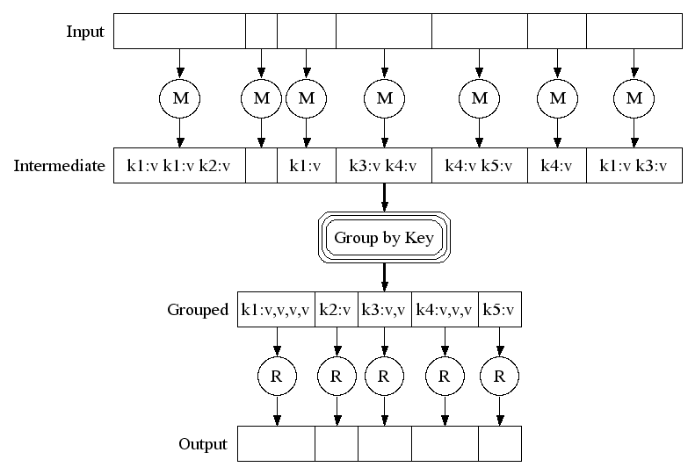
Map-Reduce: A diagram
Big document
MAP:
Read input and produces a set of key-value pairs
Group by key:
Collect all pairs with same key
(Hash merge, Shuffle, Sort, Partition)
Reduce:
Collect all values belonging to the key and output

Slide 24
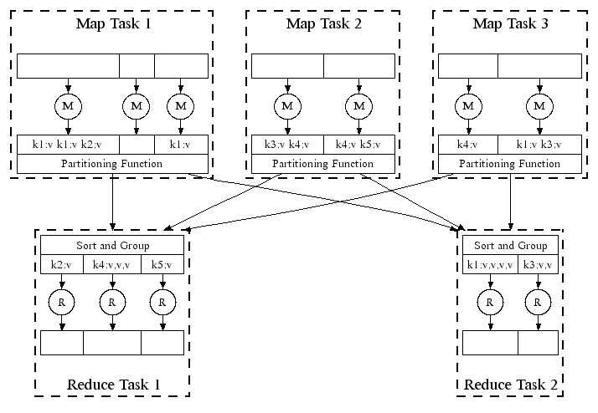
Map-Reduce: In Parallel
All phases are distributed with many tasks doing the work

Slide 25
Map-Reduce
Programmer specifies:
  Map and Reduce and input files
Workflow:
  Read inputs as a set of key-value-pairs
  Map transforms input kv-pairs into a new set of k'v'-pairs
  Sorts & Shuffles the k'v'-pairs to output nodes
  All k’v’-pairs with a given k’ are sent to the same reduce
  Reduce processes all k'v'-pairs grouped by key into new k''v''-pairs
  Write the resulting pairs to files
All phases are distributed with many tasks doing the work
Input 0
Input 1
Input 2
Map 0
Map 1
Map 2
Shuffle
Reduce 0
Reduce 1
Out 0
Out 1

Slide 26
Map-Reduce Environment
Map-Reduce environment takes care of:
  Partitioning the input data
  Scheduling the programmer’s execution across a set of machines
  Perform the group-by key step
  Handling node failures
  Managing inter-machine communication

Slide 27
Data Flow
Input and final output are stored on a distributed file system (FS):
  Scheduler tries to schedule map tasks “close” to physical storage location of input data
Intermediate results are stored on local FS
of Map and Reduce workers
Output is often input to another
MapReduce task

Slide 28
Coordination: Master
Master node takes care of coordination:
  Task status: (idle, in-progress, completed)
  Idle tasks get scheduled as workers become available
  When a map task completes, it sends the master the location and sizes of its R intermediate files, one for each reducer
  Master pushes this info to reducers
Master pings workers periodically to detect failures

Slide 29
Dealing with Failures
Map worker failure
  Map tasks completed or in-progress at
  worker are reset to idle
  Reduce workers are notified when task is rescheduled on another worker
Reduce worker failure
  Only in-progress tasks are reset to idle (because the completed tasks’ results are stored in DFS)
  Reduce task is restarted
Master failure
  MapReduce task is aborted and client is notified

Slide 30
How many Map and Reduce jobs?
M map tasks, R reduce tasks
Rule of a thumb:
  Make M much larger than the number of nodes in the cluster
  One DFS chunk per map is common
  Improves dynamic load balancing and speeds up recovery from worker failures
Usually R is smaller than M
  Because output is spread across R files

Slide 31
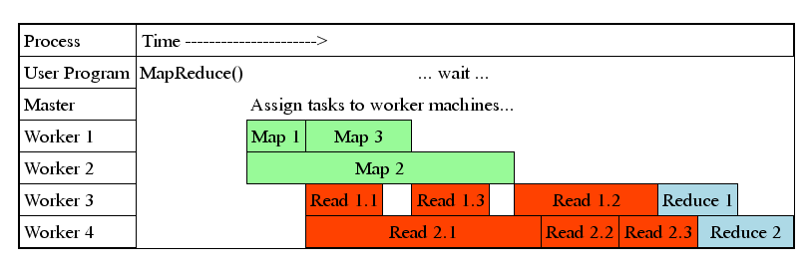
Task Granularity & Pipelining
Fine granularity tasks: map tasks >> machines
  Minimizes time for fault recovery
  Can do pipeline shuffling with map execution
  Better dynamic load balancing

Slide 32
Refinements: Backup Tasks
Problem
  Slow workers significantly lengthen the job completion time:
    Other jobs on the machine
    Bad disks
    Weird things
Solution
  Near end of phase, spawn backup copies of tasks
    Whichever one finishes first “wins”
Effect
  Dramatically shortens job completion time

Slide 33
Refinement: Combiners
Often a Map task will produce many pairs of the form (k,v₁), (k,v₂), … for the same key k
  E.g., popular words in the word count example
Can save network time by
pre-aggregating values in
the mapper:
  combine(k, list(v₁)) → v₂
  Combiner is usually same
  as the reduce function
Works only if reduce
function is commutative and associative

Slide 34
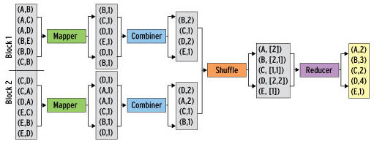
Refinement: Combiners
Back to our word counting example:
  Combiner combines the values of all keys of a single mapper (single machine):
  Much less data needs to be copied and shuffled!

Slide 35
Combiners
Combiner trick works only when the Reduce function is commutative and associative
  Works with sum
  Does not work with average or median

Slide 36
Refinement: Partition Function
Want to control how keys get partitioned
  Inputs to map tasks are created by contiguous splits of input file
  Reduce needs to ensure that records with the same intermediate key end up at the same worker
System uses a default partition function:
  hash(key) mod R
Sometimes useful to override the hash function:
  E.g., hash(hostname(URL)) mod R ensures URLs from a host end up in the same output file

Slide 37
Problems Suited for
Map-Reduce

Slide 38
Example: Host size
Suppose we have a large web corpus
Look at the metadata file
  Lines of the form: (URL, size, date, …)
For each host, find the total number of bytes
  That is, the sum of the page sizes for all URLs from that particular host
Map
  For each record output (hostname(url), size)
Reduce
  Sum the sizes for each host

Slide 39
Example: Language Model
Other examples:
  Link analysis and graph processing
  Machine Learning algorithms
Statistical machine translation:
  Need to count number of times every 5-word sequence occurs in a large corpus of documents
Very easy with MapReduce:
  Map:
    Extract (5-word sequence, count) from document
  Reduce:
    Combine the counts

Slide 40
Example: Join By Map-Reduce
Compute the natural join R(A,B) ⋈ S(B,C)
R and S are each stored in files
Tuples are pairs (a,b) or (b,c)
A | B
a₁ | b₁
a₂ | b₁
a₃ | b₂
a₄ | b₃
B | C
b₂ | c₁
b₂ | c₂
b₃ | c₃
A | C
a₃ | c₁
a₃ | c₂
a₄ | c₃
⋈
=
S
R

Slide 41
Map-Reduce Join
Use a hash function h from B-values to 1...k
A Map process turns:
  Each input tuple R(a,b) into key-value pair (b,(a,R))
  Each input tuple S(b,c) into (b,(c,S))
Map processes send each key-value pair with key b to Reduce process h(b)
  Hadoop does this automatically; just tell it what k is.
Each Reduce process matches all the pairs (b,(a,R)) with all (b,(c,S)) and outputs (a,b,c).

Slide 42
Cost Measures for Algorithms
In MapReduce we quantify the cost of an algorithm using
Communication cost = total I/O of all processes
Elapsed communication cost = max of I/O along any path
(Elapsed) computation cost analogous, but count only running time of processes
  Note that here the big-O notation is not the most useful
  (adding more machines is always an option)

Slide 43
Example: Cost Measures
For a map-reduce algorithm:
  Communication cost = input file size + 2 × (sum of the sizes of all files passed from Map processes to Reduce processes) + the sum of the output sizes of the Reduce processes.
  Elapsed communication cost is the sum of the largest input + output for any map process, plus the same for any reduce process

Slide 44
What Cost Measures Mean
Either the I/O (communication) or processing (computation) cost dominates
  Ignore one or the other
Total cost tells what you pay in rent from
your friendly neighborhood cloud
Elapsed cost is wall-clock time using parallelism

Slide 45
Cost of Map-Reduce Join
Total communication cost
= O(|R|+|S|+|R ⋈ S|)
Elapsed communication cost = O(s)
  We’re going to pick k and the number of Map processes so that the I/O limit s is respected
  We put a limit s on the amount of input or output that any one process can have. s could be:
    What fits in main memory
    What fits on local disk
With proper indexes, computation cost is linear in the input + output size
  So computation cost is like comm. cost

Slide 46
Pointers and Further Reading

Slide 47
Implementations
Google
  Not available outside Google
Hadoop
  An open-source implementation in Java
  Uses HDFS for stable storage
  Download: http://lucene.apache.org/hadoop/
Aster Data
  Cluster-optimized SQL Database that also implements MapReduce

Slide 48
Cloud Computing
Ability to rent computing by the hour
  Additional services e.g., persistent storage
Amazon’s “Elastic Compute Cloud” (EC2)
Aster Data and Hadoop can both be run on EC2
For CS341 (offered next quarter) Amazon will provide free access for the class

Slide 49
Reading
Jeffrey Dean and Sanjay Ghemawat: MapReduce: Simplified Data Processing on Large Clusters
  http://labs.google.com/papers/mapreduce.html
Sanjay Ghemawat, Howard Gobioff, and Shun-Tak Leung: The Google File System
  http://labs.google.com/papers/gfs.html

Slide 50
Resources
Hadoop Wiki
  Introduction
    http://wiki.apache.org/lucene-hadoop/
  Getting Started
    http://wiki.apache.org/lucene-hadoop/GettingStartedWithHadoop
  Map/Reduce Overview
    http://wiki.apache.org/lucene-hadoop/HadoopMapReduce
    http://wiki.apache.org/lucene-hadoop/HadoopMapRedClasses
  Eclipse Environment
    http://wiki.apache.org/lucene-hadoop/EclipseEnvironment
Javadoc
  http://lucene.apache.org/hadoop/docs/api/

Slide 51
Resources
Releases from Apache download mirrors
  http://www.apache.org/dyn/closer.cgi/lucene/hadoop/
Nightly builds of source
  http://people.apache.org/dist/lucene/hadoop/nightly/
Source code from subversion
  http://lucene.apache.org/hadoop/version_control.html

Slide 52
Further Reading
Programming model inspired by functional language primitives
Partitioning/shuffling similar to many large-scale sorting systems
  NOW-Sort ['97]
Re-execution for fault tolerance
  BAD-FS ['04] and TACC ['97]
Locality optimization has parallels with Active Disks/Diamond work
  Active Disks ['01], Diamond ['04]
Backup tasks similar to Eager Scheduling in Charlotte system
  Charlotte ['96]
Dynamic load balancing solves similar problem as River's distributed queues
  River ['99]

