Slide 1
Protection of outsourced data
Maria Angel Marquez Andrade

Slide 2
Protecting data
Including:
Propietary information
Health care data
Financial data
To follow privacy and security regulations, corporate compliance, and trade regulations [1]
Mostly from honest-but-curious servers
Employing:
Encryption
CryptDB
Fragmentation
[1] Kenan, Kevin. Cryptography in the database: the last line of defense. Addison Wesley, 2006.
Notes:
We want to protect data from the server, because the server is not trusted.

Slide 3
External third party,
stores and manages
the data
User
Server
Person who
accesses the
outsourced data
Client
User’s front
end
Data Owner
Organization or individual
who outsources her data

Slide 4
Data Encryption
Provides privacy and integrity
Queries must be executed on encrypted data
  Create indexes
Applied at different granularity levels:
  Table or Attribute (whole relation is returned)
  Tuple
  Cell (many decrypt operations)
Notes:
Modified encrypted data can be detected .Since the server is not trusted decryption can only take place at the client side, hence the server must execute queries on the encrypted data.
Good balance between client workload in query execution and decryption.

Slide 5
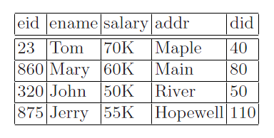
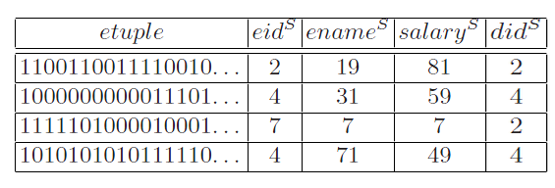
The emp table is mapped to a corresponding table at the server: empS(etuple, eidS, enameS, salaryS, addrS, didS) [2].
[2] Hore, Bijit, Sharad Mehrotra, and Hakan Hacigümüç. "Managing and querying encrypted data.
" Handbook of Database Security (2008): 163-190.
Notes:
Prescription doesn-t have an index, hence only the client can search it.

Slide 6
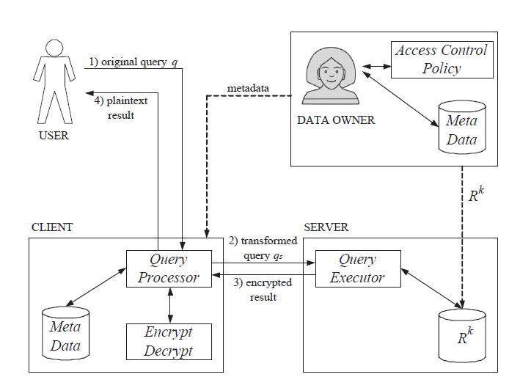
User formulates query(q)
Client maps q into qs and qc, and sends qs to the server.
The server executes query qs
The client decrypts the result and evaluates qc to remove spurious tuples.
Figure 2: Query evaluation process [3]
[3] Sabrina De Capitani di Vimercati, Sara Foresti, and Pierangela Samarati. "Protecting data in outsourcing scenarios." Handbook on securing cyber-physical critical infrastructure (2012).

Slide 7
Indexing techniques:
Encryption-based indexes:
Support equality queries.
Not order preserving (translate range condition into equality condition)
Order preserving encryption indexes:
Order Preserving Encryption Schema(OPES) and OPESS.
Support comparison operations.
Privacy homomorphic indexes:
Support arithmetic and comparison operations.
Arithmetic operations are time consuming.
Indexes should not reveal too much information.
Notes:
Beware of inference on distributions.

Slide 8
Access control
Encryption keys for each user’s data must be managed.
Neither the server not client can enforce restrictions.
The data owner must create an access control policy
Access matrix: a row for each user U and a column
for each resource R( relation, tuple, cell).
Notes:
The client should not be involved in each access request, and the server is not trusted.

Slide 9
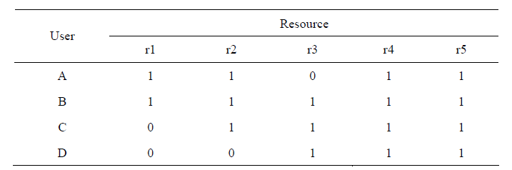
Table 2. An example of Access Matrix [4]
Using one key for each resource would require too many keys.
Adopt a key derivation method: each user has only 1 key.
The data owner encrypts r1 with a key that {A,B} can derive.
[4] Yu, WB Yonghong, and Wenyang BAI. "Integrated Privacy Protection and Access Control over Outsourced Database Services.
" Journal of Computational Information Systems 6.8 (2010): 2767-2777.

Slide 10
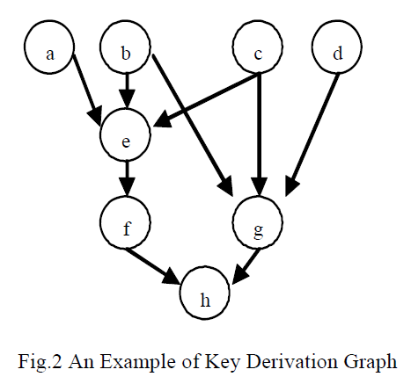
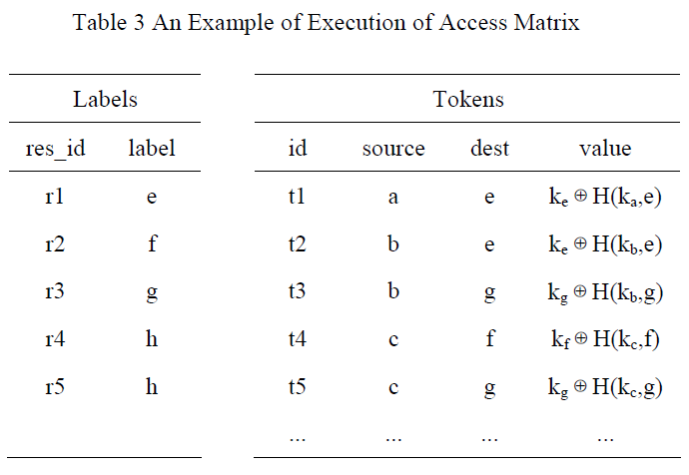
[4] Yu, WB Yonghong, and Wenyang BAI. "Integrated Privacy Protection and Access Control over Outsourced Database Services.
" Journal of Computational Information Systems 6.8 (2010): 2767-2777.
DAG hierarchy:
  Given two keys ki and kj, to derive kj from ki there exists a public token ti,j and a label lj.
  Where ti,j = kj XOR f( ki, lj ).
However, the problem of minimizing the # of tokens while remaining equivalent to the access matrix is NP-hard. (Use heuristics).
NP-hardness results imply that for many combinatorial
optimization problems there are no efficient algorithms that find an
optimal solution, or even a near optimal solution, on every instance. A
heuristic for an NP-hard problem is a polynomial time algorithm that
produces optimal or near optimal solutions on some input instances,
but may fail on others[4].
[4] Feige, Uriel. "Rigorous analysis of heuristics for NP-hard problems.
"Proceedings of the 16th annual ACM-SIAM Symposium on Discrete Algorithms. 2005.
Notes:
Tokens are an extension of your key to access resources,

Slide 11
Drawbacks of encryption
Query evaluation is not always possible or efficient.
Data which is not sensitive is also encrypted.
The user has to decrypt always.

Slide 12
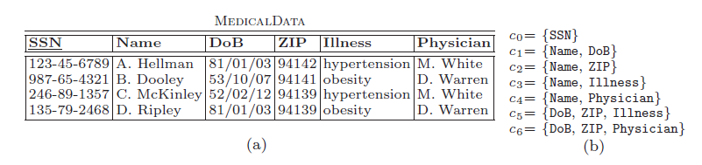
Data fragmentation
The association of data is what should be secured.
Confidenciality constraint c over relation R(A1,…,An) can be a singleton or an association.
c0= {SSN} is a singleton. The values of this attribute should be encrypted.
c1= {Name, Ilness} is an association. The attributes should not appear together as plaintext.
Fig. 2. An example of plaintext relation (a) and its well defined constraints (b) [5]
[5]Ciriani, Valentina, et al. "Combining fragmentation and encryption to protect privacy in data storage.“
ACM Transactions on Information and System Security (TISSEC) 13.3 (2010): 22.
Notes:
Because the association of SSN with any data is sensitive.

Slide 13
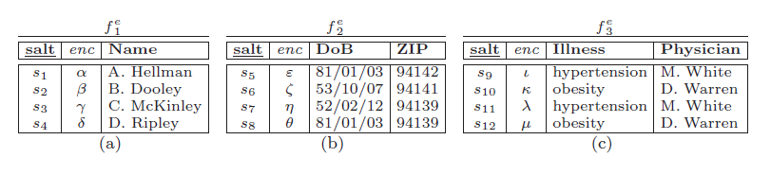
Fig. 3. An example of physical fragments for the relation in Figure 2(a) [5]
Fragment relation R into unlinkable fragments that follow confidenciality constraints.
Each fragment contains all data.
Encrypt tuples which cannot appear as plaintext with a salt(to prevent frequency attacks).
Finding a fragmentation that minimizes client workload is NP-hard.
[5]Ciriani, Valentina, et al. "Combining fragmentation and encryption to protect privacy in data storage.“
ACM Transactions on Information and System Security (TISSEC) 13.3 (2010): 22.

Slide 14
Querying the data
Evaluate query (q) by chosing one fragment
Chose a fragment in which is possible to execute the most selective conditions in the server side.
Drawbacks of fragmentation
Confidenciality constraints are difficult to create.
Updating the data is difficult.

