Slide 1
Extending Database Usability
Michelle Brown, MSc. Student

Slide 2
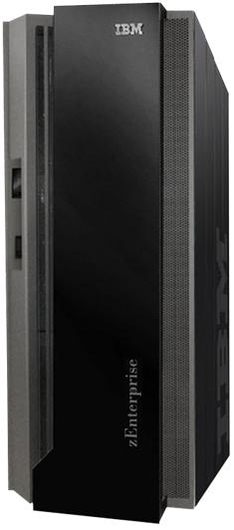
Why do we care?
Why Bother?
IBM Mainframe
$75,000
Database Administrator
$80,000 a year

Slide 3
Why do we care?
Cost

Slide 4
Why do we care?
Cost

Slide 5
Why do we care?
Other Problems
Missed Opportunities
User has to explain needs to support staff
Notes:
-Airline example (willingness change dates for cheaper flight)

Slide 6
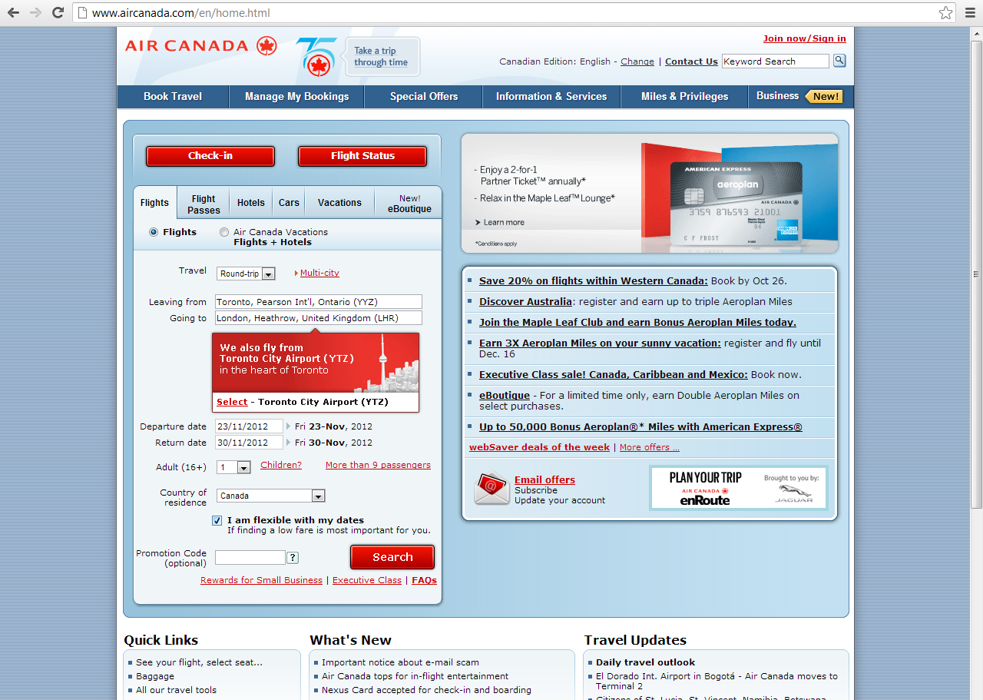
Why do we care?
Flight Booking Example

Slide 7
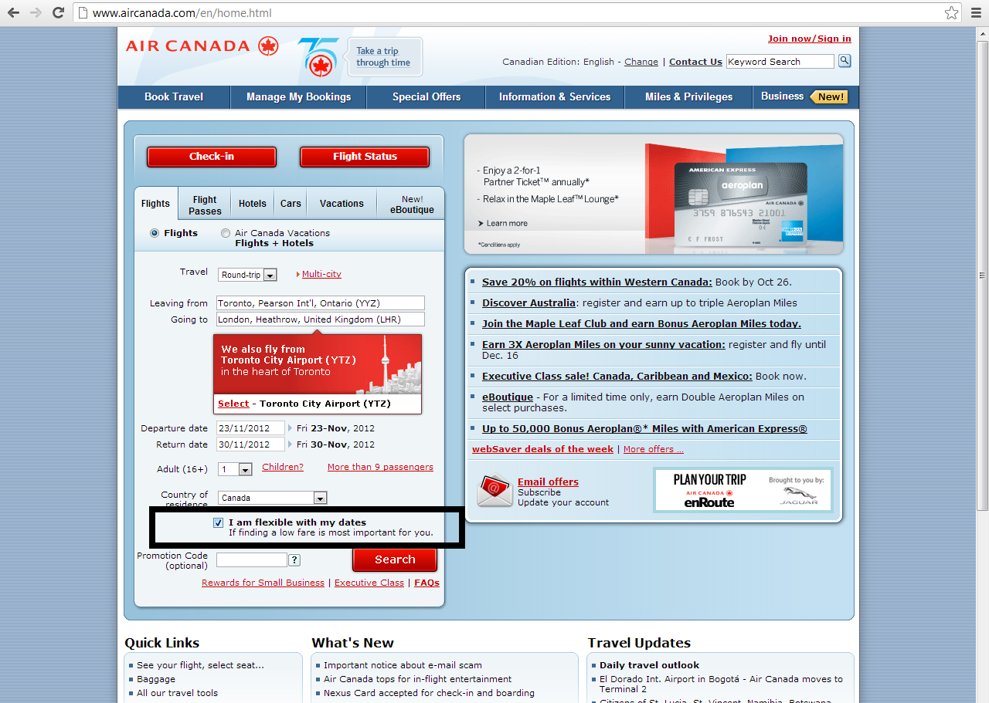
Why do we care?
Flight Booking Example

Slide 8
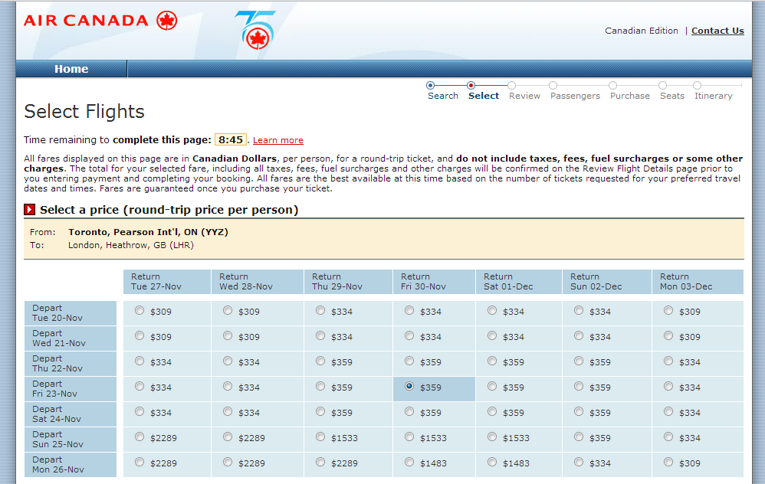
Why do we care?
Flight Booking Example

Slide 9
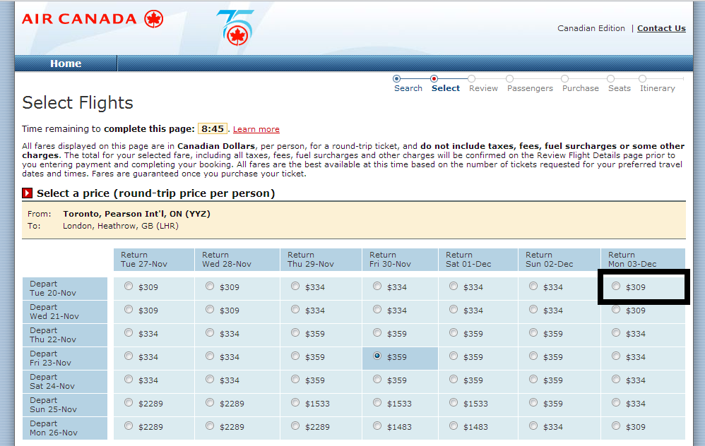
Why do we care?
Flight Booking Example

Slide 10
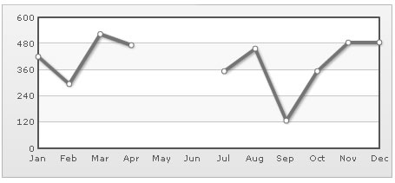
Why do we care?
Other Problems
Missing Users
Useful data not tracked because of difficultly
Databases are:
Hard to design
Hard to modify
Hard to query
Notes:
-A lot of people wish to track data, but don’t because of the usability hurdle

Slide 11
Current Usability Problems

Slide 12
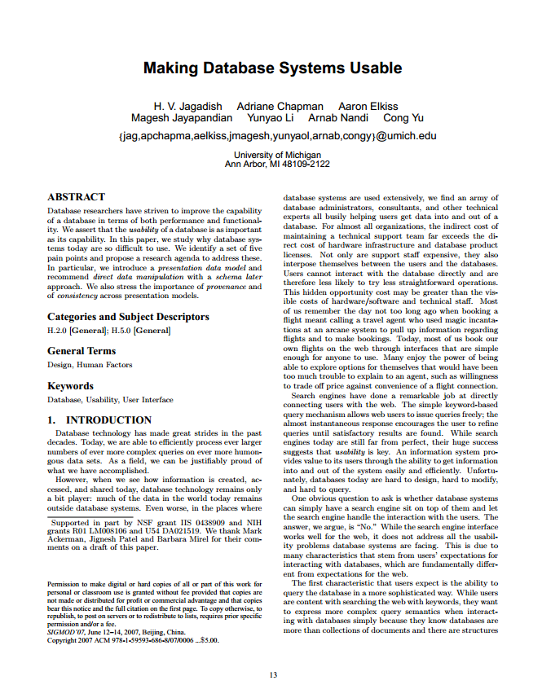
Usability problems
Making Database Systems Usable
Paper by Jagadish et al.
Outlines types of usability problems
5 identified types
Painful Relations
Painful Options
Unexpected Pain
Unseen Pain
Birthing Pain

Slide 13
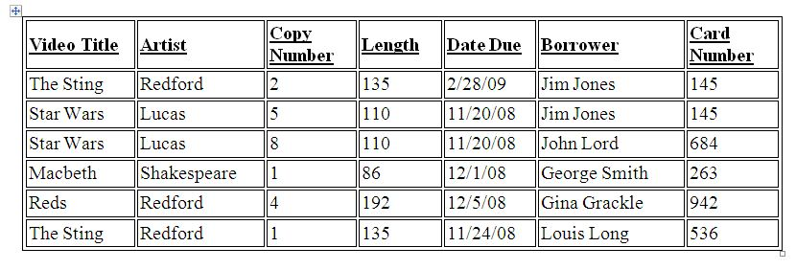
Usability problems
Painful Relations
Single table is natural for most
Normalization is key in relational design
So hard for users to locate single piece of data

Slide 14
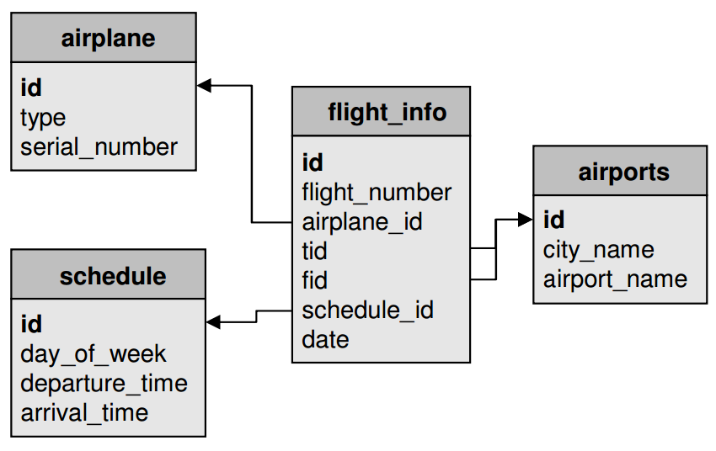
Usability problems
Painful Relations

Slide 15
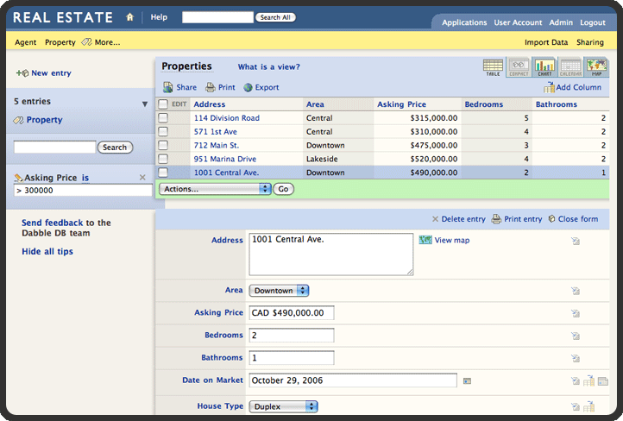
Usability problems
Painful Relations

Slide 16
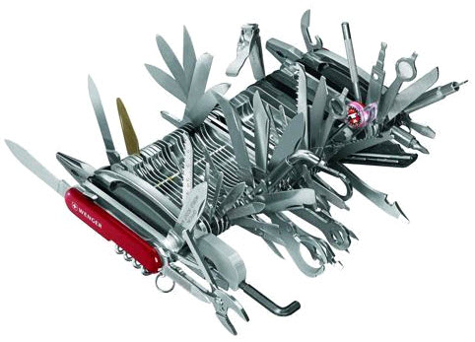
Usability problems
Painful Options

Slide 17
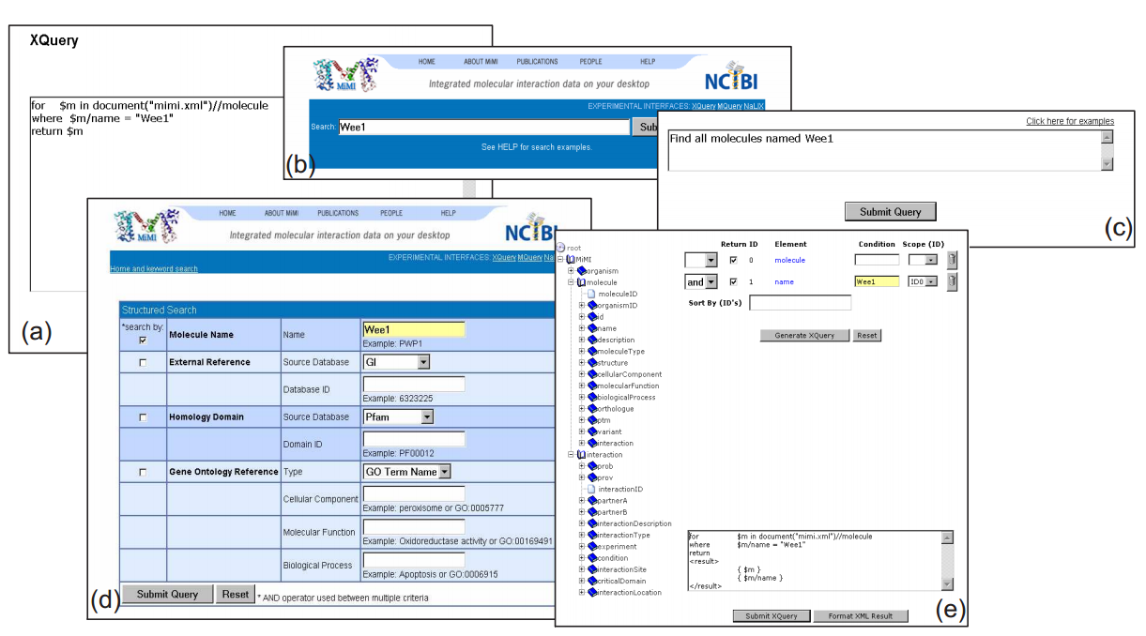
Usability problems
Painful Options

Slide 18
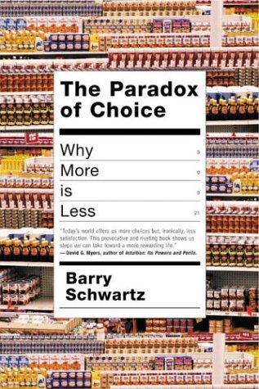
Usability problems
Painful Options

Slide 19
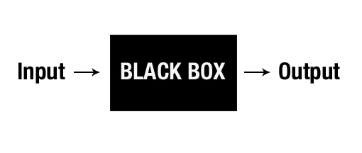
Usability problems
Unexpected Pain
System details shielded from user

Slide 20
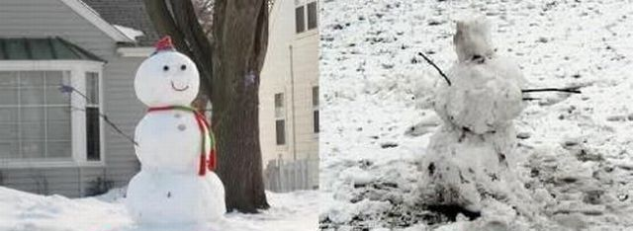
Usability problems
Unexpected Pain
Mental model of user and model of system might not match

Slide 21
Usability problems
Unexpected Pain
Two types of unexpectedness:
Unable to query: user knows what data they want but don’t know how to get it
Unexpected results: result set does not match with expected result set

Slide 22
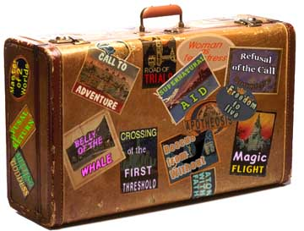
Usability problems
Unexpected Pain
Airline Example: Unable to query

Slide 23
Usability problems
Unexpected Pain
Airline Example: Unexpected results
Users need to know where and why

Slide 24
Usability problems
Unseen Pain
Querying currently requires prediction
Does not follow WYSIWYG principle of usability

Slide 25
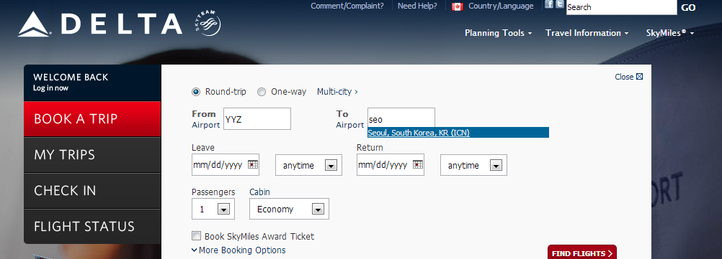
Usability problems
Unseen Pain
Airline Example:

Slide 26
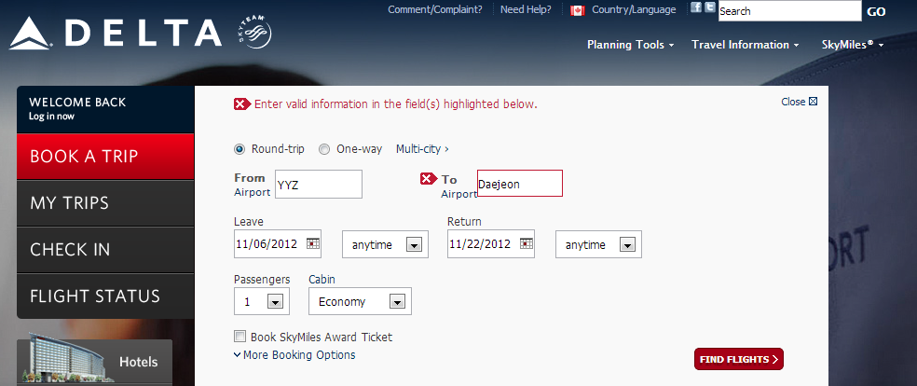
Usability problems
Unseen Pain
Airline Example:

Slide 27
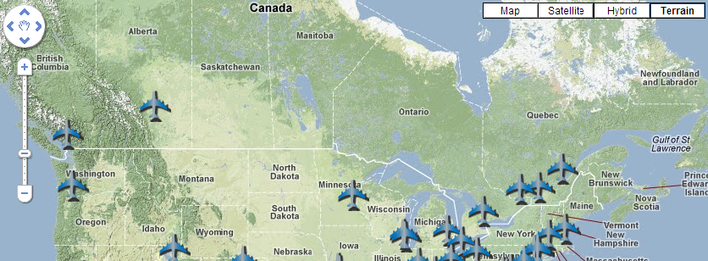
Usability problems
Unseen Pain

Slide 28
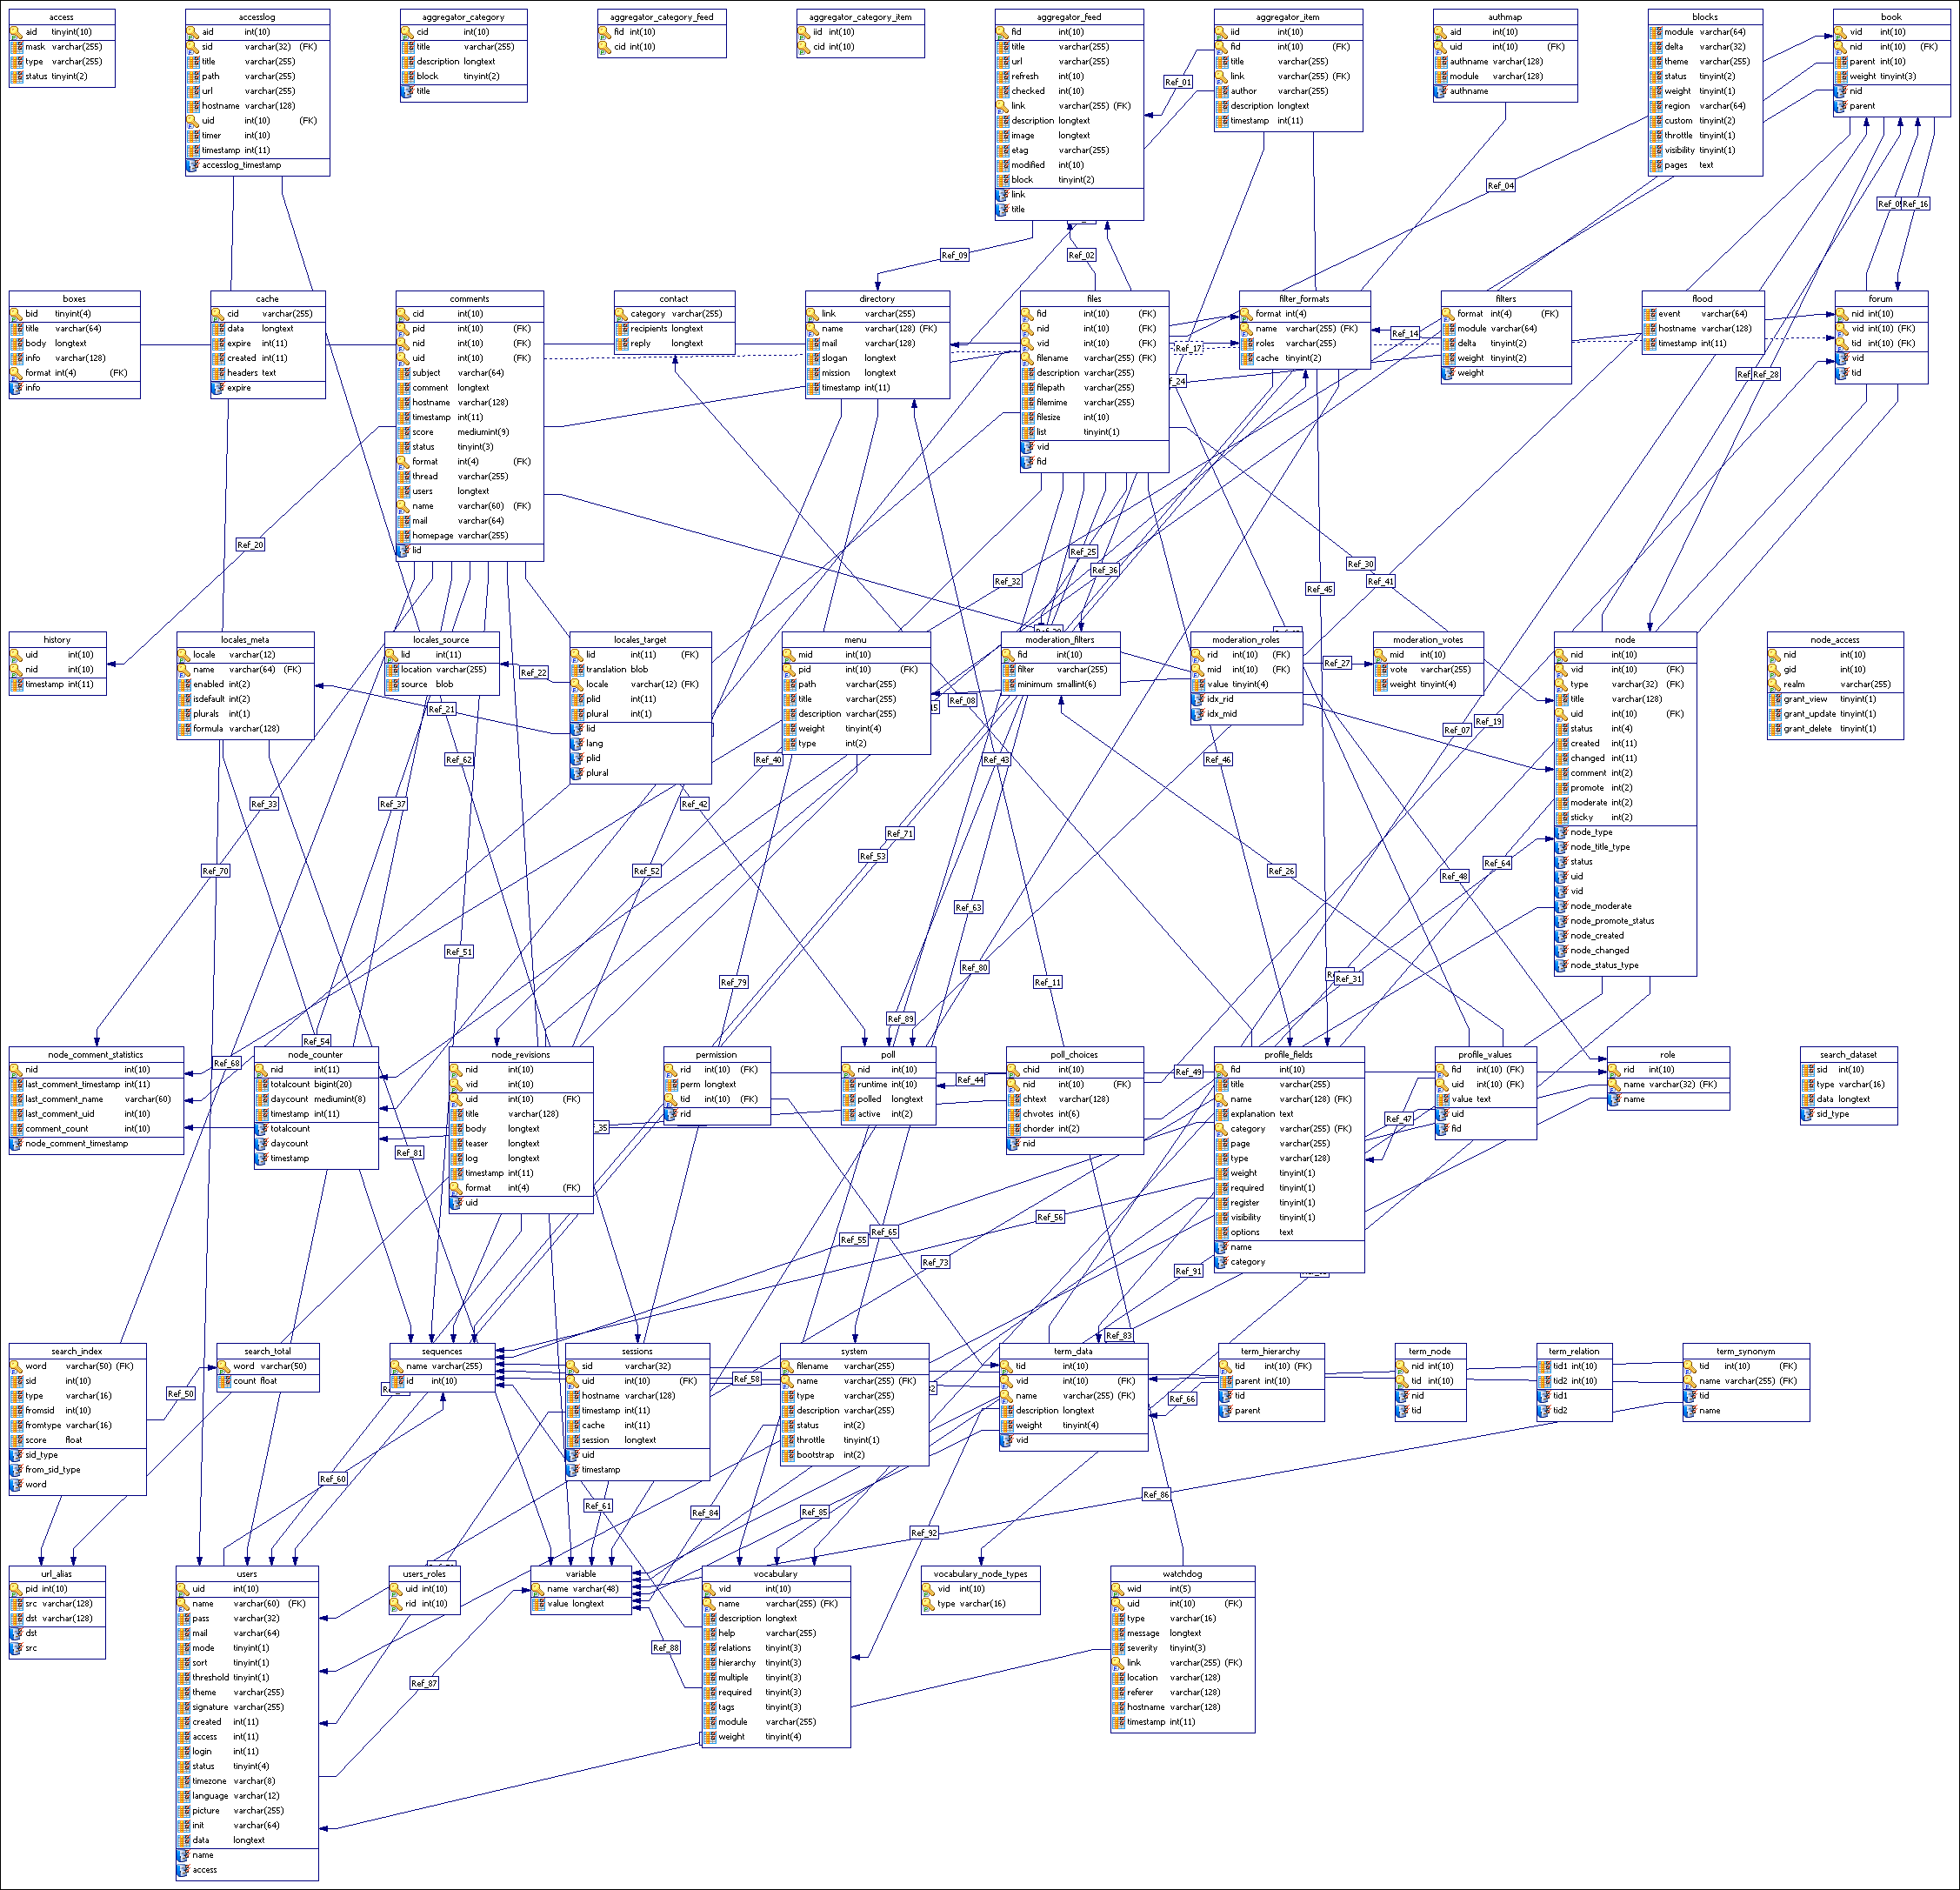
Usability problems
Birthing Pain
Everyday users want to store information
Creating a database is too difficult for most
Involves making a schema

Slide 29
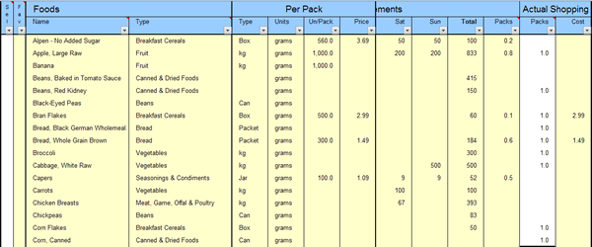
Usability problems
Birthing Pain
Shopping Example:

Slide 30
Usability problems
Birthing Pain
Users do not have clear idea of final structure at inception
The structure will grow as more information becomes available
Information structures might be heterogeneous
These properties must be supported

Slide 31
Current Work in improving usability

Slide 32
Current work
Google Fusion Tables
Design Foundations
Targeted at new users
Seamless integration with the web
Ease of use
Incentives for sharing data
Collaboration

Slide 33
Current work
Google Fusion Tables – New Users
Non-profits
Collaborating scientists
Small businesses

Slide 34
Current work
Google Fusion Tables – Web Integration
Publishing/ Visualising Data
Easily assessable

Slide 35
Current work
Google Fusion Tables – Ease of Use
Pay-as-you-go data management principles
No installation
No schema needed

Slide 36
Current work
Google Fusion Tables – Data Sharing
Afraid of:
Loss of attribution
Misuse and corruption of data
Others not being able to find their data

Slide 37
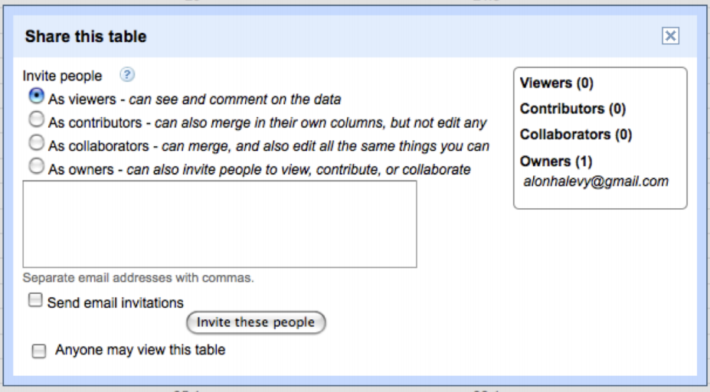
Current work
Google Fusion Tables – Collaboration
Allows joining of data from multiple datasets from multiple users
Allows for commenting on data at levels down to individual cells
Can specify level of collaboration

Slide 38
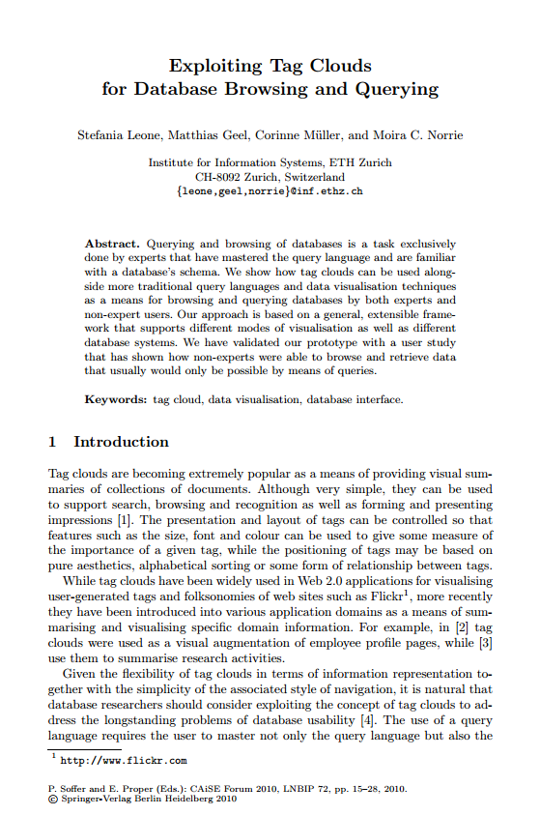
Current work
Tag Cloud Browsing and Querying
Academic example of extending usability
Goal: provide non-expert and expert users with
a user friendly interface for browsing data

Slide 39
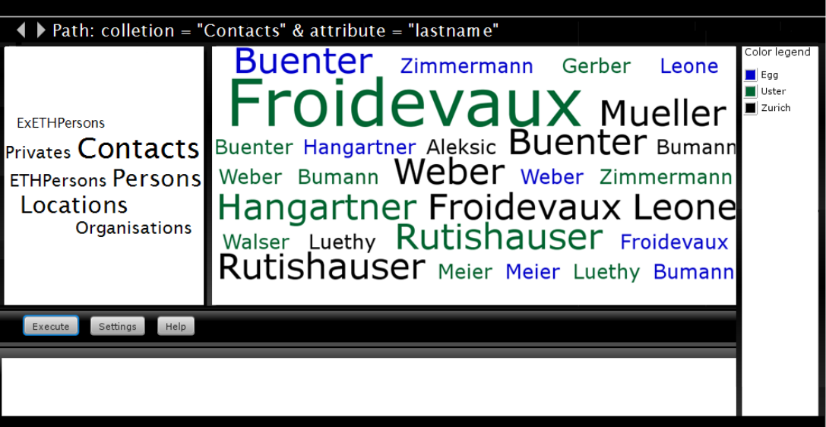
Current work
Tag Cloud Browsing and Querying - Method
Use tag clouds to display data
Two attributes displayed below
Space below for regular SQL queries

Slide 40
Current work
Tag Cloud Browsing and Querying - Method

Slide 41
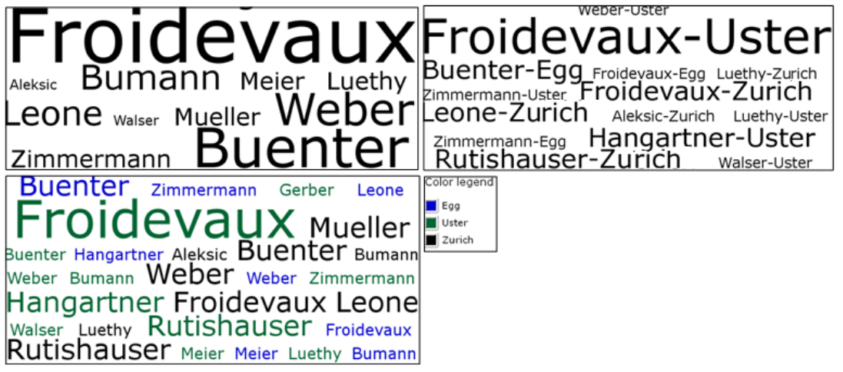
Current work
Tag Cloud Browsing and Querying - Method

Slide 42
Current work
Tag Cloud Browsing and Querying - Method
10 Participants
5 Experts
5 Non-experts
Asked to find answers to 5 queries
Then asked about experiences with system

Slide 43
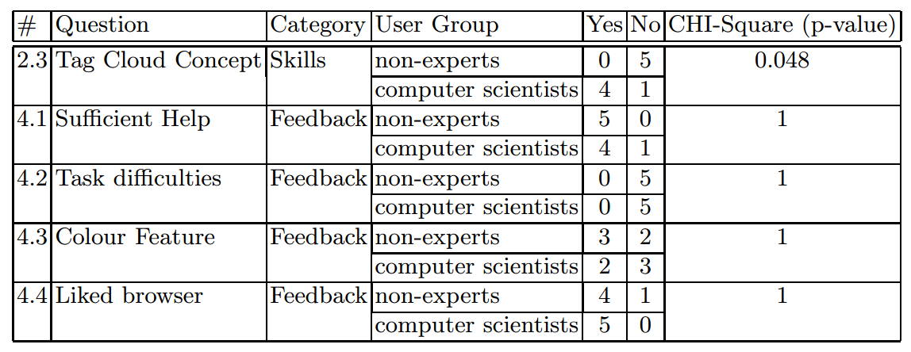
Current work
Tag Cloud Browsing and Querying - Results
All non-experts completed tasks successfully
One expert could not complete 2 of the 5 tasks
Plan to research further and compare to conventional tools

Slide 44
Conclusion
Summary
Databases are currently expensive and difficult to maintain
So they are mostly only used by big businesses
Research into improving usability though is creating more user groups

