Slide 1
CryptDB: Protecting Confidentiality with Encrypted Query Processing by
Raluca Ada Popa
Catherine M. S. Redfield
Nickolai Zeldovich
Hari Balakrishnan
MIT CSAIL
Bože Zekan discusses ...
SOSP’11, October 23-26, 2011, Cascais,Portugal. Copyright 2011, ACM 978-1-4503-0977-6/11/10
Notes:
Confidentiality: limiting read privileges (ex. select) to those who are authorized to read the data. Is the C of the CIA security model.
CryptDB does not guarantee availability, can’t prevent unauthorized deletion/alteration of db data, and doesn’t completely hide table structures.
CryptDB can be extended to ensure the integrity, freshness, and completeness of results returned to the application.

Slide 2
Some Confidentiality Breaches from this Year
Apple 12 million device records, hacked from FBI agent's computer
New York State Electric & Gas Co 1.8 million billings via unauthorized access
Global Payments, Inc. 1.5 million payment-card numbers hacked
Utah Dept. of Technology Services 780,000 health files, East European hackers
53 universities worldwide (ex. John Hopkins, Harvard, Princeton, Stanford, Cornell, Ohio State, New York ) Hacked by Team GhostShell (Oct 8)
Northwest Florida State College 279,000 personal records hacked (Oct 10)
Intel, Citibank, DreamHost, Healing Touch Day Spa, Ruby’s Diner, Masons of California, American Third Position, Boca Ski Club, Sailboat Owners Inc, US Navy, EPA, NASA, PBS, LA County Police Canine Association, NH Dept of Corrections, Verisign, High Tech Crime Solutions, CA Dept of Justice, Computer and Technology Crime High-Tech Response Team (CATCH) , ...
Notes:
So why is there a need for encrypted databases? No matter who you are, if you have data, someone else wants it.
Big business: Apple, Intel, Cityibank
Small business: Healing Touch Day Spa, Ruby’s Diner
Community and recreational groups: Masons of California, American Third Position, Boca Ski Club, Sailboat Owners Inc
White supremacists: American Third Position
Government and law enforcement

Slide 3
Some Website Confidentiality Breaches from this Year
LinkedIn.com, Mountain View, California 6.4 million accounts had their encrypted passwords stolen and posted online
Gamigo, Hamburg, Germany 3 million US accounts hacked (8,243,809 million worldwide)
Yahoo! Voices, Sunnyvale, California 453,492 users had their plain-text passwords stolen via hacker using SQL injection.
Formspring, San Francisco, California 420,000 user accounts on development server exposed
Nvidia, Santa Clara, California 400,000 developer forum accounts exposed
PlaySpan, Foster City, California. 100,000 User IDs, encrypted passwords, and email addresses exposed. (Oct 10)
www.privacyrights.org/data-breach/
www.networkworld.com/slideshow/52525

Slide 4
Confidentiality and CryptDB
CryptDB protects against two types of threats to confidentiality:
1. the curious in-house or 3rd party DBA with full access to the DBMS, who reads but doesn’t alter data or queries
2. an attacker who has taken control of the DBMS and application servers and can access the encryption keys
Notes:
- Generally harder to detect a DBA who just reads data compared to a DBA who alters data

Slide 5
Design Challenges
1. tradeoff between minimizing the amount of confidential information revealed to the DBMS server vs. its ability to efficiently execute a variety of queries.
minimizing amounts of leaked and decrypted data when an adversary compromises the application server and the DBMS server.
→ the stronger the encryption, the slower the query results
(esp. for inequalities, ranges, order by)
Notes:
1. For example, consider if data between application and DBMS is intercepted – or – what data might be journaled
2. “Leaked”, “data leakage” refers to any information that can be inferred from the still encrypted data

Slide 6
Some Previous Approaches
encrypt sensitive data and run all computations (application logic) on clients
2. consider theoretical solutions such as fully homomorphic encryption
- allows servers to compute arbitrary functions over encrypted data w/o first decrypting it
- computationally expensive
Notes:
Approximately 100,000X slower than decrypting data, manipulating it, and encrypting it.
Darpa is spending $20 million on research to speed this up.

Slide 7
CryptDB (Overview) – Key ideas
Introduce a db proxy which executes queries over encrypted data
“Onions of encryption” adjust the encryption scheme depending on the run time SQL query so that most secure encryption is used which still allows efficient query evaluation
3. Chain encryption keys to the online user’s password so that a user’s private data can only be decrypted if that user is on line.
Notes:
1. Possible b/c SQL's set of operators can be made to work efficiently over encrypted data.
2. "onions of encryption“ = layered or cascaded encryption = a sequence of encryptions using multiple keys. (This is enough to overcome the first threat of a compromised DBMS)
3. (This is enough to prevent decryption of the data for any user not logged in).

Slide 8
Application server
runs the application code and issues DBMS queries on behalf of one or more users
is modified so that it provides the db proxy with encryption keys
DBMS server
all its data is encrypted (including table and column names)
cluelessly processes encrypted data as if it were unencrypted
has user defined functions (UDFs) installed to allow it to compute on ciphertexts for certain operations
has some auxiliary tables (ex. Encrypted keys) used by the db proxy
Notes:
→ its query plan for an encrypted query is typically the same as for the original query, except that the operators comprising the query, such as selections, projections, joins, aggregates, and orderings, are performed on ciphertexts, and may use modified operators in some cases.

Slide 9
Database proxy
Encrypts queries received from application and sends them to DBMS
Changes some query operators if necessary, while preserving query's semantics
Decrypts DBMS returned results and send them to the application
Stores master key(s) and an annotated version of application schema (which it uses to check access rights, and to keep track of current encryption level, or onion layer, on each column)
Decides the key = f(user, query) to be used for encrypting/decrypting each data item
Notes:
Major point to notice: encryption granularity is to the column level (not to the row or field level) → change any field’s level of encryption, most change all the fields above and below it in the column

Slide 10
Processing a query:
db proxy intercepts application’s query and rewrites it by anonymizing table and column names & encrypting constants with the key of the encryption scheme best suited for the operation and the user
2. db proxy checks if the DBMS needs to adjust encryption level before executing the query
- if yes → issue an UPDATE query that invokes a UDF to adjust the encryption level layer of the appropriate columns
3. db proxy sends the encrypted query to the DBMS server
DBMS executes query using standard SQL (invoking UDFs for aggregation or keyword searches) and returns the encrypted results
5. db proxy intercepts and decrypts results, and sends them to the application
Notes:
1. Column names are anonymized by assigning them their corresponding onion names.
2. Encryption level aka onion layer

Slide 11
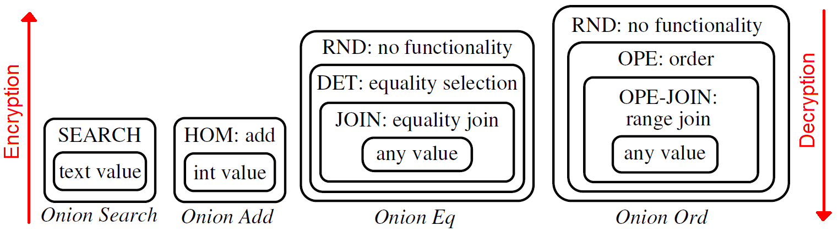
Implementing Layered Encryption
(aka Onions of Encryption)
Seven different cryptographic systems are available to be
cascaded into onions (RND, HOM, SEARCH, DET, (OPE-)JOIN, OPE)
Strong systems leak less data from a compromised DBMS
and are used as the onion’s outer layer.
Inner onion layers are progressively weaker systems and
are only accessed as required by the query.
Notes:
- Each type is best suited for a different SQL operator. Listed from strong to weak wrt cryptographic strength.

Slide 12
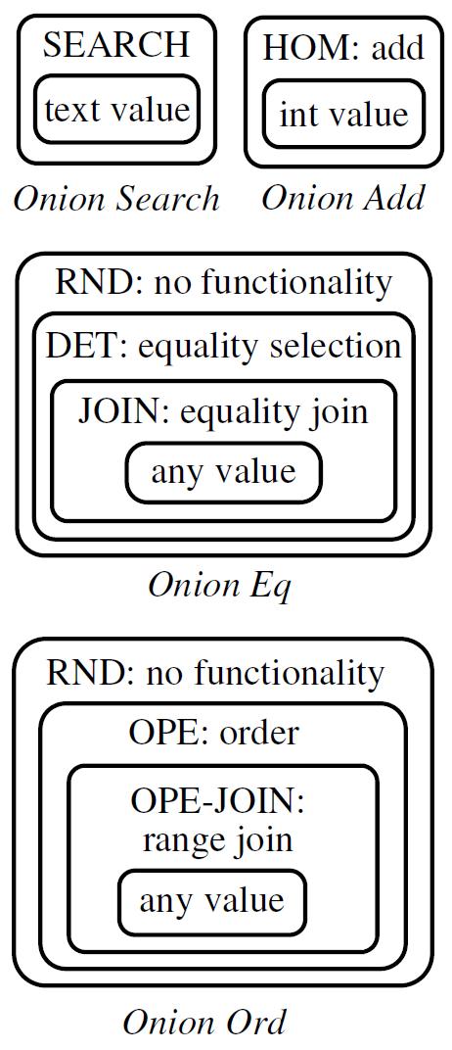
Cryptographic System Details
Random (RND): same plaintext produces different ciphertexts → no leaks (strong), but no efficient computation → used for SELECTs with no predicates
Deterministic (DET): same plaintext produces the same ciphertext
→ leaks the number of occurrences (i.e. histogram)
allows equality checks (SELECTs with equality predicates,
equality joins, GROUP BY, COUNT, DISTINCT
Order-preserving encryption (OPE):
plaintext1 < plaintext2 ←→ ciphertext1 < ciphertext2
→ leaks order (weak) → only used when demanded by user → allows range queries, ORDER BY, MIN, MAX, SORT
Homomorphic encryption (HOM):
E_{KeyHOM}(plaintext1) * E_{KeyHOM}(plaintext2)
= E_{KeyHOM}(plaintext1 + plaintext2)
→ allows SUM, +, AVG when proxy invokes UDF
Notes:
RND: AES w/CBC and random IV; DET: AES with a CMC variant;
OPE: first implementation of Boldyrev et al [4] idea, equiv. to random mapping that preserves order
HOM: using the limited, Paillier's cryptosystem: (multiplication modulo some public key)

Slide 13
Cryptographic System Details
Equi-join (JOIN): necessary b/c different keys are used for DET on columns to prevent cross-column correlation leaks
exponential and elliptic curve system that uses RND and DET to
allow one joined column’s key to synchronize to another join
column’s key for equality checks
Range-join (OPE-JOIN): occurs rarely, involves order checks, and can't use same dynamic technique as JOIN
joined columns must be declared and assigned matching DET
keys ahead of time
Word search (SEARCH): allows LIKE on full word searches, but not regular expressions, and requires a call to a UDF
ex. SELECT * FROM messages WHERE msg LIKE "% alice %"
→ strong but leaks the number of keywords contained in text
Notes:
Equi-join: JOIN(v) = JOIN-ADJ(v) || DET (v) JOIN-ADJ(v) = p ^ K.PRFKo(v) K is columns unique key, Ko is a common key
After adjustment, matching prefix among column item indicates shared equal value between joined columns
SEARCH: first time implementation of Song et al [46]. Each column requiring search has text split into keywords using standard delimiters, duplicates removed, and words then randomly permuted and encrypted

Slide 14
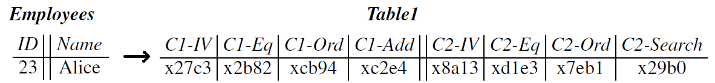
Encrypting the DBMS Data and Incorporating Onions
Application Table (Employees) vs. Table created by DBMS server (Table1)
each application column is expanded into multiple columns (i.e. 1 column
per allowable onion versions)
→ memory storage size increases with number of onions and because
ciphertext is typically larger than plaintext
initially all Table1 fields are encrypted to the highest security level of the
onion (= outer layer) assigned to its column (i.e. RND, HOM, or SEARCH).
At runtime, the proxy dynamically removes or re-add layers of encryption
as necessary to perform a SQL operation
→ stored ciphertext changes even though plaintext remains unchanged
Notes:
Application requirements dictate how many additional columns are needed. Typically, size increases 3.76 times.
Proxy never decrypts the data past the least-secure encryption onion layer.

Slide 15
Keys and Onions
Proxy assigns different keys across tables, columns, onions,
and onion layers (to minimize column correlation leaks).
For table T, column C, onion O, and encryption layer L, the proxy
uses the key: KeyT,C,O,L = E_{MK}(T, C, O, L) (1)
For each layer of each onion, the same key encrypts all the
values in that column at the same time
→ no need to compute separate keys for each
manipulated row but entire column must be
re-encrypted for any layer changes of its onion
Single user system keys are derived from a master key
(MK). Multiuser system keys are derived from MK and keys
rooted in user passwords
Notes:
Proxy keeps track of current layer being used for each onion

Slide 16
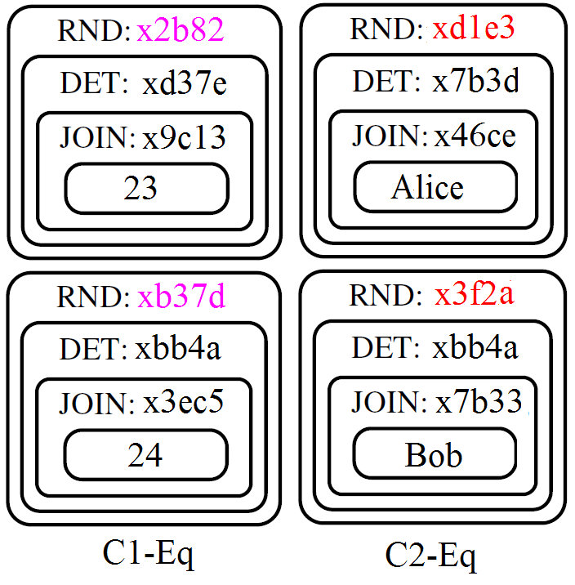
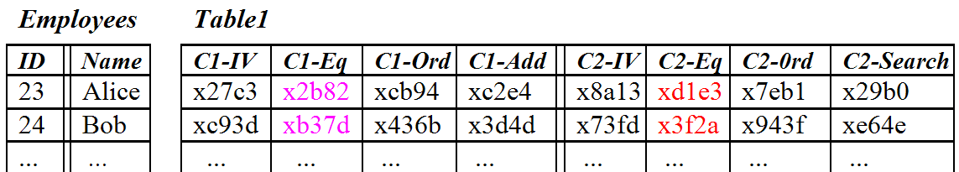
An Dynamic Encrypted SQL Query
Ex: Assume Eq Onions are at the default RND encryption layer, on columns C1-Eq and C2-Eq and that the query is:
SELECT ID FROM Employees
WHERE Name = ‘Alice’
need to get to DET layer of
Eq Onions

Slide 17
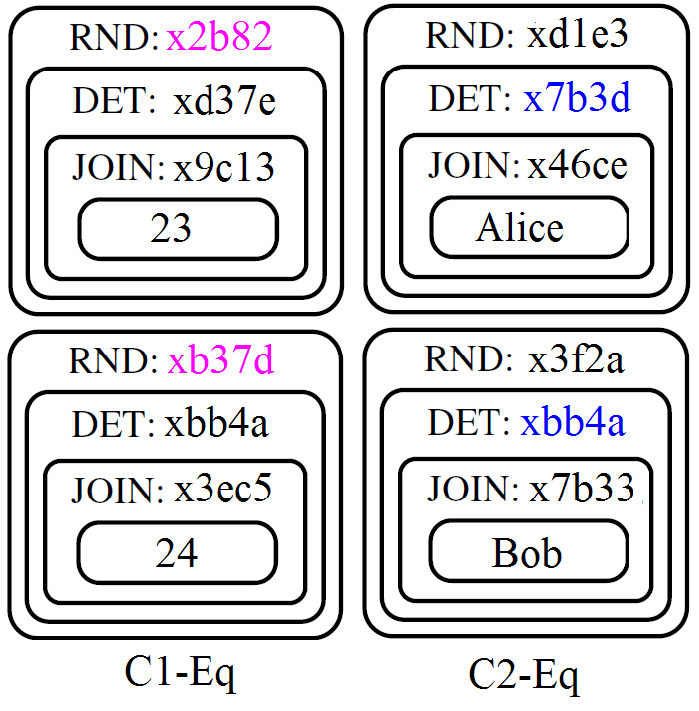
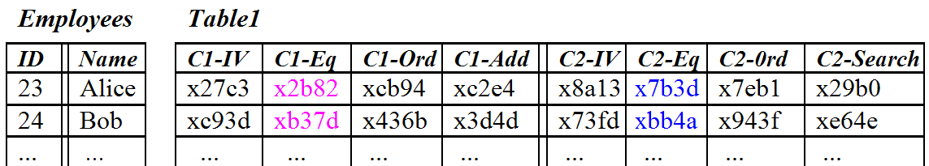
Step 1: Proxy sends to the DBMS:
UPDATE Table1
SET C2-Eq = DECRYPT RND(KeyT1,C2,Eq,RND, C2-Eq, C2-IV)
DBMS decrypts entire C2-Eq column to DET layer:
D_{KeyT1,C2,Eq,RND}(xd1e3, x8a13) = x7b3d
D_{KeyT1,C2,Eq,RND}(x3f2a, x73fd) = xbb4a
...
→ every row is fetched and altered!
Proxy updates its internal state to
log that Table1 column C2-Eq is
now at layer DET in the DBMS.

Slide 18
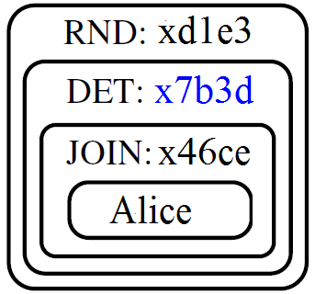
Step 2: Proxy encrypts “Alice”, to its EQ onion,
DET layer encryption value of x7b3d via
E_{KeyT1,C2,Eq,DET}(E_{KeyT1,C2,Eq,JOIN}(Alice))
(equivalent to moving outwards through onion,
or adding a layer)
Proxy generates query and sends it to DBMS:
SELECT C1-Eq, C1-IV FROM Table1 WHERE C2-Eq = x7b3d
NB: Proxy must request the random IV from column C1-IV in
order to decrypt the RND ciphertext from C1-Eq
Eq Onion layers and encrypted values remain unchanged
from previous UPDATE step (i.e. still at the DET layer)
Notes:
IV = initialization value

Slide 19
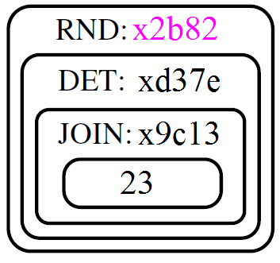
Step 3: Proxy receives encrypted RND level
result x2b82 and decrypts it using:
D_{KeyT1,C1,Eq,JOIN}(D_{KeyT1,C1,Eq,DET}
(D_{KeyT1,C1,Eq,RND} (x2b82, x27c3) ) ) = 23
(equivalent to moving inwards through the
onion, or removing a layer)
Proxy sends decrypted result 23 to the application
Table1’s data, and C1-Eq and C2-Eq’s current layer/level,
remain unchanged from previous step.

Slide 20
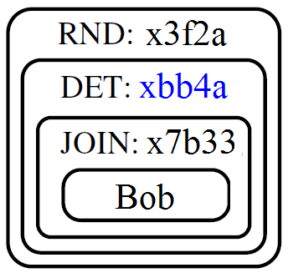
Misc: If next query is also an equality check
Ex. SELECT COUNT(*) FROM Employees
WHERE Name = ‘Bob’
then no new DBMS decryptions are necessary,
as C2-Eq onion/column is already at DET level,
→ proxy directly issues:
SELECT COUNT(*) FROM Table1 WHERE C2-Eq = xbb4a
and xbb4a = E_{KeyT1,C2,Eq,DET} ( E_{KeyT1,C2,Eq,JOIN}(Bob) )
Subsequent equality checks require no en/decryptions on
C2-Eq; en/decryptions only happen when a different operator is requested on that column (ex. JOIN, SELECT w/no WHERE)
-
Notes:
Proxy encrypts each constant or update column value with each onion layer that has not yet been stripped off

Slide 21
More Misc: INSERT, DELETE, and UPDATE are handled similar to SELECT, but ...
for INSERTs and UPDATEs, changing any single data item
requires changing multiple encrypted columns on every row
(for eg, consider Bob legally changing his name to Rob)
Most other DBMS mechanisms (transactions, indexing) work the same way over encrypted data as they do over plaintext, with no modifications (ex. BEGIN, COMMIT, ABORT) but ...
CryptDB doesn’t encrypt NULLs
CryptDB currently does not support stored procedures
an application requested column index results in several
DBMS column indexes being built
Notes:
Some dbs will break when they attempt to work with an encrypted NULL
CryptDB will ask DBMS to build indexes any of that column’s exposed DET, JOIN, OPE, or OPE-JOIN onion layers, but not for RND, HOM, or SEARCH.

Slide 22
Multiple User and Protection Against Threat Type 2
To protect against threat type 2:
CryptDB annotates its db schema per the application’s access control policy
- Users are specified by PRINCTYPE, data to be encrypted by ENC_FOR, and user authorization (including via delegation) by SPEAKS_FOR
- For each private data item in a row, the name of the principal that should have access to that data must be stored in another column in the same row.

Slide 23
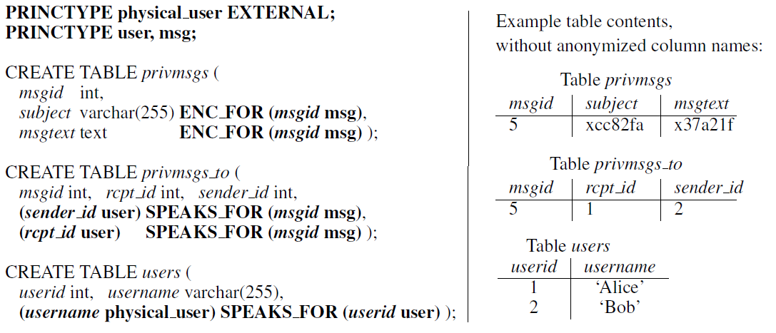
Multiple User and Protection Against Threat type 2
Part of phpBB’s schema with annotations to secure private messages. Only the sender and receiver may see the private message.

Slide 24
Multiple User and Protection Against Threat Type 2
2. CryptDB limits the amount of information disclosed through a compromising of the system by using key chaining.
- The logged in user's password (ex. application-level password) is used to derive the onion keys for their accessible data (as specified in the access control policy annotations).
- If attacker supplies an incorrect password, returned data (if any) will still not be properly decrypted
- When the user logs out, the application must inform the proxy, so that the proxy forgets the user’s password as well as any keys derived from the user’s password.

Slide 25
Security and Performance Improvement Ideas
Allow developers to specify the minimum onion layer that can be exposed. (ex. all credit cards must be at RND)
Doing ORDER BY at the proxy (as it is already getting the entire result set) keeps column at RND instead of OPE
Immediately restore onion layer to it most secure level, to minimize leakage, for infrequent queries
Allow developer to disable the automatic encryption of non-sensitive fields.
If query set is known, developer can discard unused onions, or adjust onion to correct level ahead of time
6. Pre-compute HOM ciphertexts during idle times, and cache common OPE constants
Notes:
Some adjustments can be made wrt performance at the expense of security

Slide 26
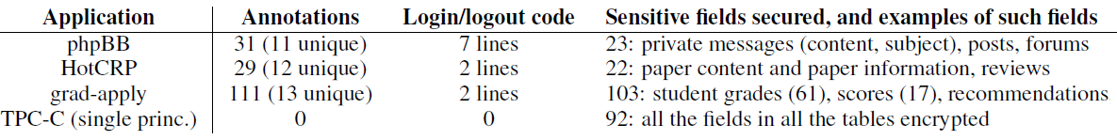
Performance: Modifications Required
Threat 2 protection for multiple user applications
requires only:
11–13 unique or 29 -111 total schema annotations to enforce privacy policies for up to 103 sensitive fields
2 to 7 lines of source code changes for three multi-user web applications

Slide 27
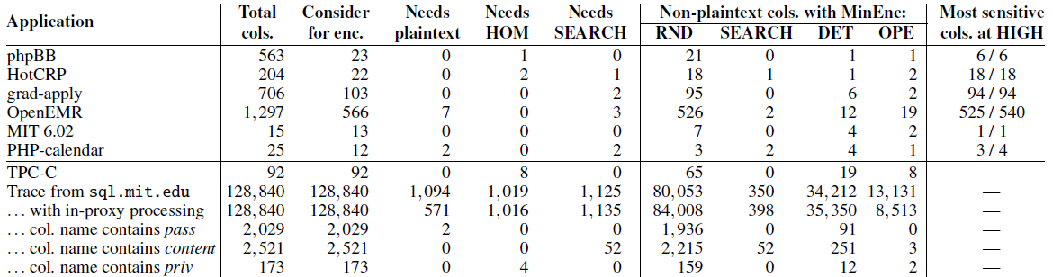
Performance: Query Completion and Data Leakage
Encrypted operations supported over > 99.2 of all columns
Optimally protects most of the sensitive fields with highly secure encryption schemes (ex. SIN)
Not optimal for the more revealing encryption schemes, but these are often on semi-sensitive data (ex timestamps)
Leaks at most the data of currently active users for the duration of the compromise (for the 2nd threat type)
Notes:
CryptDB can't directly support computation and comparison on the same column ex. WHERE salary > age*2 + 10 (requires splitting the query and having the proxy do some work)
HIGH security = RND, HOM, and DET (if columns have no repetitions)
In TPC-C benchmark tests, OPE use is not trivial (from ORDER BY, inequality WHERE, MIN, MAX)

Slide 28
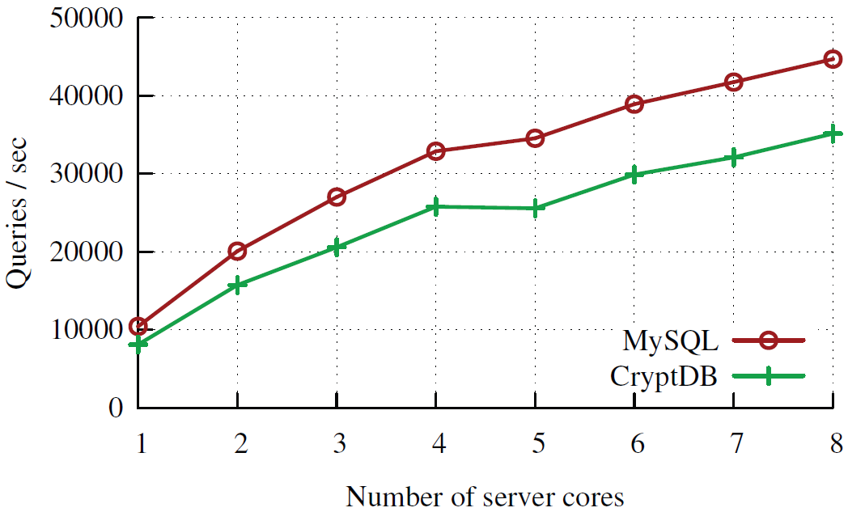
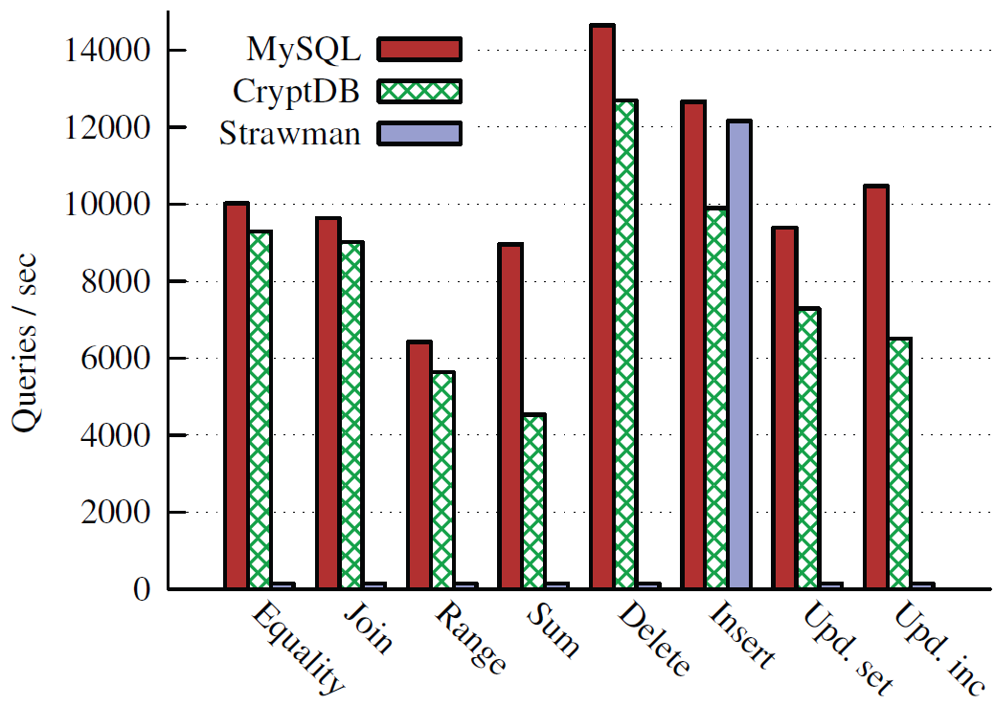
Performance: TPC-C Throughput
(w/ CryptDB trained on query set)
Conditions: all date encrypted, “CryptDB trained”→ no onion adjustments required during the test
SUM and incremented UPDATE are hit the hardest, (b/c of their use of HOM)
Overall throughput reduction of 26%
Notes:
strawman → converts queries and table data to plaintext to do the queries. Performs poorly b/c indexes are of no use since they're encrypted
TPC-C = Transaction Processing Performance Council's On-Line Transaction Processing (OLTP) benchmark)

Slide 29
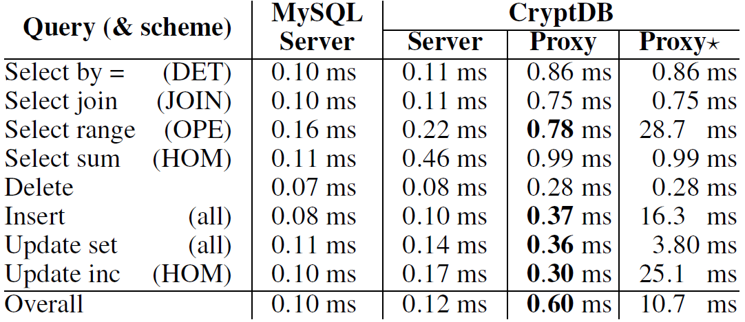
Performance: TPC-C Throughput
(w/ CryptDB trained on query set)
Proxy adds on avg 0.60ms to a query (24% spent in MySQL proxy, 23% in en/decrypting, 53% in parsing and processing queries)
Base proxy uses < 20MB of memory (add 10MB to store 30,000 pre-computed HOM ciphertexts; add 3MB to cache 30,000 common OPE constants)

Slide 30
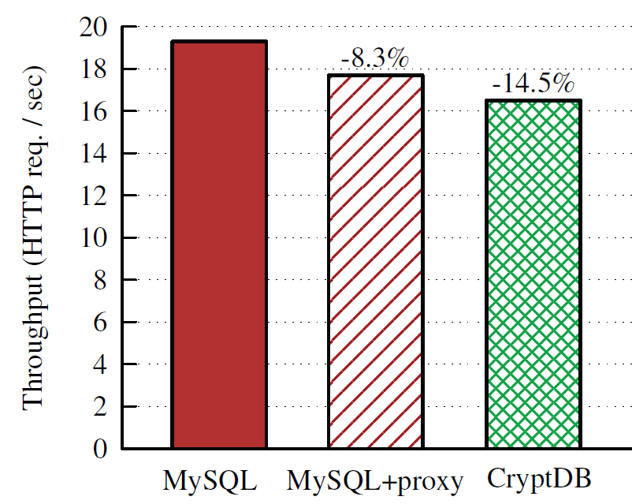
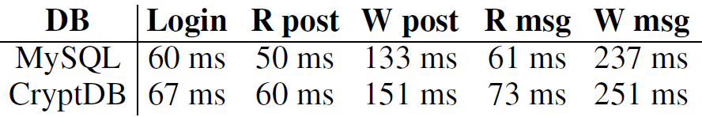
Performance: Multi-user phpBB Web Forum Application
When hit with 5 known vulnerabilities, an attacker not logged in received encrypted data, even w/ root access to all servers
14.5% throughput reduction (but not all fields encrypted). More than ½ of penalty is due to just adding the proxy
CryptDB adds 7–18ms (6–20%) of processing time per phpBB request.

Slide 31
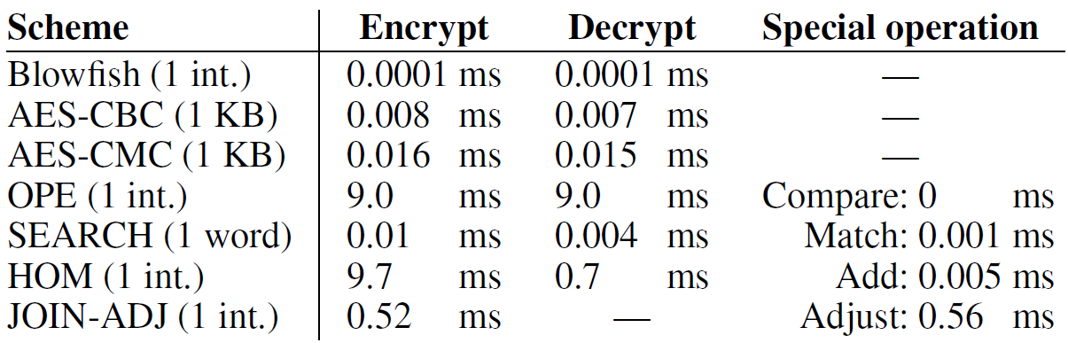
Miscellaneous Information
Encryption Times:
AES-CBC used for RND, AES-CMC used for DET
Source available at: http://css.csail.mit.edu/cryptdb/
Consists of 18000 lines of C++ code and 150 lines of Lua code

