Slide 1
Graphical User Interfaces (Part 2)

Slide 2
View
view
presents the user with a sensory (visual, audio, haptic) representation of the model state
a user interface element (the user interface for simple applications)

Slide 3
Simple Applications
simple applications often consist of just a single window (containing some controls)
JFrame window with border, title, buttons

Slide 4
View as a Subclass of JFrame
a View can be implemented as a subclass of a JFrame
hundreds of inherited methods but only a dozen or so are commonly called by the implementer (see URL below)
Object
Component
user interface item
Container
holds other components
Window
plain window
Frame
window with title and border
JFrame
View
http://java.sun.com/docs/books/tutorial/uiswing/components/frame.html

Slide 5
Implementing a View
the View is responsible for creating:
the Controller
all of the user interface (UI) components
menus JMenuBar, JMenu, JMenuItem
buttons JButton
labels JLabel
text fields JTextField
file dialog JFileChooser
the View is also responsible for setting up the communication of UI events to the Controller
each UI component needs to know what object it should send its events to

Slide 6
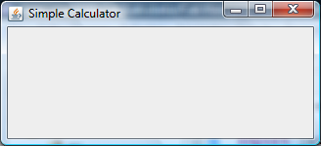
CalcView: Create Controller
public class CalcView extends JFrame
{
public CalcView(CalcModel model)
{
super("Simple Calculator");
model.clear();
CalcController controller =
new CalcController(model, this);
this.setDefaultCloseOperation(JFrame.EXIT_ON_CLOSE);
}
}

Slide 7
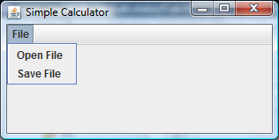
Menus
a menu appears in a menu bar (or a popup menu)
each item in the menu is a menu item
menu
JMenu
menu bar
JMenuBar
menu item
JMenuItem
JMenuBar
+ add(JMenu)
*
JMenu
+ add(JMenuItem)
*
JMenuItem
http://docs.oracle.com/javase/tutorial/uiswing/components/menu.html

Slide 8
Menus
to create a menu
create a JMenuBar
create one or more JMenu objects
add the JMenu objects to the JMenuBar
create one or more JMenuItem objectes
add the JMenuItem objects to the JMenu

Slide 9
Menus
JMenuBar menuBar = new JMenuBar();
JMenu fileMenu = new JMenu("File");
menuBar.add(fileMenu);
JMenuItem printMenuItem = new JMenuItem("Print");
fileMenu.add(printMenuItem);

Slide 10
CalcView: Menubar, Menu, Menu Items

Slide 11
Labels and Text Fields
a label displays unselectable text and images
a text field is a single line of editable text
the ability to edit the text can be turned on and off
label
JLabel
text field (edit off)
JTextField
label
JLabel
text field (edit on)
JTextField
http://docs.oracle.com/javase/tutorial/uiswing/components/label.html
http://docs.oracle.com/javase/tutorial/uiswing/components/textfield.html

Slide 12
Labels
to create a label
JLabel label = new JLabel("text for the label");
to create a text field (20 characters wide)
JTextField textField = new JTextField(20);

Slide 13
CalcView: Labels and Text Fields

Slide 14
Buttons
a button responds to the user pointing and clicking the mouse on it (or the user pressing the Enter key when the button has the focus)
button
JButton
http://docs.oracle.com/javase/tutorial/uiswing/components/button.html

Slide 15
Buttons
to create a button
JButton button = new JButton("text for the button");

Slide 16
CalcView: Buttons

Slide 17
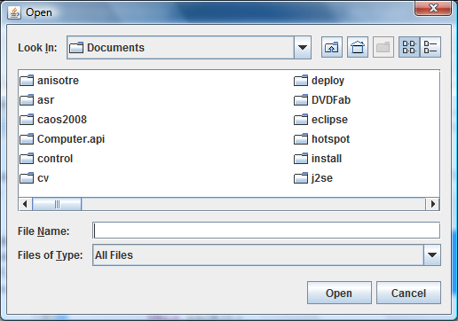
File Chooser
a file chooser provides a GUI for selecting a file to open (read) or save (write)
file chooser (for
choosing a file to open)
JFileChooser
http://docs.oracle.com/javase/tutorial/uiswing/components/filechooser.html

Slide 18
CalcView: File Chooser

Slide 19
Event Driven Programming
so far we have a View with some UI elements (buttons, text fields, menu items)
now we need to implement the actions
each UI element is a source of events
button pressed, slider moved, text changed (text field), etc.
when the user interacts with a UI element an event is triggered
this causes an event object to be sent to every object listening for that particular event
the event object carries information about the event
the event listeners respond to the event

Slide 20
Not a UML Diagram
event
listener A
event
listener B
event
source 1
event object 1
event
listener C
event
source 2
event object 2
event
listener D

Slide 21
Not a UML Diagram
"open"
event object "open"
"save"
"sum"
"subtract"
Controller
"multiply"
"divide"
event object "clear"
"clear"
implements
ActionListener
AbstractButton
ActionEvent

Slide 22
Implementation
each JButton and JMenuItem has two inherited methods from AbstractButton
public void addActionListener(ActionListener l) public void setActionCommand(String actionCommand)
for each JButton and JMenuItem
call addActionListener with the controller as the argument
call setActionCommand with a string describing what event has occurred

Slide 23
CalcView: Add Actions

