Slide 1
A Singleton Puzzle: What is Printed?
public class Elvis {
public static final Elvis INSTANCE = new Elvis();
private final int beltSize;
private static final int CURRENT_YEAR =
Calendar.getInstance().get(Calendar.YEAR);
private Elvis() { this.beltSize = CURRENT_YEAR – 1930; }
public int getBeltSize() { return this.beltSize; }
public static void main(String[] args) {
System.out.println("Elvis has a belt size of " +
INSTANCE.getBeltSize());
}
}
from Java Puzzlers by Joshua Bloch and Neal Gafter

Slide 2
A Singleton Puzzle: Solution
Elvis has a belt size of -1930 is printed
to solve the puzzle you need to know how Java initializes classes (JLS 12.4)
the call to main() triggers initialization of the Elvis class (because main() belongs to the class Elvis)
the static attributes INSTANCE and CURRENT_YEAR are first given default values (null and 0, respectively)
then the attributes are initialized in order of appearance

Slide 3
public static final Elvis INSTANCE = new Elvis();
this.beltSize = CURRENT_YEAR – 1930;
private static final int CURRENT_YEAR =
Calendar.getInstance().get(Calendar.YEAR);
the problem occurs because initializing INSTANCE requires a valid CURRENT_YEAR
solution: move CURRENT_YEAR before INSTANCE
CURRENT_YEAR == 0
at this point

Slide 4
Aggregation and Composition
[notes Chapter 4]

Slide 5
Aggregation and Composition
the terms aggregation and composition are used to describe a relationship between objects
both terms describe the has-a relationship
    the university has-a collection of departments
    each department has-a collection of professors

Slide 6
Aggregation and Composition
composition implies ownership
    if the university disappears then all of its departments disappear
    a university is a composition of departments
aggregation does not imply ownership
    if a department disappears then the professors do not disappear
    a department is an aggregation of professors

Slide 7
Aggregation
suppose a Person has a name and a date of birth
public class Person {
private String name;
private Date birthDate;
public Person(String name, Date birthDate) {
this.name = name;
this.birthDate = birthDate;
}
public Date getBirthDate() {
return birthDate;
}
}

Slide 8
the Person example uses aggregation
  notice that the constructor does not make a copy of the name and birth date objects passed to it
  the name and birth date objects are shared with the client
  both the client and the Person instance are holding references to the same name and birth date
// client code somewhere
String s = "Billy Bob";
Date d = new Date(91, 2, 26); // March 26, 1991
Person p = new Person(s, d);

Slide 9
 | 64 | client
s |  | 250
d |  | 350
p |  | 450
 |  | ...
 | 250 | String object
 |  | ...
 |  | ...
 | 350 | Date object
 |  | ...
 |  | ...
 | 450 | Person object
name |  | 250
birthDate |  | 350

Slide 10
what happens when the client modifies the Date instance?
  prints Fri Nov 03 00:00:00 EST 1995
// client code somewhere
String s = "Billy Bob";
Date d = new Date(90, 2, 26); // March 26, 1990
Person p = new Person(s, d);
d.setYear(95); // November 3, 1995
d.setMonth(10);
d.setDate(3);
System.out.println( p.getBirthDate() );

Slide 11
because the Date instance is shared by the client and the Person instance:
  the client can modify the date using d and the Person instance p sees a modified birthDate
  the Person instance p can modify the date using birthDate and the client sees a modified date d

Slide 12
note that even though the String instance is shared by the client and the Person instance p, neither the client nor p can modify the String
  immutable objects make great building blocks for other objects
  they can be shared freely without worrying about their state

Slide 13
UML Class Diagram for Aggregation
number of Date
objects each Person has
number of String
objects each Person has
1
1
Date
Person
String
open diamonds
indicate aggregation

Slide 14
Another Aggregation Example
3D videogames use models that are a three-dimensional representations of geometric data
  the models may be represented by:
    three-dimensional points (particle systems)
    simple polygons (triangles, quadrilaterals)
    smooth, continuous surfaces (splines, parametric surfaces)
    an algorithm (procedural models)
rendering the objects to the screen usually results in drawing triangles
  graphics cards have specialized hardware that does this very fast

Slide 15
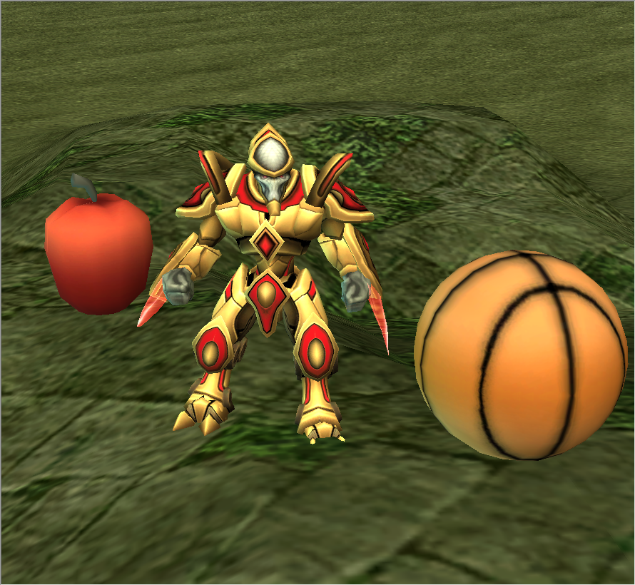

Slide 16
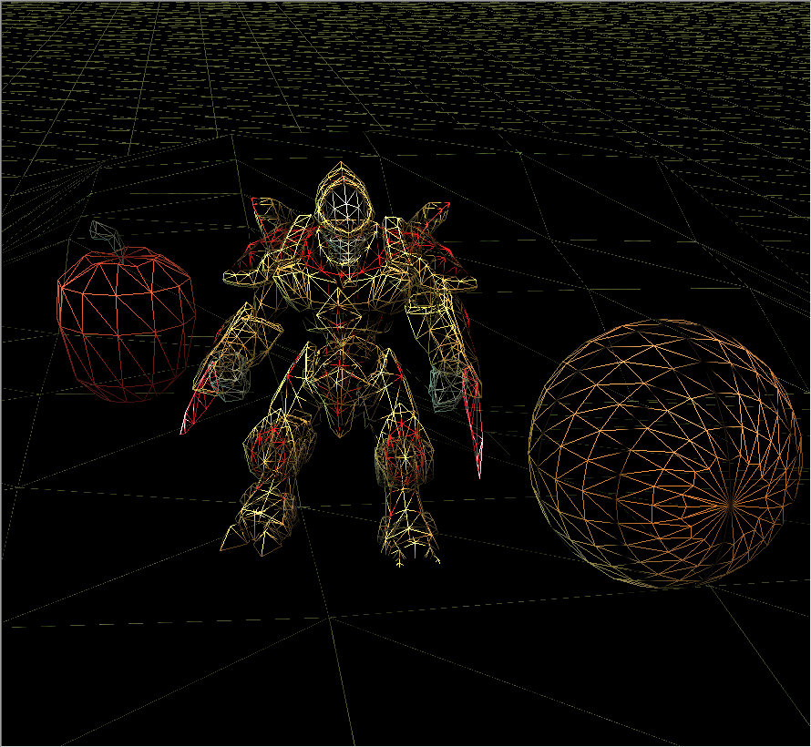

Slide 17
Aggregation Example
a Triangle has 3 three-dimensional Points
3
Triangle
Point
Triangle
+ Triangle(Point, Point, Point)
+ getA() : Point
+ getB() : Point
+ getC() : Point
+ setA(Point) : void
+ setB(Point) : void
+ setC(Point) : void
Point
+ Point(double, double, double)
+ getX() : double
+ getY() : double
+ getZ() : double
+ setX(double) : void
+ setY(double) : void
+ setZ(double) : void

Slide 18
Triangle
// attributes and constructor
public class Triangle {
private Point pA;
private Point pB;
private Point pC;
public Triangle(Point c, Point b, Point c) {
this.pA = a;
this.pB = b;
this.pC = c;
}

Slide 19
Triangle
// accessors
public Point getA() {
return this.pA;
}
public Point getB() {
return this.pB;
}
public Point getC() {
return this.pC;
}

Slide 20
Triangle
// mutators
public void setA(Point p) {
this.pA = p;
}
public void setB(Point p) {
this.pB = p;
}
public void setC(Point p) {
this.pC = p;
}
}

Slide 21
Triangle Aggregation
implementing Triangle is very easy
attributes (3 Point references)
  are references to existing objects provided by the client
accessors
  give clients a reference to the aggregated Points
mutators
  set attributes to existing Points provided by the client
we say that the Triangle attributes are aliases

Slide 22
// client code
Point a = new Point(-1.0, -1.0, -3.0);
Point b = new Point(0.0, 1.0, -3.0);
Point c = new Point(2.0, 0.0, -3.0);
Triangle tri = new Triangle(a, b, c);

Slide 23
 | 64 | client
a |  | 250
b |  | 350
c |  | 450
tri |  | 550
 | 250 | Point object
x |  | -1.0
y |  | -1.0
z |  | -3.0
 | 350 | Point object
x |  | 0.0
y |  | 1.0
z |  | -3.0
 | 450 | Point object
x |  | 2.0
y |  | 0.0
z |  | -3.0
 | 550 | Triangle object
pA |  | 250
pB |  | 350
pC |  | 450

Slide 24
// client code
Point a = new Point(-1.0, -1.0, -3.0);
Point b = new Point(0.0, 1.0, -3.0);
Point c = new Point(2.0, 0.0, -3.0);
Triangle tri = new Triangle(a, b, c);
Point d = tri.getA();
boolean sameObj = a == d;
client asks the triangle for one
of the triangle points and checks
if the point is the same object
that was used to create the triangle

Slide 25
 | 64 | client
a |  | 250
b |  | 350
c |  | 450
tri |  | 550
d |  | 250
sameObj |  | true
 | 250 | Point object
x |  | -1.0
y |  | -1.0
z |  | -3.0
 | 350 | Point object
x |  | 0.0
y |  | 1.0
z |  | -3.0
 | 450 | Point object
x |  | 2.0
y |  | 0.0
z |  | -3.0
 | 550 | Triangle object
pA |  | 250
pB |  | 350
pC |  | 450

Slide 26
// client code
Point a = new Point(-1.0, -1.0, -3.0);
Point b = new Point(0.0, 1.0, -3.0);
Point c = new Point(2.0, 0.0, -3.0);
Triangle tri = new Triangle(a, b, c);
Point d = tri.getA();
boolean sameObj = a == d;
tri.setC(d);
client asks the triangle to set
one point of the triangle to d

Slide 27
 | 64 | client
a |  | 250
b |  | 350
c |  | 450
tri |  | 550
d |  | 250
sameObj |  | true
 | 250 | Point object
x |  | -1.0
y |  | -1.0
z |  | -3.0
 | 350 | Point object
x |  | 0.0
y |  | 1.0
z |  | -3.0
 | 450 | Point object
x |  | 2.0
y |  | 0.0
z |  | -3.0
 | 550 | Triangle object
pA |  | 250
pB |  | 350
pC |  | 250

Slide 28
// client code
Point a = new Point(-1.0, -1.0, -3.0);
Point b = new Point(0.0, 1.0, -3.0);
Point c = new Point(2.0, 0.0, -3.0);
Triangle tri = new Triangle(a, b, c);
Point d = tri.getA();
boolean sameObj = a == d;
tri.setC(d);
b.setX(0.5);
b.setY(6.0);
b.setZ(2.0);
client changes the coordinates of
one of the points (without asking
the triangle for the point first)

Slide 29
 | 64 | client
a |  | 250
b |  | 350
c |  | 450
tri |  | 550
d |  | 250
sameObj |  | true
 | 250 | Point object
x |  | -1.0
y |  | -1.0
z |  | -3.0
 | 350 | Point object
x |  | 0.5
y |  | 6.0
z |  | 2.0
 | 450 | Point object
x |  | 2.0
y |  | 0.0
z |  | -3.0
 | 550 | Triangle object
pA |  | 250
pB |  | 350
pC |  | 250

Slide 30
Triangle Aggregation
if a client gets a reference to one of the triangle's points, then the client can change the position of the point without asking the triangle
run demo program in class here

Slide 31
pointB = new Point(0.0, 1.0, -3.0);
tri = new Triangle(new Point(-1.0, -1.0, -3.0),
pointB,
new Point(2.0, 0.0, -3.0));
// Draw triangle
gl.glBegin(GL2.GL_TRIANGLES);
gl.glColor3f(0.0f, 1.0f, 1.0f); // set the color
gl.glVertex3d(tri.getA().getX(),
tri.getA().getY(),
tri.getA().getZ());
gl.glVertex3d(tri.getB().getX(),
tri.getB().getY(),
tri.getB().getZ());
gl.glVertex3d(tri.getC().getX(),
tri.getC().getY(),
tri.getC().getZ());
gl.glEnd();
// the client moves a point without help from the triangle
delta += 0.05f;
pointB.setY(1.0 + Math.sin(delta));
client and triangle
share a reference to
pointB
draw the triangle
by asking tri for
the coordinates
of each of its points
client uses pointB
to change the point
coordinates

