Slide 1
Introduction to Computer Science II
CSE1030Z
Notes:
login 5065

Slide 2
Before We Begin
Bethune College is looking for Class Representatives
http://bethune.yorku.ca/classreps/
interested in research?
interested in graduate school?
have good university grades?
looking for a summer job?
consider applying for an NSERC USRA Award

Slide 3
NSERC Undergraduate Student Research Awards (USRA) 2013
Information session
Friday, January 11, 1:30–2:30
Lassonde–3033 (Comp Science & Eng building)
Duration and value of awards
16 weeks on a full-time basis (Apr 29–Aug 16, 2013)
$4,500 from NSERC + at least $1,125 from the supervisor
Application deadline
Friday, January 25, 2013, 3:00PM
See www.cse.yorku.ca/undergrad/usra/ for procedure

Slide 4
NSERC Undergraduate Student Research Awards (USRA) 2013
Eligibility
Canadian citizens or permanent residents
Full-time students in natural sciences and engineering
Completed 18 credits of their degree program by December 31, 2012
A cumulative GPA of at least “B”
Program coordinator
Prof. Burton Ma, burton@cse.yorku.ca
For more info
See www.cse.yorku.ca/undergrad/usra/

Slide 5
Who Am I?
Dr. Burton Ma
office
Lassonde 2046
hours : Tuesdays 1:30-4:30PM and by appointment
email
burton@cse.yorku.ca

Slide 6
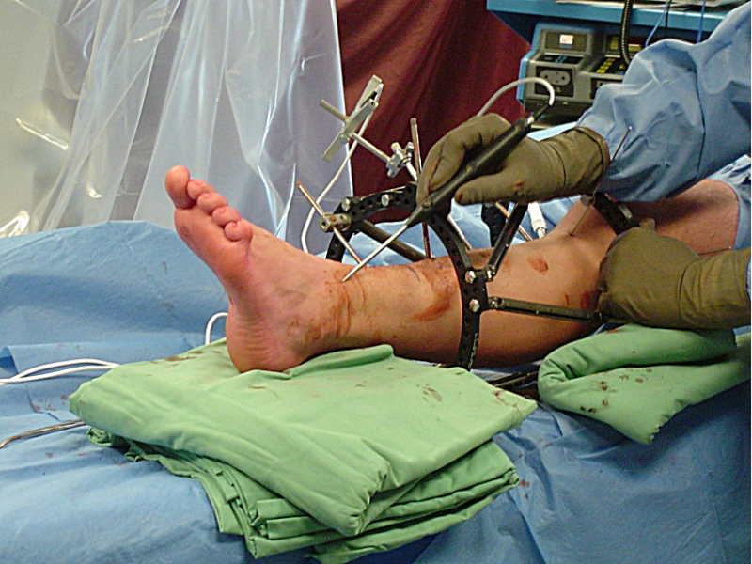
What Do I Do?

Slide 7
Course Format
everything you need to know is on the course website
http://www.cse.yorku.ca/course/1030

Slide 8
CSE1030 Overview
in CSE1020, you learned how to use objects to write Java programs
a Java program is made up of one or more interacting objects
each object is an instance of a class
where do the classes come from?
in CSE1030, you will learn how to design and implement classes
introduction to concepts in software engineering and computer science

Slide 9
CSE1020 Review
critique the following program
public class hairsOnHead
{
public static void main(String[] args) {
int Diameter = 17;
double f = 0.5;
double areaCovered = f * Math.PI * Diameter * Diameter;
int d = 200;
double numberofhairs = areaCovered * d;
System.out.print("The number of hairs on a human head is ");
System.out.println(numberofhairs);
}
}

Slide 10
CSE1020 Review
there are many style errors
public class hairsOnHead
{
public static void main(String[] args) {
int Diameter = 17;
double f = 0.5;
double areaCovered = f * Math.PI * Diameter * Diameter;
int d = 200;
double numberofhairs = areaCovered * d;
System.out.print("The number of hairs on a human head is ");
System.out.println(numberofhairs);
}
}
class names should start with a capital letter
inconsistent brace alignment
variable names should start with a lowercase letter; magic number
variable names should be informative; magic number
variable names should be informative; magic number
variable names should use camelcase
inconsistent indenting

Slide 11
CSE1020 Review
what does the following program print?
public class Puzzle01
{
public static void main(String[] args)
{
System.out.print("C" + "S" + "E");
System.out.println('1' + '0' + '3' + '0' + 'z');
}
}
Notes:
CSE318
49 + 48 + 51 + 48 + 122

Slide 12
CSE1020 Review
which of the following methods are associated with a class?
static boolean disjoint(Collection<?> c1, Collection<?> c2)
void setIcon(Icon newIcon)
String toString()
static int round(double a)
static void showMessageDialog(Component parent, Object message)

Slide 13
CSE1020 Review
what is the return type for each of the following methods?
static boolean disjoint(Collection<?> c1, Collection<?> c2)
void setIcon(Icon newIcon)
String toString()
static int round(double a)
static void showMessageDialog(Component parent, Object message)

Slide 14
CSE1020 Review
how many parameters do each of the following methods have, and what are their types?
static boolean disjoint(Collection<?> c1, Collection<?> c2)
void setIcon(Icon newIcon)
String toString()
static int round(double a)
PrintStream printf(String format, Object... args)

Slide 15
CSE1020 Review
what is a method precondition
what is a method postcondition?
what happens if a precondition is violated?
who is responsible if a postcondition is false?

Slide 16
CSE1020 Review
a type.lib.Fraction object has two attributes: a numerator and a denominator
draw the memory diagram for the following program
after line 1 completes
after line 2 completes
import type.lib.Fraction;
public class Fraction1 {
public static void main(String[] args) {
Fraction f = new Fraction(1, 2); // 1
f.add(new Fraction(3, 4)); // 2
}
}

Slide 17
CSE1020 Review
class X is an aggregation of one Y; it has a method getY that returns a reference to its Y object
what are the values of sameState and sameObject?
Y y = new Y();
X x = new X(y); // x has a reference to y
boolean sameState = y.equals(x.getY());
boolean sameObject = y == x.getY();

Slide 18
CSE1020 Review
class X is an composition of one Y; it has a method getY that returns a reference to its Y object
what are the likely values of sameState and sameObject?
Y y = new Y();
X x = new X(y); // x uses composition with y
boolean sameState = y.equals(x.getY());
boolean sameObject = y == x.getY();

Slide 19
CSE1020 Review
class X is an composition of one Y; it has a method getY that returns a reference to its Y object
furthermore, Y is immutable
what are the likely values of sameState and sameObject?
Y y = new Y();
X x = new X(y); // x uses composition with y
boolean sameState = y.equals(x.getY());
boolean sameObject = y == x.getY();

Slide 20
CSE1020 Review
consider the following UML diagram
which statements are true?
Object is a CreditCard
CreditCard is an Object
RewardCard is an Object
RewardCard is a CreditCard
a CreditCard is usable anywhere a RewardCard is required
a RewardCard is usable anywhere a CreditCard is required

Slide 21
CSE1020 Review
t is a reference to a List<String> object
write some code that prints out each element of t
Notes:
for (String s : t)
System.out.println(s);

Slide 22
CSE1020 Review
p is a reference to a Map<String, Integer> object
write some code that prints out each key-value pair of p
Notes:
for (Map.Entry<String, Integer> e : p.entrySet())
System.out.println(e.getKey() + ": " + e.getValue());
for (String s : p.keySet())
System.out.println(s + “: “ + p.get(s));

Slide 23
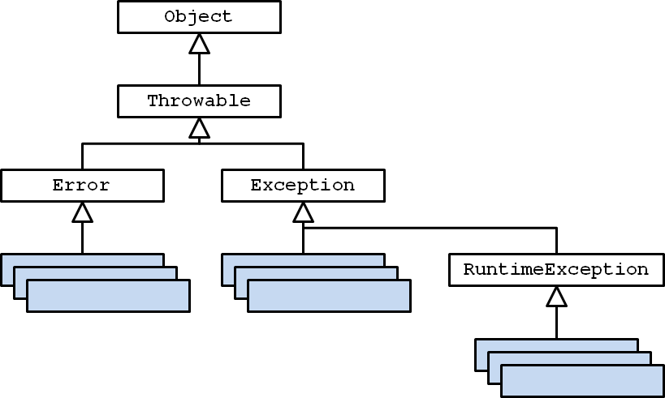
CSE1020 Review
consider the UML diagram for Java exceptions:
checked exceptions are subclasses of … ?
unchecked exceptions are subclasses of … ?

Slide 24
CSE1020 Review
consider the UML diagram for some common exceptions:
will the following code fragment compile?
try { // some legal code not shown here }
catch (IndexOutOfBoundsException e) { // not shown }
catch (StringIndexOutOfBoundsException e) { // not shown }

