Slide 1
Fiducial Registration 2

Slide 2
Issues
the use of the least-squares criteria assumes
identically distributed noise in each point
isotropic noise in each point
more accurate (although more complicated) algorithms are available if these criteria are not met
Matei and Meer, IEEE PAMI, 28(10), Oct 2006

Slide 3
Characterizing Error
most commonly used noise distribution is the zero-mean Gaussian (or normal) distribution
mean (location)
covariance (spread)
fiducial localization error

Slide 4
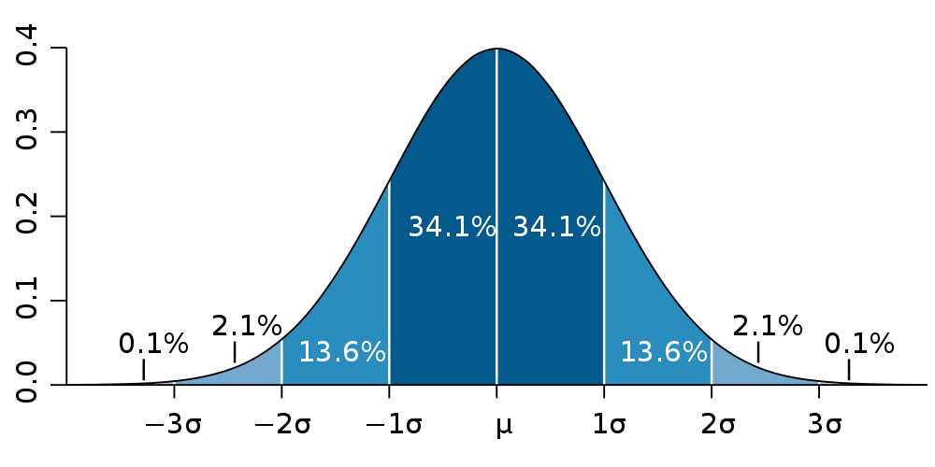
Characterizing Error
in 1D
standard deviation
variance

Slide 5
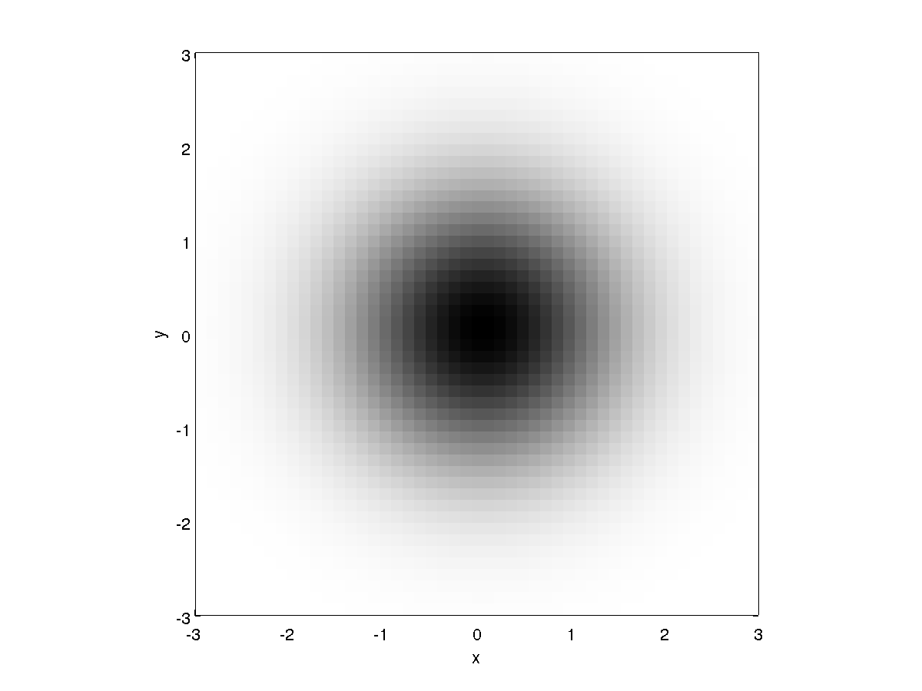
Characterizing Error
in 2D
isotropic

Slide 6
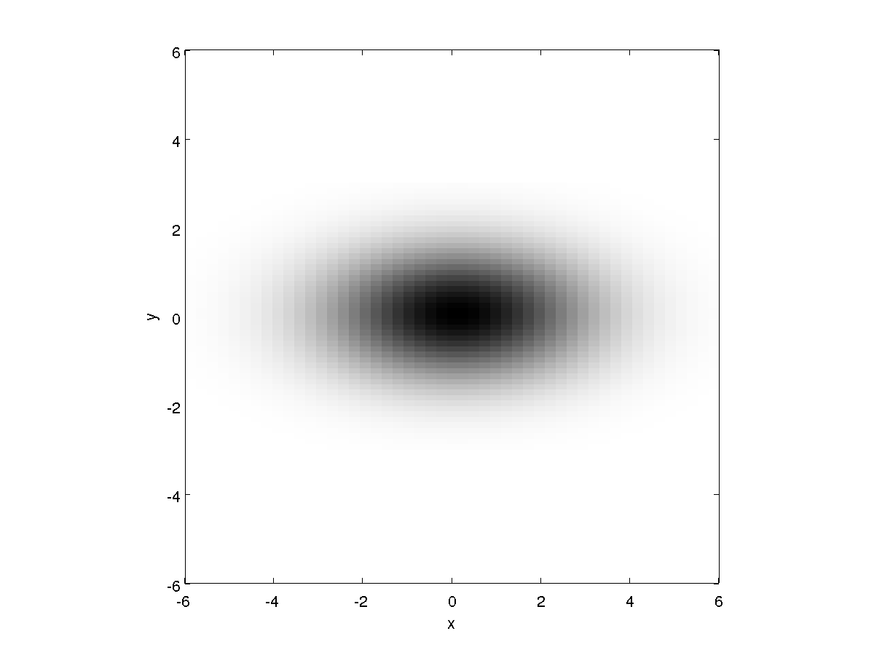
Characterizing Error
in 2D
anisotropic

Slide 7
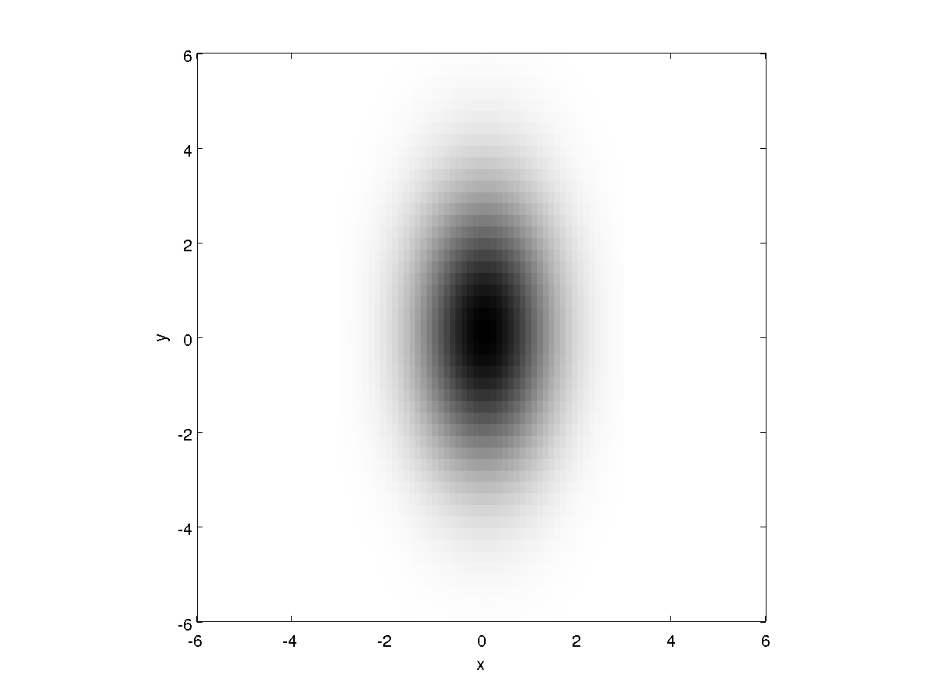
Characterizing Error
in 2D
anisotropic

Slide 8
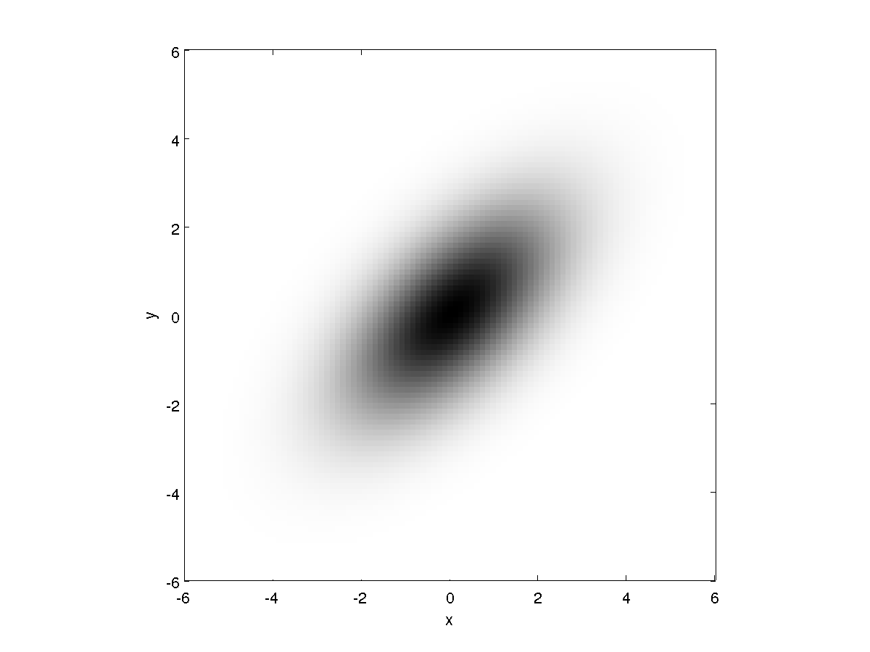
Characterizing Error
in 2D
anisotropic

Slide 9
Horn's Method and FLE
Horn's method (and all other ordinary least-squares methods) is optimal when FLE is identical and isotropic
{L}
{R}

Slide 10
Horn’s Method and FLE
if we assume the measurement noise occurs only in {L}
FLE is independent, isotropic, zero-mean Gaussian
FLE is additive
has same distribution as n_{i}

Slide 11
Horn’s Method and FLE
what happens if the FLE is in {R}?
what happens if the FLE is in {L} and {R}?

