Slide 1
Math/CSE 1019C: Discrete Mathematics for Computer Science Fall 2012
Jessie Zhao
jessie@cse.yorku.ca
Course page:
http://www.cse.yorku.ca/course/1019

Slide 2
Final Exam
Time: Dec 20th , 2pm
Location: TM TMEAST
Assignment 6 is released!

Slide 3
Analysis of Algorithms
Measures of efficiency:
Running time
Space used (Not included in this course)
Efficiency as a function of input size
Number of data elements (numbers, points)
Number of bits in an input number
Example: Find the factors of a number n
Example: Determine if an integer n is prime
Example: Find the max in A[1..n]

Slide 4
What operations are counted?
Arithmetic (add, subtract, multiply, etc.)
Data movement (assign)
Control (branch, subroutine call, return)
Comparison

Slide 5
Analysis of Find-max
COUNT the number of cycles (running time) as a function of the input size
Running time (upper bound): c1 + c5 – c3 – c4 + (c2 + c3 + c4)n
Running time (lower bound): c1 + c5 – c3 – c4 + (c2 + c3 )n

Slide 6
Best/Worst/Average Case Analysis
Best case: A[1] is the largest element.
Worst case: elements are sorted in increasing order
Average case: ? Depends on the input characteristics
What do we use?
Worst case or Average-case is usually used:
Worst-case is an upper-bound; in certain application domains (e.g., air traffic control, surgery) knowing the worst-case time complexity is of crucial importance
Finding the average case can be very difficult; needs knowledge of input distribution.
Best-case is not very useful

Slide 7
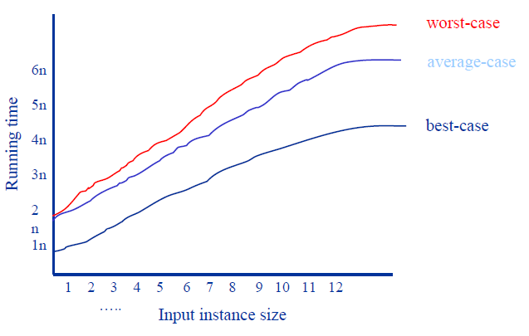
Best/Worst/Average Case

Slide 8
Running time upper bound: c1 + c5 – c3 – c4 + (c2 + c3 + c4)n
What are the values of ci?
Machine-dependent
Constant to n
A simpler expression: a + bn
The running time is Θ(n)
a + bn is O(n)
∃ constants C and k such that ∀n>k a + bn ≤ Cn
a + bn is Ω(n)
∃ constants C and k such that ∀n>k a + bn ≥ Cn

Slide 9
Bounds on running time
1. O() is used for upper bounds “grows slower than”
2. Ω() used for lower bounds “grows faster than”
3. Θ() used for denoting matching upper and lower bounds. “grows as fast as”
The rules for getting the running time are
1. Throw away all terms other than the most significant one
2. Throw away the constant factors.
3. The expression is Θ() of whatever’s left.

Slide 10
Sorting and Searching
Very basic operations
Used very, very often in real applications
LOTS of new ideas

Slide 11
Searching an array
Given an array A[1..n] does there exist a number (key) x?
Unsorted array: linear search
Input: A[1..n]: array of distinct integers; x: an integer.
Output: The location of n in A[1..n], or 0 if n is not found.
LinearSearch(A,x)
j=1
Loop
<loop invariant>: x is not in the scanned subarray.
Exit when j>n or x=A[j]
j=j+1
End loop
if j<=n then return j
else return 0

Slide 12
Proof using loop invariant
Loop
Prove its correctness
Input
Loop
Loop Invariant I
Exit when E
<code>
End Loop
Output
Step 1. Basis case: Input->I
Step 2. Inductive Step: Assume I(i) is true before the ith interaction. Prove it is true after i+1 iteration.
I(i)∧˥E->I(i+1)
Step 3. Show loop terminate and return the correct results. I∧E->Output

Slide 13
LinearSearch(A,x)
j=1
Loop
<loop invariant>: x is not in the scanned subarray.
Exit when j>n or x=A[j]
j=j+1
End loop
if j<=n then return j
else return 0
Proof by using loop invariant.
Basis Case: j=1. No element is scanned.
Inductive Step: Assume x is not in the scanned subarray A[1..j-1]. Prove x is not in A[1..j] if the loop does not terminate. Prove the output is correct if the loop terminates.
If the loop does not terminate.
j<=n and x≠A[j]. Then x is not in A[1..j].
If the loop terminates.
j>n or x=A[j]
If j>n, then j=n+1. By loop invariant, x is not in A[1..n]. The output 0 is correct.
If x=A[j], the n j is returned. The output j is correct.

Slide 14
LinearSearch(A,x)
j=1
Loop
<loop invariant>: x is not in the scanned subarray.
Exit when j>n or x=A[j]
j=j+1
End loop
if j<=n then return j
else return 0
Running Time?
Outside the loop: Constant O(C)
The loop: O(n)
Overall: O(n)

Slide 15
Sorted array: Can we do better?
Binary search: Use the sorted property to eliminate large parts of the array
Input: L[1..n]: a sorted array L(i)<L(j) if 1≤i<j≤n; x: an integer.
Output: The location of n in A[1..n], or 0 if n is not found.
BinarySearch(L,x)
i=1, j=n
Loop
<loop invariant>: If x is in L[1..n], then x is in L[i..j].
Exit when j<=i
mid = ⌊(i+j)/2⌋
If (x ≤ L(mid)) then
j=mid
Else
i=mid+1
End if
End loop
if (x=L(i)) then return i
else return 0
Running time?
O(log n)

Slide 16
By preprocessing (sorting) the data into a data structure (sorted array), we were able to speed up search queries.
Very common idea in Computer Science
Many other data structures are commonly used: linked lists, trees, hash tables,….
CSE 2011: Data Structures
CSE 4101: Advanced Data Structures

Slide 17
Sorting
Input: A[1..n]: array of distinct numbers
Output: A[1..n]: a sorted array A(i)<A(j) if 1≤i<j≤n
Simple algorithm using FindMax
1. j=n
2. while (j>1){
3. maxindex = index of max A[1..j]
4. swap (A[maxindex], A[j])
5. j=j-1
6. }
Proof and Running time? O(n²)

Slide 18
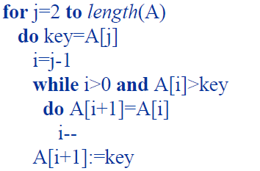
Sorting: Insertion sort
We maintain a subset of elements sorted within a list.
Initially, think of the first element in the array as a sorted list of length one.
One at a time, we take one of the elements (from the original list) and we insert it into the sorted list where it belongs. This gives a sorted list that is one element longer than it was before.
When the last element has been inserted, the array is completely sorted.
Insert A[j] into the sorted list A[1..j-1]

Slide 19
Insert A[j] into the sorted list A[1..j-1]
Loop Invariant: at the start of each for loop, A[1…j-1] consists of elements originally in A[1…j-1] but in sorted order
Proof:
Basis Step: j = 2, the invariant holds because A[1] is a sorted array.

Slide 20
Insert A[j] into the sorted list A[1..j-1]
Loop Invariant: at the start of each for loop, A[1…j-1] consists of elements originally in A[1…j-1] but in sorted order
Inductive Step: Assume elements in A[1…j-1] are sorted.
The inner while loop moves elements A[j-1], A[j-2], …, A[k] one position right without changing their order.
Then the former A[j] element is inserted into kth position so that A[k-1] ≤ A[k] ≤ A[k+1].
A[1…j] is sorted.

Slide 21
Insert A[j] into the sorted list A[1..j-1]
Loop Invariant: at the start of each for loop, A[1…j-1] consists of elements originally in A[1…j-1] but in sorted order
Termination: the loop terminates, when j=n+1.
By loop invariant: “A[1…n] consists of elements originally in A[1…n] but in sorted order”
The output A[1..n] is correctly sorted.

Slide 22
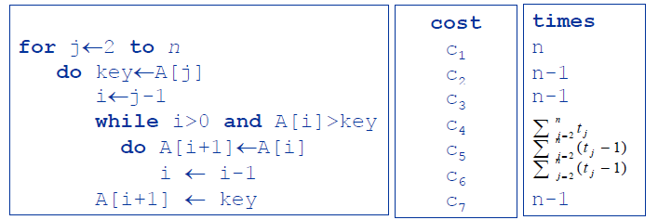
Analysis of Insertion Sort
Let’s compute the running time as a function of the input size.
What is the running time?
O(n²)

Slide 23
Many, many other sorts
bubble sort O(n²)
merge sort, quick sort, heap sort
O(nlogn)
Linear time sorts (require certain type of input): counting sort, radix sort, bucket sort.

Slide 24
Greedy Algorithm
Optimization problems
Find a solution to the given problem that either minimizes or maximizes the value of some parameters.
Greedy Algorithm
Select the best choice at each step
Does the solution always be optimal?

Slide 25
Greedy Algorithm
Example: Want to make change for ANY amount using the fewest number of coins
Simple “greedy” algorithm: keep using the largest denomination possible
Works for our coins: 1,5,10, 25,100.
Does it always work?
Fails for the following coins: 1,5,7,10
e.g: 14 =10 + 1 +1 +1 +1, 14 = 7 + 7

Slide 26
Prove the greedy algorithm works for {1,5,10, 25,100}.
Lemma 1. Using the fewest coins possible has at most three 25(quarters), two 10(dimes), one 5(nickels), four 1(cents), and can not have two 10 and one 5 together.
Proof by contradiction: If we have more than any above numbers, then we can replace them with fewer coins.

Slide 27
Prove the greedy algorithm works for {1,5,10, 25,100}.
Proof by contradiction:
Assume there is an integer n, such that there is a way to make changes using less coins than the greedy algorithm.
Suppose different numbers for 100 (dollars): x dollars for greedy algorithm, and y dollars for the optimal solution
By greedy algorithm x>=y
If x>y, then we need to make up at least 100 from {1,5,10, 25}. This is impossible by lemma 1.
Similarly we can prove the greedy solution and the optimal solution won’t have different numbers for {1,5,10, 25}.
Q.E.D.

Slide 28
Goals
Understand existing classic algorithms
Design simple algorithms
Prove the correctness of an algorithm
Loop Invariant
Analyze the time complexity of an algorithm

