Slide 1
Math/CSE 1019C: Discrete Mathematics for Computer Science Fall 2012
Jessie Zhao
jessie@cse.yorku.ca
Course page:
http://www.cse.yorku.ca/course/1019

Slide 2
Test 1 is ready to pick up!
For questions regarding Assignment 1 marking, please refer to Maria (mma@cse.yorku.ca).
For questions regarding Test 1 marking, please come to my office hours.
Assignment 4 is released today!

Slide 3
Review: Countability
A set is countable if
it is finite or
it has the same cardinality as the set of the positive integers Z⁺ i.e. |A| = |Z⁺|. The set is countably infinite
We write |A| = |Z+| = ℵ0= aleph null
A set that is not countable is called uncountable
Proving the set is countable infinite involves (usually) constructing an explicit bijection with Z⁺

Slide 4
Review: Countability
We have showed the following sets are countable by constructing a bijective function from each set to Z⁺
The set of odd positive integers
f(n)=2n-1
The set of integers
f(n) = n/2 if n is even, and f(n)=(n-1)/2 if n is odd.

Slide 5
Review: Countability
The union of two countable sets is countable.
Assume A and B are disjoint. (If not, then consider (A-B) and B, since A ∪ B=(A-B) ∪B)
Both finite
A∪B is finite, and therefore countable
A is finite and B is countably infinite
A={a_{1,…,}a_{|A|} }, g:N → B is a bijection
New bijection h₁: Z⁺ → A ∪ B
h(n)=a_{n} , if n≤|A|
=g(n-|A|), if n>|A|
Both countably infinite
f: Z⁺ → A, g: Z⁺ → B are bijections
New bijection h₂: Z⁺ → A ∪ B
h₂ (n) = f(n/2) if n is even
= g((n-1)/2) if n is odd.

Slide 6
The rationals are countable
Step 1. Show that Z⁺ x Z⁺ is countable.
Step 2. Show injection between Q⁺, Z⁺ x Z⁺.
Step 3. Construct a bijection from Q⁺ to Q
(details done on the board)

Slide 7
The reals are not countable
Wrong proof strategy:
Suppose it is countable
Write them down in increasing order
Prove that there is a real number between any two successive reals.
WHY is this incorrect?
(Note that the above “proof” would show that the rationals are not countable!!)

Slide 8
The reals are not countable - 2
Cantor diagonalization argument (1879)
VERY powerful, important technique.
Proof by contradiction.
Sketch (details done on the board)
- Assume countable
- look at all numbers in the interval [0,1)
- list them in ANY order
- show that there is some number not listed

Slide 9
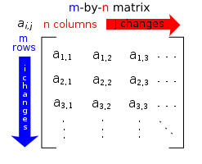
Matrix
A matrix is a rectangular array of numbers.

Slide 10
Matrix Arithmetic
A+B and A-B requires that A and B have the same number of columns and rows.
Let A=[ ], B=[ ] be m-by-n matrices
A+B=[ ]
A-B=[ ]
Example:

Slide 11
The product of A and B, denoted by AB.
AB requires: The number of columns in A is the same as the number of rows in B.
Let A be an m*k matrix and B be a k*n matrix. AB=[ ] is a m*n matrix.
Example
AB=?
BA=?

Slide 12
Transpose
Let A=[ ] be an m*n matrix. The transpose of A, denoted by A’, is an n*m matrix A’=[ ]
Example
More about Matrices: Linear Algebra

Slide 13
The Growth of Functions
How fast does a function grow? How to measure it?
We quantify the concept that g grows at least as fast as f.
What really matters in comparing the complexity of algorithms?
We only care about the behaviour for large problems
Even bad algorithms can be used to solve small problems

Slide 14
Big-O Notation
Assume f:Z➝R and g: Z➝R.
f(x) is O(g(x)) iff ∃ constants C and k such that
∀x>k |f(x)| ≤ C|g(x)|
Constants C and k are called witnesses
The choice of C may depend on the choice of k
When there is one pair of witnesses, there are infinitely many pairs of witnesses

Slide 15
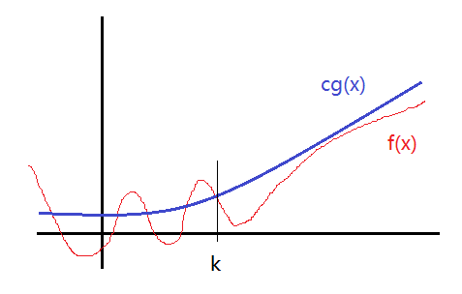
Big-O Notation

Slide 16
Big-O Notation
O(g) is a set called a complexity class
O(g) contains all the functions which g dominates
Notation: f is O(g) or f=O(g) means f∈O(g)

Slide 17
Example: f(x) = x²+2x+1 is O(x²).
Proof:
Observe that whenever x>1, 1<x<x² is true.
Then it follows that for x>1
0 ≤ x²+2x+1 = |f(x)| ≤ x²+2x²+x²=4x² = 4|x²|
∴k=1 and C=4
∴f(x) = O(x²) or f(x) ∈ O(x²)

Slide 18
Example: f(x) = 7x² is O(x³).
Proof:
Observe that whenever x>1, x² <x³ is true.
Then it follows that for x>1
0 ≤ 7x² = |f(x)| ≤ 7x³ = 7|x³|
∴k=1 and C=7
∴f(x) = O(x³) or f(x) ∈ O(x³)

Slide 19
Is it true that x³ is O(7x²)?
Determine whether witnesses exist or not.
Assume we can find C and k such that
x³≤C(7x²) whenever x>k
i.e. x≤7C whenever x>k
No matter what C and k are, the inequality x≤7C cannot hold for all x with x>k.
So, x³ is not O(7x²).

Slide 20
Growth of polynomial functions
The leading term of a polynomial function determines its growth
Let
where are real numbers.
Then f(x) is O(xⁿ).
See the proof in textbook

Slide 21
Properties of Big-O
f is O(g) iff O(f)⊆O(g)
The set O(g) is closed under addition:
If f₁(x) and f₂(x) are both O(g(x)), then (f₁ +f₂)(x) is O(g(x))
The set O(g) is closed under multiplication by a scalar a (a∈R):
If f is O(g) then af is O(g)

Slide 22
Properties of Big-O
If f is O(g) and g is O(h) then f=O(h)
O(f) ⊆ O(g) ⊆ O(h)
If f₁ is O(g₁) and f₂ is O(g₂) then
f₁ f₂ is O(g₁g₂)
f₁ +f₂ is O(max{g₁,g₂})

Slide 23
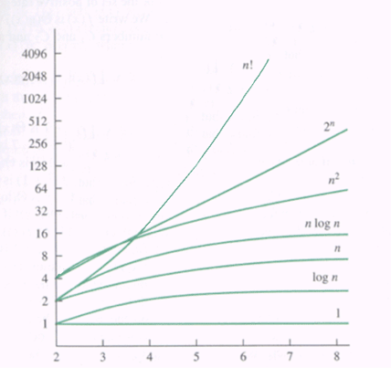
Important Complexity Classes
O(1) ⊆ O(logn) ⊆ O(n) ⊆ O(nlogn) ⊆ O(n²) ⊆ O(nʲ)⊆ O(cⁿ) ⊆ O(n!)
where j>2 and c>1

Slide 24
Some crucial facts
Logarithmic << Polynomial
log1000n << n^{0.001} for sufficiently large n
Linear << Quadratic
1000n << 0.0001n² for sufficiently large n
Polynomial << Exponential
n ¹⁰⁰⁰ << 2^{0.001n} for sufficiently large n

Slide 25
Example: Find the complexity class of the function (nn!+3 ^{n+2} +3n¹⁰⁰)(n^{n} +n2^{n})
Solution:
This means to simplify the expression. Throw out stuff which you know doesn’t grow as fast.
Use the property that if f is O(g) then f+g is O(g)
(i) For nn!+3^{n+2} +3n¹⁰⁰, eliminate 3^{n+2} and 3n¹⁰⁰ since n! grows faster than both of them
(ii) Now simplify n^{n} + n2^{n}, which grows faster? Take the log (base 2) of both (since the log is an increasing function whatever conclusion we draw about the logs will also apply to the original functions)
Compare nlogn and logn+n, nlogn grows faster so we keep n^{n} .
The complexity class is O(nn! n^{n} )

Slide 26
Big-Omega
Assume f:Z➝R and g: Z➝R.
f(x) is Ω(g(x)) iff ∃ positive constants C and k such that
∀x>k |f(x)| ≥ C|g(x)|
Big-O vs Big-Omega :
Big-O provides upper bound for functions
Big-Omega provides lower bound for functions

Slide 27
Big-Theta
Assume f:Z➝R and g: Z➝R.
f(x) is Θ(g(x)) iff f(x)=O(g(x)) and f(x)=Ω(g(x))
Big-Theta Θ provides both upper and lower bounds for functions

