Slide 1
Math/CSE 1019C: Discrete Mathematics for Computer Science Fall 2012
Jessie Zhao
jessie@cse.yorku.ca
Course page:
http://www.cse.yorku.ca/course/1019

Slide 2
No Assignment is released today!
No Class on Thanks Giving! Oct 8th
Test 1 on Oct 15^{th,}
Ch1.1-1.8
7pm-8:20pm
Location: SLH F
Lecture: 8:40pm, SLH A.

Slide 3
Review of Sets
What is a set?
Unordered collection of distinct elements
How to describe a set?
Roster method: A={5,7,3}
set builder (predicates): S = {x | P(x)}
Cardinality |S|
number of (distinct) elements |A| = 3

Slide 4
Exercises
What is the cardinality of {∅,{∅,{∅}}}? What is its power set?
Prove that A ⊂ B iff P(A) ⊂P(B).
Draw the Venn Diagrams for

Slide 5
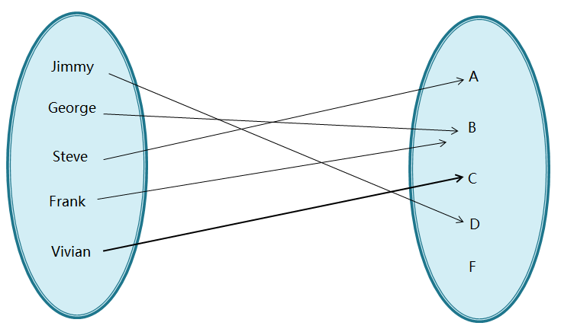
Review of Functions
A function from A to B is an assignment of exactly one element of B to each element of A.
grade: S → G
S G

Slide 6
This is not a function!
Every member of the domain must be mapped to a member of the co-domain
S G
Jason

Slide 7
This is not a function!
No member of the domain may map to more than one member of the co-domain
S G

Slide 8
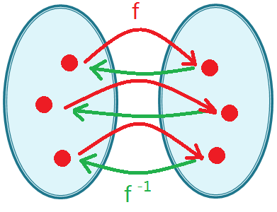
Surjections (onto)
Injections (1-1)
Bijections (1-1 correspondence): Invertible

Slide 9
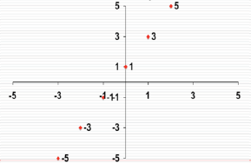
Graphs of Functions
Let f: A➝B. The graph of f is the set of ordered pairs {(a,b) | a∈A and f(a)=b}
Example: The graph of f:Z->Z where f(x)=2x+1

Slide 10
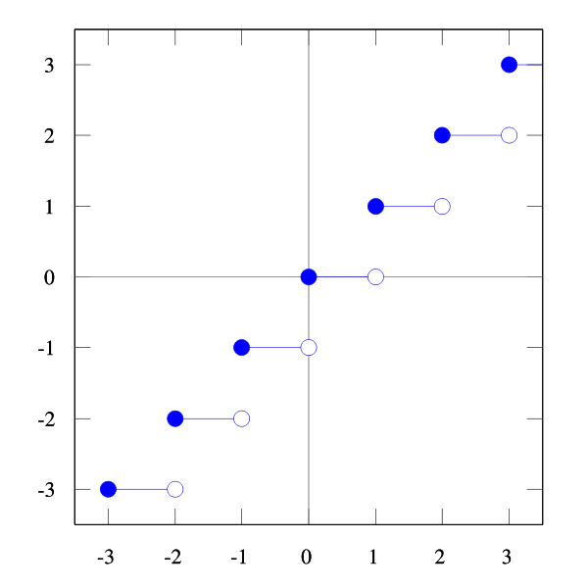
The Graph of Floor function R->Z
⌊x⌋ is the largest integer that is less than or equal to x.

Slide 11
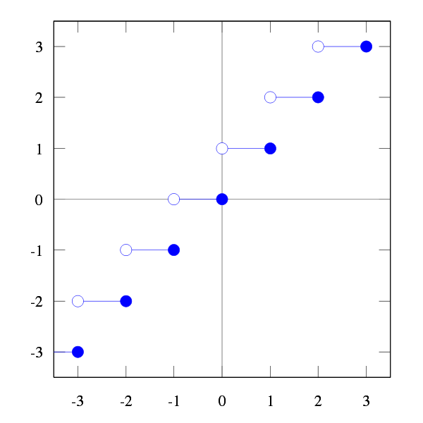
The Graph of Ceiling function R->Z
⌈x⌉ is the smallest integer that is greater than or equal to x.

Slide 12
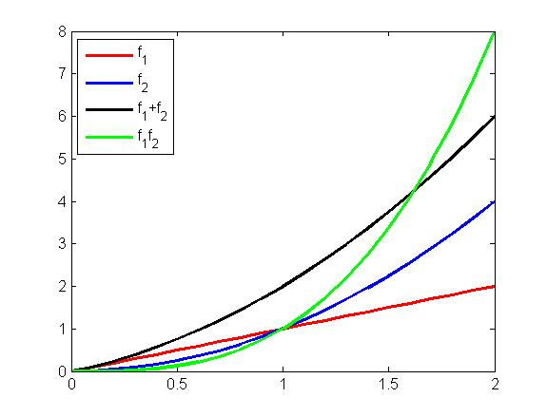
Let f and g be functions from A to R. Then f₁+f₂ and f₁f₂ are also functions from A to R
(f₁+f₂)(x) = f₁ (x) + f₂ (x)
(f₁f₂)(x) =f₁ (x) f₂(x)
Example:
f₁(x)=x, f₂(x)=x²
(f₁+f₂ )(x)=x + x²
(f₁f₂ )(x)= x³
Notice the difference
between and fg

Slide 13
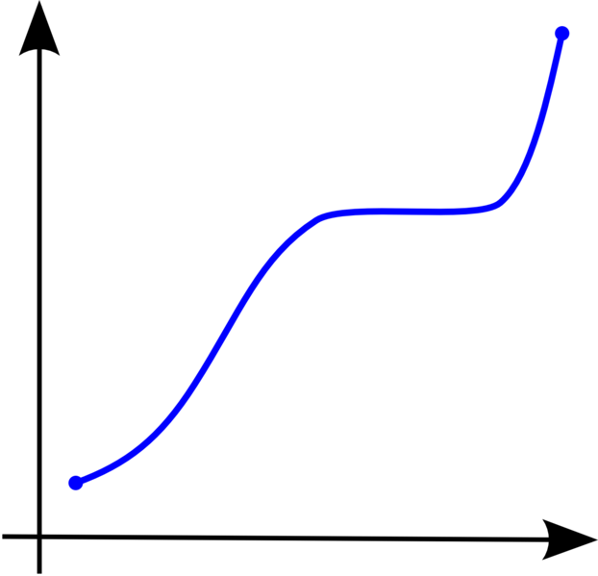
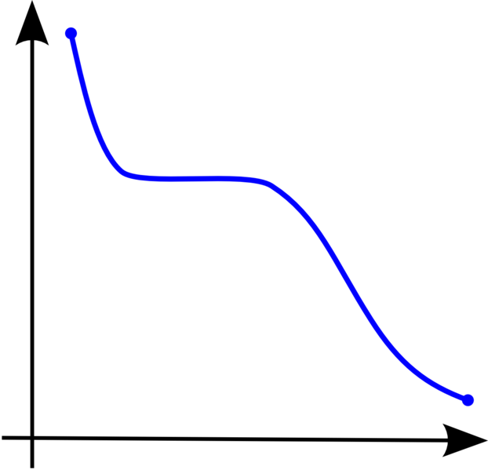
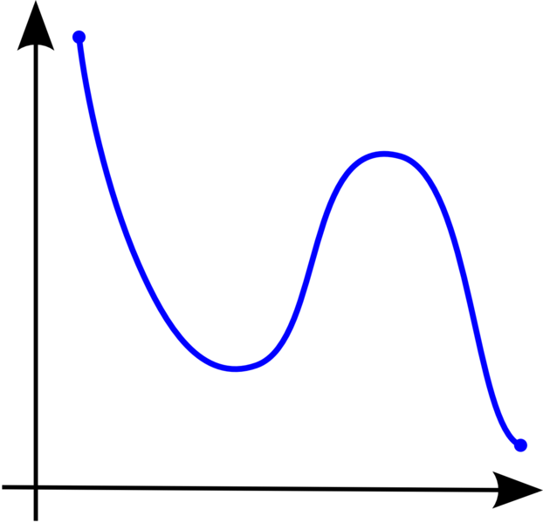
Monotonic Functions
The domain and codomain of f are subsets of R. x, y are in the domain of f and x<y.
f is (monotonically) increasing if f(x)≤f(y)
f is strictly increasing if f(x)<f(y)
f is (monotonically) decreasing if f(x)≥f(y)
f is strictly decreasing if f(x)>f(y)
Increasing Decreasing Not Monotonic

Slide 14
More Exercises for functions
Show that ⌈x+n⌉ is ⌈ x ⌉ +n for x∈R and n∈Z.
Proof:
Assume ⌈ x ⌉ = m.
m-1 < x ≤ m
n+m-1 < x+n ≤ m+n
⌈ x+n ⌉ = m+n = ⌈ x ⌉ +n
Q.E.D.

Slide 15
More Exercises for functions
Show that ⌊2x⌋ is ⌊ x ⌋ + ⌊ x+1/2 ⌋ for x∈R.
Proof:
Assume x=n+e where n∈Z, e∈R and 0≤e<1.
Case 1: 0≤e<1/2
⌊ 2x⌋= ⌊ 2n+2e ⌋ = 2n (0≤2e<1)
⌊ x ⌋ = ⌊ n+e ⌋ = n (0≤e<1/2)
⌊ x+1/2 ⌋ = ⌊ n+e+1/2 ⌋ = n (1/2≤e+1/2<1)
So, ⌊ 2x ⌋ = ⌊ x ⌋ + ⌊ x+1/2 ⌋
Case 2: 1/2≤e<1
⌊ 2x⌋ = ⌊ 2n+2e ⌋ =2n+1 (1≤2e<2)
⌊ x ⌋ = ⌊ n+e ⌋= n (1/2≤e<1)
⌊ x+1/2 ⌋ = ⌊ n+e+1/2 ⌋ = n +1 (1≤e+1/2<1 1/2)

Slide 16
More Exercises for functions
Changing bases: In general need to go through the decimal representation
E.g: 101₇ = ?₉
101₇ = 1*7² +0*7¹ + 1*7⁰ = 50
Decimal to Base 9:
d₁ = n rem 9 = 5, n = n div 9 = 5
b₂ = n rem 9 = 5, n = n div 9 = 0.
STOP
So 101₇ = 55₉

Slide 17
More Exercises for functions
Changing bases that are powers of 2:
Can often use shortcuts.
Binary to Octal:
10111101 = 275₈
Binary to Hexadecimal:
10111101 = BD₁₆
Hexadecimal to Octal: Go through binary, not decimal.

Slide 18
More Exercises for functions
1. Prove that a strictly increasing function from R to itself is one to one
2. Suppose that f:Y->Z and g:X->Y are invertible. Show that

Slide 19
Sequences
A sequence is an ordered list, possibly infinite, of elements
notated by {a₁, a₂, a₃ ...} or
where k is the upper limit (usually ∞)
A sequence is a function from a subset of the Z (usually {0,1,2,...}) to another set
an is the image of the the integer n. We call an a term of the sequence, and n is its index or subscript

Slide 20
Arithmetic Progressions
An arithmetic progression is a sequence of the form
a, a+d, a+2d, a+3d,. . ., a+(n-1)d,...
a is the initial term
d is the common difference
E.g.
{-1, 3, 7, 11, ...}
{7,4,1,-2, ...}

Slide 21
Geometric Progressions
An geometric progression is a sequence of the form
a, ar, ar², ar³,. . ., arⁿ,...
a is the initial term
r is the common ratio
E.g.
{1,-1,1,-1,1, ...}
{2,10,50,250,1250, ...}

Slide 22
Useful Sequences
{n²}: 1, 4, 9, 16, 25, ....
{n³}: 1, 8, 27, 64, 125, ...
{n ⁴}: 1, 16, 81, 256, 343, ...
{2ⁿ}: 2, 4, 8, 16, 32, ...
{3ⁿ}: 3, 9, 27, 81, 243, ...
{n!}: 1, 2, 6, 24, 120, ...
{f_{n}}: 1, 1, 2, 3, 5, 8, …

Slide 23
Series
A series is the sum of the terms of a sequence
S = a₁ + a₂ + a₃ + a₄ + …
Consider the sequence S₁, S₂, S₃, … S_{n}, where
S_{i} = a₁ + a₂ + … + a_{i}
In general we would like to evaluate sums of series – useful in algorithm analysis.
e.g. what is the total time spent in a nested loop?

Slide 24
Summations
Given a sequence {ai} the summation notation for its terms am, am+1,..., an
represent am + am+1 + … + an
E.g.

Slide 25
Summation of Arithmetic Progression
Given a arithmetic progression a, a+d, a+2d, a+3d, . . ., a+nd, its summation is
Proof on board
You should also be able to determine the sum if the index starts at k and/or ends at n-1, n+1, etc.
Page 166: useful summation formula

Slide 26
Summation of Geometric Progression
Given a geometric progression a, ar², ar³, ... , arⁿ, its summation is
Proof on board
You should also be able to determine the sum if the index starts at k and/or ends at n-1, n+1, etc.

Slide 27
Infinite series
Let x be a real number with |x|<1. Find
How about |x|≥1?
Need to be very careful with infinite series
In general, tools from calculus are needed to know whether an infinite series sum exists.

Slide 28
Double Summation
loop 1: for i=1 to 4
loop 2: for j=1 to 3
S = S + ij

Slide 29
Cardinality
Recall: A set is finite if its cardinality is some (finite) integer n
For two sets A and B
|A| = |B| if and only if there is a bijection from A to B
|A| ≤ |B| if there is an injection from A to B
|A| = |B| if |A| ≤ |B| and |B| ≤ |A|
|A| ≤ |B| if A⊆B

Slide 30
Infinite sets
Why do we care?
Cardinality of infinite sets
Do all infinite sets have the same cardinality?

Slide 31
Countability
A set is countable if
it is finite or
it has the same cardinality as the set of the positive integers Z⁺ i.e. |A| = |Z⁺|. The set is countably infinite
We write |A| = |Z+| = ℵ0= aleph null
A set that is not countable is called uncountable

Slide 32
Countability implies that there is a listing of the elements of the set.
Fact (Will not prove): Any subset of a countable set is countable.
Proving the set is countable involves (usually) constructing an explicit bijection with Z⁺

Slide 33
Show that the set of odd positive integers S is countable.
Proof:
To show that S is countable, we will show a bijective function between Z⁺ and S.
Consider f: Z⁺ ->S be such that f(n) = 2n-1.
To see f is one-to-one, suppose that f(n)=f(m), then 2n-1=2m-1, so n=m.
To see f is onto, suppose that t∈S, i.e. t=2k-1 for some positive integer k. Hence t=f(k).
Q.E.D.

Slide 34
The integers are countable
Write them as
0, 1, -1, 2, -2, 3, -3, 4, -4, ……
Find a bijection between this sequence
and 1,2,3,4,…..
Notice the pattern:
1 → 0 2 → 1
3 → -1 4 → 2
5 → -2 6 → 3
So f(n) = n/2 if n even
-(n-1)/2 o.w.

Slide 35
Other simple bijections
Union of two countable sets A, B is countable:
Say f: N → A, g:N → B are bijections
New bijection h: N → A ∪ B
h(n) = f(n/2) if n is even
= g((n-1)/2) if n is odd.

Slide 36
The rationals are countable
Step 1. Show that Z⁺ x Z⁺ is countable.
Step 2. Show injection between Q⁺, Z⁺ x Z⁺.
Step 3. Construct a bijection from Q⁺ to Q

