Slide 1
Math/CSE 1019C: Discrete Mathematics for Computer Science Fall 2012
Jessie Zhao
jessie@cse.yorku.ca
Course page:
http://www.cse.yorku.ca/course/1019

Slide 2
Permutation
For any integer n>0, the number of permutations of a set with n elements is n!
A permutation of a set of elements is an ordering of the elements.
E.g. the set of elements {a, b, c} can be ordered in the following ways:
abc acb cba bac bca cab
By the product rule, there are n(n-1)(n-2)..1=n! permutations

Slide 3
Ex: Suppose there are 50 students in the class,
In how many ways can the whole class stand in a line?
50!
In how many ways can we select three students to stand in a line?
50*49*48

Slide 4
r-permutation
An r-permutation is an ordering of r elements of a set of n elements, denoted by P(n,r)
E.g. the 2-permutations of the set of elements {a, b, c} are:
ab ac ba bc ca cb
By the product rule, there are n(n-1)(n-2)....(n-r+1) r-permutations

Slide 5
r-permutation
P(n,r) = n!/(n-r)! = n(n-1)(n-2)....(n-r+1) for 0≤r≤n
Special cases:
P(n,0) = 1
P(0,0) = 1
P(n,n) = n!

Slide 6
Recall: How many one-to-one functions are there from a set with m elements to one with n elements?
n(n-1)...(n-m+1) when m≤n
0 when m>n

Slide 7
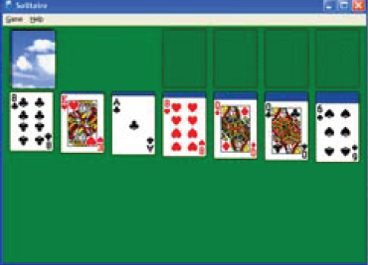
For the solitaire hand that show initially
How many possible hands?
p(52,7)
How many possible hands with no Aces?
p(48,7)
How many possible hands with one or more Aces?
P(52,7)-P(48,7)

Slide 8
Combinations
An r-combination is an unordered selection of r elements of a set of n elements, denoted by C(n,r)
E.g. the 2-combinations of the set of elements {a,b, c} are:
{a,b} {a,c} {b,c}

Slide 9
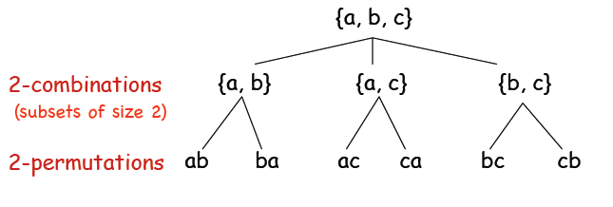
Combinations & Permutations
There are r! permutation of each subset
There are more r-permutation than r-combinations.

Slide 10
Combinations
Corollary: C(n,r) = C(n,n-r)

Slide 11
For a deck of 52 cards,
How many poker hands of five cards can there be?
C(52,5)=2,598,960
How many ways are there to select 47 cards?
C(52,47)=C(52,5)=2,598,960

