Slide 1
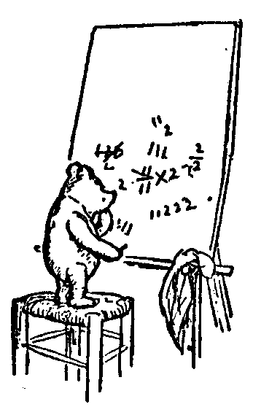
Halting Problem is Uncomputable
One page proof Halting is Undecideable
History of Computability
The Halting Problem
Understanding Quantifiers
Some Uncomputable Problem
Halting Problem is Uncomptable
Review
Questions
Jeff Edmonds
York University
Many Courses

Slide 2
Please feel free
to ask questions!
Notes:
2

Slide 3
One page proof Halting is Undecidable
Watch YouTube Video
https://www.youtube.com/watch?v=92WHN-pAFCs
Notes:
3

Slide 4
One page proof Halting is Undecidable
∀M ∃ I M(I)≠Halting(I)
We will do this
same proof
in more detail.
Suppose there was a working algorithm:
  Halt(“M”,I) = whether program M halts on input I
Construct from it another algorithm:
  P_{hard}(M) = if(Halt(“M”,“M”)) loop forever
  else halt
  = halts ↔ program M does not halt on input M.
Paradox: P_{hard}(“P_{hard}”) = ?
On test I do not want
this proof,
but the first order
logic one.
program P_{hard} halts on input P_{hard}
↔
program P_{hard} does not halt on input P_{hard}
Contradiction!

Slide 5
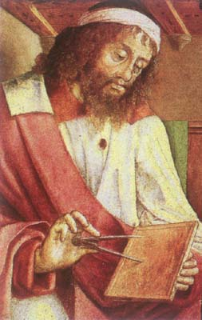

History of Computability
In the beginning:
Euclid said,
“ Let there be an algorithm for GCD”
And so it was.
GCD(a,b) = GCD(x,y)
⟨x,y⟩
⇒ ⟨y,x mod y⟩
And it was good.
Euclid (300 BC)
He gave a new understanding of
“Algorithm”

Slide 6
History of Computability
As one gets closer to God,
everything is possible.
We must only learn how to do it.
Unknown
Euclid (300 BC)
Known
GCD

Slide 7
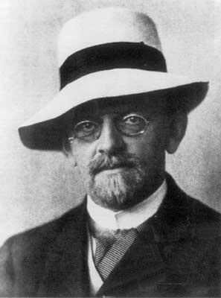
History of Computability
Can every problem be computed?
Or are some Uncomputable?
Hilbert (1900)
Need to formally define
“Algorithm”

Slide 8
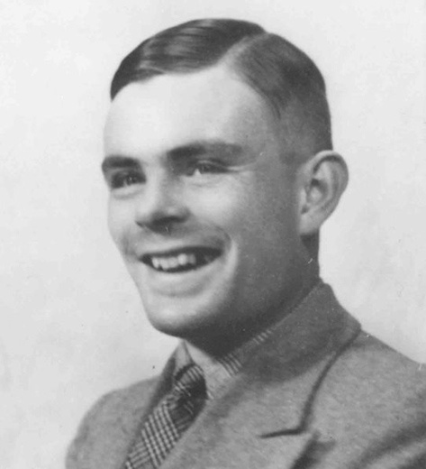
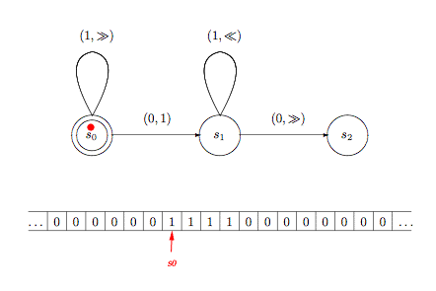
History of Computability
Computable
A problem is Computable
if it can be computed by a
Turing Machine. (1936)
Turing (1936)
Need to formally define
“Algorithm”

Slide 9

History of Computability
Computable
Equivalent via
compiler to:
Java:
Turing (1936)
Need to formally define
“Algorithm”

Slide 10
History of Computability
Computable
Halting
Problem
Turing proves that
the halting problem is
NOT Computable!
Turing (1936)

Slide 11
Halting Problem
The Halting Problem:
  For each possible input ⟨“M”,I ⟩
  Halts knowing whether M halts on I.
No such program!
You could just run M on I and see what happens.
If M halts then we halt and report that.
But what if M on I does not halt?
When will you stop the simulation?
An algorithm that decides the halting problem must halt on every input.

Slide 12
Halting Problem
loop a = 1 … 1,000,000
s := s+a
end loop
Halts
loop a > 0
s := s+a
end loop
Does not halt

Slide 13

Halting Problem
loop a,b,c,z > 2
  exit when a^{z} + b^{z} = c^{z}
end loop
Proof of not halting =
Proof of
Fermat’s Last Theorem
loop
  chaotic behavior
  exit when
  special event
end loop
Chaotic behavior =
not knowing what it will do without doing it.
How can we know it will not halt without running it forever?

Slide 14
Halting Problem
loop a,b,c,z > 2
  exit when a^{z} + b^{z} = c^{z}
end loop
Proof of not halting =
Proof of
Fermat’s Last Theorem
F(x,y)
z = x + yi
loop
  z = z² + c
  exit when
  converges
end loop
Chaotic behavior =
not knowing what it will do without doing it.
How can we know it will not halt without running it forever?

Slide 15

Halting Problem
F(x,y)
z = x + yi
loop
  z = z² + c
  exit when
  converges
end loop

Slide 16

Halting Problem
∀M ∃ I M(I)≠Halting(I)
Sorry. No algorithm exists that tells you for every computer program whether it halts!
i.e. No algorithm that
on every input
halts and gives
the correct answer.

Slide 17
Some Uncomputable Problem
A Computational Problem P states
  for each possible input I
  what the required output P(I) is.
An Algorithm/Program/Machine M is
  a set of instructions
  (described by a finite string “M”)
  on a given input I
  follow instructions and
    produces output M(I)
    or runs forever.
Eg: Sorting
Eg: Insertion Sort

Slide 18
Some Uncomputable Problem
Problem P is computable if
∃M,
∀I,
M(I)=P(I)
I have a machine M that I claim works and is fast.
Oh yeah, I have an input I for which it does not.
I win if M on input I gives
the correct output
What we have been doing all along.

Slide 19
Some Uncomputable Problem
Problem P is uncomputable if
∃M,
∀I,
M(I)=P(I)
∀M, ∃I, M(I) ≠ P(I)
I have an machine M that I claim works and is fast.
Oh yeah, I have an input I for which it does not .
I win if M on input I gives
the wrong output

Slide 20
Some Uncomputable Problem
∃P_{hard} ∀M ∃I_{M} M(I_{M})≠P_{hard}(I_{M})
Our goal is to prove that there is
an uncomputable computation problem P_{hard},
i.e. one for which each TM M fails to compute,
because there in an input I_{M} on which
it gives the wrong answer
i.e. M(I_{M})≠P_{hard} (I_{M})
This is stated using the above
first order logic statement.

Slide 21
Some Uncomputable Problem
∃P_{hard} ∀M ∃I_{M} M(I_{M})≠P_{hard}(I_{M})
I give a hard problem P_{hard.}
I have an TM M that I claim solves the problem.
I give an input I_{M}
on which I claim it does not .
I win if M(I_{M})≠P_{hard}(I_{M}).
We say that input I_{M} is
TM M’s nemesis input
proves M does not solve P_{hard}.

Slide 22
Some Uncomputable Problem
∃P_{hard} ∀M ∃I_{M} M(I_{M})≠P_{hard}(I_{M})
I give a hard problem P_{hard.}
I have an TM M that I claim solves the problem.
Usually I would
choose input I_{M}
after knowing P_{hard}.
But instead I am going to choose I_{M} first.

Slide 23
Some Uncomputable Problem
∃P_{hard} ∀M ∃I_{M} M(I_{M})≠P_{hard}(I_{M})
For each TM M,
I choose a nemesis input I_{M}
which will eliminate it
At this point there is nothing special about the choice of I_{M} except it
should be private to M.
The one key property of the TMs
is that each TM M has a finite description “M” identifying it.
It is often dangerous to focus on oneself. Lets make M’s nemesis input be I_{M} =“M”.

Slide 24


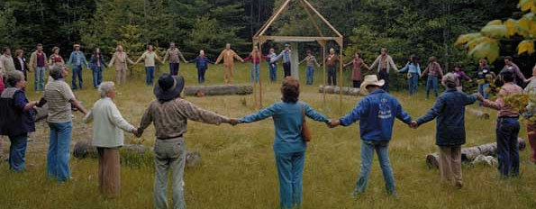
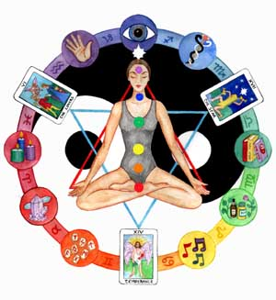
Some Uncomputable Problem
∃P_{hard} ∀M ∃I_{M} M(I_{M})≠P_{hard}(I_{M})
What does TM M do when you feed it a description “M”
of itself as input?
This is not really a problem:
  Compliers can compile themselves.
  Editors can edit the code for the editor.
Don’t read to much new age meaning into us defeating M by feeding it its own description “M”.

Slide 25
Some Uncomputable Problem
∃P_{hard} ∀M ∃I_{M} M(I_{M})≠P_{hard}(I_{M})
Lets make M’s nemesis input be I_{M} =“M”.
I now define the hard problem P_{hard.}
If input I_{M}=“M” is going to eliminate M (wrt P_{hard}),
then we need M(“M”)≠P_{hard}(“M” ).
No problem.
For each input I, I get to design P_{hard}(I).
For I=“M”, I define
P_{hard}(“M”) to be anything but M(“M”)

Slide 26
Some Uncomputable Problem
∃P_{hard} ∀M ∃I_{M} M(I_{M})≠P_{hard}(I_{M})
P_{hard} = ¬Problem_{diagonal}
I₁ I₂ I₃ … I_{i} …
M₁
M₂
M₃
M₄
M_{i}
Outputs “Hi”
Runs forever
…
M_{i} and I_{i} are described by the same string.
Diagonal is gives
…
M(“M”)

Slide 27
Some Uncomputable Problem
∃P_{hard} ∀M ∃I_{M} M(I_{M})≠P_{hard}(I_{M})
P_{hard} = ¬Problem_{diagonal}
I₁ I₂ I₃ … I_{i} …
M₁
M₂
M₃
M₄
M_{i}
Outputs “I hate myself”
Outputs “I love myself”
…
Halts and laughs
Runs forever
M_{i} and I_{i} are described by the same string.
Diagonal is gives
…
¬Problem_{diagonal}(“M”) ≠
M(“M”)

Slide 28
Some Uncomputable Problem
∃P_{hard} ∀M ∃I_{M} M(I_{M})≠P_{hard}(I_{M})
Enough chat.
Lets actually play proving the game.

Slide 29
Some Uncomputable Problem
∃P_{hard} ∀M ∃I_{M} M(I_{M})≠P_{hard}(I_{M})
I give a hard problem P_{hard.}
For I=“M”, I define
P_{hard}(“M”) to be anything but M(“M”)
I have an TM M that I claim solves the problem.
I give input I_{M} = “M”
on which I claim it does not .
I win because M(“M”)≠P_{hard}(“M”).

Slide 30
Some Uncomputable Problem
P_{hard} = ¬P_{diagonal}
Computable
Halting(M,I)
Turing 1936
Known
GCD

Slide 31
Halting Problem
Undecidable
The Problem ¬P_{diagonal} requires:
  for each possible input “M”
  Halt and do something different than M(“M”).

Slide 32
Halting Problem
Undecidable
The Problem ¬P_{diagonal} requires:
  for each possible input “M”
  Halt knowing what M does on “M”.
The Universal Simulation Problem P_{Universal} requires:
  for each possible input “M”
  Does what M does on “M”. (May not halt)
Doable
These seem the same.
Why can’t I use M_{Universal} to solve ¬P_{diagonal}
But what if M on “M” does not halt?
When will you stop the simulation?

Slide 33
Halting Problem
The Problem ¬P_{diagonal} requires:
  for each possible input “M”
  Halt knowing what M does on “M”.
then could
solve
¬P_{diagonal}
The Universal Simulation Problem P_{Universal} requires:
  for each possible input “M”
  Does what M does on “M”. (May not halt)
The Halting Problem P_{Halting} requires:
  for each possible input “M”
  Halts knowing whether M halts on “M”.
If could
solve
P_{Halting}
(with “Oracle”)

Slide 34
Halting Problem
The M_{diagonal} does:
for each possible input “M”
The danger of using M_{universal} to
simulate M on “M” is if it does not halt.
If M_{Halting} says M does halts on “M”,
then it is safe to run M on “M”
to learn what it does.
else M_{Halting} says M does not halts on “M”,
report this.
Either way, we halt and know
what M does on “M”.
then could
solve
¬P_{diagonal}
If could
solve
P_{Halting}
(with “Oracle”)

Slide 35
Halting Problem
But can’t
solve
¬P_{diagonal}
then could
solve
¬P_{diagonal}
So can’t
solve
P_{Halting}
If could
solve
P_{Halting}
(with “Oracle”)
Undecidable

Slide 36
Some Uncomputable Problem
P_{hard} = ¬Problem_{diagonal}
Computable
Halting(M,I)
Turing 1936
Known
GCD

Slide 37
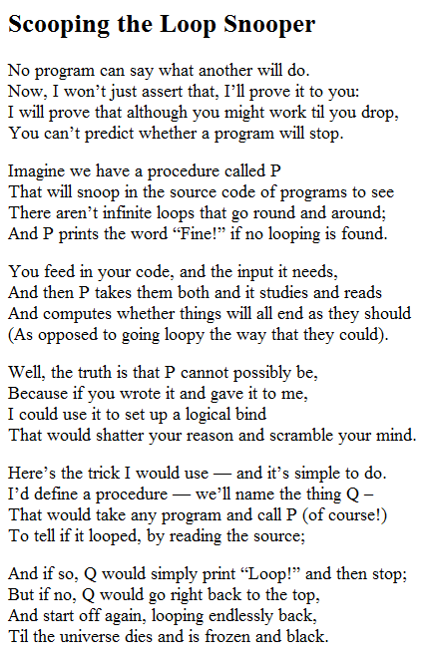
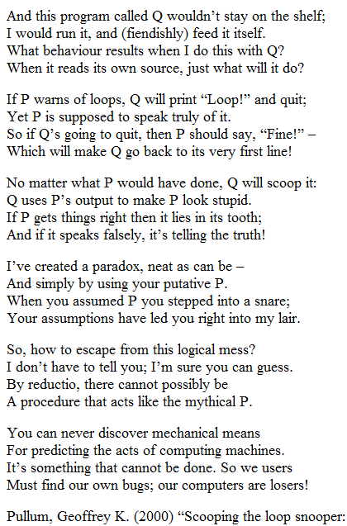
Halting Problem

Slide 38
Review
Define P_{Halting}
The Halting Problem P_{Halting} requires:
  for each possible input ⟨“M”,I ⟩
  must halt
  the required output P_{Halting} (“M”,I) is
  does TM M halt on input I?

Slide 39
Review
Define P_{hard} = ¬Problem_{diagonal}
I give a hard problem P_{hard.} requires:
  for each possible input “M”
  must halt
  the required output P_{hard}(“M”)
  is anything but M(“M”)

Slide 40
Review
Argue P_{hard} = ¬Problem_{diagonal}
is undecidable.
Every TM M fails to solve P_{hard}
because on input “M”
it gives the wrong answer.
i.e. P_{hard}(“M”) ≠ M(“M”)

Slide 41
Review
Argue P_{Halting}
is undecidable.
If P_{Halting} was decidable,
then ¬Problem_{diagonal} would be decidable.
But ¬Problem_{diagonal} is undecidable
and hence so P_{Halting} is.

Slide 42
Review
The M_{diagonal} does:
for each possible input “M”
The danger of using M_{universal} to
simulate M on “M” is if it does not halt.
If M_{Halting} says M does halts on “M”,
then it is safe to run M on “M”
to learn what it does.
else M_{Halting} says M does not halts on “M”,
report this.
Either way, we halt and know
what M does on “M”.
then could
solve
¬P_{diagonal}
If could
solve
P_{Halting}
(with “Oracle”)

Slide 43
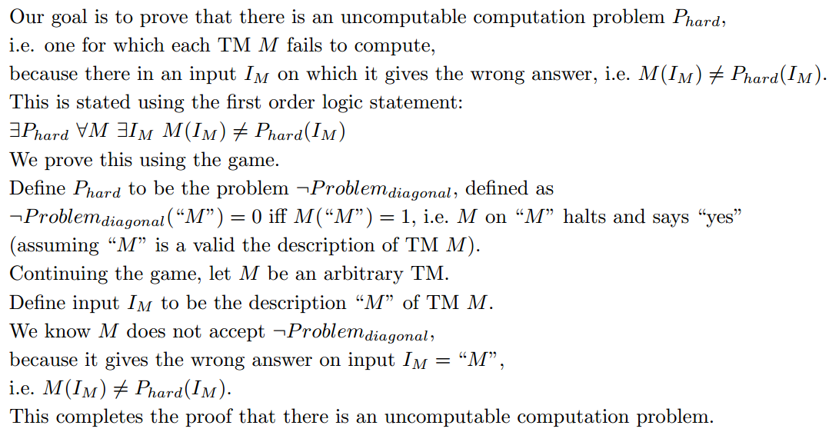
Review
∃P_{hard} ∀M ∃I_{M} M(I_{M})≠P_{hard}(I_{M})

Slide 44
Multiple Choice Questions
∃ M, ∀ I, M(I)=P(I)
∀ I, ∃ M, M(I)=P(I)
1) Which of this is FALSE
  M is a Turing Machine which is computationally
  the same as a Java program.
  P is a Java program.
  P is a computational problem like Sorting
  I could be the description “M”.

Slide 45
Multiple Choice Questions
∃ M, ∀ I, M(I)=P(I)
∀ I, ∃ M, M(I)=P(I)
2) Which of this is FALSE
  The two lines say the same thing.
  The first line requires one machine M
  that must give the correct answer for each input.
  The second line allows a separate machine M_{I}
  for each input I. It is easy to write an algorithm
  that gives the correct answer for a single input.

Slide 46
Multiple Choice Questions
∃ M, ∀ I, M(I)=P(I)
∀ I, ∃ M, M(I)=P(I)
3) Which of this is FALSE
  The task of Halting(M,I) Problem is to
  determine if M halts on I.
  The task of Halting(M,I) Problem is to ensure
  that M halts on I.
  The Halting Problem is the classic uncomputable problem.

Slide 47
Multiple Choice Questions
∃ M, ∀ I, M(I)=P(I)
∀ I, ∃ M, M(I)=P(I)
4) Which of this is FALSE
  Given enough time and resources, any
  computational problem can be solved given
  any input.
  There are computational problems such that
  each algorithm fails to give the correct answer
  on some input.
  If P(I)=yes for computational problem P on input I, then the
  algorithm that always says yes gives the correct answer for
  this input.

Slide 48
Multiple Choice Questions
∃ M, ∀ I, M(I)=P(I)
∀ I, ∃ M, M(I)=P(I)
5) Which of this is FALSE
  To prove that an algorithm M does not solve the
  problem P, it is sufficient to demonstrate one input
  I_{M} on which it fails to give the correct answer,
  i.e. P(I_{M})≠M(I_{M}).
  To prove that an algorithm M does solve the
  problem P, it is sufficient to demonstrate one input
  I_{M} on which it does give the correct answer,
  i.e. P(I_{M})=M(I_{M}).

Slide 49
The End

Slide 50
Material for CSE 4111 but not for CSE2001

Slide 51
One page proof Halting is Undecidable
∀M ∃ I M(I)≠Halting(I)
Same Proof
Suppose there was a working algorithm:
  Halt(“M”,I) = whether program M halts on input I
Construct from it another algorithm:
  P_{hard}(M) = if(Halt(“M”,“M”)) loop forever
  else halt
  = halts ↔ program M does not halt on input M.
Paradox: P_{hard}(“P_{hard}”) = ?
What M does on “M”,
defines P_{diagonal}.
Reduction from
P_{hard} to Halt.
Negating defines ¬P_{diagonal}.
Proof P_{hard} is undecidable.
program P_{hard} halts on input P_{hard}
↔
program P_{hard} does not halt on input P_{hard}
Contradiction!

Slide 52
Some Uncomputable Problem
∃P_{hard} ∀M ∃I_{M} M(I_{M})≠P_{hard}(I_{M})
Compare the first order logic of
  there are more reals than integers.
  There is an uncomputable problem.
∀List, ∃xϵR, ∀iϵN List(i)≠x
∃P_{hard} ∀M ∃I_{M} M(I_{M})≠P_{hard}(I_{M})
A problem P_{hard} is an “real-like” object.

Slide 53
Some Uncomputable Problem
∃P_{hard} ∀M ∃I_{M} M(I_{M})≠P_{hard}(I_{M})
Compare the first order logic of
  there are more reals than integers.
  There is an uncomputable problem.
∀List, ∃xϵR, ∀iϵN List(i)≠x
∃P_{hard} ∀M ∃I_{M} M(I_{M})≠P_{hard}(I_{M})
A TM M is an “integer-like” object.

Slide 54
Some Uncomputable Problem
∃P_{hard} ∀M ∃I_{M} M(I_{M})≠P_{hard}(I_{M})
Compare the first order logic of
  there are more reals than integers.
  There is an uncomputable problem.
List maps integers i to reals x.
maps TM M to problems P.
∀List, ∃xϵR, ∀iϵN List(i)≠x
?
∃P_{hard} ∀M ∃I_{M} M(I_{M})≠P_{hard}(I_{M})
∀ model of computation in which
each machine M
specifies a problem P that it accepts
and has a finite description “M”.

Slide 55
Some Uncomputable Problem
∃P_{hard} ∀M ∃I_{M} M(I_{M})≠P_{hard}(I_{M})
Compare the first order logic of
  there are more reals than integers.
  There is an uncomputable problem.
the j^{th} digit of List(i)
≠ the j^{th} digit of x
∃j
∀List, ∃xϵR, ∀iϵN List(i)≠x
∃P_{hard} ∀M ∃I_{M} M(I_{M})≠P_{hard}(I_{M})

Slide 56
Halting Problem
Acceptable
∃P ∀M ∃ I M(I)≠P(I)
Co-Acceptable
Yes instance
➔ Halt and answer “yes”
No instance
➔ Run forever or answer “no”
Yes instance
➔ Run forever or answer “yes”
No instance
➔ Halt and answer “no”
Problem_{diagonal}
¬ Problem_{diagonal}
Or any other useful thing about what the program does.
Computable
Yes instance
➔ Halt and answer “yes”
No instance
➔ Halt and answer “no”
  Does program P output 5
  on input I
Halting

Slide 57
Halting Problem
∃P ∀M ∃ I M(I)≠P(I)
The proof for ¬Problem_{diagonal} (“M”)
used only two properties of TMs
Each TM M is described by a finite string “M”.
Given a description “M” of a TM and of an input I,
the output M(I) is well defined.
The proof for Halting(“M”,I)
used two more properties of TMs
There is a TM Universal_{TM}(“M”,I ).
You can build one TM from another.
Which models of computation have these properties?
TM, Java, Recursive, Register Machines, ….

Slide 58
Halting Problem
∃P ∀M ∃ I M(I)≠P(I)
The proof for ¬Problem_{diagonal} (“M”)
used only two properties of TMs
Each TM M is described by a finite string “M”.
Given a description “M” of a TM and of an input I,
the output M(I) is well defined.
Yes
Yes
The proof for Halting(“M”,I)
used two more properties of TMs
There is a TM Universal_{TM}(“M”,I ).
You can build one TM from another.
No
Yes
Which models of computation have these properties?
Primitive Recursive Program?

Slide 59
Halting Problem
∃P ∀M ∃ I M(I)≠P(I)
If Universal_{PRP} has k levels of recursion,
then its running time is bounded by Ackermann_{k}(n)
If M_{PRP} has k+1 levels of recursion,
then it must be simulated for time Ackermann_{k+1}(n)
There is a PRP Universal_{PRP}(“M_{PRP}”,I ).
No
Primitive Recursive Program?

Slide 60
Halting Problem
Acceptable
∃P ∀M ∃ I M(I)≠P(I)
Co-Acceptable
Yes instance
➔ Halt and answer “yes”
No instance
➔ Run forever or answer “no”
Yes instance
➔ Run forever or answer “yes”
No instance
➔ Halt and answer “no”
Problem_{diagonal}
¬ Problem_{diagonal}
Computable
Yes instance
➔ Halt and answer “yes”
No instance
➔ Halt and answer “no”
M_{PRP} definitely halts
so the answer is “yes”
Halting_{PRP}( M_{PRP},I ).

Slide 61
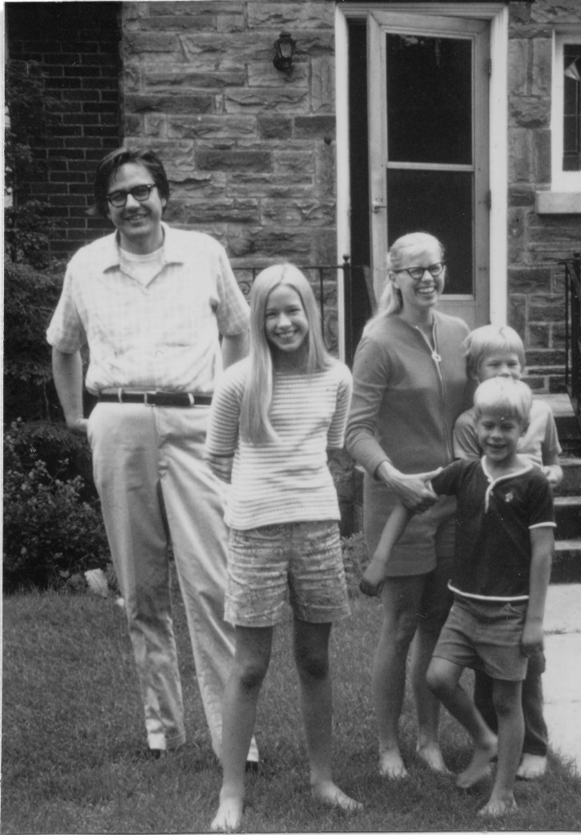
History of Classifying Problems
Computable
Halting
Exp
Time: input size ⇒ running time
For large n, n¹⁰⁰ << 2^{n}
Poly
Jack Edmonds 1965
Known
GCD

Slide 62
Time Hierarchy
The set of computational problems
computable in time T(n).
Computable
Exp
And in time ωT(n)log(T(n)).
ωT(n)log(T(n)) time
T(n) time
Here T(n) is an
arbitrary function.
Poly
Known
GCD

Slide 63
Time Hierarchy
Is there a computational problem
computable in time ωT(n)log(T(n))
but not in time T(n)?
Computable
Exp
ωT(n)log(T(n)) time
Yes!
Some problem
T(n) time
Poly
Known
GCD

Slide 64
Time Hierarchy
Construct a computational problem
for which no Turing Machine computes it in time T(n).
I₁ I₂ I₃ … I_{j} …
M₁
M₂
M₃
M₄
M_{i}
Put a 1 in the matrix at <i,j> iff
TM M_{i} outputs “1” on instance I_{j}
within time T(n).
…
1
…

Slide 65
Time Hierarchy
Construct a computational problem
for which no Turing Machine computes it in time T(n).
I₁ I₂ I₃ … I_{i} …
M₁
M₂
M₃
M₄
M_{i}
Problem_{diagonal} (“M”)=1
iff M(“M”) halts in time T(n)
with “yes”.
But want is n?
The input is the TM “M”.
We want |“M”| to be constant
as n grows.
…
1
…
Problem_{diagonal} (“MI”)=1
iff M(“MI”) halts in time T(n)
with “yes”.
n = |“MI”|

Slide 66
Time Hierarchy
Construct a computational problem
for which no Turing Machine computes it in time T(n).
I₁ I₂ I₃ … I_{i} …
M₁
M₂
M₃
M₄
M_{i}
Problem_{diagonal} (“MI”)=1
iff M(“MI”) halts in time T(n)
with “yes”.
Claim: No TM decides
¬Problem_{diagonal} in time T(n).
…
1
…
Proof: TM M gives the wrong answer on instance M
or takes more than T(n) time.
M(“MI”) halts in time T(n) and says “yes”
➔ Problem_{diagonal}(“MI”) = 1
➔¬Problem_{diagonal} (“MI”) = 0
➔ wrong answer

Slide 67
Time Hierarchy
Construct a computational problem
for which no Turing Machine computes it in time T(n).
I₁ I₂ I₃ … I_{i} …
M₁
M₂
M₃
M₄
M_{i}
Problem_{diagonal} (“MI”)=1
iff M(“MI”) halts in time T(n)
with “yes”.
Claim: No TM decides
¬Problem_{diagonal} in time T(n).
…
1
…
Proof: TM M gives the wrong answer on instance M
or takes more than T(n) time.
M(“MI”) halts in time T(n) and says “no”
➔ Problem_{diagonal}(“MI”) = 0
➔¬Problem_{diagonal} (“MI”) = 1
➔ wrong answer

Slide 68
Time Hierarchy
Construct a computational problem
for which no Turing Machine computes it in time T(n).
I₁ I₂ I₃ … I_{i} …
M₁
M₂
M₃
M₄
M_{i}
Problem_{diagonal} (“MI”)=1
iff M(“MI”) halts in time T(n)
with “yes”.
Claim: No TM decides
¬Problem_{diagonal} in time T(n).
…
1
…
Proof: TM M gives the wrong answer on instance M
or takes more than T(n) time.
M(“MI”) takes more than time T(n).
➔ Uses too much time.

Slide 69
Time Hierarchy
¬Problem_{diagonal} (“MI”)=0
iff M(“MI”) halts in time T(n) with “yes”.
Claim: No TM decides ¬Problem_{diagonal} in time T(n).

Slide 70
Time Hierarchy
¬Problem_{diagonal} (“MI”)=0
iff M(“MI”) halts in time T(n) with “yes”.
Claim: There is a TM that decides ¬Problem_{diagonal}
in time ωT(n)log(T(n)).
On input “MI”,
simulate M on “MI” for T(n) time
and output “no”
iff M has halted and has output “yes”.
Simulation time by TM_{Universal}(“M”,I) is O(|“M”|×T(|I|)).
= ωT(n)
Funny |“M”| does not grow with n,
but neither is it bounded by any fixed constant c.
So we will bound it by ω, which grows faster than c.

Slide 71
Time Hierarchy
¬Problem_{diagonal} (“MI”)=0
iff M(“MI”) halts in time T(n) with “yes”.
Claim: There is a TM that decides ¬Problem_{diagonal}
in time ωT(n)log(T(n)).
On input “MI”,
simulate M on “MI” for T(n) time
and output “no”
iff M has halted and has output “yes”.
Simulation time by TM_{Universal}(“M”,I) is O(|“M”|×T(|I|)).
= ωT(n)
+ O(T(n)log(T(n)))
But TM_{Universal} also takes O(log(T(n))) time
to increment the time counter
for a total of O(T(n)log(T(n))) time.

Slide 72
Time Hierarchy
Specify one such problem
that is a little nicer.
Computable
Exp
No idea!!
ωT(n)log(T(n)) time
Problem_{diagonal}
T(n) time
Poly
Known
GCD

