Slide 1
2001: Countable
and Uncountable Infinite
Description Length and Carnality
Random vs Patterned
Countable
Countable via a List
Countable via Finite Descriptions
Uncountable
Hierarchy of Infinities
Some Uncomputable Problem
Not covered
Jeff Edmonds
York University
Lecture 6.0
COSC 2001

Slide 2
Finite
S = { a | a is a planck size quantum in the universe }
Planck’s length = 10⁻³⁵ m.
Width of universe = 100 billion light years
= 10²⁷ m.
= 10⁶² planck’s lengths.
|S| = volume = (width)³ = 10¹⁸⁶ planck size quantum
= finite
Anything bigger is not really of this reality.

Slide 3
Countably Infinite
S₀ = { α | α is a 0/1 string of length 5 } = { 00000, 00001, 00010, …
|S₀| =
2⁵
2 choices × 2 choices × … × 2 choices
S₁ = { α | α is a 0/1 string of length arbitrarily long but finite }
interpret α as the description of an integer in binary eg 101₂=5
= { n | n is an integer }
interpret α as an ascii string eg “cat”
= { s | s is a finite string in ascii }
interpret α as the description of a fraction eg “3/4”
= { x | x is a fraction/rational }
interpret α as the description of a Turing Machine / Alg
= { M | M is a TM }
|S₁| =
2^{arbitrarily long but finite}
= |Integers|
= countably infinite

Slide 4
Uncountable
S₀ = { α | α is a 0/1 string of length 5 }
|S₀| =
2⁵
2 choices × 2 choices × … × 2 choices
S₂ = { α | α is a 0/1 string of length infinite }
interpret α as the description of a real in binary eg 0.10010…₂
= { r | r is a real in (0..1) }
interpret α as a function from ints to {0,1}
eg f(0) = 1, f(1) = 0, f(2) = 0, f(3) = 1, f(4) = 0, …
= { f | f:ints→{0,1} }
interpret α as a function from finite strings to {N,Y}
eg L(0) = Y, L(1) = N, L(10) = N, L(11) = Y, L(100) = N, …
ie L is a language.
= { L | L:strings→{N,Y} } = { L | L is a language }
= { P | P is a computational problem }
|S₂| =
0 1 2 3 4 …
2^{infinite}
= |Reals|
= uncountable
>> |Integers|

Slide 5
Description Length vs Cardnality
 | |”α”| = length of description of each item | |{α}| = cardnality of set containing all such items
Finite | 5 | 2⁵
Integers | Arbitrarily long but finite | Countably Infinite
Reals | Infinite (countable) | Uncountable

Slide 6
Some Uncomputable Problem
|Integers|
=
|Fractions|
<<
|Reals|
Each defined by
a finite string
Each defined by
a finite string
Most defined by
an infinite string
<<
Set of TM/Algorithms
Each defined by
a finite string
Countable in size
Set of Comp. Problems
For each input I,
must define what P does.
Most defined by
an infinite string
Uncountable in size
Most problems
do not have
an algorithm!!!
∃P ∀M ∃ I M(I)≠P(I)

Slide 7

Random vs Patterned
Consider these binary strings of length n:
1010101010101010101010 …
  Pattern: alternate 0 and 1
  Definitely patterned.
11.00100100001111110110 ...
  Binary representation of π
  No pattern → “random”
11001110100101010100111 …
  I flipped a fair coin for each bit.
  Definitely random.
11101111100101010101110 …
  I flipped an unfair coin so that #0 = 0.49n
  Not quite random
Which is more random?
How were they produced?

Slide 8

Random vs Patterned
Consider these binary strings of length n:
1010101010101010101010 …
11.00100100001111110110 ...
11001110100101010100111 …
11101111100101010101110 …
Which is more random?
What is the probability of getting THIS string
by flipping n coins?
$1/{2^{n}}$
So each is equally likely
so equally “random”.

Slide 9
Random vs Patterned
Consider these binary strings of length n:
1010101010101010101010 …
  Has a short description
  “alternate 0 and 1”
11.00100100001111110110 ...
  Has a short description “π”
11001110100101010100111 …
  I flipped a fair coin for each bit.
  Could call this one “Bob’s string” so that it has a short description.
  (This feels like a cheat).
11101111100101010101110 …
Which is more random?
Which has a short description?
If only Bob knew it, he would have to send n bits to tell you the string.

Slide 10
Random vs Patterned
Consider these binary strings of length n:
1010101010101010101010 …
  Has a short description
  “alternate 0 and 1”
11.00100100001111110110 ...
  Has a short description “π”
11001110100101010100111 …
  I flipped a fair coin for each bit.
  Could call this one “Bob’s string” so that it has a short description.
  (This feels like a cheat).
Which is more random?
Which has a short description?
There are 2^{n}
n bit strings
There are 2^{n-k}
n-k bit descriptions
Only 2^{n}/2^{n-k} = 2^{-k} fraction of strings can be compressed by k bits.
Only 2^{-n/2} ≈ 0 fraction of strings can be compressed by half.
If only Bob knew it, he would have to send n bits to tell you the string.

Slide 11
Random vs Patterned
Consider these binary strings of length n:
1010101010101010101010 …
  “Loop i = 1..^{n}/₂
  print(“10”)”
11.00100100001111110110 ...
  Newton could write short code
  to give the bits of π.
11001110100101010100111 …
11101111100101010101110 …
Which is more random?
Which is outputted
by a Java program
with a short description?
Kolmogorov Complexity
There are 2^{n}
n bit strings
There are 2^{n-k}
n-k bit Java programs
Only 2^{n}/2^{n-k} = 2^{-k} fraction of strings can be compressed by k bits.
Only 2^{-n/2} ≈ 0 fraction of strings can be compressed by half.

Slide 12
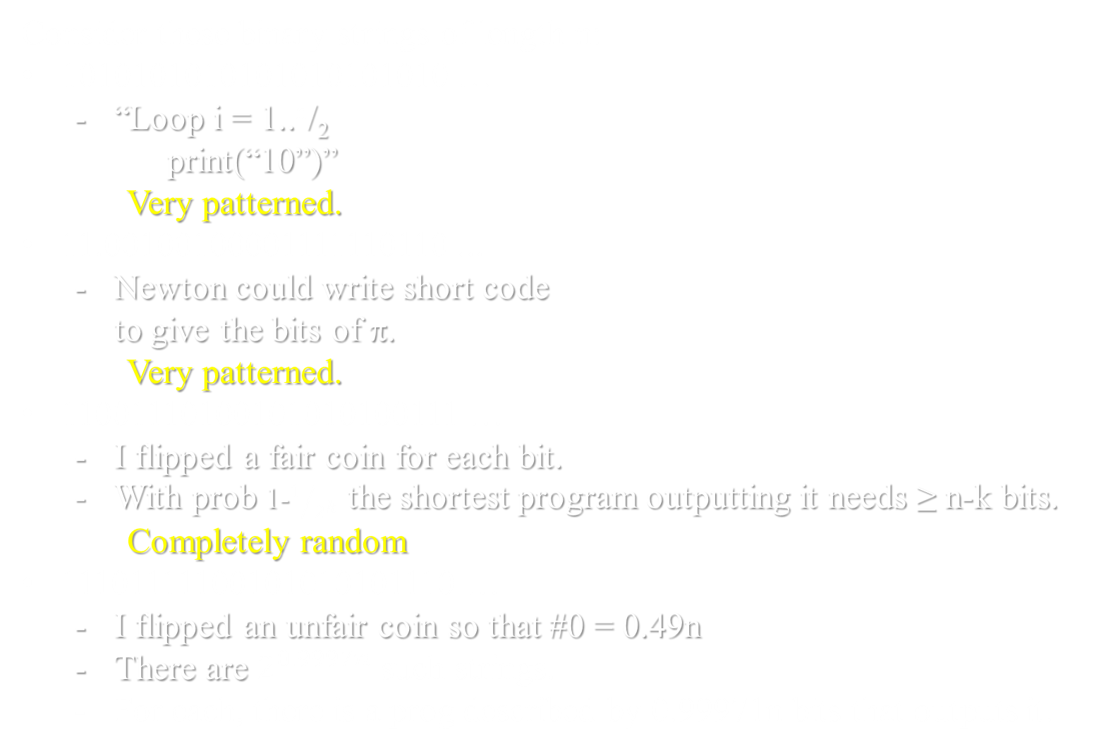
Random vs Patterned
Consider these binary strings of length n:
1010101010101010101010 …
  “Loop i = 1..^{n}/₂
  print(“10”)”
  Very patterned.
11.00100100001111110110 ...
  Newton could write short code
  to give the bits of π.
  Very patterned.
11001110100101010100111 …
  I flipped a fair coin for each bit.
  With prob 1-$1/{2^{k}}$ the shortest program outputting it needs ≥ n-k bits.
Completely random
11101111100101010101110 …
  I flipped an unfair coin so that #0 = 0.49n
  There are $2^{0.9997n}$ such strings.
  For each, there is a prog described by 0.99971n bits that outputs it.
Which is more random?
Which is more random?
Which is outputted
by a Java program
with a short description?
Kolmogorov Complexity
Here H(x) = -[x log₂(x) + (1-x) log₂(1-x)]
and H(0.49) = 0.9997.
Not quite random

Slide 13
Random vs Patterned
Which is more random?
Which is more random?
Which is outputted
by a Java program
with a short description?
This says nothing
about running time
Only about information
Kolmogorov Complexity

Slide 14
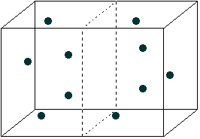
Random vs Patterned
If half the room only had 49% of the particles,
it would not be considered “random”.
The entropy would be too low.
The entropy would increase by going 50-50.
11101111100101010101110 …
  I flipped an unfair coin so that #0 = 0.49n
Not quite random

Slide 15
Random vs Patterned
Entropy measures the complexity of a set of strings.
Kolmogorov Complexity measures the complexity of one string.
Can we relate them?

Slide 16
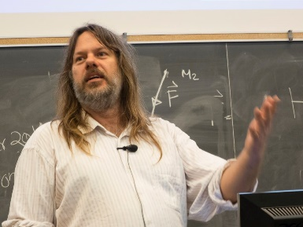
Random vs Patterned
The Micro State α of your system is a binary string
describing the position and the velocity of every particle.
Kolmog(α) = the min # of bits to describe a Java program that outputs α.
Consider any identifiable Macro Property M(α) of your system.
Let S_{M} = { α | M(α) }, ie set of micro states consistent with macro state.
ThermoEntropy(M) = log₂(|S_{M}|)
Kolmog(M) = the min # of bits needed to describe a Java program
that determines M(α). Should be small to be a good “Macro property”
Theorem: Kolmog(α) ≤ ThermoEntropy(M) + Kolmog(M) + 1000
≥ ThermoEntropy(M´) (for some M´)
Every micro state consistent with this macro state
has low entropy/randomness.

Slide 17
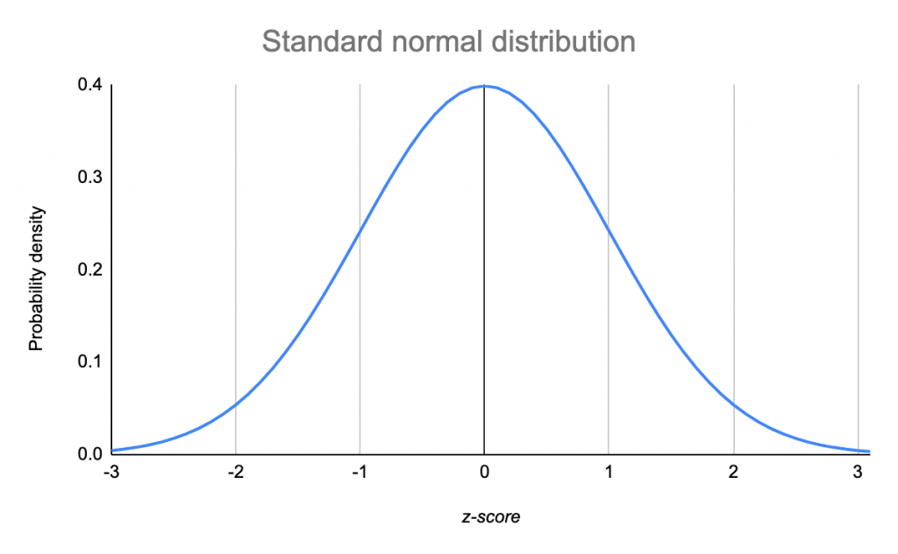
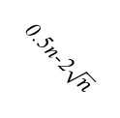
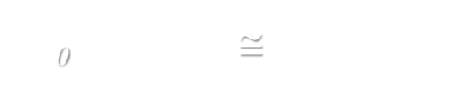
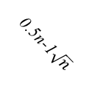
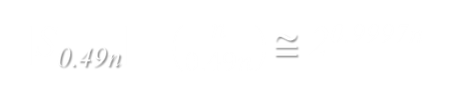
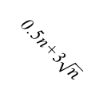
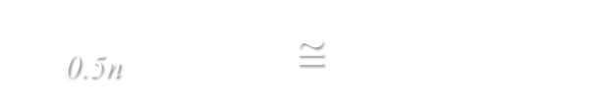
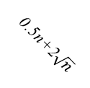

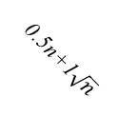
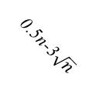
Random vs Patterned
Example:
Our micro state is some binary string α of length n.
Our macro property M(α) is that exactly 0.49n bits are zero.
N = # of strings of length n with this property
Let S be the set of binary strings of length n with exactly 0s.
|S_{cn}| = number of way to choose where to put the 0s
= $\left(\begin{matrix}n \\ cn\end{matrix}\right)$
_{cn}
cn
≅ 2^{H(c)‧n}
H(c) = -[c log₂(c)+(1-c)log₂(1-c)]
(Shannon’s Entropy Function
|S_{0.5n}| = $\left(\begin{matrix}n \\ 0.5n\end{matrix}\right)$ ≅ ${2^{n}}/{\sqrt{n}}$
H(c)
2^{n}
|S_{0.49n}| =$\left(\begin{matrix}n \\ 0.49n\end{matrix}\right)$≅ 2^{0.9997n}
|S₀| = $\left(\begin{matrix}n \\ 0\end{matrix}\right)$≅ 2⁰ = 1
0.5n-3$\sqrt{n}$
0.5n-2$\sqrt{n}$
0.5n-1$\sqrt{n}$
0.5n
0.5n+1$\sqrt{n}$
0.5n+2$\sqrt{n}$
0.5n+3$\sqrt{n}$
c

Slide 18
Random vs Patterned
Example:
Our micro state is some binary string α of length n.
Our macro property M(α) is that exactly 0.49n bits are zero.
N = # of strings of length n with this property
ThermoEntropy(M) = log₂(N) = 0.9997n
Let S be the set of binary strings of length n with exactly 0s.
≅ 2^{0.9997n}
_{0.49n}
0.49n
α∈S_{0.49n}
β∈Labels
_{0.49n}
_{n}
Map(β) = α
_{0.9997n}
|S_{0.49n}| =$\left(\begin{matrix}n \\ 0.49n\end{matrix}\right)$≅ 2^{0.9997n}
000000000011111111111
000000000101111111111
000000000110111111111
000000000111011111111
111111111110000000000
000000000000000000
000000000000000001
000000000000000010
000000000000000011
1111111111111111111
2^{0.9997n}
This is a crazy mapping.
Can it be done by a small Java program?
2^{0.9997n}
…
…

Slide 19
Random vs Patterned
Theorem: Kolmog(α) ≤ ThermoEntropy(M) + Kolmog(M) + 1000
Let J_{M}(α) be a Java program that tests if α has the macro property.
Let J_{next}(α_{i})=α_{i+1} return the next string with this property.
loop
α_{i} = α_{i} +1
if(J_{M}(α)) return(α_{i})
α∈S_{0.49n}
β∈Labels
_{0.49n}
_{n}
Map(β) = α
_{0.9997n}
000000000011111111111
000000000101111111111
000000000110111111111
000000000111011111111
111111111110000000000
000000000000000000
000000000000000001
000000000000000010
000000000000000011
1111111111111111111
α_{i}
α_{i+1}
2^{0.9997n}
This is a crazy mapping.
Can it be done by a small Java program?
2^{0.9997n}
…
…

Slide 20
Random vs Patterned
Theorem: Kolmog(α) ≤ ThermoEntropy(M) + Kolmog(M) + 1000
Let J_{map}(β)=α prints the string α mapped to label β.
α = 000…0
loop i=1..β
α = J_{next}(α)
print(α)
This program does print our string.
Its running time is horrific.
But what we care about is the number of bits to describe the program.
α∈S_{0.49n}
β∈Labels
_{0.49n}
_{n}
Map(β) = α
_{0.9997n}
000000000011111111111
000000000101111111111
000000000110111111111
000000000111011111111
111111111110000000000
000000000000000000
000000000000000001
000000000000000010
000000000000000011
1111111111111111111
α_{i}
α_{i+1}
2^{0.9997n}
This is a crazy mapping.
Can it be done by a small Java program?
2^{0.9997n}
…
…

Slide 21
Random vs Patterned
Theorem: Kolmog(α) ≤ ThermoEntropy(M) + Kolmog(M) + 1000
Let J_{map}(β)=α prints the string α mapped to label β.
α = 000…0
loop i=1..β
α = J_{next}(α)
print(α)
J_{next}(α)
loop
α_{i} = α_{i} +1
if(J_{M}(α)) return(α_{i})
Kolmog(α) ≤ # bits to describe J_{map}(β)
=
log₂(N)
ThermoEntropy(M)
|β| +
|J_{M}(α)| +
1000
=
+ Kolmog(M)
+ 1000

Slide 22
Random vs Patterned
Theorem: Kolmog(α) ≤ ThermoEntropy(M) + Kolmog(M) + 1000
Theorem: ThermoEntropy(M) = 0 for some the def of a macro state
Define the Macro State M to be
those strings that are exactly α.
N = 1.
ThermoEntropy(M) = log₂(N) = 0.
Kolmog(M) = Kolmog(α)
No.
A macro property needs to be identifiable to
to meer humans observing the physical space.

Slide 23
Random vs Patterned
Theorem: Kolmog(α) ≤ ThermoEntropy(M) + Kolmog(M) + 1000
Theorem: ThermoEntropy(M´) ≤ Kolmog(α) (for some M´)
Define the Macro State of S_{M´} = { α´ | Kolmog(α´) ≤ Kolmog(α) }
|S_{M}| = the number of Java programs with Kolmog(α) bits
= 2^{Kolmog(α)}.
ThermoEntropy(M´) = log₂(|S_{M}|) = Kolmog(α).
Is this tight?

Slide 24
End

Slide 25
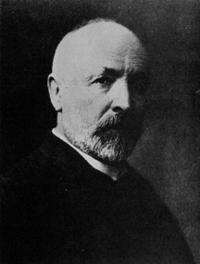
Countable Infinity
A finite set contains some integer number of elements.
{ , 4, }
The size of an infinite set is bigger than any integer.
The set of natural numbers N = {1,2,3,4,… }
The set of fractions Q = {¹/₂, ²/₃, ... }
The set of reals R = {2.34323…, 34.2233…, π, e, …}
Are these infinite sets the same “size”?
Two sets have the same size
if there is a bijection between them.
|{ , 4, }|
= |{ 1, 2, 3 }|
= 3
Cantor (1874)

Slide 26
Do N and E have the same cardinality?
Countable Infinity
N = { 0, 1, 2, 3, 4, 5, 6, 7, …. }
E = The even, natural numbers.

Slide 27
Countable Infinity
E and N do not have the same cardinality!
E is a proper subset of N with plenty left over.
0, 1, 2, 3, 4, 5, 6, 7, 8,….
0, 2, 4, 6, 8,….
f(x)=x is not a bijection.

Slide 28
Countable Infinity
E and N do have the same cardinality!
0, 1, 2, 3, 4, 5, ….…
0, 2, 4, 6, 8,10, ….
f(x) = 2x is a bijection

Slide 29
Countable Infinity
Lesson:
Cantor’s definition only requires that bijection between the two sets.
Not that all 1-1 correspondences
are onto.
This distinction never arises when the sets are finite.

Slide 30
Countable Infinity
If this makes you feel uncomfortable…..
TOUGH! It is the price that you must pay to reason about infinity

Slide 31
Countable Infinity
The set of integers N = {1,2,3,4,… }
The set of fractions Q = {¹/₂, ²/₃, ... }
Are these infinite sets the same “size”?
Two sets have the same size
if there is a mapping between them.
|{ , 4, }|
= |{ 1, 2, 3 }|
= 3

Slide 32
Countable Infinity
The set of integers N = {1,2,3,4,… }
The set of fractions Q = {¹/₂, ²/₃, ...
Are these infinite sets the same “size”?
Two sets have the same size
if there is a mapping between them.
1,2,3,4,… }
Q looks bigger.
|{ , 4, }|
= |{ 1, 2, 3 }|
= 3

Slide 33
Countable Infinity
No way!
The rationals are dense: between any two there is a third. You can’t list them one by one without leaving out an infinite number of them.

Slide 34
Countable Infinity
Don’t jump to conclusions!
There is a clever way to list the rationals, one at a time, without missing a single one!

Slide 35
Countable Infinity
...
...
6
⁶/₁
⁶/₂
⁶/₃
⁶/₄
⁶/₅
⁶/₆
⁶/₇
⁶/₈
All positive
fractions
5
⁵/₁
⁵/₂
⁵/₃
⁵/₄
⁵/₅
⁵/₆
⁵/₇
⁵/₈
4
⁴/₁
⁴/₂
⁴/₃
⁴/₄
⁴/₅
⁴/₆
⁴/₇
⁴/₈
3
³/₁
³/₂
³/₃
³/₄
³/₅
³/₆
³/₇
³/₈
2
²/₁
²/₂
²/₃
²/₄
²/₅
²/₆
²/₇
²/₈
...
Count them
by mapping.
1
¹/₁
¹/₂
¹/₃
¹/₄
¹/₅
¹/₆
¹/₇
¹/₈
1 2 3 4 5 6 7 8
Oops we never
get to ²/₁!
{ 1, 2, 3, 4, 5, 6, …. }
All positive integers

Slide 36
Countable Infinity
...
...
6
⁶/₁
⁶/₂
⁶/₃
⁶/₄
⁶/₅
⁶/₆
⁶/₇
⁶/₈
All positive
fractions
5
⁵/₁
⁵/₂
⁵/₃
⁵/₄
⁵/₅
⁵/₆
⁵/₇
⁵/₈
4
⁴/₁
⁴/₂
⁴/₃
⁴/₄
⁴/₅
⁴/₆
⁴/₇
⁴/₈
Over counting just
means we proved
|N|≥|Q|
3
³/₁
³/₂
³/₃
³/₄
³/₅
³/₆
³/₇
³/₈
2
²/₁
²/₂
²/₃
²/₄
²/₅
²/₆
²/₇
²/₈
...
Count them
by mapping.
1
¹/₁
¹/₂
¹/₃
¹/₄
¹/₅
¹/₆
¹/₇
¹/₈
1 2 3 4 5 6 7 8
Every rational gets
mapped to some integer!
|N|=|Q|
Q is “Countable”
{ 1, 2, 3, 4, 5, 6, …. }
All positive integers

Slide 37
Countable Infinity
How is it that we can loop over all tuples ⟨a,b,c⟩
ensuring that we eventually get to each?
loop a,b,c ≥ 0
  print(a,b,c);
end loop
loop a ≥ 0
loop b ≥ 0
loop c ≥ 0
print(a,b,c);
No, this inner loop will never exit.
We will never get to b=1

Slide 38
Countable Infinity
How is it that we can loop over all tuples ⟨a,b,c⟩
ensuring that we eventually get to each?
loop a,b,c ≥ 0
  print(a,b,c);
end loop
Though this will never list them all.
Each ⟨a,b,c⟩ will eventually be listed.
loop sum = 0,1,2,…..
loop a = 0,…,sum
loop b = 0,…,sum-a
c = sum-a-b
print(a,b,c);
Eg: ⟨3,7,5⟩ gets printed
when sum = 15, a=3,
and b=7.
The set of tuples {⟨a,b,c⟩} is countable.

Slide 39
Countable Infinity
A set S is called countable if |S| ≤ |N|
|S| = |{ , 4, , ….. }|
≤ |{ 1, 2, 3, 4, 5, … }| = |N|
Note a finite set is countable.
If also |S| ≥ |N|, then S is called countably infinite.

Slide 40
Countable Infinity
A set S is called countable if |S| ≤ |N|
|S| = |{ , 4, , ….. }|
≤ |{ 1, 2, 3, 4, 5, … }| = |N|
There is a list containing each object
∃List, ∀xϵS, ∃ iϵN List(i) = x
Each integer (index in list)
lists at most one object xϵS
i x = List(i)
1:
2:
3:
4:
5:
Each object xϵS
appears some where in the list
4

Slide 41
Countable Infinity
A set S is called countable if |S| ≤ |N|
|S| = |{ , 4, , ….. }|
Give each object a
finite description.
“apple” “four” “chair”
≤ |{ 1, 2, 3, 4, 5, … }| = |N|
Two equivalent definitions of a set S being “Countable”
There is a list containing each object
∃List, ∀xϵS, ∃ iϵN List(i) = x
Each object xϵS has (at least one) finite description
such that each description uniquely identifies that object.
My name is
Herr Dr Professor Wizard the great great great ….
Just because you have an infinite name does not mean the set { } is not countable!
I call you
Bob

Slide 42
Countable Infinity
A set S is called countable if |S| ≤ |N|
|S| = |{ , 4, , ….. }|
Give each object a
finite description.
“apple” “four” “chair”
≤ |{ 1, 2, 3, 4, 5, … }| = |N|
Two equivalent definitions of a set S being “Countable”
There is a list containing each object
∃List, ∀xϵS, ∃ iϵN List(i) = x
Each object xϵS has (at least one) finite description
such that each description uniquely identifies that object.
∃Language, ∀xϵS, ∃ nameϵASCII* Language(name) = x
|S| ≤ |ASCII*| ≤ |N|

Slide 43
Countable Infinity
A set S is called countable if |S| ≤ |N|
|S| = |{ , 4, , ….. }|
Give each object a
finite description.
“apple” “four” “chair”
‘a’ ‘p’ ‘p’ ‘l’ ‘e’
‘c’ ‘h’ ‘a’ ‘i’ ‘r’
Break each description
into a string of characters.
‘f’ ‘o’ ‘u’ ‘r’
61 70 70 6C 65
63 68 61 69 72
Convert each character
to Hex-Ascii.
66 6F 75 72
Concatenate the Hex
into one Hex integer.
≤ |{ 6170706C65, 666F7572, 6368616972, … }|
≤ |{ 1, 2, 3, 4, 5, … }| = |N|
The number of such
integers is at most the
number of integers.
Hence, this set of
objects is countable.

Slide 44
Countable Infinity
A set S is called countable if |S| ≤ |N|
The set of fractions
|Q| = |{¹/₂, ²/₃, ¹¹/₈ ,... }|
Give each object a
finite description.
“¹/₂ ” “²/₃” “¹¹/₈”
Break each description
into a string of characters.
‘1’ ‘/’ ‘2
‘2’ ‘/’ ‘3’
‘1’ ‘1’ ‘/’ ‘8’
Convert each character
to Hex-Ascii.
31 2F 32
32 2F 32
31 31 2F 38
Concatenate the Hex
into one Hex integer.
≤ |{312F32, 322F32, 31312F38, … }|
The number of such
integers is at most the
number of integers.
≤ |{ 1, 2, 3, 4, 5, … }| = |N|
Hence, this set of
objects is countable.

Slide 45
Countable Infinity
A set S is called countable if |S| ≤ |N|
The set of finite sets of integers
|S| = |{ {3,23,…,98}. ... }|
Give each object a
finite description.
“{3,23,…,98}”
Break each description
into a string of characters.
‘{’ ‘3’ ‘,’ ‘2’ ‘3’ ‘,’ …. ‘,’ ‘9’ ‘8’ ‘3’ ‘7’ ‘}’
7B 33 2C 32 32 2C … 2C 39 38 33 37 7D
Convert each character
to Hex-Ascii.
7B332C32322C…2C393833377D
Concatenate the Hex
into one Hex integer.
≤ |{ 1, 2, 3, 4, 5, … }| = |N|
The number of such
integers is at most the
number of integers.
Hence, this set of
objects is countable.

Slide 46
Countable Infinity
A set S is called countable if |S| ≤ |N|
The set of finite sets of integers
|S| = |{ {3,23,…,98}. ... }|
Give each object a
finite description.
“{3,23,…,98}”
“{23,3,…,98}”
It is ok if an object
is given more than
one description.
‘{’ ‘3’ ‘,’ ‘2’ ‘3’ ‘,’ …. ‘,’ ‘9’ ‘8’ ‘3’ ‘7’ ‘}’
7B 33 2C 32 32 2C … 2C 39 38 33 37 7D
As long as each
description
uniquely identifies
an object.
7B332C32322C…2C393833377D
≤ |{ 1, 2, 3, 4, 5, … }| = |N|

Slide 47
Countable Infinity
A set S is called countable if |S| ≤ |N|
The set of reals
|R| = |{2.34323…, 34.2233…, π, e, …}|
Give each object a
finite description.
Does π or e require and infinite description?
No. π, e describe them just fine.
Does 0.101001000100001000001…. needs an infinite description.
0
1
2
3
4
5
No. I just describe it just fine.

Slide 48
Countable Infinity
A set S is called countable if |S| ≤ |N|
The set of reals
|R| = |{2.34323…, 34.2233…, π, e, …}|
Give each object a
finite description.
We say that a real number x repeats if the
pattern of digits repeats after a finite number
0.345 123 123 123 123 123…
Is the set of all repeating real numbers countable.
Yes. Each has a distinguishing finite description, namely
0.345123
x = 0.345 123 123 123 123 123…
1000x = 345. 123 123 123 123 123…
999x = 345
x = ³⁴⁵/₉₉₉

Slide 49
Countable Infinity
A set S is called countable if |S| ≤ |N|
The set of reals
|R| = |{2.34323…, 34.2233…, π, e, …}|
Give each object a
finite description.
We say that a real number x is computable
if there exists a TM M that on no input will print out each of its digits in decimal notation, 3.4642946….
Given that a real number has an infinite number of digits, at no point will it have printed out all of its digits. But for every integer i, at some point in time, M will have printed out the first i digits of x.
Is the set of all computable real numbers countable.
Yes. Each computable number has a distinguishing finite description, namely
this TM M.

Slide 50
Countable Infinity
A set S is called countable if |S| ≤ |N|
The set of reals
|R| = |{2.34323…, 34.2233…, π, e, …}|
Give each object a
finite description.
Tell me a real number that needs an infinite description.
Impossible. If you can tell it to me,
then it has a finite description.
We say that a real number x is random if it is produced by flipping a 10 sided dice for each of its infinite number of digits.
Is the set of all random real numbers countable.
No. Each random number does need an
infinite amount of information to specify it.

Slide 51
Countable Infinity
A set S is called countable if |S| ≤ |N|
The set of reals
|R| = |{2.34323…, 34.2233…, π, e, …}|
Give each object a
finite description.
Most real seems to require an infinite description.
>>
|R| |{ 1, 2, 3, … }| = |N|
loop reals r
  print(r)
end loop
Can we loop over all reals
ensuring that we eventually get to each?
No!

Slide 52
Uncountable Infinity
A set S is called countable if |S| ≤ |N|
|S| = |{ , 4, , ….. }|
≤ |{ 1, 2, 3, 4, 5, … }| = |N|
∃List, ∀xϵS, ∃ iϵN List(i) = x
Each integer i is able to hit at most one element List(i)=xϵS.
If this can hit every element of element xϵS,
then |S| ≤ |N|.

Slide 53
Uncountable Infinity
A set S is called countable if |S| ≤ |N|
|S| = |{ , 4, , ….. }|
≤ |{ 1, 2, 3, 4, 5, … }| = |N|
∃List, ∀xϵS, ∃ iϵN List(i) = x
A set S is called uncountable if |S| > |N|
∀List, ∃xϵS, ∀iϵN List(i)≠x
i.e. find an x is not mapped to any natural number.
Proof by game:
Let List be an arbitrary mapping from N likely to S.
I construct a value xϵS.
Let i be an arbitrary natural number.
I prove that List(i)≠x

Slide 54
Uncountable Infinity
Proof that |R| > |N|
i.e. ∀List, ∃xϵR, ∀iϵN List(i)≠x
Let List be an arbitrary mapping from N to R.
i x=List(i)
12.34323834749308477599304 …
8.50949039988484877588487 …
930.93994885783998573895002 …
34.39498837792008948859069 …
0.00343988348757590125473 …
…..
Proof by
Diagonalization
We find a real number x_{diagonal} that is not in the list.
The i^{th} digit will be the i^{th} digit of the i^{th} number List(i)
increased by one (mod 10).
Let i be arbitrary in N.
I prove that List(i)≠x_{diagonal}
They differ in the i^{th} digit
x_{diagonal} = 0.41004 …

Slide 55
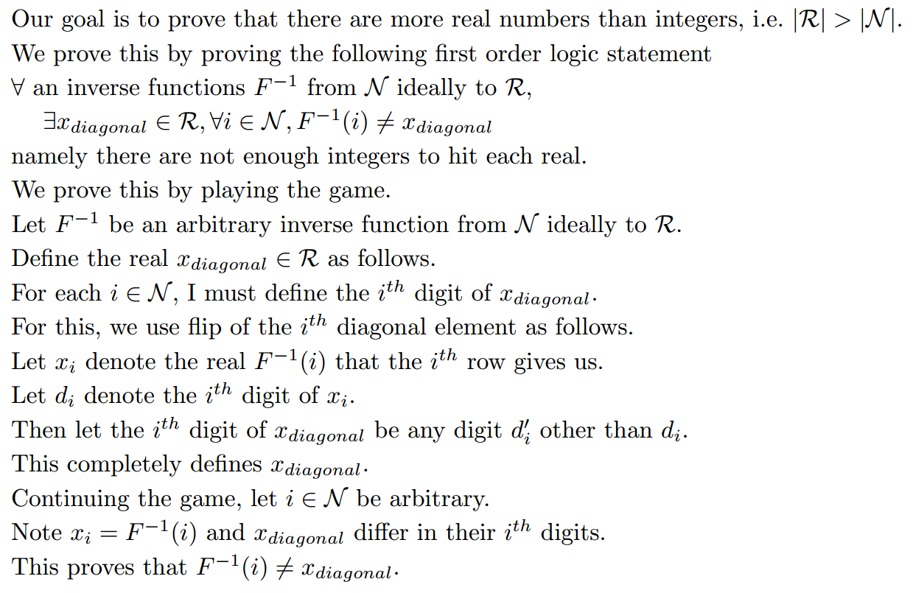
Uncountable Infinity
Proof that |R| > |N|
i.e. ∀List, ∃xϵR, ∀iϵN List(i)≠x
List
List
List
List
List
List

Slide 56
Hierarchy of Infinities
|Integers|
=
|Fractions|
<<
|Reals|
Each defined by
a finite string
Each defined by
a finite string
Most defined by
an infinite string
Set of finite subsets of the integers
{{2,3},{1,3,5,6}, … }
Each defined by a finite string
The set is countable in size
Set of possibly infinite subsets of the integers
{{2,3,…},{1,3,…}, … }
Most defined by a infinite string
The set is uncountable in size

Slide 57
Hierarchy of Infinities
<<
|Reals|
Most defined by
an infinite string
Set of finite subsets of the reals
{{2.394..,3.3563..},{1.982..,3.345..,5.32..}, … }
Each defined by a string of countably infinite length.
The set is same size as the reals
Set of possibly infinite subsets of the reals
{{2.394..,3.3563..,…},{1.982..,3.345..,…}, … }
Each defined by a string of uncountably infinite length.
The set is much bigger than the reals!
There is an infinite hierarchy of infinities!

Slide 58
Some Uncomputable Problem
∃P ∀M ∃ I M(I)≠P(I)
|Integers|
=
|Fractions|
<<
|Reals|
Each defined by
a finite string
Each defined by
a finite string
Most defined by
an infinite string
<<
Set of TM/Algorithms
Each defined by
a finite string
Countable in size
Set of Comp. Problems
For each input I,
must define what P does.
Most defined by
an infinite string
Uncountable in size
Most problems
do not have
an algorithm!!!

Slide 59
Some Uncomputable Problem
∃P ∀M ∃ I M(I)≠P(I)
Some problem
Computable
Known
GCD

Slide 60
Done

Slide 61
Material for CSE 4111 but not for CSE2001

Slide 62
Countable Infinity
A set S is called countable if |S| ≤ |N|
|S| = |{ , 4, , ….. }|
≤ |{ 1, 2, 3, 4, 5, … }| = |N|
The mapping does not need to be bijective
Is it ok that some xϵS is not mapped?
No, or else |S| might be bigger.
Is it ok if some iϵN is mapped to twice?
No, or else |S| might be larger.
Is it ok if the same xϵS is mapped from more than once?
Yes: as this only makes seem |N| bigger.
Is it ok if some iϵN is not mapped to?
Yes, as this only makes seem |N| bigger.
Such a function F is called Injective.

Slide 63
A Hierarchy of Objects
A “Character” Object:
  One of a prespecified finite set of objects.
  Eg:
    A character c ∈ ASCII.
    A bit b ∈ {0,1}
    A digit d ∈ {0,1,..,9}

Slide 64
A Hierarchy of Objects
An “Integer-Like” Object:
  Has a finite description.
  i.e. a finite sequence of “characters”
  with which the object is uniquely identified.
  Eg:
    An integer i, eg 5.
    A string s, eg “Jeff”
    A fraction ⁴/₅
    Something you might hold u, eg “apple”
    A finite set/tuple/list of level 1 objects
    eg {3,5,12}
    eg a list allocating an integer to each person alive.

Slide 65
A Hierarchy of Objects
A “Real-Like” Object:
  Each such x has a countably infinite description “x”.
  i.e. a sequence of “characters”
  with which the object is uniquely identified.
  All of these characters can’t be written down.
  Each character is indexed by an “integer-like” object i.
  Let “x”(i) denote the i^{th} char of the obj’s description.
  Eg:
    There is a real x whose description is
    “x” = “75.31928361899…”
    “x”(1) = ‘7’, “x”(0) = ‘5’, and “x”(-1) = ‘3’.

Slide 66
A Hierarchy of Objects
A “Real-Like” Object:
  Each such x has a countably infinite description “x”.
  i.e. a sequence of “characters”
  with which the object is uniquely identified.
  All of these characters can’t be written down.
  Each character is indexed by an “integer-like” object i.
  Let “x”(i) denote the i^{th} char of the obj’s description.
  Eg:
    A computational decision problem P(I).
    “P”(I) ∈ {yes,no}
    i.e. the Ith char of the obj’s descr.
    would tell you P(I).

Slide 67
A Hierarchy of Objects
A “Set-of-Reals-Like” Object:
  A set of “real-like” objects.
  Eg:
    An arbitrary subset of reals S, eg {5.319…, 9.234…, … }
    A set of functions F, eg {f, g, h, … }
  The size of such sets is uncountable.
  The characters in its description need to be indexed by
  real numbers!

Slide 68
A Hierarchy of Objects
A “Real-Like” Object:
  Each such x has a countably infinite description “x”.
  i.e. a sequence of “characters”
  with which the object is uniquely identified.
  All of these characters can’t be written down.
  Each character is indexed by an “integer-like” object i.
  Let “x”(i) denote the i^{th} char of the obj’s description.
  Eg:
    There is an real x whose description is
    “x” = “75.31928361899…”
    “x”(1) = ‘7’, “x”(0) = ‘5’, and “x”(-1) = ‘3’.

Slide 69
A Hierarchy of Objects
A “Real-Like” Object:
  Each such x has a countably infinite description “x”.
  i.e. a sequence of “characters”
  with which the object is uniquely identified.
  All of these characters can’t be written down.
  Each character is indexed by an “integer-like” object i.
  Let “x”(i) denote the i^{th} char of the obj’s description.
  Eg:
    A point <x,y> within the plain.
    “<x,y>” = “<75.31928361899… , 4.325643… >”
    If “<x,y>”(1), “<x,y>”(0), “<x,y>”(-1), …
    indexed the characters of “x” ,
    we would run out of indexes before getting to “y”.

Slide 70
A Hierarchy of Objects
A “Real-Like” Object:
  Each such x has a countably infinite description “x”.
  i.e. a sequence of “characters”
  with which the object is uniquely identified.
  All of these characters can’t be written down.
  Each character is indexed by an “integer-like” object i.
  Let “x”(i) denote the i^{th} char of the obj’s description.
  Eg:
    A point <x,y> within the plain.
    “<x,y>” = “<75.31928361899… , 4.325643… >”
    “<x,y>”(<1,1>) = ‘7’, “<x,y>”(<2,0>) = ‘4’, …
    Note i=<2,0> is an “integer-like” object.

Slide 71
A Hierarchy of Objects
A “Real-Like” Object:
  Each such x has a countably infinite description “x”.
  i.e. a sequence of “characters”
  with which the object is uniquely identified.
  All of these characters can’t be written down.
  Each character is indexed by an “integer-like” object i.
  Let “x”(i) denote the i^{th} char of the obj’s description.
  Eg:
    An infinite set/tuple/list of “integer-like” objects
    Eg The set of positive integer N, eg { 0, 1, 2, 3,… }
    Eg A set of integer S with “S” = “{ 3, 6, 7, … }”
    “S”(i) ∈ {yes/no}
    would tell you whether or not i is in S.
i.e. the i^{th} char of the obj’s descr.

Slide 72
A Hierarchy of Objects
A “Real-Like” Object:
  Each such x has a countably infinite description “x”.
  i.e. a sequence of “characters”
  with which the object is uniquely identified.
  All of these characters can’t be written down.
  Each character is indexed by an “integer-like” object i.
  Let “x”(i) denote the i^{th} char of the obj’s description.
  Eg:
    An infinite set/tuple/list of “integer-like” objects
    The size of such a set is said to be countable
    because it’s elements can be indexed by the integers.

Slide 73
A Hierarchy of Objects
A “Real-Like” Object:
  Each such x has a countably infinite description “x”.
  i.e. a sequence of “characters”
  with which the object is uniquely identified.
  All of these characters can’t be written down.
  Each character is indexed by an “integer-like” object i.
  Let “x”(i) denote the i^{th} char of the obj’s description.
  Eg:
    A function f from the integers to the digits {0,…,9}
    Eg f(i) = i²+5 mod 10
    “f”(i) ∈ {0,…,9}
    would tell you f(i).
i.e. the i^{th} char of the obj’s descr.

Slide 74
A Hierarchy of Objects
A “Real-Like” Object:
  Each such x has a countably infinite description “x”.
  i.e. a sequence of “characters”
  with which the object is uniquely identified.
  All of these characters can’t be written down.
  Each character is indexed by an “integer-like” object i.
  Let “x”(i) denote the i^{th} char of the obj’s description.
  Eg:
    A function f from the integers to the
    Eg f(i) = i²+5
    “f”(i) ∈
    would tell you f(i).
    Is this fair to have an integer as a “character”?
integers
{0,1,2,… }

Slide 75
A Hierarchy of Objects
A “Real-Like” Object:
  Each such x has a countably infinite description “x”.
  i.e. a sequence of “characters”
  with which the object is uniquely identified.
  All of these characters can’t be written down.
  Each character is indexed by an “integer-like” object i.
  Let “x”(i) denote the i^{th} char of the obj’s description.
  Eg:
    A function f from the integers to the integers
    Eg f(i) = i²+5
    For each “integer” <i,j>,
    “f”(<i,j>) ∈ {0,…,9}
    would tell you the j^{th} digit of f(i).

Slide 76
A Hierarchy of Objects
A “Real-Like” Object:
  Each such x has a countably infinite description “x”.
  i.e. a sequence of “characters”
  with which the object is uniquely identified.
  All of these characters can’t be written down.
  Each character is indexed by an “integer-like” object i.
  Let “x”(i) denote the i^{th} char of the obj’s description.
  Eg:
    A function f from the integers to the
    Eg f(i) =√ i
    For each “integer” <i,j>,
    “f”(<i,j>) ∈ {0,…,9}
    would tell you the j^{th} digit of f(i).
reals

Slide 77
A Hierarchy of Objects
A “Real-Like” Object:
  Each such x has a countably infinite description “x”.
  i.e. a sequence of “characters”
  with which the object is uniquely identified.
  All of these characters can’t be written down.
  Each character is indexed by an “integer-like” object i.
  Let “x”(i) denote the i^{th} char of the obj’s description.
  Eg:
    A computational decision problem P(I),
    as computed by a TM M(I).
    “P”(I) ∈ {yes,no}
    would tell you P(I).
    Remember a string I is an “integer-like” object.
i.e. the Ith char of the obj’s descr.

Slide 78
A Hierarchy of Objects
A “Set-of-Reals-Like” Object:
  A set of “real-like” objects.
  Eg:
    The set R of all reals
    An arbitrary set of reals S, eg {5.319…, 9.234…, … }
    A set of functions F, eg {f, g, h, … }
  The size of such sets is uncountable.
  The characters in its description need to be indexed by
  real numbers!

Slide 79
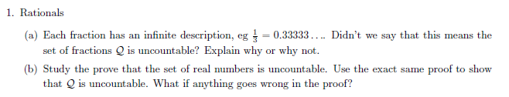
Homework

Slide 80
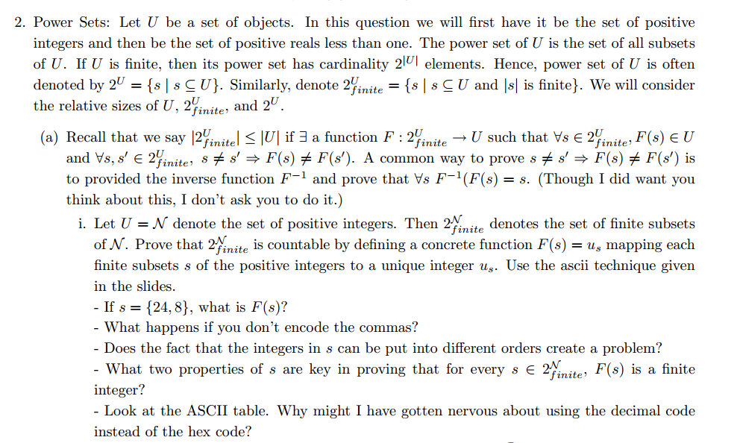
Homework

Slide 81
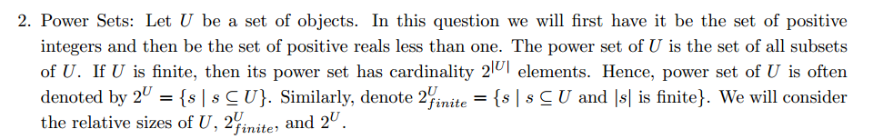
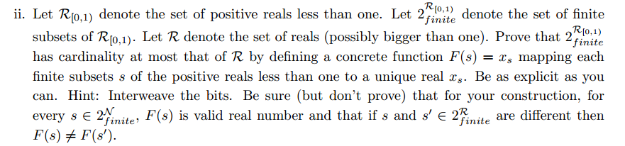
Homework

Slide 82
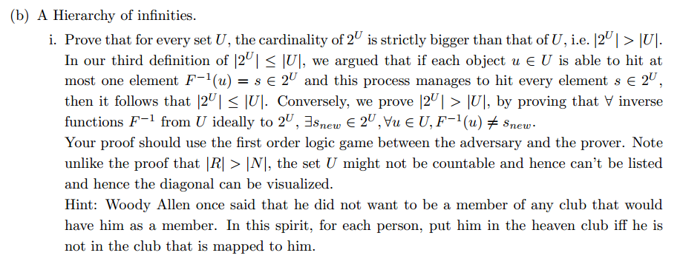
Homework

Slide 83
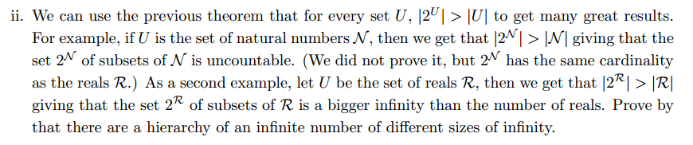
Homework

Slide 84
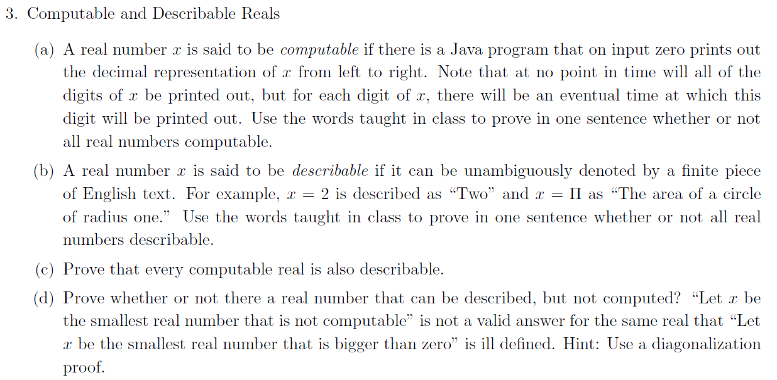
Homework

Slide 85
Homework

