Slide 1
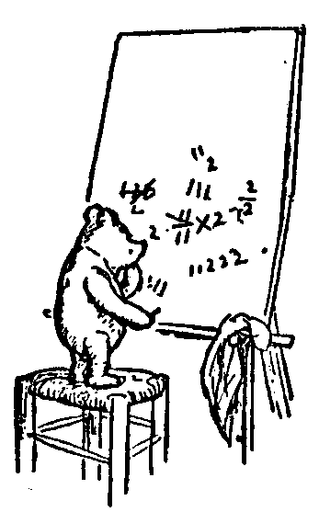

Welcome
CSE 2001: Introduction to the Theory of Computation
Jeff Edmonds
www.cse.yorku.ca/~jeff/courses/2001
jeff@cse.yorku.ca
CSB 3044, ext. 33295
647-688-7413
Jeff Edmonds
York University
Lecture 1
COSC 2001

Slide 2
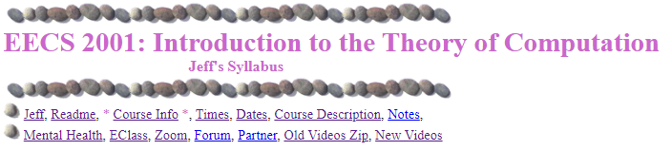
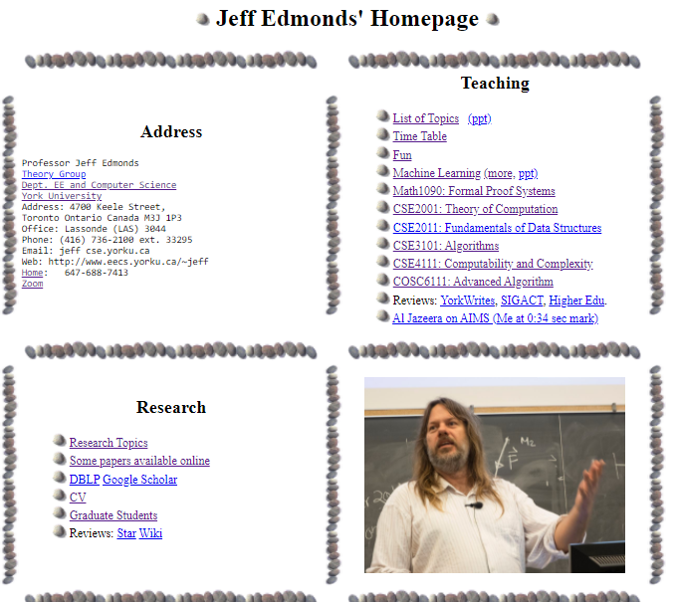
Course Info
https://www.eecs.yorku.ca/~jeff/courses/2001/syllabus/

Slide 3
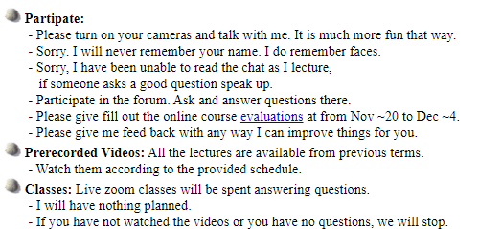
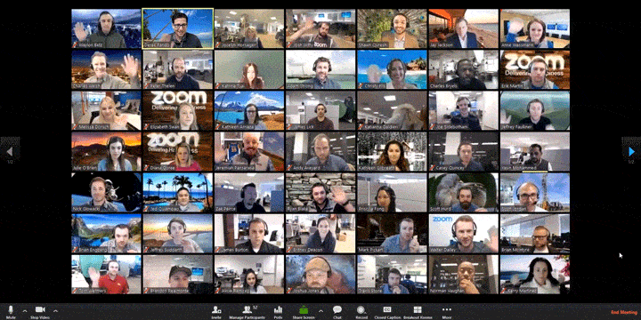
Course Info
https://www.eecs.yorku.ca/~jeff/courses/2001

Slide 4
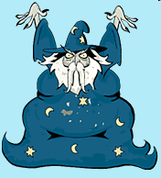
Course Info
https://www.eecs.yorku.ca/~jeff/courses/2001
Some students feel too intimidated to talk to the professor.
Actually, he is just a guy
who has been doing this for a while.

Slide 5
Course Info
https://www.eecs.yorku.ca/~jeff/courses/2001

Slide 6






Course Info
https://www.eecs.yorku.ca/~jeff/courses/2001
Let’s go early!

Slide 7
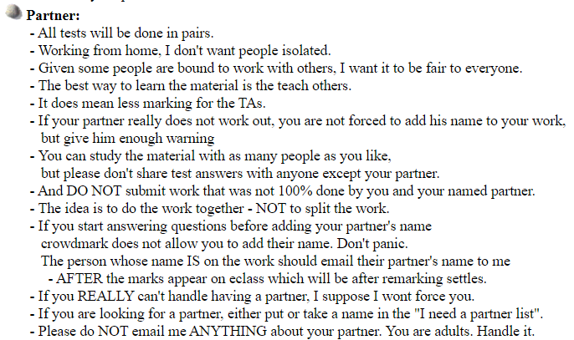

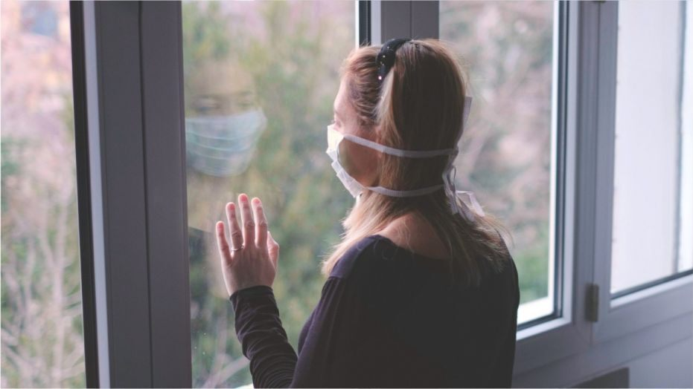





Course Info
https://www.eecs.yorku.ca/~jeff/courses/2001

Slide 8
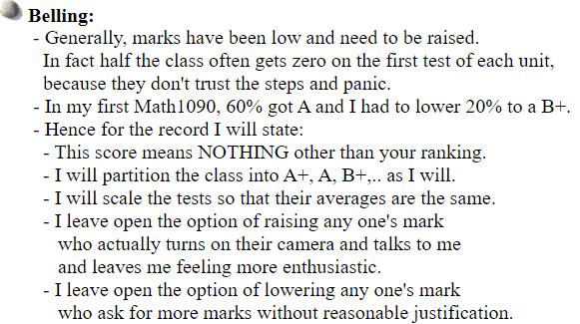
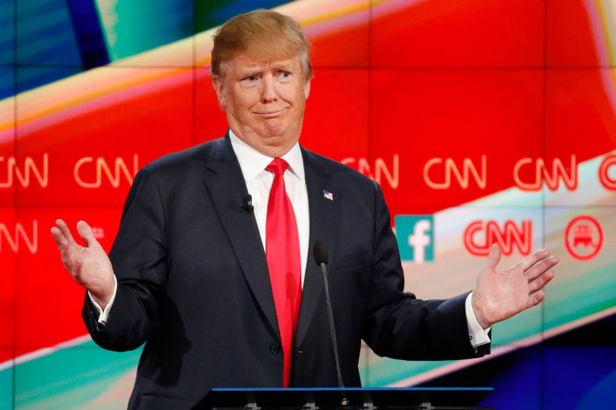

Course Info
https://www.eecs.yorku.ca/~jeff/courses/1090
I have no idea!?!

Slide 9
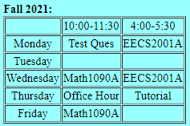
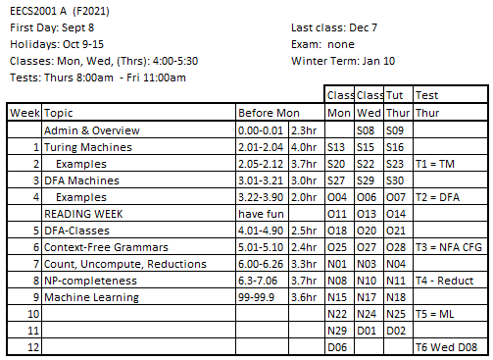
Course Info
https://www.eecs.yorku.ca/~jeff/courses/2001/syllabus/

Slide 10
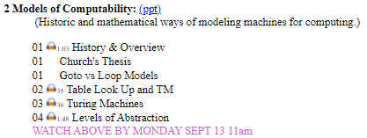
Course Info
https://www.eecs.yorku.ca/~jeff/courses/2001/syllabus/

Slide 11
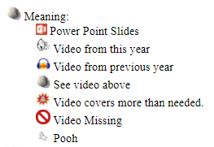
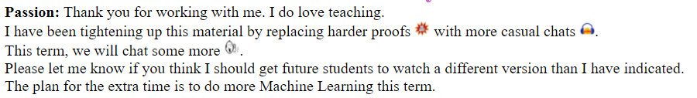
Course Info
https://www.eecs.yorku.ca/~jeff/courses/2001/syllabus/
I have cut hard proofs out over the years.
Remind me to make these during some class.

Slide 12
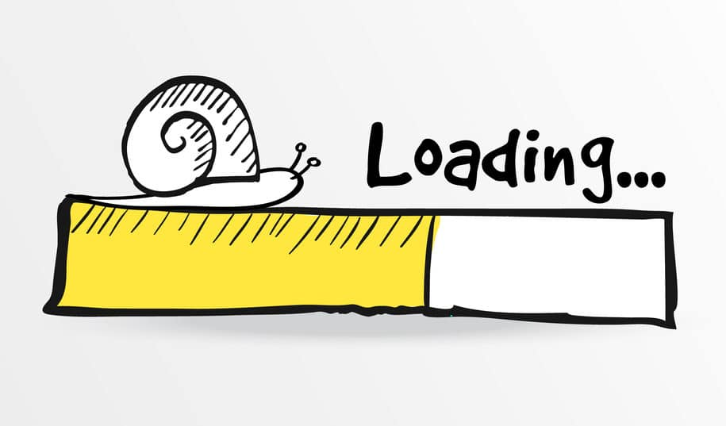
Course Info
https://www.eecs.yorku.ca/~jeff/courses/2001/syllabus/
Incase, your internet is slow,
All old videos and notes have
been put in one big zip file.
Recordings of the tutorials will be put here.

Slide 13
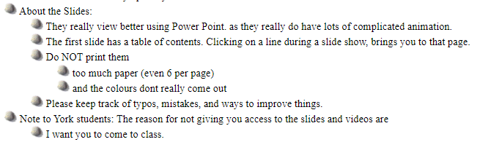


Course Info
https://www.eecs.yorku.ca/~jeff/courses/2001/syllabus/

Slide 14
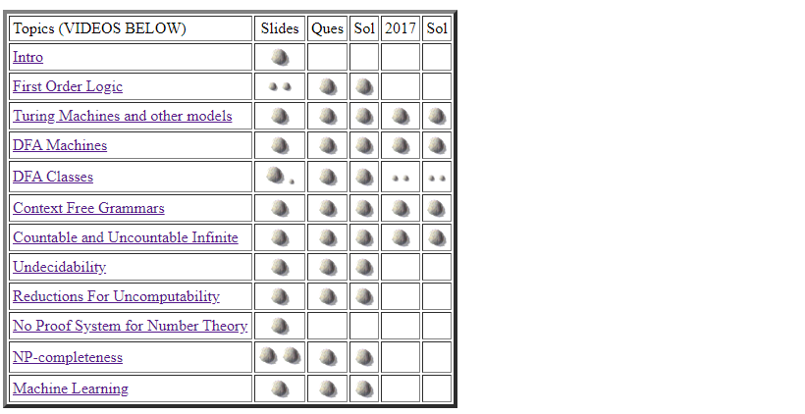
Course Info
https://www.eecs.yorku.ca/~jeff/courses/2001/syllabus/

Slide 15

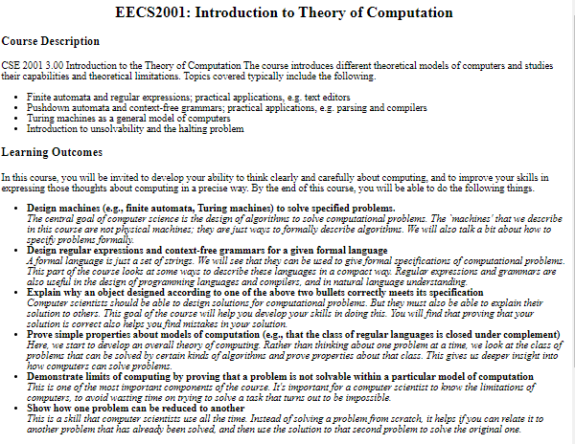
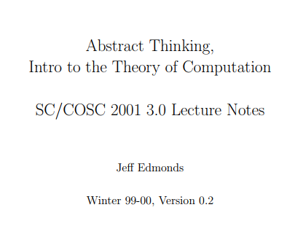
Course Info
https://www.eecs.yorku.ca/~jeff/courses/2001/syllabus/

Slide 16
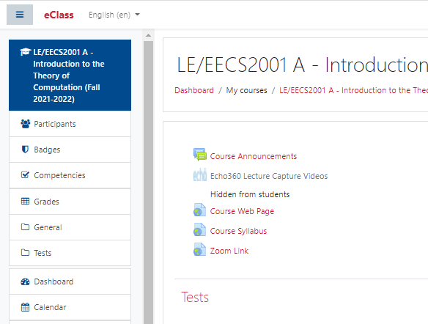
Course Info
https://www.eecs.yorku.ca/~jeff/courses/2001/syllabus/

Slide 17
Course Info
https://www.eecs.yorku.ca/~jeff/courses/2001/syllabus/

Slide 18

Course Info
https://www.eecs.yorku.ca/~jeff/courses/2001/syllabus/
If someone sets up a Discord thread, I will link it here.
Don’t assume I will or won’t read Discord or Zoom messages.

Slide 19
Course Info
https://www.eecs.yorku.ca/~jeff/courses/2001/syllabus/

Slide 20
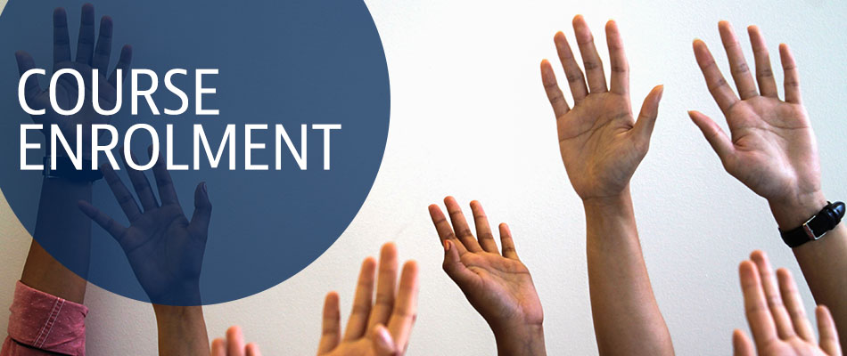
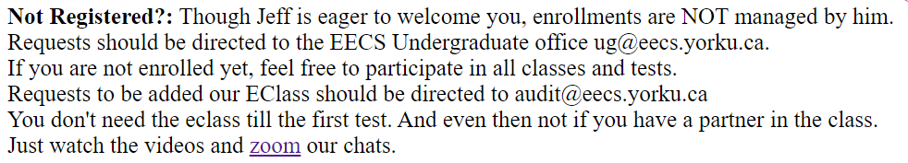
The class should have 100 but has 185.
I am happy to let any one in.
I have told this to the powers to be.
Now it is in their hands.
Please do not ask me about it.
In the meantime, attend lectures!

Slide 21
Zoom Time
What shall we do for 4.5 hrs/week of zoom time?
By Monday, you should have watched the lecture by yourself.
This amounts to ~2:30 hrs of videos.
An advisor told me that this means we need to do 2:30 hrs/week less zoom time.
I can
  give a quick overview
  answer questions
  go over practice questions
  help you get ready for the test!
Lets see how needed they are.
Maybe we will skip some.

Slide 22
When you email me something
- 2001 in topic
- picture helps

Slide 23
Study Now!
You spend 50hrs/week
on your programming course.
People do work hard
on my assignments.
But they don’t really
study the material deeply
until they fail the midterm.

Slide 24
Read Ahead
You are expected to read the lecture notes before the lecture.
This will facilitate more productive discussion during class.
Also please
proof read
assignments
& tests.
Like in an
English class

Slide 25
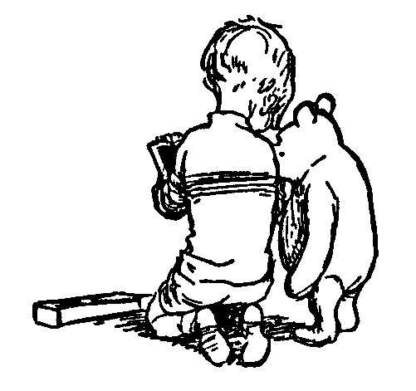
Explaining
We are going to test you on your ability to explain the material.
Hence, the best way of studying is to explain the material over and over again out loud to yourself, to each other, and to your stuffed bear.

Slide 26
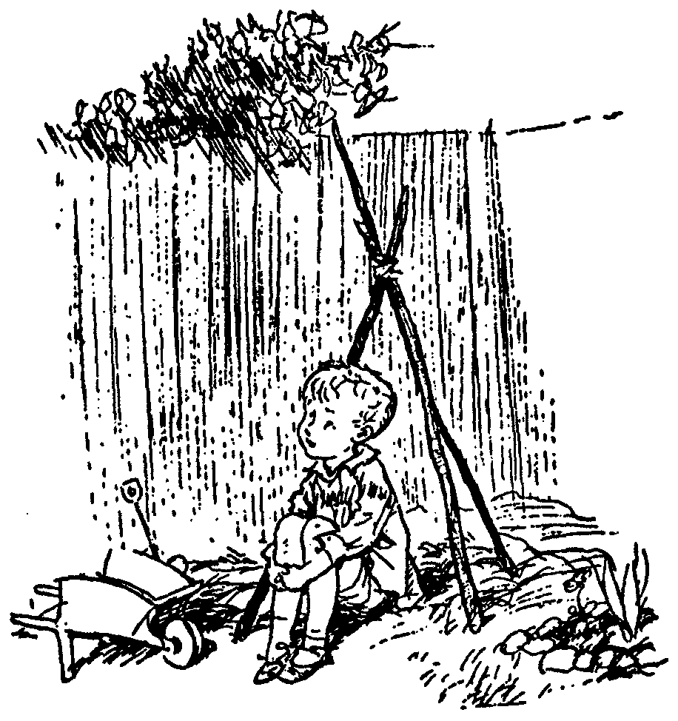
Day Dream
While going along with your day
Mathematics is not all linear thinking.
Allow the essence of the material to seep into your subconscious
Pursue ideas that percolate up and flashes of inspiration that appear.

Slide 27
Useful Learning Techniques
Before reading the solutions
to the assignments.
Work hard on solving them on your on.
Study the text and slides.
Get help, but not answers from
friends, TA, professor, …

Slide 28
Useful Learning Techniques
After reading the solutions
to the assignments.
Study the solutions.
Understand the solutions.
Memorize the solutions.
The questions on the tests
will be different.
But the answers
will be surprisingly close.

Slide 29

Thinking Abstractly
Introduction to
Theory of Computation
I have complained for years.
This should not be a second year course.
It teaches
theory is hard and useless!!!
Though I have cut out some of the harder proofs.
But it is useful for teaching

Slide 30

Thinking Abstractly
This course requires completely changing
the way you think about computation.
Though I keep warning people,
they tend not to get it until they are
Devastated
by the midterm
Change your thinking now.

Slide 31

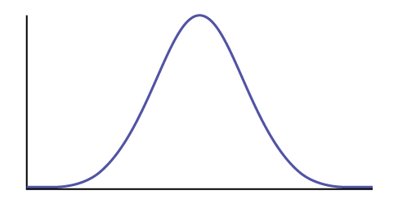
Thinking Abstractly
0 50 100
For the people who can’t,
the material is impossible.
For the people who
can think abstractly
the material is easy.

Slide 32
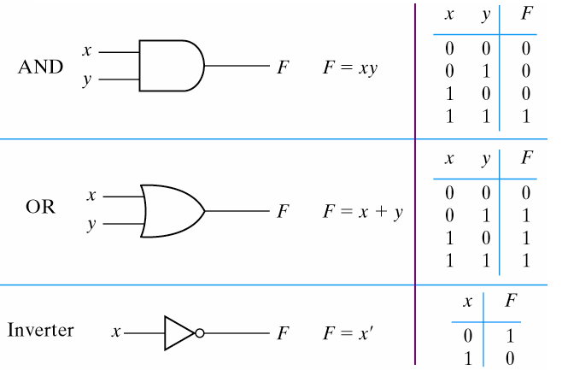
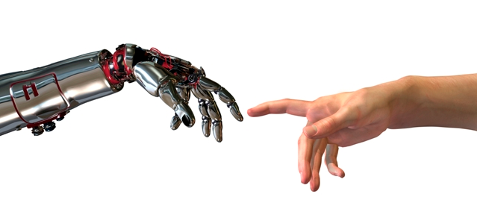
Thinking Abstractly
The psychological profiling of a successful person is mostly the ability to shift levels of abstraction, from low level to high level.
To understand the detailed workings.
To understand the big picture.
Donald Kunth

Slide 33
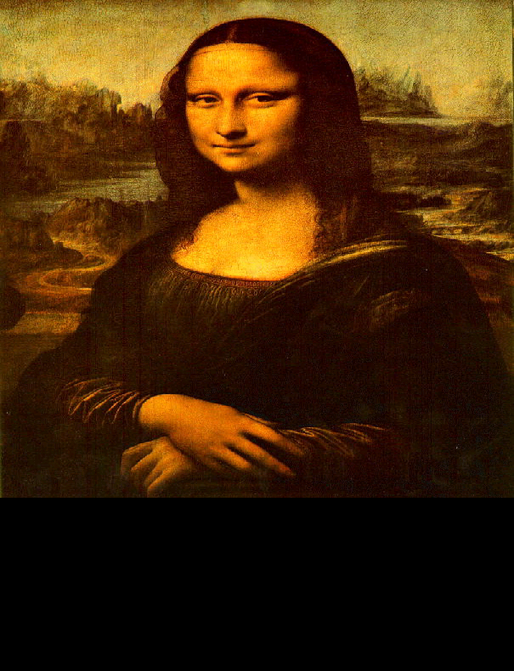
Thinking Abstractly
The psychological profiling of a successful person is mostly the ability to shift levels of abstraction, from low level to high level.
To understand the detailed workings.
To understand the big picture.
To understand complex things
in simple ways.
Donald Kunth
=

Slide 34
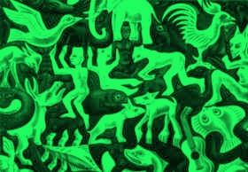
Thinking Abstractly
Paradigm Shift
Is the black the form and the green the background?
Is the green the form and the black the background?
It is helpful to have different ways of looking at it.

Slide 35
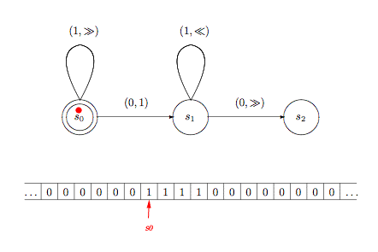
Turing Machines
Representation of an Algorithm
A Turing machine
Is historically the first model of computation.
It is abstract.
It is NOT practical.
We will try to give
it “meaning”.
Instead of trying to design TMs, we will compile any Java like program into a TM.

Slide 36
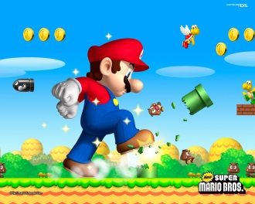
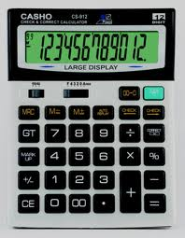

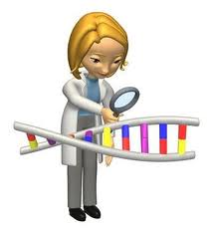
Finite Automata
Representation of an Algorithm
The input arrives as a stream.
One character at a time.
It cannot be reread.
Eg:
  simple iterative algorithms
  simple mechanical or electronic devices like elevators and calculators
  simple processes like the job queue of an operating system
  simple patterns within strings of characters.
  simple languages of strings
{01,100,01110,… }

Slide 37
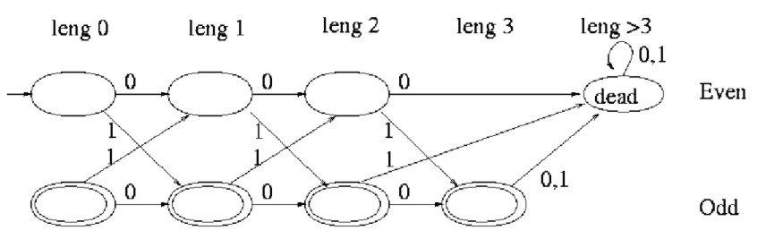
Finite Automata
Representation of an Algorithm
The input arrives as a stream.
One character at a time.
It cannot be reread.
Pros and Cons?

Slide 38
DFA and Turing Machines
Representation of an Algorithm
Pros:
Cons:
Good for theorems about algorithms
Having a different way of thinking of algorithms,
provides a deeper understanding.
Mathematical mumbo jumbo
Too abstract
Students resist it

Slide 39
Regular Expression
Representation of an Algorithm
Regular Expression are a quick notation
for defining a language of strings.
  Any finite set of finite strings is a regular expression
    Eg R = {0,01,11}, then L(R) = {0,01,11}.
  R₁∪R₂ , R₁∙R₂ , and R*
  representing L₁∪L₂ , L₁∙L₂ , and L*
Extended Regular Expressions
  Also R₁∩R₂ and R

Slide 40
Complexity Classes
These languages are called
Regular Languages.
Linear
Problems which have
TM/Java programs that solve them
in linear time
DFA=NFA
=Extended Regular
=Regular

Slide 41
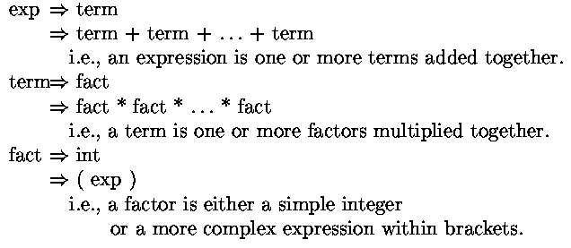
Context Free Grammar
Representation of an Algorithm

Slide 42
Context Free Grammar
Representation of an Algorithm
Pros:
Cons:
  Adds “meaning” to the string.
  Can be used to evaluate/process the string.
  Mircosoft Word underlines poor grammar with green.
  Used in a compiler to produce machine code.
Mathematical mumbo jumbo
Too abstract
Students resist it

Slide 43
Hierarchy of Infinities
|Integers|
=
|Fractions|
<<
|Reals|
Each defined by
a finite string
Each defined by
a finite string
Each defined by
an infinite string

Slide 44
Hierarchy of Infinities
|Integers|
=
|Fractions|
...
...
6
⁶/₁
⁶/₂
⁶/₃
⁶/₄
⁶/₅
⁶/₆
⁶/₇
⁶/₈
All positive
fractions
5
⁵/₁
⁵/₂
⁵/₃
⁵/₄
⁵/₅
⁵/₆
⁵/₇
⁵/₈
4
⁴/₁
⁴/₂
⁴/₃
⁴/₄
⁴/₅
⁴/₆
⁴/₇
⁴/₈
3
³/₁
³/₂
³/₃
³/₄
³/₅
³/₆
³/₇
³/₈
2
²/₁
²/₂
²/₃
²/₄
²/₅
²/₆
²/₇
²/₈
...
Count them
by mapping.
1
¹/₁
¹/₂
¹/₃
¹/₄
¹/₅
¹/₆
¹/₇
¹/₈
1 2 3 4 5 6 7 8
Every rational gets
mapped to some integer!
{ 1, 2, 3, 4, 5, 6, …. }
All positive integers

Slide 45
Hierarchy of Infinities
|Fractions|
<<
|Reals|
Proof that |R| > |N|
Given a list of all real numbers
12.34323834749308477599304 …
8.50949039988484877588487 …
930.93994885783998573895002 …
34.39498837792008948859069 …
0.00343988348757590125473 …
…..
Proof by
Diagonalization
We find a real number x_{diagonal} that is not in the list.
x_{diagonal} = 0.41004 …

Slide 46
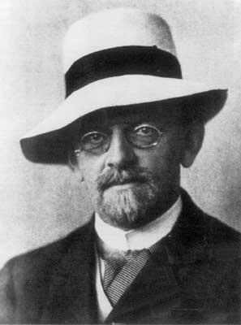
History of Computability
Can every problem be computed?
Or are some Uncomputable?
Hilbert (1900)
Need to formally define
“Algorithm”

Slide 47
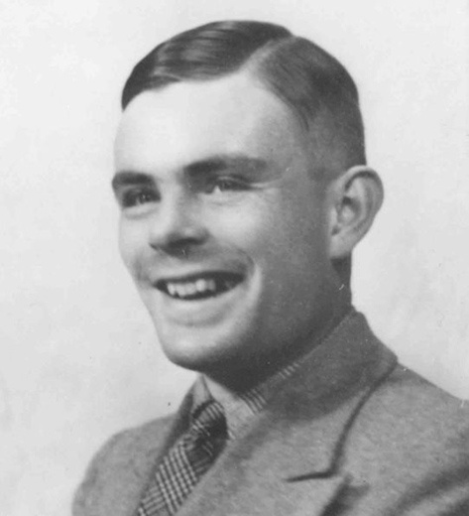
History of Computability
Computable
A problem is Computable
if it can be computed by a
Turing Machine. (1936)
Turing (1936)
Need to formally define
“Algorithm”

Slide 48

History of Computability
Computable
Equivalent via
compiler to:
Java:
Turing (1936)
Need to formally define
“Algorithm”

Slide 49
History of Computability
Computable
Halting
Problem
Turing proves that
the halting problem is
NOT Computable!
Turing (1936)

Slide 50
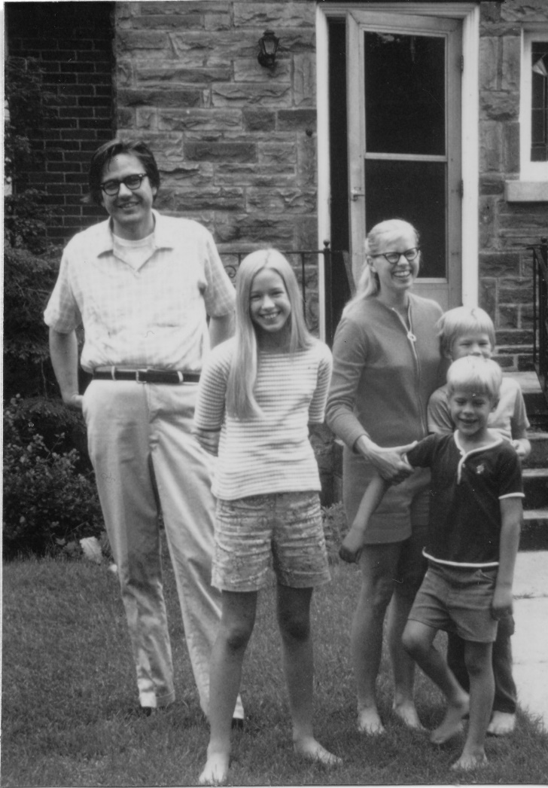
History of Classifying Problems
Computable
Halting
Exp
Poly
Jack Edmonds 1965
Known
GCD

Slide 51

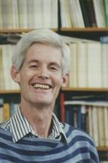
History of Classifying Problems
Computable
Halting
Exp
NP
Non-Deterministic
Polynomial Time
Jack Edmonds
Steve Cook
SAT
Poly
exponential time to search
poly time to verify given witness
Known
Circuit-Sat Problem:
Does a circuit have a satisfying assignment.
Matching
GCD

Slide 52
History of Classifying Problems
Computable
Halting
Exp
NP
Non-Deterministic
Polynomial Time
Jack Edmonds
Steve Cook
SAT
Poly
exponential time to search
poly time to verify given witness
Known
Circuit-Sat Problem:
Does a circuit have a satisfying assignment.
Matching
GCD

Slide 53
History of Classifying Problems
Computable
Halting
Exp
Games
NP
SAT
complete
Steve Cook 1971
≥_{poly} Prob’
Let’s compare
the problems in NP
SAT
Poly
None are harder than SAT!
Known
Circuit-Sat Problem:
Does a circuit have a satisfying assignment.
Matching
GCD

Slide 54
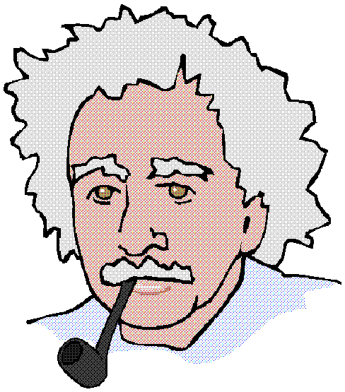
History of Classifying Problems
Given an oracle for SAT,
how can you quickly solve other problems?
Other
Problem
SAT
Oracle

Slide 55
History of Classifying Problems
Design an alg.
Assume have an alg.
≤
Other
Problem
SAT
Oracle
Proof by Reductions

Slide 56
History of Classifying Problems
Other Input
Other Output
SAT Input
SAT Output
≤
Other
Problem
SAT
Oracle
Proof by Reductions

Slide 57
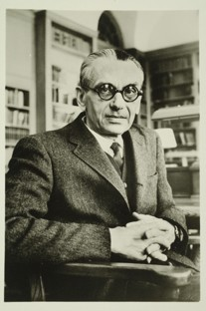
Gödel’s Incompleteness Theorem
Some things have no proof
and whether true or false
depends on your world view.
For every proof system S,
there are math statements Φ
which are either not proved
or proved incorrectly!
Gödel 1931

Slide 58
Abstract away the inessential features of a problem
Value Simplicity
=
Goal: Understand and think about complex algorithm in simple ways.
Don’t tune out. There are deep ideas within the simplicity.

Slide 59
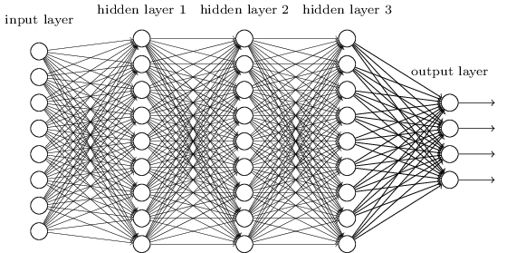
Machine Learning
Machine learning:
Is changing our lives at a rate like never before.
For better or worse
It is where the jobs are.
The few that will be left.
York is starting a whole new grad program in it.
x₁
w₁
w₂
cat
pixel_{i,j}
dog
face
bicycle.
x_{n}
w_{m}
E(w₁,…,w_{m})

Slide 60
Machine Learning
It suddenly occurred that machine learning theory falls under “Theory of Computation”
I could teach it in 2001!
This is NOT part of this course.
I got approval from the departmental chair to do 2 hours.
I got addicted to making slides and it may be 4 hours worth.
I want to do is slow so that everyone gets it.
x₁
w₁
w₂
cat
pixel_{i,j}
dog
face
bicycle.
x_{n}
w_{m}
E(w₁,…,w_{m})

Slide 61
Machine Learning
It may be what gets you a job.
It is good to understand our changing world
I find it oddly spiritual.
Give me and the department
a lot of feedback on how you like it.
As I am excited, I think I will do it first!
Thoughts?
x₁
w₁
w₂
cat
pixel_{i,j}
dog
face
bicycle.
x_{n}
w_{m}
E(w₁,…,w_{m})

Slide 62
End

